Slide 2
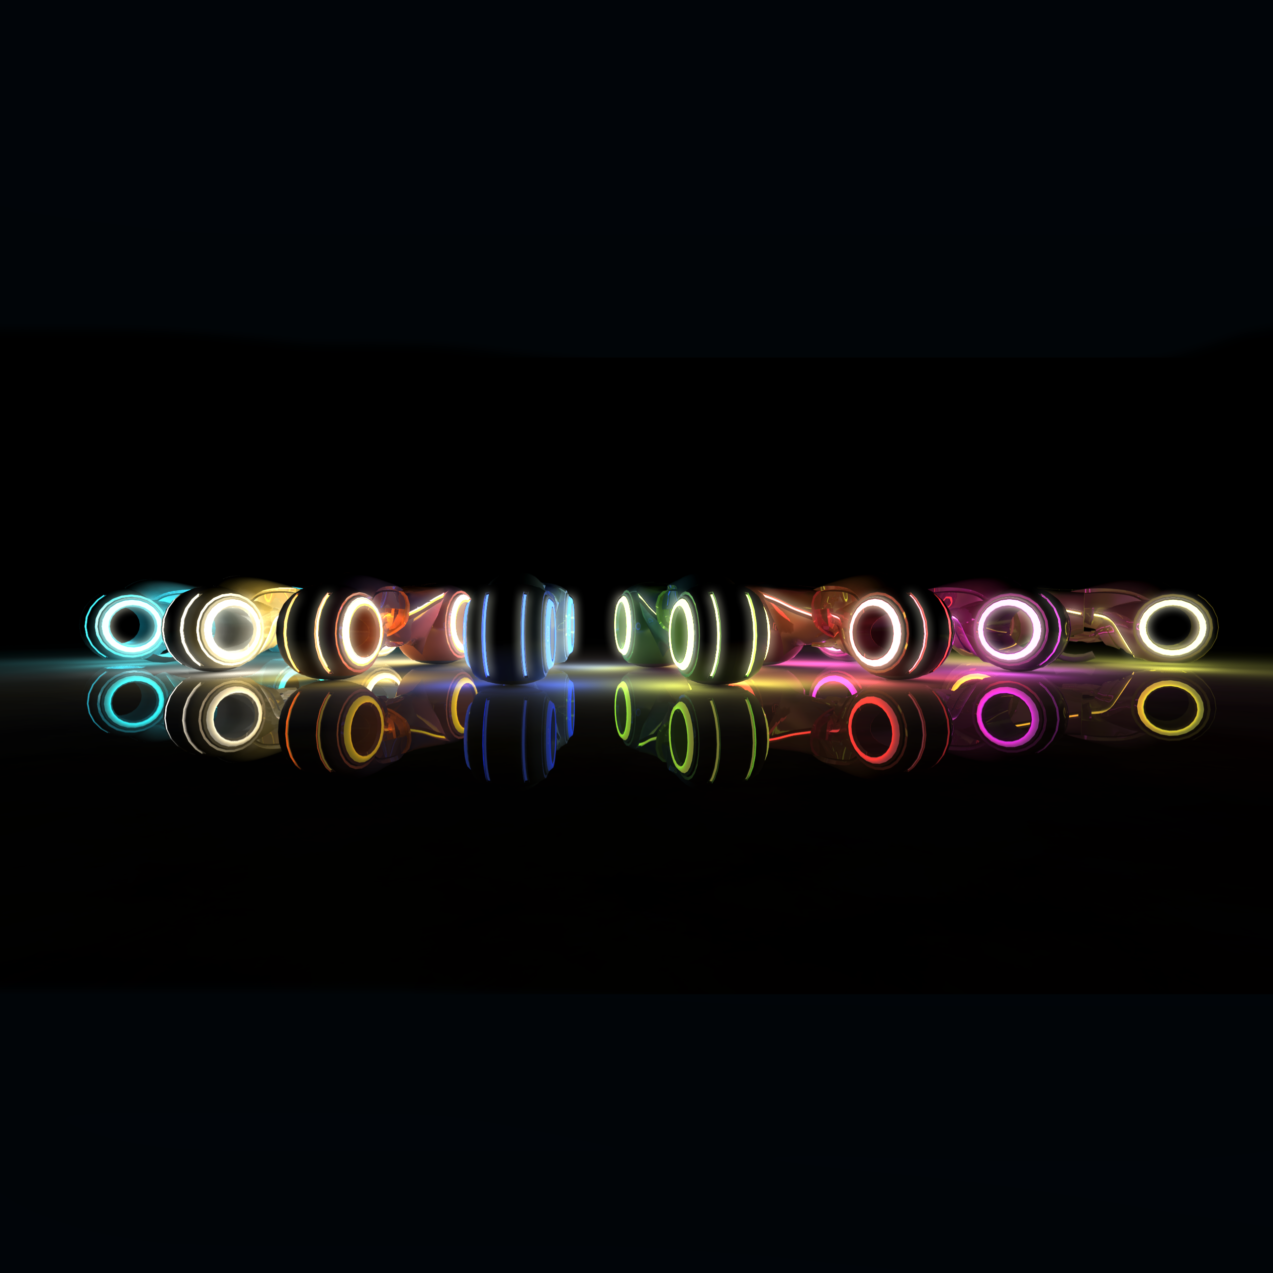

Slide 3
Distributed Systems
TRONIUM a Tron clone
Alexandra, Alexander, Christian, Lukas, Marko, Tom
http://tronium.ch.gg
© Department of Computer Science | ETH Zürich

Slide 4
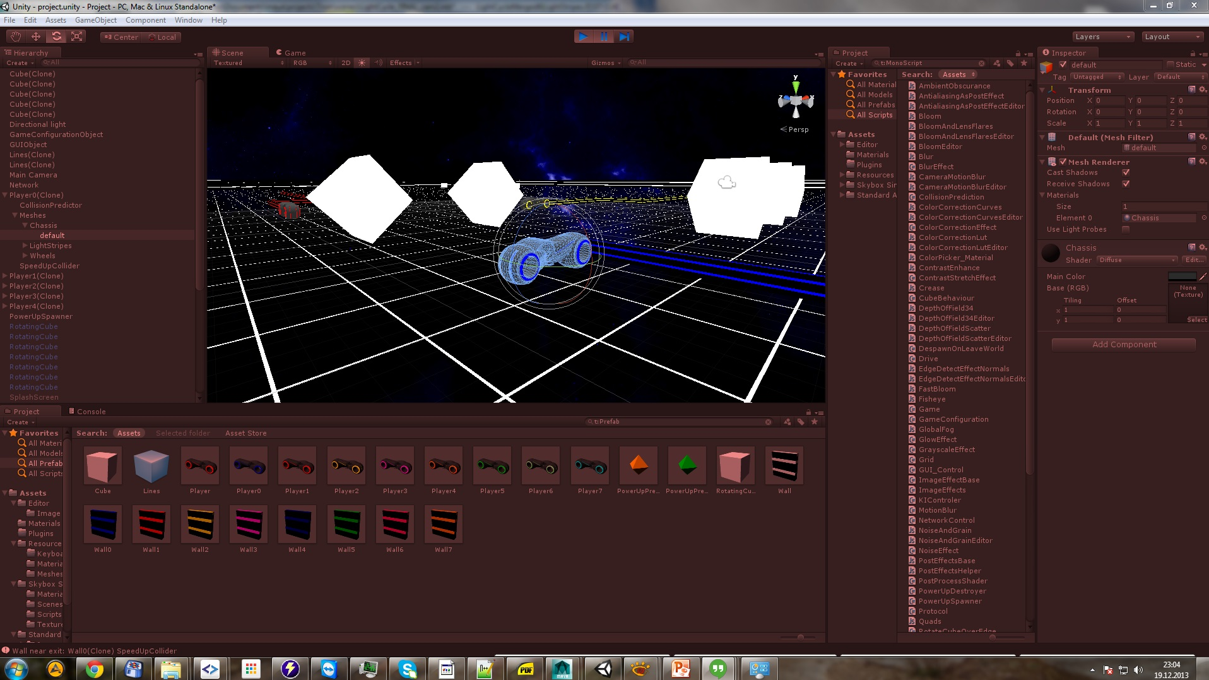
http://tronium.ch.gg

Slide 5
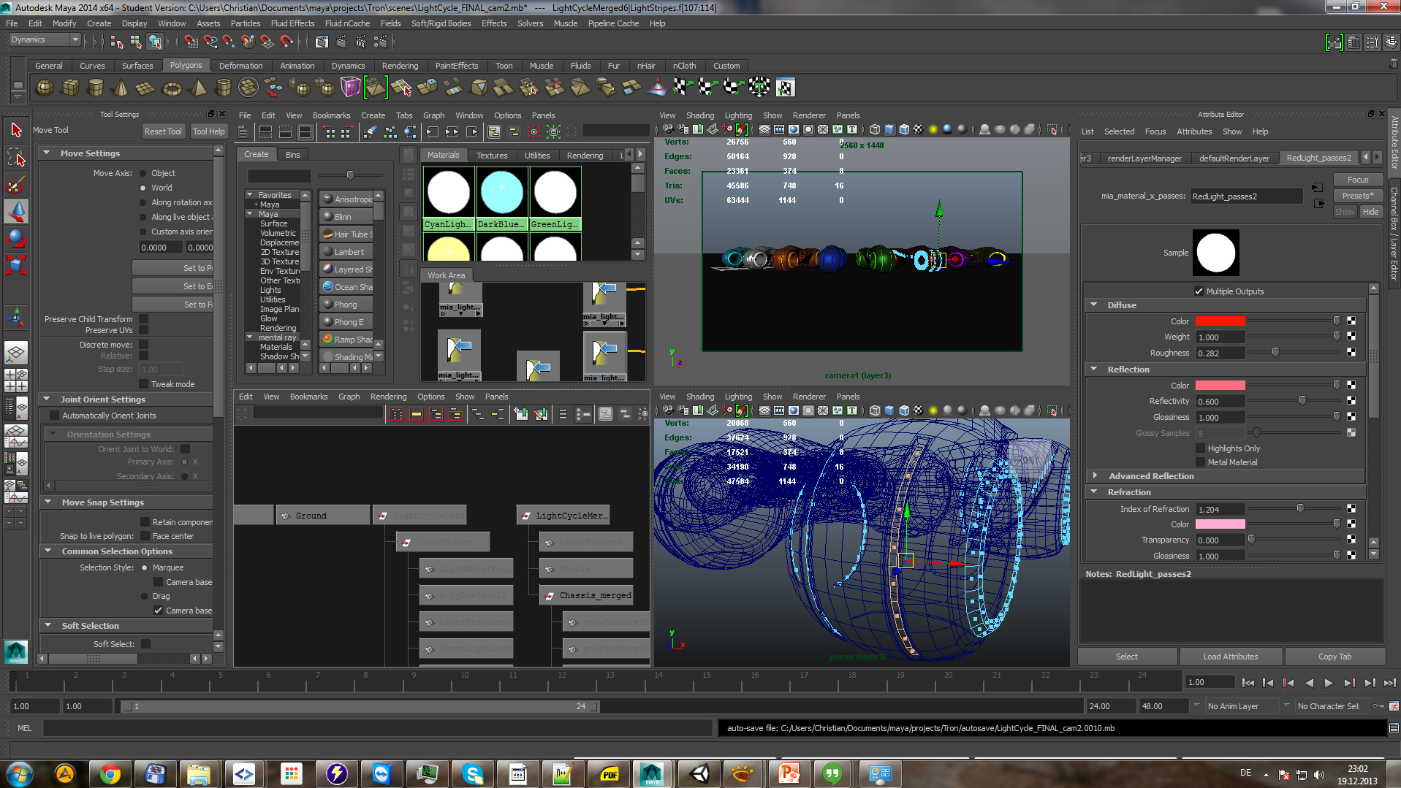
http://tronium.ch.gg

Slide 6
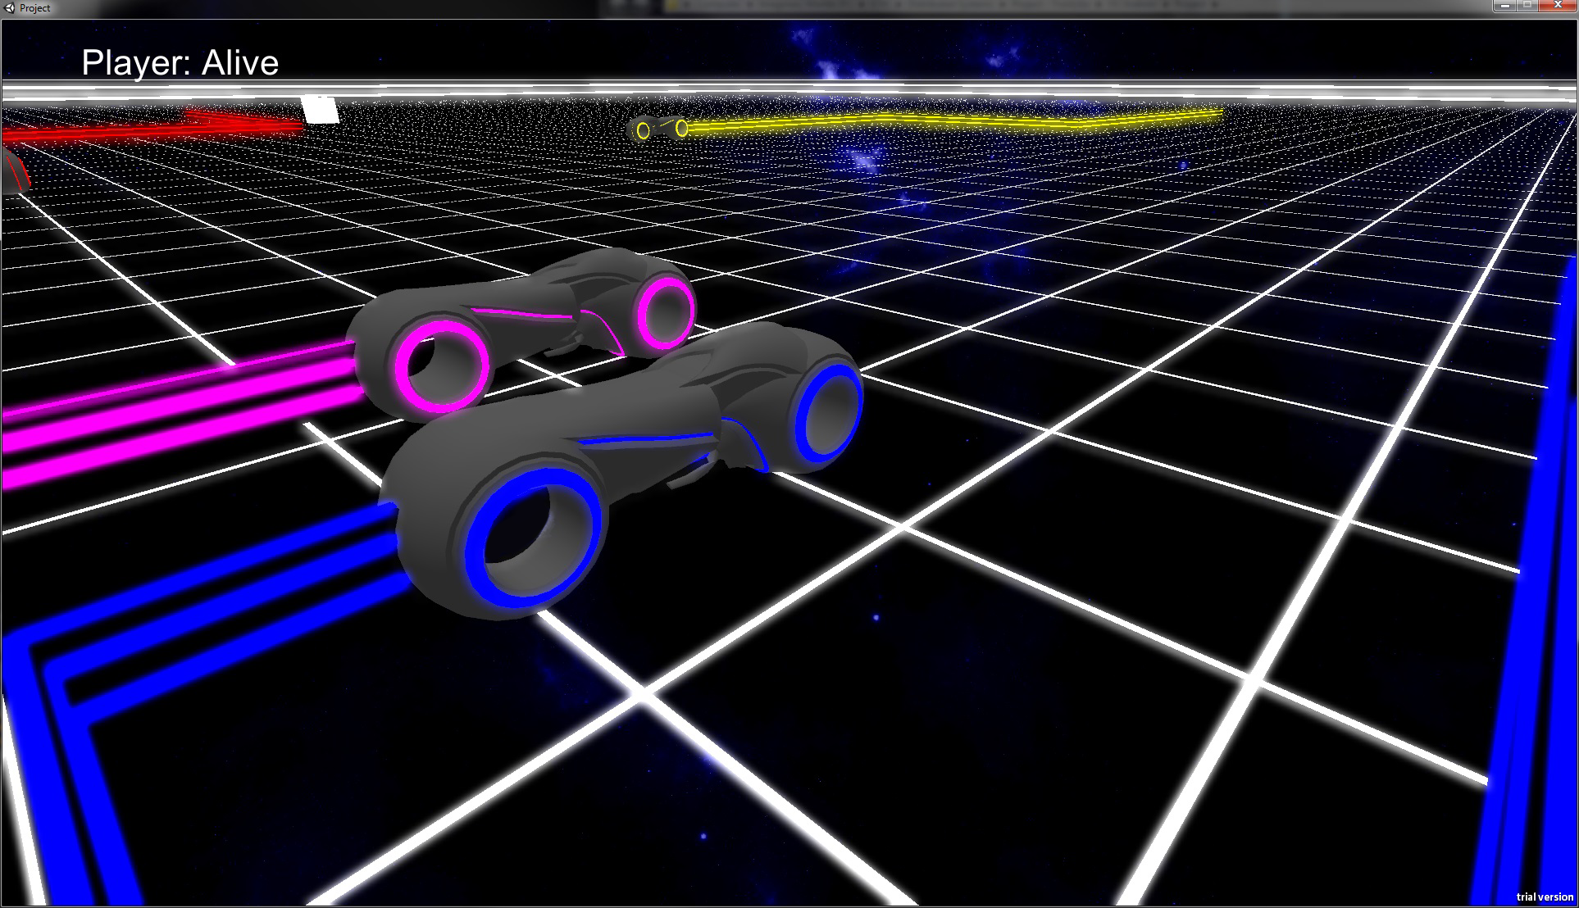
http://tronium.ch.gg

