Slide 1
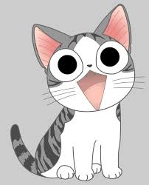
This Code Day I Had 2 options: make something with raspberry pi or make something with python (I don’t know any other coding language's)

Slide 2
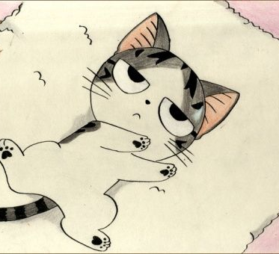
After failing with raspberry pi I decided to make a game: After looking at many possibilities I decided to make Tetris

Slide 3
Things I used
Python 3
Py Game Zero: https://pygame-zero.readthedocs.io/en/stable/
An Integrated Development environment called mu-editor: https://codewith.mu/
A video and sound rendering program called Pitivi: http://www.pitivi.org/
A video recording program called easy screen cast: https://github.com/EasyScreenCast/EasyScreenCast
And YouTube
And PowerPoint
Video: Youtube video thingy
GitHub:https://github.com/EvgenyYukhanov/7thgradepython/tree/master/codeday-seattle-2019

Slide 4
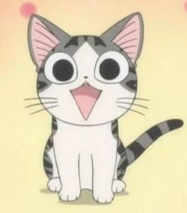
Thanks' for listening!!!

