Slide 1
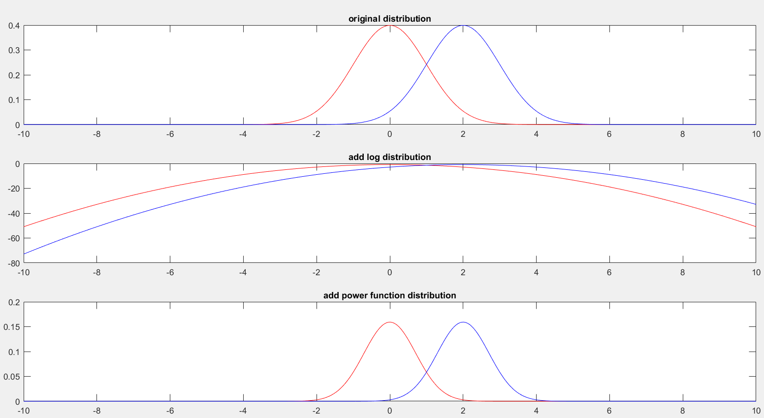
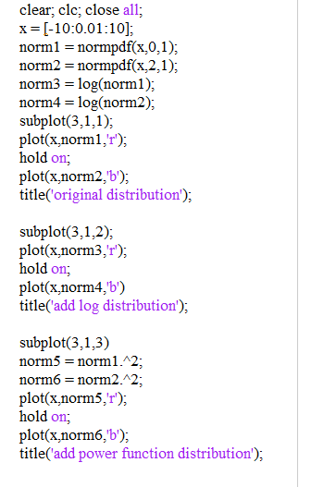

Slide 2
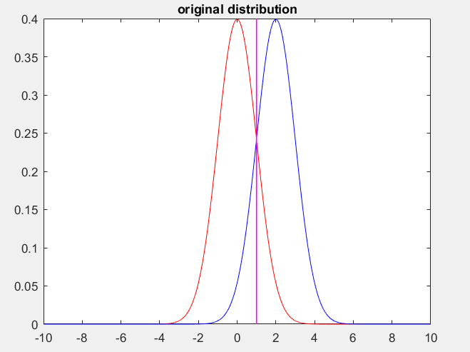

For this simple cases, It is clear that the intersection of two original Gaussian distribution N(0,1) adn N(2,1) is at the point x = 1;
For the log and the power function, because the value of pdf is positive and log, power function is monotonic increasing in the positive side, the intersection of log(pdf(x)) and (pdf)^2 should be the x =1.
To disriminate two discribution, we want that:
Clearly, the threshold of original distribution should be choose x =1 and it is shown in the figure at the right side. To be clear we limit the x to be [-10,10]. So to calculate the error probability in this specfic cases, we should do the calculation as follow:
Apply this calculation for all 3 model, we can calculate the error in the end:
Model | error probability
Function1 | 0.3173
Function2 | 0.9938
Function3 | 0.1573

Slide 3
Seems that the log function will mix the distribution and power function will do the converse thing.
But when comes to the parameter estimation, the situation is different.

Slide 4
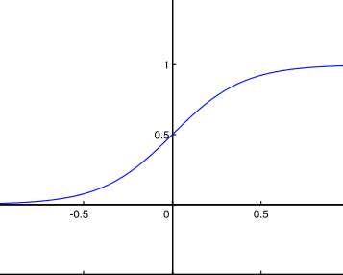
We build the simplest the logistic model
1. logistic model is discriminate model and it is same kind of model with our test model before.
2. logisitc model can be interperted as 2 layers neural network whose output shape is 1 and loss function is cross binary entropy
3.I don't use any Φ machine function here
input
sigmoid
.....

Slide 5
Add function to the model
C
A
C
A
B
B
input
input
sigmoid
....
sigmoid
A: Add function before multiply weights
B: Add function after multiply weights
C: Add function after sigmoid function

Slide 6

Add power function
Add quartic function to place C
C
input
sigmoid
...
For original logistic regression we have
The result of weights is exactly the same!

Slide 7
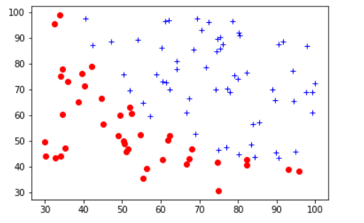
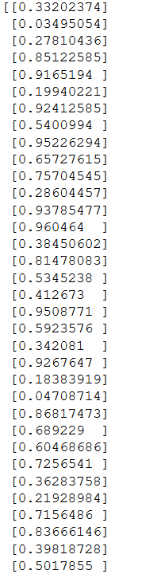
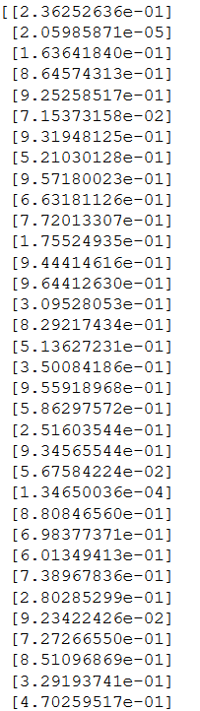
Test the result
C
input
sigmoid
...
dataset
original logistic regression model
add power function logistic regression model

Slide 8

Test the result
The model will finally break down, if we keep increasing the parameter in the power function
add power function f(x) = pow(x,1000) logistic regression model
To large power function will do harm to the classification

Slide 9
Add the power function to A and B
A
B
Add the power function at place A
input
sigmoid
Add the power function at place B

Slide 10
For the log function we do the same thing
A
B
C
input
sigmoid
because f(x) = log(x) require the x>0, so we can only add the log function in the place A and C

Slide 11
Test the result
A
C
input
sigmoid
Add the power function at place A
Add the power function at place C

Slide 12
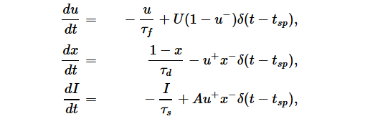
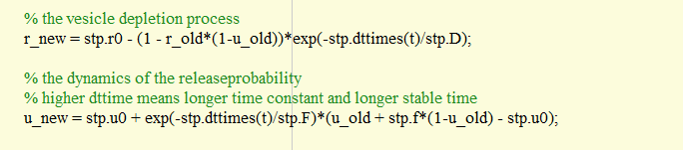
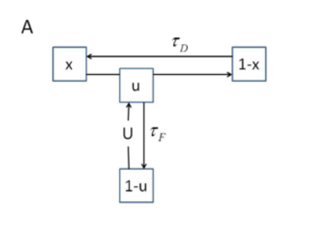
t is the duration time, why not change it to the reciprocal of neuron output

Slide 13
1.stp 加在一个神经元上，plot出来，看看有什么区别
2.加x之后，分布有什么区别

