Slide 1

Alexander Martinez
Lab 18: Inrush and Operation Current
Notes:
Shared Document with questions:
https://docs.google.com/document/d/1hzmHP0FQbqre-sEhfdFKW25kCHrw2cxthhCXGVC6FgY/edit#heading=h.vyvxd94gsqza

Slide 2
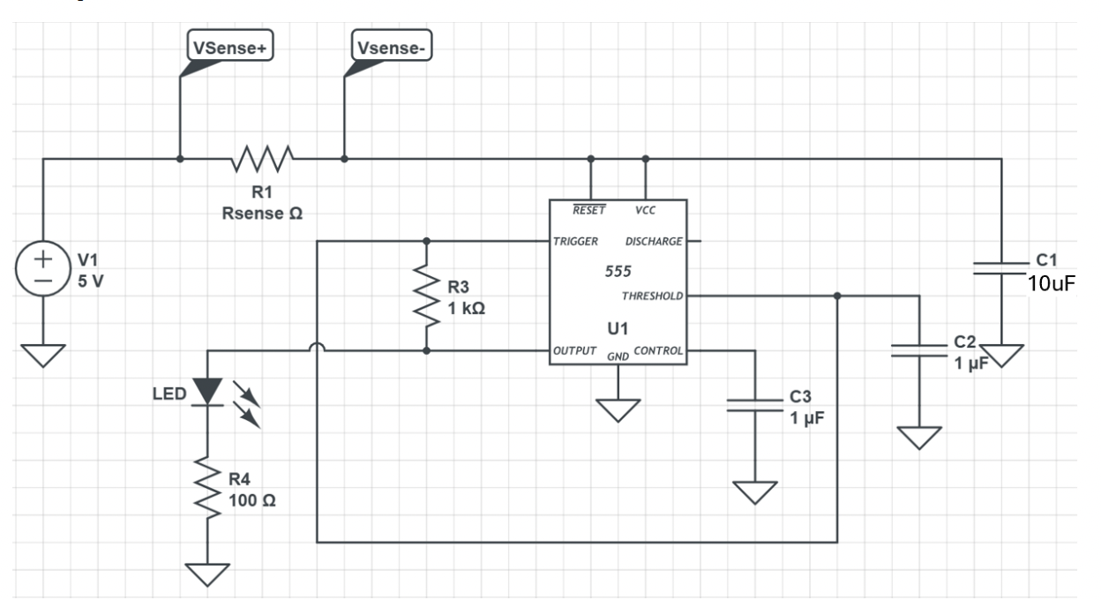
The Circuit
This circuit contains a 555 timer with a 5V supply and a current sense resistor R1 (which was chosen to be 1 Ohm). A LED is driven by the output of the 555 timer with a current limiting 100 Ohm resistor.
VCC has a 10uF decoupling capacitor attached. The 555 timer is designed to operate with a 50% duty cycle and about a 500Hz frequency with a 1k Ohm resistor and a 1uF capacitor.
The current sense resistor should not affect the performance of the circuit, and 1 Ohm should accomplish this.

Slide 3
What is Inrush Current?
The current drawn is dependent on the initial load when the power supply is connected. A large current for the circuit’s capacitors to be charged is drawn. This transient current is called inrush current. This current then settles and a steady current remains. Using the sense resistor, these currents can be measured if it is connected in series with the VRM via differential probing.
The inrush current can be estimated using approximation related to Thevenin resistance of the VRM. The Thevenin resistance of the Arduino Uno which is used for this experiment is around 2 Ohms. This means the maximum current can be 2.5A.

Slide 4
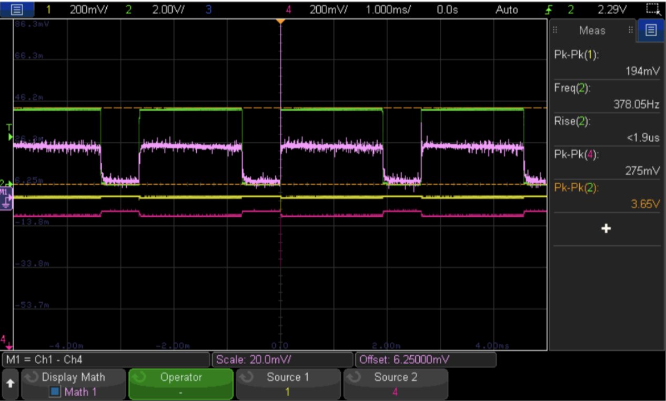
Steady State Current
To the right, green is the 555 output and is used as the trigger. Yellow is the voltage at the high side of the sense resistor, and red (4) is the voltage at the low side of the sense resistor. Pink is the differential voltage between these using the math function (yellow – red).
Pink is 20mV/div so a voltage across the resistor of 20mV. Therefore, the steady state current is 20mV/1Ohm = 20mA.

Slide 5
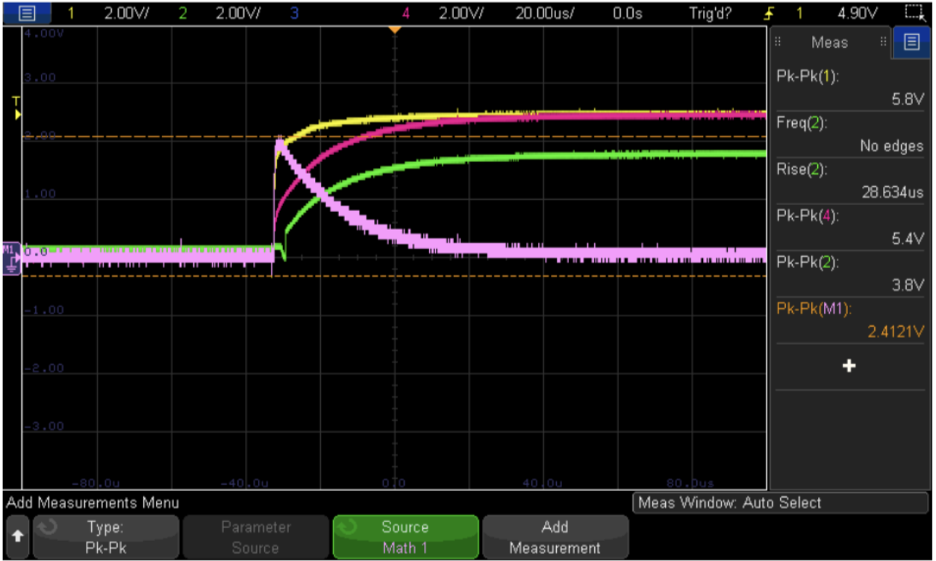
Inrush Current
Now, the high side of the resistor is shown in yellow and acts as the trigger. Red is the low side, and green is the 555 output. The pink is the transient voltage across the sense resistor, which is about 2.4V. The inrush current here must then be 2.4V/1Ohm = 2.4A.
This is a super high current and may damage components if the supply does not cater to this event.

Slide 6
Conclusion
Using differential probing across the current sense resistor using single ended 10x probes, the steady state and inrush current can be measured. How large the inrush current demonstrates the importance of choosing a good power supply.
Notes:
https://docs.google.com/document/d/1hzmHP0FQbqre-sEhfdFKW25kCHrw2cxthhCXGVC6FgY/edit#heading=h.vyvxd94gsqza
This is our first one. So we are doing our best. Have some grace. We will figure this out together.
For OIT members only due to time constraints. Attendees place their names and department in chat. (2 minutes)
Share Agenda. Then take slide down to talk about the Why and OneDrive Overview.
Why? Teaching, research, and creative work can not occur without technology and technology is evolving faster than ever - all while security risks continue to grow. OIT works with the campus community to continually support these changing technological needs and security concerns. To better enable OIT to understand and support faculty needs, especially given the variety of ways in which faculty use technology, a mechanism for more direct communication is essential. These community sessions will act as a space for individual faculty and members of OIT to come together, discuss specific technology changes and challenges, so as to ensure technology acts as an enabler to faculty’s work and productivity.
Intent of our meeting. Due to the rapid acceleration of the rate of change around information technology (IT) and the impact of this change on faculty’s day-to-day interactions with technology, this meeting is a space to have regular dialogue and feedback between individual faculty and OIT regarding specific technology topics so as to work together and ensure technology is enabling faculty’s work all while ensuring good stewardship of CU Boulder’s IT investments and the campus community.
How are topics chosen? IT topics or related issues that impact faculty will be discussed and chosen via discussions with the Boulder Faculty Assembly’s Academic Technologies and Services Committee (BFA ATSC) chair and OIT liaisons to the BFA ATSC. The initial focus will be in the productivity space with recent technology changes such as OneDrive, Email/Quarantine, Google Drive, etc., and it may also include proposed changes to solicit faculty input.
Logistics: twice monthly meetings
Format of Discussion Space.

