Slide 1
Lumatone Keyboard
Alex Halloran

Slide 2
Overview
Create a large hexagonal keyboard for microtonal music
Each key is velocity sensitive using a hall effect sensor
The key data is read using an Arduino nano and midi data is sent using midi over USB

Slide 3
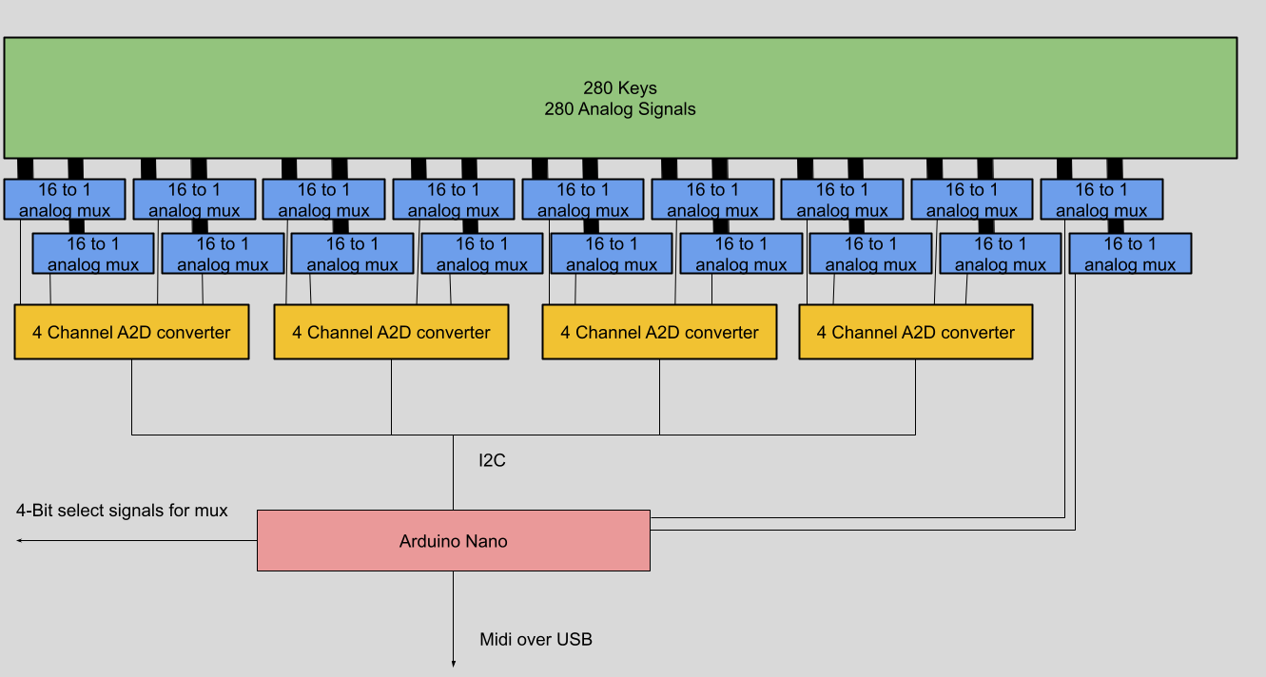
Overview

Slide 4
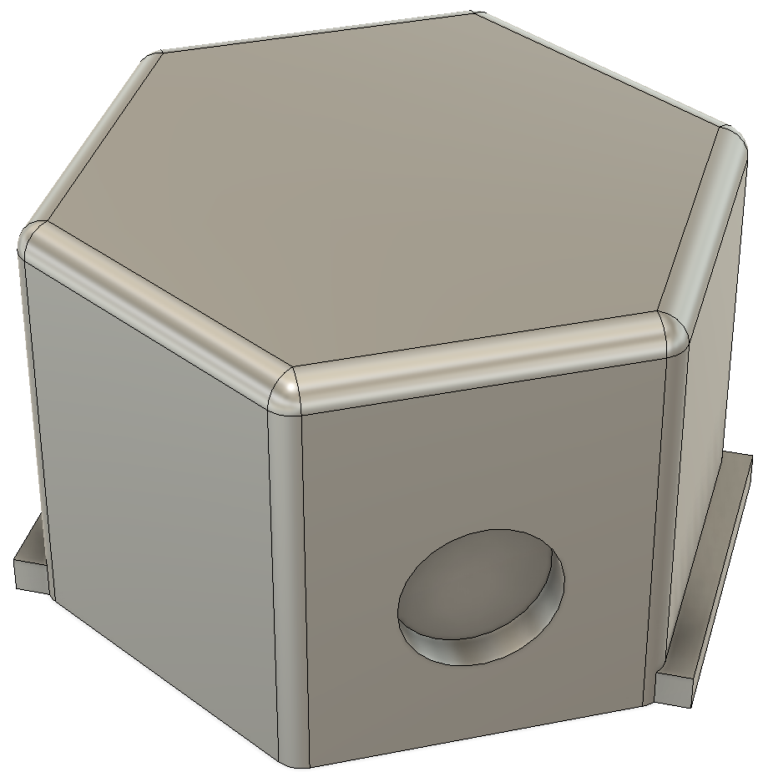
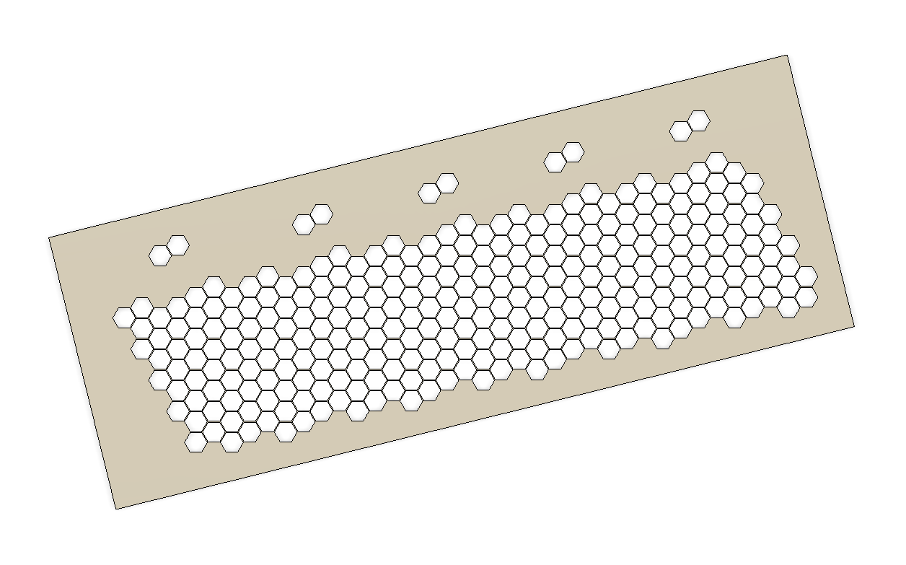
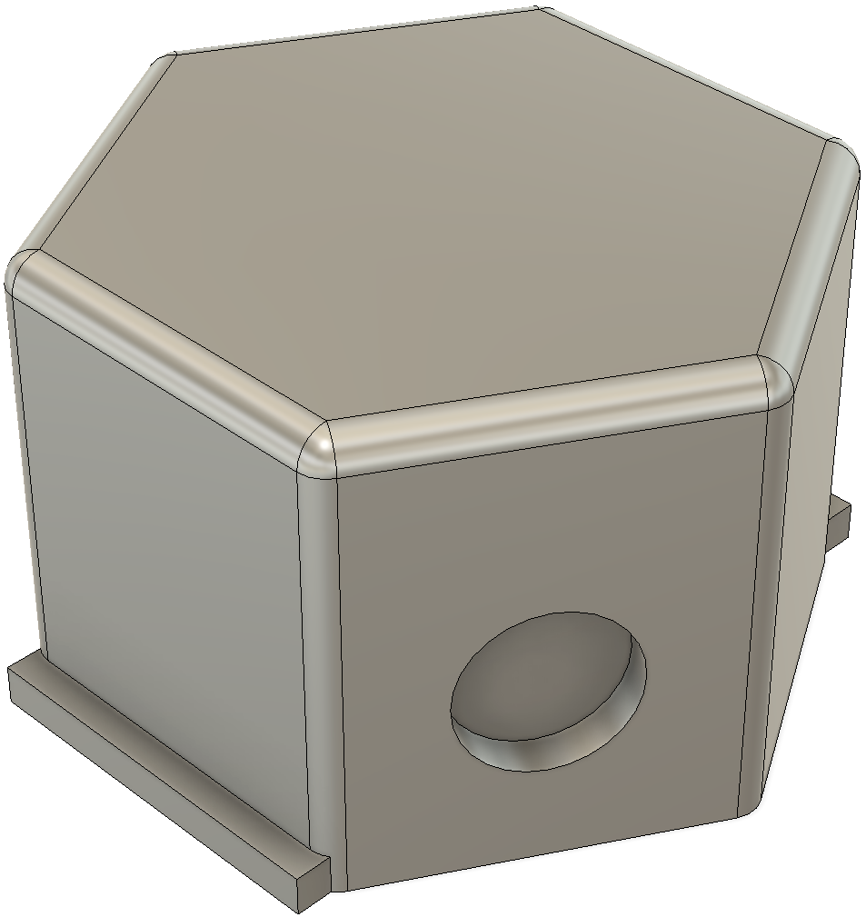
Overview

Slide 5
Educational Value
3D modeling
Circuit design
Soldering experience
Integrating parts to create a full functioning system

Slide 6
Component Cost
All 3d filament and electronic parts are already bought
Other needed materials / equipment
Sandpaper
Soldering equipment
5x1 mm magnets
The total cost ~ $20

Slide 7
Timeline
September 26 – All parts should have arrived. All 3D printing should be complete
October 3 – Sanding / Glueing 3D-printed parts should be complete
October 10 – Soldering should be complete
October 17 – Software and assembly should be complete

