Slide 1
测试pptx
Just for test，you can replace your file to test

Slide 2
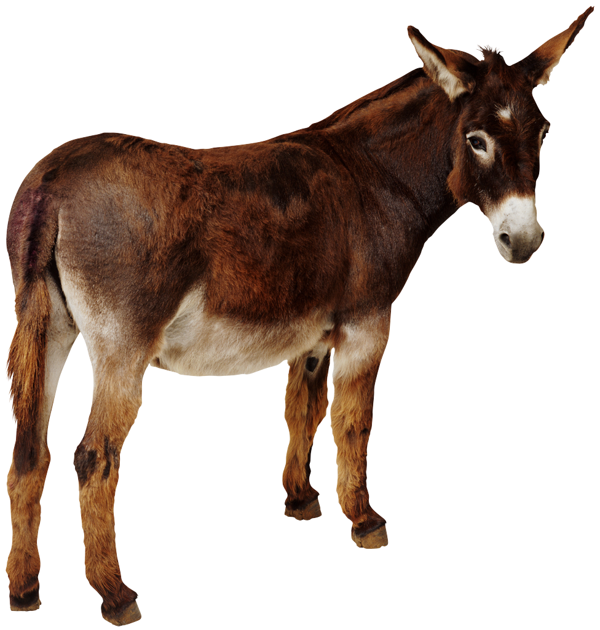
Picture test

