Slide 1
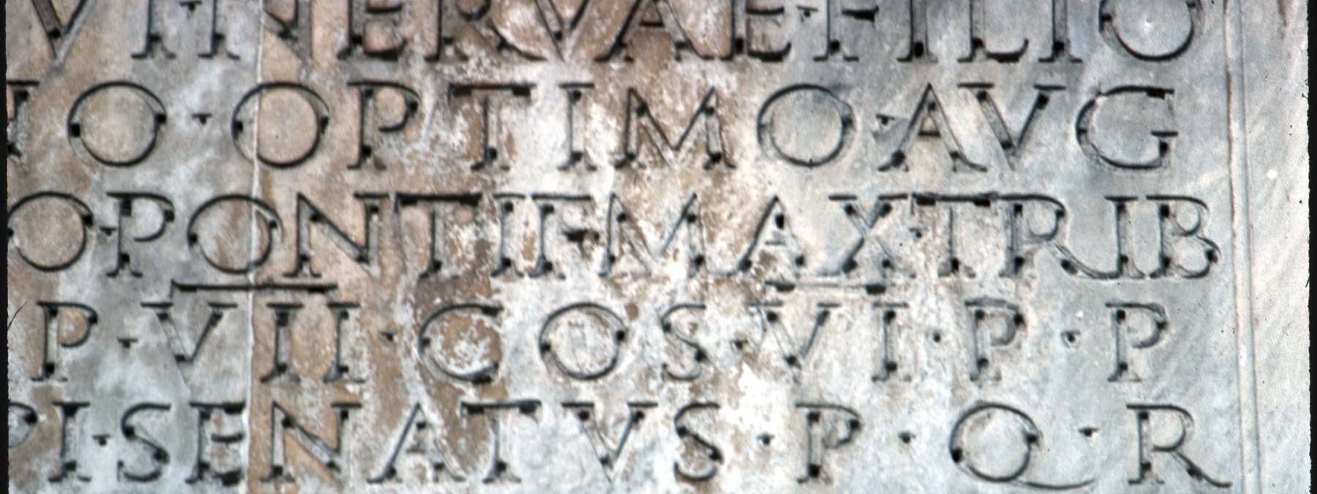
XML and Epidoc
Part 1: Introduction to XML
A simple introduction
Latin 002 Class project

Slide 2
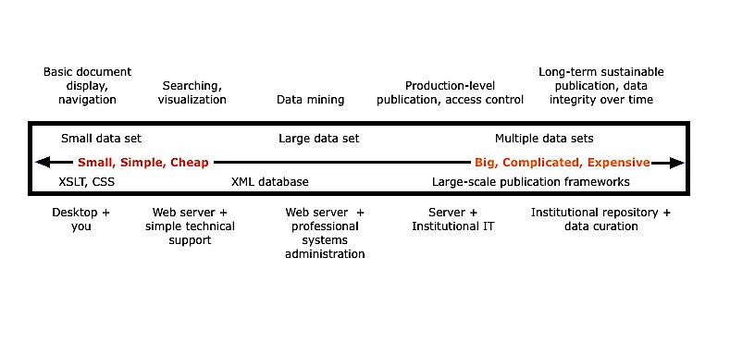
The Emerging Digital Humanities lifecycle
Image from the Women Writers Project
Notes:
So why are you being forced to learn this? And more importantly, why am I here. Well, increasingly humanities work is being informed by, and taking advantage of computers. And digital projects in the humanities seem to follow a lifecycle that looks a lot like this diagram. At the end of our time, you will have he basic building blocks to create a small micro DH data set. That micro DH project could ultimately end up as a capstone which needs stewarding and curating in order to be ingested into the Institutional Repository.

Slide 3
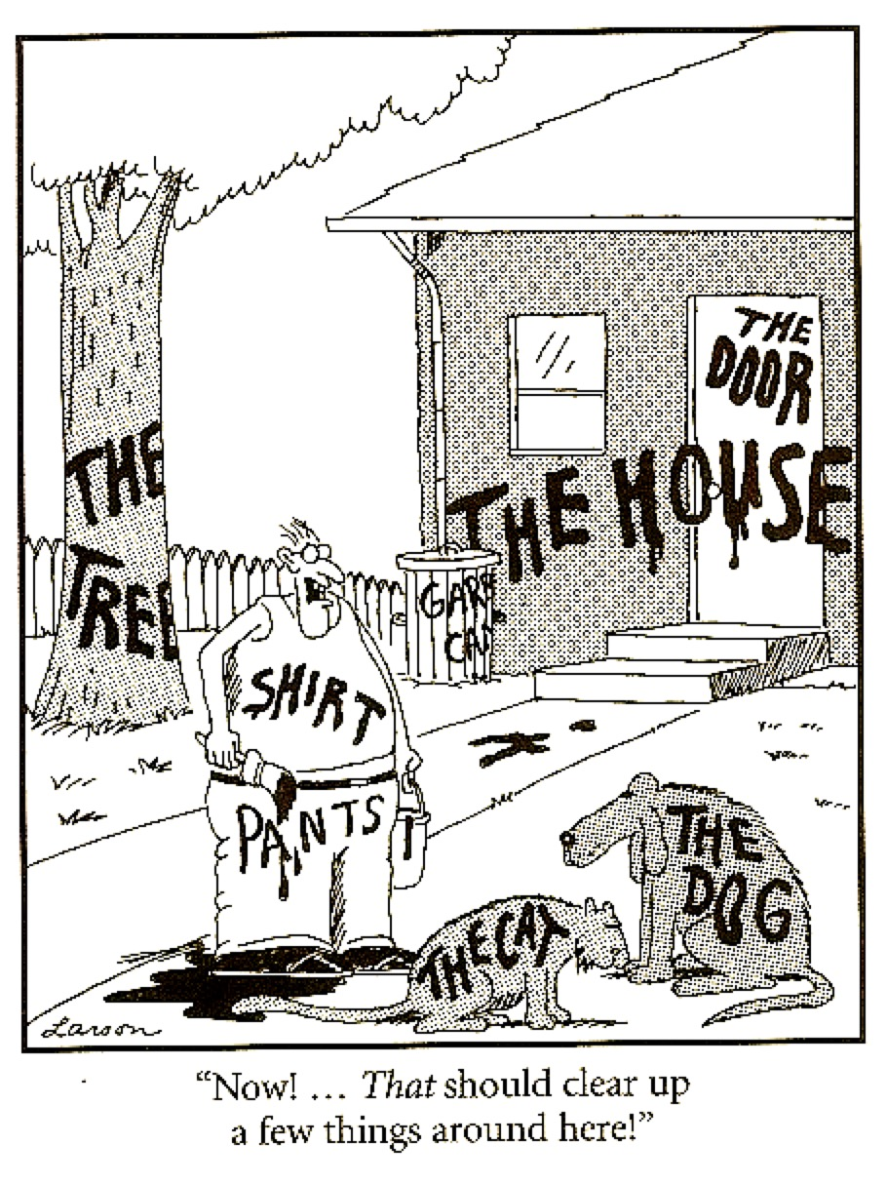
A Gentle introduction
One way to understand what XML does is to think about it as a way of structuring, or organizing information.
Structure is what makes digital information useful to us; it helps us find things, it helps us identify them and understand what they are, and it helps us communicate about them to other people.
Notes:
Note: When structuring information, it is more important to be consistently wrong than inconsistently right.

Slide 4
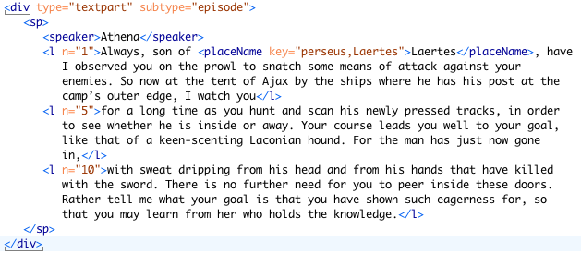
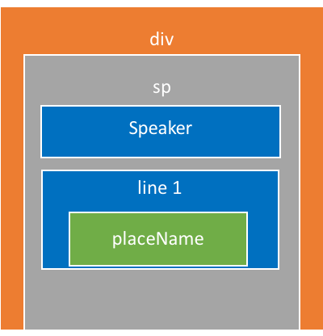
Xml as a means of structuring information
Notes:
XML provides a very specific way of structuring information and of looking at the world. It asks us to identify pieces of information that we are interested in, and it asks us to group them together. We can represent these groupings in various different visual ways, all of which represent the same thing—XML’s structure. The first useful metaphor is that of a set of nested boxes, like in this example. These boxes always nest perfectly within each other, and do not overlap.

Slide 5
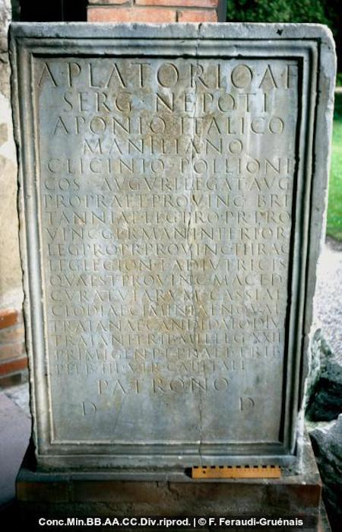
The relationship between xml and TEI
XML
Syntax
<?xml version="1.0" encoding="UTF-8"?>
<root>
<element>Content
<element attribute = "value">More content.</element>
</element>
</root>
TEI
Schema = Epidoc
…
<body>
<div type=”edition">
<ab>
<lb n="1"/><persName <expan><abbr>A</abbr><ex>ulo</ex></expan>
</ab>
</div>
</body>
Lines
Persons
Abbreviations
XML defines a syntax for text encoding. It is a method for distinguishing our markup from the content that we are marking up. The TEI provides the specifics of the actual encoding language. It translates our concepts into XML, and provides a controlled vocabulary that we use in marking up the text.
Notes:
Today we will mostly be looking at the syntax of xml, and the rules for creating xml documents.

Slide 6
So what does this look like….
XML declaration
Specifies that the document uses a subset of TEI P5 elements called Epidoc, and further, is a subset of those rules, specific to Brown—your processor will validate against this.
<?xml version="1.0" encoding="UTF-8"?>
<?oxygen RNGSchema="http://cds.library.brown.edu/projects/usepigraphy/schema/exp-epidoc.rng" type="xml"?>
<TEI xmlns="http://www.tei-c.org/ns/1.0" xmlns:xi="http://www.w3.org/2001/XInclude">
<teiHeader>
<fileDesc>
<titleStmt>
<title>MD.Balt.JHU.L.119c</title>
</titleStmt>
<!—publicationStmt start here -->
<publicationStmt>
<authority>Brown University &amp; Tufts University</authority>
<idno type="USEpigraphy" xml:id="MD.Balt.JHU.L.119c">Repeat USEP ID</idno>
</publicationStmt>
…
Root element
TEI namespace attributes
Comment
Predefined Entity
Tag
Attribute
Attribute Value
Notes:
Note the root element. This is absolutely necessary to create xml.
Our root element declares that this document uses the TEI
There are five predefined entities:
&lt; represents "<";
&gt; represents ">";
&amp; represents "&";
&apos; represents "'";
&quot; represents '"'.
The EpiDoc schema, the set of rules that tells an XML editor or processor what elements, attributes and other content are available in an EpiDoc file
XML processors are classified as validating or non-validating depending on whether or not they check XML documents for validity. A processor that discovers a validity error must be able to report it, but may continue normal processing.

Slide 7
Let’s Break that down
What my mark-up <emph>actually</emph> looks like

