Slide 1



Introduction to XSLT for tei
Kick-Off: Setting up oXygen
A gentle introduction to stylesheets as adapted from the Women Writers Project and Further Adventures in XML

Slide 2
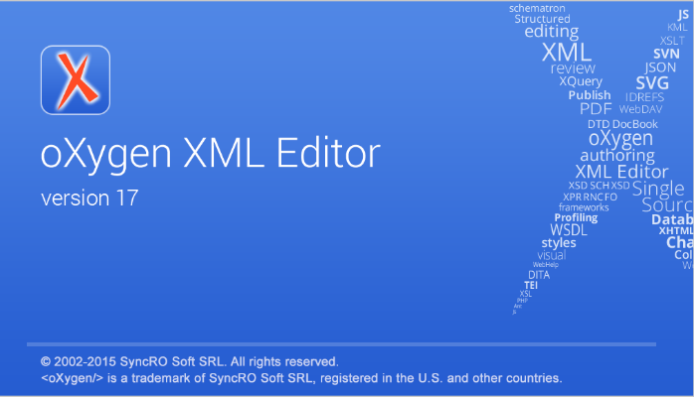
Let’s Open oXygen and 2_Stylesheets/Part 1/namespace.xslt

Slide 3
Set your Processor to saxon-PE 9.6.0.7
Validating XSLT Stylesheets
Oxygen XML Editor performs the validation of XSLT documents with the help of an XSLT processor that you can configure in the preferences pages according to the XSLT version. For XSLT 1.0, the options are: Xalan, Saxon 6.5.5, Saxon 9.6.0.7 and a JAXP transformer specified by the main Java class. For XSLT 2.0, the options are: Saxon 9.6.0.7 and a JAXP transformer specified by the main Java class. For XSLT 3.0, the options are Saxon 9.6.0.7 and a JAXP transformer specified by the main Java class.
To access the XSLT preferences quickly, use the Validation options action from the Document > Validate menu.

Slide 4
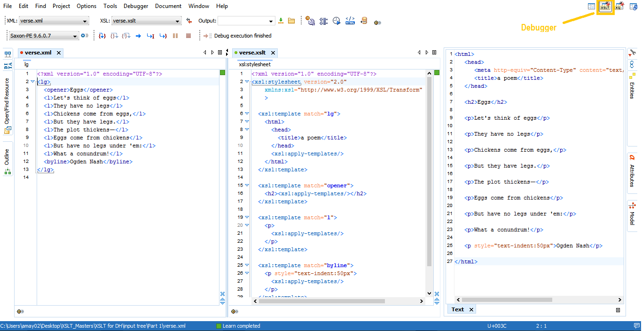
Debugger view

