Slide 1

Predictors for Dementia
By Alex Putz
Notes:
To use this title animation slide with a new image simply 1) move the top semi-transparent shape to the side, 2) delete placeholder image, 3) click on the picture icon to add a new picture, 4) Move semi-transparent shape back to original position, 5) Update text on slide.

Slide 2
Overview
Goal
Identify identifying factors that can assist with early identification of dementia using the dementia_predictions dataset.
Dementia is a neuro-degenerative disorder.
It is described as a progressive loss of intellectual functioning due to an organic disease of the brain.
Data Overview:
This data set uses 15 different criteria across 343 participants ages 60-98.

Slide 3
Method
Imported CSV file and Modules into Colab Notebook
Data Exploration, Cleaning, and Descriptive Statistics
Checked for Correlation with Pearsonr
Split data into sample populations through conditional filtering
Checked sample population distribution with Histograms
Performed statistical analysis using t-test
Found 95% confidence intervals

Slide 4
The Data
In this analysis will determine if there is a relationship Clinical Dementia Ratings based on:
Mini-Mental Status Exam (MMSE) score
Age
SES
Education
Normalized Whole Brain Volume (nWBV)
Amplitude/Stimulus Intensity Funtion (ASF)

Slide 5
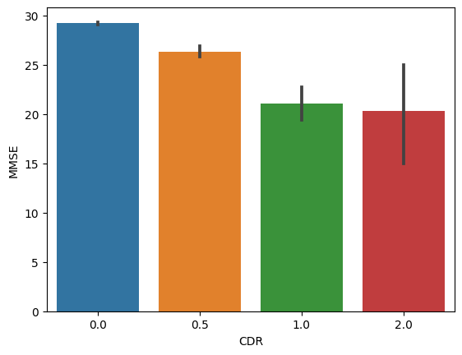
MMSE
The MMSE is a diagnostic tool that assesses cognitive function by comparing the score with a normative sample.
Hypothesis:
Does MMSE score predict the likelihood of Dementia?
H0: No difference based on MMSE
Ha: There is a difference based on high vs low MMSE
Results:
T-Value: -13.37 P-Value: 1.5e-33
P-Value is less than .05
The results are statistically significant.
Confidence Intervals at 95%:
Between 3.5 and 4.9
The results meet the confidence interval, and are
reliable.

Slide 6
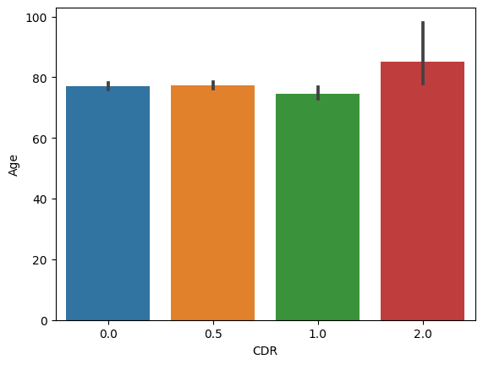
Age
The ages of the participants varied between 60 and 98.
Hypothesis:
H0: No difference in CDR across age.
Ha: There is a significant difference in CDR across age
Results:
T-Value: -.40 P-Value: .69 > .05
The results are not statistically significant
Confidence Intervals at 95%:
Between -1.2 and 1.9
The results meet the confidence
Interval. Which means they are reliable

Slide 7
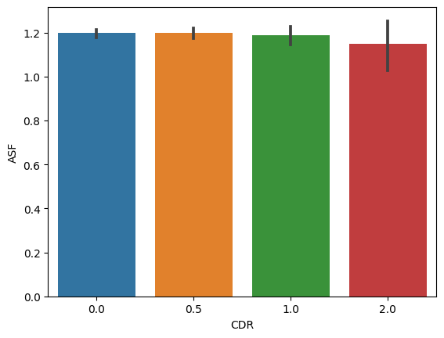
ASF
Amplitude/Stimuli Intensity Function
The amplitude of a person’s brainwaves when exposed to a stimuli.
Hypothesis:
H0: No difference in CDR across ASF levels
Ha: There is a difference in CDR across ASF levels
Results:
T-Value: -0.26 P-Value: .80
P-Value is greater than .05
The results are not statistically significant
Confidence Intervals at 95%:
Between -0.24 and .03
The results meet the confidence
Interval. Which means they are reliable

Slide 8
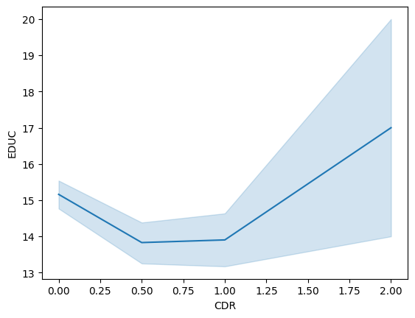
Education Level
The number of years a person received a formal education.
Hypothesis:
H0: No difference in CDR across education levels
Ha: There is a difference in CDR across education levels
Results:
T-Value: -4.3 P-Value: 2.3e-05
P-Value is less than .05
The results are statistically significant
Confidence Intervals at 95%:
CI is between .68 and 1.8
The results meet the confidence Interval. Therefore
they are reliable.

Slide 9
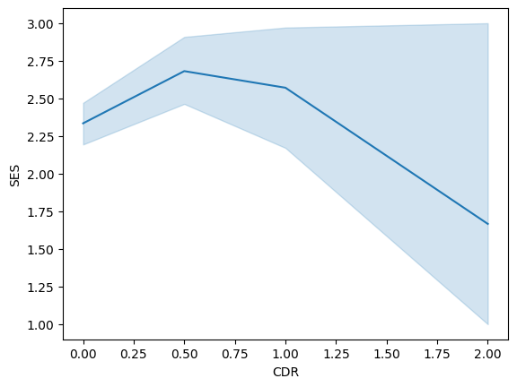
SES
Social Economic Status- is a measurement of a person economic and social position based on the relation to others.
Hypothesis:
H0: There is no difference in CDR across SES
Ha: There is a difference in CDR across SES.
Results:
T-Value: -2.5 P-Value: .014
P-Value is less than .05
The results are statistically significant
Confidence Intervals at 95%:
Between -.54 and -.07
The results meet the confidence
Interval. Therefor they are likely reliable.

Slide 10
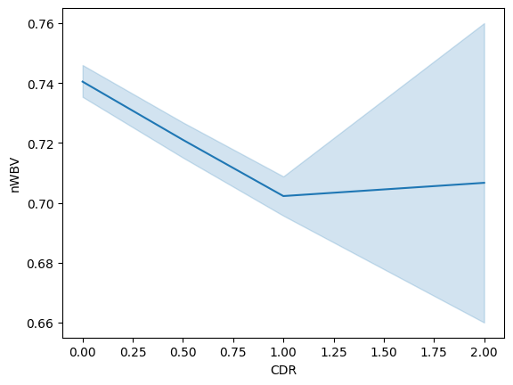
nWBV
Normalized Whole Brain Volume
It is a measurement of the volume of the brain structures when compared to skull size.
Hypothesis:
H0: There is no difference in CDR based on nWBV.
Ha: There is a difference in CDR between nWBV
Results:
T-Value: -6.6 P-Value: 1.11e-10
P-Value is less than .05
The results are statistically significant
Confidence Intervals at 95%:
Between .67 and 1.8
The results meet the confidence
Interval. Which means they are likely reliable.

Slide 11
5
Interpretation
All of the variables met the confidence intervals. Meaning the results are reliable and would likely be similar in a larger sample size.
MSSE Score, education level, socioeconomic status, and normalized whole brain volumes could be very accurate tools for early diagnosis of dementia and warrant further research.

Slide 12
Implications
At risk groups include people who:
Score below 25 on the MSSE
Are from lower SES
Have less education
Have smaller nWBV

