Slide 1
数据模块的设计和实现
登录模块
商品管理模块
主界面
会员管理模块
点单和追加消费模块
服务生管理模块
结账模块
营业额统计模块
预约模块
用户管理模块

Slide 2
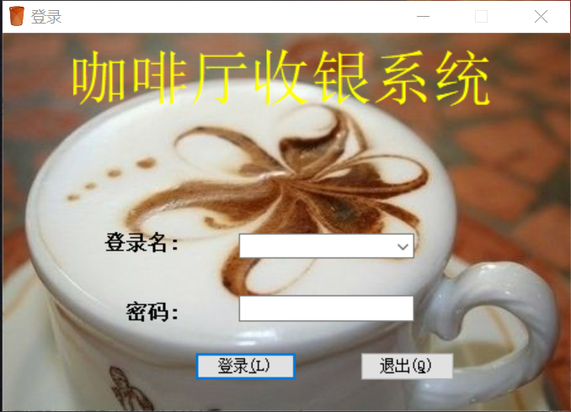
该模块的主要代码如下：
//点击退出事件
private void btnclose_Click(object sender, EventArgs e)
{ Application.Exit(); }
//点击确认事件
private void btnenter_Click(object sender, EventArgs e)
{ if (get())
{ int num=0;
try{ //查询数据库语句
string sql = string.Format("select count(*) from admin where
UId='{0}' and PassWord='{1}'",cboname.Text,txtpassword.Text);
//创建command对象
SqlCommand cmd = new SqlCommand(sql, DBHelper.con);
//打开数据库
DBHelper.con.Open();
num = Convert.ToInt32(cmd.ExecuteScalar()); }
catch(Exception ex)
{ MessageBox.Show(ex.Message); }
finally { DBHelper.con.Close(); }
在登录模块中，不同的账号对应不同的权限，包括服务生、收银员、店经理和老板四种，可通过登陆店经理账号进行统一管理，如果输入账号或密码错误或为空，系统会弹出对话框提示用户，这种设计充分考虑到了系统的安全性

Slide 3
//判断帐号密码
if (num == 1)
{ SqlDataReader dr;
string sql1 = string.Format("select Role from admin where UId='{0}' and PassWord='{1}'", cboname.Text, txtpassword.Text);
SqlCommand cmd1 = new SqlCommand(sql1, DBHelper.con);
DBHelper.con.Open();
dr = cmd1.ExecuteReader();
while (dr.Read())
{ UserTable.role = dr["Role"].ToString(); }
DBHelper.con.Close();
UserTable.name = cboname.Text;
MainFrom mf = new MainFrom();
mf.Show();
this.Visible = false; }
else
{ MessageBox.Show("用户类型密码不匹配;", "提示", MessageBoxButtons.OK, MessageBoxIcon.Error); } } }

Slide 4
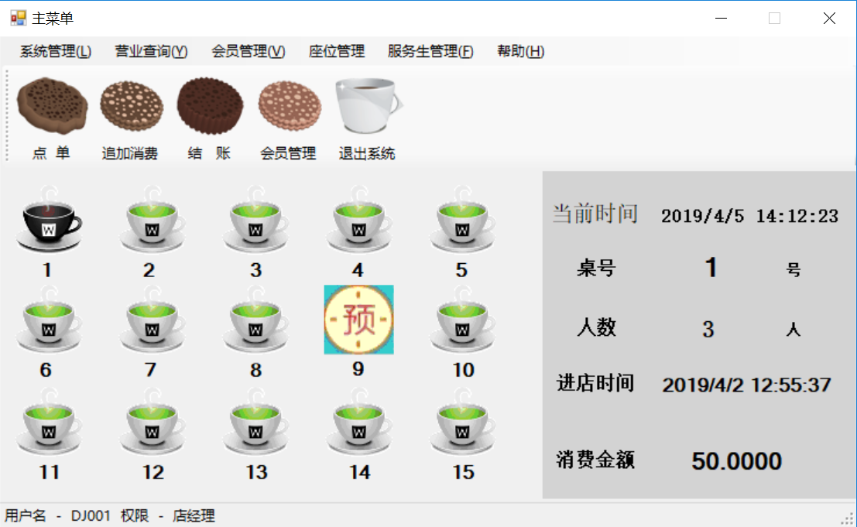
登陆后出现系统主界面，主页面上方包含了本系统的全部功能，左侧是咖啡厅座位情况，黑色代表有人，白色代表空桌，有 “预“字样的代表已被预约，右侧是座位详情，显示了当前时间。点击已开台座位会出现桌号，人数，进店时间和消费金额。最下方显示了用户名和使用权限

Slide 5
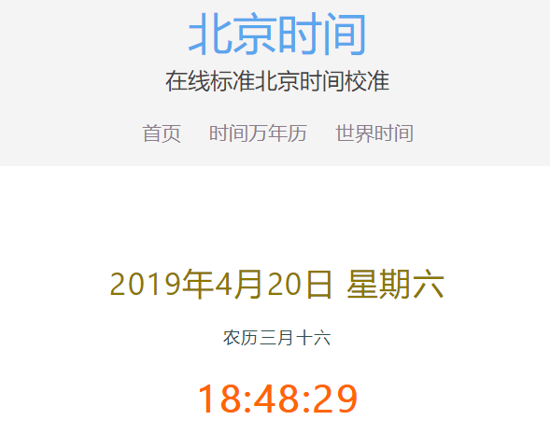
namespace index { public partial class MainFrom : Form
{ string table; //当前桌子号
PictureBox[ ] picturebox; public static bool timetf = false; public static bool timebook = false;
DateTime tbsj; public MainFrom() { InitializeComponent(); }
public DateTime GetBeijingTime()
{ DateTime dt; WebRequest wrt = null; WebResponse wrp = null;
try { wrt = WebRequest.Create("http://www.beijing-time.org/time.asp");
wrp = wrt.GetResponse(); string html = string.Empty;
using (Stream stream = wrp.GetResponseStream())
{ using (StreamReader sr = new StreamReader(stream, Encoding.UTF8))
{ html = sr.ReadToEnd(); } }
string[] tempArray = html.Split(';’); for (int i = 0; i < tempArray.Length; i++)
{ tempArray[i] = tempArray[i].Replace("\r\n", ""); }
string year = tempArray[1].Split('=')[1]; string month = tempArray[2].Split('=')[1];
string day = tempArray[3].Split('=')[1]; string hour = tempArray[5].Split('=')[1];
string minite = tempArray[6].Split('=')[1]; string second = tempArray[7].Split('=')[1];
dt = DateTime.Parse(year + "-" + month + "-" + day + " " + hour + ":" + minite + ":" + second);
tbsj = dt; }
catch (WebException) { return DateTime.Parse("2011-1-1"); }
catch (Exception) { return DateTime.Parse("2011-1-1"); } finally
{ if (wrp != null) wrp.Close(); if (wrt != null) wrt.Abort(); } return dt; }

Slide 6
权限
显示1号桌的信息
if(UserTable.role.Trim()== "店经理")
{
系统管理ToolStripMenuItem.Visible = true;
营业查询ToolStripMenuItem.Visible = true;
添加管理ToolStripMenuItem.Visible = true;
服务生管理ToolStripMenuItem.Visible = true;
toolStrip1.Visible = true;
}
private void pictureBox1_MouseClick
(object sender, MouseEventArgs e)
{ table = "1";
showtablesm();
showmain(); }
进入其他功能
显示时间
private void toolStripButton3_Click
(object sender, EventArgs e)
{
if (panduanjiezhang())
{ jiezhang jz = new jiezhang(this);
jz.ShowDialog(); } }
private void timer1_Tick(object sender, EventArgs e)
{
this.labtimenow.Text= DateTime.Now.ToString(); //显示当前时间
if (timetf == true)
{
showpic();//数据绑定
timetf = false; }

Slide 7
private void showmain()
{ bool a=false;
try { string sql = string.Format("select * from TableNumber where TableId={0}",table);
SqlCommand cmd = new SqlCommand(sql, DBHelper.con);
DBHelper.con.Open(); SqlDataReader reader = cmd.ExecuteReader();
if (reader.Read()) { a = Convert.ToBoolean(reader["Tablefettle"]); } reader.Close(); }
catch (Exception ex) { MessageBox.Show(ex.Message); } finally { DBHelper.con.Close(); }
label19.Text = ""; label20.Text = ""; label21.Text = "";
if (a == true) { try { string sql = string.Format("select * from Tables where Ctable={0}",table);
SqlCommand cmd = new SqlCommand(sql, DBHelper.con);
DBHelper.con.Open(); SqlDataReader reader = cmd.ExecuteReader();
if (reader.Read())
{ label19.Text = reader["people"].ToString();
label20.Text = reader["time"].ToString();
label21.Text = reader["monry"].ToString(); } reader.Close(); }

Slide 8
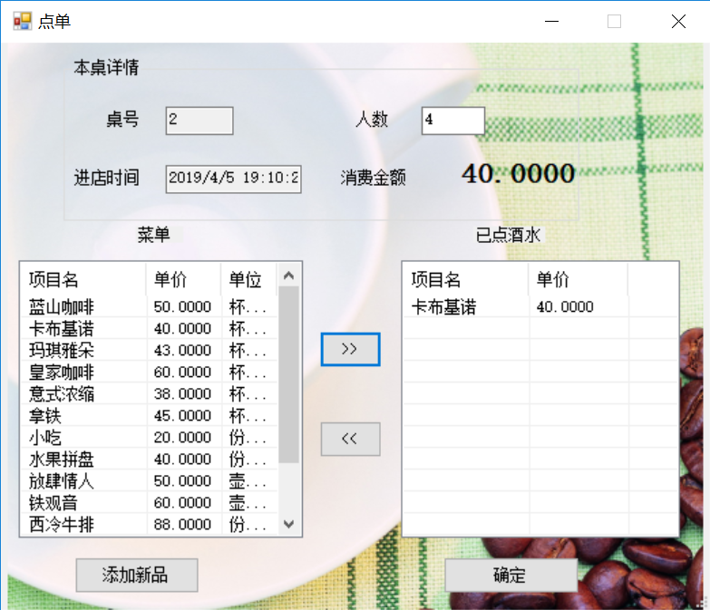
点单和追加消费模块
选择桌号后点击点单按钮，即可开始点单。点单界面会显示选择的桌号和进店时间，需要手动输入人数，将要点的商品从左侧加到右侧，上方会计算出消费总金额，取消已点菜品只需从右侧删去即可。
显示界面
private void diandan_Load(object sender, EventArgs e)
{ string sql = "select * from commoidty";
//加载菜单显示
show(sql, this.listView1);
//座号
textBox1.Text = UserTable.talbeNo.ToString();
//时间
textBox3.Text = DateTime.Now.ToString();
sum(); showlist2(); }

Slide 9
显示菜单
string name = ""; double price = 0; string type = "";
private void show(string sql, ListView lv)
{ try
{ SqlCommand cmd = new SqlCommand(sql, DBHelper.con);
DBHelper.con.Open();
SqlDataReader reader = cmd.ExecuteReader();
while (reader.Read())
{ name = reader["CName"].ToString();
price = Convert.ToDouble(reader["Cprice"]);
type = reader["Ctype"].ToString();
ListViewItem lvi = new ListViewItem(reader["CName"].ToString());
lvi.Tag = (int)reader["CID"]; lv.Items.Add(lvi);
lvi.SubItems.AddRange(new string[] { reader["Cprice"].ToString(), reader["Ctype"].ToString() }); }
reader.Close(); }
catch (Exception ex)
{ MessageBox.Show(ex.Message); }
finally { DBHelper.con.Close(); } }

Slide 10
点单
private void button2_Click(object sender, EventArgs e)
{ int id = (int)this.listView1.SelectedItems[0].Tag;
string sql = string.Format("select * from commoidty where CID={0}", id);
//加载菜单显示
show(sql, listView2);
try { string sql1 = string.Format("insert into Diandan (Dtable,DName,Dmoney) values({0},'{1}',{2})", textBox1.Text, name, price);
SqlCommand cmd = new SqlCommand(sql1, DBHelper.con);
DBHelper.con.Open(); listView1.Items.Clear();
int result = 0; result = cmd.ExecuteNonQuery();
} catch (Exception ex)
{ MessageBox.Show(ex.Message); }
finally
{ DBHelper.con.Close(); }
sum(); sql = "select * from commoidty";
show(sql, this.listView1); }

Slide 11
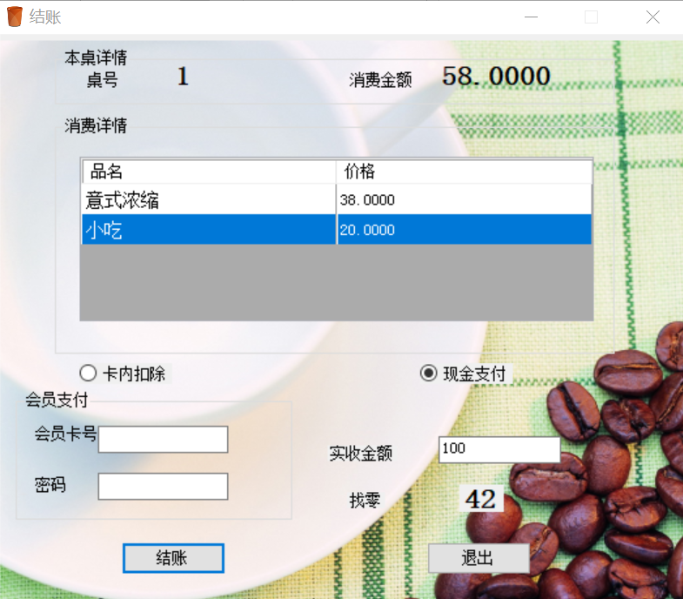
结账模块
用餐结束后选择桌号，点击结账按钮即可结账，结账界面上方显示桌号和该桌消费金额，中间是消费详情，下方可以选择消费方式，包括会员卡余额支付和现金支付，会自动计算找零

Slide 12
//验证支付方式
private void accounts()
{ if (readio()) { if (radioButton1.Checked == true)
{ int num = 0; double a = 0; double b = 0;
//判断卡号密码正确
try{string sql = string.Format("select count(*) from VIp where VIP={0} and VIppass='{1}’”,
int.Parse(textBox1.Text), textBox2.Text);
SqlCommand cmd = new SqlCommand(sql, DBHelper.con);
DBHelper.con.Open(); num = Convert.ToInt32(cmd.ExecuteScalar()); }catch (Exception ex)
{ MessageBox.Show(ex.Message); } finally { DBHelper.con.Close(); }
if (num == 1) //有这个会员
{ //查询这个卡上的余额
try {string sql = string.Format("select Vipprice from VIp where VIP={0} and VIppass='{1}’”,
int.Parse(textBox1.Text), textBox2.Text); SqlCommand cmd = new SqlCommand(sql, DBHelper.con);
DBHelper.con.Open(); SqlDataReader reader = cmd.ExecuteReader();
if (reader.Read()) {a = Convert.ToDouble(reader["Vipprice"]); b = a - Convert.ToDouble(label9.Text); } }
catch (Exception ex)
{ MessageBox.Show(ex.Message); } finally { DBHelper.con.Close(); }
MessageBox.Show("付款成功,剩余余额度为" + b.ToString() + "元", "余额提示", MessageBoxButtons.OK,
MessageBoxIcon.Information);

Slide 13
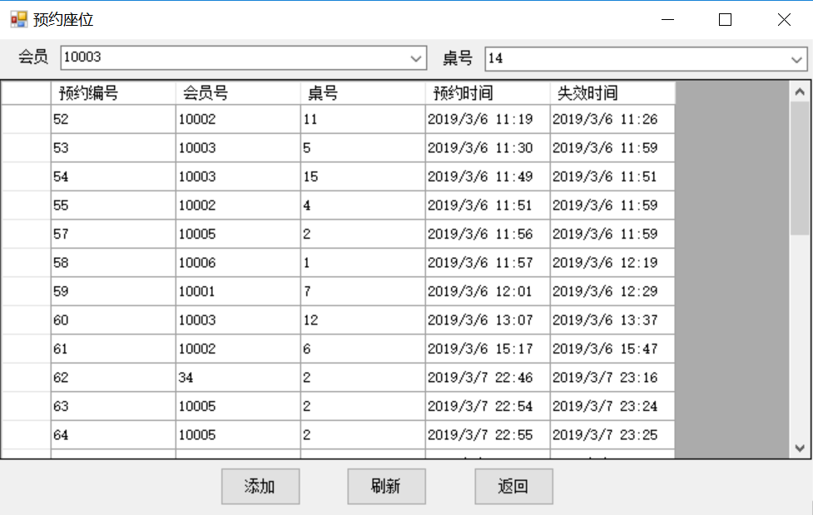
预约模块
若成为咖啡厅会员，即可享受预约座位特权，预约座位界面需要先选择会员编号，再选择想要预约的桌号，注意选择的桌号不能是已被占用或已被预约的桌号，点击添加即可预约成功，此时主界面会在相应桌显示已被预约图案

Slide 14
private void Button1_Click(object sender, EventArgs e)
{ if (comboBox1.Text != ""&& comboBox2.Text != "")
{ String insert = "insert into Book(BookVIP,BookTable,BookTime,InvalidTime)";
insert = insert + " values(@ai,@ei,@ci,@di)";
String update = "update TableNumber set Tablebook='true' where TableId=" + comboBox2.Text.ToString().Trim();
DBHelper.con.Open();
SqlCommand cmd = new SqlCommand(insert, DBHelper.con);
cmd.Parameters.Add("@ai", SqlDbType.Char).Value = comboBox1.Text.Trim();
cmd.Parameters.Add("@ei", SqlDbType.Char).Value = comboBox2.Text.Trim();
cmd.Parameters.Add("@ci", SqlDbType.Char).Value = System.DateTime.Now;
cmd.Parameters.Add("@di", SqlDbType.Char).Value = System.DateTime.Now.AddMinutes(+30);
cmd.ExecuteNonQuery(); SqlCommand cmd1 = new SqlCommand(update, DBHelper.con);
cmd1.ExecuteNonQuery(); MessageBox.Show("预约座位成功", "提示"); DBHelper.con.Close(); 更新();
comboBox2.Items.Clear(); SqlDataReader dr2; DBHelper.con.Open();
SqlCommand cmd2 = new SqlCommand("select * from TableNumber where Tablefettle='false' and Tablebook<>'true’”,
DBHelper.con); dr2 = cmd2.ExecuteReader();
while (dr2.Read()) { comboBox2.Items.Add(dr2["TableId"].ToString()); }
dr2.Close(); DBHelper.con.Close(); MainFrom.timetf = true; }
else { MessageBox.Show("会员、桌号不能为空!", "提示"); } }

Slide 15
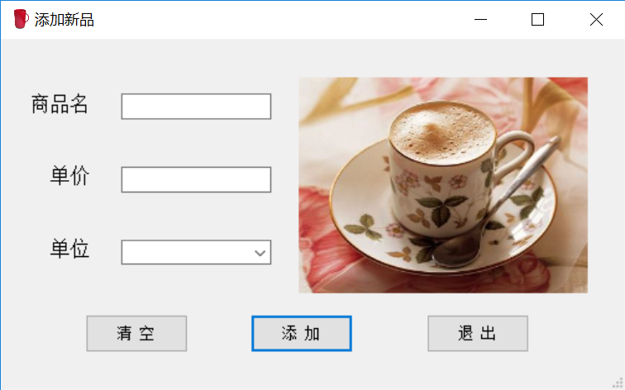
商品管理模块
本系统还可添加新品，便于商品管理，添加时需填写商品名，单价和单位

Slide 16
private void button1_Click(object sender, EventArgs e)
{ if (get())
{ int result = 0;
try
{ //数据库查询语句
string sql = string.Format("insert into commoidty (CName,Cprice,Ctype) values ('{0}',{1},'{2}')",
txtname.Text, txtprice.Text, cbotype.Text);
SqlCommand cmd = new SqlCommand(sql, DBHelper.con);
DBHelper.con.Open(); result = cmd.ExecuteNonQuery(); }
catch (Exception ex)
{ MessageBox.Show(ex.Message); }
finally { DBHelper.con.Close(); }
if (result == 1)
{ MessageBox.Show("添加成功", "提示"); txtname.Text = ""; txtprice.Text = ""; cbotype.Text = ""; }
else { MessageBox.Show("添加失败", "提示"); } } }

Slide 17
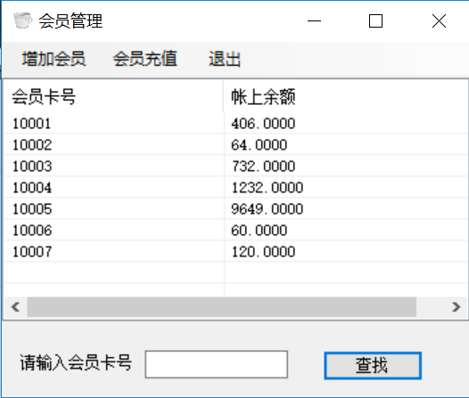
会员管理模块
为了实现咖啡厅现代化，系统的管理，本系统配有会员管理，可以实现添加，删除，查询，修改会员，以及为会员充值

Slide 18
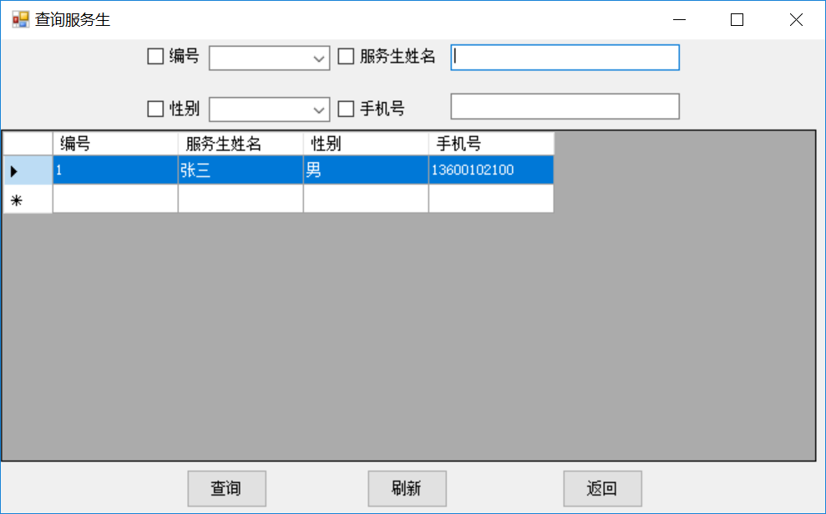
服务生管理模块
咖啡厅经理有管理服务生的权限，包括增加，删除，查询，修改服务生，十分方便且安全。服务生信息包括编号、服务生姓名、性别和手机号

Slide 19
private void Button1_Click(object sender, EventArgs e)
{ String kh = "select WID as 编号,Wname as 服务生姓名,Wsex as 性别,Wphone as 手机号 from Waiter where 1=1";
DataSet setkh = new DataSet();
if (checkBox1.Checked == true)
{ kh = kh + " and WID=" + comboBox2.Text; }
else { kh = kh + " and 1=1"; }
if (checkBox2.Checked == true)
{ kh = kh + " and Wname like '%" + TextBox1.Text + "%’”; }
else { kh = kh + " and 1=1"; }
if (checkBox3.Checked == true)
{ kh = kh + " and Wsex like '%" + comboBox1.Text + "%’”; }
else { kh = kh + " and 1=1"; }
if (checkBox4.Checked == true)
{ kh = kh + " and Wphone like '%" + TextBox2.Text + "%’”; }
else { kh = kh + " and 1=1"; }
SqlDataAdapter da1 = new SqlDataAdapter(kh, DBHelper.con);
setkh.Clear(); da1.Fill(setkh, "Waiter"); DataGridView1.DataSource = setkh.Tables[0]; }

Slide 20
private void button1_Click(object sender, EventArgs e)
{ if (textBox1.Text==""){ MessageBox.Show("请输入会员号"); }
else if (textBox2.Text == "") { MessageBox.Show("请输入充值金额"); }
else { try { int money = Convert.ToInt32(textBox2.Text);
string sql = string.Format("update Vip set Vipprice=Vipprice+{1} where VIP={0}", textBox1.Text, money);
DBHelper.con.Open(); SqlCommand cmd = new SqlCommand(sql, DBHelper.con);
int num = cmd.ExecuteNonQuery();
if (num == 1)
{ MessageBox.Show("充值成功，金额为：" + money); }
else
{ MessageBox.Show("充值失败"); } }
catch (Exception ex)
{ MessageBox.Show(ex.Message); }
finally
{ DBHelper.con.Close(); } this.Close(); } }

Slide 21
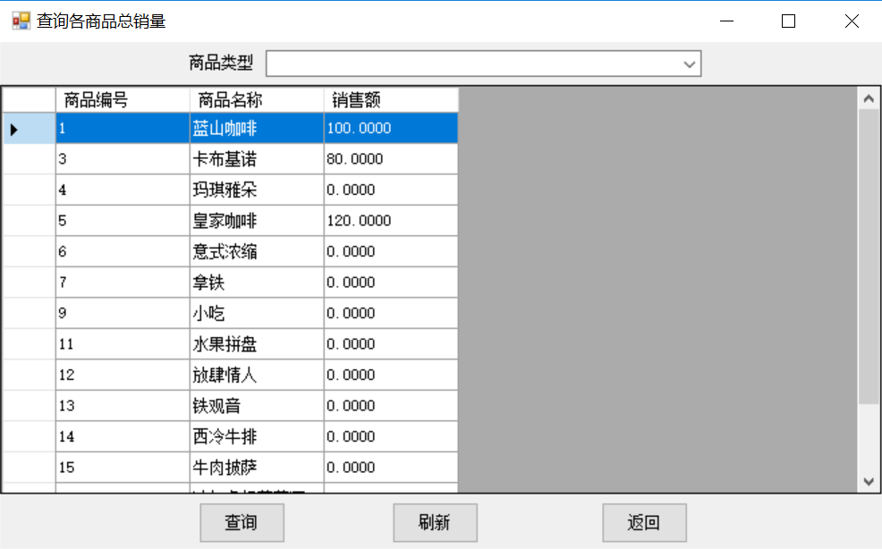
营业额统计模块
店经理和老板都有权限查询咖啡厅的商品营业销量，此功能便于修改菜单，统计营业额以及宣传畅销品，查询商品总销量界面会显示不同商品的总销量

Slide 22
private void Button1_Click(object sender, EventArgs e)
{
if (this.comboBox1.Text != "")
{
String kh = "select * from Sales where [商品编号]=" + comboBox1.Text.Split(' ')[0];
DataSet setkh = new DataSet();
SqlDataAdapter da1 = new SqlDataAdapter(kh, DBHelper.con);
setkh.Clear();
da1.Fill(setkh, "Sales");
DataGridView1.DataSource = setkh.Tables[0];
}
else
{ MessageBox.Show("商品编号不能为空!", "提示"); } }

Slide 23
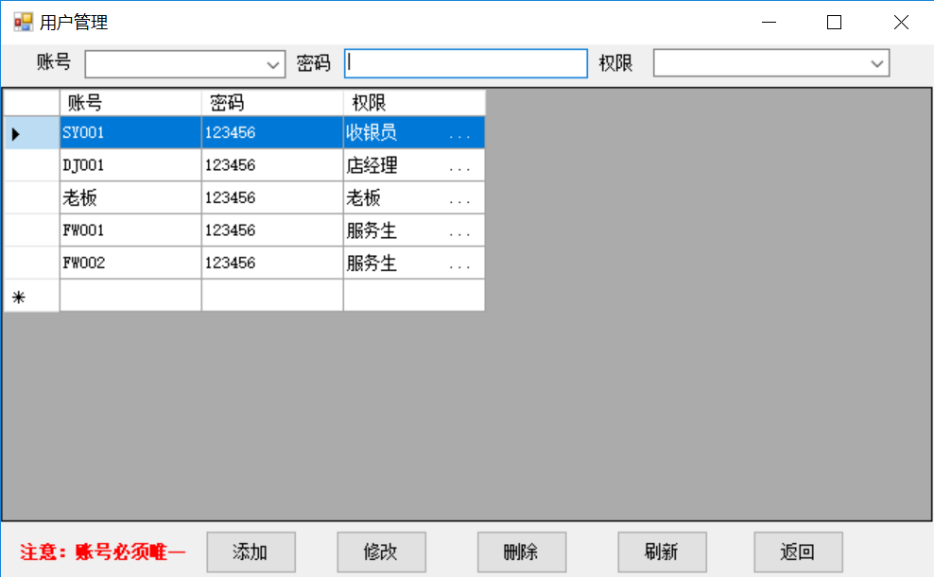
用户管理模块
店经理有权限进行用户管理，即添加、修改、删除和查询使用者账号信息，每个账号包括登陆账号、密码和该账号的权限，包括服务生、收银员、店经理和老板四种权限，不同权限可使用不同范围的功能，使用者可根据需要进行选择

Slide 24
private void button2_Click(object sender, EventArgs e)
{ if (comboBox2.Text!=""&&TextBox1.Text != ""&&comboBox1.Text != "")
{ String insert = "insert into admin(UId,PassWord,Role)";
insert = insert + " values(@ai,@ei,@ci)";
DBHelper.con.Open();
SqlCommand cmd = new SqlCommand(insert, DBHelper.con);
cmd.Parameters.Add("@ai", SqlDbType.Char).Value = comboBox2.Text.Trim();
cmd.Parameters.Add("@ei", SqlDbType.Char).Value = TextBox1.Text.Trim();
cmd.Parameters.Add("@ci", SqlDbType.Char).Value = comboBox1.Text.Trim();
cmd.ExecuteNonQuery();
MessageBox.Show("添加成功", "提示");
更新();
DBHelper.con.Close();
}
else
{ MessageBox.Show("账号、密码、权限不能为空!", "提示"); } }

