Slide 1
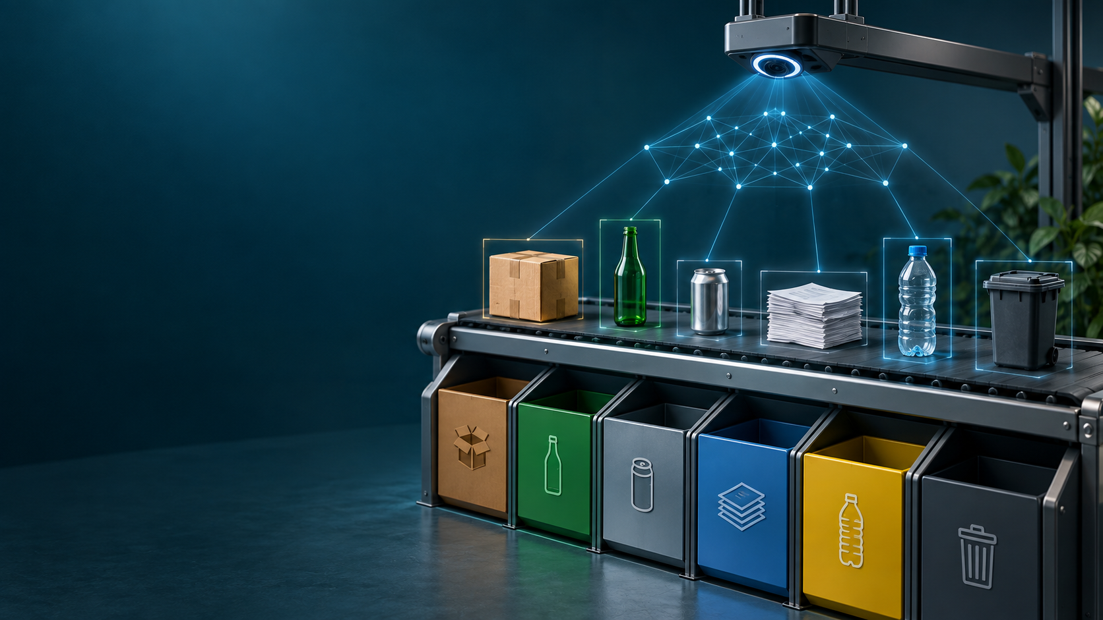
MaterialFocusNet
Attention-Guided Household
Waste Classification
Deep Learning Final Project
Abdullayev Namig
PyTorch | TrashNet | Google Colab
Notes:
Hello. My name is Abdullayev Namig. This is my Deep Learning final project, MaterialFocusNet. The project classifies household waste images into six material categories and compares a custom attention-guided CNN with a baseline CNN.
Cover illustration generated for this presentation. Dataset: TrashNet, github.com/garythung/trashnet.

Slide 2
Household waste classification
A focused computer-vision task for better sorting decisions
One image
One material prediction
cardboard
glass
metal
paper
plastic
trash
A single household-waste item
MaterialFocusNet
learns visual features
Why it matters: incorrect sorting contaminates recycling streams. Images contain differences in texture, transparency, shape, and reflection.
Abdullayev Namig | Deep Learning Final Project | 2
Notes:
Waste sorting is a useful real-world image-classification problem. The model receives one image containing one waste item and predicts one of six material classes. Visual cues such as texture, transparency, shape, and reflections make this difficult with simple rules.
Source: project notebook and final held-out test run.

Slide 3
TrashNet dataset
Public RGB image dataset for waste classification
Class distribution
The trash class has fewer images. I use stratified splits and class-weighted loss to reduce bias toward frequent classes.
2,527
6
70 / 15 / 15
224 × 224
RGB images
classes
train / validation / test
model input
Abdullayev Namig | Deep Learning Final Project | 3
Notes:
I used TrashNet, which contains 2,527 RGB images across six waste classes. Paper has 594 images, while trash has only 137. This imbalance matters, so I use stratified splits and weighted cross-entropy loss.
Source: TrashNet dataset, github.com/garythung/trashnet.

Slide 4
Data preparation
Training images vary; validation and test images remain deterministic
Stratified split
70% training, 15% validation, 15% held-out test
Training transforms
Random crop, horizontal flip, rotation, colour jitter
Evaluation transforms
Resize and centre crop
Normalization
Mean and standard deviation from training images only
The held-out test set is never used to choose model settings.
Abdullayev Namig | Deep Learning Final Project | 4
Notes:
I split the dataset into training, validation, and held-out test sets. Training uses augmentation to make the model more robust. Validation and test sets use deterministic preprocessing. I calculate normalization values using only training images to avoid data leakage.
Source: project notebook and final held-out test run.

Slide 5
Model architecture
A controlled comparison between a simple CNN and MaterialFocusNet
Baseline CNN
MaterialFocusNet
Block 1
Block 2
Block 3
Block 1
Block 2
Block 3 + SE
Block 4 + SE
Conv 3×3
32 channels
Conv 3×3
64 channels
Conv 3×3
128 channels
32 channels
64 channels
128 channels
192 channels
Adaptive pooling and classifier
Squeeze-and-Excitation attention reweights channels that carry useful material cues
Shared choices: Conv 3×3, BatchNorm, ReLU, max pooling, adaptive average pooling, dropout
Abdullayev Namig | Deep Learning Final Project | 5
Notes:
The baseline is a three-block CNN. MaterialFocusNet is deeper and includes Squeeze-and-Excitation, or SE, attention in the deeper blocks. SE attention learns which channels are important for material cues such as glass transparency and metal reflections. Both models use Batch Normalization, ReLU, pooling, and dropout.
Source: project notebook and final held-out test run.

Slide 6
Training and hyperparameter choices
Validation macro F1 guides checkpoint selection
Optimizer
AdamW
Batch size
32
Maximum epochs
60
Loss
Weighted cross-entropy
Selection metric
Validation macro F1
Regularization
Dropout and weight decay
Tuning note
The validation split guides model selection. The notebook does not include a separate grid-search table. A documented table of candidate learning rates and dropout values is a useful future improvement.
Abdullayev Namig | Deep Learning Final Project | 6
Notes:
Both models use the same training protocol. I use AdamW, batch size 32, weighted cross-entropy, a maximum of 60 epochs, and validation macro F1 for checkpoint selection. I want to be transparent: the notebook does not show a separate grid-search table. The validation split guides the selected configuration, and a tuning table is a clear future extension.
Source: project notebook and final held-out test run.

Slide 7
Reproducible experiment workflow
The same split and protocol support a fair baseline comparison
1
2
3
4
5
Download
TrashNet
Split and
preprocess
Train
baseline
Train
custom model
Evaluate
held-out test
Outputs: learning curves, confusion matrices, classification report, checkpoints, and final comparison table
Abdullayev Namig | Deep Learning Final Project | 7
Notes:
The experiment begins by downloading TrashNet and creating the fixed stratified split. Then the same preprocessing and training protocol are used for the baseline and MaterialFocusNet. Finally, each model is evaluated on the held-out test set and the notebook produces metrics and visual outputs.
Source: project notebook and final held-out test run.

Slide 8
Final held-out test results
MaterialFocusNet achieves the stronger macro F1-score
Model | Accuracy | Macro F1
Baseline CNN | 69.74% | 69.02%
MaterialFocusNet | 72.63% | 71.43%
+2.41 percentage points in macro F1
Accuracy, precision, recall, and F1 all improve for the custom model.
Abdullayev Namig | Deep Learning Final Project | 8
Notes:
These are the final results on the held-out test set. The baseline CNN achieved 69.74 percent accuracy and 69.02 percent macro F1. MaterialFocusNet achieved 72.63 percent accuracy and 71.43 percent macro F1. That is an improvement of 2.41 percentage points in macro F1.
Source: project notebook and final held-out test run.

Slide 9
Class-level performance
The model performs best on cardboard and paper
Class
F1-score
Cardboard
0.864
Interpretation
Paper
0.802
Cardboard and paper have strong visual texture cues. Glass, metal, plastic, and the smaller trash class remain harder.
Plastic
0.696
Metal
0.672
Glass
0.636
Trash
0.615
Abdullayev Namig | Deep Learning Final Project | 9
Notes:
The class-level F1-scores show that cardboard and paper are the strongest categories. Glass, metal, plastic, and trash are more difficult because materials can look similar and trash has fewer training images. This chart supports the need for more diverse images and more examples of the minority class.
Source: project notebook and final held-out test run.

Slide 10
Challenges and limitations
The benchmark is useful, but real deployment would need broader data
Small dataset
2,527 images can lead to overfitting
Class imbalance
Trash has far fewer images than paper or glass
Similar materials
Glass, plastic, and metal can share visual cues
Controlled backgrounds
Real environments include clutter, shadows, and multiple objects
Mitigation in this project: augmentation, dropout, weight decay, weighted loss, validation-based checkpoint selection
Abdullayev Namig | Deep Learning Final Project | 10
Notes:
The main challenges are limited data, class imbalance, visually similar materials, and controlled image backgrounds. In this project, I reduce these risks using augmentation, dropout, weight decay, class-weighted loss, and validation-based checkpoint selection. A real deployment would need more diverse data.
Source: project notebook and final held-out test run.

Slide 11
Conclusion
MaterialFocusNet improves waste classification over a simpler baseline CNN.
72.63%
71.43%
test accuracy
macro F1
Future work
More trash images
More realistic backgrounds
Documented tuning experiments
Transfer-learning comparison
Thank you
Notes:
In conclusion, MaterialFocusNet achieved better performance than the baseline CNN. It reached 72.63 percent test accuracy and 71.43 percent macro F1. Future work includes collecting more trash images, testing realistic backgrounds, documenting multiple tuning experiments, and comparing with transfer-learning models. Thank you for watching.
Source: project notebook and final held-out test run.

