Slide 1

Final project by Larionov Aleksandr

Slide 2
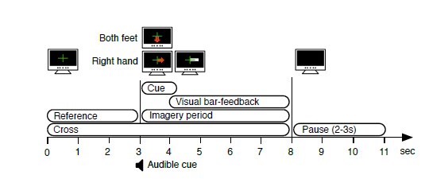
Data information
The EEG signals were acquired from 13 electrode positions (according to the International 10-20 System of Electrode Placement). The order of the channels in the data is FC3, FCz, FC4, C5, C3, C1, Cz, C2, C4, C6, CP3, CPz, CP4. The acquisition hardware was a g.GAMMAsys active electrode system along with a g.USBamp amplifier (g.tec, Guger Technologies OEG). The system sampled at 512 Hz. The EEG signals are in µV.
The array EEG data, holds the EEG signal in µV in a matrix (datapoints × channels) of double values.
Label 1 indicates hand movement imagery, while label 2 indicates movement imagery of both feet.
The array trial, indicates the position in datapoints where every trial starts.

Slide 3
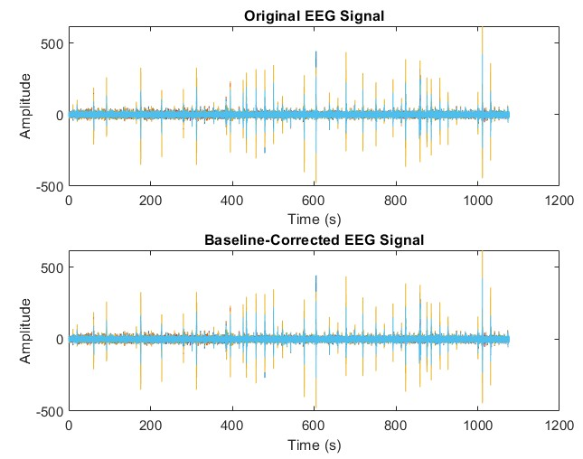
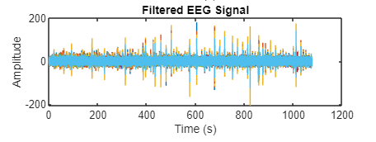
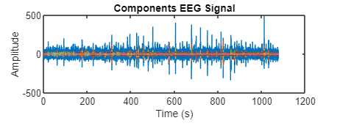
Data preprocessing

Slide 4
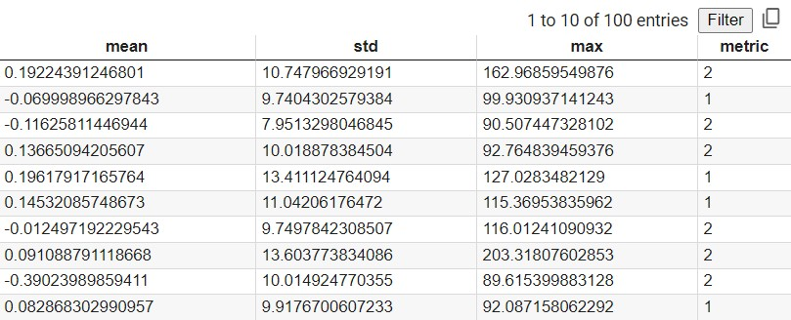

Features representing
Split train and test data – 70/30

Slide 5
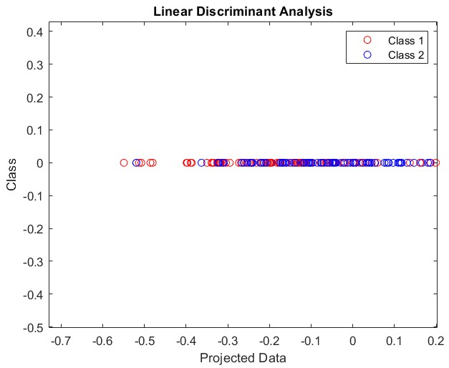
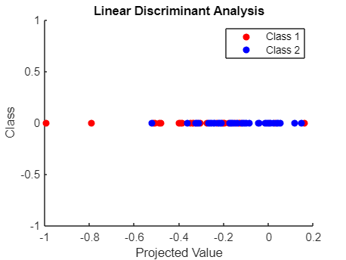
LDA results

Slide 6
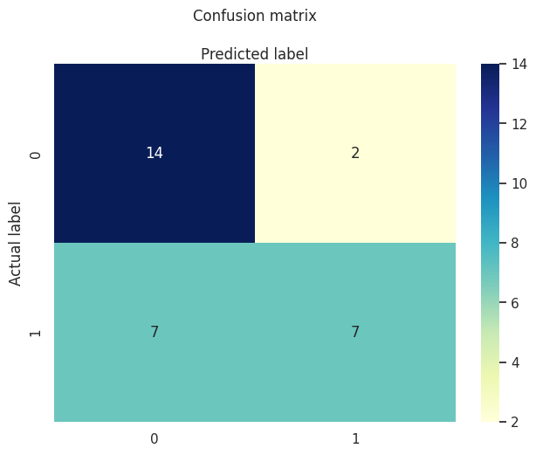
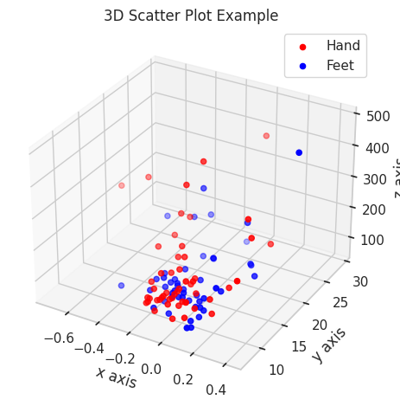

Logistic regression results

Slide 7

Thanks for attention!!!
https://colab.research.google.com/drive/1zxAj1xN_FfTZHv_t0t1RgY1pKiSAaE3f?usp=sharing

