Slide 1
CS583 Probabilistic Graphical Models
Lecture 10. MAP Queries and Junction Trees
Oleksandr Narykov
onarykov@iit.edu

Slide 2
Finding good elimination orderings
Finding the best order is NP-hard
Best = optimal time and space complexity
Heuristics
Min-neighbors
Min-fill
Weighted versions of min-neighbors and min-fill

Slide 3
Irrelevant nodes in Bayesian networks
X: all variables, Y: query variables, E: evidence variables, W = X – Y – E: remaining variables
A node X_{i}∈W is irrelevant for the query P(Y|e) if it can be removed from the network without effecting the value of P(Y|e)
Obvious:
If Z⊆W is d-separated from Y given E, then Z is irrelevant
Perhaps less obvious:
Let Z be ancestors of Y∪E. Then W \ Z is irrelevant

Slide 4
MAP Queries

Slide 5
Querying a distribution
All variables: X, evidence variables: E
Probability query
P(Y|e)
MAP query
W = X \ E (i.e., all the non-evidence variables)
MAP|e = argmax_{w}P(w,e)
Marginal MAP query
MAP(Y|e) = argmax_{y}P(y|e)
Let Z = X \ E∪Y
MAP(Y|e) = argmax_{y} ∑_{z}P(z, y|e)

Slide 6
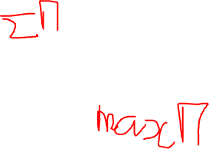
Variable elimination for MAP
Variable elimination works by multiplying and summing
It’s also called sum-product algorithm
We can use the same technique for MAP, if we replace the sum operator with a max operator
The algorithm is called max-product
A few differences
Sum is replaced with max
All variables (except evidence) are eliminated
We need to trace back our steps to find the MAP assignment

Slide 7
Examples
Two variables
Student network
Markov network

Slide 8
Two variables
Network
A → B
Parameters
P(A) = [0.4; 0.6]
P(B|A=t) = [0.8; 0.2]
P(B|A=f) = [0.3; 0.7]
MAP ?
MAP|A=t ?
MAP|B=t ?

Slide 9
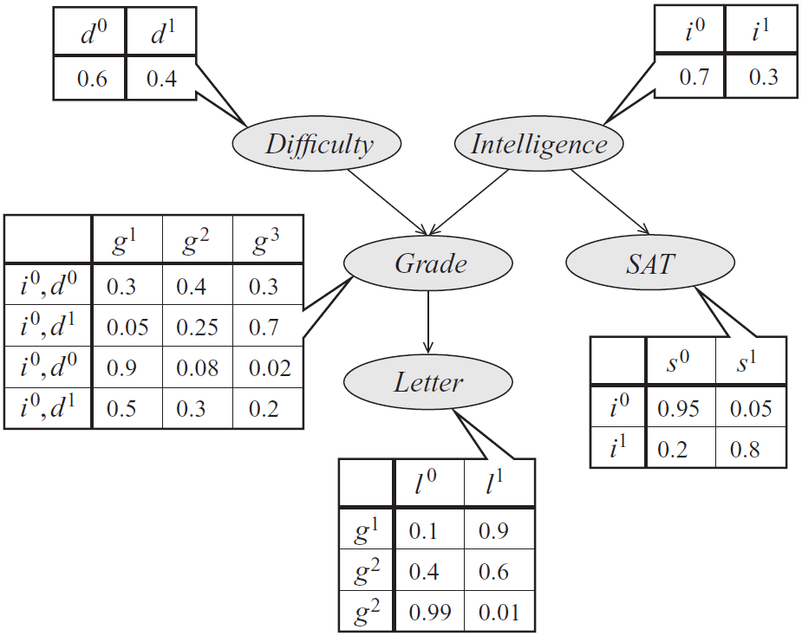
MAP on the student network
MAP ?
MAP | G=g¹ ?
Industrious
i⁰, d⁰
i⁰, d¹
i¹, d⁰
i¹, d¹
g¹
g²
g³
Notes:
MAP: D=d1, I=i0, G=g3, L=l0, S=s0
MAP|G=g1: D=d0, I=i1, L=l1, S=s1

Slide 10
MAP on a Markov network
A | B | φ(A,B)
T | T | 5
T | F | 1
F | T | 1
F | F | 5
A | φ(A)
T | 2
F | 1
A
B
B | φ(B)
T | 1
F | 4
A | C | φ(A,C)
T | T | 6
T | F | 1
F | T | 1
F | F | 6
C
B | C | φ(B,C)
T | T | 1
T | F | 10
F | T | 10
F | F | 1
C | φ(C)
T | 1
F | 8

Slide 11
Complexity
All the arguments from the sum-product algorithm carry over
Same variable ordering heuristics can be applied
Message passing on a junction-tree structure can be done

Slide 12
Marginal Map
Marginal MAP query
MAP(Y|e) = argmax_{y}P(y|e)
Let Z = X \ E∪Y
MAP(Y|e) = argmax_{y} ∑_{z}P(z, y|e)
We need to sum out Z
Max-sum-product algorithm
First, eliminate Z using sum-product algorithm
Then, find MAP for Y using max-product algorithm
Unfortunately, max and sum cannot be interleaved
The variables are partitioned into three disjoint sets: E, Z, Y
This partitioning limits which orders we can choose, as we can order only within Z and within Y

Slide 13
Junction Trees

Slide 14
Motivation
We are interested in multiple marginal/conditional probabilities
In variable elimination, we define our target upfront and then eliminate the others
If we need probabilities for other variables, there is no apparent way of reusing shared computations
In the student example, assume that I’m interested in P(G) and P(L). What are some of the shared computations?

Slide 15
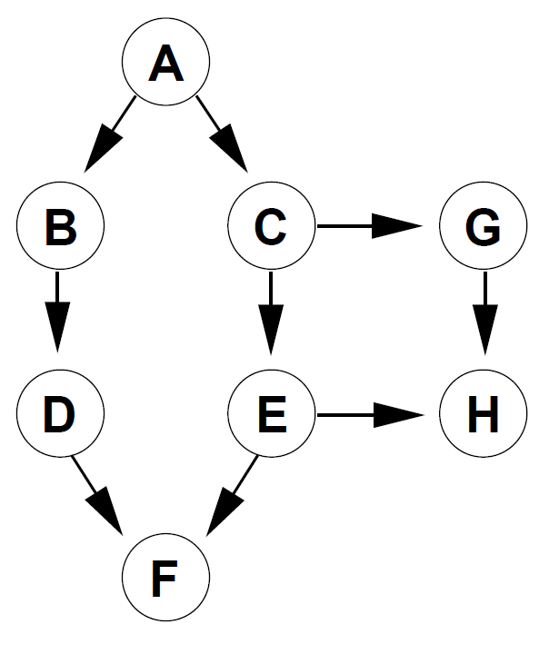
Example
Calculate P(H) using variable elimination
Now, calculate P(G) using variable elimination
Notes:
Eliminate in the following order: B, F, D, A, C.

Slide 16
Variable elimination as graph transformation
First, construct the moral graph
Then, eliminate variables so that each elimination introduces the fewest number of edges
Take note of the factors

Slide 17
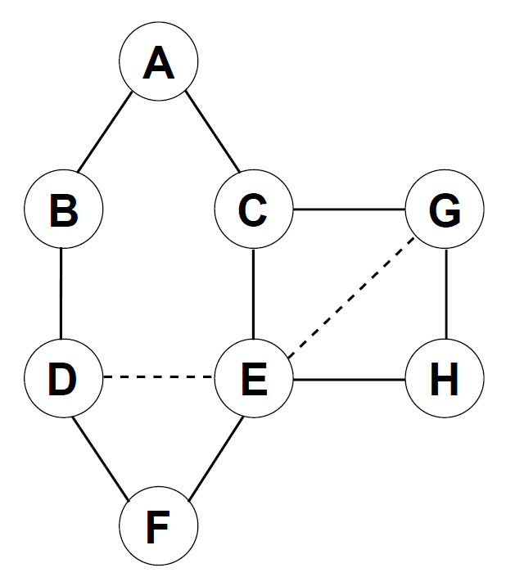
Example - moralize

Slide 18
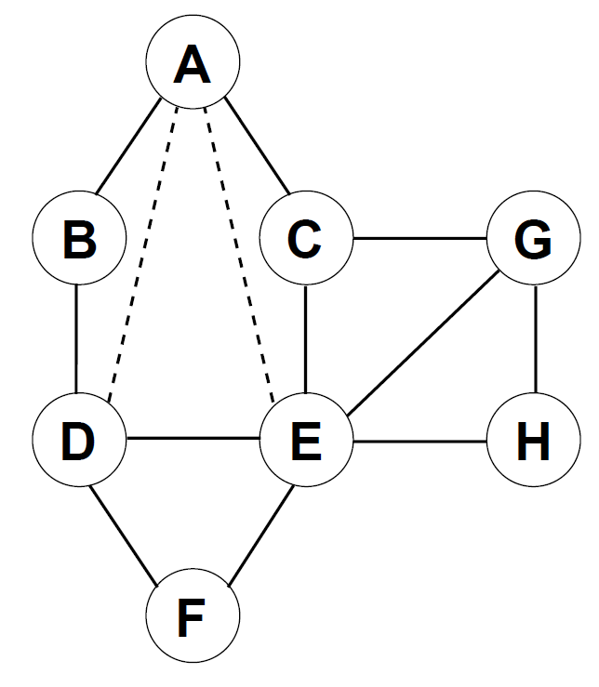
Elimination order: H, G, F, C, B, D, E, A

Slide 19
Cluster graph
A cluster graph U for a set of factors Φ over X is an undirected graph, each of whose nodes are associated with a cluster C_{i} ⊆ X.
A cluster graph must be family preserving – each factor φ∈Φ must be associated with a cluster C_{i}, denoted as α(φ), such that Scope[φ] ⊆ C_{i}.
Each edge between a pair of clusters C_{i} and C_{j} is associated with a sepset S_{ij} ⊆ C_{i} ∩C_{j}

Slide 20
Running intersection property
Let T be a cluster tree. T has running intersection property if, whenever there is a variable X such that X∈C_{i} and X∈C_{j}, then X is also in every cluster in the unique path in T between C_{i} and C_{j}.
A cluster tree that satisfies the running intersection property is also called the join/clique/junction tree.
Theorem: A cluster tree obtained through a run of variable elimination satisfies the running intersection property; that is, it is a clique tree.

Slide 21
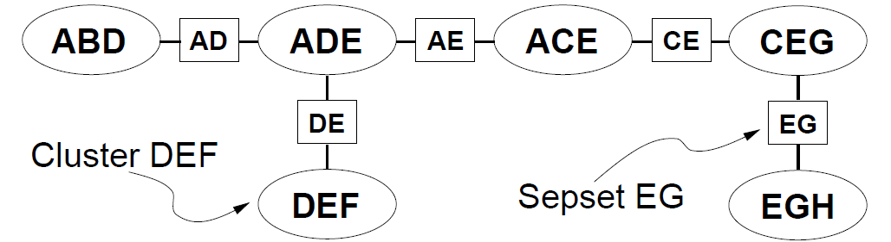
Example clique tree
P(A)
P(B|A)
P(E|C)
P(D|B)
P(C|A)
P(G|C)
P(F|D,E)
P(H|E,G)

Slide 22
Construct a clique tree
Moralize the graph
Pick a variable elimination order
Eliminate the variables, noting the maximal cliques
The cliques are the nodes of the tree
Until a tree is formed (i.e., n-1 edges are added)
Connect two disconnected components by a maximal size sepset

Slide 23
Elimination order: H, G, F, C, B, D, E, A

Slide 24
Variable elimination on junction tree
P(E|C)
←Eliminate E
P(C|A)
P(G|C)
←Eliminate C
←Eliminate G
→Eliminate B
→Eliminate D
→Eliminate A
P(A)
↓Eliminate A
↑Eliminate F
↓Eliminate C
↑Eliminate H
P(B|A)
P(D|B)
P(F|D,E)
P(H|E,G)

Slide 25
Message passing on junction tree
Clusters receive from and send messages to its neighbors
Each message pass consists of elimination of one or more variables
A cluster C_{i} is ready to send a message to its neighbor C_{j}, when it receives messages from its all other neighbors
A message from C_{i} to C_{j} is computed as follows
C_{i} multiples all the factors assigned to it, and all the messages it received from its other neighbors
It sums out C_{i} \ S_{ij}

Slide 26
A message

Slide 27
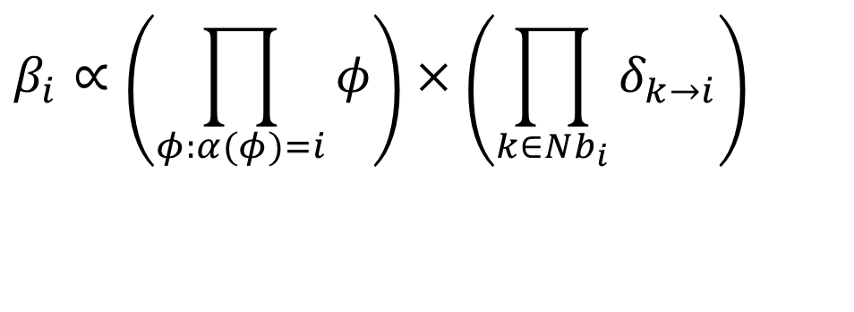
Belief
$$β_{i}∝\left(\prod_{φ:α(φ)=i}{φ}\right)×\left(\prod_{k∈Nb_{i}}{δ_{k→i}}\right)$$

