Slide 1
CS583 Probabilistic Graphical Models
Lecture 7. Markov Networks. Part 2
Oleksandr Narykov
onarykov@iit.edu

Slide 2
Assignment 1
Please follow the instructions in the Word file.
The writing part should be submitted in a single PDF or Word file.
Python submissions should be in .ipynb files and run correctly with Python 3.10.
Usage of Anaconda distribution is encouraged.

Slide 3
Markov Networks
Structure
  Undirected graphs
Parameters
  ?
The joint distribution
  ?
Independencies
  ?

Slide 4
Independencies in Markov networks
Separation
  X ⊥ Y | Z if X and Y are separated in H given Z
Pairwise independencies
  X ⊥ Y | X \ {X, Y}
Local independencies
  X ⊥ X \ MB(X) | MB(X), where MB stands for Markov Blanket. Markov Blanket of a variable X in a Markov network H is its neighbors.

Slide 5
Markov Networks
Structure
  Undirected graphs
Parameters
  ?
The joint distribution
  ?
Independencies
  Separation
  Pairwise independencies
  Local independencies

Slide 6
Markov Networks
Structure
  Undirected graphs
Parameters
  Conditional Probability Distributions?
The joint distribution
  ?
Independencies
  Separation
  Pairwise independencies
  Local independencies

Slide 7
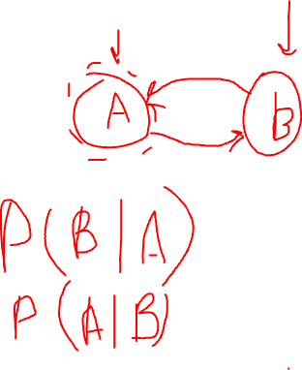
Conditioned on the neighbors?
Consider the simple graph of A – B
Can we say
  P(A, B) = P(A | B)P(B | A)?
Notes:
No!

Slide 8
Marginals on the (maximal) cliques?
Consider the simple graph of A – B
Can we say
  P(A, B) = P(A, B)?
Now consider A – B – C
Can we say
  P(A, B, C) = P(A, B) P(B, C)?
How would you parameterize Markov Networks?

Slide 9
Parameterization
Parameterization is perhaps the least intuitive concept about MNs
Bayesian networks
  P(X_{i} | Pa(X_{i}))
Markov networks
  Cannot use probability distributions directly, but
  MNs provide more flexibility in the parameterization

Slide 10
Factors
Let D be a set of random variables
Definition: A factor φ is a function from Val(D) to R.
A factor is nonnegative if all entries are nonnegative
The scope of factor, denoted as, Scope[φ], is the set of variables D it is associated with

Slide 11
An example
Structure: A – B – C
Factors: φ(A, B) and φ(B, C)
Remember the factors are functions from D to R.
How can we represent the joint P(A, B, C) using factors?

Slide 12
Factor graphs
Definition: A factor graph F is an undirected graph containing two types of nodes
  Random variables (ovals)
  Factor nodes (squares).
F contains edges between ovals and squares.
F is parameterized by a set of factors, where each factor node (square) is associated with precisely one factor whose scope is the square’s neighbor ovals.

Slide 13
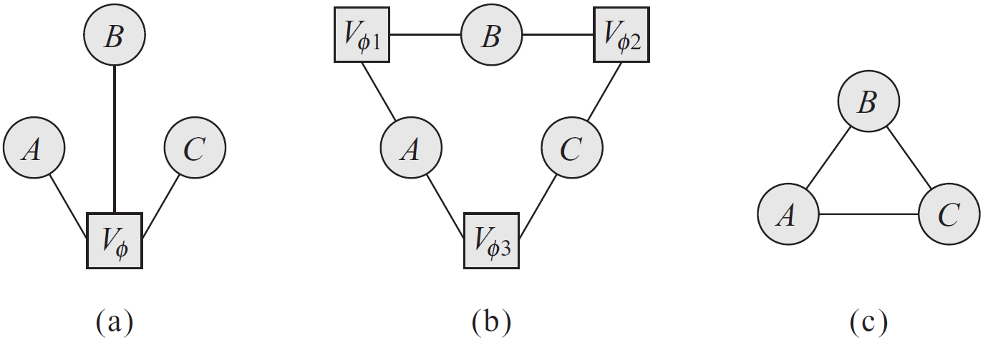
Factor graph example
Markov network as a clique over three variables, A, B, C
One factor -> one clique; one clique -> one or zero factors
How would you represent a pairwise MRF with factors over the nodes and edges?

Slide 14
Gibbs Distribution
Definition: A distribution P is a Gibbs distribution parameterized by a set of factors Φ = {φ(D₁), …, φ(D_{k})} if it is defined as follows:
X₁, …, X_{n}
What is Z?
φ(D_{i}) are factors, but what are D_{i}?
Can you relate this to Bayesian Network parameterization?

Slide 15
Markov network factorization
We say that a distribution P with Φ = {φ(D₁), …, φ(D_{k})} factorizes over a Markov network H if each D_{i} (i=1, …, k) is a complete subgraph of H
The factors φ(D_{i}) are called the clique potentials
D_{i} can be maximal cliques but they do not have to be

Slide 16
Example
A | B | φ(A,B)
T | T | 0.5
T | F | 0.1
F | T | 0.1
F | F | 0.3
B | C | φ(B,C)
T | T | 0.1
T | F | 0.2
F | T | 0.6
F | F | 0.1
A | B | C | φ(A,B)*φ(B,C) | P(A,B,C)
T | T | T | 0.05 | 0.11
T | T | F | 0.10 | 0.22
T | F | T | 0.06 | 0.13
T | F | F | 0.01 | 0.02
F | T | T | 0.01 | 0.02
F | T | F | 0.02 | 0.04
F | F | T | 0.18 | 0.39
F | F | F | 0.03 | 0.07
 |  | Z | 0.46 | 1.00
A | B | P(A,B)
T | T | 0.33
T | F | 0.15
F | T | 0.07
F | F | 0.46
B | C | P(B,C)
T | T | 0.13
T | F | 0.26
F | T | 0.52
F | F | 0.09
Is φ(A, B) = P(A, B)?
What is the most likely assignment to A, B according to φ(A, B)? How about P(A, B)?
A | P(A)
T | 0.48
F | 0.52
B | P(B)
T | 0.39
F | 0.61
C | P(C)
T | 0.65
F | 0.35

Slide 17
Example
A | B | φ(A,B)
T | T | 5
T | F | 1
F | T | 1
F | F | 3
B | C | φ(B,C)
T | T | 1
T | F | 2
F | T | 6
F | F | 1
A | B | C | φ(A,B)*φ(B,C) | P(A,B,C)
T | T | T | 5 | 0.11
T | T | F | 10 | 0.22
T | F | T | 6 | 0.13
T | F | F | 1 | 0.02
F | T | T | 1 | 0.02
F | T | F | 2 | 0.04
F | F | T | 18 | 0.39
F | F | F | 3 | 0.07
 |  | Z | 46 | 1.00
A | B | P(A,B)
T | T | 0.33
T | F | 0.15
F | T | 0.07
F | F | 0.46
B | C | P(B,C)
T | T | 0.13
T | F | 0.26
F | T | 0.52
F | F | 0.09
Multiplied all the factors by 10. What changed?
A | P(A)
T | 0.48
F | 0.52
B | P(B)
T | 0.39
F | 0.61
C | P(C)
T | 0.65
F | 0.35

Slide 18
Markov Networks
Structure
  Undirected graphs
Parameters
  Factors
The joint distribution
  P(X) = 1/Z Πφ(D_{i})
Independencies
  Separation
  Pairwise independencies
  Local independencies

Slide 19
Parameterization
Factors over maximal cliques
Pairwise Markov random fields
  Factors over nodes, and
  Factors over connected pairs (i.e., edges)
Pairwise Markov random fields do not introduce additional independencies, however,
  The number of parameters is quadratic instead of exponential, but, of course,
  The sets of distributions that can be represented over maximal cliques and pairwise interactions are not the same
Notes:
A clique with n variables: 2^n parameters.
Pairwise: n(n-1) edges: 4n(n-1) params. n nodes: 2n params. Total: 4n^2-2n params.

Slide 20
Log-Linear models
ɛ(D) = -ln(φ(D)) is often called the energy function.
In statistical physics, the probability of a physical state depends inversely on its energy.
Log-linear models guarantee that the factors are positive, in turn guaranteeing that the probability is positive.

Slide 21
Log-linear models
X₁, …, X_{n}

Slide 22

Log-linear example
A | B | φ(A,B) | ɛ(A,B)
T | T | 5 | -1.61
T | F | 1 | 0.00
F | T | 1 | 0.00
F | F | 3 | -1.10
B | C | φ(B,C) | ɛ(B,C)
T | T | 1 | 0.00
T | F | 2 | -0.69
F | T | 6 | -1.79
F | F | 1 | 0.00
A | B | C | φ(A,B)*φ(B,C) | ɛ(A,B)+ɛ(B,C) | exp(-Σɛi) | P(A,B,C)
T | T | T | 5.00 | -1.61 | 5.00 | 0.11
T | T | F | 10.00 | -2.30 | 10.00 | 0.22
T | F | T | 6.00 | -1.79 | 6.00 | 0.13
T | F | F | 1.00 | 0.00 | 1.00 | 0.02
F | T | T | 1.00 | 0.00 | 1.00 | 0.02
F | T | F | 2.00 | -0.69 | 2.00 | 0.04
F | F | T | 18.00 | -2.89 | 18.00 | 0.39
F | F | F | 3.00 | -1.10 | 3.00 | 0.07
 |  | Z | 46.00 |  | 46.00 | 1.00

Slide 23
Features
Correction: A factor φ(D) is an arbitrary function
Definition: A feature f(D), is a function from D to R.
Features provide an easy mechanism for specifying certain types of interactions more compactly.
An important useful function is the indicator function.
  Given a predicate, the indicator function is
    1 if the predicate is true, and
    0 otherwise.
Example indicator functions?

Slide 24
Log-linear model
A distribution is a log-linear model over a Markov network H is it is associated with
  A set of features F = {f₁(D₁), …, f_{k}(D_{k})}, where each D is a complete subgraph in H,
  A set of weights w₁, …, w_{k}
It is possible to have several features over the same scope.
Features are especially useful for domains where variables have huge domains.

Slide 25
Three different parameterizations
Undirected graph
Factor graph
Features
Factor graph is finer grained than the undirected graph representation and it is at least as rich
Feature representation is finer grained than the factor graph representation and it is at least as rich
Which representation to use?
UGs are good for discussing independencies, factor graphs are well suited for inference, and features are well suited for learning.

Slide 26
Ising models
One of the earliest types of Markov network models
Arose in statistical physics as a model for the energy of a physical system involving a system of interacting atoms
Each random variable X_{i} is binary with {+1, -1}.
Edges: ε(x_{i}, x_{j}) = -w_{ij}x_{i}x_{j}
Nodes: ε(x_{i}) = -u_{i}x_{i}
Depending on the weights, w_{ij}, the model prefers various configurations
  w_{ij}>0: x_{i} and x_{j} are preferred to have the same value
    Ferromagnetic
  w_{ij}<0: x_{i} and x_{j} are preferred to have different values
    Antiferromagnetic
  w_{ij}=0: x_{i} and x_{j} are non-interacting

Slide 27
Metric MRFs
Nodes X₁ through X_{n}, related by a set of edges, E, and each X_{i} can take a label from V = {v₁, …, v_{K}}
Each node has its own preferences among the possible labels
  Node potentials
We also want smoothness over the graph; the neighboring nodes should take similar labels.
  Edge potentials
Objective: MAP assignment to X
  So, we can drop 1/Z

Slide 28
Metric MRFs
,…,
,…,
,…,
λ_{i,j} ≥0. The lowest energy, 0, is obtained when two neighboring nodes take the same value, and a higher energy when they do not.

Slide 29
Metric MRFs
We may want a more general distance function between labels in the case of multiclass case
  Maybe some labels are more similar than others
Definition: A function, μ: V x V → [0, ∞] , is a metric if it satisfies
  Reflexivity
    μ(v_{k}, v_{l})=0, if and only if k=l
  Symmetry
    μ(v_{k}, v_{l}) = μ(v_{l}, v_{k})
  Triangle inequality
    μ(v_{k}, v_{l}) + μ(v_{l}, v_{m}) ≥ μ(v_{k}, v_{m})
Metric MRF: ɛ(v_{k}, v_{l}) = μ(v_{k}, v_{l})

Slide 30
CRFs
Definition: A conditional random field is an undirected graph H whose nodes correspond to X∪Y; H is parameterized by a set of factors φ_{i}(D_{i}), where D_{i} ⊄ X. The network encodes the following distribution:
Z(X) = Σ_{Y}Π_{i}φ(D_{i})
Why do we want P(Y|X) and not necessarily P(Y,X)?
Why does Z have X as an argument?

Slide 31
MRFs for Vision (Box 4.B)
Tasks
  Image segmentation, noise removal, object recognition, etc.
Typically, pairwise MRFs are used
  Variables are pixels and edges exist between adjacent pixels
Image denoising
  Restore the true value of all the pixels
  Node potential: penalizes large deviations from the observed pixel value
  Edge potential: prefers continuity in the predicted pixel values
    Don’t want to smooth too much to allow object boundaries

Slide 32
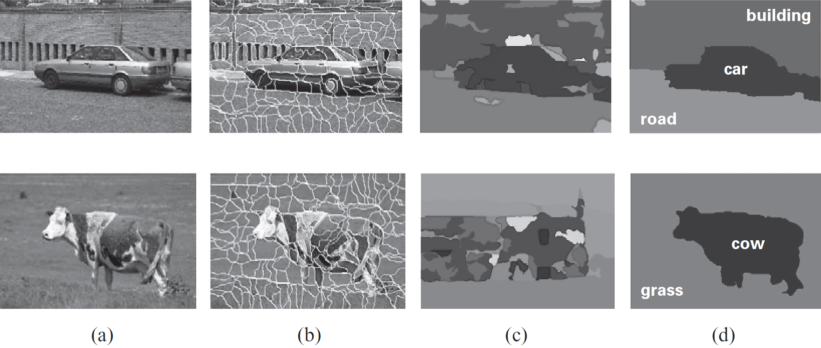
Image Segmentation Example

Slide 33
CRFs for text analysis (box 4.e)
Tasks: Part-of-speech tagging, identifying named entities, structured information extraction
Target: Y, the labels for each word (or a phrase)
Input: X, the text
Features: Capture often domain knowledge about interactions
  Within target variables, and
  Between the target variables and the input
  (No features between solely input variables)
Notes:
Noun, pronoun (e.g., he, they), adjective, verb, adverb (e.g., very), preposition (e.g., in), conjunction (e.g., and), interjection (e.g., alas), article (e.g., the) https://en.wikipedia.org/wiki/Part_of_speech#English

Slide 34
Named entity recognition (box 4.e)
Task: Identify named entities such as people, places, organizations, etc.
Entities span multiple words and entities might not be apparent from individual words
  “Chicago” is a location, “Chicago Tribune” is an organization
Given text of length T, words X_{t}, 1 ≤ t ≤ T, define target variables Y_{t}.
Y_{t} represents B-PERSON, I-PERSON, B-LOC., I-LOC., B-ORG., I-ORG., and OTHER.

Slide 35
Named entity recognition (box 4.e)
A common structure is a linear-chain CRF
Factors
  φ_{t}(Y_{t}, Y_{t+1}): Dependency between neighboring target variables
  φ_{t}(Y_{t}, X₁, …, X_{T}): Dependency between a target and its context
Rather than a table, represent it as a log-linear model with features
  Thousands of features that encode domain knowledge
More details in the book; highly recommend to read it
Software – many implementations out there in Java, Matlab, C++, Python

Slide 36
From distributions to graphs
Task: Given a P, find a Markov network structure H that is a minimal I-Map for P
Procedure 1: Pairwise independencies
  Add edges between X and Y, if P does not entail X ⊥ Y | X \ {X, Y}
Procedure 2: Local independencies
  Add edges between X and all Y ∈ MB_{P}(X)
Theorems: Let P be a positive distribution and H be the structure constructed through above procedures. Then H is a unique minimal I-Map for P.

Slide 37
Bayesian networks & markov networks
We’ve said that the set of distributions that can be represented using BNs and MNs are different.
Can we go from a BN to a MN and/or vice versa?

Slide 38
BNs to MNs
Proposition: Let B be a Bayesian network over X. Then P_{B}(X) is a Gibbs distribution defined by the factors Φ={φ(X_{i})} for X_{i} ∈X, where φ(X_{i}) = P_{B}(X_{i} | Parents(X_{i})). The partition function Z is 1.

Slide 39
BNs to MNs
Given a Bayesian network structure G, find a Markov network structure H that is a minimal I-Map for G.
Definition: Moralized graph: The moral graph M[G] of a Bayesian network structure G over X is an undirected graph over X that contains an undirected edge between X and Y if
  There is a directed edge between X and Y in G, or
  X and Y are both parents of the same node in G
Moralized: Parents of a node are married by adding an edge between them

Slide 40
BNs to MNs
Proposition: Let G be any Bayesian network. The moralized graph M[G] is a minimal I-Map for G.
Proposition: Let G be any moral Bayesian network. The moralized graph M[G] is a P-Map for G.

Slide 41
MNs to BNs
Given a Markov network structure H, find a Bayesian network structure G that is a minimal I-Map for H.
Use one of the two algorithms we discussed earlier
  Alg. 1: Pick an order of the variables
  Alg. 2: Start with a fully connected graph

Slide 42
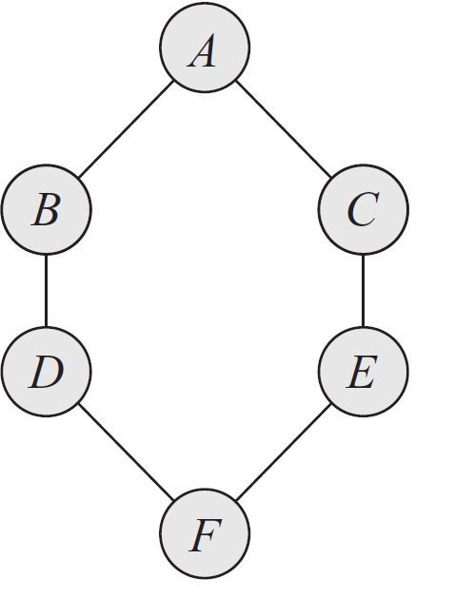
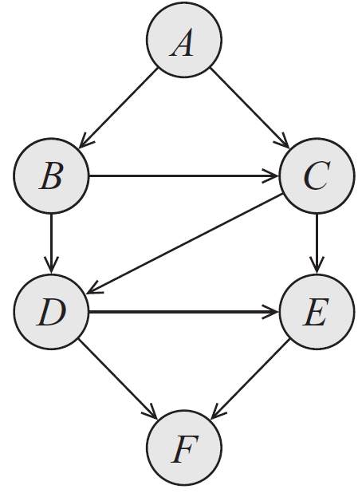
MNs to BNs
Notes:
Order: A, B, C, D, E, F

Slide 43
MNs to BNs
Theorem: Let H be a Markov network structure and let G be any Bayesian network structure that is a minimal I-Map for H. Then, G can have no immoralities.
Definition: Chordal graph: A graph where the longest minimal loop is a triangle. Also called triangulated.
Corollary: Let H be a Markov network structure and let G be any Bayesian network structure that is a minimal I-Map for H. Then, G is necessarily chordal.

Slide 44
MNs to BNs
Theorem: Let H be a nonchordal Markov network. Then, there is no Bayesian network G which is a perfect map for H.
Theorem: Let H be a chordal Markov network. Then, there is a Bayesian network G which is a perfect map for H.

