Slide 1
CS583 Probabilistic Graphical Models
Lecture 3. Bayesian Networks. Part 2
Oleksandr Narykov
onarykov@iit.edu

Slide 2
Links to the repositories
Main CS583 repository
https://github.com/AlexandrNP/CS583-2024/
Updated pgmpy notebook examples
https://github.com/AlexandrNP/pgmpy_notebook_updated

Slide 3
Python Libraries
Install Python package:
Install and play with the pgmpy Python package https://github.com/pgmpy/pgmpy
Check your environment by using example notebooks: https://github.com/pgmpy/pgmpy_notebook/tree/master/notebooks
Requirements:
Python 3.10 compatible
Advisable to install latest Anaconda distribution

Slide 4
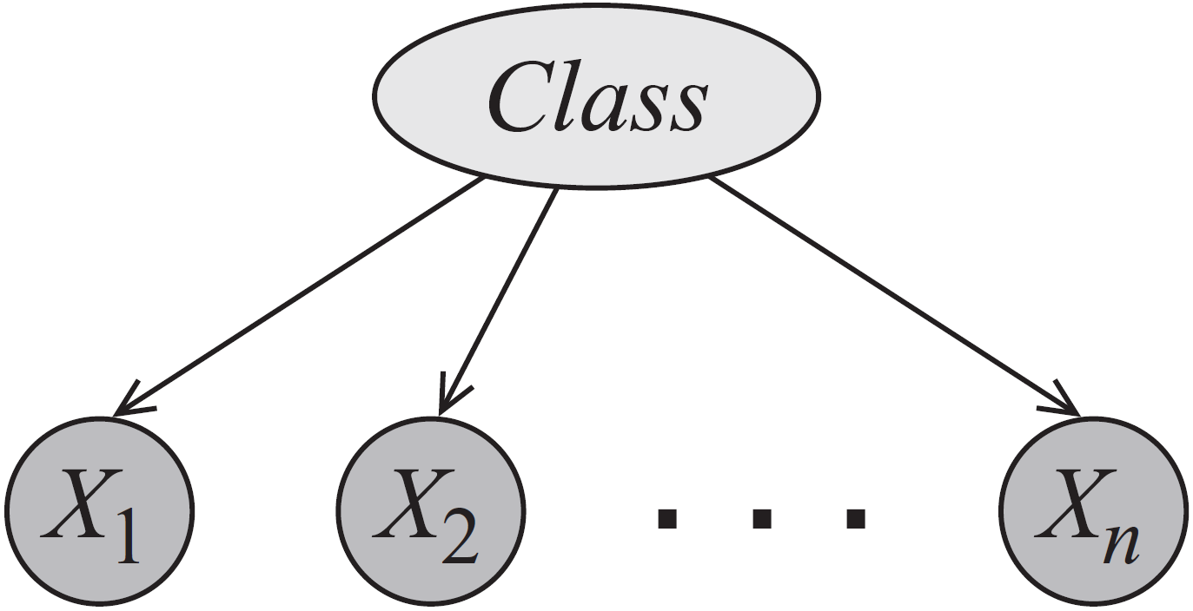
Naïve Bayes

Slide 5
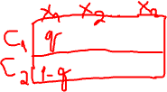
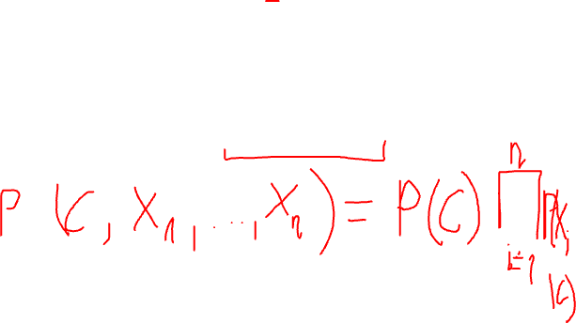
Naïve Bayes
How do we write the joint P(C, X₁, X₂, …, X_{n})?
How many independent parameters are needed if C and X_{i} are all binary?
Naïve Bayes is used for classification: given attributes of an object (X_{i}), classify it into one of pre-given categories (C) (i.e., P(C|X₁, …, X_{n}).
Notes:
P(C, X1, …, Xn) = P(C) prod P(Xi | C)

Slide 6

Bayesian Networks
A Bayesian Network is a directed acyclic graph whose nodes are random variables and edges represent, intuitively, the direct influence of one node on another
Naïve Bayes is a special Bayesian network
Bayesian networks is
A data structure that provides the skeleton for representing a joint distribution compactly in a factorized way
A compact representation for a set of conditional independence assumptions about a distribution

Slide 7
The student example
So far we have I, S, G
We add two more random variables
Student’s grade also depends on the difficulty (D) of the class: Val(D) = {easy(d⁰), hard(d¹)}
Student’s professor writes a recommendation letter (L), where Val(L)={weak (l⁰), strong(l¹)}
Professor writes the letter based only the grade and it is a stochastic function of the grade

Slide 8
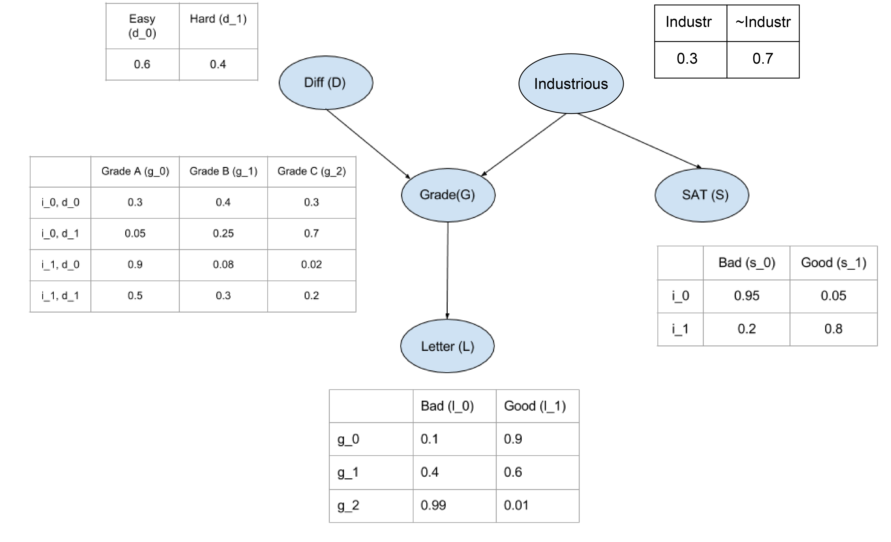
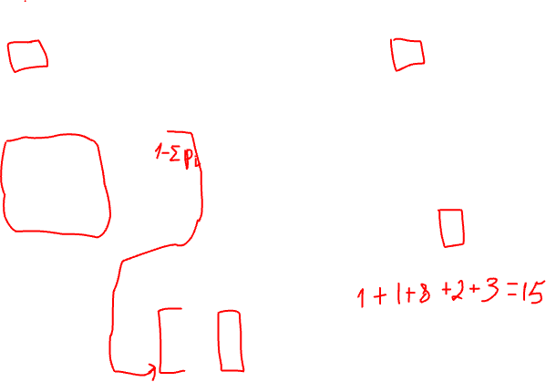
The student network
1. The structure
i¹, d⁰
i¹, d¹
2. Parameters:
Local probability model
Conditional probability distribution
g³
How many parameters?

Slide 9
The joint?
What is the meaning of P(i¹, d⁰, g², s¹, l⁰)?
Probability that
The student is industrious
The class is easy
The industrious student gets a C in an easy class
The industrious student gets a high score in SAT
The student who got a C in the class gets a weak letter
= P(i¹) P(d⁰) P(g²|i¹, d⁰) P(s¹|i¹)P(l⁰|g²)

Slide 10
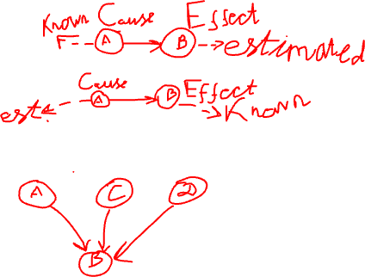
Reasoning Patterns
Causal reasoning
Causes to effects
Evidential reasoning
Effects to causes
Intercausal reasoning
Explaining away

Slide 11
Evidental Reasoning
Causes to effects
Don’t know anything. Probability of a strong letter (evidence)
P(l¹) = 0.502
Learn that the student is not industrious
P(l¹|i⁰) = 0.389
Additionally, learn the class is easy
P(l¹|i⁰, d⁰) = 0.513

Slide 12
Causal Reasoning
Effects to causes
Don’t know anything. Probability of a student being industrious (cause)
P(i¹) = 0.3
Learn that the student got a C in a class
P(i¹|g³) = 0.079
Or, learn that the student received a weak letter
P(i¹|l⁰) = 0.14
Learn both
P(i¹|g³, l⁰) = 0.079

Slide 13
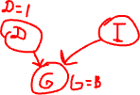
Intercausal reasoning
Different causes of the same effect interact
Don’t know anything. Probability of a student being industrious
P(i¹) = 0.3
Learn that the student got a B in a class
P(i¹|g²) = 0.175
Learn that the class was difficult
P(i¹|g², d¹) = 0.34
Student’s B is explained away with the other cause

Slide 14
Reasoning Types
Causal
A → B → C
Evidental
A ← B ← C
Intercausal
A → B ← C

Slide 15
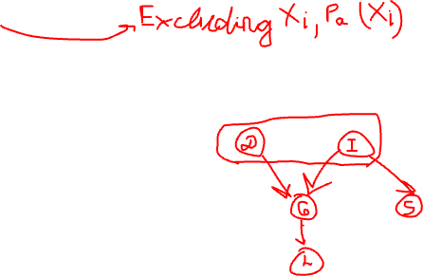
Bayesian Network Structure
A Bayesian network structure G is a directed acyclic graph whose nodes represent random variables X₁, …, X_{n}. Let Pa(X_{i}) denote the parents of X_{i}, and ND(X_{i}) denote the variables that are not descendants of X_{i}. Then G encodes the following set of conditional independence assumptions:
X_{i} ⊥ ND(X_{i}) | Pa(X_{i})
These independencies are called the local independencies
Clarification. A node itself and its parents are part of non-descendants according to the definition of ND. A clearer statement would be, in my opinion:
X_{i} ⊥ ND(X_{i}) \ {X_{i} ∪ Pa(X_{i})} | Pa(X_{i})

Slide 16
Bayesian Network Factorization
Why is this factorization useful?
How can you prove this factorization holds?

Slide 17
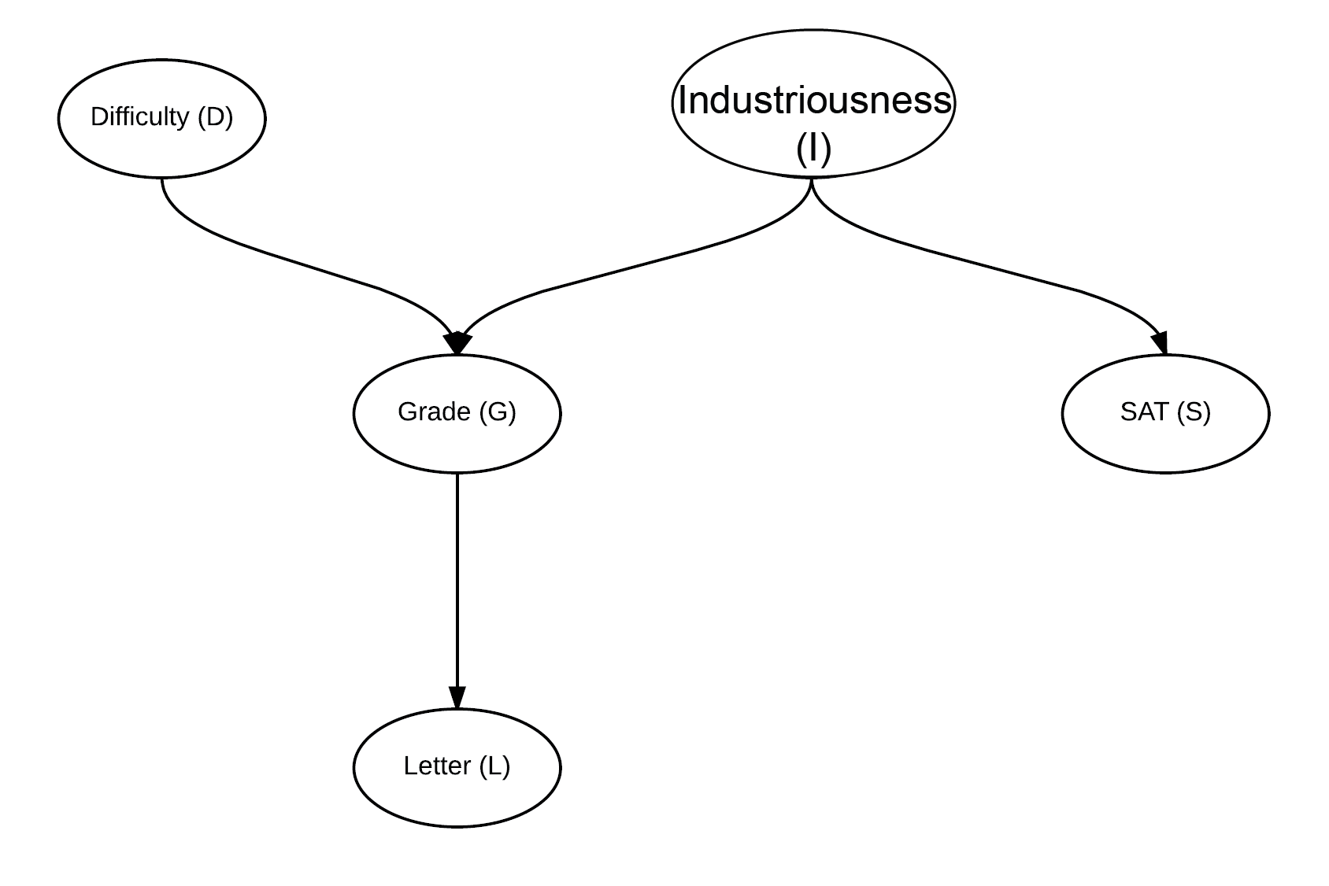

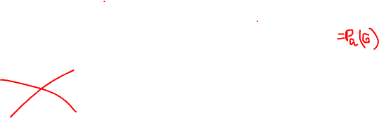















Local independencies example
D ⊥ I, S
I ⊥ D
S ⊥ D, G, L | I
G ⊥ S | D, I
L ⊥ D, I, S | G

Slide 18
Factorization example
P(I, D, S, G, L) =
P(I)*
P(D)*
P(S | I)*
P(G | I, D)*
P(L | G)

Slide 19
Equivalence
Local conditional independence assertions ⇒ Bayesian network factorization
Bayesian network factorization ⇒ Local conditional independence assertions

Slide 20
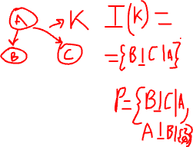
I-Map
Let P be a distribution over X. We define I(P) to be the set of independencies of the form X ⊥ Y | Z that hold in P.
“P satisfies independencies of the structure K” ≡ I(K) ⊆ I(P)
If I(K) ⊆ I(P) ⇒ K is an I-Map for P
For K to be an I-Map of P, any independence assertion made by K has to be true in P. However, it is possible that P can contain additional independencies
That is, whatever K says independent is independent in P, but K may not know all the independencies in P

Slide 21
P-Map
Definition: Perfect Map: A graph structure G is a perfect map (P-Map) for a distribution P, if I(G) = I(P)

Slide 22
Two Graphs
A
A
B
C
B
C
G₁
G₂
What are the local independence assertions made by G₁? G₂?
Notes:
All variables are independent
No variables are locally independent

Slide 23
Theorems
Local conditional independence assertions ⇒ Bayesian network factorization
I-Map to Factorization
Bayesian network factorization ⇒ Local conditional independence assertions
Factorization to I-Map

Slide 24
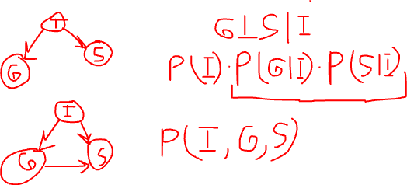
I-Map to Factorization
Theorem: Let G be a BN structure over X, and let P be joint distribution over the same space. If G is an I-Map for P, then P factorizes according to G.
Proof?

Slide 25
Factorization to I-Map
Theorem: Let G be a BN structure over X and let P be a joint distribution over the same space. If P factorizes over G, then G is an I-Map for P.

Slide 26
Independencies in graphs
We have already seen the local independence assertions
Are there additional independence statements we can make simply based on the graph structure?
Yes.
Will these additional independencies help us reduce the number parameters further?
No.
Why are they useful then?

Slide 27
Dependence ≡ Information flow
X and Y are independent if the information cannot flow from one to the other
No trail between X and Y
Information cannot flow; X and Y are independent
X and Y are connected by an edge
Information can flow; X and Y are not independent
X and Y are not connected by an edge, but there is a trail between them
Depends…

Slide 28
Trails
Causal trail
X → Z → Y
Information can flow between X and Y if Z is not observed; if Z is observed, it blocks the information flow. X ⊥ Y | Z
E.g, I → G → L
If we don’t know the student’s grade, then knowing her intelligence tells us something about the strength of the letter. But, once we know her grade, I and L are independent
Evidential trail
X ← Z ← Y
Information can flow between X and Y if Z is not observed; if Z is observed, it blocks the information flow. X ⊥ Y | Z
Notes:
Note: Make these variables italic

Slide 29
Trails
Common cause
X ← Z → Y
Information can flow between X and Y if Z is not observed; if Z is observed, it blocks the information flow. X ⊥ Y | Z
E.g, G ← I → S
If we don’t know the student’s intelligence, then knowing his SAT score tells us something about his grade. If we know his intelligence, then his grade and SAT score are independent

Slide 30











Trails
Common effect
X → Z ← Y (v-structure)
Information can flow between X and Y only if Z or at least one of Z’s descendants is observed
E.g. D → G ← I
If we do not know the grade or the letter quality, then D and I are independent. If we know, however, the grade or the letter quality, then D and I interact

Slide 31
D-Separation
To answer whether X_{i} and X_{j} are independent given E
Find all trails between X_{i} and X_{j}
If information can flow through at least one trail, then X_{i} and X_{j} are dependent given E; otherwise they are independent given E

Slide 32
More Formally
Let G be a BN structure and X₁ ↔ … ↔ X_{n} a trail in G. Let E be the observed set of variables. The information can flow along the trail X₁ ↔ … ↔ X_{n} if
Whenever we have a v-structure X_{i-1} → X_{i} ← X_{i+1}, then X_{i} or one of its descendants is in E; and
No other node along the trail is in E

Slide 33
D-separation example
Are the following statements true?
D ⊥ G ?
D ⊥ L ?
D ⊥ I ?
D ⊥ I | G ?
D ⊥ I | L ?
D ⊥ S | L ?
Notes:
No
No
Yes
No
No
No
D _|_ L Yes

Slide 34
Soundness and completeness
Soundness
If G is an I-Map for P, whenever d-separation claims that X ⊥ Y | Z, is it guaranteed to hold in P?
Yes (we proved this for local independencies. The proof for the general case is more involved)
Completeness
If G is an I-Map for P, whenever X ⊥ Y | Z in P, can d-separation detect it?
Unfortunately, no.

Slide 35
I-Equivalence
If two BN structures G_{i} and G_{j} encode exactly the same independencies, i.e., if I(G_{i}) = I(G_{j}), then G_{i} and G_{j} are I-equivalent
Why is this an important concept?
A given distribution can be represented with one of I-equivalent structures and it might be impossible to identify a unique structure
E.g., X → Y and X ← Y are I-equivalent. Then, we cannot readily argue whether X causes Y or Y causes X.
Spurious correlation examples:
https://www.tylervigen.com/spurious-correlations

Slide 36
I-Equivalence
Definitions:
Skeleton of Bayesian network G is the undirected version of G
That is, G and its skeleton have the same node and edge set, except edges in G are directed, whereas in its skeleton, the edges are undirected
A v-structure X → Z ← Y is an immorality if there is no direct edge between X and Y (informally, it is an immorality if the parents are not married)
Theorem: Two Bayesian networks are I-Equivalent if and only if they have the same skeleton and the same set of immoralities

Slide 37
From Distributions to Graphs
For a given P, we would like to find a structure that represents P
One approach is to take any graph that is an I-Map for P
This is not a good idea. Why?
Definition: Minimal I-Map: A graph G is a minimal I-Map for a P, if it is an I-Map for P, and removal of a single edge from G renders it to be not an I-Map

Slide 38
Finding Minimal I-Maps
Given a distribution P over X, how can we find a structure G that is a minimal I-Map for P?
The procedure is given on page 79
Pick an ordering of the variables, X₁, X₂, …, X_{n}
For each X_{i}, find minimal subset U of {X₁, X₂, …, X_{i-1}} such that X_{i} ⊥ {X₁, X₂, …, X_{i-1}} \ U | U
Set U to be the parents of X_{i}
Assume I(P^{student}) = I(G^{student}). Construct a minimal network using the order
D, I, S, G, L
L, S, G, I, D
L, D, S, I, G

Slide 39
Finding I-equivalent structures
Start with a fully connected undirected graph
Assume a max indegree of d
For all pairs X-Y
Search for a set U where X ⊥Y | U and |U| ≤ d (U has to be a subset of neighbors of X or neighbors of Y)
If such a U cannot be found, then X and Y are connected, otherwise,
Remove the edge X-Y and record U as the witness set for X and Y
Find all immoralities; For all X-Z-Y where X and Y are not directly connected
If Z∈U, then X-Z-Y is not an immorality, otherwise
It is an immorality, orient the edges as X→Z←Y
Orient any other edges if necessary by applying three rules

Slide 40
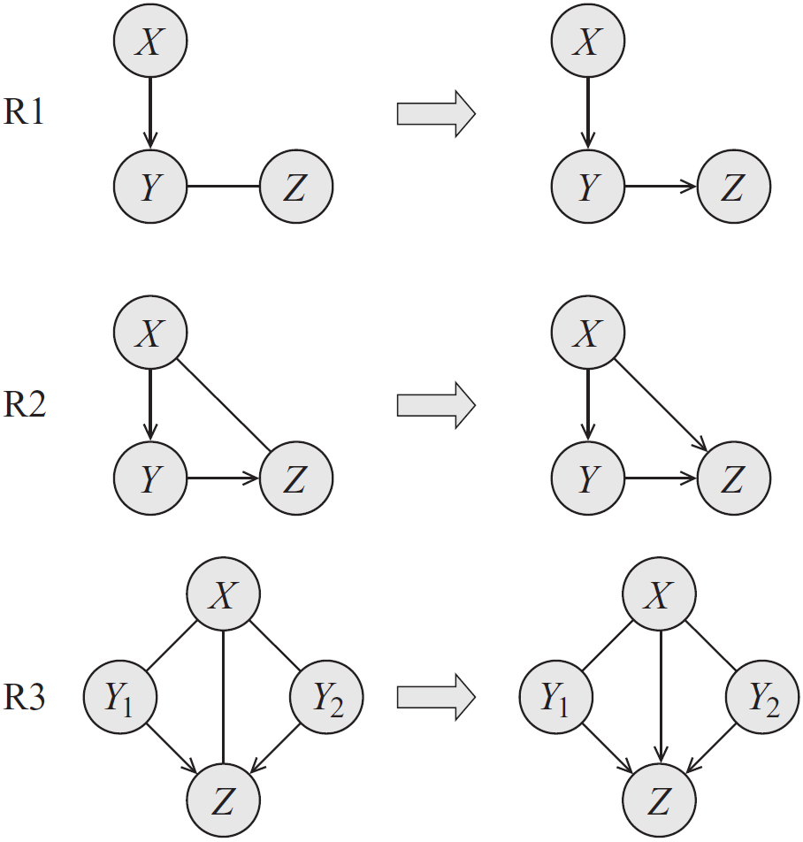
Rules for orienting the edges

Slide 41
Next
Markov networks

Slide 42
Links for Class
Main CS583 repository
https://github.com/AlexandrNP/CS583
If you do not get a notification with access to the repository, send an email to onarykov@iit.edu
Updated pgmpy notebook examples
https://github.com/AlexandrNP/pgmpy_notebook_updated
Spurious correlation examples:
https://www.tylervigen.com/spurious-correlations

