Slide 1
CS583 Probabilistic Graphical Models
Lecture 5. Bayesian Networks. Part 4
Markov Networks. Part 1
Oleksandr Narykov
onarykov@iit.edu

Slide 2
Bayesian Networks
Minimal I-Map

Slide 3
From Distributions to Graphs
For a given P, we would like to find a structure that represents P
One approach is to take any graph that is an I-Map for P
This is not a good idea. Why?
Definition: Minimal I-Map: A graph G is a minimal I-Map for a P, if it is an I-Map for P, and removal of a single edge from G renders it to be not an I-Map

Slide 4
Finding Minimal I-Maps
Given a distribution P over X, how can we find a structure G that is a minimal I-Map for P?
The procedure is given on page 79
Pick an ordering of the variables, X₁, X₂, …, X_{n}
For each X_{i}, find minimal subset U of {X₁, X₂, …, X_{i-1}} such that X_{i} ⊥ {X₁, X₂, …, X_{i-1}} \ U | U
Set U to be the parents of X_{i}

Slide 5
Finding I-equivalent structures
Start with a fully connected undirected graph
Assume a max indegree of d
For all pairs X-Y
Search for a set U where X ⊥Y | U and |U| ≤ d (U has to be a subset of neighbors of X or neighbors of Y)
If such a U cannot be found, then X and Y are connected, otherwise,
Remove the edge X-Y and record U as the witness set for X and Y
Find all immoralities; For all X-Z-Y where X and Y are not directly connected
If Z∈U, then X-Z-Y is not an immorality, otherwise
It is an immorality, orient the edges as X→Z←Y
Orient any other edges if necessary by applying three rules

Slide 6
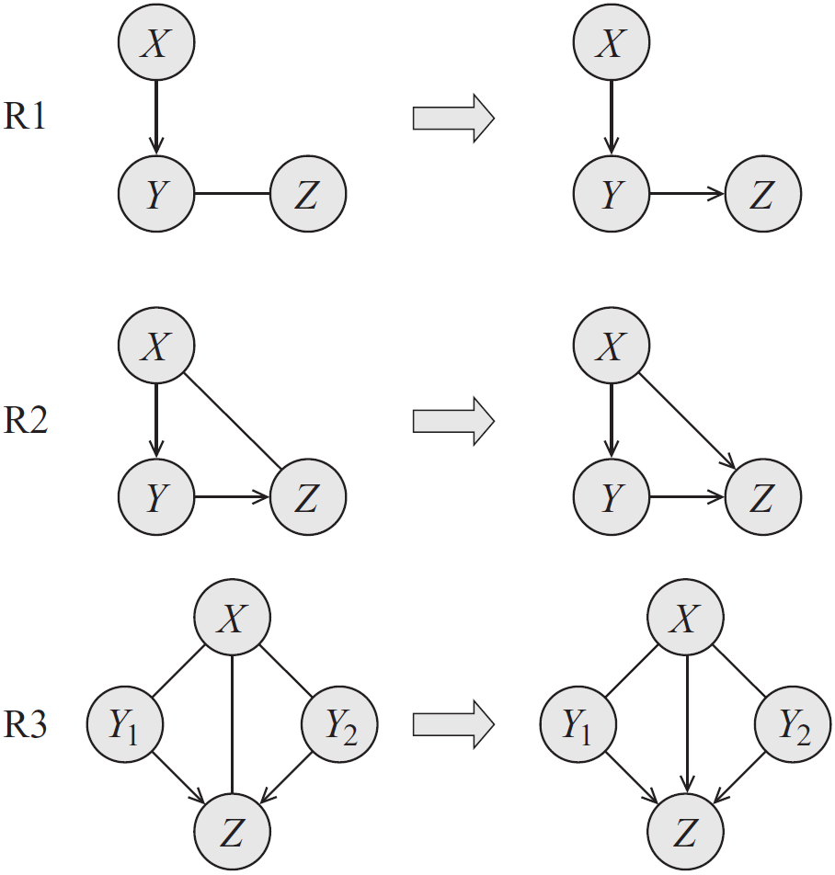
Rules for orienting the edges

Slide 7
Markov Networks

Slide 8
Motivation for Markov Networks
There are distributions that cannot be represented Bayesian networks (and vice versa)
Guaranteeing acyclicity can be hard

Slide 9
An example
We’d like a graph where
A ⊥ C | B, D
B ⊥ D | A, C
(A, B), (B, C), (C, D), and (D, A) are correlated but no causal direction exists
Alice and Charles pair and Bob and Debbie pair do not talk to each other directly
Alice and Bob, Bob and Charles, and Alice and Debbie pairs agree most of the time, and Charles and Debbie pair disagrees most of the time

Slide 10
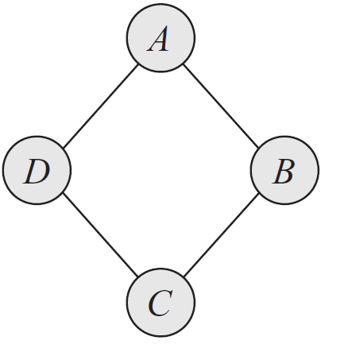
Example

Slide 11
Graphs
Structure
Parameters
The joint distribution
Independencies

Slide 12
Bayesian Networks
Structure
Directed acyclic graph
Parameters
Conditional probability distributions
The joint distribution
P(X) = ΠP(X_{i} | Pa(X_{i}))
Independencies
X_{i} ⊥ ND(X_{i}) | Pa(X_{i})
D-separation

Slide 13
Markov Networks
Structure
?
Parameters
?
The joint distribution
?
Independencies
?

Slide 14
Markov Networks
Structure
Undirected graphs
Parameters
?
The joint distribution
?
Independencies
?

Slide 15
Independencies in Markov networks
Separation
X ⊥ Y | Z if X and Y are separated in H given Z
Pairwise independencies
X ⊥ Y | X \ {X, Y}
Local independencies
X ⊥ X \ MB(X) | MB(X), where MB stands for Markov Blanket. Markov Blanket of a variable X in a Markov network H is its neighbors.

Slide 16
Markov Networks
Structure
Undirected graphs
Parameters
?
The joint distribution
?
Independencies
Separation
Pairwise independencies
Local independencies

Slide 17
Markov Networks
Structure
Undirected graphs
Parameters
Conditional Probability Distributions?
The joint distribution
?
Independencies
Separation
Pairwise independencies
Local independencies

Slide 18
Conditioned on the neighbors?
Consider the simple graph of A – B
Can we say
P(A, B) = P(A | B)P(B | A)?
Notes:
No!

Slide 19
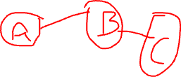
Marginals on the (maximal) cliques?
Consider the simple graph of A – B
Can we say
P(A, B) = P(A, B)?
Now consider A – B – C
Can we say
P(A, B, C) = P(A, B) P(B, C)?
How would you parameterize Markov Networks?

Slide 20
Parameterization
Parameterization is perhaps the least intuitive concept about MNs
Bayesian networks
P(X_{i} | Pa(X_{i}))
Markov networks
Cannot use probability distributions directly, but
MNs provide more flexibility in the parameterization

Slide 21
Factors
Let D be a set of random variables
Definition: A factor φ is a function from Val(D) to R.
A factor is nonnegative if all entries are nonnegative
The scope of factor, denoted as, Scope[φ], is the set of variables D it is associated with

Slide 22
An example
Structure: A – B – C
Factors: φ(A, B) and φ(B, C)
Remember the factors are functions from D to R.
How can we represent the joint P(A, B, C) using factors?

Slide 23
Gibbs Distribution
Definition: A distribution P is a Gibbs distribution parameterized by a set of factors Φ = {φ(D₁), …, φ(D_{k})} if it is defined as follows:
X₁, …, X_{n}
What is Z?
φ(D_{i}) are factors, but what are D_{i}?
Can you relate this to Bayesian Network parameterization?

Slide 24
Markov network factorization
We say that a distribution P with Φ = {φ(D₁), …, φ(D_{k})} factorizes over a Markov network H if each D_{i} (i=1, …, k) is a complete subgraph of H
The factors φ(D_{i}) are called the clique potentials
D_{i} can be maximal cliques but they do not have to be

Slide 25
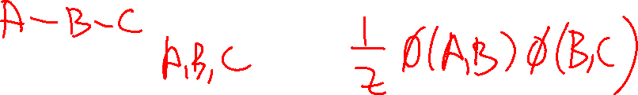
Example
A | B | φ(A,B)
T | T | 0.5
T | F | 0.1
F | T | 0.1
F | F | 0.3
B | C | φ(B,C)
T | T | 0.1
T | F | 0.2
F | T | 0.6
F | F | 0.1
A | B | C | φ(A,B)*φ(B,C) | P(A,B,C)
T | T | T | 0.05 | 0.11
T | T | F | 0.10 | 0.22
T | F | T | 0.06 | 0.13
T | F | F | 0.01 | 0.02
F | T | T | 0.01 | 0.02
F | T | F | 0.02 | 0.04
F | F | T | 0.18 | 0.39
F | F | F | 0.03 | 0.07
 |  | Z | 0.46 | 1.00
A | B | P(A,B)
T | T | 0.33
T | F | 0.15
F | T | 0.07
F | F | 0.46
B | C | P(B,C)
T | T | 0.13
T | F | 0.26
F | T | 0.52
F | F | 0.09
Is φ(A, B) = P(A, B)?
What is the most likely assignment to A, B according to φ(A, B)? How about P(A, B)?
A | P(A)
T | 0.48
F | 0.52
B | P(B)
T | 0.39
F | 0.61
C | P(C)
T | 0.65
F | 0.35

Slide 26
Example
A | B | φ(A,B)
T | T | 5
T | F | 1
F | T | 1
F | F | 3
B | C | φ(B,C)
T | T | 1
T | F | 2
F | T | 6
F | F | 1
A | B | C | φ(A,B)*φ(B,C) | P(A,B,C)
T | T | T | 5 | 0.11
T | T | F | 10 | 0.22
T | F | T | 6 | 0.13
T | F | F | 1 | 0.02
F | T | T | 1 | 0.02
F | T | F | 2 | 0.04
F | F | T | 18 | 0.39
F | F | F | 3 | 0.07
 |  | Z | 46 | 1.00
A | B | P(A,B)
T | T | 0.33
T | F | 0.15
F | T | 0.07
F | F | 0.46
B | C | P(B,C)
T | T | 0.13
T | F | 0.26
F | T | 0.52
F | F | 0.09
Multiplied all the factors by 10. What changed?
A | P(A)
T | 0.48
F | 0.52
B | P(B)
T | 0.39
F | 0.61
C | P(C)
T | 0.65
F | 0.35

Slide 27
Markov Networks
Structure
Undirected graphs
Parameters
Factors
The joint distribution
P(X) = 1/Z Πφ(D_{i})
Independencies
Separation
Pairwise independencies
Local independencies

Slide 28
Parameterization
Factors over maximal cliques
Pairwise Markov random fields
Factors over nodes, and
Factors over connected pairs (i.e., edges)
Pairwise Markov random fields do not introduce additional independencies, however,
The number of parameters is quadratic instead of exponential, but, of course,
The sets of distributions that can be represented over maximal cliques and pairwise interactions are not the same
Notes:
A clique with n variables: 2^n parameters.
Pairwise: n(n-1) edges: 4n(n-1) params. n nodes: 2n params. Total: 4n^2-2n params.

Slide 29
Factor graphs
Definition: A factor graph F is an undirected graph containing two types of nodes
Random variables (ovals)
Factor nodes (squares).
F contains edges between ovals and squares.
F is parameterized by a set of factors, where each factor node (square) is associated with precisely one factor whose scope is the square’s neighbor ovals.

Slide 30
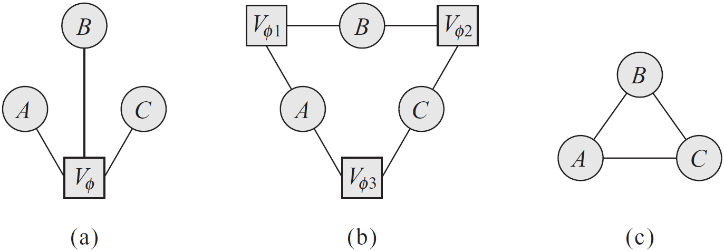
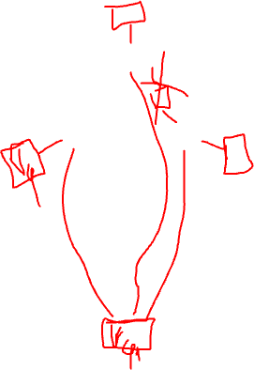
Factor graph example
Markov network as a clique over three variables, A, B, C
How would you represent a pairwise MRF with factors over the nodes and edges?

Slide 31
Log-Linear models
ɛ(D) = -ln(φ(D)) is often called the energy function.
In statistical physics, the probability of a physical state depends inversely on its energy.
Log-linear models guarantee that the factors are positive, in turn guaranteeing that the probability is positive.

Slide 32
Log-linear models
X₁, …, X_{n}

Slide 33

Log-linear example
A | B | φ(A,B) | ɛ(A,B)
T | T | 5 | -1.61
T | F | 1 | 0.00
F | T | 1 | 0.00
F | F | 3 | -1.10
B | C | φ(B,C) | ɛ(B,C)
T | T | 1 | 0.00
T | F | 2 | -0.69
F | T | 6 | -1.79
F | F | 1 | 0.00
A | B | C | φ(A,B)*φ(B,C) | ɛ(A,B)+ɛ(B,C) | exp(-Σɛi) | P(A,B,C)
T | T | T | 5.00 | -1.61 | 5.00 | 0.11
T | T | F | 10.00 | -2.30 | 10.00 | 0.22
T | F | T | 6.00 | -1.79 | 6.00 | 0.13
T | F | F | 1.00 | 0.00 | 1.00 | 0.02
F | T | T | 1.00 | 0.00 | 1.00 | 0.02
F | T | F | 2.00 | -0.69 | 2.00 | 0.04
F | F | T | 18.00 | -2.89 | 18.00 | 0.39
F | F | F | 3.00 | -1.10 | 3.00 | 0.07
 |  | Z | 46.00 |  | 46.00 | 1.00

