Slide 1
CS583 Probabilistic Graphical Models
Lecture 16. Parameter Estimation Part 3. Structure Learning
Oleksandr Narykov
onarykov@iit.edu

Slide 2
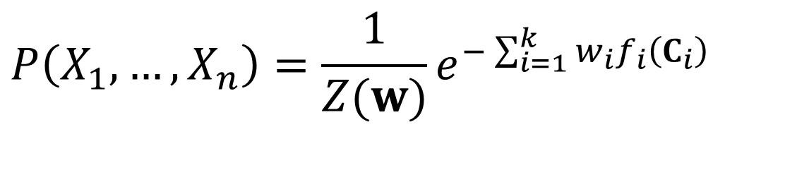
Log-linear models
A distribution is a log-linear model over a Markov network H is it is associated with
A set of features F = {f₁(C₁), …, f_{k}(C_{k})}, where each C is a complete subgraph in H,
A set of weights w₁, …, w_{k}
It is common to have several features over the same scope
$$P\left(X_{1},…,X_{n}\right)=\frac{1}{Z(w)}e^{−\sum_{i=1}^{k}{w_{i}f_{i}\left(C_{i}\right)}}$$

Slide 3
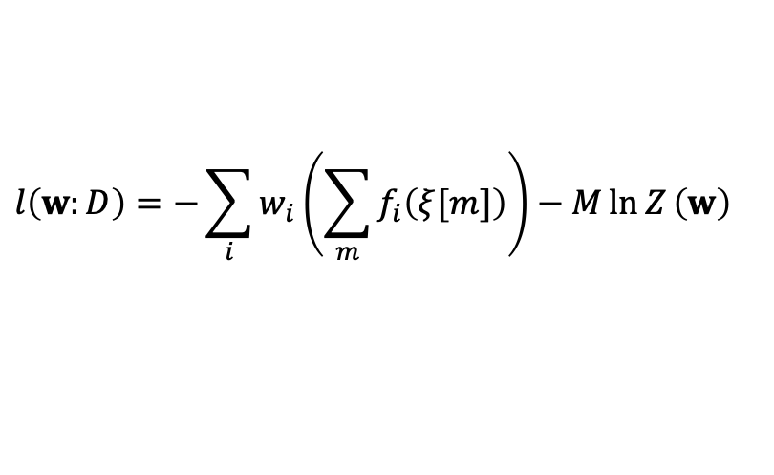
Log-linear models – log-likelihood
Given a domain X={X₁, …, X_{n}} and a dataset D = {ξ[1], ξ[2], …, ξ[M]}, where ξ[i] is an instance, i.e., a complete assignment to the variables X
The log-likelihood is
We are abusing the notation a little for clarity. The feature functions are defined over cliques, but here we passed them the whole instance. They just ignore the irrelevant portions of the instance
$$l\left(w:D\right)=−\sum_{i}{w_{i}\left(\sum_{m}{f_{i}\left(ξ[m]\right)}\right)−M\ln{Z}\left(w\right)}$$

Slide 4
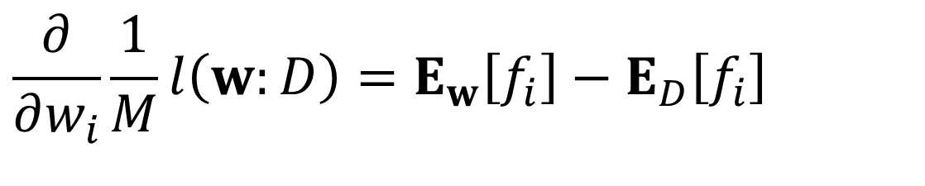
Derivative of l(w:d)/m wrt to w_{i}
$$\frac{∂}{∂w_{i}}\frac{1}{M}l\left(w:D\right)=E_{w}\left[f_{i}\right]−E_{D}\left[f_{i}\right]$$
Let’s prove it.

Slide 5
E_{w}[f_{i}] – E_{D}[f_{i}]
E_{D}[f_{i}] can be computed by summing f_{i} over the instances in D and dividing by M
How can we compute E_{w}[f_{i}]?
It is impossible to iterate over all possible values of X
Remember f_{i} is defined over a set of variables C_{i} and it ignores (i.e. equals zero for) the rest of the variables
Perform inference to compute P_{w}(c_{i})
Now we have the gradient, we can optimize w using gradient ascent

Slide 6
Gradient Ascent
Find maximum of f(θ) where there is no closed form solution
Start with some initial guess θ₀
While change is not much
θ_{i+1} = θ_{i} + η*f’(θ_{i})
η is called the learning rate and it is a user specified parameter

Slide 7
f = -2x² + 8x + 10

Slide 8
f = sin(x)

Slide 9
f = -2x² + 8x + 10
f’ = -4x + 8
Start with x₀ = 6
Use η = 0.2
x₁ = x₀ + η*f’(x₀)
x₁ = 6 + 0.2*(-4*6 + 8) = 6 – 0.2*16 = 6 – 3.2 = 2.8
x₂ = x₁ + η*f’(x₁)
x₂ = 2.8 + 0.2*(-4*2.8 + 8) = 2.8 – 0.2*3.2 = 2.8 – 0.64 = 2.16
x₃ = x₂ + η*f’(x₂)
x₃ = 2.16 + 0.2*(-4*2.16 + 8) = 2.16 – 0.2*0.64 = 2.16 – 0.128 = 2.032
x₄ = x₃ + η*f’(x₃)
x₄ = 2.032 + 0.2*(-4*2.032 + 8) = 2.032 – 0.2*0.128 = 2.032 – 0.0256 = 2.0064

Slide 10
Bayesian priors
There was no closed form solution for the maximum likelihood formulation
There is no closed form solution for full Bayesian approach either
We instead find the parameters that maximize p(θ)P(D|θ)

Slide 11
L₂-Regularization
Assume p(w) is zero-mean diagonal Gaussian with equal variances
In the log space, it gives rise to a penalty of the form
It penalizes large weights

Slide 12
L₁-Regularization
Assume p(w) is zero-mean Laplace distribution
In the log space, it gives rise to a penalty of the form
It penalizes large weights

Slide 13
Why small weights?
The prior for the weights is zero; unless the data tells us otherwise, we will treat the feature as not needed by the model
Large weights are more susceptible to the noise in the data
A small difference in the feature value can cause big changes in the probability
Small weights give rise to smoother probabilities

Slide 14
L₂ vs L₁
L₂ forces the large weights to get closer to zero and places an emphasis on the large weights
Even though the weights get closer to zero, they are often not zero
L₁ also penalizes large weights but the emphasis is not necessarily on the large weights
Some of the weights become zero
Leads to a sparser representation

Slide 15
Learning rate
As we have seen with examples, the learning rate is an important parameter
If it is too large, then we can overshoot
If it is too small, then it takes a long time to converge
There is no single value that works for all datasets and domains
There are approaches that chooses an appropriate learning rate at each step
E.g., line search

Slide 16
MN Parameter estimation summary
There is no closed form solution for both maximum likelihood estimation and Bayesian estimation
The likelihood function is concave; there is a single global optimum (note that the objective function has a single global optimum value but there might be many parameter values that achieve the same global optimum)
Gradient ascent methods are applied to estimate the parameters
The gradient computation requires running inference, which is costly
In practice, regularization (L₂, L₁) is used to avoid overfitting

Slide 17
Structure Learning

Slide 18
Why learn?
Alternative
Elicit the structure and the parameters from experts
Problems
Knowledge might not exist or might be insufficient
Might take weeks/months
The model might be different for different places
A model in the US vs. Europe might be different
The model might change over time
It is, however, often easier to collect data
E.g., patient records are often available

Slide 19
P*
Assume the domain is governed by P*
A network model M*=(K*, θ*)
We are given a dataset D = {x[1], … x[n]}
n samples from P*
We typically assume that the data is IID
Independent and identically distributed
We can learn
Parameters for a given structure
Parameters and the structure of the network

Slide 20
Ideally
Ideally, we want to learn M that captures P* precisely
Unfortunately, this goal is often not achievable due to
Computational reasons, but more importantly,
Limited data
Examples:
You want to estimate P(Heads), and you want to see each heads and each tails at least 100 times
How much data (in expectation) do you need?
You have k binary variables. You want to see the least likely case at least 100 times. How much data (in expectation) do you need in the best case where each case is uniformly distributed?

Slide 21
Goals of learning
Because we have to learn approximate models, we have to define the goal of learning
One approximate model for a purpose might not be the best approximate model for another purpose
Goals
Density estimation
Specific prediction tasks
Knowledge discovery

Slide 22
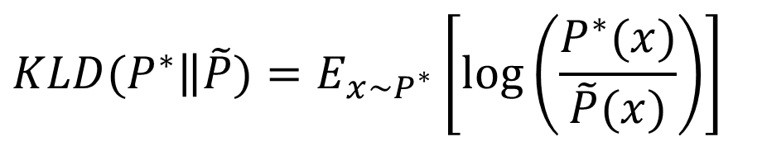
Density estimation
Goal: Use the network for various inference tasks
E.g., missing data prediction, reasoning about several variables and scenarios, etc.
Learn M̃ such that P̃ is as close as possible to P*
How do evaluate the quality of M̃? That is, how do we define distance?
Relative entropy/Kullback-Liebler (KL) divergence
$$KLD(\left.P^{∗}\right\|\tilde{P})=E_{x∼P^{∗}}\left[\log\left(\frac{P^{∗}(x)}{\tilde{P}(x)}\right)\right]$$

Slide 23
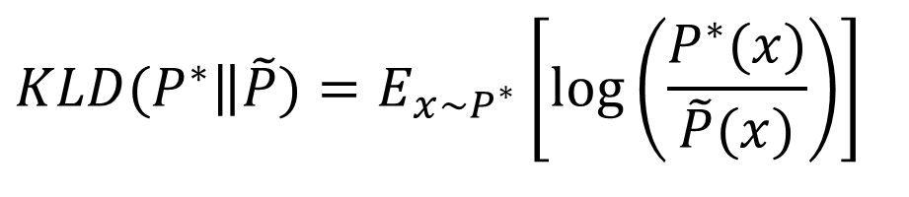
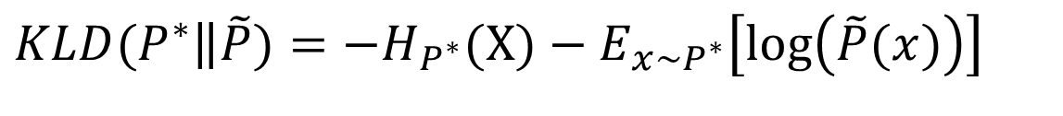
KL-Divergence
$$KLD(\left.P^{∗}\right\|\tilde{P})=E_{x∼P^{∗}}\left[\log\left(\frac{P^{∗}(x)}{\tilde{P}(x)}\right)\right]$$
We need to know P*
P* is not known in real-world settings
$$KLD(\left.P^{∗}\right\|\tilde{P})=−H_{P^{∗}}(X)−E_{x∼P^{∗}}\left[\log\left(\tilde{P}(x)\right)\right]$$

Slide 24
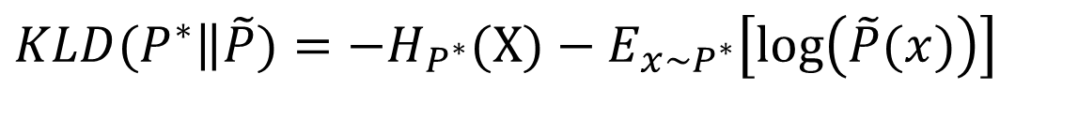
Expected log-likelihood
$$KLD(\left.P^{∗}\right\|\tilde{P})=−H_{P^{∗}}(X)−E_{x∼P^{∗}}\left[\log\left(\tilde{P}(x)\right)\right]$$
To find P̃ to minimize KLD(P*|P̃), we can maximize the second term E_{P*}[log(P̃)]
E_{P*}[log(P̃)] is also called expected log-likelihood

Slide 25
Likelihood/log-likelihood
Likelihood of the data given model M
P(D : M)
Log-likelihood of the data given model M:
log P(D : M))

Slide 26
Specific prediction tasks
We are interested in predicting a set of variables Y given another set X
We are interested in P(Y|X)
E.g., conditional random fields
Expected conditional log-likelihood
Like log-likelihood, except, we don’t require our model to provide a distribution over only X

Slide 27
Knowledge discovery
We would like to discover knowledge about P*
E.g.,
Direct and indirect dependencies
Nature of the dependencies (positive/negative correlation)
Goal is not to model just P* but it is to extract M*
The correct model might not be identifiable
Remember that given a Bayesian network structure, there might be many I-Equivalent versions of it
Inferring weak edges requires a lot of data
Inferring the lack of edges requires a lot of data

Slide 28
Learning as optimization
We define a criterion that we want to optimize
Log-likelihood, conditional log-likelihood, etc.
We have a hypothesis space
A set of candidate models
An objective function
Quantifies our preferences over candidates
Learning = finding a high-scoring model within the hypothesis space

Slide 29
Empirical risk
We don’t have access to P*
We can instead construct an empirical distribution P̃ using the data training data D
P̃(x) = Count(x∈D) / |D|
Let’s analyze P̃
What’s good about it?
It is the distribution with the highest log-likelihood on D
Make sure you see that
What’s wrong about it?
Notes:
Two independent coins.
Counts = 23, 26, 28, 23
P1 = empirical
LL1 = -138.272
P2 = 0.25 for all
LL2 = -138.629

Slide 30
Overfitting / generalization
P̃ overfits the data: it doesn’t capture the regularities, rather it captures every bit of detail
If we had an infinite mount of data (or close to it), then this would not be a problem, but
In limited data, the details can be accidental
We want our model to generalize instead
Be able to perform well with unseen data

Slide 31
Bias/variance trade-off
If we choose a simple hypothesis class
E.g., if we assume every variable is marginally independent, no matter how much data, we might not be able to capture P*
High bias
If we choose a complex hypothesis class
E.g., if we assume every variable is connected to every other variable, then there won’t be enough data to estimate the parameters correctly. Moreover, the estimated parameters will vary drastically if the training data is only slightly different
High variance
We need to strike a balance between bias and variance to achieve better generalization
Notes:
Occam’s razor

Slide 32
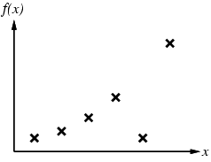
Curve Fitting

Slide 33
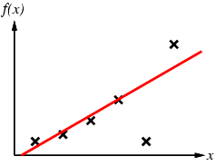
Curve Fitting

Slide 34
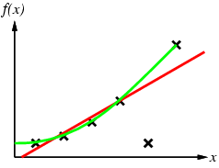
Curve Fitting

Slide 35
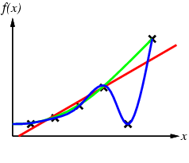
Curve Fitting

Slide 36
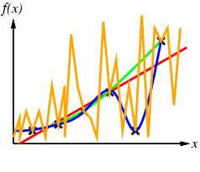
Curve Fitting

Slide 37
Evaluating Generalization performance
Hold-out testing
Split the data into training set and test set
Learn on the training set, evaluate on the test set
Need large data
Cross-validation
Split the data into k parts
Withhold i-th partition and train model on the rest of the data
Test on i-th partition
Nested cross-validation
Necessary to avoid overfitting when tuning model’s parameters

