Slide 1
CS583 Probabilistic Graphical Models
Lecture 23. Neural Graphical Models
Oleksandr Narykov
onarykov@iit.edu

Slide 2

Neural Graphical Models
Shrivastava, Harsh, and Urszula Chajewska. "Neural graphical models." European Conference on Symbolic and Quantitative Approaches with Uncertainty. Cham: Springer Nature Switzerland, 2023
https://arxiv.org/pdf/2210.00453.pdf

Slide 3
Rationale
PGMs are used to understand the dynamics of the system
In theory, a complex relationships between inputs can be represented
In practice, due to computational limitations a lot of simplifications are introduced: input data type, distribution type, graph structure
Neural networks can be used to capture dependency structure between groups of features
Neural Graphical Models (NGM) aim to represent complex feature dependencies in a reasonable computational time

Slide 4
Problem Setting
Input data X that have M samples with each sample consisting of D features
Input graph G which can be directed, undirected or have mixed-edge types that represents our belief about the feature dependency relationships
In case if G is not provided, structure learning algorithms are employed

Slide 5
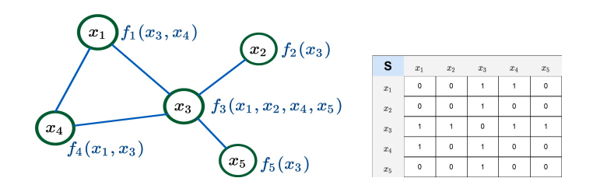
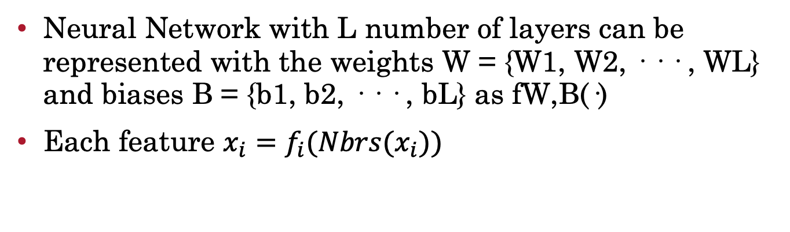
Representation
Neural Network with L number of layers can be represented with the weights W = {W1, W2, · · · , WL} and biases B = {b1, b2, · · · , bL} as fW,B(·)
Each feature $x_{i}=f_{i}(Nbrs(x_{i}))$

Slide 6
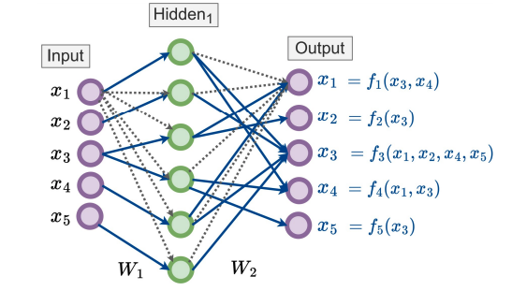
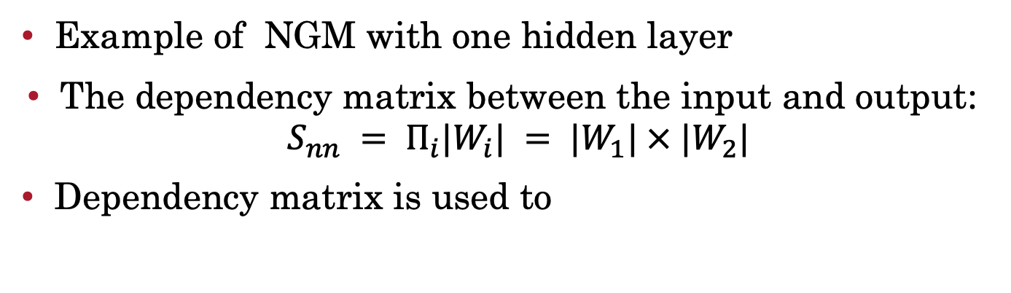
Learning
Example of NGM with one hidden layer
The dependency matrix between the input and output: $S_{nn} = Π_{i}|W_{i}| = |W_{1}| × |W_{2}|$
Dependency matrix is used to

Slide 7
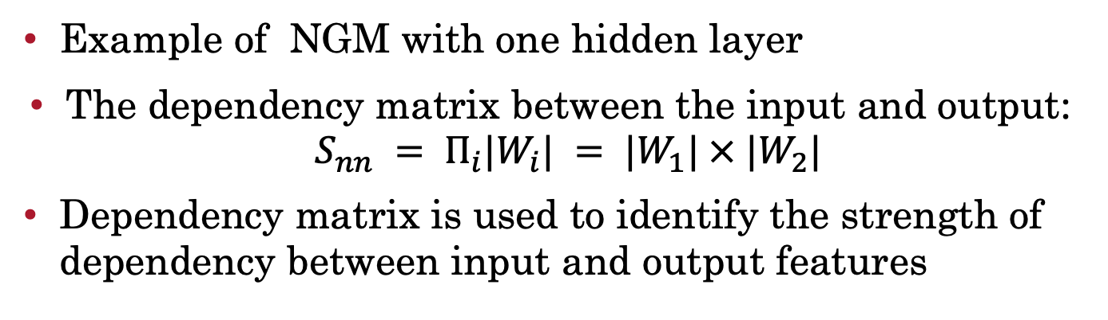
Learning
Example of NGM with one hidden layer
The dependency matrix between the input and output: $S_{nn} = Π_{i}|W_{i}| = |W_{1}| × |W_{2}|$
Dependency matrix is used to identify the strength of dependency between input and output features

Slide 8
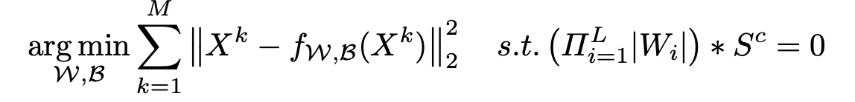
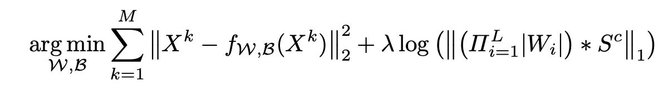
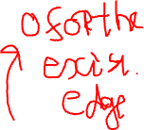
Learning
Optimization task with soft constraints:
Optimization task with Lagrangian:

Slide 9
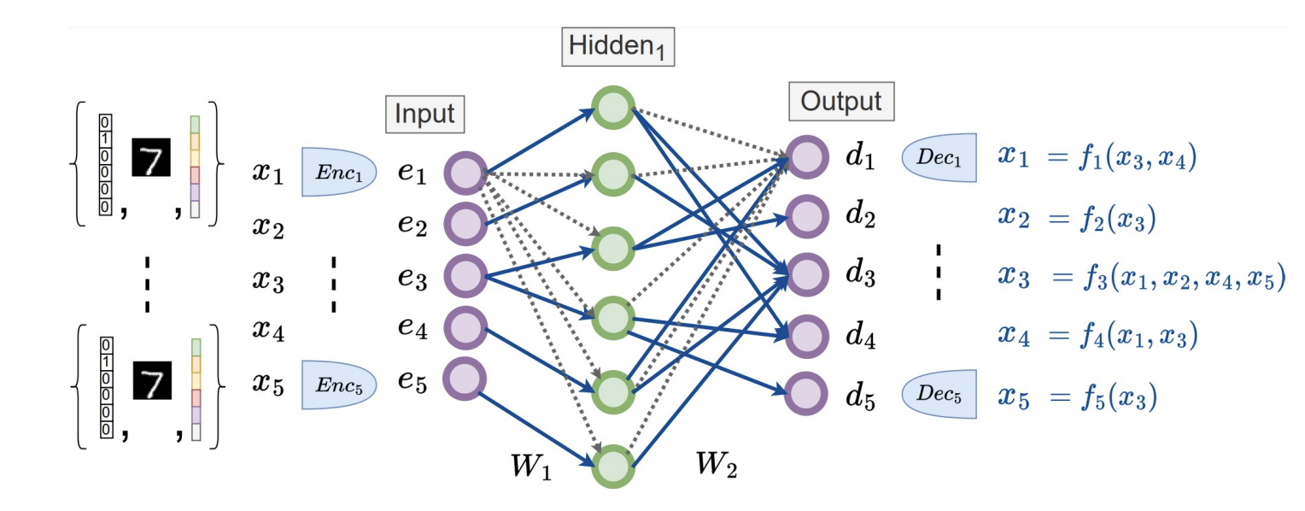
Projection Modules

Slide 10
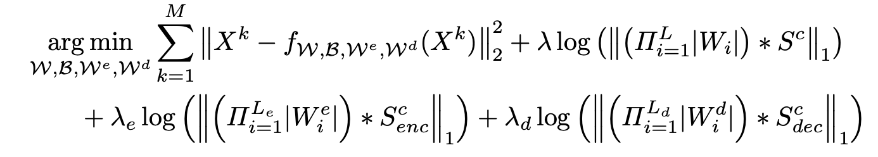
Projection Modules
Extending soft graph constraints:

Slide 11
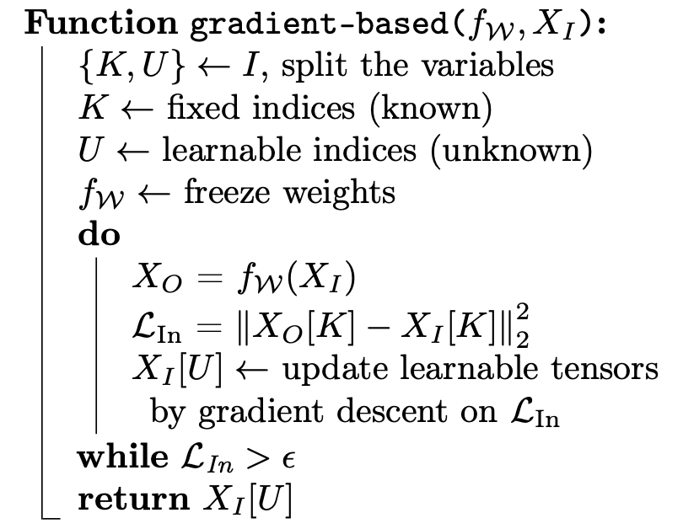
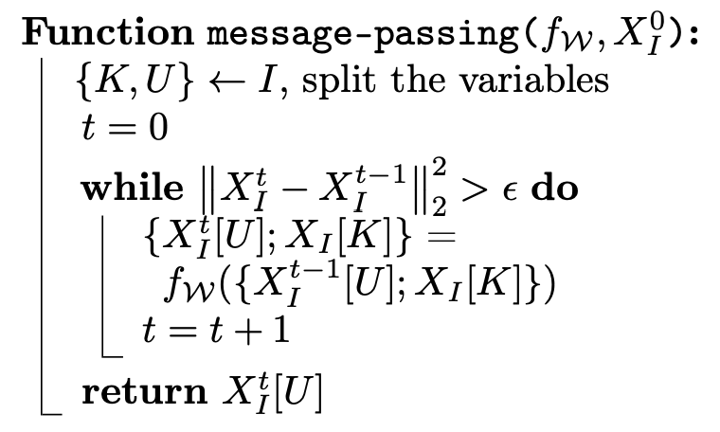
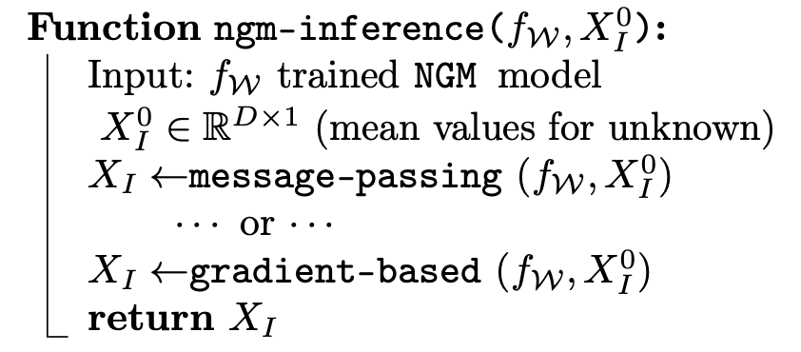
Inference

Slide 12
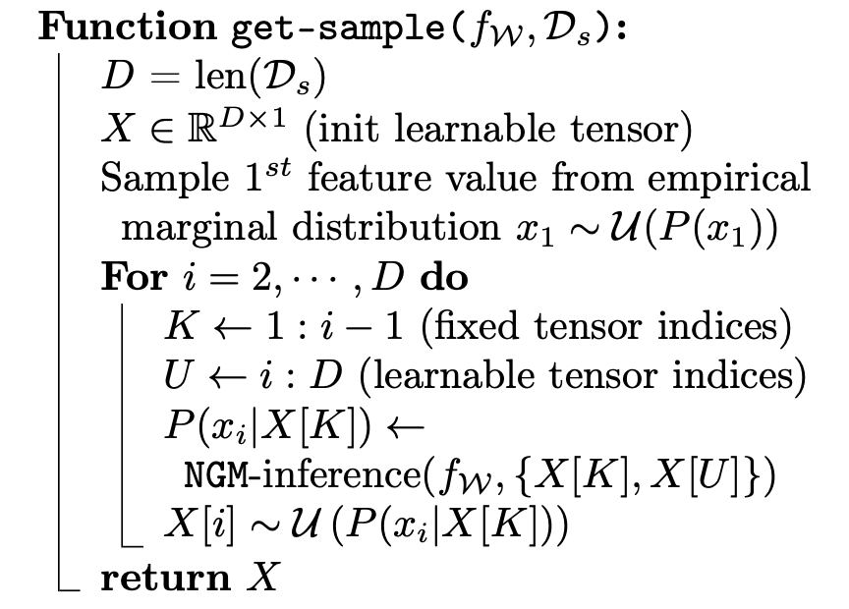
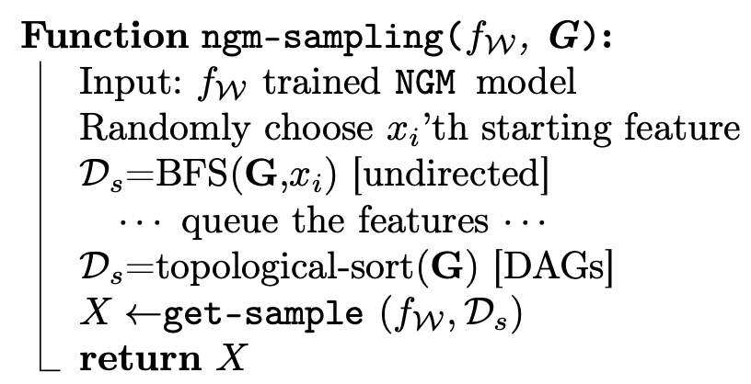
Sampling

Slide 13
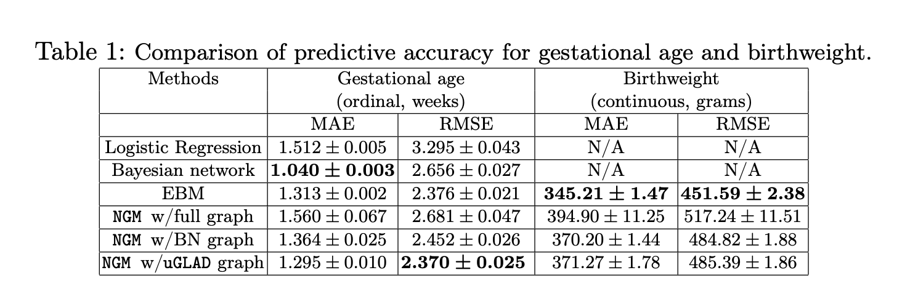
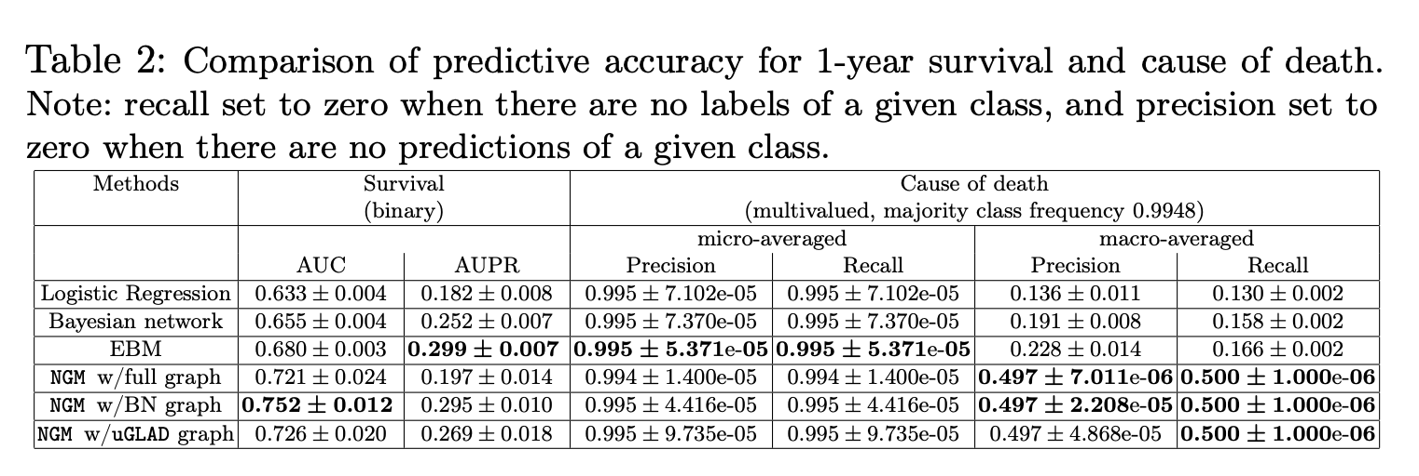
Results

