Slide 1
CS583 Probabilistic Graphical Models
Lecture 24. Review
Oleksandr Narykov
onarykov@iit.edu

Slide 2
Bayesian Networks

Slide 3
Motivation
A combination of prior knowledge and data-based reasoning
Directly incorporating knowledge into the model structure
Modeling random processes (generative modeling)
Uncertainty quantification
Causal inference
Notes:
Without assumptions you cannot make predictions
Declarative representations are different from the purely data-driven machine learning algorithms
They allow us to incorporate prior domain knowledge into generative model and separate it from

Slide 4
Summation Rule
Given P(X, Y), P(X) can be computed using
P(X) = Σ_{y}P(X,y) where y ranges over Val(Y)

Slide 5
Chain Rule
P(X₁, X₂, X₃, …, X_{k}) =
P(X₁) P(X₂|X₁) P(X₃|X₁,X₂)… P(X_{k} |X₁, X₂, X₃, …, X_{k-1})
or
P(X₂) P(X₁|X₂) P(X₃|X₁,X₂)… P(X_{k} |X₁, X₂, X₃, …, X_{k-1})
or
P(X₂) P(X₃|X₂) P(X₁|X₃,X₂)… P(X_{k} |X₁, X₂, X₃, …, X_{k-1})
or
Pick an order, then
P(first)P(second|first)P(third|first,second)…P(last|all_previous)

Slide 6
Bayes Rule
Bayes Rule
P(X|Y) = P(Y|X)P(X) / P(Y)
Conditional Bayes Rule
P(X|Y, Z) = P(Y|X, Z)P(X|Z) / P(Y|Z)

Slide 7
Exercise
In a state, 60% of the hospitalized patients are vaccinated.
P(v | h) = 0.6
What does this number tell you about the effectiveness of the vaccines in preventing hospitalizations?
Notes:
P(~v|h) = 0.4
P(h|v) = P(v|h)*P(h)/P(v)=0.6/0.8
P(h|~v) = P(~v|h)*P(h)/P(~v)=0.4/0.2

Slide 8
Marginal Independence
An event α is independent of an event β in P, denoted as P╞ α ⊥ β, if
P(α|β) = P(α), or
P(β) = 0
Proposition: A distribution P satisfies α ⊥ β if and only if
P(α, β) = P(α) P(β)
Corollary: α ⊥ β implies β ⊥ α

Slide 9
Conditional Independence
Two events are independent given another event
An event α is independent of event β given event γ in P, denoted as P╞ (α ⊥ β | γ), if
P(α|β, γ) = P(α| γ), or
P(β, γ) = 0
Proposition: A distribution P satisfies α ⊥ β | γ if and only if
P(α, β | γ) = P(α| γ) P(β| γ)
Notes:
Examples:
Traffic, John arrives late, Mary arrives late. J ind M | T
Height, Knowledge, Age. H ind K | A

Slide 10
Querying a distribution
Evidence (E=e): what is known, Query (Y): variables of interest, X is the set of all variables that include E, Y, and potentially others
Probability query
P(Y|e) = ?
MAP query
W = X \ E (i.e., all the non-evidence variables)
MAP(W|e) = argmax_{w}P(w,e)
Important: We cannot find w by finding the maximum likely value for each variable individually
Marginal MAP query
MAP(Y|e) = argmax_{y}P(y|e)
Let Z = X \ E∪Y
MAP(Y|e) = argmax_{y} ∑_{z}P(z, y|e)

Slide 11
Bayesian Network Factorization
Why is this factorization useful?
How can you prove this factorization holds?

Slide 12
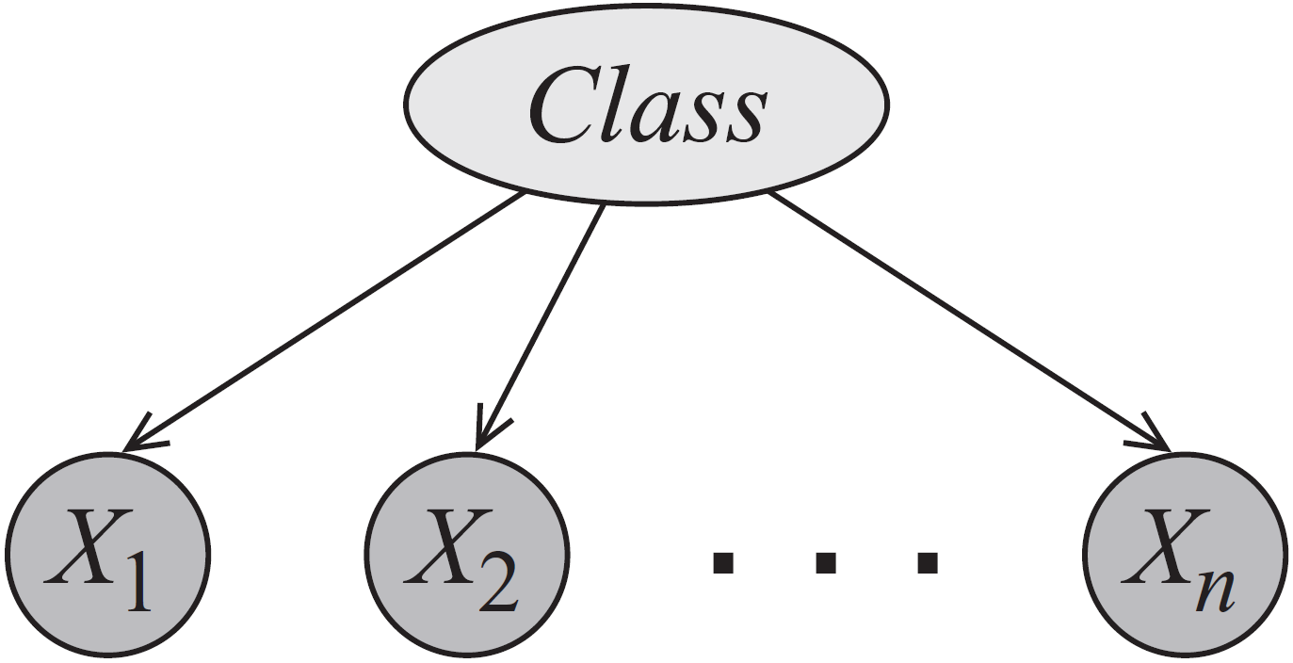
Naïve Bayes

Slide 13
I-Map
Let P be a distribution over X. We define I(P) to be the set of independencies of the form X ⊥ Y | Z that hold in P.
“P satisfies independencies of the structure K” ≡ I(K) ⊆ I(P)
If I(K) ⊆ I(P) ⇒ K is an I-Map for P
For K to be an I-Map of P, any independence assertion made by K has to be true in P. However, it is possible that P can contain additional independencies
That is, whatever K says independent is independent in P, but K may not know all the independencies in P

Slide 14
Reasoning Types
Causal
A → B → C
Evidental
A ← B ← C
Intercausal
A → B ← C

Slide 15
D-Separation
To answer whether X_{i} and X_{j} are independent given E
Find all trails between X_{i} and X_{j}
If information can flow through at least one trail, then X_{i} and X_{j} are dependent given E; otherwise they are independent given E

Slide 16
Trails
Causal trail
X → Z → Y
Information can flow between X and Y if Z is not observed; if Z is observed, it blocks the information flow. X ⊥ Y | Z
E.g, I → G → L
If we don’t know the student’s grade, then knowing her intelligence tells us something about the strength of the letter. But, once we know her grade, I and L are independent
Evidential trail
X ← Z ← Y
Information can flow between X and Y if Z is not observed; if Z is observed, it blocks the information flow. X ⊥ Y | Z
Notes:
Note: Make these variables italic

Slide 17
Trails
Common cause
X ← Z → Y
Information can flow between X and Y if Z is not observed; if Z is observed, it blocks the information flow. X ⊥ Y | Z
E.g, G ← I → S
If we don’t know the student’s intelligence, then knowing his SAT score tells us something about his grade. If we know his intelligence, then his grade and SAT score are independent

Slide 18
Trails
Common effect
X → Z ← Y (v-structure)
Information can flow between X and Y only if Z or at least one of Z’s descendants is observed
E.g. D → G ← I
If we do not know the grade or the letter quality, then D and I are independent. If we know, however, the grade or the letter quality, then D and I interact

Slide 19
Markov Networks

Slide 20
Motivation for Markov Networks
There are distributions that cannot be represented Bayesian networks (and vice versa)
Guaranteeing acyclicity can be hard

Slide 21
An example
We’d like a graph where
A ⊥ C | B, D
B ⊥ D | A, C
(A, B), (B, C), (C, D), and (D, A) are correlated but no causal direction exists
Alice and Charles pair and Bob and Debbie pair do not talk to each other directly
Alice and Bob, Bob and Charles, and Alice and Debbie pairs agree most of the time, and Charles and Debbie pair disagrees most of the time

Slide 22
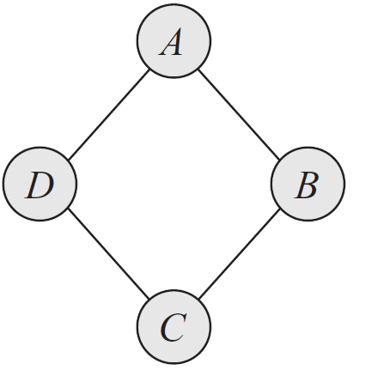
Example

Slide 23
Parameterization
Parameterization is perhaps the least intuitive concept about MNs
Bayesian networks
P(X_{i} | Pa(X_{i}))
Markov networks
Cannot use probability distributions directly, but
MNs provide more flexibility in the parameterization

Slide 24
Factors
Let D be a set of random variables
Definition: A factor φ is a function from Val(D) to R.
A factor is nonnegative if all entries are nonnegative
The scope of factor, denoted as, Scope[φ], is the set of variables D it is associated with

Slide 25
Gibbs Distribution
Definition: A distribution P is a Gibbs distribution parameterized by a set of factors Φ = {φ(D₁), …, φ(D_{k})} if it is defined as follows:
X₁, …, X_{n}
What is Z?
φ(D_{i}) are factors, but what are D_{i}?
Can you relate this to Bayesian Network parameterization?

Slide 26
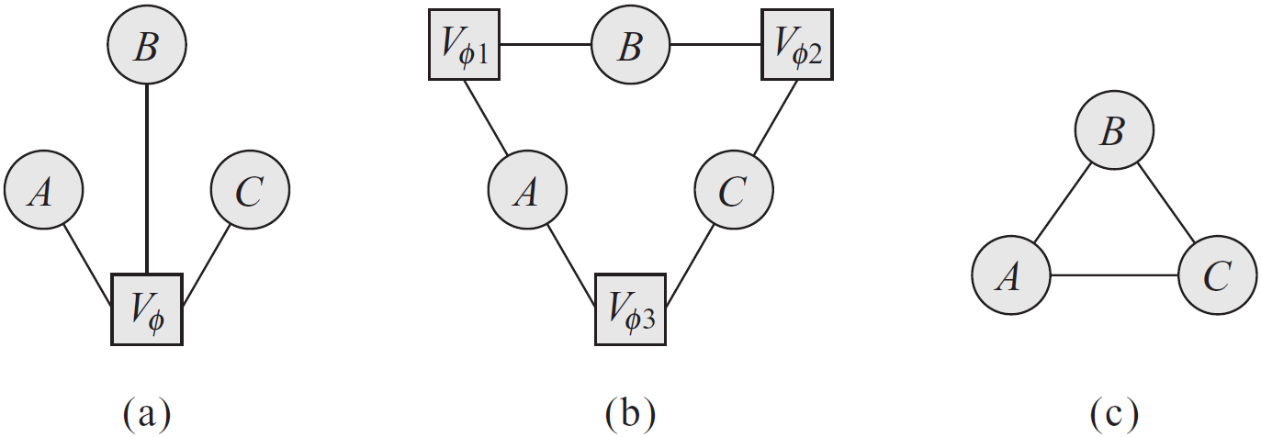
Factor graph example
Markov network as a clique over three variables, A, B, C

Slide 27
Log-Linear models
ɛ(D) = -ln(φ(D)) is often called the energy function.
In statistical physics, the probability of a physical state depends inversely on its energy.
Log-linear models guarantee that the factors are positive, in turn guaranteeing that the probability is positive.

Slide 28
Variable Elimination

Slide 29
Task
Given a graphical model over X (structure and parameters)
Compute P(Y | e), where Y ⊆ X and E ⊆ X
There are several approaches
Exact inference
Variable elimination
Belief propagation
Approximate inference
Sampling
This slide deck: variable elimination

Slide 30
Variable elimination
P(Y | e) = P(Y, e) / P(e)
W = X – Y – E
P(y, e) = Σ_{w}P(y, e, w)
P(e) = Σ_{y},_{w}P(y, e, w)
Or, better yet: P(e) = Σ_{y}P(y, e)

Slide 31
Variable elimination
X: all variables, Y: query variables, E: evidence variables, W = X – Y – E: remaining variables
Write down the joint for P(X)
Set X_{i} ∈ E to their values
Pick an order for X_{j} ∈ W
Sum out each X_{j} from the joint
Multiply the factors φ(X_{j}, Z₁), …, φ(X_{j}, Z_{k}) to create ψ(X_{j}, Z₁,…, Z_{k})
Sum out X_{j} from ψ(X_{j}, Z₁,…, Z_{k}) to create τ(Z₁,…, Z_{k})
What remains is τ(Y, e). Normalize it to get P(Y | e).

Slide 32
Parameter Estimation

Slide 33
Uniform prior
We have a uniform prior over θ_{X}. That is, p(θ_{X})=1
P(X[M+1]=x¹|x[1],…,x[M])? That is, P(X[M+1]=x¹|D)?
For the binary case, P(X[M+1]=x¹|D) = (t + 1) / (t + f + 2), where t is the number of True cases and f is the number of False cases in D
This is also called Laplace smoothing
What about the posterior, P(θ|D), if the prior P(θ) is uniform?

Slide 34
Beta Distribution
θ ~ Beta(α,β) if p(θ) = γθ^{α−1}(1−θ)^{β−1} where γ is a normalizing constant
Mean: α/(α+β)
Mode: (α−1)/(α+β−2)
Note that the mode is closer to the mean when α and β are large
Read more at
https://en.wikipedia.org/wiki/Beta_distribution
Notes:
~Binomial for discrete
X^(a-1)*(1-X)^(b-1)
import numpy as np
from scipy.stats import beta
import matplotlib.pylab as plt
x=np.linspace(0,1)x
plt.plot(x,beta.pdf(x, 15, 10))
plt.show()

Slide 35
Dirichlet priors
Generalizes the Beta distribution for multinomials
What is P(X[M+1]=x^{i}|D) if the prior is Dirichlet?
P(X[M+1]=x^{i}|D) = (n_{i}+α_{i}) / (|D|+ α) where n_{i} is the number of times the i^{th} case appears in D and α = α₁ + α₂ + … + α_{K}
What is the posterior, P(θ|D), if the prior is Dirichlet?
P(θ|D) = Dirichlet(n₁ + α₁, n₂ + α₂, …, n_{K} + α_{K})

Slide 36
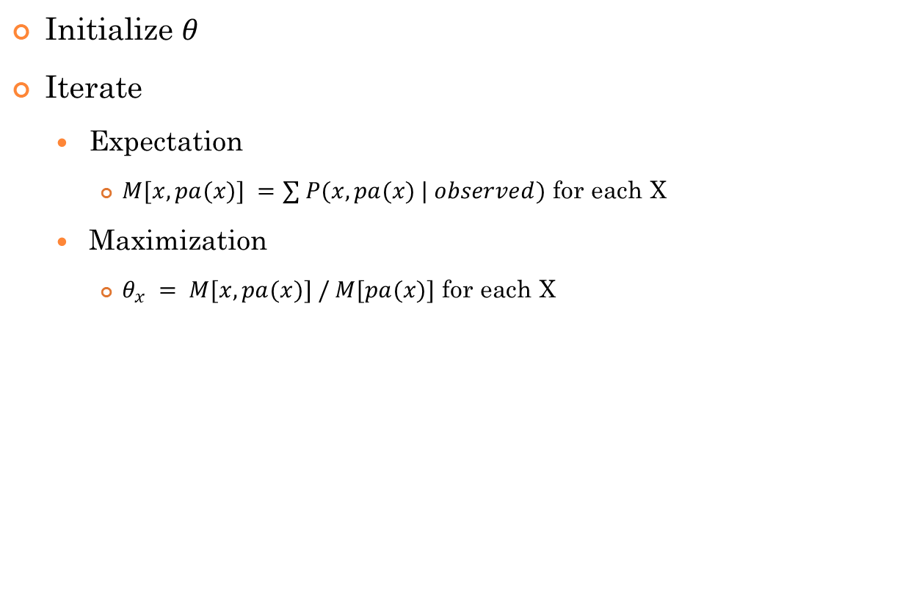
Expectation Maximization (EM)
Initialize $θ$
Iterate
Expectation
$M[x, pa(x)] =∑ P(x, pa(x) | observed)$ for each X
Maximization
$θ_{x} = M[x, pa(x)] / M[pa(x)]$ for each X

Slide 37
Structure Learning

Slide 38
Three approaches
Constraint-based structure learning
View Bayesian network as a representation of independencies
Test for conditional dependence and independence in the data
Sensitive to failure in individual independence tests
Score-based structure learning
Hypothesis space of possible models
Find the highest scoring structure
The hypothesis space is super exponential 2^(O(n²))
Bayesian model averaging
Rather than learning a structure, learn an ensemble of structures
Again, the number of structures is immense
It is efficient for some while it has to be approximate for others

Slide 39
Independence tests
X² statistic
Mutual information
X² and MI are zero when X and Y are independent
Extension of X² statistic to conditional independence queries

Slide 40
Bayesian score
Bayesian approach puts a distribution on anything we are uncertain about
In parameter estimation, we put a distribution on θ
In this case, we have the following distributions
P(G)
p(θ_{G}|G)
Given data D, the posterior P(G|D) is
P(G|D) = P(D|G) P(G) /P(D)
P(D) is a normalizing constant
score_{B}(G : D) = logP(D| G) + log P(G)

Slide 41
P(D|G)
There is a closed form solution on page 801 of the book
If we use a Dirichlet priors for all parameters in the network, as M→∞
l(θ:D) is the loglikelihood and Dim[G] is the model dimension, i.e., the number of independent parameters in G

Slide 42
BIC score
A trade-off between the fit to the data and the model complexity
The mutual information grows linearly in M whereas the model complexity grows logarithmically
The larger the M the more emphasis on fit to the data

