Slide 1
CS583 Probabilistic Graphical Models
Lecture 17. Structure Learning
Oleksandr Narykov
onarykov@iit.edu

Slide 2
Task
We are given fully observed data
Our task is to learn the structure (and the parameters)

Slide 3
Goal: knowledge discovery
There are at least two problems
Unidentifiability
Given observational data, the best we can hope to learn is an I-Equivalent structure to G*
Weak connections
Due to noise, two variables will almost never be independent
If a connection is weak, how do we determine if it is due to noise or it is a real weak connection?

Slide 4
Goal: density estimation
Adding an unnecessary edge is very costly for parameter estimation
Each unnecessary binary parent divides the data into half – data fragmentation
The estimated parameters have high variance
For better generalization, it is preferable to have a sparse structure
In fact, if the data is limited, it might be even better to have a sparser structure than G*

Slide 5
Bayesian Networks

Slide 6
Three approaches
Constraint-based structure learning
View Bayesian network as a representation of independencies
Test for conditional dependence and independence in the data
Sensitive to failure in individual independence tests
Score-based structure learning
Hypothesis space of possible models
Find the highest scoring structure
The hypothesis space is super exponential 2^(O(n²))
Bayesian model averaging
Rather than learning a structure, learn an ensemble of structures
Again, the number of structures is immense
It is efficient for some while it has to be approximate for others

Slide 7
1. Constraint-based approaches
In the BN slide deck, we have seen two procedures
Find minimal I-MAP
Find all I-equivalent structures
We assumed that, given a distribution P, we could answer any independence question perfectly
We’ll now assume that we don’t have access to P but instead we have access to a dataset D

Slide 8
Independence in the data?
Assume we toss two coins independently
We first toss one coin, record it, and then toss the next coin, and record the outcome
We repeat this process 100 times
Assume we get 25 H/H, 23 H/T, 27 T/H, 25 T/T
Based on the data, can we say that the two coins are independent?

Slide 9
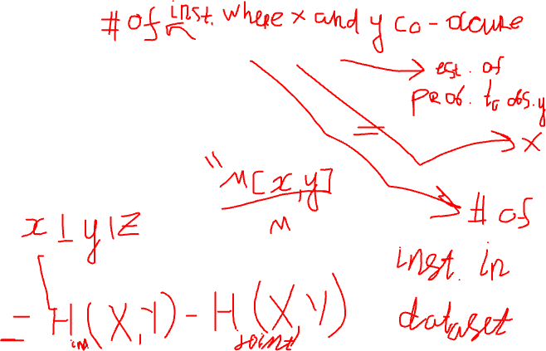
Independence tests
X² statistic
Mutual information
X² and MI are zero when X and Y are independent
Extension of X² statistic to conditional independence queries

Slide 10
Independence tests
X² statistic
Mutual information
X² and MI are zero when X and Y are independent
Extension of X² statistic to conditional independence queries

Slide 11
Three approaches
Constraint-based structure learning
View Bayesian network as a representation of independencies
Test for conditional dependence and independence in the data
Sensitive to failure in individual independence tests
Score-based structure learning
Hypothesis space of possible models
Find the highest scoring structure
The hypothesis space is super exponential 2^(O(n²))
Bayesian model averaging
Rather than learning a structure, learn an ensemble of structures
Again, the number of structures is immense
It is efficient for some while it has to be approximate for others

Slide 12
2. Score-based approaches
2.1 Maximum likelihood score
2.2. Bayesian score

Slide 13
2.1 Maximum likelihood score
Find a model, <G, θ_{G}> that would make the data D as probable as possible
In order to find the maximum likelihood pair <G, θ_{G}>
We should find the structure G that achieves the highest likelihood when we use the MLE parameters for G

Slide 14
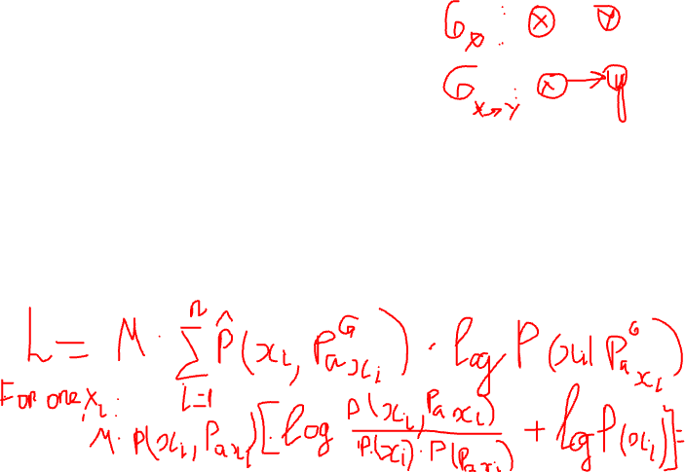
Two variable case
Given two variables X and Y
Consider two structures: G∅ and G_{X→Y}.
What is score_{L}(G_{X→Y} : D) - score_{L}(G∅ : D)?
The general equation for score_{L}(G : D) is as follows:
Notes:
Likelihood = M*1/M*(i=1 to n) (for all possible values of xi, pa(xi)) count(xi, pa(xi))*log(P(xi|pa(xi)))
For a single xi:
M*P(xi,pa(xi))log(P(xi|pa(xi)) = M*P(xi,pa(xi))[log(P(xi,pa(xi))/(P(xi)P(pa(xi)))) + log(P(xi))] = M*I(Xi; Pa(Xi)) – M*H(Xi)

Slide 15
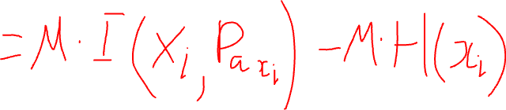
Two variable case
Given two variables X and Y
Consider two structures: G∅ and G_{X→Y}.
What is score_{L}(G_{X→Y} : D) - score_{L}(G∅ : D)?
The general equation for score_{L}(G : D) is as follows:
Notes:
Likelihood = M*1/M*(i=1 to n) (for all possible values of xi, pa(xi)) count(xi, pa(xi))*log(P(xi|pa(xi)))
For a single xi:
M*P(xi,pa(xi))log(P(xi|pa(xi)) = M*P(xi,pa(xi))[log(P(xi,pa(xi))/(P(xi)P(pa(xi)))) + log(P(xi))] = M*I(Xi; Pa(Xi)) – M*H(Xi)

Slide 16
Limitations of ml score
Can score_{L}(G_{X→Y} : D) be smaller than score_{L}(G∅ : D) ever?
They are equal only when X and Y are truly independent and otherwise score_{L}(G_{X→Y} : D) is always bigger
I_{P}(X; Y∪Z) ≥ I_{P}(X; Y)
Adding a parent can never decrease the maximum likelihood score
The highest scoring structure is the complete graph
One remedy is to bound the indegree of the graph

Slide 17

2.2 Bayesian score
Bayesian approach puts a distribution on anything we are uncertain about
In parameter estimation, we put a distribution on θ
In this case, we have the following distributions
P(G)
p(θ_{G}|G)
Given data D, the posterior P(G|D) is
P(G|D) = P(D|G) P(G) /P(D)
P(D) is a normalizing constant
score_{B}(G : D) = logP(D| G) + log P(G)

Slide 18

P(D|G)
There is a closed form solution on page 801 of the book
If we use a Dirichlet priors for all parameters in the network, as M→∞
l(θ:D) is the loglikelihood and Dim[G] is the model dimension, i.e., the number of independent parameters in G

Slide 19

BIC score
A trade-off between the fit to the data and the model complexity
The mutual information grows linearly in M whereas the model complexity grows logarithmically
The larger the M the more emphasis on fit to the data

Slide 20
Score equivalence
A score satisfies score equivalence if for all I-Equivalent structures G and G’, score(G : D) = score(G’: D)
The likelihood score satisfies score equivalence
The Bayesian score satisfies score equivalence if and only if we use BDe priors
Notes:
X->Y
Y->X
X->Y->Z
Z->Y->X
X<-Y->Z

Slide 21
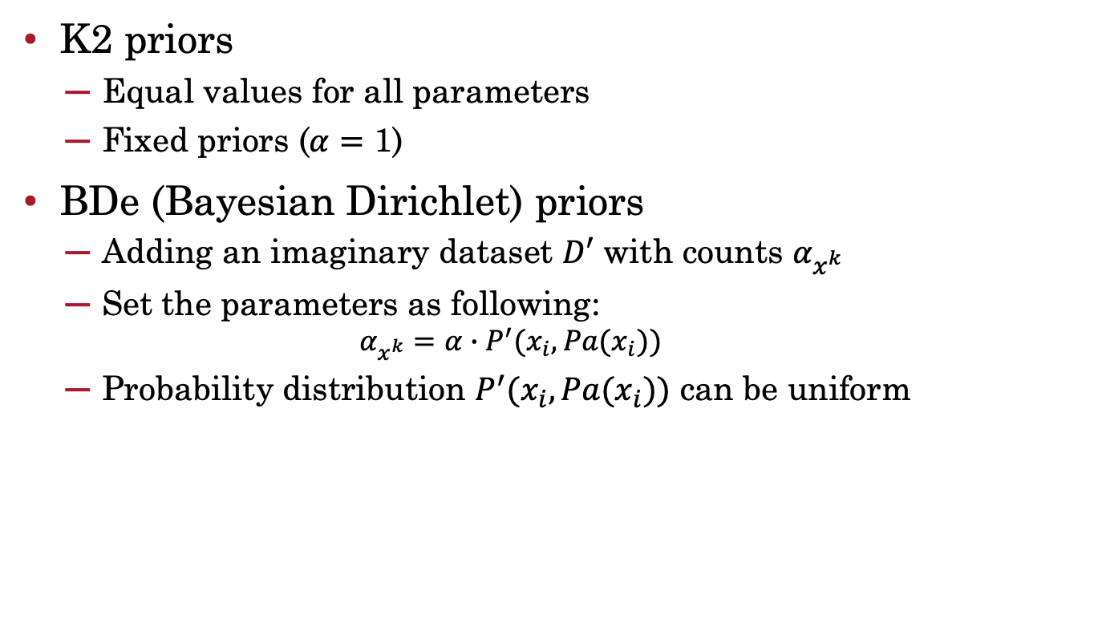
Priors
K2 priors
Equal values for all parameters
Fixed priors ($α=\text{1}$)
BDe (Bayesian Dirichlet) priors
Adding an imaginary dataset $D′$ with counts $α_{x^{k}}$
Set the parameters as following:
$$α_{x^{k}}=α∙P^{′}(x_{i}, Pa(x_{i}))$$
Probability distribution $P^{′}(x_{i}, Pa(x_{i}))$ can be uniform
Notes:
X->Y
Y->X
X->Y->Z
Z->Y->X
X<-Y->Z

Slide 22

Decomposable score
A structure score score(G : D) is decomposable if it can be written as
where FamScore(X|U : D) measures how well a set of variables U serves as parents of X in D.
The likelihood score is decomposable
FamScore(X|U : D) = M*[I(X;U) – H(X)]
The Bayesian score is decomposable under certain natural assumptions

Slide 23
Why is decomposability important?
When searching for structures, small changes to the structure change the score of the structure, but
The score of the structure can be updated efficiently by recomputing the scores for only the affected families
For example
Adding or deleting an edge changes the score for only one variable
Reversing an edge changes the score for only two variables

Slide 24
Structure search
So far, we have discussed computing a score for a given structure
How can we find the highest scoring structure?
Three scenarios
A tree-structured network
Known variable order
General graphs

Slide 25
Tree-structured networks
Each variable has at most one parent
Can be learned efficiently – in polynomial time
They capture the most important dependencies and they serve as a good baseline
Define Δ(G) = score(G : D) – score(G∅ : D)
We know score(G∅ : D)=Σ_{i}FamScore(X_{i} : D)
Δ(G) = Σ_{j} FamScore(X_{j} |Pa(X_{j}) : D) – FamScore(X_{j} : D)
Algorithm
Define a fully connected undirected graph where the edge weight between X_{i} and X_{j} is FamScore(X_{i} |X_{j} : D) – FamScore(X_{i} : D)
Find the maximum spanning forest
Complexity: O(n²M + n²logn)

Slide 26
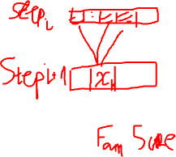
Known variable order
A variable order is given
Assuming a variable order is problematic, but in some cases, the order is natural, such as a temporal one
A variable’s parents can be only the variables that precede it
To find the parent of the n^{th} node, we need to consider 2^{n-1} potential sets
We can bound the indegree to be d; then the algorithm is exponential in d but polynomial in n

Slide 27
General graphs
Finding the best scoring G is NP-hard
Even if we limit the indegree to be d, finding the best scoring G is NP-hard when d≥2
Heuristic algorithms that might find the best one but not guaranteed
This is a combinatorial optimization problem
Search the search space to find a good scoring G
Use local search
Need three components
The search space
Scoring function
A search procedure

Slide 28
Search space
The search space is a graph
Whose nodes are potential solutions,
Connected by search operators that allow us to move from one candidate solution to another
We choose the following search operators
Edge addition
Edge deletion
Edge reversal
Why can’t we just start from G∅ and use only edge addition operators? Why do we need edge deletion and reversal?
When is edge reversal useful? Can’t we just do it in two steps by deleting an edge and adding back it in the reverse direction?

Slide 29
Search procedure
Start with an initial graph
It can be the empty graph, a random graph, the best tree, or a network that is hand constructed
Apply the search operators to generate new candidate structures, score them, and move to the one that has the highest score
The runtime is roughly O(K*n²*(M+n*d))
K is the number of iterations,
n is the number of variables,
M is the number of data instances,
d is the max indegree

Slide 30
Local maxima
What happens if none of the operators find a better scoring structure than the current one?
We hit either a local maxima or a plateau
Unfortunately, plateaus are pretty common
When the scoring function satisfies score equivalence, then all the I-equivalent structures have equal score
The edge reversal operator will generate many I-equivalent structures

Slide 31
How to deal with local maxima and plateaus?
Basin flooding
Keep track of visited states
Tabu search
Keep a list of recently performed operations and do not reverse their effect in the next L steps
Data perturbation
Make small changes to data D through replicas and removals.
The new data will cause similar networks to differ, but the big trends will be preserved

Slide 32
How score decomposition comes in handy
Adding and deleting an edge changes the family of one variable and reversal changes the family of two variables
We keep track of how much the score would change for each candidate operation
Let’s say we are considering to add the edge X→Y.
We compute the score change, but we decide to do a better operation which does not change Y’s family.
In the next step, we do not need to compute the score change for X→Y; we can use the previous computation.

Slide 33
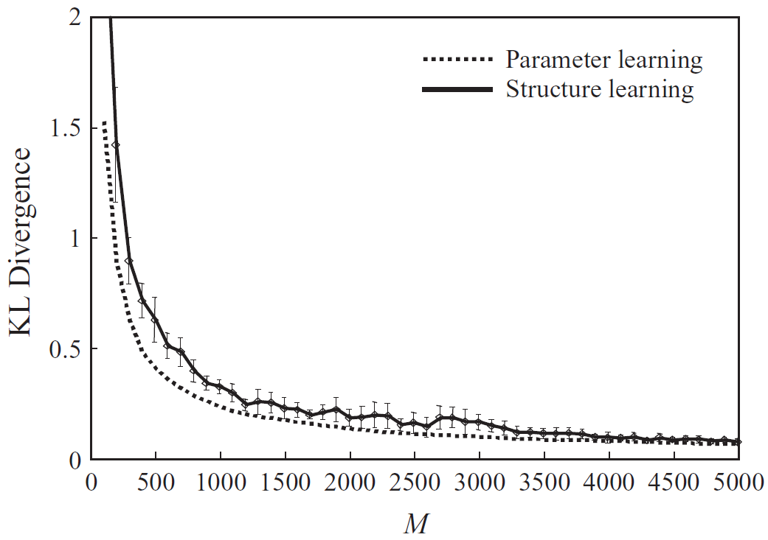
How good is local search?

Slide 34
Summary
Not all the dependencies seen in the data are real
Determining the edge directionality is sometimes impossible
We have seen two structure learning approaches
Constraint-based
Sensitive to independence failures, which are common in real-world datasets
Score-based
Maximum likelihood score
Bayesian Information Criterion (BIC) score
Tree-structured networks can be learned in polynomial time
General structure learning is NP-hard but there are many local search algorithms that perform fairly well in practice

Slide 35
Markov Networks

Slide 36
Structure learning
Two approaches
Constraint-based
Score-based

Slide 37
Constraint-based
Assume H* is a P-Map for P*
We already know the algorithm
See Markov Networks slide deck
Use chi2, mutual information for independence test

Slide 38
Score-based
To compute the score for a candidate structure, we need to estimate the parameters
Unlike Bayesian networks, parameter estimation cannot be done independently for each variable
Unlike Bayesian networks, parameter estimation requires running inference
Unlike Bayesian networks, the score for a structure does not decompose over variables
There is no clean and efficient way of reusing computations

Slide 39
In Practice
Log-linear models are learned
Search is performed over candidate features (over candidate cliques)
L₁-regularization is used so that the weights of the useless features become zero
If all the weights for all features for a candidate clique become zero, that clique is gone
If there is a single feature with a non-zero weight, the clique is retained
To achieve sparse solutions, block L₁-reqularization is used where a block of features for a candidate clique are penalized together

