Slide 1
CS583 Probabilistic Graphical Models
Lecture 18. Parameter Estimation Example. Sampling
Oleksandr Narykov
onarykov@iit.edu

Slide 2
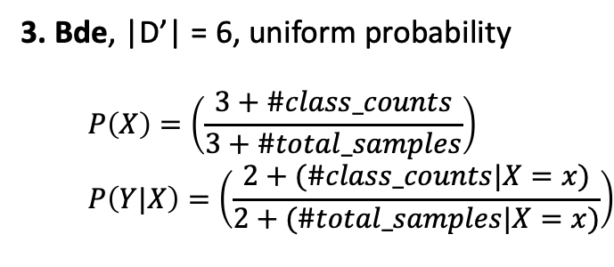
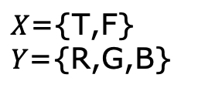
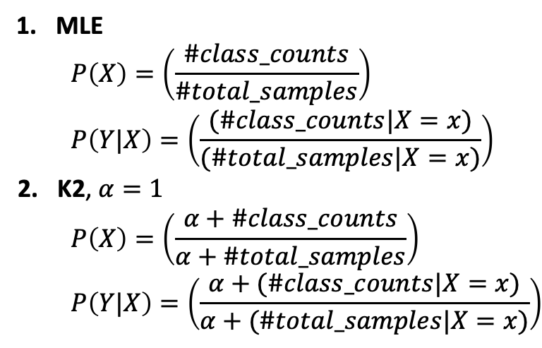
Estimating Parameters with Priors: MLE, K2, BDe
$$X\text{=\{}\text{T}\text{,}\text{F}\text{\}}$$
$$Y\text{=\{}\text{R}\text{,}\text{G}\text{,}\text{B}\text{\}}$$
MLE
$$P\left(X\right)=\left(\frac{\#class_counts}{\#total_samples}\right)$$
$$P\left(Y|X\right)=\left(\frac{(\#class_counts|X=x)}{(\#total_samples|X=x)}\right)$$
K2, $α=1$
$$P\left(X\right)=\left(\frac{α+\#class_counts}{α+\#total_samples}\right)$$
$$P\left(Y|X\right)=\left(\frac{α+(\#class_counts|X=x)}{α+(\#total_samples|X=x)}\right)$$
X | Y | Counts
T | R | 10
T | B | 20
F | G | 30
F | B | 40
3. Bde, |D’| = 6, uniform probability
$$P\left(X\right)=\left(\frac{3+\#class_counts}{3+\#total_samples}\right)$$
$$P\left(Y|X\right)=\left(\frac{2+(\#class_counts|X=x)}{2+(\#total_samples|X=x)}\right)$$

Slide 3
Sampling motivation
Exact inference is NP-hard
Exact inference with an arbitrary structured network containing thousands of variables is impractical
Various approximate inference techniques
Variational inference
Sampling

Slide 4
Sampling
The basic idea
Generate data using the network and the parameters
Use the data to answer the queries
For this to work
Sampling needs to be more efficient than running inference
Enough data need to be sampled for precision

Slide 5

We’ll cover
Forward sampling
Bayesian networks, no evidence
Rejection sampling
Bayesian networks, with evidence
Likelihood weighting
Bayesian networks, with evidence
Gibbs sampling
Bayesian networks and Markov networks, with or without evidence

Slide 6
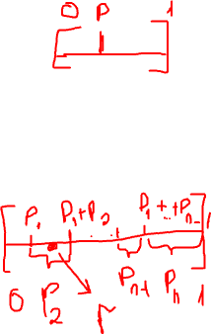
Preliminaries: how to sample from a distribution
Discrete
Binary [p, 1-p]
Sample a random number r from [0,1]. If r<p, then it is the first value, otherwise it is the second.
Multinomial [p₁, p₂, …, p_{n}]
Create [0, p₁, p₁+p₂, p₁+p₂+p₃, …, p₁+p₂+…+p_{n}]
Sample a random number r from [0, 1]. Find i where p₁+p₂+…+p_{i-1} < r < p₁+p₂+…+p_{i}
Continuous
Depends on the distribution
For e.g., many different methods to sample from Gaussian distribution

Slide 7
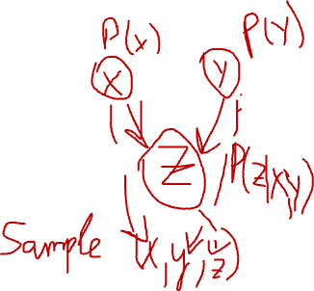
Forward sampling
Use for Bayesian networks and marginal probabilities
For each variable V_{i} that is ready
Sample a value v_{i} for V_{i} using P(V_{i} | Pa(V_{i}))
Repeat this process M times to generate M instances
A variable is ready if
It has no parents, or
You have sampled its all parents
To compute marginal
Use maximum likelihood estimate
Count and normalize

Slide 8
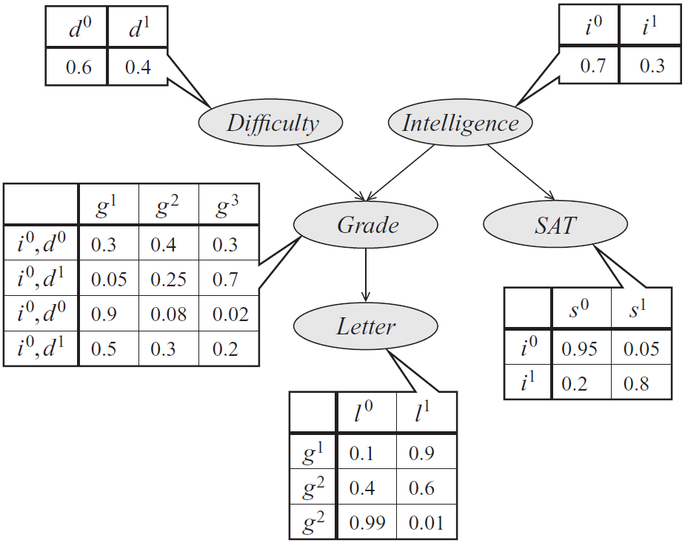
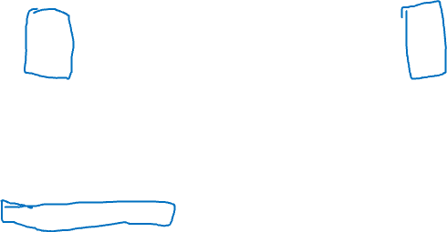
Forward sampling on the student network
D and I are ready.
Sample D from P(D): d⁰.
Only I is ready.
Sample I from P(I): i¹.
G and S are now ready.
Sample G from P(G|i¹,d⁰): g¹.
S and L are ready.
Sample S from P(S|i¹): s⁰.
L is ready.
Sample L from P(L|g¹): l⁰
The instance is <d⁰,i¹,s⁰,g¹,l⁰>
Repeat the process from step 1 M times.
Industrious
i⁰, d⁰
i⁰, d¹
i¹, d⁰
i¹, d¹
g¹
g²
g³

Slide 9
Forward sampling on the student network
The sampled data is
Iteration | D | I | S | G | L
1 | d⁰ | i¹ | s⁰ | g¹ | l⁰
… | … | … | … | … | …
M | … | … | … | … | …
P(D=d⁰) = # of rows with D=d⁰ / (# of rows with D=d⁰ + # of rows with D=d¹)

Slide 10
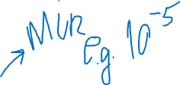
Bounds
Absolute error ε bound with probability at least 1-δ
M ≥ ln(2/δ) / 2ε²
E.g.
δ=0.1, ε=0.1 ⇒ M ≥ 150
δ=0.01, ε=0.1 ⇒ M ≥ 265
δ=0.01, ε=0.01 ⇒ M ≥ 26,491
Relative error ε bound with probability at least 1-δ
M ≥ 3ln(2/δ) / P(y)ε²
A big problem with using this bound is that we do not know P(y)

Slide 11
Conditional probability queries
P(y, e) and P(e) can be separately estimated
Then P(y | e) = P(y, e)/ P(e)
For this to work, both P(y, e) and P(e) need to be estimated with relative low error
If we estimate P(y, e) and P(e) with small absolute error, then P(y, e)/ P(e) can be arbitrarily off.

Slide 12
Where is the evidence?
If evidence is only at the root variables, it is easy; don’t sample those variables; just set them to their respective values
E.g., if E = {d¹, i⁰} in the student network, then don’t sample D and I. Just set D=d¹ and I=i⁰
If the evidence is at the intermediate or leaf nodes (e.g., if any of G, S, L is in the evidence)
Rejection sampling
Likelihood sampling

