Slide 1
CS583 Probabilistic Graphical Models
Lecture 1. Foundations
Oleksandr Narykov
onarykov@iit.edu

Slide 2
Introduction
Probabilistic graphical models features
Bayesian reasoning
Declarative representations
Recommended literature
Probabilistic Graphical Models: Principles and Techniques by D. Koller, N. Friedman
Selected chapters from Information Theory, Inference, and Learning Algorithms by D. MacKay
Math-oriented class
Programming language: Python.
Library: pgmpy https://pgmpy.org/
Notes:
Without assumptions you cannot make predictions
Declarative representations are different from the purely data-driven machine learning algorithms
They allow us to incorporate prior domain knowledge into generative model and separate it from

Slide 3
Motivation
A combination of prior knowledge and data-based reasoning
Directly incorporating knowledge into the model structure
Modeling random processes (generative modeling)
Uncertainty quantification
Causal inference
Notes:
Without assumptions you cannot make predictions
Declarative representations are different from the purely data-driven machine learning algorithms
They allow us to incorporate prior domain knowledge into generative model and separate it from

Slide 4
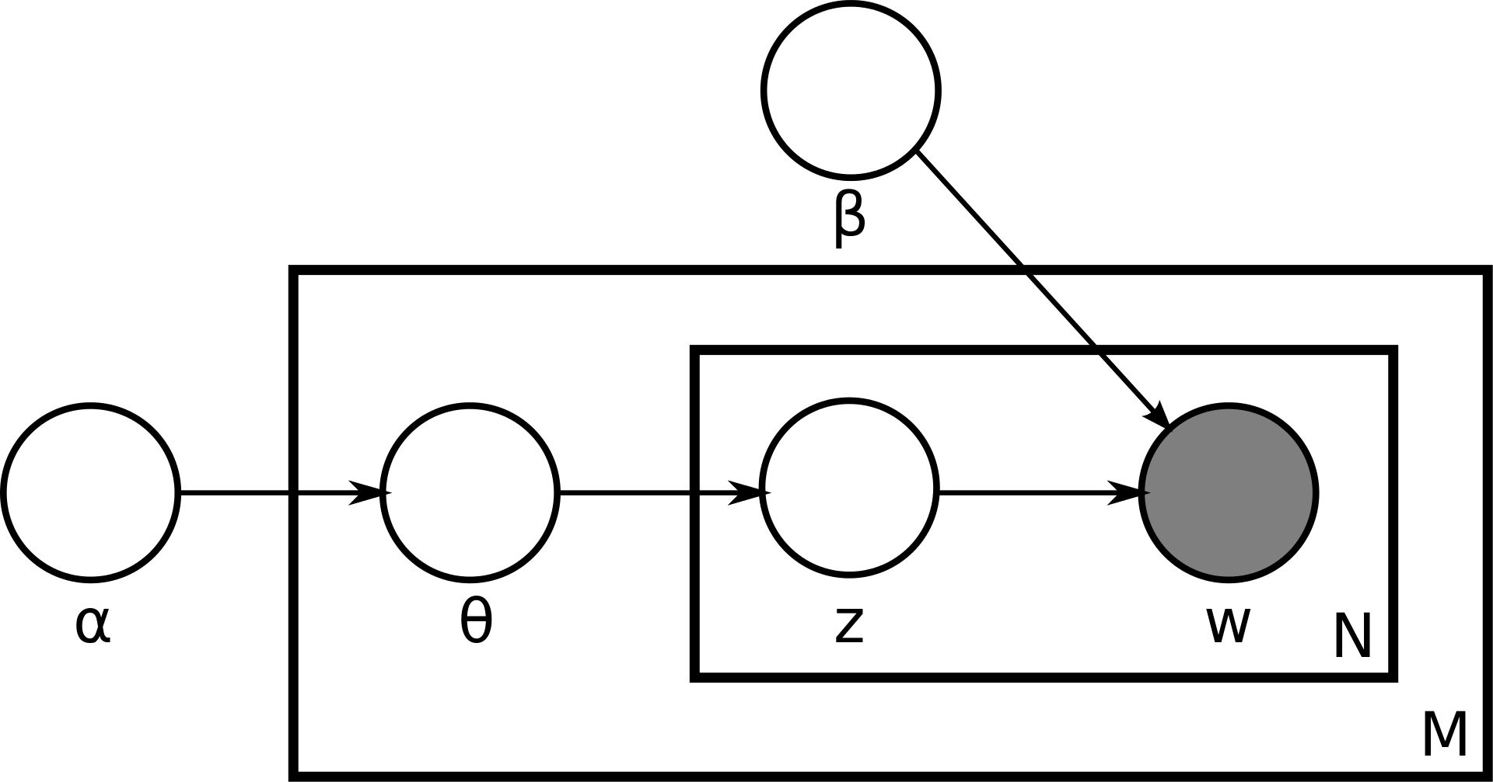
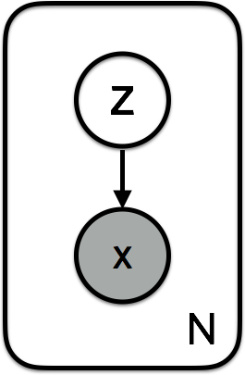
Motivation
Latent Dirichlet Allocation (Wikipedia)
Variational Autoencoder
Notes:
Without assumptions you cannot make predictions
Declarative representations are different from the purely data-driven machine learning algorithms
They allow us to incorporate prior domain knowledge into generative model and separate it from

Slide 5
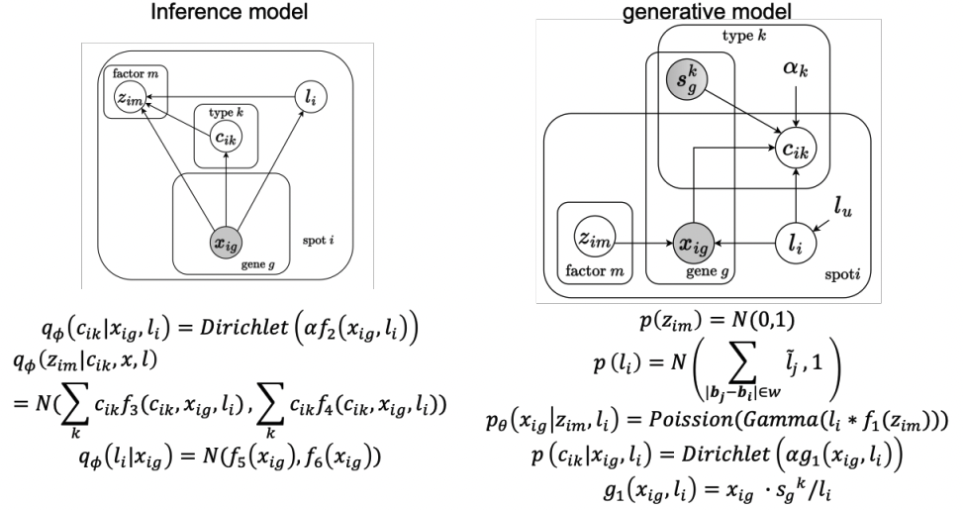
Motivation
He, Siyu, et al. "Starfysh reveals heterogeneous spatial dynamics in the breast tumor microenvironment." bioRxiv (2022): 2022-11.
Notes:
Without assumptions you cannot make predictions
Declarative representations are different from the purely data-driven machine learning algorithms
They allow us to incorporate prior domain knowledge into generative model and separate it from

Slide 6
Probability

Slide 7
Probability Distribution
Ω: Space of possible outcomes
E.g., Rolling a die Ω = {1, 2, 3, 4, 5, 6}
S: Measurable events
E.g., An odd roll of die S = {1, 3, 5}
A probability distribution P over (Ω, S) is a mapping from events in S to real values that satisfies
P(α) ≥ 0 for all α∈S
P(Ω) = 1
If α,β∈S and α∩β=∅, then P(α∪β) = P(α) + P(β)
Notes:
What is P(a V b) if a ^ b is not empty?

Slide 8
Random Variables
A problem is represented through variables
Age, fever, lab tests, …
Industrious (student), Difficulty (of a class), Grade (of a student in that class), …
A variable takes on values from its domain
Fever takes on True, False
Grade takes on A, B, C
Can be either discrete or continuous
Grade is discrete, Age is continuous
In an uncertain world, a variable takes on values from its domain probabilistically
For example, Grade can be A, B, or C probabilistically
P(Grade = A), P(Grade = B), P(Grade = C)

Slide 9
Random Variables – Notation
Capital: X: variable
Lowercase: x: a particular value of X
Val(X): the set of values X can take
Bold Capital: X: a set of variables
Bold lowercase: x: an assignment to all variables in X
P(X=x) will be shortened as P(x)
P(X=x ∩ Y=y) will be shortened as P(x,y)

Slide 10
Table – the most basic representation
Industrious | P(Industrious)
~industrious | 0.7
industrious | 0.3
Grade | P(Grade)
a | 0.25
b | 0.37
c | 0.38

Slide 11

Joint Distribution
Several random variables
X={X₁, X₂, …, X_{n}}
Joint Distribution
P(X) = P(X₁, X₂, …, X_{n})
Specifies a probability value to all possible assignments

Slide 12
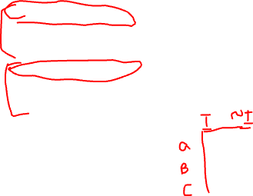
Joint Distribution
Industrious | Grade | P(Industrious, Grade)
~industrious | a | 0.07
~industrious | b | 0.28
~industrious | c | 0.35
industrious | a | 0.18
industrious | b | 0.09
industrious | c | 0.03

Slide 13
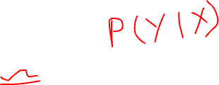
Conditional Probability
P(X|Y) = P(X, Y) / P(Y)
What do the following mean?
P(Grade)
P(Grade | Industrious)
P(Grade | Industrious = industrious)
P(Grade = a | Industrious = ~industrious)

Slide 14
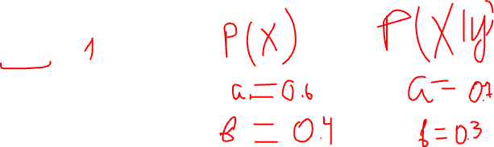
Summation Rule
Given P(X, Y), P(X) can be computed using
P(X) = Σ_{y}P(X,y) where y ranges over Val(Y)
Answer the following
Σ_{x}P(X) = ?
Σ_{x}P(X|y) = ?

Slide 15
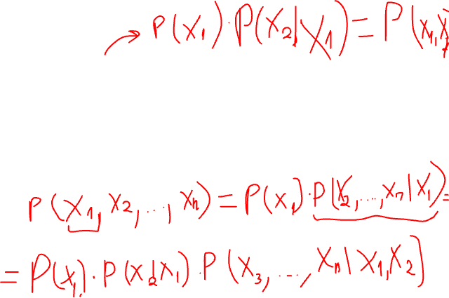
Chain Rule
P(X₁, X₂, X₃, …, X_{k}) =
P(X₁) P(X₂|X₁) P(X₃|X₁,X₂)… P(X_{k} |X₁, X₂, X₃, …, X_{k-1})
or
P(X₂) P(X₁|X₂) P(X₃|X₁,X₂)… P(X_{k} |X₁, X₂, X₃, …, X_{k-1})
or
P(X₂) P(X₃|X₂) P(X₁|X₃,X₂)… P(X_{k} |X₁, X₂, X₃, …, X_{k-1})
or
Pick an order, then
P(first)P(second|first)P(third|first,second)…P(last|all_previous)

Slide 16
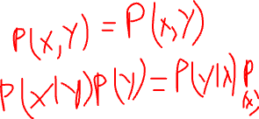
Bayes Rule
Bayes Rule
P(X|Y) = P(Y|X)P(X) / P(Y)
Conditional Bayes Rule
P(X|Y, Z) = P(Y|X, Z)P(X|Z) / P(Y|Z)

Slide 17
Bayes Rule
Can we compute P(α|β) from P(β|α)?
E.g.,
In a class, 70% of the industrious students got an A.
P(a | industrious ) = 0.7
John got an A. What is the probability of John being industrious given he got an A?
P( industrious | a) = ?
Note: these numbers have nothing to do with the previous tables and numbers.

Slide 18
Class Example
Let’s say there are 100 students in the class
Let’s say 10 of them are industrious, 90 are ~industrious
Probability of a randomly picked student being industrious
P(industrious) = 0.1
We know that 70% of the industrious students got an A.
P(a|industrious) = 0.7
7 industrious students got an A; 3 did not get an A.
What is P(industrious|a) = ?
Depends on P(a)

Slide 19
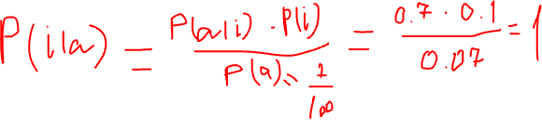
Very Hard Class
industrious
∼industrious
A
3
7
0
90
P(i|a) = ?
Notes:
P(s|a) = 7/7 = 1

Slide 20
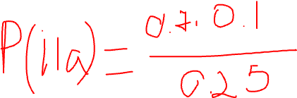
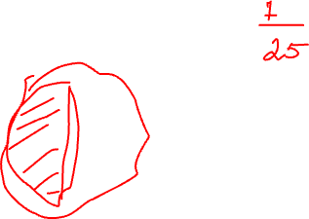
Medium Hard Class
industrious
∼industrious
A
3
7
18
72
P(i|a) = ?
Notes:
P(s|a) = 7/25 = 0.28

Slide 21
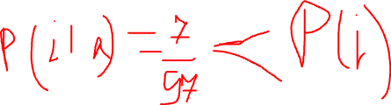
Weird Class
industrious
∼industrious
A
3
7
90
0
P(i|a) = ?
Notes:
P(s|a) = 7/97 ≈ 0.07

Slide 22
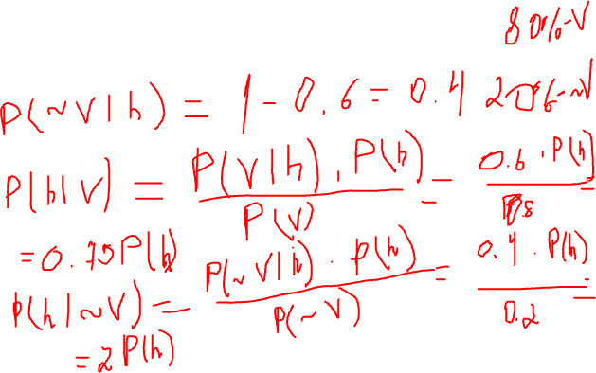
Exercise
In a state, 60% of the hospitalized patients are vaccinated.
P(v | h) = 0.6
What does this number tell you about the effectiveness of the vaccines in preventing hospitalizations?
Notes:
P(~v|h) = 0.4
P(h|v) = P(v|h)*P(h)/P(v)=0.6/0.8
P(h|~v) = P(~v|h)*P(h)/P(~v)=0.4/0.2

Slide 23
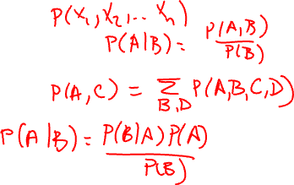
So Far
Definition of probability distributions
Random variables
Joint distribution
Conditional distribution
Chain rule
Summation rule
Bayes rule

Slide 24
Marginal Independence
An event α is independent of an event β in P, denoted as P╞ α ⊥ β, if
P(α|β) = P(α), or
P(β) = 0
Proposition: A distribution P satisfies α ⊥ β if and only if
P(α, β) = P(α) P(β)
Can you prove it?
Corollary: α ⊥ β implies β ⊥ α

Slide 25
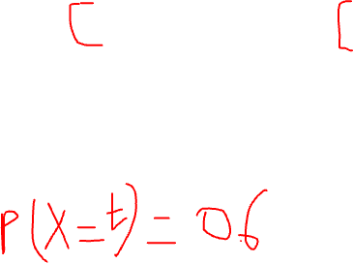

Marginal Independence
X | Y | P(X, Y)
t | t | 0.18
t | f | 0.42
f | t | 0.12
f | f | 0.28
Is X ⊥ Y?
Notes:
P(X=t) = 0.6
P(X=f) = 0.4
P(Y=t) = 0.3
P(Y=f) = 0.7

Slide 26
Conditional Independence
Two events are independent given another event
An event α is independent of event β given event γ in P, denoted as P╞ (α ⊥ β | γ), if
P(α|β, γ) = P(α| γ), or
P(β, γ) = 0
Proposition: A distribution P satisfies α ⊥ β | γ if and only if
P(α, β | γ) = P(α| γ) P(β| γ)
Notes:
Examples:
Traffic, John arrives late, Mary arrives late. J ind M | T
Height, Knowledge, Age. H ind K | A

Slide 27

Querying a distribution
Evidence (E=e): what is known, Query (Y): variables of interest, X is the set of all variables that include E, Y, and potentially others
Probability query
P(Y|e) = ?
MAP query
W = X \ E (i.e., all the non-evidence variables)
MAP(W|e) = argmax_{w}P(w,e)
Important: We cannot find w by finding the maximum likely value for each variable individually
Marginal MAP query
MAP(Y|e) = argmax_{y}P(y|e)
Let Z = X \ E∪Y
MAP(Y|e) = argmax_{y} ∑_{z}P(z, y|e)

Slide 28
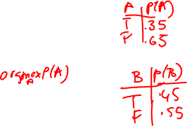
MAP Example
A | B | P(A, B)
t | t | 0.10
t | f | 0.25
f | t | 0.35
f | f | 0.30
Maximum likely assignment for A =
f
Maximum likely assignment for B =
f
MAP (A,B) =
<A=f, B=t>

Slide 29
Continuous Spaces
Assume X is continuous and Val(X) = [0,1]
If you would like to assign the same probability to all real numbers in [0, 1], what is, for e.g., P(X=0.5) = ?
Answer: P(X=0.5) = 0.

Slide 30
Probability Density Function
We define probability density function, p(x), a non-negative integrable function, such that

Slide 31
Uniform Distribution
A variable X has a uniform distribution over [a,b] if it has the PDF
Check and make sure that p(x) integrates to 1.

Slide 32
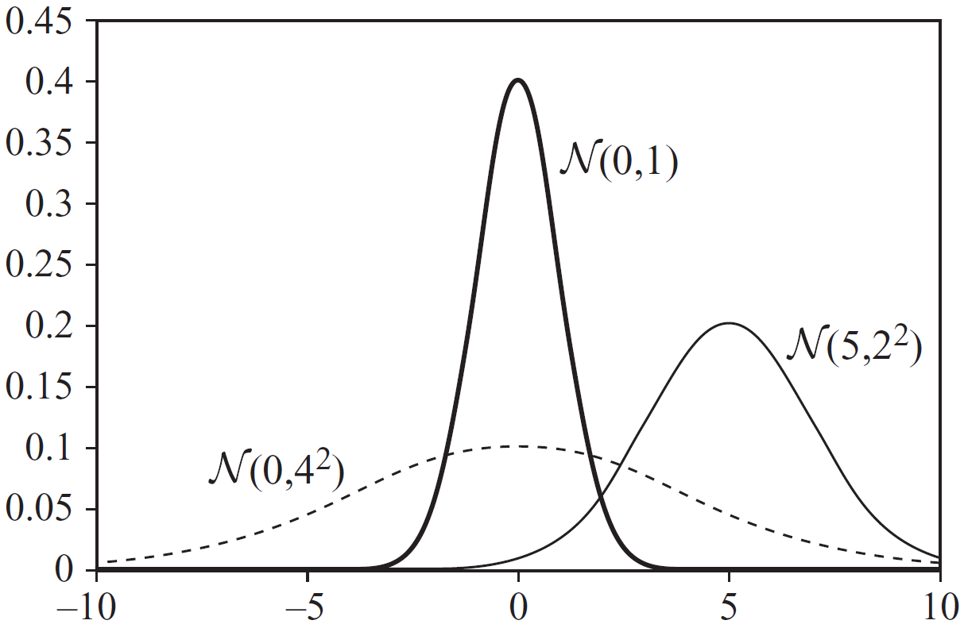
Gaussian Distribution
A variable X has a Gaussian distribution with mean μ and variance σ², if it has the PDF
Can p(x) be ever greater than 1?

Slide 33
Conditional Probability
We want P(Y|X=x) where X is continuous, Y is discrete
P(Y|X=x) = P(Y,X=x) / P(X=x)
What’s wrong with this expression?
Instead, we use the following expression

Slide 34
Conditional Probability
We want p(Y|X) where X is discrete, Y is continuous
How would you represent it?

Slide 35
Expectation
What about E[X*Y]?
Notes:
E[X*Y] = E[X] * E[Y] iff X and Y are independent

Slide 36
Variance
Can you derive the second expression using the first expression?
What is Var[X+Y]?
Notes:
Var[X+Y] = Var[X] + Var[Y] iff X and Y are independent

Slide 37
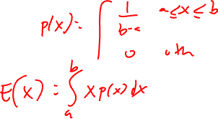
Uniform and Gaussian Distribution
If X∼N(μ,σ²), then E[X] = μ, Var[X] = σ²
What about the expectation and variance of a uniform distribution?

Slide 38
Next
Bayesian networks

