Slide 1
CS583 Probabilistic Graphical Models
Lecture 2. Bayesian Networks. Part 1
Oleksandr Narykov
onarykov@iit.edu

Slide 2
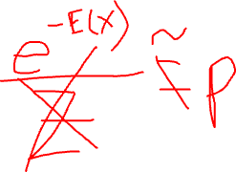
Querying a distribution
Evidence (E=e): what is known, Query (Y): variables of interest, X is the set of all variables that include E, Y, and potentially others
Probability query
P(Y|e) = ?
MAP query
W = X \ E (i.e., all the non-evidence variables)
MAP(W|e) = argmax_{w}P(w,e)
Important: We cannot find w by finding the maximum likely value for each variable individually
Marginal MAP query
MAP(Y|e) = argmax_{y}P(y|e)
Let Z = X \ E∪Y
MAP(Y|e) = argmax_{y} ∑_{z}P(z, y|e)

Slide 3
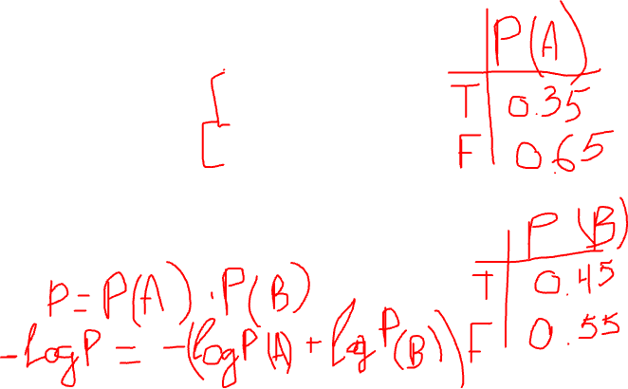
MAP Example
A | B | P(A, B)
t | t | 0.10
t | f | 0.25
f | t | 0.35
f | f | 0.30
Maximum likely assignment for A =
f
Maximum likely assignment for B =
f
MAP (A,B) =
<A=f, B=t>

Slide 4
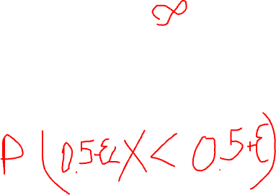
Continuous Spaces
Assume X is continuous and Val(X) = [0,1]
If you would like to assign the same probability to all real numbers in [0, 1], what is, for e.g., P(X=0.5) = ?
Answer: P(X=0.5) = 0.

Slide 5
Probability Density Function
We define probability density function, p(x), a non-negative integrable function, such that

Slide 6
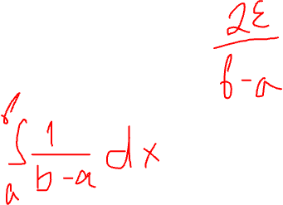
Uniform Distribution
A variable X has a uniform distribution over [a,b] if it has the PDF
Check and make sure that p(x) integrates to 1.

Slide 7
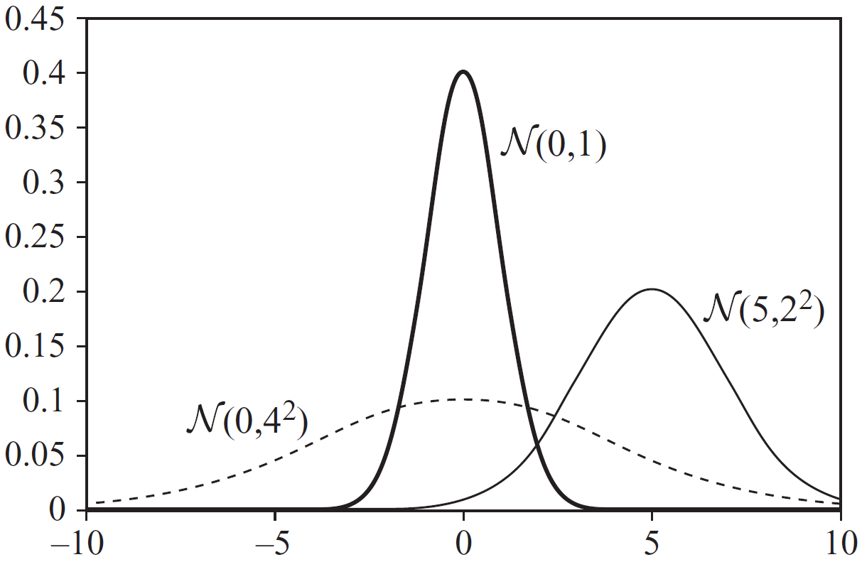
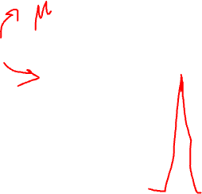
Gaussian Distribution
A variable X has a Gaussian distribution with mean μ and variance σ², if it has the PDF
Can p(x) be ever greater than 1?

Slide 8
Conditional Probability
We want P(Y|X=x) where X is continuous, Y is discrete
P(Y|X=x) = P(Y,X=x) / P(X=x)
What’s wrong with this expression?
Instead, we use the following expression

Slide 9
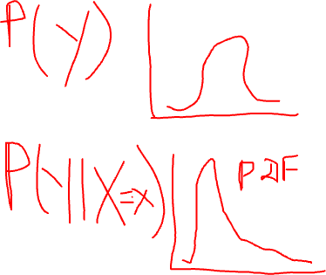
Conditional Probability
We want p(Y|X) where X is discrete, Y is continuous
How would you represent it?

Slide 10
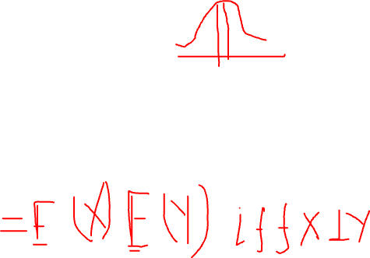
Expectation
What about E[X*Y]?
Notes:
E[X*Y] = E[X] * E[Y] iff X and Y are independent

Slide 11
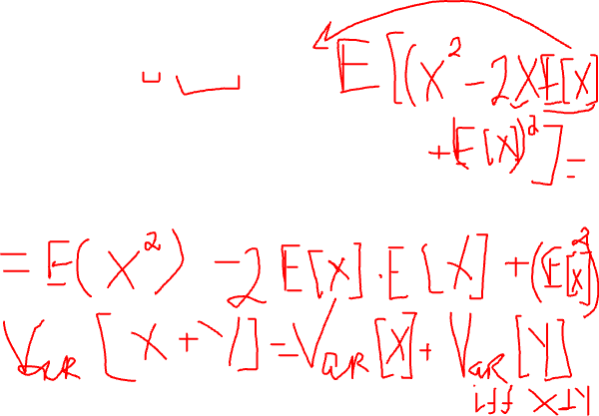
Variance
Can you derive the second expression using the first expression?
What is Var[X+Y]?
Notes:
Var[X+Y] = Var[X] + Var[Y] iff X and Y are independent

Slide 12
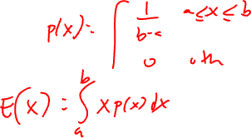
Uniform and Gaussian Distribution
If X∼N(μ,σ²), then E[X] = μ, Var[X] = σ²
What about the expectation and variance of a uniform distribution?

Slide 13
So Far
Definition of probability distributions
Random variables
Joint distribution
Conditional distribution
Chain rule
Summation rule
Bayes rule
Expectation
Variance

Slide 14
Graphs

Slide 15
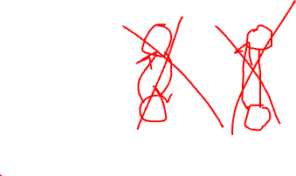
Graphs
A graph consists of nodes and edges
Nodes: X={X₁, X₂, …, X_{n}}
Undirected Edge: X_{i} – X_{j}
Directed Edge: X_{i} → X_{j}
Between a pair of nodes, at most one type of edge exists
We cannot have X_{i} → X_{j} and X_{j} → X_{i} at the same time, and
We cannot have X_{i} → X_{j} and X_{i} – X_{j} at the same time
Some edge: X_{i}  X_{j}

Slide 16
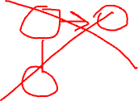
Directed and undirected
A graph is directed if its all edges are directed
A graph is undirected if its all edges are undirected

Slide 17
Relationships
X_{i} → X_{j}
X_{i} is the parent
X_{j} is the child
X_{i} – X_{j}
X_{i} and X_{j} are neighbors
X_{i}  X_{j}
X_{i} and X_{j} are adjacent
Degree of X_{i}: The number of edges X_{i} is part of
Indegree of X_{i}: The number of directed edges pointing to X_{i}
Degree of a graph: The maximal degree of a node in the graph

Slide 18
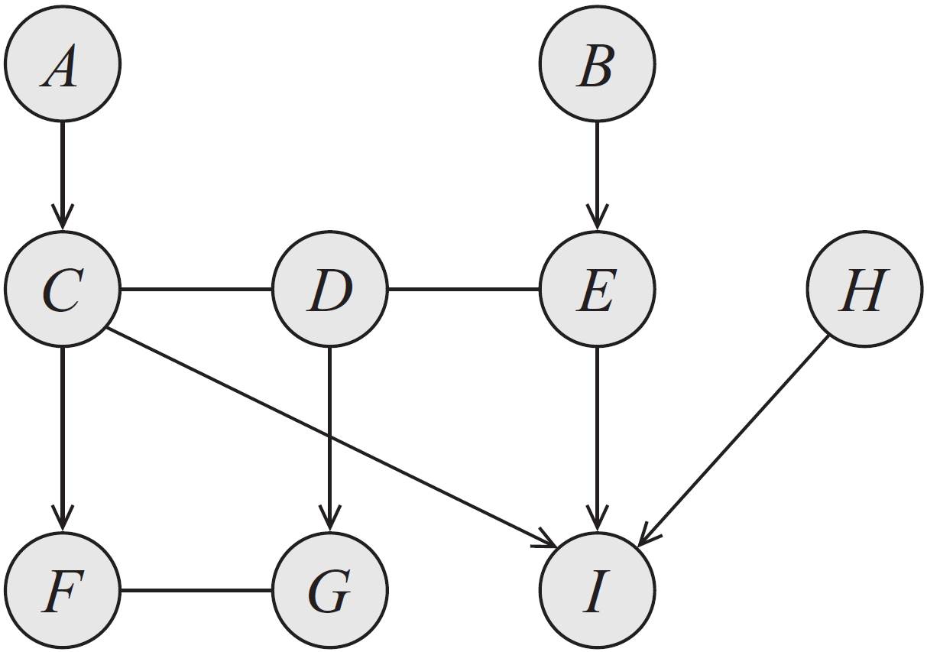

Example
Examples of:
Parents
Children
Neighbors
Adjacent nodes
Degree
Indegree
Notes:
Parents, children, neighbors, adjacent nodes, degree, indegree

Slide 19
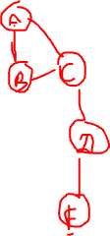
Complete Graphs and Cliques
A subgraph over X⊆X is complete if every two nodes in X are connected by some edge
Such a set X is also called a clique
A clique is maximal if for any superset of nodes Y⊃X, Y is not a clique

Slide 20
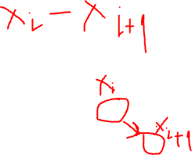
Paths and Trails
X₁, X₂, …, X_{k} forms a path if, for every i =1, 2, …, k-1, we have that either X_{i} – X_{i+1} or X_{i} → X_{i+1}.
A path is directed if, for at least one i, X_{i} → X_{i+1}.
X₁, X₂, …, X_{k} forms a trail if, for every i =1, 2, …, k-1, we have X_{i}  X_{i+1}.
What is the difference between a path and a trail? Is every path also a trail? Is every trail also a path?

Slide 21
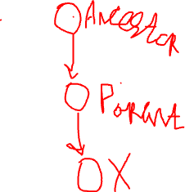
Ancestors and descendants
X_{i} is an ancestor of X_{j} if there is a directed path from X_{i} to X_{j}
X_{i} is a descendant of X_{j} if there is a directed path from X_{j} to X_{i}
Nondescendants(X_{i}) ≡ X \ Descendants(X_{i})

Slide 22
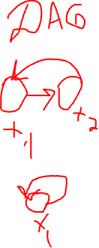
Cycles and Loops
A cycle is a directed path from a node to itself
A graph is acyclic if it contains no cycles
A directed acyclic graph is the one where all edges are directed and there are no cycles
A loop is a trail from a node to itself
A graph is singly-connected if it contains no loops

Slide 23
Bayesian Networks

Slide 24

Motivation
We would like to represent a joint distribution P over X = {X₁, X₂, …, X_{n}}
Why is such a P useful?
The naïve representation ⇒ Specify a value for each possible combination
If all X_{i} are binary, how many numbers are needed to represent P with 1000 variables?
How many atoms in the observable universe?
Notes:
2^N
log(2) = 0.30103
Log(2^1000) = 301.03
2^1000 = 10^301.03
The number of atoms in the observable universe is estimated to be 10^80.
2^x = 10^80
x = 80/0.30103 = 265.75
Using all the atoms in the observable universe, we can represent a joint distribution of only 266 variables.

Slide 25
Why is 2^{n} bad?
Computational challenges
Answering queries requires manipulating exponential number of entries
Storing exponential number of entries is almost always impossible
Cognitive challenges
How can we wrap our minds around about a specific assignment and its corresponding, extremely small, probability?
How can an expert provide those numbers or even verify they are correct?
Statistical challenges
We often would like to estimate probabilities from data; estimation requires repetition. How can we have a dataset where an exponential number of events are present and repeated multiple times?

Slide 26
We would like to have a representation that is
Compact
Easy to store, manipulate, understand, and estimate
Intuitive
Easy to understand, verify, and construct
Modular
Easy to add and remove variables
Declarative
Separates representation and reasoning

Slide 27
Compactness
A joint distribution P over X = {X₁, X₂, …, X_{n}} requires exponential number of numbers
Reduce the number of parameters through independence
Marginal independence
Conditional independence

Slide 28
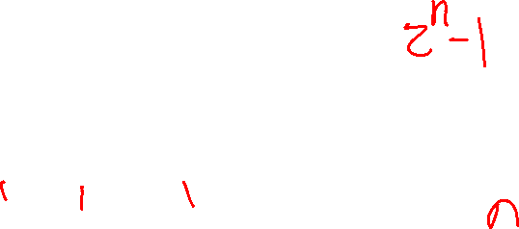
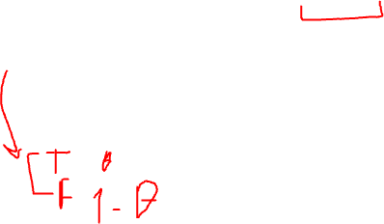
Marginal Independence
Represent a joint distribution P over X = {X₁, X₂, …, X_{n}}, where all X_{i} are binary
How many independent parameters?
Assume for ∀i≠j, X_{i} ⊥ X_{j}
P(X) = P(X₁)P(X₂)…P(X_{n})
Now, how many independent parameters?

Slide 29
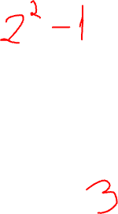
Conditional Probabilities
Two variables, Industrious (I) and SAT score (S)
Industrious: false (i⁰), true (i¹)
SAT score: low (s⁰), high (s¹)
I | S | P(I, S)
i⁰ | s⁰ | 0.665
i⁰ | s¹ | 0.035
i¹ | s⁰ | 0.06
i¹ | s¹ | 0.24
What’s the number of independent parameters needed?
Notes:
3 independent parameters

Slide 30
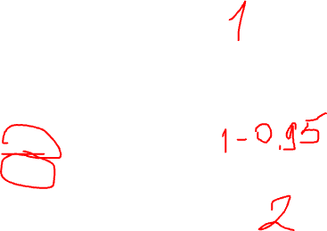
Conditional Probabilities
P(I, S) = P(I)P(S|I)
P(I)
i⁰ | i¹
0.7 | 0.3
P(S|I)
I | s⁰ | s¹
i⁰ | 0.95 | 0.05
i¹ | 0.2 | 0.8
What’s the number of independent parameters needed?
Notes:
3 independent parameters

Slide 31

A new variable
Let’s add the variable grade (G), with three possible values, A (g¹), B (g²), and C (g³).
Can we assume that G is independent of I or S in real life?
A more reasonable assumption is to assume that I determines S and G; that is, S and G are conditionally independent
This is not totally true either, but then, in the real-world, we cannot really assume anything is independent of anything
Butterfly effect?

Slide 32
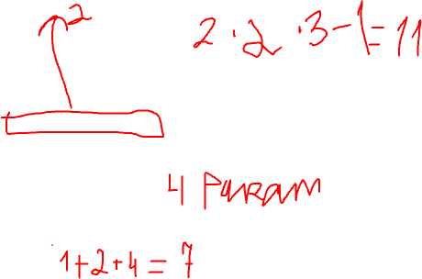
Conditional independence
P(I, S, G) = P(S, G|I)P(I) = P(S|I)P(G|I)P(I)
P(I, S, G) = P(I)P(S|I) P(G|S, I) = P(I)P(S|I) P(G|I)
We already have P(I) and P(S|I). We need to specify P(G|I)
P(G|I)
I | g¹ | g² | g³
i⁰ | 0.2 | 0.34 | 0.46
i¹ | 0.74 | 0.17 | 0.09
What’s the number of independent parameters needed for P(I, S, G) if we use the full joint table?
What if we use the factorization P(I, S, G) = P(I)P(S|I) P(G|I)?

Slide 33
Conditional independencies
Compactness
Fewer parameters to specify
Intuition
Easier to specify
Modularity
Adding a new variable does not cause us to change all the entries in the joint table

Slide 34
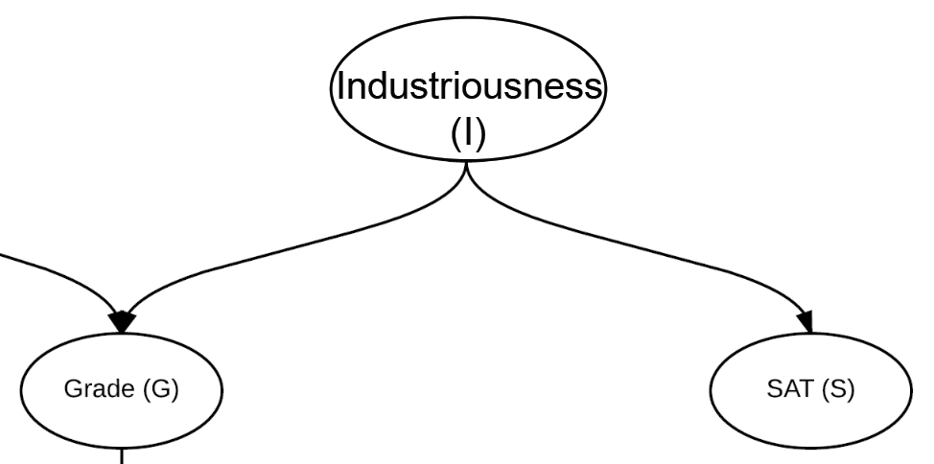

Bayesian network representation

Slide 35
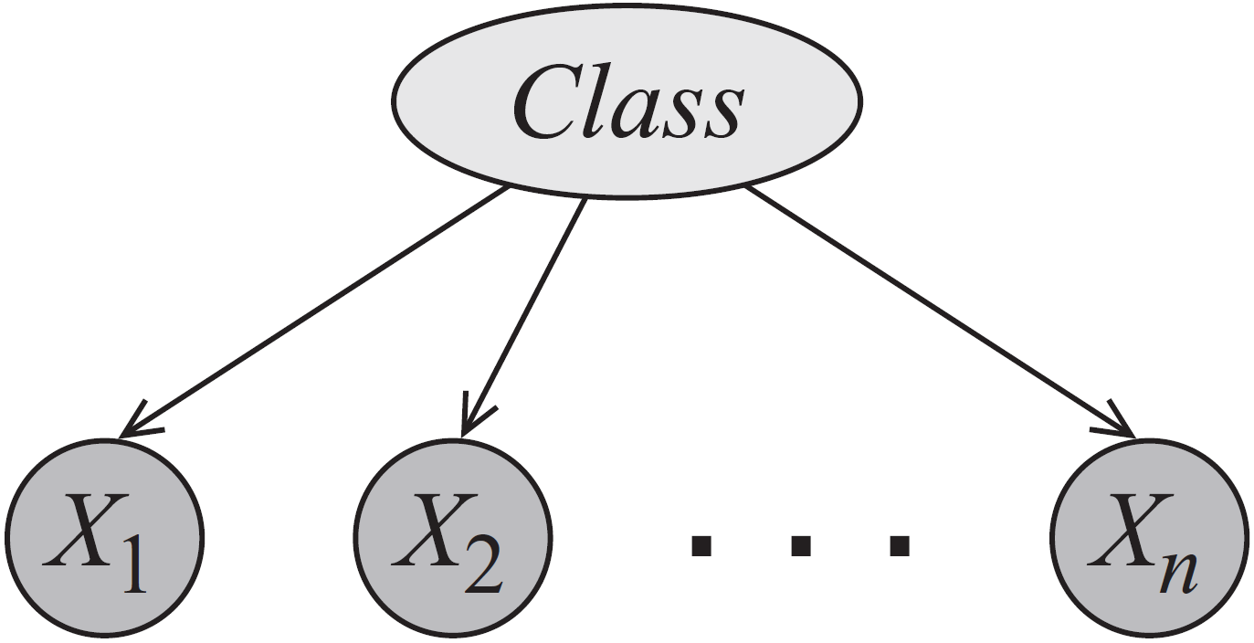
Naïve Bayes

Slide 36
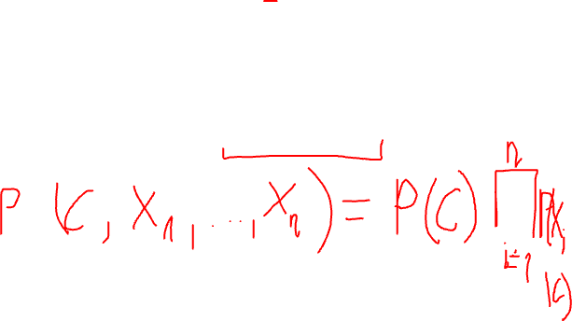
Naïve Bayes
How do we write the joint P(C, X₁, X₂, …, X_{n})?
How many independent parameters are needed if C and X_{i} are all binary?
Naïve Bayes is used for classification: given attributes of an object (X_{i}), classify it into one of pre-given categories (C) (i.e., P(C|X₁, …, X_{n}).
Notes:
P(C, X1, …, Xn) = P(C) prod P(Xi | C)

Slide 37

Bayesian Networks
A Bayesian Network is a directed acyclic graph whose nodes are random variables and edges represent, intuitively, the direct influence of one node on another
Naïve Bayes is a special Bayesian network
Bayesian networks is
A data structure that provides the skeleton for representing a joint distribution compactly in a factorized way
A compact representation for a set of conditional independence assumptions about a distribution

Slide 38
The student example
So far we have I, S, G
We add two more random variables
Student’s grade also depends on the difficulty (D) of the class: Val(D) = {easy(d⁰), hard(d¹)}
Student’s professor writes a recommendation letter (L), where Val(L)={weak (l⁰), strong(l¹)}
Professor writes the letter based only the grade and it is a stochastic function of the grade

Slide 39
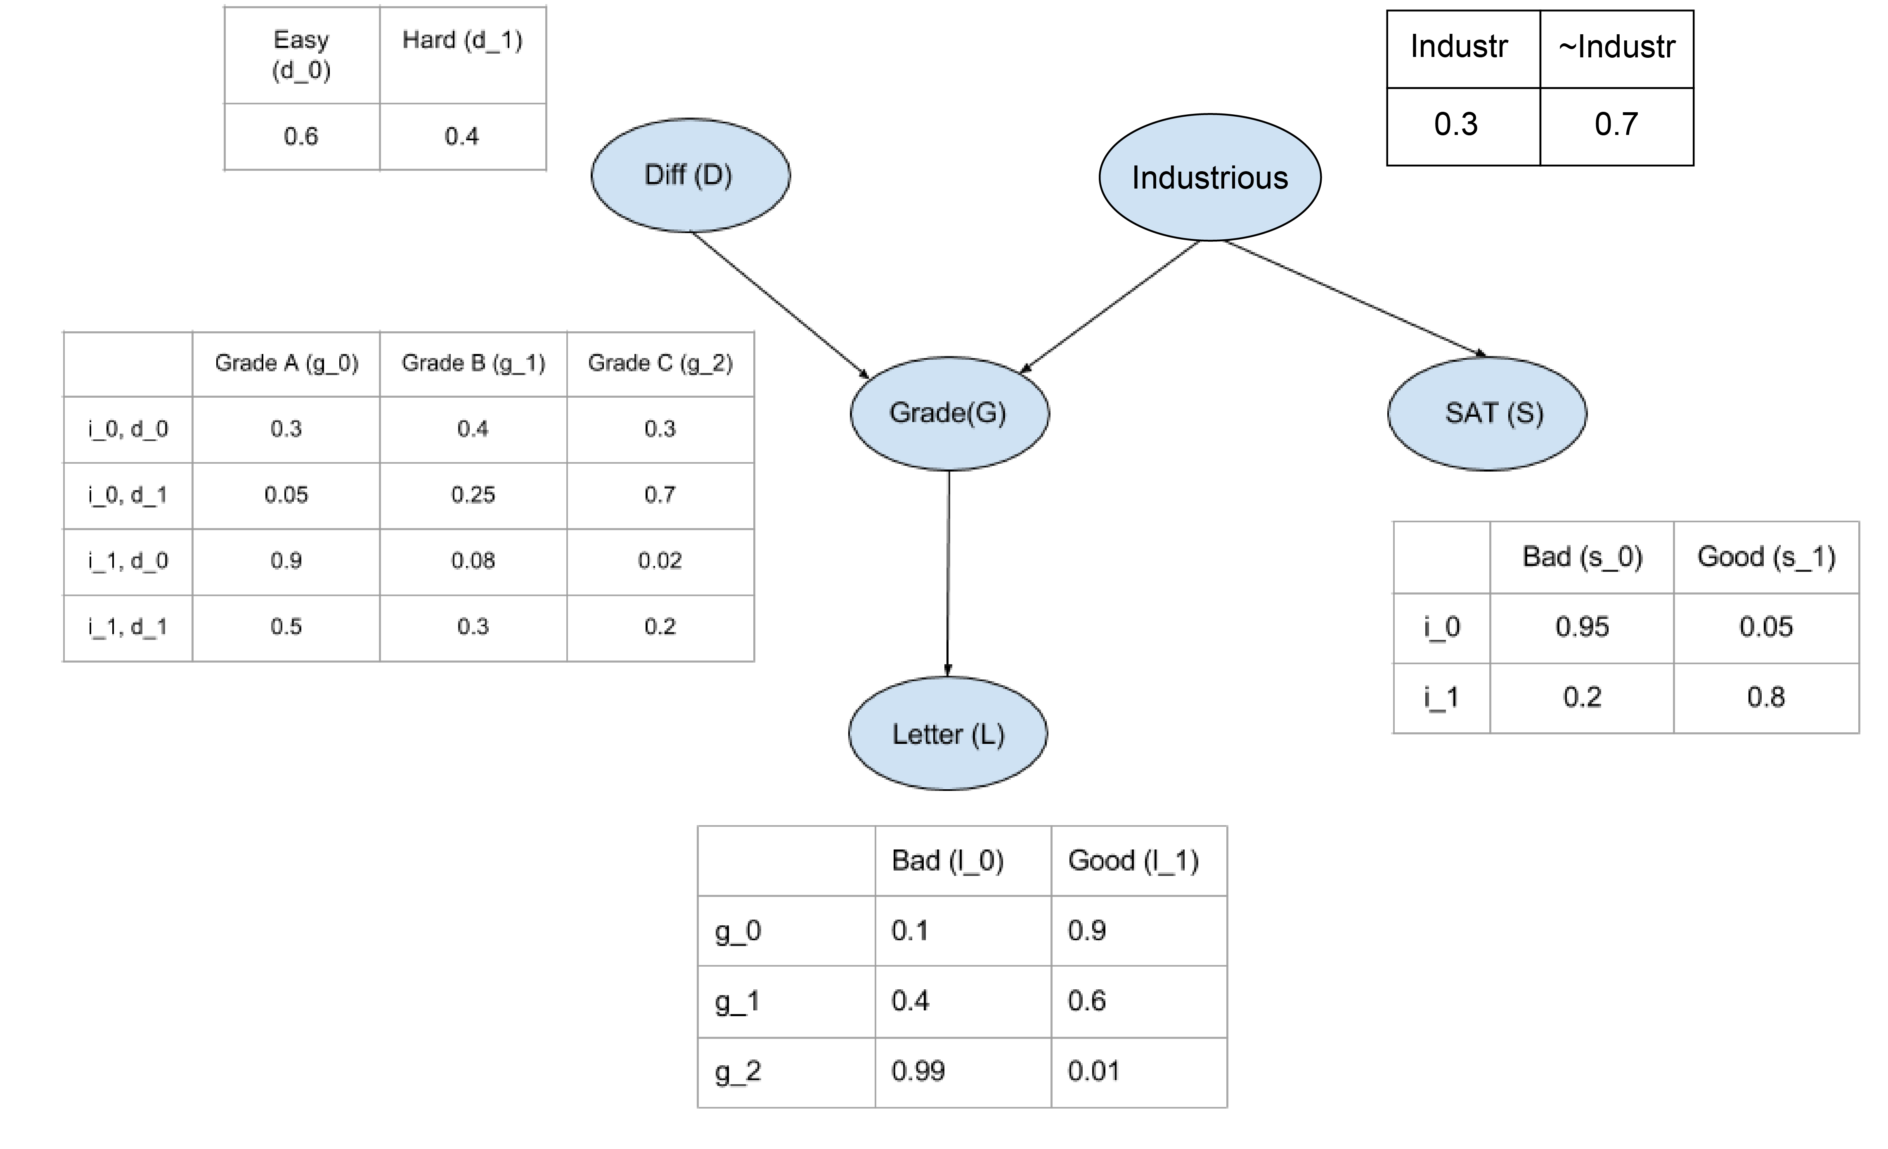

The student network
1. The structure
i¹, d⁰
i¹, d¹
2. Parameters:
Local probability model
Conditional probability distribution
g³
How many parameters?

Slide 40
Python Libraries
Install Python package:
Install and play with the pgmpy Python package https://github.com/pgmpy/pgmpy
Check your environment by using example notebooks: https://github.com/pgmpy/pgmpy_notebook/tree/master/notebooks

