Slide 1
CS583 Probabilistic Graphical Models
Lecture 9. Inference
Oleksandr Narykov
onarykov@iit.edu

Slide 2
Inference. Variable Elimination

Slide 3
Task
Given a graphical model over X (structure and parameters)
Compute P(Y | e), where Y ⊆ X and E ⊆ X
There are several approaches
Exact inference
Variable elimination
Belief propagation
Approximate inference
Sampling
This slide deck: variable elimination

Slide 4
Variable elimination
P(Y | e) = P(Y, e) / P(e)
W = X – Y – E
P(y, e) = Σ_{w}P(y, e, w)
P(e) = Σ_{y},_{w}P(y, e, w)
Or, better yet: P(e) = Σ_{y}P(y, e)

Slide 5
P(y, e) = Σ_{w}P(y, e, w)
P(Y, E, W) can be represented as
∏ P(X_{i} | Pa(X_{i}))
1/Z ∏ φ(D_{i})
The problem with P(y, e) = Σ_{w}P(y, e, w) is that the joint representation is exponential
The very first problem we were trying to avoid

Slide 6
Complexity
Unfortunately, exact inference is NP-hard in worst case
Proof: pages 288 and 289. Reduction from 3-SAT
Approximate inference is also NP-hard in worst case
Proof: pages 291 and 292.
Good news:
In general, we care about the cases we encounter in practice; not the worst-case scenario

Slide 7
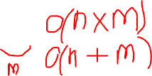
Key idea
Summation can be moved inside
Σ_{x}Σ_{y} x*y = Σ_{x}x*(Σ_{y} y)
If x has n and y has m possible values, how many operations are needed, if we use
Σ_{x}Σ_{y} x*y ?
Σ_{x}x*(Σ_{y} y) ?

Slide 8
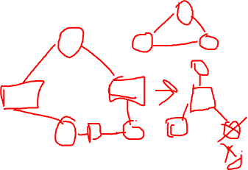
Variable elimination
X: all variables, Y: query variables, E: evidence variables, W = X – Y – E: remaining variables
Write down the joint for P(X)
Set X_{i} ∈ E to their values
Pick an order for X_{j} ∈ W
Sum out each X_{j} from the joint
Multiply the factors φ(X_{j}, Z₁), …, φ(X_{j}, Z_{k}) to create ψ(X_{j}, Z₁,…, Z_{k})
Sum out X_{j} from ψ(X_{j}, Z₁,…, Z_{k}) to create τ(Z₁,…, Z_{k})
What remains is τ(Y, e). Normalize it to get P(Y | e).

Slide 9
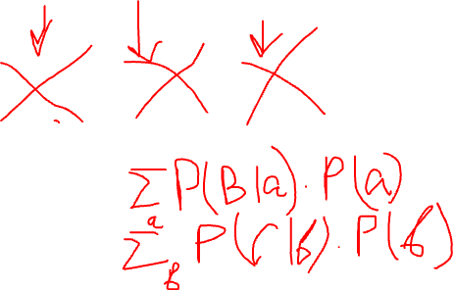
Chain Example
A
B
C
D
P(B) = ?
P(C) = ?
P(D) = ?
Notes:
N x M
N + M

Slide 10
Elimination as graph transformation
Eliminating X
Multiply all the factors X participates in
Sum out X
Graph transformation (need to be moralized first)
Connect all of X’s neighbors
Remove X

Slide 11

Representation
P(D)
P(I)
D
I
D
I
D
I
P(G|D,I)
P(S|I)
G
S
G
S
G
S
P(L|G)
L
L
L

Slide 12
If we first eliminate i then s
P(D)
P(I)
P(D)
P(D)
D
I
D
D
P(G|D,I)
P(S|I)
τ₁(G,D,S)
τ₂(G,D)
G
S
G
S
G
P(L|G)
P(L|G)
P(L|G)
L
L
L

Slide 13
If we first eliminate s then i
P(D)
P(I)
P(D)
P(I)
P(D)
D
I
D
I
D
P(G|D,I)
P(S|I)
P(G|D,I)
τ₁(I)
τ₂(G,D)
G
S
G
G
P(L|G)
P(L|G)
P(L|G)
L
L
L

Slide 14
Finding good elimination orderings
Finding the best order is NP-hard
Best = optimal time and space complexity
Heuristics
Min-neighbors
Min-fill
Weighted versions of min-neighbors and min-fill

Slide 15
Irrelevant nodes in BNs
X: all variables, Y: query variables, E: evidence variables, W = X – Y – E: remaining variables
A node X_{i}∈W is irrelevant for the query P(Y|e) if it can be removed from the network without effecting the value of P(Y|e)
Obvious:
If Z⊆W is d-separated from Y given E, then Z is irrelevant
Perhaps less obvious:
Let Z be ancestors of Y∪E. Then W \ Z is irrelevant

Slide 16
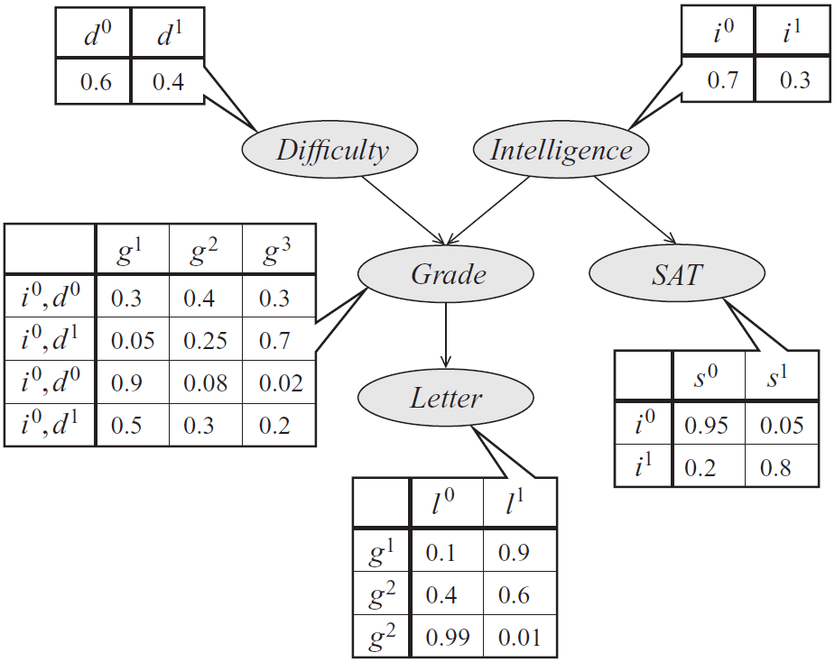
Student network example
P(D)
P(I)
P(S)
P(G)
P(L)
Industrious
i⁰, d⁰
i⁰, d¹
i¹, d⁰
i¹, d¹
g¹
g²
g³

Slide 17
Student network example
P(S | I=i⁰)
P(D | I=i⁰)
P(I | G=g¹)
P(D | G=g¹)
P(D | I=i⁰, G=g¹)
Industrious
i⁰, d⁰
i⁰, d¹
i¹, d⁰
i¹, d¹

Slide 18
P(L) – order: I, S, D, G
Variable | All Factors | Participates | New Factor After * | # *s | New Factor After + | # +s | # Ops
I | P(I), P(D), P(S|I), P(G|D,I), P(L|G) | P(I), P(S|I), P(G|D, I) | ψ₁(G,D,S,I) | 2*3*2*2*2=48 | τ₁(G,D,S) | 1*3*2*2=12 | 60
S | P(D), P(L|G), τ₁(G,D,S) | τ₁(G,D,S) | ψ₂(G,D,S) | 0 | τ₂(G,D) | 1*3*2=6 | 6
D | P(D), P(L|G), τ₂(G,D) | P(D), τ₂(G,D) | ψ₃(G,D) | 1*3*2=6 | τ₃(G) | 1*3 | 9
G | P(L|G), τ₃(G) | P(L|G), τ₃(G) | ψ₄(L,G) | 1*2*3=6 | τ₄(L) | 2*2=4 | 10
Normalize | τ₄(L) |  |  |  |  | 1 | 3 (2 divs)
Total |  |  |  |  |  |  | 88

Slide 19
P(L) – order: S, I, D, G
Variable | All Factors | Participates | New Factor After * | # *s | New Factor After + | # +s | # Ops
S | P(I), P(D), P(S|I), P(G|D,I), P(L|G) | P(S|I) | ψ₁(I,S) | 0 | τ₁(I) | 1*2=2 | 2
I | P(I), P(D), P(G|D,I), P(L|G) τ₁(I) | P(I), P(G|D,I), τ₁(I) | ψ₂(G,D,I) | 2*3*2*2=24 | τ₂(G,D) | 1*3*2=6 | 30
D | P(D), P(L|G), τ₂(G,D) | P(D), τ₂(G,D) | ψ₃(G,D) | 1*3*2=6 | τ₃(G) | 1*3 | 9
G | P(L|G), τ₃(G) | P(L|G), τ₃(G) | ψ₄(L,G) | 1*2*3=6 | τ₄(L) | 2*2=4 | 10
Normalize | τ₄(L) |  |  |  |  | 1 | 3 (2 divs)
Total |  |  |  |  |  |  | 54

Slide 20
Querying a distribution
All variables: X, evidence variables: E
Probability query
P(Y|e)
MAP query
W = X \ E (i.e., all the non-evidence variables)
MAP|e = argmax_{w}P(w,e)
Marginal MAP query
MAP(Y|e) = argmax_{y}P(y|e)
Let Z = X \ E∪Y
MAP(Y|e) = argmax_{y} ∑_{z}P(z, y|e)

Slide 21
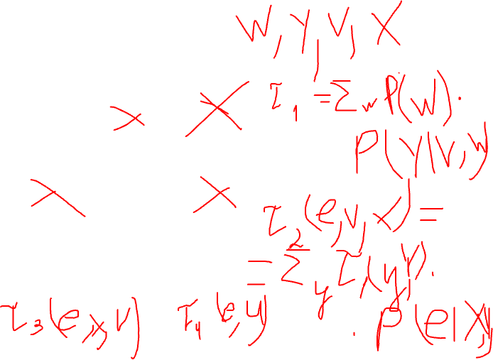
Query: P(U|e)
Factors: P(U), P(V), P(W)
U
V
W
P(X|U,V), P(Y|V,W)
P(e|X,Y)
X
Y
E
Notes:
Ordering: W, Y, V, X
F1(Y, V) = sum_w(P(w)*P*(Y|V,w)
F2(e, V, X) = sum_y( F1(y,V) * P(e|X,y) )
F3(e, X, U) = sum_v( P(v) * P(X|U,v)*F2(e,v,X) )
F4(e, U) = sum_x( e, x, U )
P(e, U) = P(U)*F4(e, U)
Renormalize to find P(U|e)

Slide 22
Variable elimination for MAP
Variable elimination works by multiplying and summing
It’s also called sum-product algorithm
We can use the same technique for MAP, if we replace the sum operator with a max operator
The algorithm is called max-product
A few differences
Sum is replaced with max
All variables (except evidence) are eliminated
We need to trace back our steps to find the MAP assignment

Slide 23
Examples
Two variables
Student network
Markov network

Slide 24
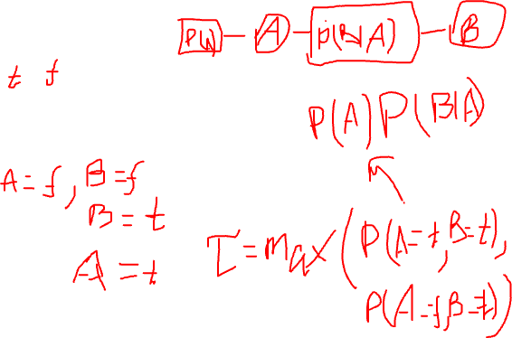
Two variables
Network
A → B
Parameters
P(A) = [0.4; 0.6]
P(B|A=t) = [0.8; 0.2]
P(B|A=f) = [0.3; 0.7]
MAP ?
MAP|A=t ?
MAP|B=t ?

Slide 25
MAP on the student network
MAP ?
MAP | G=g¹ ?
Industrious
i⁰, d⁰
i⁰, d¹
i¹, d⁰
i¹, d¹
g¹
g²
g³
Notes:
MAP: D=d1, I=i0, G=g3, L=l0, S=s0
MAP|G=g1: D=d0, I=i1, L=l1, S=s1

Slide 26
What if MAP is not unique?
Network
A → B
Parameters – I
P(A) = [0.5; 0.5]
P(B|A=t) = [0.4; 0.6]
P(B|A=f) = [0.6; 0.4]
Parameters – II
P(A) = [0.4; 0.6]
P(B|A=t) = [0.25; 0.75]
P(B|A=f) = [0.5; 0.5]

Slide 27
MAP on a Markov network
A | B | φ(A,B)
T | T | 5
T | F | 1
F | T | 1
F | F | 5
A | φ(A)
T | 2
F | 1
A
B
B | φ(B)
T | 1
F | 4
A | C | φ(A,C)
T | T | 6
T | F | 1
F | T | 1
F | F | 6
C
B | C | φ(B,C)
T | T | 1
T | F | 10
F | T | 10
F | F | 1
C | φ(C)
T | 1
F | 8

Slide 28
Complexity
All the arguments from the sum-product algorithm carry over
Same variable ordering heuristics can be applied
Message passing on a junction-tree structure can be done

Slide 29
Marginal Map
Marginal MAP query
MAP(Y|e) = argmax_{y}P(y|e)
Let Z = X \ E∪Y
MAP(Y|e) = argmax_{y} ∑_{z}P(z, y|e)
We need to sum out Z
Max-sum-product algorithm
First, eliminate Z using sum-product algorithm
Then, find MAP for Y using max-product algorithm
Unfortunately, max and sum cannot be interleaved
The variables are partitioned into three disjoint sets: E, Z, Y
This partitioning limits which orders we can choose, as we can order only within Z and within Y

