Slide 1
CS583 Probabilistic Graphical Models
Lecture 19. Sampling. Causal Inference
Oleksandr Narykov
onarykov@iit.edu

Slide 2
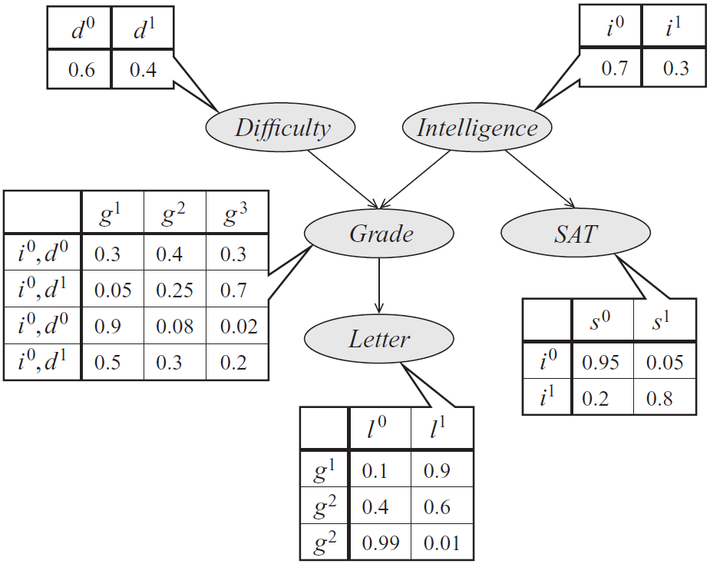
Forward sampling on the student network
D and I are ready.
Sample D from P(D): d⁰.
Only I is ready.
Sample I from P(I): i¹.
G and S are now ready.
Sample G from P(G|i¹,d⁰): g¹.
S and L are ready.
Sample S from P(S|i¹): s⁰.
L is ready.
Sample L from P(L|g¹): l⁰
The instance is <d⁰,i¹,s⁰,g¹,l⁰>
Repeat the process from step 1 M times.
Industrious
i⁰, d⁰
i⁰, d¹
i¹, d⁰
i¹, d¹
g¹
g²
g³

Slide 3
Forward sampling on the student network
The sampled data is
Iteration | D | I | S | G | L
1 | d⁰ | i¹ | s⁰ | g¹ | l⁰
… | … | … | … | … | …
M | … | … | … | … | …
P(D=d⁰) = # of rows with D=d⁰ / (# of rows with D=d⁰ + # of rows with D=d¹)

Slide 4
Conditional probability queries
P(y, e) and P(e) can be separately estimated
Then P(y | e) = P(y, e)/ P(e)
For this to work, both P(y, e) and P(e) need to be estimated with relative low error
If we estimate P(y, e) and P(e) with small absolute error, then P(y, e)/ P(e) can be arbitrarily off.

Slide 5
Where is the evidence?
If evidence is only at the root variables, it is easy; don’t sample those variables; just set them to their respective values
E.g., if E = {d¹, i⁰} in the student network, then don’t sample D and I. Just set D=d¹ and I=i⁰
If the evidence is at the intermediate or leaf nodes (e.g., if any of G, S, L is in the evidence)
Rejection sampling
Likelihood sampling

Slide 6
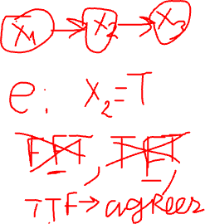
Rejection sampling
Given evidence e
Sample an instance x^{(i)} using forward sampling
If x^{(i)} and and e disagree, then reject the instance
To compute the conditional, use MLE
Count and normalize
Notes:
M*P(e) will be kept, M*(1-P(e)) will be rejected.

Slide 7
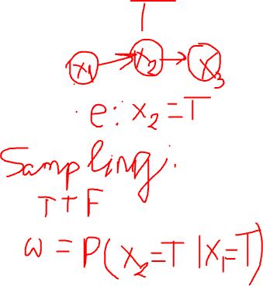
Likelihood weighting
Sample like forward sampling, except
When a variable is in the evidence set,
Set its value to evidence value
Each instance has a weight
w = Π_{v∈e}P(v|Pa(v))
Counts are now weighted by each instance’s weight
If evidence is unlikely, the rejection rate will be high

Slide 8
Likelihood weighting on a chain
Network
A → B
Parameters
P(A) = [p; 1-p]
P(B|A=t) = [q; 1-q]
P(B|A=f) = [r; 1-r]
P(A|B=t) = ?

Slide 9
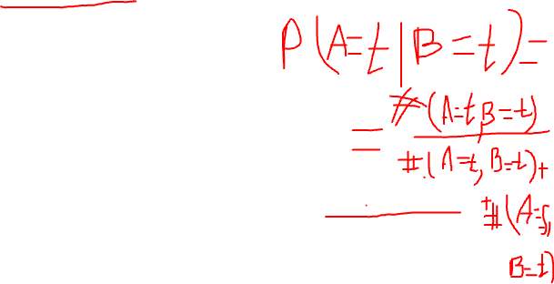
P(A|B=t)
Exact inference
P(A=t|B=t) =
P(A=t, B=t) / P(B=t)
P(A=t)P(B=t|A=t) / Σ_{A} P(A)P(B=t|A)
p*q / (p*q + (1-p)*r)
Likelihood weighting
Sample M instances
Sample A randomly from [p, 1-p]
Set B=t
The weight of the instance i is
If A=t, w_{i}=P(B=t|A=t)=q, else w_{i}=P(B=t|A=f)=r
Out of M instances
Approximately p*M have A=t and each has weight q
Approximately (1-p)*M have A=f and each has weight r
P(A=t|B=t) = p*M*q / (p*M*q + (1-p)*M*r) = p*q / (p*q + (1-p)*r)

Slide 10
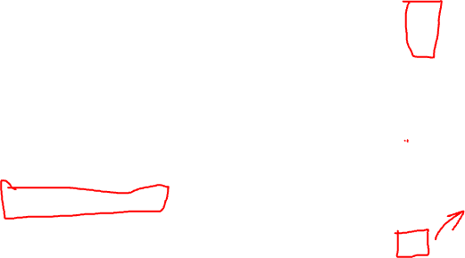
Likelihood weighting on the student network
Assume S=s¹
w=1
D and I are ready.
Sample D from P(D): d⁰.
I is ready.
Sample I from P(I): i¹.
G and S are now ready.
Sample G from P(G|i¹,d⁰): g¹.
S and L are ready.
Set S=s1
w=w*P(s¹|i¹)
L is ready.
Sample L from P(L|g¹): l⁰
The instance is <d⁰,i¹,s1,g¹,l⁰> and its weight is w
Repeat the process from step 1 M times.
Industrious
i⁰, d⁰
i⁰, d¹
i¹, d⁰
i¹, d¹
g¹
g²
g³

Slide 11
Gibbs sampling
Works for both
Bayesian and Markov networks
With and without evidence
Huge body of work on it
More details can be found at Chapter 12 Section 3

Slide 12
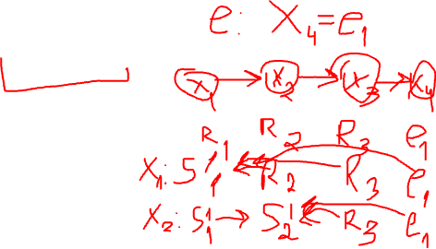
Gibbs sampling
All variables: X, evidence variables: E, variables of interest: Y ⊆ X \ E
Set evidence variables E to their values e
Initialize the remaining variables X \ E somehow (random is (probably) OK)
For each variable X_{i} ∈ X \ E
Sample X_{i} using P(X_{i}| X \ X_{i})
Discard the first N instances
Use the last M instances to compute P(Y|e)

Slide 13
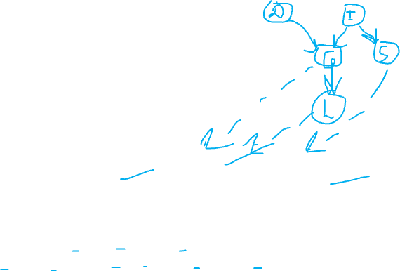
P(X_{i} | X \ X_{i})
P(I|D=d⁰, G=g², L=l¹, S=s¹) = ?

Slide 14
P(X_{i} | X \ X_{i})
Multiply all the factors that include X_{i} using the most recently sampled (or evidence) values for the remaining variables
Normalize it
The approach works for both Bayesian and Markov networks

Slide 15

Markov Chain Monte Carlo
Instead of building a sample from scratch, take the last generated sample
Resample one variable at a time, conditioned on the rest of the variables
Samples are not independent, but their average is still a consistent estimator
Key feature: both upstream and downstream variables conditioned on evidence
Notes:
P(A|B=T,C=T) prop f(A)*f(A,B=T)*f(A,C=T)
A=T => 2*5*6 = 60
A=F => 1*1*1 = 1
P(A=T|B=T,C=T) = 60/61

Slide 16
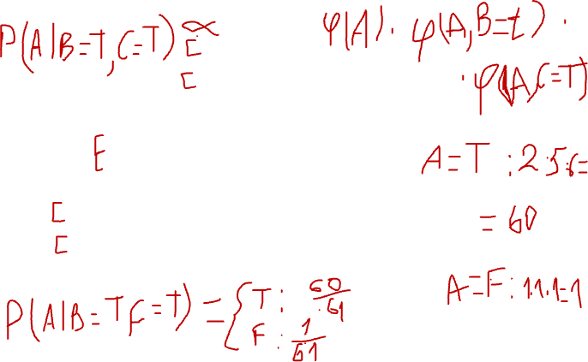
Markov network example
A | B | φ(A,B)
T | T | 5
T | F | 1
F | T | 1
F | F | 5
A | φ(A)
T | 2
F | 1
A
B
B | φ(B)
T | 1
F | 4
A | C | φ(A,C)
T | T | 6
T | F | 1
F | T | 1
F | F | 6
C
B | C | φ(B,C)
T | T | 1
T | F | 10
F | T | 10
F | F | 1
C | φ(C)
T | 1
F | 8
Start with random values: A=F, B=T, C=T.
Sample A. Which distribution do we sample A from?
Notes:
P(A|B=T,C=T) prop f(A)*f(A,B=T)*f(A,C=T)
A=T => 2*5*6 = 60
A=F => 1*1*1 = 1
P(A=T|B=T,C=T) = 60/61

Slide 17
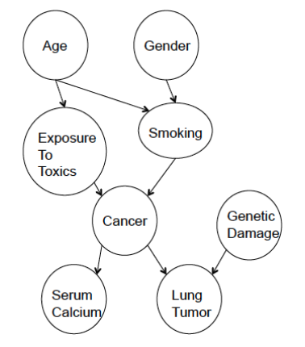
Causal Bayesian Networks

Slide 18
Causal Bayesian Networks
BNs are not necessarily causal
BN is only an efficient representation of a joint distribution in terms of conditional distributions
Several different BNs can represent the same distribution– equivalence class
A
D
C
F
B
E

Slide 19
Causal Bayesian Networks
A causal model is a DAG G with vertices X₁, . . . , X_{N} representing events
Almost like a BN. However, paths are causal.
A causes B only if A is an ancestor of B in G
A → B means A is a direct cause of B.
Wrong causal assumptions ⇒ wrong conclusions
A
D
C
F
B
E

Slide 20
Causal Bayesian Networks
A and B are causally independent
C, D, E, and F are causally dependent on A and B
A and B are direct causes of C
A and B are indirect causes of D, E and F
If C is prevented from changing with A and B, then A and B will no longer cause changes in D, E and F
A
D
C
F
B
E

Slide 21
Correlation Does Not Imply Causation
A
C
C – ice cream sales
B – temperature
A – shark attacks
B

Slide 22
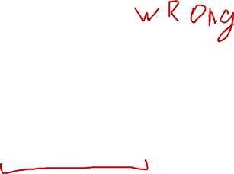
Probabilistic causality
Deterministic causation
If A causes B, then A must always be followed by B.
Smoking does not cause cancer.
Probabilistic causation
A probabilistically causes B if A's occurrence increases the probability of B
Smoking may cause cancer
Reflects either imperfect knowledge of a deterministic system or system under study is inherently probabilistic, such as quantum mechanics

Slide 23
Interventions
A
Do operator
P(A|do (C=low)) = ?
C
B
C – ice cream sales
B – temperature
A – shark attacks

Slide 24
Randomized Controlled Trials
Genetics
Treatment
?
Disease
Drug vs Placebo
Need to be able to measure genetics
Difficult to avoid bias

Slide 25
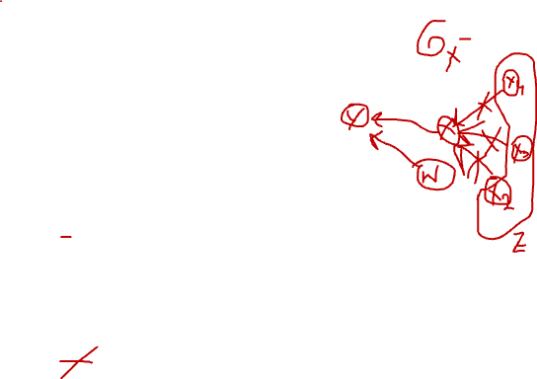
Do-calculus
X, Y , Z, W - disjoint sets of events (sets of nodes); may be empty
G_{X¯} the graph with all edges into X removed.
G _{¯X} the graph with all edges out of X removed.
Z(X) subset of nodes in Z which are not ancestors of X.
W – subset of witness nodes
y; do(x) shorthand for Y = y; respectively do(X = x).
1. Ignoring observations:
P(y | do(x), z,w) = P(y | do(x),w) if (Y ⊥ Z | X, W ) in G_{X¯}
2. Action/observation exchange: the back-door criterion. Decide if we can treat an intervention as an observation
P(y | do(x), do(z),w) = P(y | do(x), z,w) if (Y ⊥ Z | X, W ) in G_{X¯,Z}
3. Ignoring actions:
P(y | do(x), do(z),w) = P(y | do(x),w) if (Y ⊥ Z | X, W ) in G_{X¯,Z(W)}

Slide 26
Examples
Rule 3
P( A = hi | do(C = low) ) = P(A = hi)
A
C
B
C – ice cream sales
B – temperature
A – shark attacks

Slide 27
Examples
Rule 3
P( A = hi | do(C = low) ) = P(A = hi)
A
C
Rule 2
P( B = low | do(C = low) ) = P(B = low|C = low)
B
C – ice cream sales
B – temperature
A – shark attacks

Slide 28
Inference with Causal Models
Probabilistic Queries
Similar to other PGMs
Intervention Queries
Ideal intervention with no other effect
If patient takes this medication what are chances of getting well?
P(H|do(M=m1)), where H=Health.
Which is different from P(H|m1) » Patients taking meds on their own are healthier 3.
Contra-factual Queries
Would the accident have happened if driver was not drunk?

