Slide 1
CS583 Probabilistic Graphical Models
Lecture 11. Template Models
Oleksandr Narykov
onarykov@iit.edu

Slide 2
Template-Based Models

Slide 3
Markov assumption
Is this a reasonable assumption?

Slide 4
Temporal models

Slide 5
Stationary
We still need to specify the CPD for all variables in X^{(0:T)}
A Markovian dynamic system is stationary (time-invariant, homogeneous) if P(X^{(t+1)}| X^{(t)}) is same for all t. Then, the process can be represented using a transition model:

Slide 6
Dynamic bayesian networks
Definition: A dynamic Bayesian network (DBN) is a pair <B₀,B→>, where B₀ is a Bayesian network over X⁽⁰⁾, representing the initial distribution over states, and B→ is a 2-time-slice Bayesian network for the process.

Slide 7
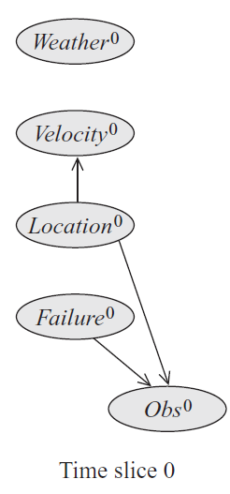
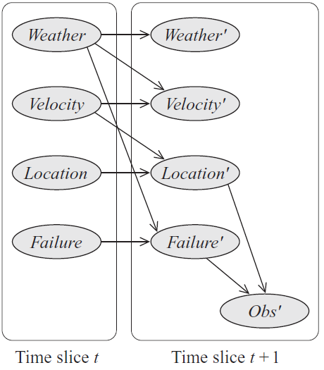
DBN example
B₀
B→

Slide 8
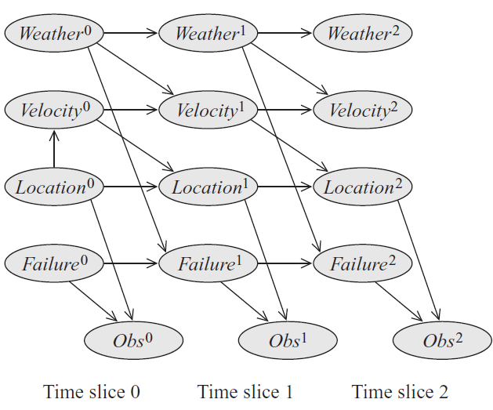
DBN example

Slide 9
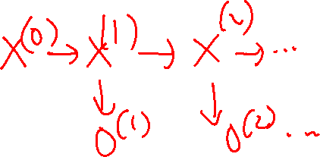
State observation models
System evolves on its own, with our observations occurring in a separate process
Our observations do not change the system
Observations are obtained from a noisy sensor
Two key assumptions
States are Markovian: X^{(t+1)} ⊥ X^{(0:t-1)} | X^{(t)}
Observations at t, O^{(t)}, are conditionally independent of the entire state sequence given the state at t, X^{(t)}:
O^{(t)} ⊥ X^{(0:(t-1))}, X^{(t+1:∞)} | X^{(t)}

Slide 10
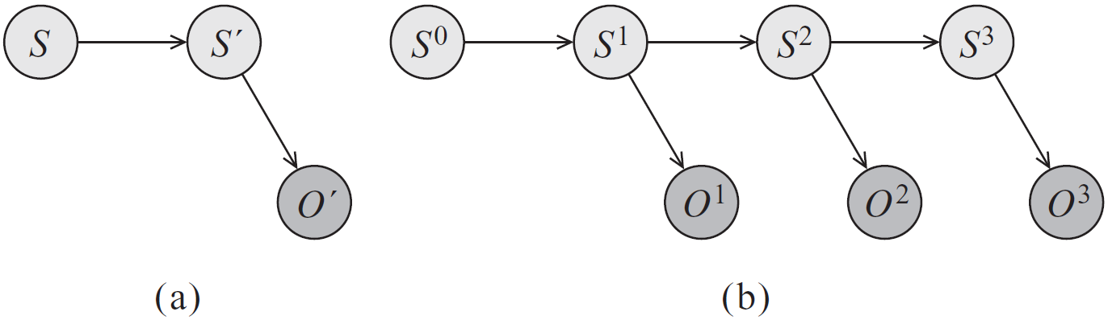
Hidden markov models
Notes:
P(S0)
P(S^t+1|S^t)
P(O^t|S^t)

Slide 11
Part-of-speech tagging
Task: Given a sentence, identify, for each word, the part of speech
E.g., noun, verb, adjective, adverb
Part-of-speech depends on the context
E.g., “can”: modal or noun?
Nearby words provide essential information
N + “can”: more likely to be a modal
“The” + “can”: more likely to be a noun

Slide 12
Part-of-speech tagging using hmms
States (X): Part-of-speech roles of the words
Observations (O): The words themselves
X⁰
X¹
X²
…
X^{T}
<start>
Word¹
Word²
Word^{T}

Slide 13
Part-of-speech tagging using hmms
States (X): Part-of-speech roles of the words
Observations (O): The words themselves
X⁰
X¹
X²
…
X^{T}
<start>
Word¹
Word²
Word^{T}
Neural networks and graphical models from Microsoft Research:
Shrivastava, Harsh, and Urszula Chajewska. "Neural graphical models." European Conference on Symbolic and Quantitative Approaches with Uncertainty. Cham: Springer Nature Switzerland, 2023.

Slide 14
In-Depth Read
“Speech and Language Processing” book by Jurafsky and Martin
The full book is freely available at https://web.stanford.edu/~jurafsky/slp3/
Chapter 8: Sequence Labeling for Parts of Speech and Named Entities
https://web.stanford.edu/~jurafsky/slp3/8.pdf
Introduces and discusses HMMs and CRFs

Slide 15
Kalman Filters
A linear dynamical system
Real-valued variables evolve linearly over time, with some Gaussian noise
Can be considered a specific kind of dynamic Bayesian network where
All variables are continuous
All dependencies are linear Gaussian
Often used for tracking systems, for example tracking airplanes using radar data

Slide 16
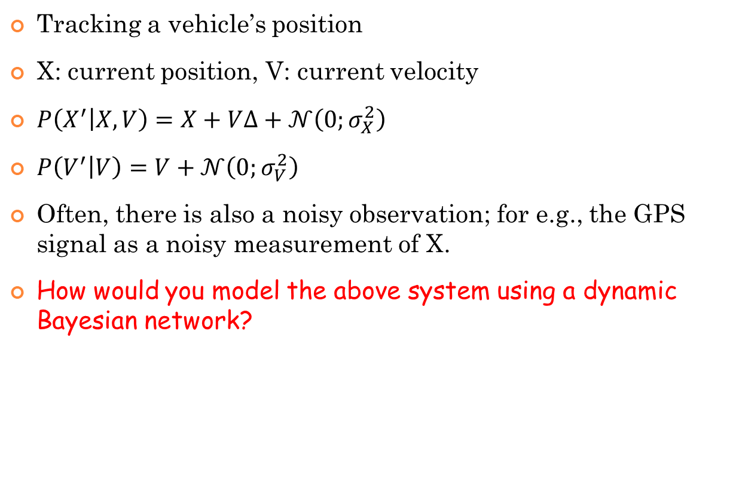
Kalman Filter Example
Tracking a vehicle’s position
X: current position, V: current velocity
$P\left(X^{′} | X,V\right)=X+V∆+𝒩\left(0;σ_{X}^{2}\right)$
$P\left(V^{′} | V\right)=V+𝒩\left(0;σ_{V}^{2}\right)$
Often, there is also a noisy observation; for e.g., the GPS signal as a noisy measurement of X.
How would you model the above system using a dynamic Bayesian network?
Notes:
O(t) O(t+1)
^
|
X(t) -> X(t+1)
V(t) |-> V(t+1)

Slide 17
Plate models
Motivation: Assume we have the following simple network
D → G ← I
There are multiple students in a given class, say CS101
Given the grade of John, we would like to reason about the grade distribution of other students
For e.g., if John got an A, we would like to be able to reason that CS101 might be an easy class and thus other students in CS101 have a higher chance of getting As as well

Slide 18
Plate models - informally
A plate is a rectangle with a Bayesian network inside
The rectangle tells us to replicate the same structure and the parameters multiple times
Let’s see some examples

Slide 19
Example – all inside
A
A¹
A²
A^{n}
.
.
.
B
B¹
B²
B^{n}
The marginal P(A) and the conditional P(B|A) are copied for each replica.

Slide 20
Example – some outside
A
A
B
B¹
B²
…
B^{n}
The conditional P(B|A) is copied for each replica.

Slide 21
Example – nested
A
A
B
B¹
B²
…
B^{n}
C
C¹¹
…
C^{1m}
C²¹
…
C^{2m}
C^{n1}
…
C^{nm}

Slide 22
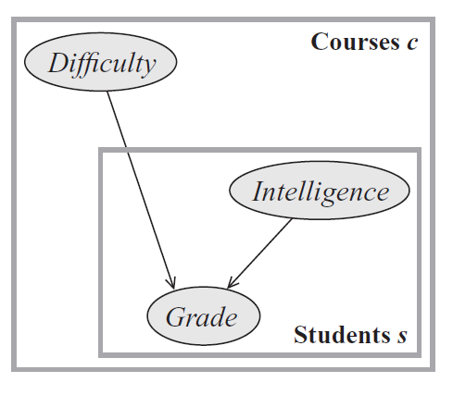
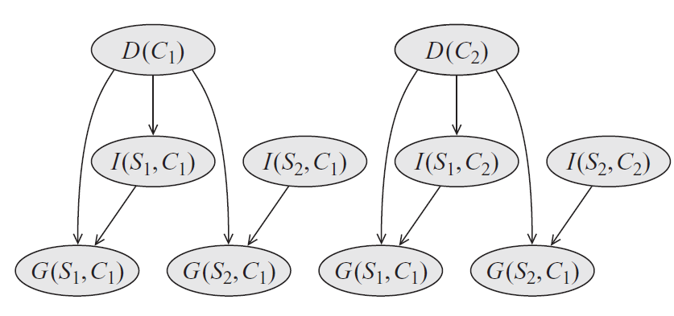
Multiple courses with each its own set of students
Industrious
We can reason across students in the same course, but we cannot reason across courses through common students, because the student variables are replicated across courses.
Notes:
Difficulty should not have an edge to Intelligence

Slide 23
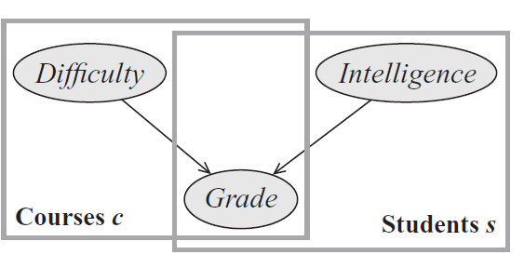
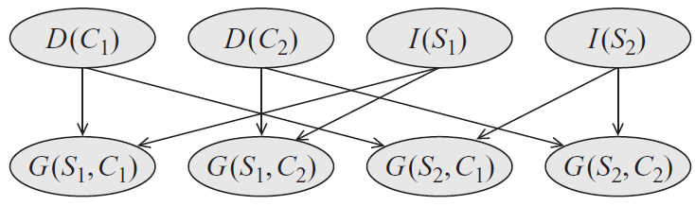
Multiple courses and multiple students
Industrious

Slide 24
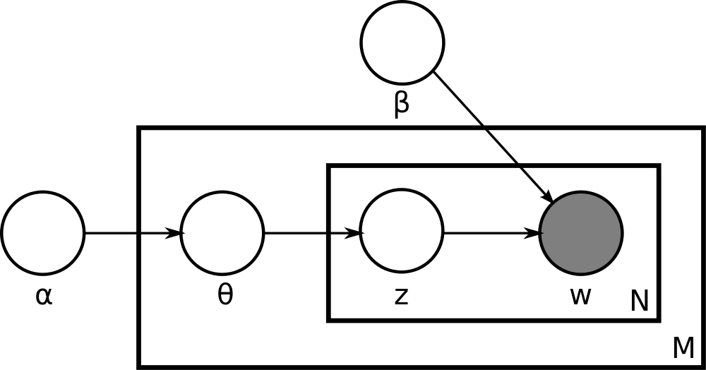
Latent Dirichlet Allocation
https://www.jmlr.org/papers/volume3/blei03a/blei03a.pdf
https://scikit-learn.org/stable/modules/generated/sklearn.decomposition.LatentDirichletAllocation.html
Notes:
α is the parameter of the Dirichlet prior on the per-document topic distributions, β is the parameter of the Dirichlet prior on the per-topic word distribution, theta_i is the topic distribution for document i,, z_ij is the topic for the jth word in document i, w_ij and is the specific word.

Slide 25
Limitations of plate models
The grade is replicated for all possible combinations of courses and students. What happens when a student takes some classes but not others?
How can you represent a variable of one object depends on a variable of another object of the same type?
How can you represent temporal models?

Slide 26
Probabilistic relational models
Specify when a dependency holds
For e.g., the dependency between a course variable and a student variable is contingent upon whether the student registered that course
Largely based on database concepts
Entities and relationships

Slide 27
Statistical relational learning (SRL)
Last decade has seen tremendous amount of work on probabilistic relational modeling
Examples
Probabilistic Relational Models (PRM)
Relational Markov Networks (RMN)
Inductive Logic Programming (ILP)
Conditional Random Fields (CRF)
Relational Dependency Networks (RDN)
Bayesian Logic Programming (BLP)
Markov Logic Networks (MLN)
http://www.cs.umd.edu/srl-book/

Slide 28
Parameter Estimation

Slide 29
Overview
Bayesian networks
Maximum likelihood estimation
Bayesian estimation
Incomplete data
Markov networks
Maximum likelihood estimation
Gradient optimization
Bayesian estimation
Regularization

Slide 30
Parameter Estimation Bayesian Networks

Slide 31
Parameter estimation for BNs
Assume the network structure is given
The data D consists of fully observed instances of the network variables
D = {x[1], x[2], …, x[n]}
Estimate the network parameters, i.e., learn the CPDs
Two approaches
Maximum likelihood estimation
Bayesian estimation

Slide 32
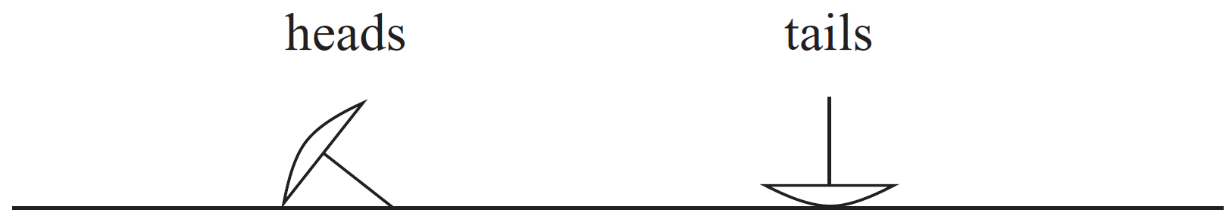
Simplest case – one variable
Imagine we have a thumbtack
Flip it, and it comes as heads or tails
P(Heads) = θ, P(Tails) = 1- θ
Assume we flip it 100 times and it comes head 30 times
What is a hypothesis θ?

Slide 33
Thumbtack tosses
Assume we have a set of thumbtack tosses
D = {x[1], …, x[n]}
Also assume each toss, x[i], is IID
We define a hypothesis space Θ
Θ is the set of all parameters θ∈[0, 1]
We formulate an objective function
The objective function tells us how good a given hypothesis (in this case θ) is

Slide 34
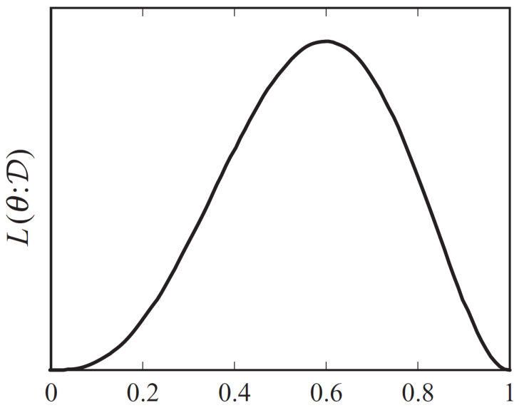
Likelihood
What is the probability, or likelihood, of seeing the sequence H, T, T, H, H?
θ∗(1− θ)∗(1− θ)∗θ∗θ = θ³(1− θ)²
When is L(θ:D) maximum?

Slide 35
Likelihood/log-likelihood
Number of heads = h, number of tails = t
Likelihood: L(θ:D) = θ^{h}(1-θ)^{t}
Log-likelihood: l(θ:D) = hlnθ + tln(1-θ)
Find θ that maximizes the log-likelihood
Take derivate of l(θ:D) with respect to θ and set it to zero

Slide 36
Maximum likelihood for a multinomial
Domain of X is {A, B, C}
We see A a times, B b times, and C c times.
P(X=A) is p, P(X=B) is q, and P(C) = 1 – p – q
What are p and q?
Proof?

Slide 37
ML for BNs
Simple structure
X→Y
General structure
The key is that the parameters for each variable can be optimized independently
Examples
Notes:
A B C P(A, B, C) T T T 0.16 T T F 0.04 T F T 0.08 T F F 0.12 F T T 0.09 F T F 0.21 F F T 0.18 F F F 0.12
Try A -> C <-B and A <- C -> B
Try a Naive Bayes

Slide 38
Bayesian estimation
Assume we flip a coin 10 times and we get 4 Heads, 6 Tails
What is P(C=H)?
Assume we flip a thumbtack 10 times and we get 4 Heads, 6 Tails
What is P(T=H)?
What if we repeat the flips 10M times and we get 4M Heads and 6M Tails?
Bayesian estimation will let us encode our prior knowledge

Slide 39
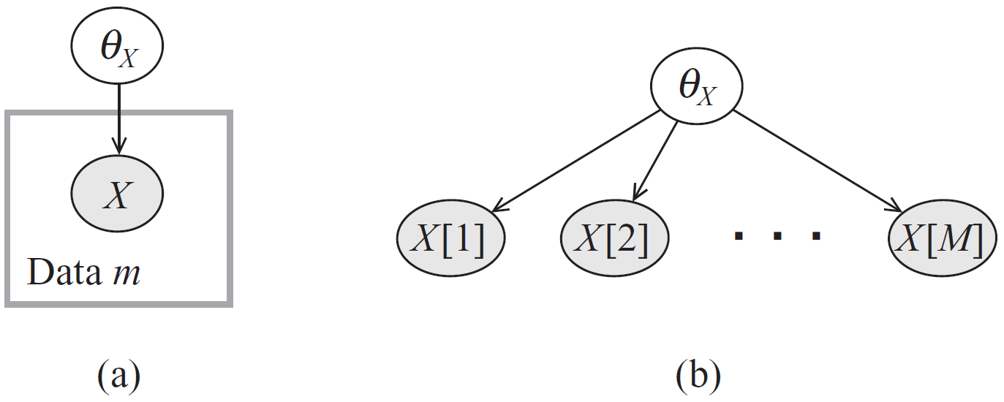
Independence?
Earlier, we assumed the tosses are independent
This is true if we know θ
If we don’t know θ, then each toss tells us something about θ, thus the next toss

Slide 40
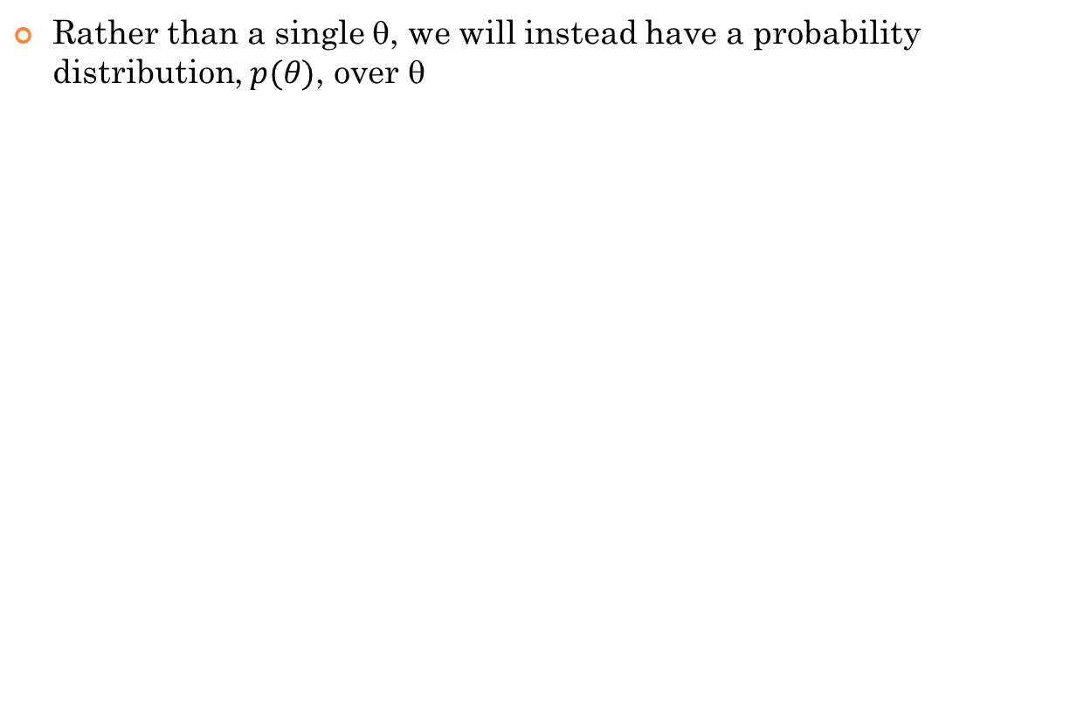
Bayesian Estimation
Rather than a single θ, we will instead have a probability distribution, $p(θ)$, over θ

Slide 41
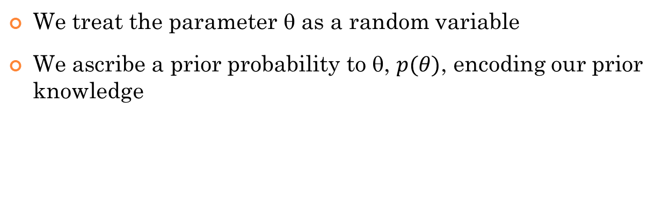
Bayesian estimation
We treat the parameter θ as a random variable
We ascribe a prior probability to θ, $p(θ)$, encoding our prior knowledge

Slide 42
Parameters
P(X[i] = x¹|θ_{x}) = θ; P(X[i] = x⁰|θ_{x}) = (1 – θ)
p(θ_{X})?
A continuous distribution over the interval [0,1]

Slide 43
Posterior and prediction
We are interested in
The probability of the next instance, given data
P(x[M+1] | D)
The posterior distribution of θ given data
p(θ | D)

Slide 44
Factorization

Slide 45
Posterior and P(x[m+1]|D)
Posterior distribution
or 1-θ
(if binary)
Posterior
Think of taking a weighted average

Slide 46
P(x[M+1]|D)
P(x[1], …, x[M]) is a constant

Slide 47
Uniform prior
We have a uniform prior over θ_{X}. That is, p(θ_{X})=1
P(X[M+1]=x¹|x[1],…,x[M])?

Slide 48
Uniform prior
We have a uniform prior over θ_{X}. That is, p(θ_{X})=1
P(X[M+1]=x¹|x[1],…,x[M])? That is, P(X[M+1]=x¹|D)?
For the binary case, P(X[M+1]=x¹|D) = (t + 1) / (t + f + 2), where t is the number of True cases and f is the number of False cases in D
This is also called Laplace smoothing
What about the posterior, P(θ|D), if the prior P(θ) is uniform?

Slide 49
Beta Distribution
θ ~ Beta(α,β) if p(θ) = γθ^{α−1}(1−θ)^{β−1} where γ is a normalizing constant
Mean: α/(α+β)
Mode: (α−1)/(α+β−2)
Note that the mode is closer to the mean when α and β are large
Read more at
https://en.wikipedia.org/wiki/Beta_distribution
Notes:
import numpy as np
from scipy.stats import beta
import matplotlib.pylab as plt
x=np.linspace(0,1)
plt.plot(x,beta.pdf(x, 15, 10))
plt.show()

Slide 50
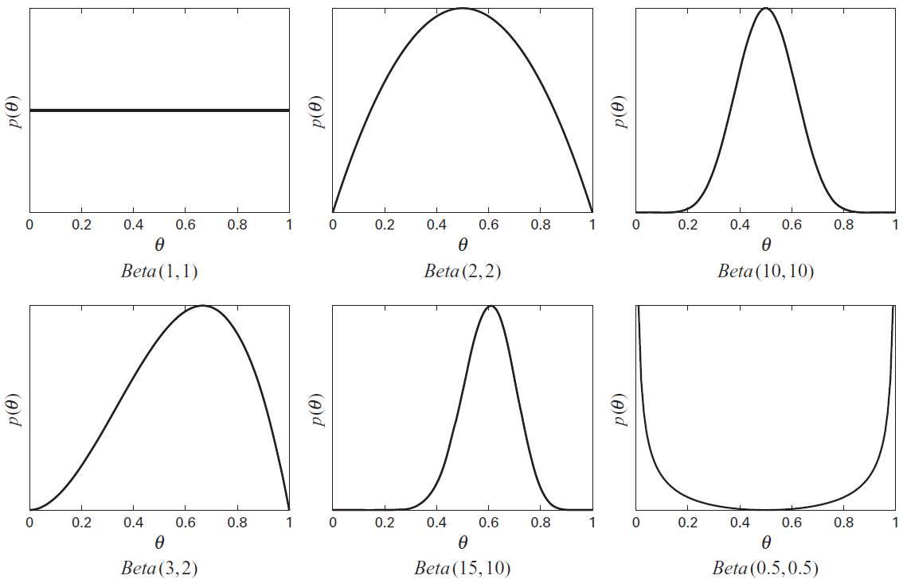
Beta Distribution
Notes:
import numpy as np
from scipy.stats import beta
import matplotlib.pylab as plt
x=np.linspace(0,1)
plt.plot(x,beta.pdf(x, 15, 10))
plt.show()

Slide 51
Beta distribution
What is P(X[M+1]=x¹|D) if the prior is Beta(α,β)?
P(X[M+1]=x¹|D) = (p + α) / (p + n + α + β)
What is the posterior, P(θ|D), if the prior is Beta(α,β)?
P(θ|D) = Beta(p + α, n + β)
α and β work like pseudo-counts for the positive and negative cases respectively
What values to choose for α and β?
It depends on our belief and the strength of our belief

Slide 52
Dirichlet priors
Generalizes the Beta distribution for multinomials
What is P(X[M+1]=x^{i}|D) if the prior is Dirichlet?
P(X[M+1]=x^{i}|D) = (n_{i}+α_{i}) / (|D|+ α) where n_{i} is the number of times the i^{th} case appears in D and α = α₁ + α₂ + … + α_{K}
What is the posterior, P(θ|D), if the prior is Dirichlet?
P(θ|D) = Dirichlet(n₁ + α₁, n₂ + α₂, …, n_{K} + α_{K})

Slide 53
Bayesian estimation
In MLE for BNs, we optimized each parameter independently
Can we do the same for Bayesian estimation for BNs?
Only if the prior also factorizes wrt the BN
What about the priors? How do we choose them?
Ask the prior for each variable to an expert
Use the same prior for all variables
This is called the K2 prior
Imagine a dataset D’ of imaginary instances
The number of imaginary instances for x is |D’|*P’(x, pa(x))
This is called the BDe prior
What is P’?
Could be anything; e.g., a marginally independent distribution

Slide 54
Bayesian estimation examples
Try a dataset using
MLE
Bayesian
K2
BDe

Slide 55
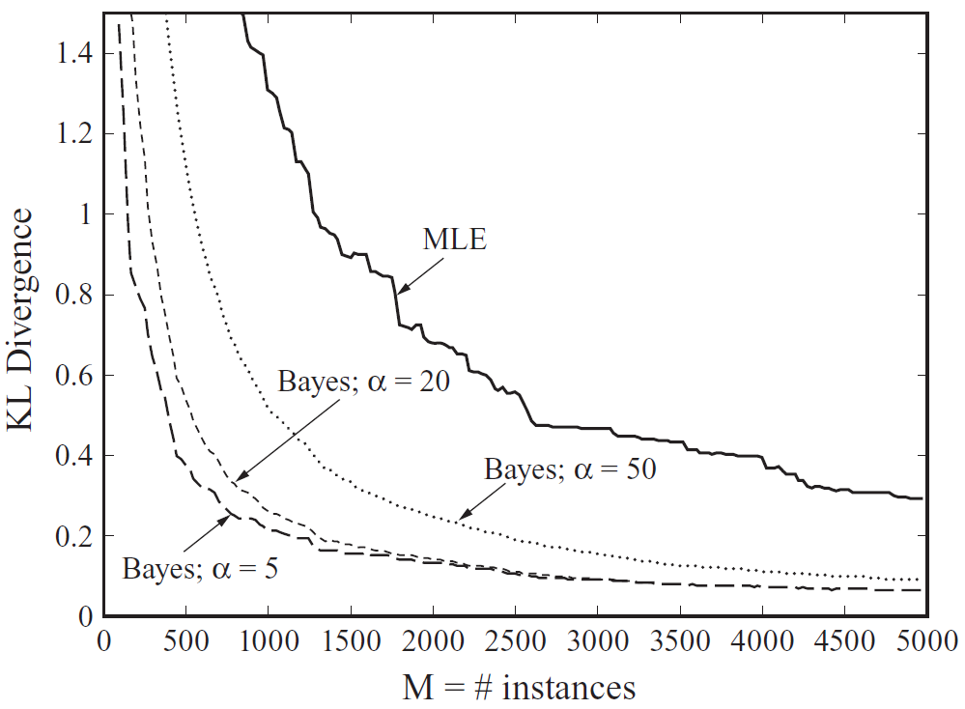
ICU Alarm network – fig 17.c.1

Slide 56
Parameter Estimation Incomplete Data

Slide 57
Missing Data
Accidental
E.g., sensor failure
Intentional
E.g., not all tests are ordered for medical diagnosis
Hidden variable
E.g., cluster assignment; hidden cause

Slide 58
Approaches
Ignore the data points with missing values
Not economical (throwing data away), not necessarily accurate (if missing intentionally), and might not be possible (hidden variables)
Imputing
Gradient optimization
Expectation Maximization

Slide 59
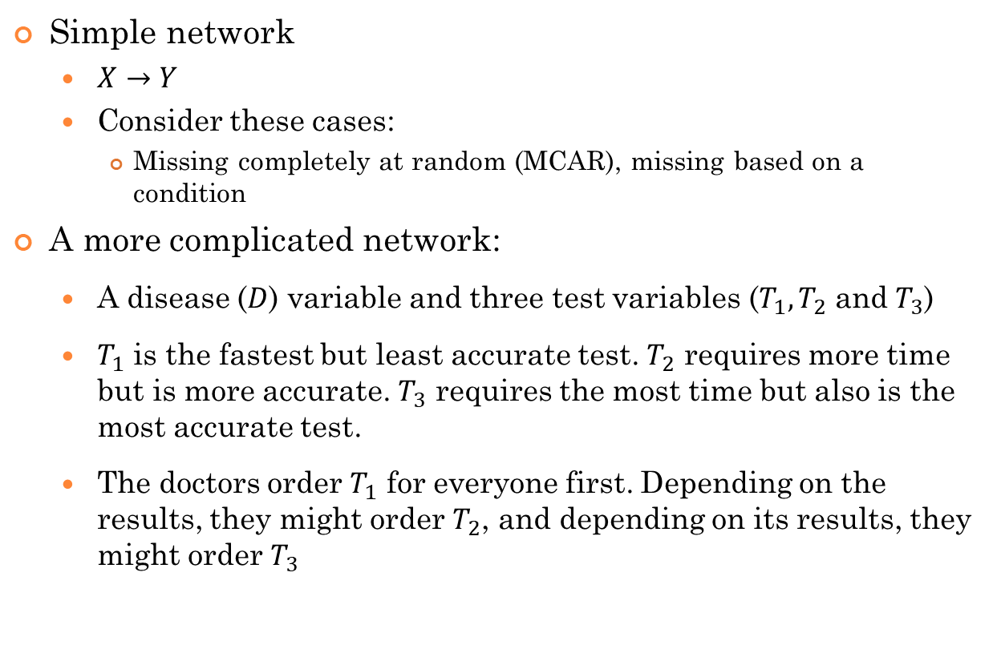
Examples
Simple network
$X→Y$
Consider these cases:
Missing completely at random (MCAR), missing based on a condition
A more complicated network:
A disease ($D$) variable and three test variables ($T_{1}, T_{2}$ and $T_{3}$)
$T_{1}$ is the fastest but least accurate test. $T_{2}$ requires more time but is more accurate. $T_{3}$ requires the most time but also is the most accurate test.
The doctors order $T_{1}$ for everyone first. Depending on the results, they might order $T_{2}$, and depending on its results, they might order $T_{3}$

Slide 60
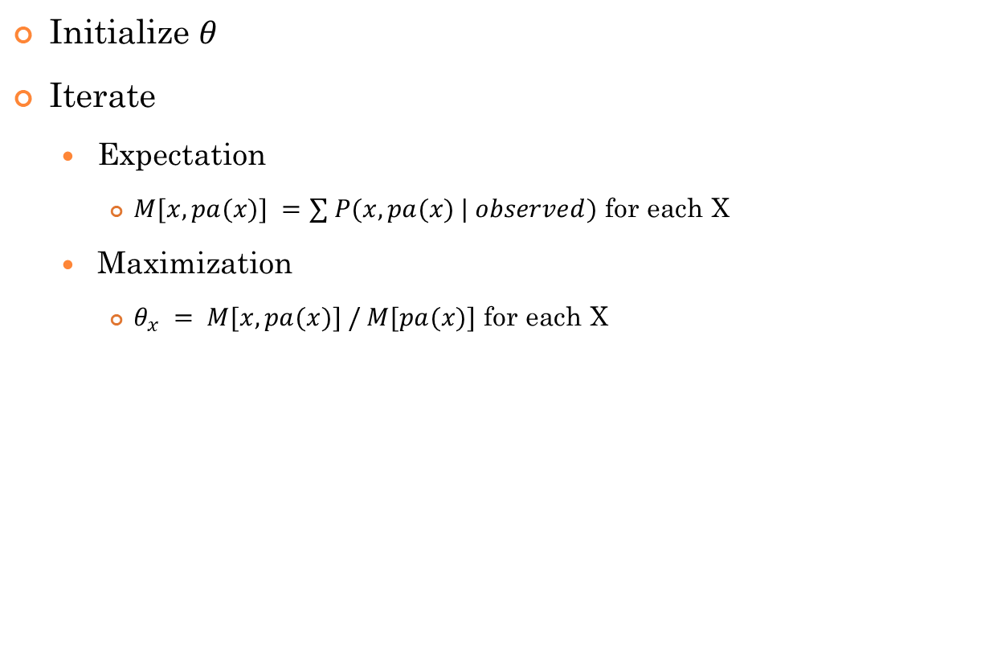
Expectation Maximization (EM)
Initialize $θ$
Iterate
Expectation
$M[x, pa(x)] =∑ P(x, pa(x) | observed)$ for each X
Maximization
$θ_{x} = M[x, pa(x)] / M[pa(x)]$ for each X

Slide 61
Parameter Estimation Markov Networks

Slide 62
Overview
Compared with Bayesian networks, the same principles apply but the issues and solutions are quite different
The most important reason for the differences is the use of global normalization constant Z
Z couples all parameters together, preventing us from optimizing each parameter independently
Even simple maximum likelihood parameter estimation does not have a closed form solution
We often resort to iterative approaches such as gradient ascent
The good news is that the likelihood objective is concave; iterative approaches converge to global optimum

Slide 63
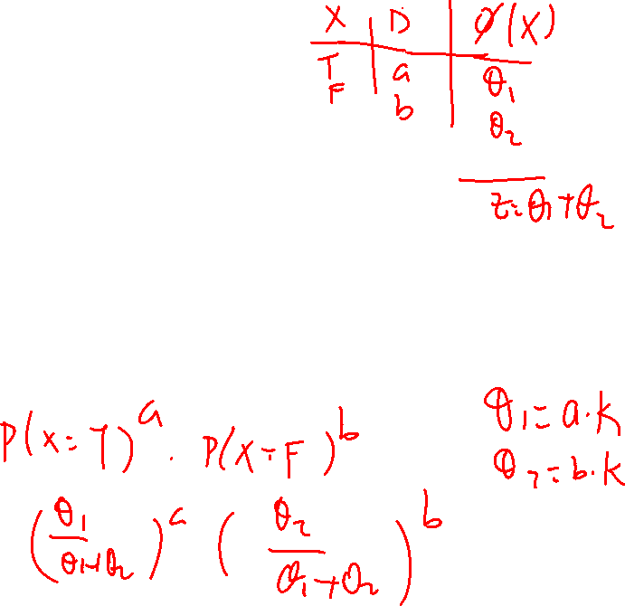
Single variable case
We have a binary variable X with domain(X) = {T, F}.
Parameters are θ₁ and θ₂
Remember, the only constraint on θ₁ and θ₂ is that they need to be non-negative
Dataset D has a T and b F instances.
What are the maximum likelihood estimates for θ₁ and θ₂?

Slide 64
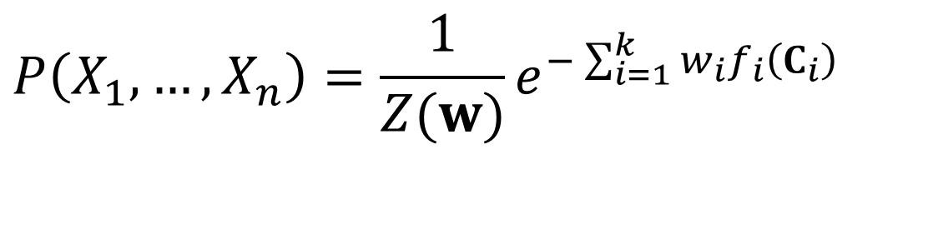
Log-linear models
A distribution is a log-linear model over a Markov network H is it is associated with
A set of features F = {f₁(C₁), …, f_{k}(C_{k})}, where each C is a complete subgraph in H,
A set of weights w₁, …, w_{k}
It is common to have several features over the same scope
$$P\left(X_{1},…,X_{n}\right)=\frac{1}{Z(w)}e^{−\sum_{i=1}^{k}{w_{i}f_{i}\left(C_{i}\right)}}$$

Slide 65
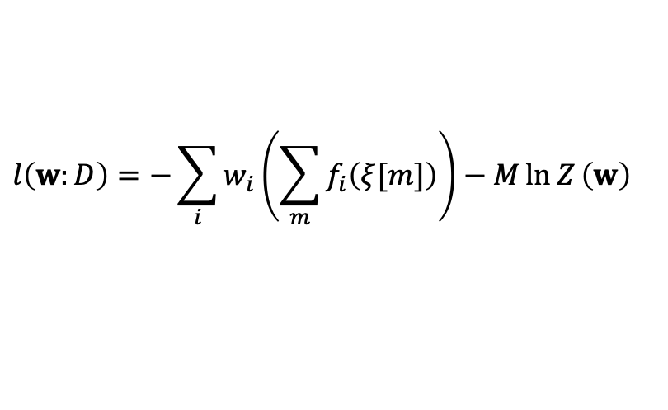
Log-linear models – log-likelihood
Given a domain X={X₁, …, X_{n}} and a dataset D = {ξ[1], ξ[2], …, ξ[M]}, where ξ[i] is an instance, i.e., a complete assignment to the variables X
The log-likelihood is
We are abusing the notation a little for clarity. The feature functions are defined over cliques, but here we passed them the whole instance. They just ignore the irrelevant portions of the instance
$$l\left(w:D\right)=−\sum_{i}{w_{i}\left(\sum_{m}{f_{i}\left(ξ[m]\right)}\right)−M\ln{Z}\left(w\right)}$$

Slide 66
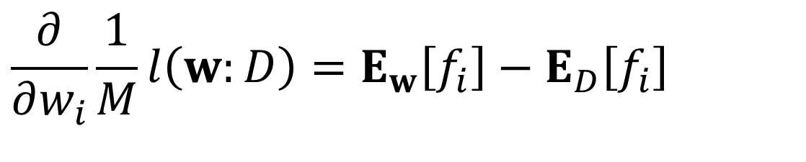
Derivative of l(w:d)/m wrt to w_{i}
$$\frac{∂}{∂w_{i}}\frac{1}{M}l\left(w:D\right)=E_{w}\left[f_{i}\right]−E_{D}\left[f_{i}\right]$$
Let’s prove it.

Slide 67
E_{w}[f_{i}] – E_{D}[f_{i}]
E_{D}[f_{i}] can be computed by summing f_{i} over the instances in D and dividing by M
How can we compute E_{w}[f_{i}]?
It is impossible to iterate over all possible values of X
Remember f_{i} is defined over a set of variables C_{i} and it ignores (i.e. equals zero for) the rest of the variables
Perform inference to compute P_{w}(c_{i})
Now we have the gradient, we can optimize w using gradient ascent

Slide 68
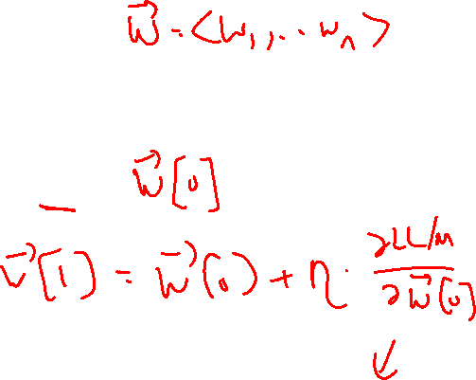
Gradient Ascent
Find maximum of f(θ) where there is no closed form solution
Start with some initial guess θ₀
While change is not much
θ_{i+1} = θ_{i} + η*f’(θ_{i})
η is called the learning rate and it is a user specified parameter

Slide 69
f = -2x² + 8x + 10

Slide 70
f = sin(x)

Slide 71
f = -2x² + 8x + 10
f’ = -4x + 8
Start with x₀ = 6
Use η = 0.2
x₁ = x₀ + η*f’(x₀)
x₁ = 6 + 0.2*(-4*6 + 8) = 6 – 0.2*16 = 6 – 3.2 = 2.8
x₂ = x₁ + η*f’(x₁)
x₂ = 2.8 + 0.2*(-4*2.8 + 8) = 2.8 – 0.2*3.2 = 2.8 – 0.64 = 2.16
x₃ = x₂ + η*f’(x₂)
x₃ = 2.16 + 0.2*(-4*2.16 + 8) = 2.16 – 0.2*0.64 = 2.16 – 0.128 = 2.032
x₄ = x₃ + η*f’(x₃)
x₄ = 2.032 + 0.2*(-4*2.032 + 8) = 2.032 – 0.2*0.128 = 2.032 – 0.0256 = 2.0064

Slide 72
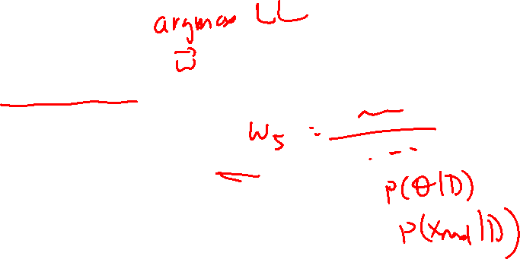
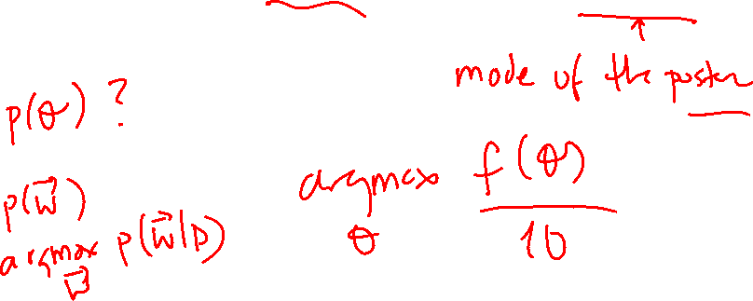
Bayesian priors
There was no closed form solution for the maximum likelihood formulation
There is no closed form solution for full Bayesian approach either
We instead find the parameters that maximize p(θ)P(D|θ)

Slide 73


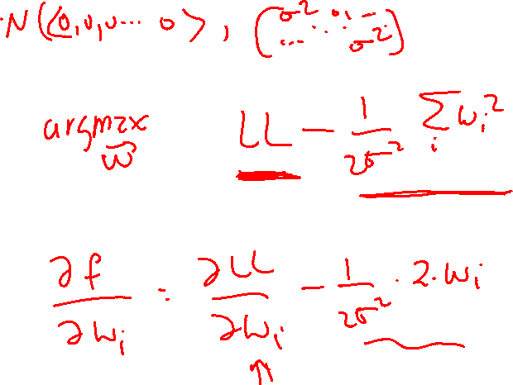

L₂-Regularization
Assume p(w) is zero-mean diagonal Gaussian with equal variances
In the log space, it gives rise to a penalty of the form
It penalizes large weights

Slide 74
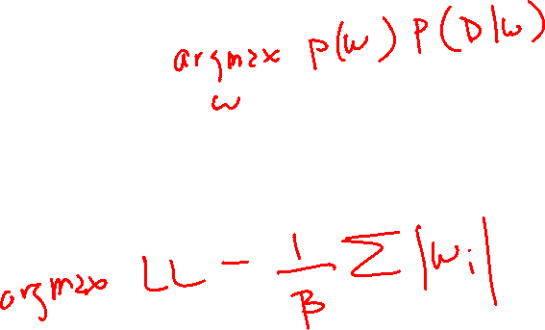
L₁-Regularization
Assume p(w) is zero-mean Laplace distribution
In the log space, it gives rise to a penalty of the form
It penalizes large weights

Slide 75
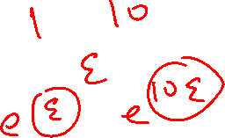
Why small weights?
The prior for the weights is zero; unless the data tells us otherwise, we will treat the feature as not needed by the model
Large weights are more susceptible to the noise in the data
A small difference in the feature value can cause big changes in the probability
Small weights give rise to smoother probabilities

Slide 76
L₂ vs L₁
L₂ forces the large weights to get closer to zero and places an emphasis on the large weights
Even though the weights get closer to zero, they are often not zero
L₁ also penalizes large weights but the emphasis is not necessarily on the large weights
Some of the weights become zero
Leads to a sparser representation

Slide 77
Learning rate
As we have seen with examples, the learning rate is an important parameter
If it is too large, then we can overshoot
If it is too small, then it takes a long time to converge
There is no single value that works for all datasets and domains
There are approaches that chooses an appropriate learning rate at each step
E.g., line search

Slide 78
MN Parameter estimation summary
There is no closed form solution for both maximum likelihood estimation and Bayesian estimation
The likelihood function is concave; there is a single global optimum (note that the objective function has a single global optimum value but there might be many parameter values that achieve the same global optimum)
Gradient ascent methods are applied to estimate the parameters
The gradient computation requires running inference, which is costly
In practice, regularization (L₂, L₁) is used to avoid overfitting

