Slide 1
CS583 Probabilistic Graphical Models
Lecture 7. Markov Networks. Part 3
Oleksandr Narykov
onarykov@iit.edu

Slide 2
Three different parameterizations
Undirected graph
Factor graph
Features
Factor graph is finer grained than the undirected graph representation and it is at least as rich
Feature representation is finer grained than the factor graph representation and it is at least as rich
Which representation to use?
UGs are good for discussing independencies, factor graphs are well suited for inference, and features are well suited for learning.

Slide 3
Ising models
One of the earliest types of Markov network models
Arose in statistical physics as a model for the energy of a physical system involving a system of interacting atoms
Each random variable X_{i} is binary with {+1, -1}.
Edges: ε(x_{i}, x_{j}) = -w_{ij}x_{i}x_{j}
Nodes: ε(x_{i}) = -u_{i}x_{i}
Depending on the weights, w_{ij}, the model prefers various configurations
w_{ij}>0: x_{i} and x_{j} are preferred to have the same value
Ferromagnetic
w_{ij}<0: x_{i} and x_{j} are preferred to have different values
Antiferromagnetic
w_{ij}=0: x_{i} and x_{j} are non-interacting

Slide 4
Metric MRFs
Nodes X₁ through X_{n}, related by a set of edges, E, and each X_{i} can take a label from V = {v₁, …, v_{K}}
Each node has its own preferences among the possible labels
Node potentials
We also want smoothness over the graph; the neighboring nodes should take similar labels.
Edge potentials
Objective: MAP assignment to X
So, we can drop 1/Z

Slide 5
Metric MRFs
,…,
,…,
,…,
λ_{i,j} ≥0. The lowest energy, 0, is obtained when two neighboring nodes take the same value, and a higher energy when they do not.

Slide 6
Metric MRFs
We may want a more general distance function between labels in the case of multiclass case
Maybe some labels are more similar than others
Definition: A function, μ: V x V → [0, ∞] , is a metric if it satisfies
Reflexivity
μ(v_{k}, v_{l})=0, if and only if k=l
Symmetry
μ(v_{k}, v_{l}) = μ(v_{l}, v_{k})
Triangle inequality
μ(v_{k}, v_{l}) + μ(v_{l}, v_{m}) ≥ μ(v_{k}, v_{m})
Metric MRF: ɛ(v_{k}, v_{l}) = μ(v_{k}, v_{l})

Slide 7
CRFs
Definition: A conditional random field is an undirected graph H whose nodes correspond to X∪Y; H is parameterized by a set of factors φ_{i}(D_{i}), where D_{i} ⊄ X. The network encodes the following distribution:
Z(X) = Σ_{Y}Π_{i}φ(D_{i})
Why do we want P(Y|X) and not necessarily P(Y,X)?
Why does Z have X as an argument?

Slide 8
MRFs for Vision (Box 4.B)
Tasks
Image segmentation, noise removal, object recognition, etc.
Typically, pairwise MRFs are used
Variables are pixels and edges exist between adjacent pixels
Image denoising
Restore the true value of all the pixels
Node potential: penalizes large deviations from the observed pixel value
Edge potential: prefers continuity in the predicted pixel values
Don’t want to smooth too much to allow object boundaries

Slide 9
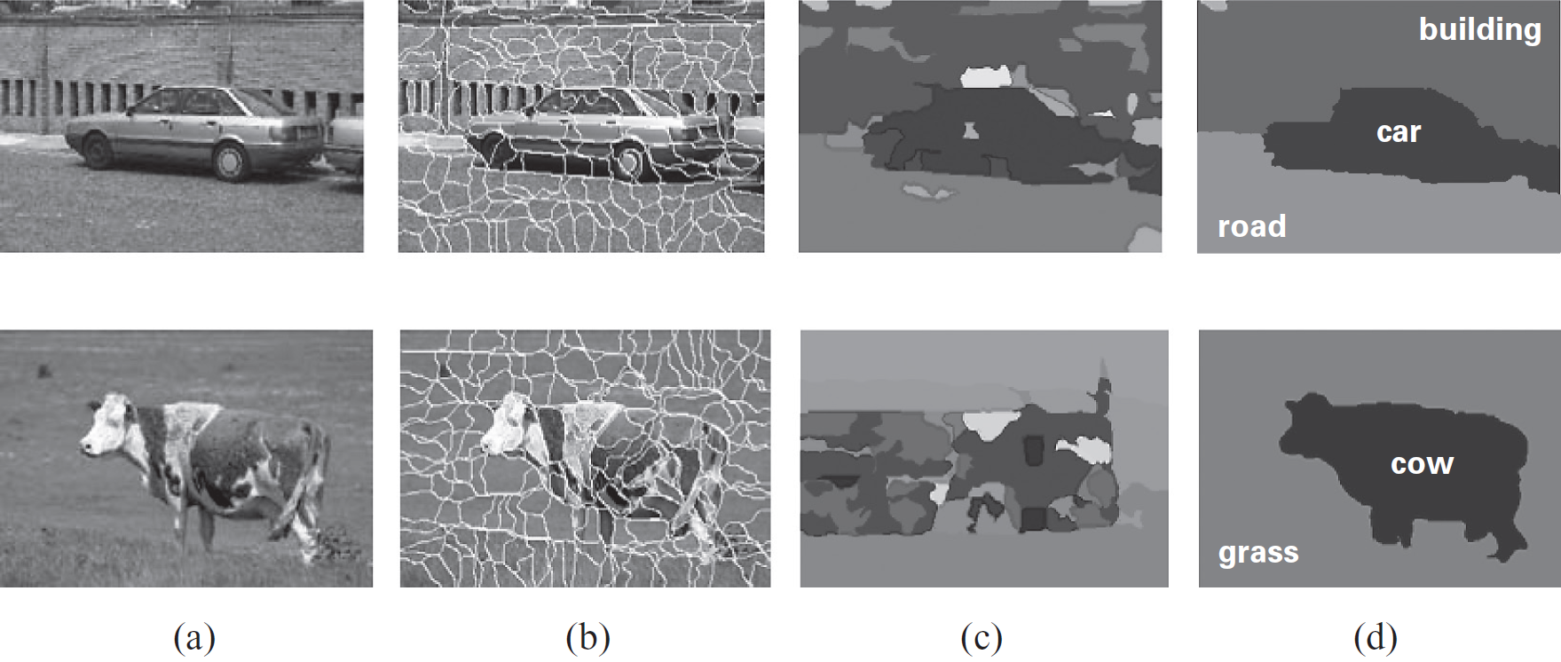
Image Segmentation Example

Slide 10
CRFs for text analysis
Tasks: Part-of-speech tagging, identifying named entities, structured information extraction
Target: Y, the labels for each word (or a phrase)
Input: X, the text
Features: Capture often domain knowledge about interactions
Within target variables, and
Between the target variables and the input
(No features between solely input variables)
Notes:
Noun, pronoun (e.g., he, they), adjective, verb, adverb (e.g., very), preposition (e.g., in), conjunction (e.g., and), interjection (e.g., alas), article (e.g., the) https://en.wikipedia.org/wiki/Part_of_speech#English

Slide 11
Named entity recognition
Task: Identify named entities such as people, places, organizations, etc.
Entities span multiple words and entities might not be apparent from individual words
“Chicago” is a location, “Chicago Tribune” is an organization
Given text of length T, words X_{t}, 1 ≤ t ≤ T, define target variables Y_{t}.
Y_{t} represents B-PERSON, I-PERSON, B-LOC., I-LOC., B-ORG., I-ORG., and OTHER.

Slide 12
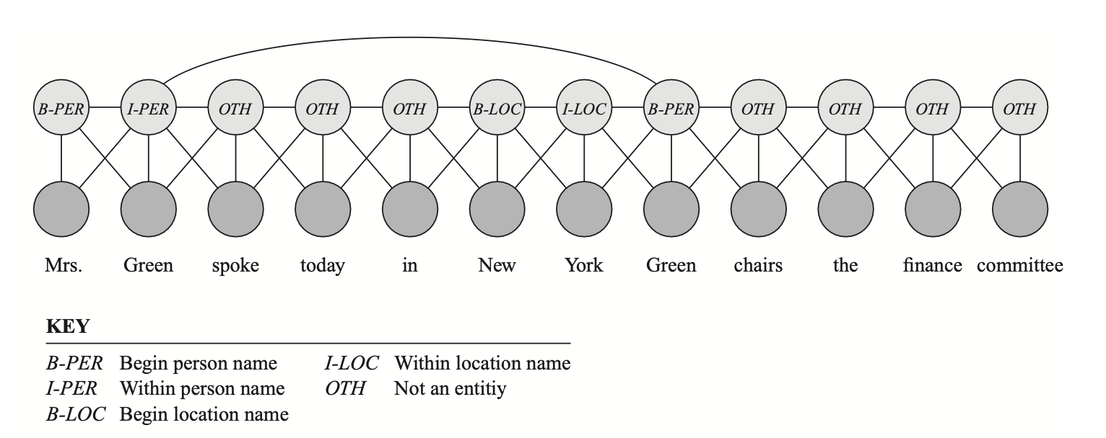
Named entity recognition

Slide 13
Named entity recognition
A common structure is a linear-chain CRF
Factors
φ_{t}(Y_{t}, Y_{t+1}): Dependency between neighboring target variables
φ_{t}(Y_{t}, X₁, …, X_{T}): Dependency between a target and its context
Rather than a table, represent it as a log-linear model with features
Thousands of features that encode domain knowledge
More details in the book; highly recommend to read it
Software – many implementations out there in Python, C++, Java, Matlab

Slide 14
From distributions to graphs
Task: Given a P, find a Markov network structure H that is a minimal I-Map for P
Procedure 1: Pairwise independencies
Add edges between X and Y, if P does not entail X ⊥ Y | X \ {X, Y}
Procedure 2: Local independencies
Add edges between X and all Y ∈ MB_{P}(X)
Theorems: Let P be a positive distribution and H be the structure constructed through above procedures. Then H is a unique minimal I-Map for P.

Slide 15
Bayesian networks & markov networks
We’ve said that the set of distributions that can be represented using BNs and MNs are different.
Can we go from a BN to a MN and/or vice versa?

Slide 16
BNs to MNs
Proposition: Let B be a Bayesian network over X. Then P_{B}(X) is a Gibbs distribution defined by the factors Φ={φ(X_{i})} for X_{i} ∈X, where φ(X_{i}) = P_{B}(X_{i} | Parents(X_{i})). The partition function Z is 1.

Slide 17
BNs to MNs
Given a Bayesian network structure G, find a Markov network structure H that is a minimal I-Map for G.
Definition: Moralized graph: The moral graph M[G] of a Bayesian network structure G over X is an undirected graph over X that contains an undirected edge between X and Y if
There is a directed edge between X and Y in G, or
X and Y are both parents of the same node in G
Moralized: Parents of a node are married by adding an edge between them

Slide 18
BNs to MNs
Proposition: Let G be any Bayesian network. The moralized graph M[G] is a minimal I-Map for G.
Proposition: Let G be any moral Bayesian network. The moralized graph M[G] is a P-Map for G.

Slide 19
MNs to BNs
Given a Markov network structure H, find a Bayesian network structure G that is a minimal I-Map for H.
Use one of the two algorithms we discussed earlier
Alg. 1: Pick an order of the variables
Alg. 2: Start with a fully connected graph

Slide 20
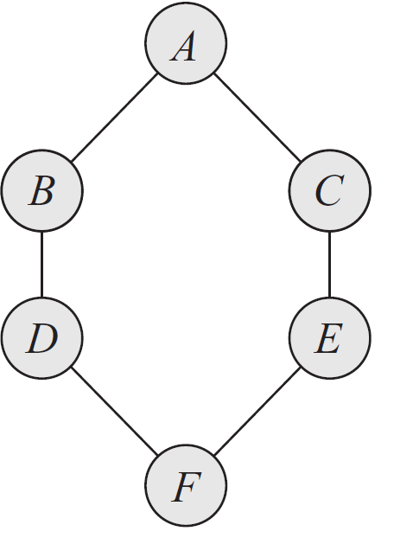
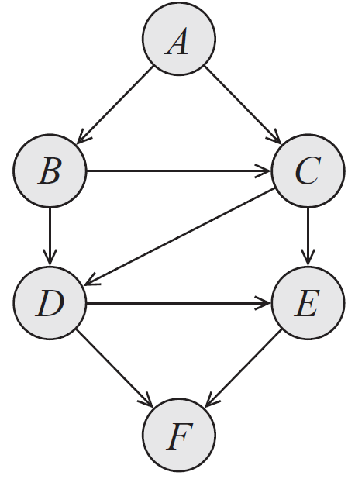
MNs to BNs
Notes:
Order: A, B, C, D, E, F

Slide 21
MNs to BNs
Theorem: Let H be a Markov network structure and let G be any Bayesian network structure that is a minimal I-Map for H. Then, G can have no immoralities.
Definition: Chordal graph: A graph where the longest minimal loop is a triangle. Also called triangulated.
Corollary: Let H be a Markov network structure and let G be any Bayesian network structure that is a minimal I-Map for H. Then, G is necessarily chordal.

Slide 22
MNs to BNs
Theorem: Let H be a nonchordal Markov network. Then, there is no Bayesian network G which is a perfect map for H.
Theorem: Let H be a chordal Markov network. Then, there is a Bayesian network G which is a perfect map for H.

Slide 23
Inference. Variable Elimination

Slide 24
Task
Given a graphical model over X (structure and parameters)
Compute P(Y | e), where Y ⊆ X and E ⊆ X
There are several approaches
Exact inference
Variable elimination
Belief propagation
Approximate inference
Sampling
This slide deck: variable elimination

