Slide 1
CS584 Machine Learning
Lecture 16. Midterm Overview
Oleksandr Narykov
onarykov@iit.edu

Slide 2
Midterm
Time – October 17, 10am-11:15am
Fully online, because we have multiple sections
Zoom link will be provided, cameras on
Cheat sheet allowed
No derivations and no programming, but questions requiring calculations are included (e.g., fit a linear regression model to the dataset)
Conceptual questions, multiple choice
What to review
Assignment 1
Probability basics
Assignment 2
Lecture slides, visualizations
Notes:
Without assumptions you cannot make predictions
Declarative representations are different from the purely data-driven machine learning algorithms
They allow us to incorporate prior domain knowledge into generative model and separate it from

Slide 3
Assignment 2
Q1. You roll two dice. What is the probability of rolling a number greater than eight, if you know the following:
No prior information is given
One dice displays the number 5? The other dice can take any value, including number 5.
One dice displays a number larger than 2?
23

Slide 4
Assignment 2
Q1. You roll two dice. What is the probability of rolling a number greater than eight, if you know the following:
No prior information is given
Outcomes where the sum of the dice is larger than eight:
(3,6), (6,3)
(4,6), (6,4)
(5,6), (6,5)
(6,6)
(4,5), (5,4)
(5,5)
(6,5) – already covered
23

Slide 5
Assignment 2
Q1. You roll two dice. What is the probability of rolling a number greater than eight, if you know the following:
No prior information is given
All possible outcomes = 6*6 = 36
23

Slide 6
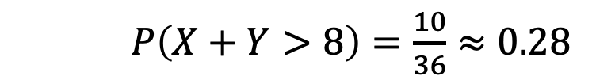
Assignment 2
Q1. You roll two dice. What is the probability of rolling a number greater than eight, if you know the following:
No prior information is given
All possible outcomes = 6*6 = 36
$P\left(X+Y>8\right)=\frac{10}{36}≈0.28$
23

Slide 7
Assignment 2
Q1. You roll two dice. What is the probability of rolling a number greater than eight, if you know the following:
b) One dice displays the number 5
Outcomes where the sum of the dice is larger than eight and one dice is 5:
(4,5)
(5,5)
(6,5)
23

Slide 8
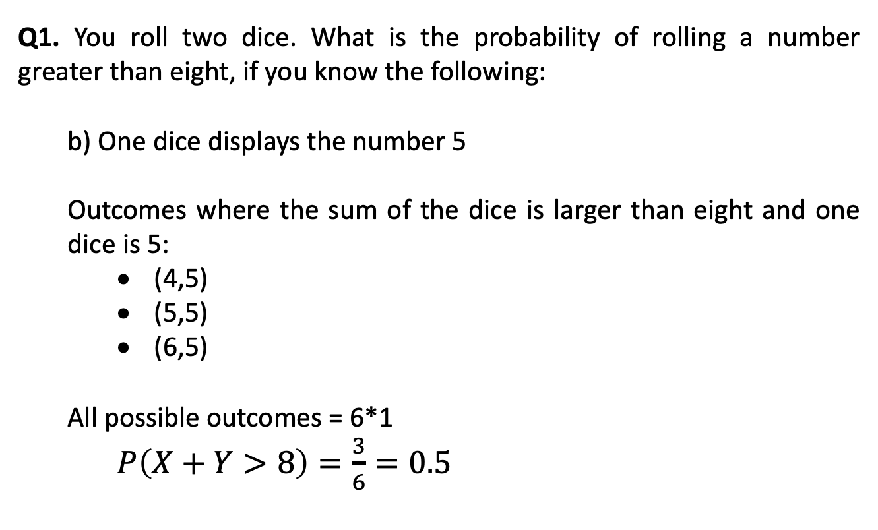
Assignment 2
Q1. You roll two dice. What is the probability of rolling a number greater than eight, if you know the following:
b) One dice displays the number 5
Outcomes where the sum of the dice is larger than eight and one dice is 5:
(4,5)
(5,5)
(6,5)
All possible outcomes = 6*1
$P\left(X+Y>8\right)=\frac{3}{6}=0.5$
23

Slide 9
Assignment 2
Q1. You roll two dice. What is the probability of rolling a number greater than eight, if you know the following:
c) One dice displays a number larger than 2
Outcomes where the sum of the dice is larger than eight and one dice is larger than two:
(3,6), (6,3)
(4,6), (6,4)
(5,6), (6,5)
(6,6)
(4,5), (5,4)
(5,5)
(6,5) – already covered
23

Slide 10
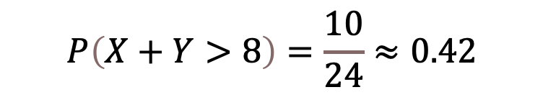
Assignment 2
Q1. You roll two dice. What is the probability of rolling a number greater than eight, if you know the following:
c) One dice displays a number larger than 2
All possible outcomes = 6*4 = 24
$$P\left(X+Y>8\right)=\frac{10}{24}≈0.42$$
23

Slide 11
Assignment 2
Q2. A doctor thinks that a patient has one of the three cancer types: Hodgkin lymphoma (c1), Diffuse Large B-cell lymphoma (c2), or T-cell lymphoma (c3).
Before the tests are conducted, they assume an equal probability for each lymphoma subtype.
The doctor carries out a test that will be positive with a probability of 0.85 if the patient is afflicted by c1, 0.4 if he has disease c2, and 0.3 if he has cancer c3.
The test comes out positive.
What are the probabilities for the patient to have a particular disease type? Provide answers for c1, c2, and c3.
23

Slide 12
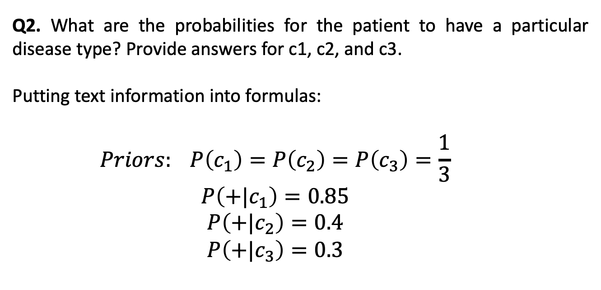
Assignment 2
Q2. What are the probabilities for the patient to have a particular disease type? Provide answers for c1, c2, and c3.
Putting text information into formulas:
$$Priors: P\left(c_{1}\right)=P\left(c_{2}\right)=P\left(c_{3}\right)=\frac{1}{3}$$
$$P\left(+|c_{1}\right)=0.85$$
$$P\left(+|c_{2}\right)=0.4$$
$$P\left(+|c_{3}\right)=0.3$$
23

Slide 13
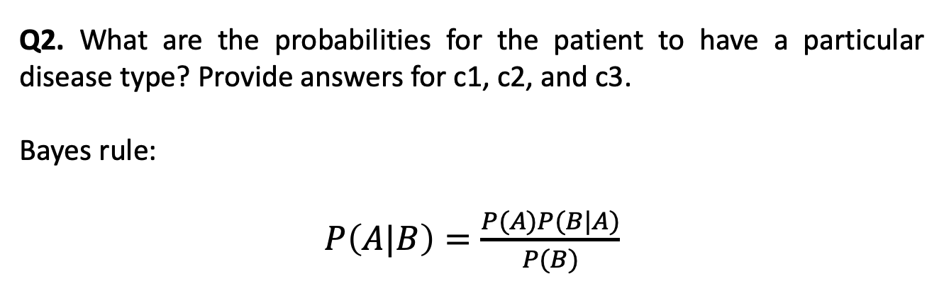
Assignment 2
Q2. What are the probabilities for the patient to have a particular disease type? Provide answers for c1, c2, and c3.
Bayes rule:
$P\left(A|B\right)=\frac{P(A)P(B|A)}{P(B)}$
23

Slide 14
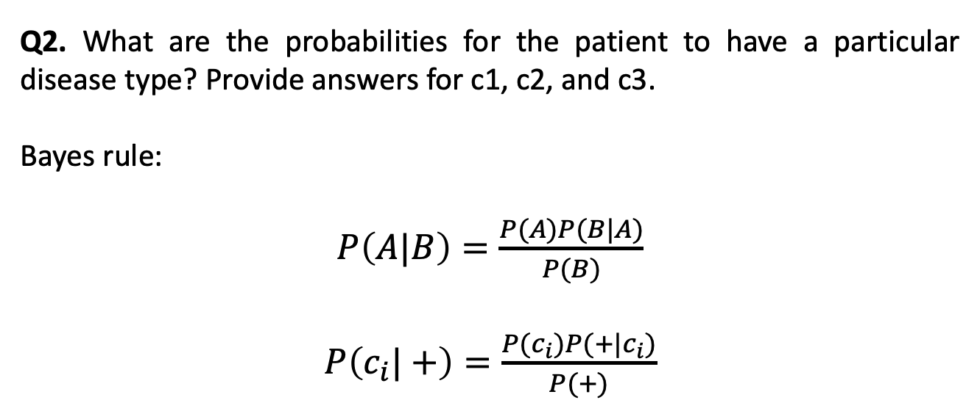
Assignment 2
Q2. What are the probabilities for the patient to have a particular disease type? Provide answers for c1, c2, and c3.
Bayes rule:
$P\left(A|B\right)=\frac{P(A)P(B|A)}{P(B)}$
$P\left(c_{i}|+\right)=\frac{P(c_{i})P(+|c_{i})}{P(+)}$
23

Slide 15
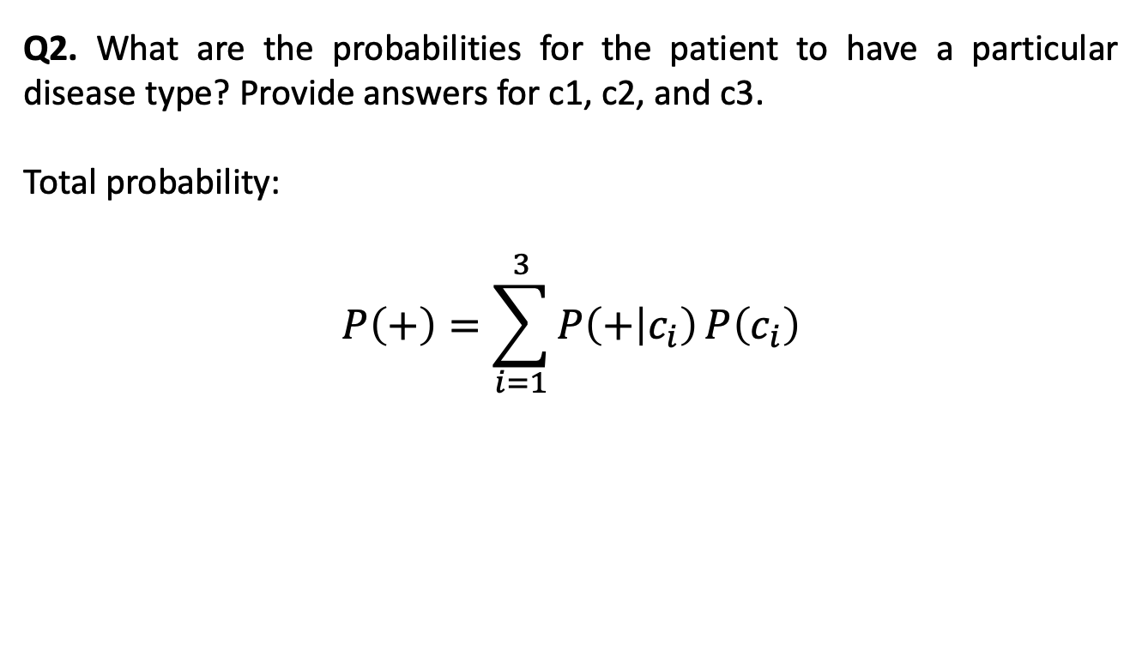
Assignment 2
Q2. What are the probabilities for the patient to have a particular disease type? Provide answers for c1, c2, and c3.
Total probability:
$$P\left(+\right)=\sum_{i=1}^{3}{P\left(+ | c_{i}\right)}P\left(c_{i}\right)$$
23

Slide 16
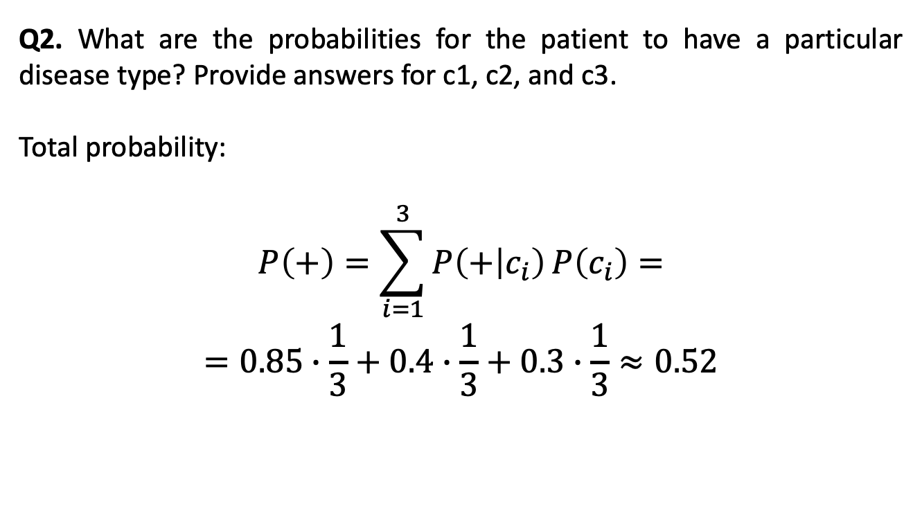
Assignment 2
Q2. What are the probabilities for the patient to have a particular disease type? Provide answers for c1, c2, and c3.
Total probability:
$$P\left(+\right)=\sum_{i=1}^{3}{P\left(+ | c_{i}\right)}P\left(c_{i}\right)=$$
$$=0.85∙\frac{1}{3}+0.4∙\frac{1}{3}+0.3∙\frac{1}{3}≈0.52$$
23

Slide 17
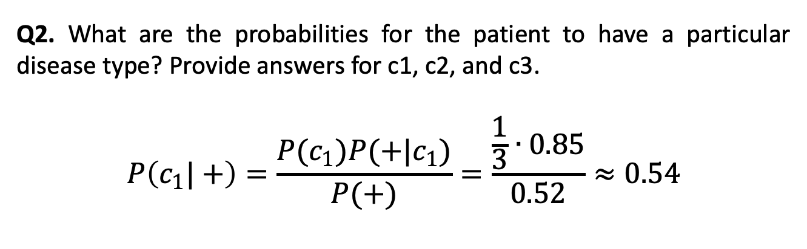
Assignment 2
Q2. What are the probabilities for the patient to have a particular disease type? Provide answers for c1, c2, and c3.
$$P\left(c_{1}|+\right)=\frac{P(c_{1})P(+|c_{1})}{P(+)}=\frac{\frac{1}{3}∙0.85}{0.52}≈0.54$$
23

Slide 18
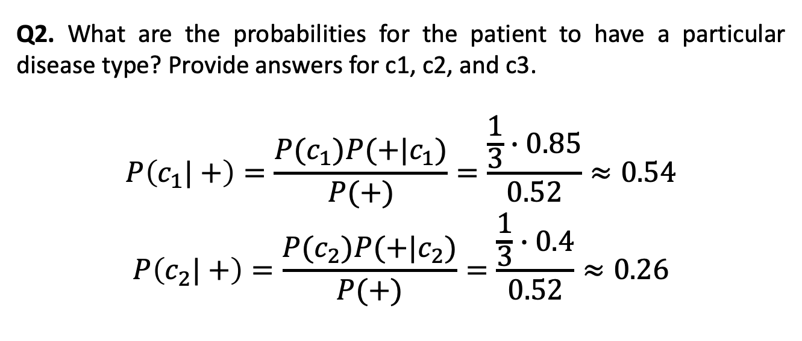
Assignment 2
Q2. What are the probabilities for the patient to have a particular disease type? Provide answers for c1, c2, and c3.
$$P\left(c_{1}|+\right)=\frac{P(c_{1})P(+|c_{1})}{P(+)}=\frac{\frac{1}{3}∙0.85}{0.52}≈0.54$$
$$P\left(c_{2}|+\right)=\frac{P(c_{2})P(+|c_{2})}{P(+)}=\frac{\frac{1}{3}∙0.4}{0.52}≈0.26$$
23

Slide 19
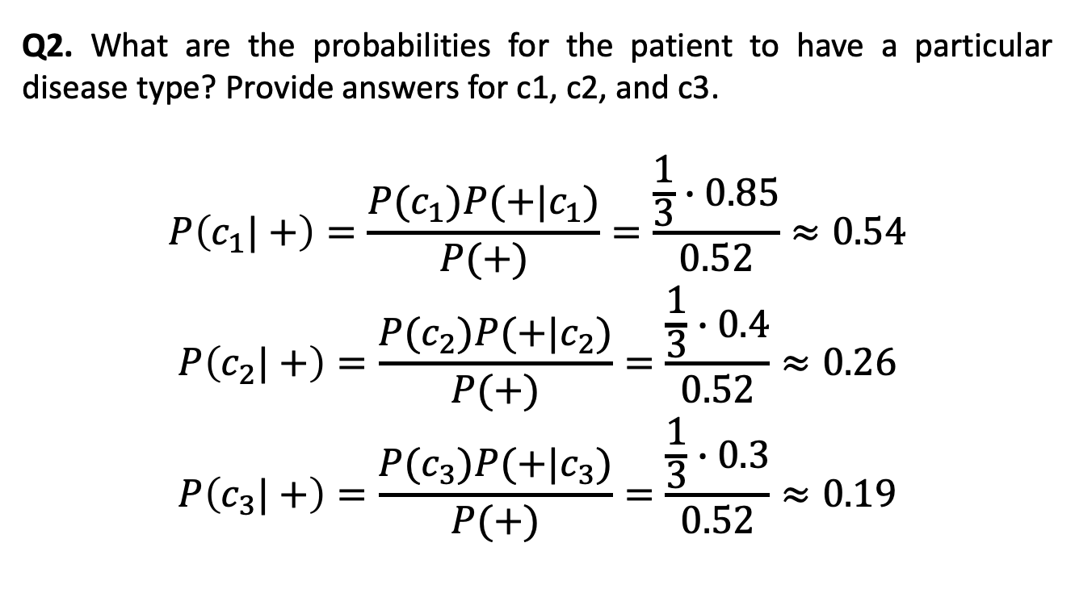
Assignment 2
Q2. What are the probabilities for the patient to have a particular disease type? Provide answers for c1, c2, and c3.
$$P\left(c_{1}|+\right)=\frac{P(c_{1})P(+|c_{1})}{P(+)}=\frac{\frac{1}{3}∙0.85}{0.52}≈0.54$$
$$P\left(c_{2}|+\right)=\frac{P(c_{2})P(+|c_{2})}{P(+)}=\frac{\frac{1}{3}∙0.4}{0.52}≈0.26$$
$$P\left(c_{3}|+\right)=\frac{P(c_{3})P(+|c_{3})}{P(+)}=\frac{\frac{1}{3}∙0.3}{0.52}≈0.19$$
23

Slide 20
Assignment 2
Q3. Conduct two iterations of the gradient descent algorithm for the linear regression model with intercept (bias column) over the following dataset:
X | Y
3 | 5
4 | 6
5 | 8
6 | 8
with the initial weights 0.1, 0.1.
Assume the learning rate is 0.5.
23

Slide 21
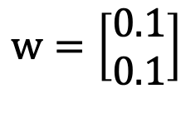
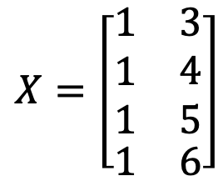
Assignment 2
Q3. Conduct two iterations of the gradient descent algorithm for the linear regression model with intercept (bias column) over the following dataset
$$X=\left[\begin{matrix}\begin{matrix}1 \\ 1 \\ 1\end{matrix} & \begin{matrix}3 \\ 4 \\ 5\end{matrix} \\ 1 & 6\end{matrix}\right]$$
$$w=\left[\begin{matrix}0.1 \\ 0.1\end{matrix}\right]$$
23

Slide 22

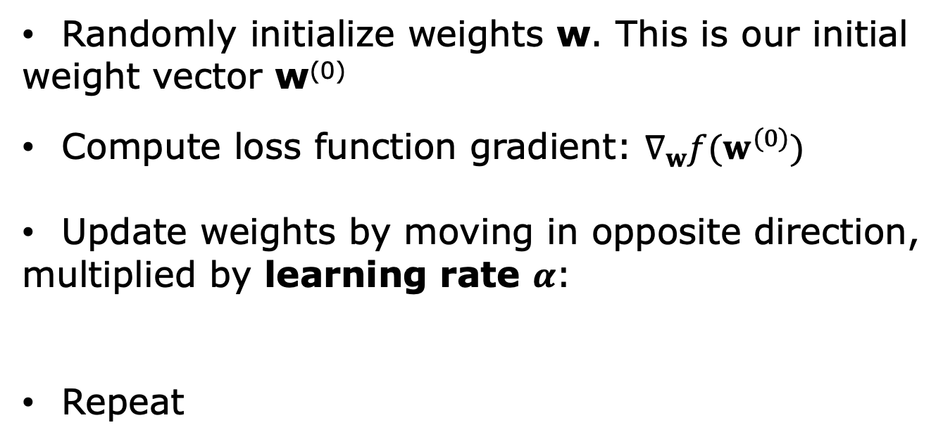

Assignemnt 2.Gradient Descent
Randomly initialize weights w. This is our initial
weight vector w⁽⁰⁾
Compute loss function gradient: $∇_{w}f(w^{(0)})$
Update weights by moving in opposite direction,
multiplied by learning rate $α$:
Repeat
$$w^{(1)}←w^{(0)}−α∇_{w}f(w^{(0)})$$
$$w^{(i)}←w^{(i−1)}−α∇_{w}f(w^{(i−1)})$$
10

Slide 23
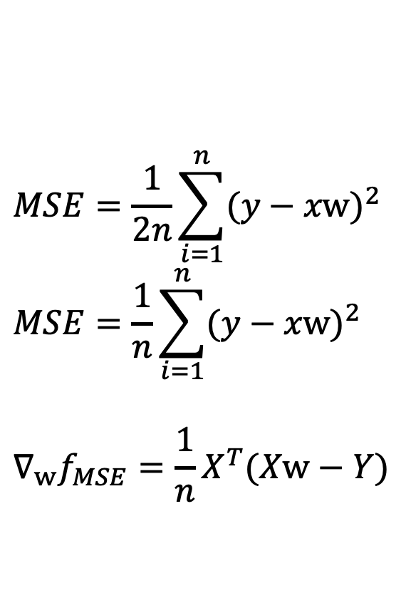
Assignemnt 2.Gradient Descent
$$MSE=\frac{1}{2n}\sum_{i=1}^{n}{{(y−xw)}^{2}}$$
$$MSE=\frac{1}{n}\sum_{i=1}^{n}{{(y−xw)}^{2}}$$
$$∇_{w}f_{MSE}=\frac{1}{n}X^{T}(Xw−Y)$$
10

Slide 24
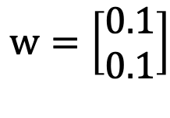
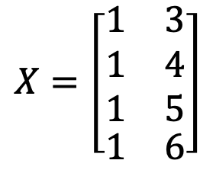
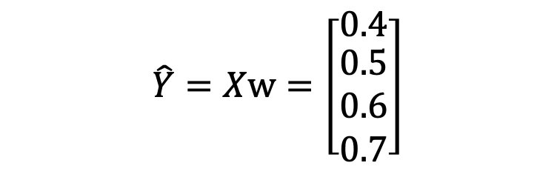
Assignment 2
Q3. Conduct two iterations of the gradient descent algorithm for the linear regression model with intercept (bias column) over the following dataset
$$X=\left[\begin{matrix}\begin{matrix}1 \\ 1 \\ 1\end{matrix} & \begin{matrix}3 \\ 4 \\ 5\end{matrix} \\ 1 & 6\end{matrix}\right]$$
$$\hat{Y}=Xw=\left[\begin{matrix}0.4 \\ \begin{matrix}0.5 \\ 0.6 \\ 0.7\end{matrix}\end{matrix}\right]$$
$$w=\left[\begin{matrix}0.1 \\ 0.1\end{matrix}\right]$$
23

Slide 25
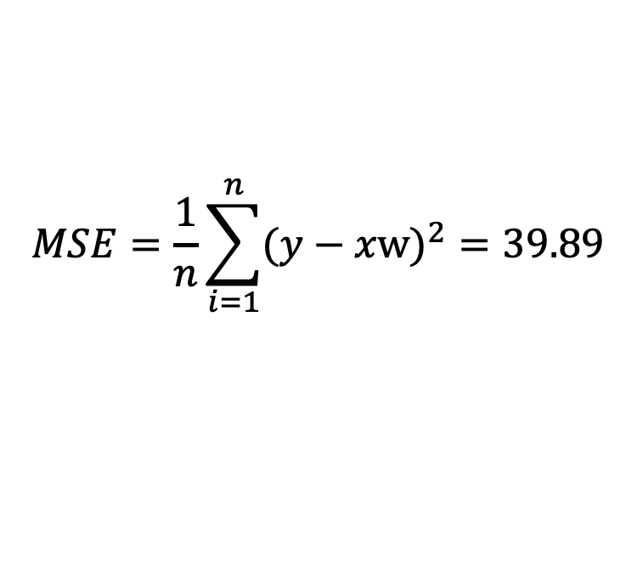
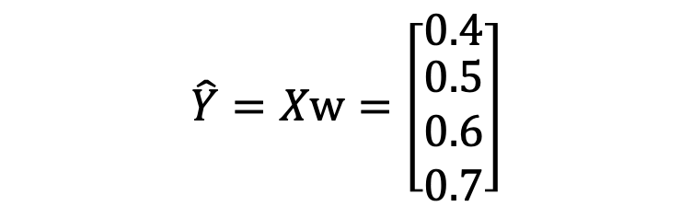
Assignment 2
Q3. Conduct two iterations of the gradient descent algorithm for the linear regression model with intercept (bias column) over the following dataset
$$X=\left[\begin{matrix}\begin{matrix}1 \\ 1 \\ 1\end{matrix} & \begin{matrix}3 \\ 4 \\ 5\end{matrix} \\ 1 & 6\end{matrix}\right]$$
$$\hat{Y}=Xw=\left[\begin{matrix}0.4 \\ \begin{matrix}0.5 \\ 0.6 \\ 0.7\end{matrix}\end{matrix}\right]$$
$$MSE=\frac{1}{n}\sum_{i=1}^{n}{{(y−xw)}^{2}}=39.89$$
$$w=\left[\begin{matrix}0.1 \\ 0.1\end{matrix}\right]$$
23

Slide 26
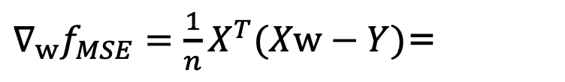
Assignment 2
Q3. Conduct two iterations of the gradient descent algorithm for the linear regression model with intercept (bias column) over the following dataset
$$X=\left[\begin{matrix}\begin{matrix}1 \\ 1 \\ 1\end{matrix} & \begin{matrix}3 \\ 4 \\ 5\end{matrix} \\ 1 & 6\end{matrix}\right]$$
$$\hat{Y}=Xw=\left[\begin{matrix}0.4 \\ \begin{matrix}0.5 \\ 0.6 \\ 0.7\end{matrix}\end{matrix}\right]$$
$$w=\left[\begin{matrix}0.1 \\ 0.1\end{matrix}\right]$$
$∇_{w}f_{MSE}=\frac{1}{n}X^{T}(Xw−Y)$=
23

Slide 27
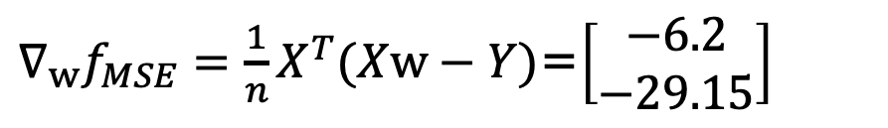
Assignment 2
Q3. Conduct two iterations of the gradient descent algorithm for the linear regression model with intercept (bias column) over the following dataset
$$X=\left[\begin{matrix}\begin{matrix}1 \\ 1 \\ 1\end{matrix} & \begin{matrix}3 \\ 4 \\ 5\end{matrix} \\ 1 & 6\end{matrix}\right]$$
$$\hat{Y}=Xw=\left[\begin{matrix}0.4 \\ \begin{matrix}0.5 \\ 0.6 \\ 0.7\end{matrix}\end{matrix}\right]$$
$$MSE=\frac{1}{n}\sum_{i=1}^{n}{{(y−xw)}^{2}}=39.89$$
$$w=\left[\begin{matrix}0.1 \\ 0.1\end{matrix}\right]$$
$∇_{w}f_{MSE}=\frac{1}{n}X^{T}(Xw−Y)$=$\left[\begin{matrix}−6.2 \\ −29.15\end{matrix}\right]$
23

Slide 28
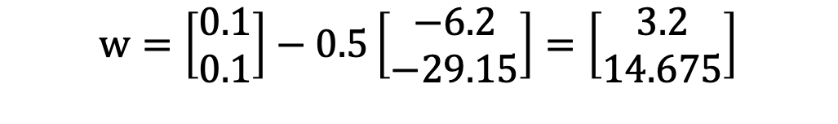
Assignment 2
Q3. Conduct two iterations of the gradient descent algorithm for the linear regression model with intercept (bias column) over the following dataset
$$X=\left[\begin{matrix}\begin{matrix}1 \\ 1 \\ 1\end{matrix} & \begin{matrix}3 \\ 4 \\ 5\end{matrix} \\ 1 & 6\end{matrix}\right]$$
$$w=\left[\begin{matrix}0.1 \\ 0.1\end{matrix}\right]−0.5\left[\begin{matrix}−6.2 \\ −29.15\end{matrix}\right]=\left[\begin{matrix}3.2 \\ 14.675\end{matrix}\right]$$
23

Slide 29
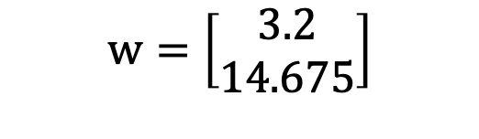
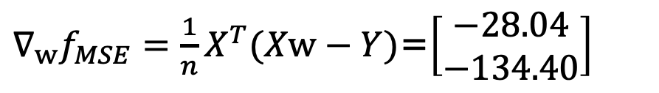
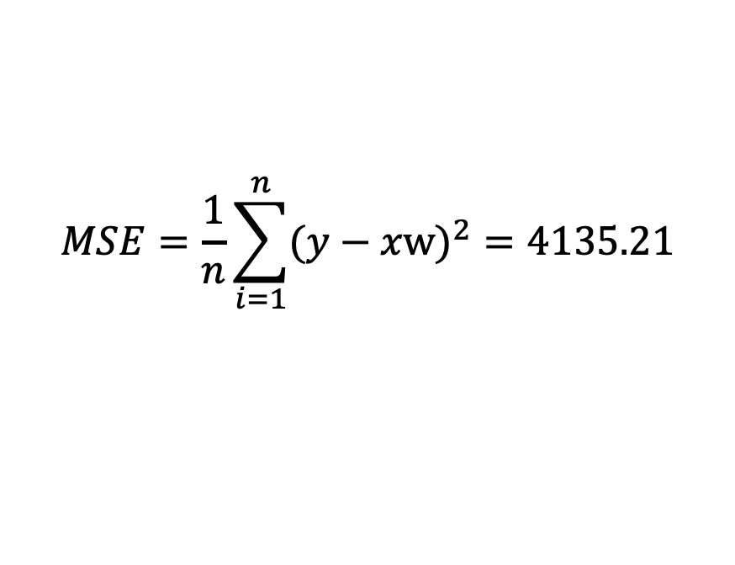
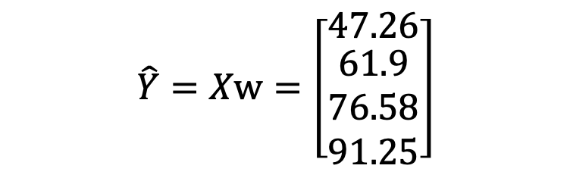
Assignment 2
Q3. Conduct two iterations of the gradient descent algorithm for the linear regression model with intercept (bias column) over the following dataset
$$X=\left[\begin{matrix}\begin{matrix}1 \\ 1 \\ 1\end{matrix} & \begin{matrix}3 \\ 4 \\ 5\end{matrix} \\ 1 & 6\end{matrix}\right]$$
$$\hat{Y}=Xw=\left[\begin{matrix}47.26 \\ \begin{matrix}61.9 \\ 76.58 \\ 91.25\end{matrix}\end{matrix}\right]$$
$$MSE=\frac{1}{n}\sum_{i=1}^{n}{{(y−xw)}^{2}}=4135.21$$
$$w=\left[\begin{matrix}3.2 \\ 14.675\end{matrix}\right]$$
$∇_{w}f_{MSE}=\frac{1}{n}X^{T}(Xw−Y)$=$\left[\begin{matrix}−28.04 \\ −134.40\end{matrix}\right]$
23

Slide 30
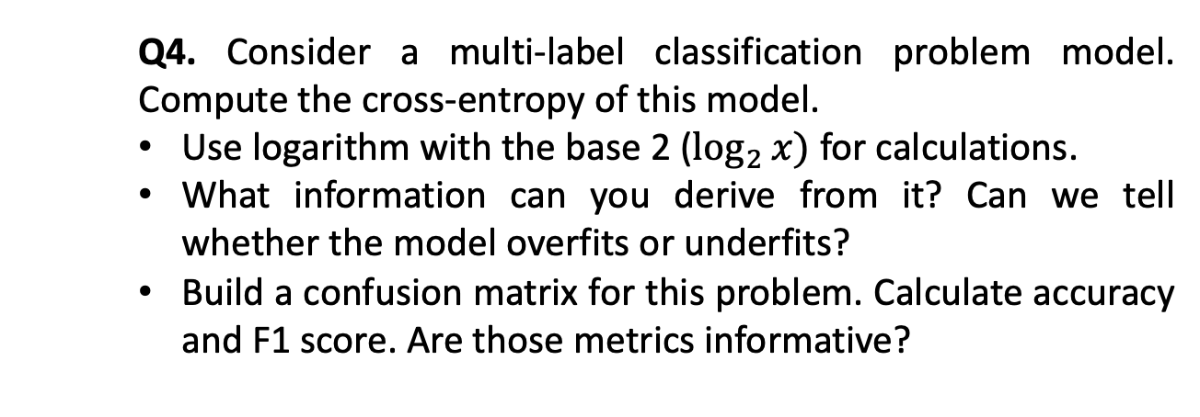
Assignment 2
Q4. Consider a multi-label classification problem model. Compute the cross-entropy of this model.
Use logarithm with the base 2 ($\log_{2}{x})$ for calculations.
What information can you derive from it? Can we tell whether the model overfits or underfits?
Build a confusion matrix for this problem. Calculate accuracy and F1 score. Are those metrics informative?
23

Slide 31
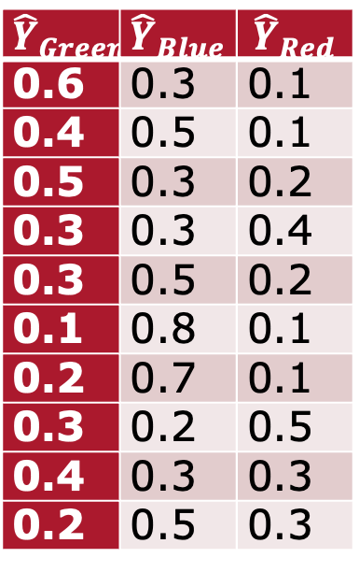
Assignment 2
Q4. Compute the cross-entropy of this model
$${\hat{Y}}_{Green}$$ | $${\hat{Y}}_{Blue}$$ | $${\hat{Y}}_{Red}$$
0.6 | 0.3 | 0.1
0.4 | 0.5 | 0.1
0.5 | 0.3 | 0.2
0.3 | 0.3 | 0.4
0.3 | 0.5 | 0.2
0.1 | 0.8 | 0.1
0.2 | 0.7 | 0.1
0.3 | 0.2 | 0.5
0.4 | 0.3 | 0.3
0.2 | 0.5 | 0.3
Y
Green
Blue
Blue
Red
Green
Green
Blue
Green
Green
Green
23

Slide 32
Assignment 2
Q4. Compute the cross-entropy of this model
$${\hat{Y}}_{Green}$$ | $${\hat{Y}}_{Blue}$$ | $${\hat{Y}}_{Red}$$
0.6 | 0.3 | 0.1
0.4 | 0.5 | 0.1
0.5 | 0.3 | 0.2
0.3 | 0.3 | 0.4
0.3 | 0.5 | 0.2
0.1 | 0.8 | 0.1
0.2 | 0.7 | 0.1
0.3 | 0.2 | 0.5
0.4 | 0.3 | 0.3
0.2 | 0.5 | 0.3
Y
Green
Blue
Blue
Red
Green
Green
Blue
Green
Green
Green
23
Notes:
CE=15.75

Slide 33
Assignment 2
Q4. Construct confusion matrix
$${\hat{Y}}_{Green}$$ | $${\hat{Y}}_{Blue}$$ | $${\hat{Y}}_{Red}$$
0.6 | 0.3 | 0.1
0.4 | 0.5 | 0.1
0.5 | 0.3 | 0.2
0.3 | 0.3 | 0.4
0.3 | 0.5 | 0.2
0.1 | 0.8 | 0.1
0.2 | 0.7 | 0.1
0.3 | 0.2 | 0.5
0.4 | 0.3 | 0.3
0.2 | 0.5 | 0.3
Y
Green
Blue
Blue
Red
Green
Green
Blue
Green
Green
Green
2 | 2 | 1
1 | 2 | 0
0 | 0 | 1
23
Notes:
CE=15.75

Slide 34
Multiclass Confusion Matrix
 | C1 | C2 | C3 | C4 | C5
C1 | TN | TN | FP | TN | TN
C2 | TN | TN | FP | TN | TN
C3 | FN | FN | TP | FN | FN
C4 | TN | TN | FP | TN | TN
C5 | TN | TN | FP | TN | TN
12

Slide 35
F1 Score
 |  | Predicted Class
 |  | Positive | Negative
Actual Class | Positive | True Positive | False Negative
 | Negative | False Positive | True Negative
2 ∗ 𝑃𝑟𝑒𝑐𝑖𝑠𝑖𝑜𝑛 ∗ 𝑅𝑒𝑐𝑎𝑙𝑙
𝐹1 =
𝑃𝑟𝑒𝑐𝑖𝑠𝑖𝑜𝑛 + 𝑅𝑒𝑐𝑎𝑙𝑙
12

Slide 36

Precision
 |  | Predicted Class
 |  | Positive | Negative
Actual Class | Positive | True Positive | False Negative
 | Negative | False Positive | True Negative
𝑇𝑟𝑢𝑒 𝑃𝑜𝑠𝑖𝑡𝑖𝑣𝑒
𝑇𝑃
𝑃𝑟𝑒𝑐𝑖𝑠𝑖𝑜𝑛 =
=
𝑃𝑟𝑒𝑑𝑖𝑐𝑡𝑒𝑑 𝑃𝑜𝑠𝑖𝑡𝑖𝑣𝑒
𝑇𝑃 + 𝐹𝑃
8

Slide 37

Recall – True Positive Rate – Sensitivity
 |  | Predicted Class
 |  | Positive | Negative
Actual Class | Positive | True Positive | False Negative
 | Negative | False Positive | True Negative
𝑇𝑟𝑢𝑒 𝑃𝑜𝑠𝑖𝑡𝑖𝑣𝑒
𝑇𝑃
𝑇𝑃𝑅 = 𝑅𝑒𝑐𝑎𝑙𝑙 =
=
𝐴𝑐𝑡𝑢𝑎𝑙 𝑃𝑜𝑠𝑖𝑡𝑖𝑣𝑒
𝑇𝑃 + 𝐹𝑁
9

Slide 38
Assignment 2
Q4. Construct confusion matrix
$${\hat{Y}}_{Green}$$ | $${\hat{Y}}_{Blue}$$ | $${\hat{Y}}_{Red}$$
0.6 | 0.3 | 0.1
0.4 | 0.5 | 0.1
0.5 | 0.3 | 0.2
0.3 | 0.3 | 0.4
0.3 | 0.5 | 0.2
0.1 | 0.8 | 0.1
0.2 | 0.7 | 0.1
0.3 | 0.2 | 0.5
0.4 | 0.3 | 0.3
0.2 | 0.5 | 0.3
Y
Green
Blue
Blue
Red
Green
Green
Blue
Green
Green
Green
2 | 2 | 1
1 | 2 | 0
0 | 0 | 1
23
Notes:
CE=15.75

Slide 39
Cross-Validation
Split your data into k disjoint sets
Each time, one set is the test set and the rest is the training set
Training Set
Test Set
Validation Set

Slide 40
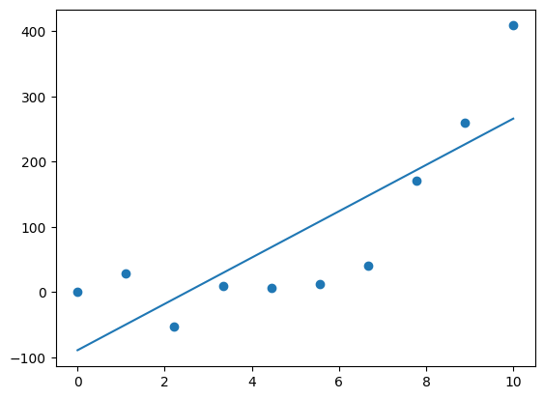
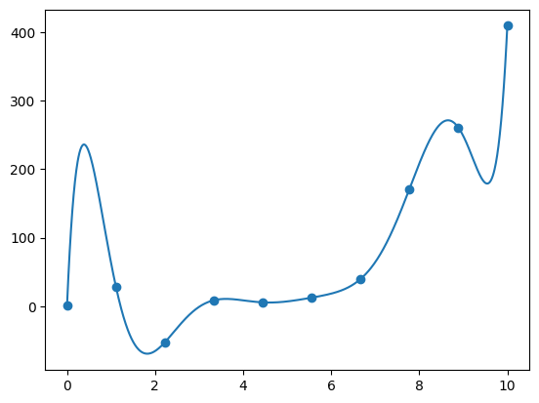
Bias / Variance Tradeoff
Making strong assumptions
Simple model
Underfitting
Allowing model to infer lots
of interdependencies in data
Very complex model
Overfitting
High Bias
High Variance

Slide 41
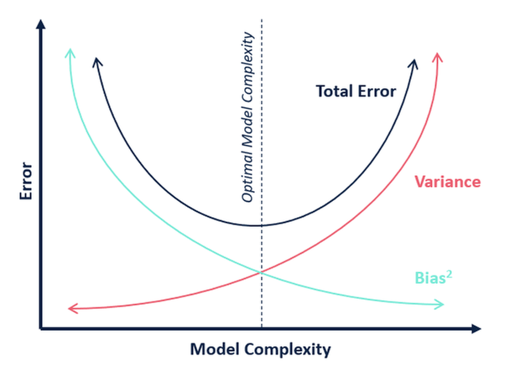
Bias / Variance Tradeoff

Slide 42
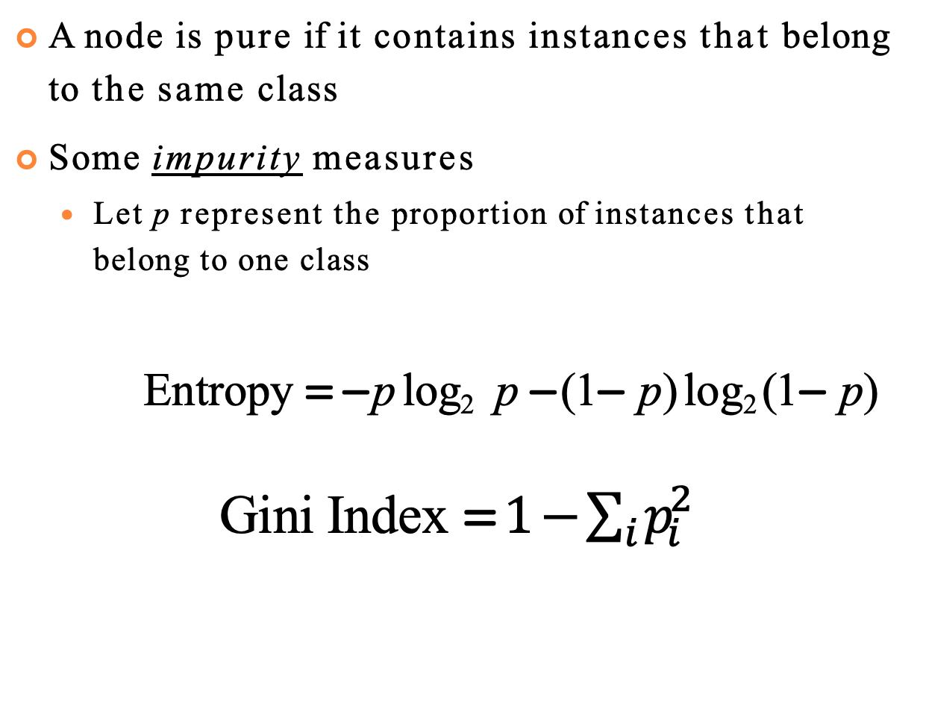
Purity
A node is pure if it contains instances that belong to the same class
Some impurity measures
Let p represent the proportion of instances that belong to one class
Entropy = − p log₂ p − (1− p) log₂ (1− p)
Gini Index =$1−\sum_{i}{p_{i}^{2}}$
18

Slide 43
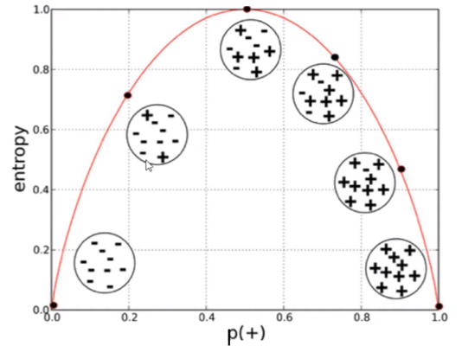
Visualization
Entropy
https://miro.medium.com/v2/resize:fit:1068/format:webp/1*vbbZdjEhxylwLj-z-qcL7w.png
18

Slide 44
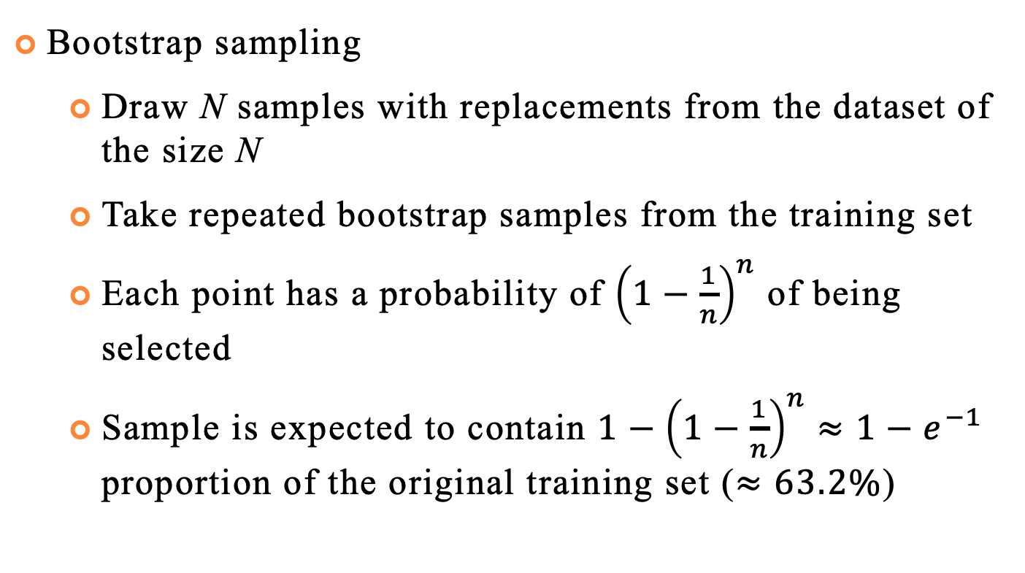
Bagging (Bootstrap Aggregation)
Bootstrap sampling
Draw N samples with replacements from the dataset of the size N
Take repeated bootstrap samples from the training set
Each point has a probability of ${\left(1−\frac{1}{n}\right)}^{n}$ of being selected
Sample is expected to contain $1−{\left(1−\frac{1}{n}\right)}^{n}≈1−e^{−1}$ proportion of the original training set ($≈63.2\%$)
39

Slide 45
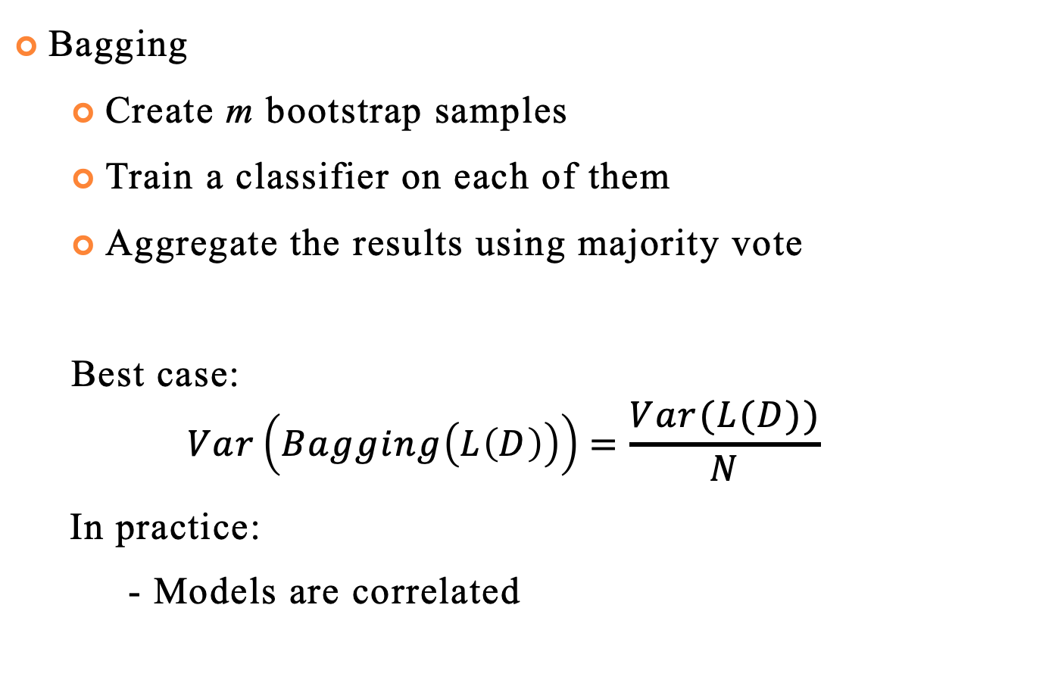
Bagging (Bootstrap Aggregation)
Bagging
Create m bootstrap samples
Train a classifier on each of them
Aggregate the results using majority vote
Best case:
$$Var\left(Bagging\left(L\left(D\right)\right)\right)=\frac{Var(L(D))}{N}$$
In practice:
- Models are correlated
39

Slide 46
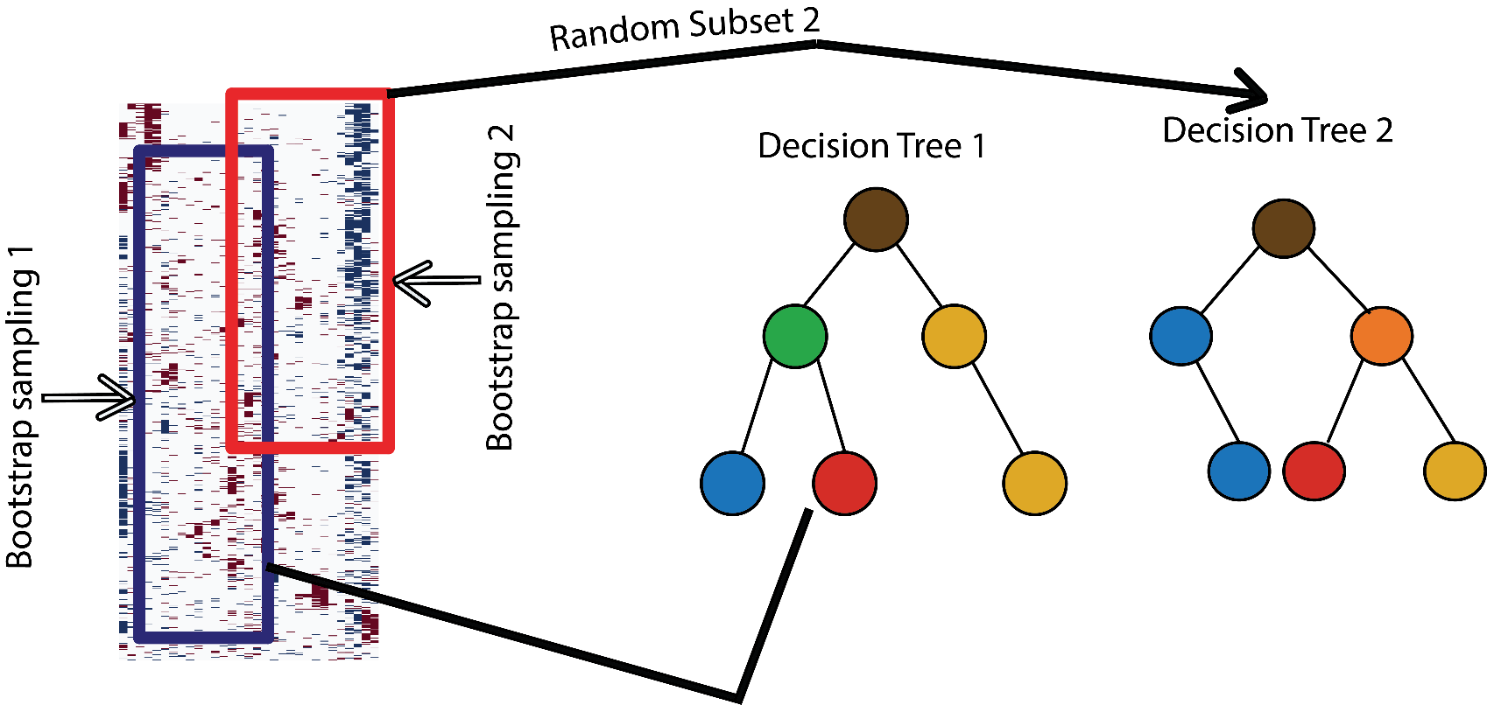
Random Forest
Introduce another source of randomness - random projections
39

