Slide 1
CS583 Probabilistic Graphical Models
Lecture 1. Foundations
Oleksandr Narykov
onarykov@iit.edu

Slide 2
Introduction
Probabilistic graphical models features
Bayesian reasoning
Declarative representations
Recommended literature
Probabilistic Graphical Models: Principles and Techniques by D. Koller, N. Friedman
Selected chapters from Information Theory, Inference, and Learning Algorithms by D. MacKay
Math-oriented class
Programming language: Python.
Library: pgmpy https://pgmpy.org/
Notes:
Without assumptions you cannot make predictions
Declarative representations are different from the purely data-driven machine learning algorithms
They allow us to incorporate prior domain knowledge into generative model and separate it from

Slide 3
Probability

Slide 4
Probability Distribution
Ω: Space of possible outcomes
E.g., Rolling a die Ω = {1, 2, 3, 4, 5, 6}
S: Measurable events
E.g., An odd roll of die S = {1, 3, 5}
A probability distribution P over (Ω, S) is a mapping from events in S to real values that satisfies
P(α) ≥ 0 for all α∈S
P(Ω) = 1
If α,β∈S and α∩β=∅, then P(α∪β) = P(α) + P(β)
Notes:
What is P(a V b) if a ^ b is not empty?

Slide 5
Random Variables
A problem is represented through variables
Age, fever, lab tests, …
Industrious (student), Difficulty (of a class), Grade (of a student in that class), …
A variable takes on values from its domain
Fever takes on True, False
Grade takes on A, B, C
Can be either discrete or continuous
Grade is discrete, Age is continuous
In an uncertain world, a variable takes on values from its domain probabilistically
For example, Grade can be A, B, or C probabilistically
P(Grade = A), P(Grade = B), P(Grade = C)

Slide 6
Random Variables – Notation
Capital: X: variable
Lowercase: x: a particular value of X
Val(X): the set of values X can take
Bold Capital: X: a set of variables
Bold lowercase: x: an assignment to all variables in X
P(X=x) will be shortened as P(x)
P(X=x ∩ Y=y) will be shortened as P(x,y)

Slide 7
Table – the most basic representation
Industrious | P(Industrious)
~industrious | 0.7
industrious | 0.3
Grade | P(Grade)
a | 0.25
b | 0.37
c | 0.38

Slide 8
Joint Distribution
Several random variables
X={X₁, X₂, …, X_{n}}
Joint Distribution
P(X) = P(X₁, X₂, …, X_{n})
Specifies a probability value to all possible assignments

Slide 9
Joint Distribution
Industrious | Grade | P(Industrious, Grade)
~industrious | a | 0.07
~industrious | b | 0.28
~industrious | c | 0.35
industrious | a | 0.18
industrious | b | 0.09
industrious | c | 0.03

Slide 10
Conditional Probability
P(X|Y) = P(X, Y) / P(Y)
What do the following mean?
P(Grade)
P(Grade | Industrious)
P(Grade | Industrious = industrious)
P(Grade = a | Industrious = ~industrious)

Slide 11
Summation Rule
Given P(X, Y), P(X) can be computed using
P(X) = Σ_{y}P(X,y) where y ranges over Val(Y)
Answer the following
Σ_{x}P(X) = ?
Σ_{x}P(X|y) = ?
Σ_{y}P(X|Y) = ?

Slide 12
Chain Rule
P(X₁, X₂, X₃, …, X_{k}) =
P(X₁) P(X₂|X₁) P(X₃|X₁,X₂)… P(X_{k} |X₁, X₂, X₃, …, X_{k-1})
or
P(X₂) P(X₁|X₂) P(X₃|X₁,X₂)… P(X_{k} |X₁, X₂, X₃, …, X_{k-1})
or
P(X₂) P(X₃|X₂) P(X₁|X₃,X₂)… P(X_{k} |X₁, X₂, X₃, …, X_{k-1})
or
Pick an order, then
P(first)P(second|first)P(third|first,second)…P(last|all_previous)

Slide 13
Bayes Rule
Bayes Rule
P(X|Y) = P(Y|X)P(X) / P(Y)
Conditional Bayes Rule
P(X|Y, Z) = P(Y|X, Z)P(X|Z) / P(Y|Z)

Slide 14
Bayes Rule
Can we compute P(α|β) from P(β|α)?
E.g.,
In a class, 70% of the industrious students got an A.
P(a | industrious ) = 0.7
John got an A. What is the probability of John being industrious given he got an A?
P( industrious | a) = ?
Note: these numbers have nothing to do with the previous tables and numbers.

Slide 15
Class Example
Let’s say there are 100 students in the class
Let’s say 10 of them are industrious, 90 are ~industrious
Probability of a randomly picked student being industrious
P(industrious) = 0.1
We know that 70% of the industrious students got an A.
P(a|industrious) = 0.7
7 industrious students got an A; 3 did not get an A.
What is P(industrious|a) = ?
Depends on P(a)

Slide 16
Very Hard Class
industrious
∼industrious
A
3
7
0
90
P(i|a) = ?
Notes:
P(s|a) = 7/7 = 1

Slide 17
Medium Hard Class
industrious
∼industrious
A
3
7
18
72
P(i|a) = ?
Notes:
P(s|a) = 7/25 = 0.28

Slide 18
Weird Class
industrious
∼industrious
A
3
7
90
0
P(i|a) = ?
Notes:
P(s|a) = 7/97 ≈ 0.07

Slide 19
Exercise
In a state, 60% of the hospitalized patients are vaccinated.
P(v | h) = 0.6
What does this number tell you about the effectiveness of the vaccines in preventing hospitalizations?

Slide 20
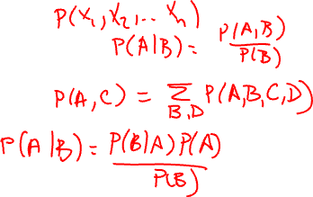
So Far
Definition of probability distributions
Random variables
Joint distribution
Conditional distribution
Chain rule
Summation rule
Bayes rule

Slide 21
Marginal Independence
An event α is independent of an event β in P, denoted as P╞ α ⊥ β, if
P(α|β) = P(α), or
P(β) = 0
Proposition: A distribution P satisfies α ⊥ β if and only if
P(α, β) = P(α) P(β)
Can you prove it?
Corollary: α ⊥ β implies β ⊥ α

Slide 22

Marginal Independence
X | Y | P(X, Y)
t | t | 0.18
t | f | 0.42
f | t | 0.12
f | f | 0.28
Is X ⊥ Y?

Slide 23
Conditional Independence
Two events are independent given another event
An event α is independent of event β given event γ in P, denoted as P╞ (α ⊥ β | γ), if
P(α|β, γ) = P(α| γ), or
P(β, γ) = 0
Proposition: A distribution P satisfies α ⊥ β | γ if and only if
P(α, β | γ) = P(α| γ) P(β| γ)
Notes:
Examples:
Traffic, John arrives late, Mary arrives late. J ind M | T
Height, Knowledge, Age. H ind K | A

Slide 24
Querying a distribution
Evidence (E=e): what is known, Query (Y): variables of interest, X is the set of all variables that include E, Y, and potentially others
Probability query
P(Y|e) = ?
MAP query
W = X \ E (i.e., all the non-evidence variables)
MAP(W|e) = argmax_{w}P(w,e)
Important: We cannot find w by finding the maximum likely value for each variable individually
Marginal MAP query
MAP(Y|e) = argmax_{y}P(y|e)
Let Z = X \ E∪Y
MAP(Y|e) = argmax_{y} ∑_{z}P(z, y|e)

Slide 25
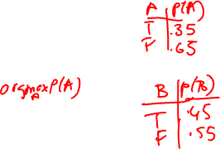
MAP Example
A | B | P(A, B)
t | t | 0.10
t | f | 0.25
f | t | 0.35
f | f | 0.30
Maximum likely assignment for A =
f
Maximum likely assignment for B =
f
MAP (A,B) =
<A=f, B=t>

Slide 26
Continuous Spaces
Assume X is continuous and Val(X) = [0,1]
If you would like to assign the same probability to all real numbers in [0, 1], what is, for e.g., P(X=0.5) = ?
Answer: P(X=0.5) = 0.

Slide 27
Probability Density Function
We define probability density function, p(x), a non-negative integrable function, such that

Slide 28
Uniform Distribution
A variable X has a uniform distribution over [a,b] if it has the PDF
Check and make sure that p(x) integrates to 1.

Slide 29
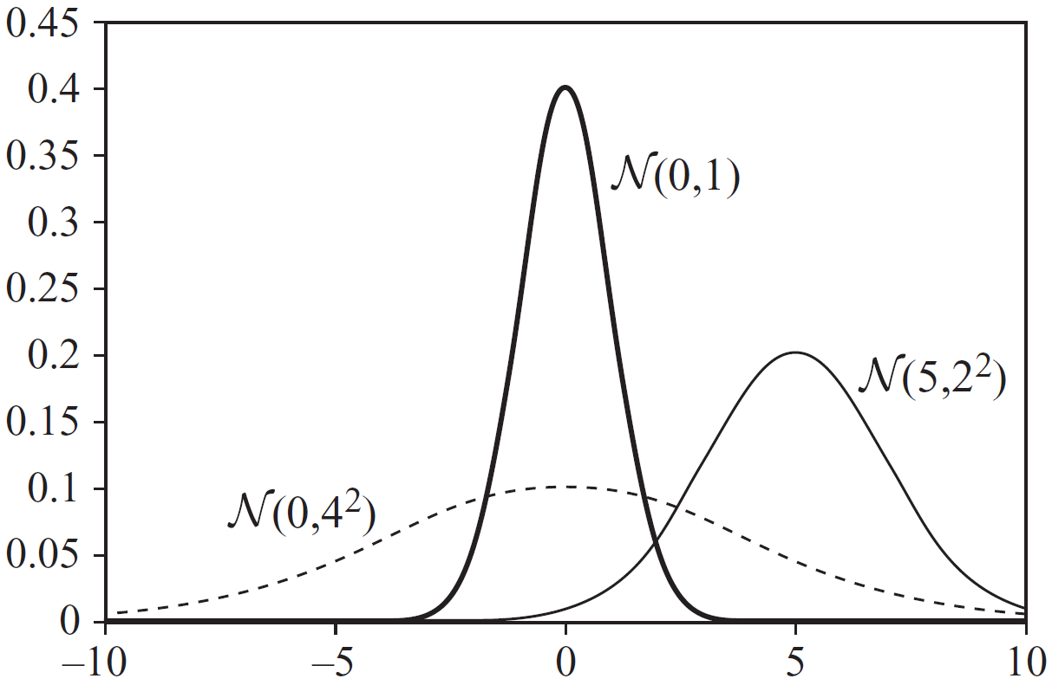
Gaussian Distribution
A variable X has a Gaussian distribution with mean μ and variance σ², if it has the PDF
Can p(x) be ever greater than 1?

Slide 30
Conditional Probability
We want P(Y|X=x) where X is continuous, Y is discrete
P(Y|X=x) = P(Y,X=x) / P(X=x)
What’s wrong with this expression?
Instead, we use the following expression

Slide 31
Conditional Probability
We want p(Y|X) where X is discrete, Y is continuous
How would you represent it?

Slide 32
Expectation
What about E[X*Y]?
Notes:
E[X*Y] = E[X] * E[Y] iff X and Y are independent

Slide 33

Variance
Can you derive the second expression using the first expression?
What is Var[X+Y]?
Notes:
Var[X+Y] = Var[X] + Var[Y] iff X and Y are independent

Slide 34
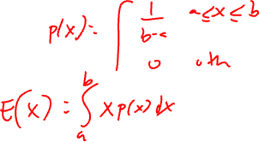
Uniform and Gaussian Distribution
If X∼N(μ,σ²), then E[X] = μ, Var[X] = σ²
What about the expectation and variance of a uniform distribution?

Slide 35
Graphs

Slide 36
Graphs
A graph consists of nodes and edges
Nodes: X={X₁, X₂, …, X_{n}}
Undirected Edge: X_{i} – X_{j}
Directed Edge: X_{i} → X_{j}
Between a pair of nodes, at most one type of edge exists
We cannot have X_{i} → X_{j} and X_{j} → X_{i} at the same time, and
We cannot have X_{i} → X_{j} and X_{i} – X_{j} at the same time
Some edge: X_{i}  X_{j}

Slide 37
Directed and undirected
A graph is directed if its all edges are directed
A graph is undirected if its all edges are undirected

Slide 38
Relationships
X_{i} → X_{j}
X_{i} is the parent
X_{j} is the child
X_{i} – X_{j}
X_{i} and X_{j} are neighbors
X_{i}  X_{j}
X_{i} and X_{j} are adjacent
Degree of X_{i}: The number of edges X_{i} is part of
Indegree of X_{i}: The number of directed edges pointing to X_{i}
Degree of a graph: The maximal degree of a node in the graph

Slide 39
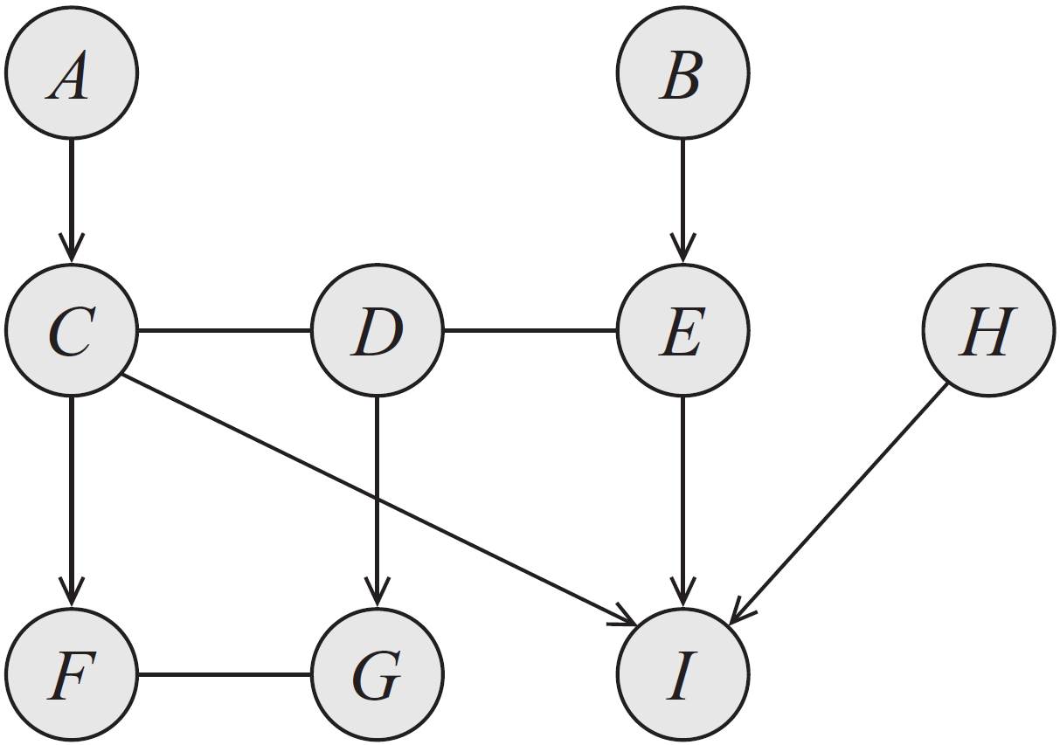
Example
Examples of:
Parents
Children
Neighbors
Adjacent nodes
Degree
Indegree
Notes:
Parents, children, neighbors, adjacent nodes, degree, indegree

Slide 40
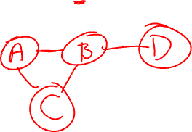
Complete Graphs and Cliques
A subgraph over X⊆X is complete if every two nodes in X are connected by some edge
Such a set X is also called a clique
A clique is maximal if for any superset of nodes Y⊃X, Y is not a clique

Slide 41
Paths and Trails
X₁, X₂, …, X_{k} forms a path if, for every i =1, 2, …, k-1, we have that either X_{i} – X_{i+1} or X_{i} → X_{i+1}.
A path is directed if, for at least one i, X_{i} → X_{i+1}.
X₁, X₂, …, X_{k} forms a trail if, for every i =1, 2, …, k-1, we have X_{i}  X_{i+1}.
What is the difference between a path and a trail? Is every path also a trail? Is every trail also a path?

Slide 42
Ancestors and descendants
X_{i} is an ancestor of X_{j} if there is a directed path from X_{i} to X_{j}
X_{i} is a descendant of X_{j} if there is a directed path from X_{j} to X_{i}
Nondescendants(X_{i}) ≡ X \ Descendants(X_{i})

Slide 43
Cycles and Loops
A cycle is a directed path from a node to itself
A graph is acyclic if it contains no cycles
A directed acyclic graph is the one where all edges are directed and there are no cycles
A loop is a trail from a node to itself
A graph is singly-connected if it contains no loops

Slide 44
Next
Bayesian networks

