Slide 1
CS584 Machine Learning
Lecture 14. Neural Networks
Oleksandr Narykov
onarykov@iit.edu

Slide 2
Assignment 1
Q1. Provide an optimal linear regression model with intercept
using a closed-form matrix formula.
Plot it along with the original dataset.
X | Y
-1 | 0
0 | 2
1 | 4
2 | 5
2

Slide 3
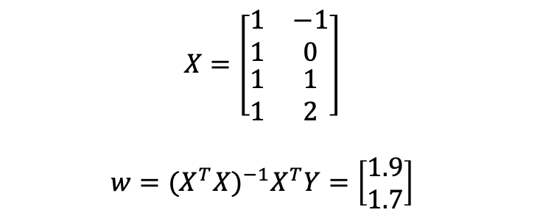
Assignment 1
Q1. Provide an optimal linear regression model with intercept
using a closed-form matrix formula.
Plot it along with the original dataset.
X | Y
-1 | 0
0 | 2
1 | 4
2 | 5
$$X=\left[\begin{matrix}\begin{matrix}1 \\ 1\end{matrix} & \begin{matrix}−1 \\ 0\end{matrix} \\ \begin{matrix}1 \\ 1\end{matrix} & \begin{matrix}1 \\ 2\end{matrix}\end{matrix}\right]$$
$$w={(X^{T}X)}^{−1}X^{T}Y=\left[\begin{matrix}1.9 \\ 1.7\end{matrix}\right]$$
2

Slide 4


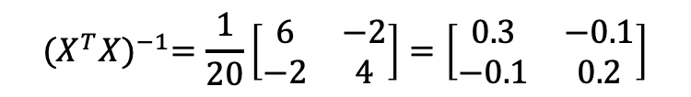

Assignment 1
Q1. Provide an optimal linear regression model with intercept
using a closed-form matrix formula.
Plot it along with the original dataset.
X | Y
-1 | 0
0 | 2
1 | 4
2 | 5
$$X=\left[\begin{matrix}\begin{matrix}1 \\ 1\end{matrix} & \begin{matrix}−1 \\ 0\end{matrix} \\ \begin{matrix}1 \\ 1\end{matrix} & \begin{matrix}1 \\ 2\end{matrix}\end{matrix}\right]$$
$$w={(X^{T}X)}^{−1}X^{T}Y=\left[\begin{matrix}1.9 \\ 1.7\end{matrix}\right]$$
$$X^{T}X=\left[\begin{matrix}4 & 2 \\ 2 & 6\end{matrix}\right]$$
$${det⁡(X}^{T}X)=6∙4−2∙2=20$$
$${(X^{T}X)}^{−1}=\frac{1}{20}\left[\begin{matrix}6 & −2 \\ −2 & 4\end{matrix}\right]=\left[\begin{matrix}0.3 & −0.1 \\ −0.1 & 0.2\end{matrix}\right]$$
2
$$X^{T}Y=\left[\begin{matrix}11 \\ 14\end{matrix}\right]$$

Slide 5
Assignment 1
Q1. Provide an optimal linear regression model with intercept
using a closed-form matrix formula.
Plot it along with the original dataset.
X | Y
-1 | 0
0 | 2
1 | 4
2 | 5
$$X=\left[\begin{matrix}\begin{matrix}1 \\ 1\end{matrix} & \begin{matrix}−1 \\ 0\end{matrix} \\ \begin{matrix}1 \\ 1\end{matrix} & \begin{matrix}1 \\ 2\end{matrix}\end{matrix}\right]$$
$$w={(X^{T}X)}^{−1}X^{T}Y=\left[\begin{matrix}1.9 \\ 1.7\end{matrix}\right]$$
$$X^{T}X=\left[\begin{matrix}4 & 2 \\ 2 & 6\end{matrix}\right]$$
$${det⁡(X}^{T}X)=6∙4−2∙2=20$$
2

Slide 6
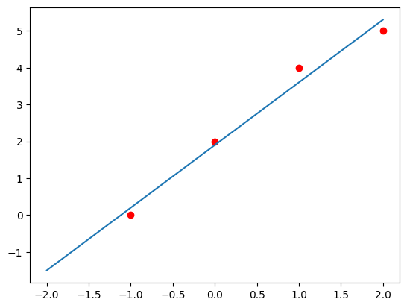
Assignment 1
Q1. Provide an optimal linear regression model with intercept
using a closed-form matrix formula.
Plot it along with the original dataset.
X | Y
-1 | 0
0 | 2
1 | 4
2 | 5
$$X=\left[\begin{matrix}\begin{matrix}1 \\ 1\end{matrix} & \begin{matrix}−1 \\ 0\end{matrix} \\ \begin{matrix}1 \\ 1\end{matrix} & \begin{matrix}1 \\ 2\end{matrix}\end{matrix}\right]$$
$$w={(X^{T}X)}^{−1}X^{T}Y=\left[\begin{matrix}1.9 \\ 1.7\end{matrix}\right]$$
$$X^{T}X=\left[\begin{matrix}4 & 2 \\ 2 & 6\end{matrix}\right]$$
$${det⁡(X}^{T}X)=6∙4−2∙2=20$$
$${(X^{T}X)}^{−1}=\frac{1}{20}\left[\begin{matrix}6 & −2 \\ −2 & 4\end{matrix}\right]=\left[\begin{matrix}0.3 & −0.1 \\ −0.1 & 0.2\end{matrix}\right]$$
2
$$X^{T}Y=\left[\begin{matrix}11 \\ 14\end{matrix}\right]$$

Slide 7
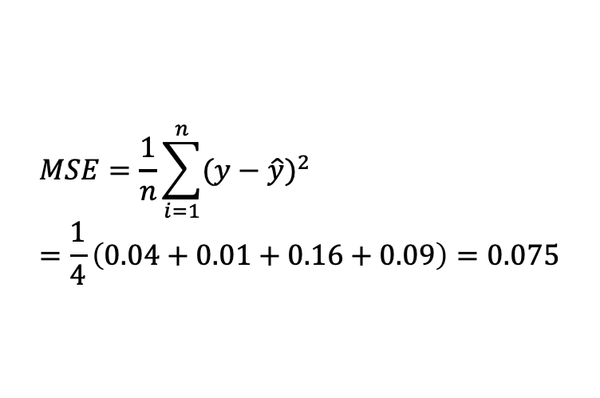
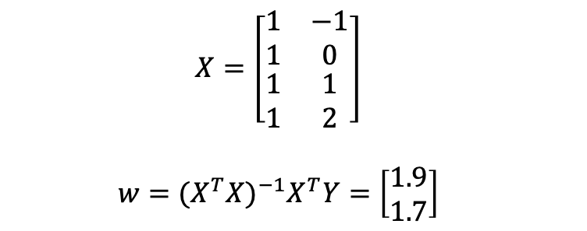
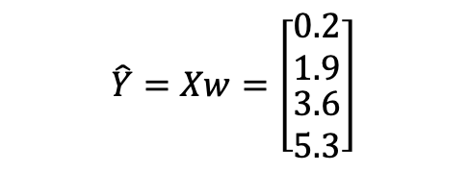
Assignment 1
Q2. Calculate MSE and MAE
$$X=\left[\begin{matrix}\begin{matrix}1 \\ 1\end{matrix} & \begin{matrix}−1 \\ 0\end{matrix} \\ \begin{matrix}1 \\ 1\end{matrix} & \begin{matrix}1 \\ 2\end{matrix}\end{matrix}\right]$$
$$w={(X^{T}X)}^{−1}X^{T}Y=\left[\begin{matrix}1.9 \\ 1.7\end{matrix}\right]$$
$$\hat{Y}=Xw=\left[\begin{matrix}\begin{matrix}0.2 \\ 1.9\end{matrix} \\ \begin{matrix}3.6 \\ 5.3\end{matrix}\end{matrix}\right]$$
X | Y
-1 | 0
0 | 2
1 | 4
2 | 5
$$MSE=\frac{1}{n}\sum_{i=1}^{n}{{(y−\hat{y})}^{2}}=\frac{1}{4}\left(0.04+0.01+0.16+0.09\right)=0.075$$
2

Slide 8
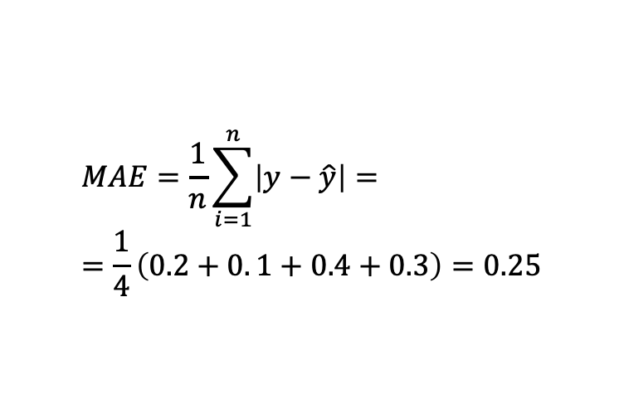
Assignment 1
Q2. Calculate MSE and MAE
$$X=\left[\begin{matrix}\begin{matrix}1 \\ 1\end{matrix} & \begin{matrix}−1 \\ 0\end{matrix} \\ \begin{matrix}1 \\ 1\end{matrix} & \begin{matrix}1 \\ 2\end{matrix}\end{matrix}\right]$$
$$w={(X^{T}X)}^{−1}X^{T}Y=\left[\begin{matrix}1.9 \\ 1.7\end{matrix}\right]$$
$$\hat{Y}=Xw=\left[\begin{matrix}\begin{matrix}0.2 \\ 1.9\end{matrix} \\ \begin{matrix}3.6 \\ 5.3\end{matrix}\end{matrix}\right]$$
X | Y
-1 | 0
0 | 2
1 | 4
2 | 5
$$MAE=\frac{1}{n}\sum_{i=1}^{n}{\left|y−\hat{y}\right|=}=\frac{1}{4}\left(0.2+0. 1+0.4+0.3\right)=0.25$$
2

Slide 9
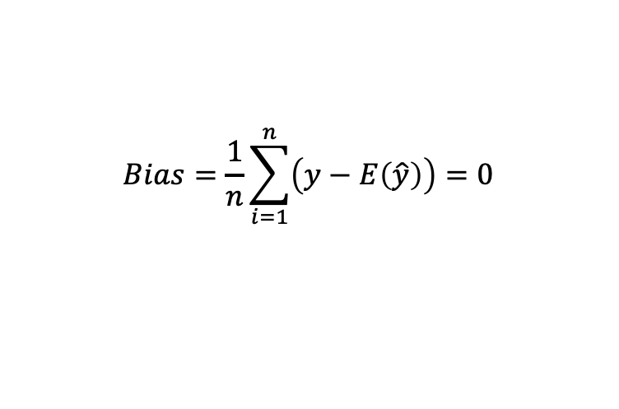
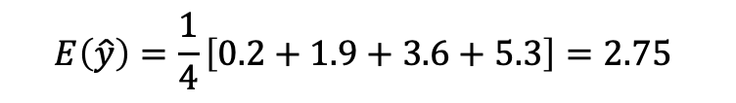
Assignment 1
Q3. Estimate bias and variance
$$X=\left[\begin{matrix}\begin{matrix}1 \\ 1\end{matrix} & \begin{matrix}−1 \\ 0\end{matrix} \\ \begin{matrix}1 \\ 1\end{matrix} & \begin{matrix}1 \\ 2\end{matrix}\end{matrix}\right]$$
$$w={(X^{T}X)}^{−1}X^{T}Y=\left[\begin{matrix}1.9 \\ 1.7\end{matrix}\right]$$
$$\hat{Y}=Xw=\left[\begin{matrix}\begin{matrix}0.2 \\ 1.9\end{matrix} \\ \begin{matrix}3.6 \\ 5.3\end{matrix}\end{matrix}\right]$$
X | Y
-1 | 0
0 | 2
1 | 4
2 | 5
$$E\left(\hat{y}\right)=\frac{1}{4}\left[0.2+1.9+3.6+5.3\right]=2.75$$
$$Bias=\frac{1}{n}\sum_{i=1}^{n}{\left(y−E\left(\hat{y}\right)\right)=0}$$
2

Slide 10
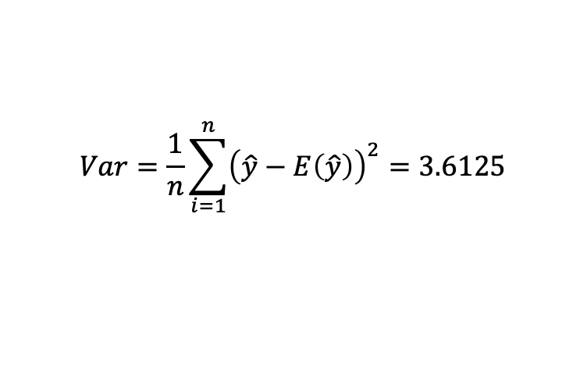
Assignment 1
Q3. Estimate bias and variance
$$X=\left[\begin{matrix}\begin{matrix}1 \\ 1\end{matrix} & \begin{matrix}−1 \\ 0\end{matrix} \\ \begin{matrix}1 \\ 1\end{matrix} & \begin{matrix}1 \\ 2\end{matrix}\end{matrix}\right]$$
$$w={(X^{T}X)}^{−1}X^{T}Y=\left[\begin{matrix}1.9 \\ 1.7\end{matrix}\right]$$
$$\hat{Y}=Xw=\left[\begin{matrix}\begin{matrix}0.2 \\ 1.9\end{matrix} \\ \begin{matrix}3.6 \\ 5.3\end{matrix}\end{matrix}\right]$$
X | Y
-1 | 0
0 | 2
1 | 4
2 | 5
$$E\left(\hat{y}\right)=\frac{1}{4}\left[0.2+1.9+3.6+5.3\right]=2.75$$
$$Bias=\frac{1}{n}\sum_{i=1}^{n}{\left(y−E\left(\hat{y}\right)\right)=0}$$
$$Var=\frac{1}{n}\sum_{i=1}^{n}{{\left(\hat{y}−E\left(\hat{y}\right)\right)}^{2}=3.6125}$$
2

Slide 11
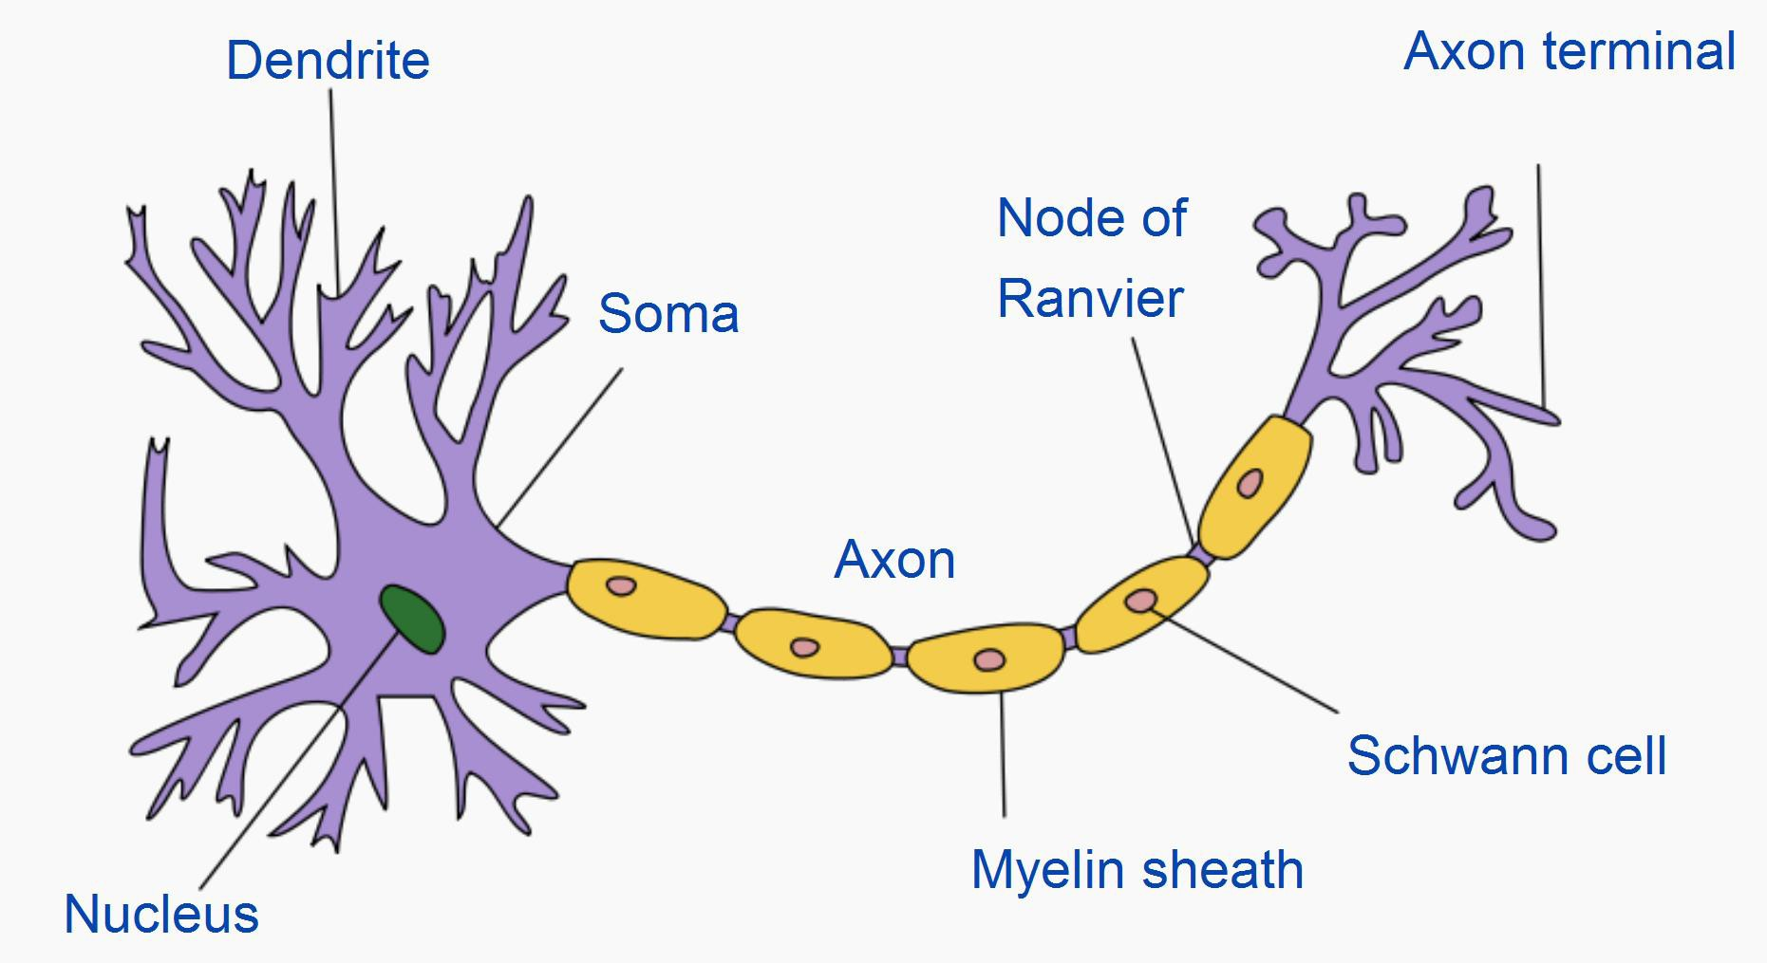
Neuron
By Quasar Jarosz at English Wikipedia, CC BY-SA 3.0, https://commons.wikimedia.org/w/index.php?curid=7616130
2

Slide 12
Neuron
Neurons can have multiple dendrites and at most one axon
Typical connections are from an axon of a neuron to dendrites of other neurons
Synaptic signals are received through dendrites and somas; signals are transmitted through axons
Signals can excite or inhibit the receiving neuron
A neuron fires when the excitement is above a threshold
Note: these are general statements and simplifications, and there are many exceptions!
3

Slide 13
Artificial Neural Networks
Artificial neural networks are inspired by real neurons
1943 – One of the first neural computational models was proposed by McCulloch and Pitts
1958 – Rosenblatt proposed perceptron
1969 – A paper by Minsky and Papert almost killed the entire field
Perceptrons are incapable of representing XOR
Computational resources are too great
1975 – Backpropagation algorithm renewed interest in neural
networks
1980s – parallel architectures were popular
Late 1990s and 2000s – other methods, such as support vector machines, became more popular
2010s – neural networks of several hidden layers are back with the
new name “deep learning”
4

Slide 14
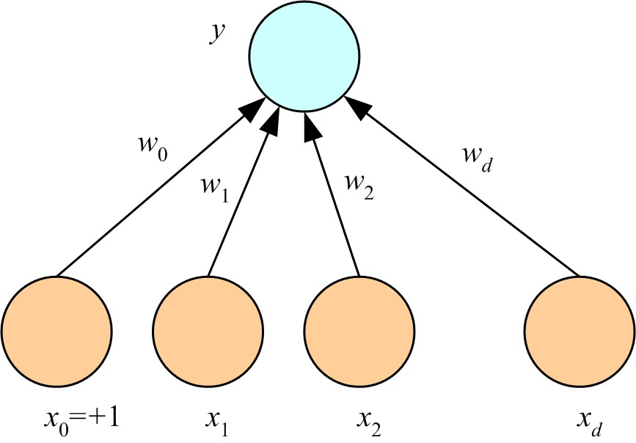
Perceptron
𝑦 = 𝑠𝑖𝑔𝑛 𝑤₀ + σ 𝑤_{𝑖}𝑥_{𝑖}
5

Slide 15
What AN Artificial Neuron Does
Takes a weighted sum of its inputs
𝑤₀ + ∑^{𝑘} 𝑤_{𝑖}𝑥_{𝑖}
𝑖=1
Assume that there is always a constant input 1, that
is, 𝑥₀ = 1. Then,

∑𝑘
𝑤_{𝑖}𝑥_{𝑖}
𝑖=0
Passes this sum through its activation function
𝑓 ∑^{𝑘} 𝑤_{𝑖}𝑥_{𝑖}
𝑖=0
6

Slide 16
Examples
Logical NOT
Logical AND
Logical OR
Logical XOR
7

Slide 17

Examples
Logical NOT
7
https://miro.medium.com/v2/resize:fit:184/format:webp/1*2YxHEu05jeYvxxd9Rsf_7A.png

Slide 18
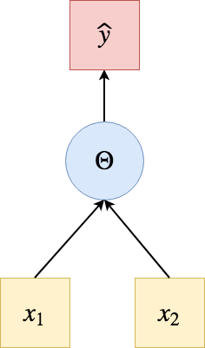
Examples
Logical AND, Logical OR
7
https://miro.medium.com/v2/resize:fit:472/format:webp/1*zNs6iNlZIs7-XhNmPHlB9Q.png

Slide 19
Simple Multilayer Network for XOR
𝑋𝑂𝑅 𝐴, 𝐵 = 𝐴 ∧ ¬𝐵 ∨ ¬𝐴 ∧ 𝐵
One perceptron for
One perceptron for
𝐴 ∧ ¬𝐵
¬𝐴 ∧ 𝐵
One perceptron for combining the outputs, through OR, of the two previous perceptrons
8

Slide 20
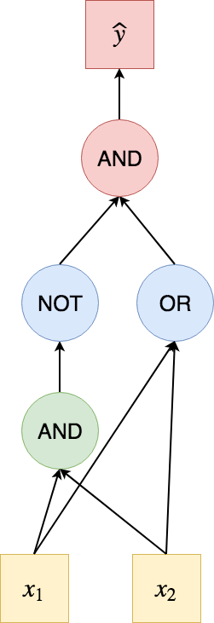
Simple Multilayer Network for XOR
𝑋𝑂𝑅 𝐴, 𝐵 = 𝐴 ∧ ¬𝐵 ∨ ¬𝐴 ∧ 𝐵
One perceptron for
One perceptron for
𝐴 ∧ ¬𝐵
¬𝐴 ∧ 𝐵
One perceptron for combining the outputs, through OR, of the two previous perceptrons
8
https://miro.medium.com/v2/resize:fit:502/format:webp/1*Rm1Cd2KDoi1ACE-5KFP_Iw.png

Slide 21
Various Activation Functions
Identity function
Bipolar step function
Binary sigmoid
Bipolar sigmoid
Hyperbolic tangent
9

Slide 22
Bipolar Step Function
𝑓 ∑^{𝑘} 𝑤_{𝑖}𝑥_{𝑖} = 𝑠𝑖𝑔𝑛 ∑^{𝑘} 𝑤 𝑥
𝑖=0 𝑖=0 𝑖 𝑖
Returns either +1 or -1 (except right on the decision boundary)
Useful for both hidden layers and output layer
However, its discontinuous and it is problematic for learning algorithms that require taking its derivative
10

Slide 23
Bipolar Sigmoid
𝑓 σ^{𝑘} 𝑤 𝑥 =
2
− 1
𝑖=0
𝑖 𝑖
− σ^{𝑘} 𝑤_{𝑖}𝑥_{𝑖}
1+𝑒
𝑖=0
This is a rescaled version of the binary sigmoid
The output of the bipolar sigmoid is between -1 and +1
Useful for output layer when the task is classification
Useful for both hidden and output layers
15

Slide 24
Identity Function
𝑓 ∑^{𝑘} 𝑤_{𝑖}𝑥_{𝑖} = ∑^{𝑘} 𝑤 𝑥
𝑖=0 𝑖=0 𝑖 𝑖
Typically used for the output neurons when the task is regression
The identity function should not be used in the hidden layers
Linear combination of linear functions is another linear function, and hence, using the identity function in the hidden layers does not increase the representative power of the neural network
11

Slide 25
Binary Sigmoid
𝑓 ∑^{𝑘} 𝑤 𝑥 =
1
𝑖=0
𝑖 𝑖
−∑^{𝑘} 𝑤_{𝑖}𝑥_{𝑖}
1+𝑒
𝑖=0
This is the logistic function that we used
Except, notice the minus sign in front of the sum
This is only a convention and does not change much
The output of the binary sigmoid is between 0
and 1
Useful for output layer when the task is classification
The output can be interpreted as a probability
12

Slide 26
Hyperbolic Tangent
₌ 𝑒
∑𝑘
𝑤_{𝑖}𝑥_{𝑖} − ∑^{𝑘} 𝑤_{𝑖}𝑥_{𝑖}
𝑓. ∑^{𝑘}
𝑤 𝑥
𝑖=0
−𝑒
𝑖=0
𝑖=0
𝑖 𝑖
∑𝑘
𝑤_{𝑖}𝑥_{𝑖} − ∑^{𝑘} 𝑤_{𝑖}𝑥_{𝑖}
𝑒 +𝑒
𝑖=0 𝑖=0
The output of tanh is between -1 and +1
Useful for output layer when the task is classification
Useful for both hidden and output layers
13

Slide 27
Relu
𝑓 ∑^{𝑘} 𝑤_{𝑖}𝑥_{𝑖} = ∑^{𝑘} 𝑤_{𝑖}𝑥_{𝑖} if ∑^{𝑘} 𝑤_{𝑖}𝑥_{𝑖} > 0;
𝑖=0 𝑖=0 𝑖=0
0 otherwise
Typically used for hidden layers, especially for
computer vision tasks
14

Slide 28
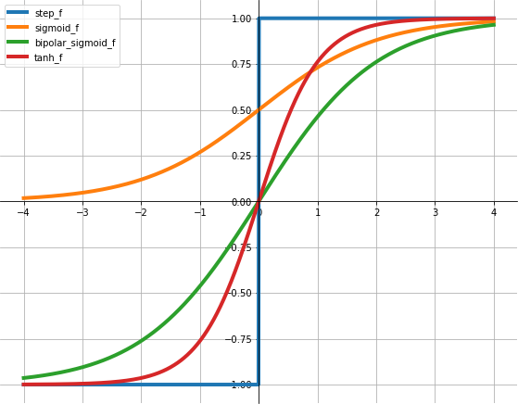
Activation Function Plots
16

Slide 29
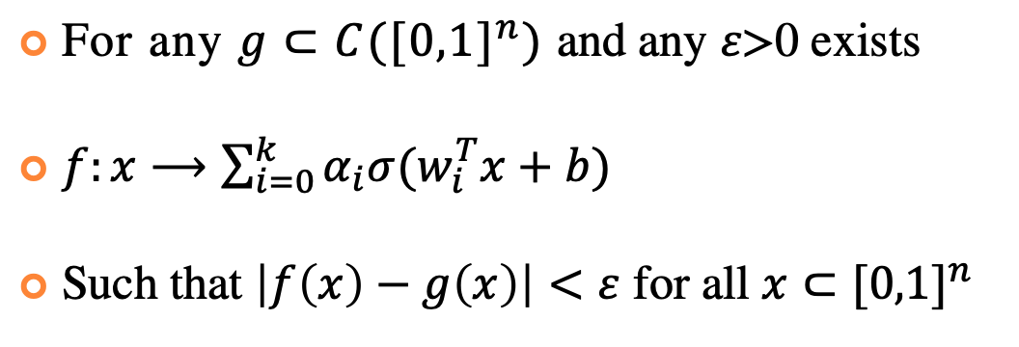
Universal Approximation
For any $g⊂C({[0,1]}^{n})$ and any $ε\text{>0}$ exists
$f:x⟶\sum_{i=0}^{k}{α_{i}σ(w_{i}^{T}x+b)}$
Such that $\left|f\left(x\right)−g\left(x\right)\right|<ε$ for all $x⊂{[0,1]}^{n}$
8

Slide 30
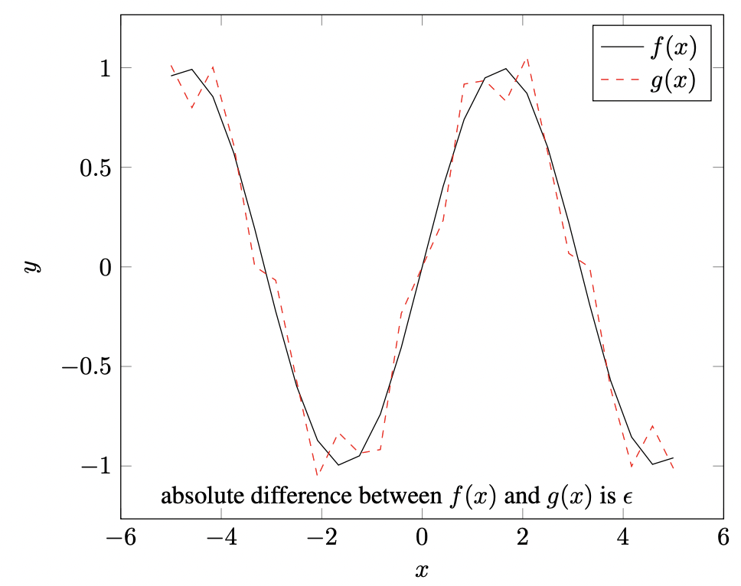
Universal Approximation
For any $g⊂C({[0,1]}^{n})$ and any $ε\text{>0}$ exists
$f:x⟶\sum_{i=0}^{k}{α_{i}σ(w_{i}^{T}x+b)}$
Such that $\left|f\left(x\right)−g\left(x\right)\right|<ε$ for all $x⊂{[0,1]}^{n}$
8

Slide 31
Deep Learning
Several hidden layers
Millions of parameters
Big data, big computation
If a neural network with a single hidden layer is a universal approximator, why go deep?
“Why and When Can Deep -- but Not Shallow -- Networks Avoid the Curse of Dimensionality: a Review” https://arxiv.org/abs/1611.00740
17

Slide 32
Example DL Network Architectures
Convolutional neural networks (CNN)
Recurrent neural networks (RNN)
Long Short-Term Memory networks (LSTM)
18

Slide 33
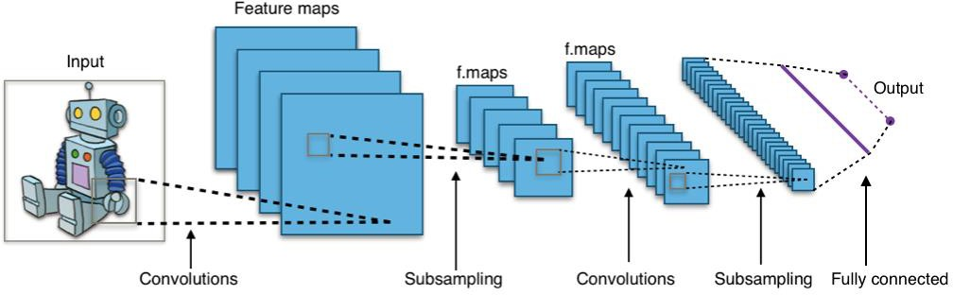
Convolutional Neural Networks
https://commons.wikimedia.org/wiki/File:Typical_cnn.png
19

Slide 34
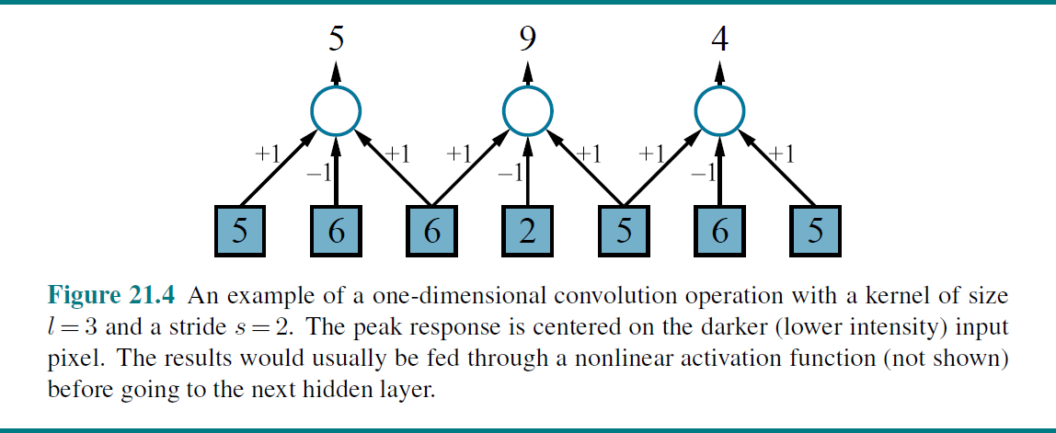
Convolution
Figure from http://aima.cs.berkeley.edu/figures.pdf
20

Slide 35
Pooling
Aggregates a set of adjacent units
Like convolution, has a kernel size and a stride size
Unlike convolution, weights are fixed (not learned)
Examples
Average pooling
Max pooling
21

