Slide 1
CS584 Machine Learning
Lecture 7. Convexity. Gradient Descent
Oleksandr Narykov
onarykov@iit.edu

Slide 2
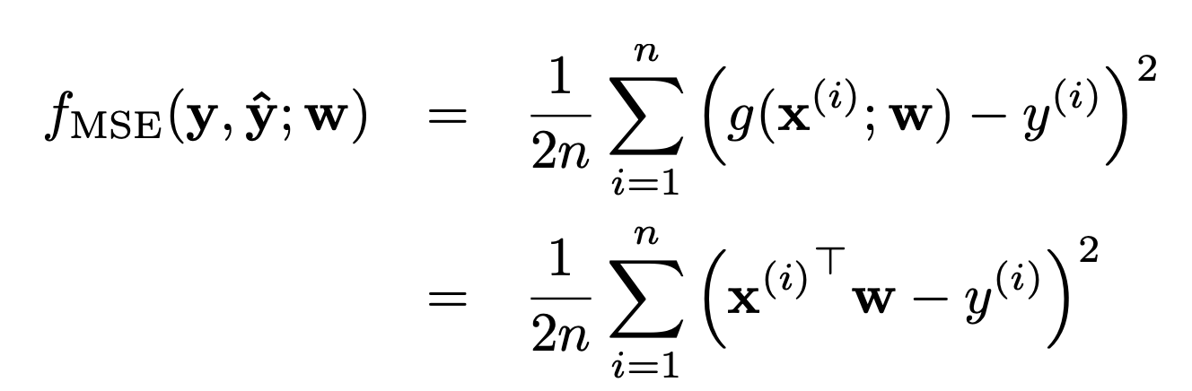
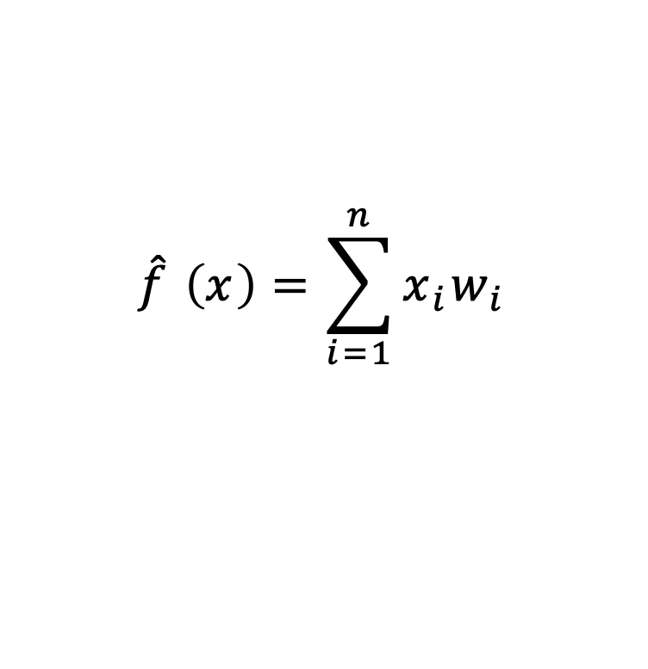
Linear Regression
$$\hat{f} \left(x\right)=\sum_{i=1}^{n}{x_{i}w_{i}}$$
10

Slide 3
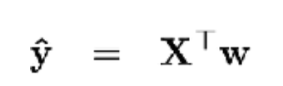
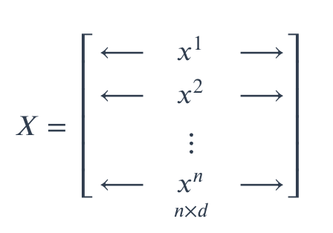

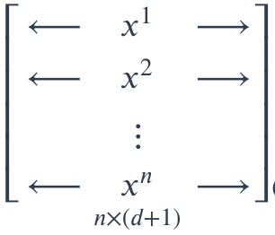


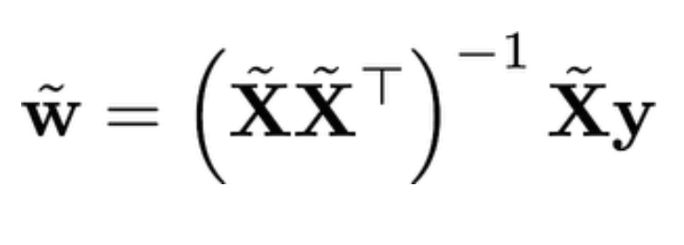

Linear Regression. Bias. Matrix Notation
$$\begin{matrix}\begin{matrix}\begin{aligned} \\ 1\end{aligned} \\ 1\end{matrix} \\ \begin{matrix}\begin{aligned}. \\ . \\ .\end{aligned} \\ \begin{aligned}1 \\ \end{aligned}\end{matrix}\end{matrix}$$
10

Slide 4
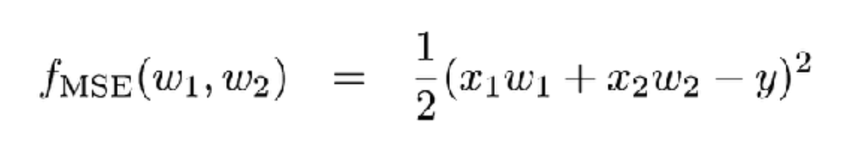
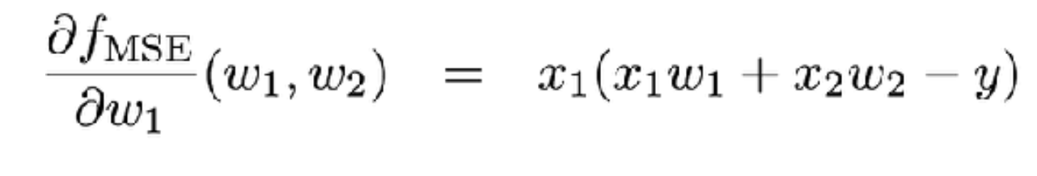
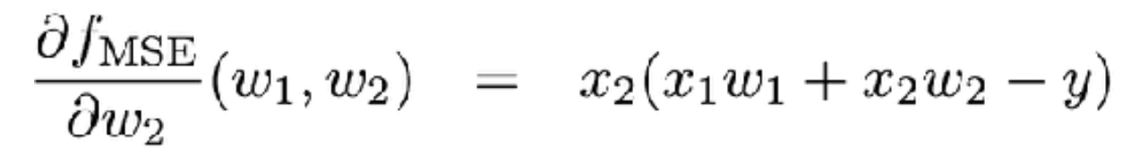
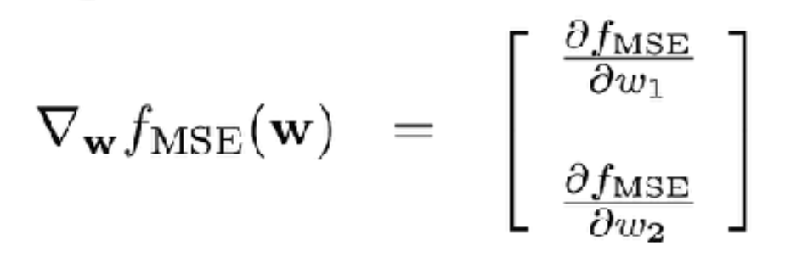
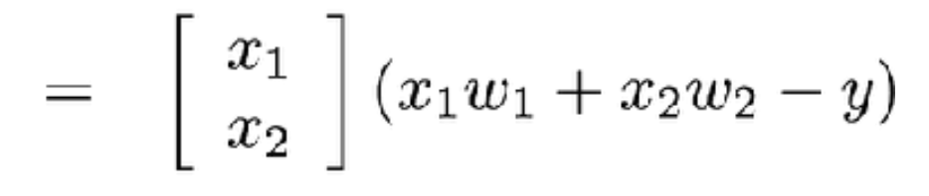
Linear Regression Gradients
10

Slide 5
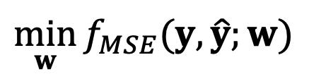
Optimization Problem
$$\min_{w}{f_{MSE}(y,\hat{y};w)}$$
10

Slide 6
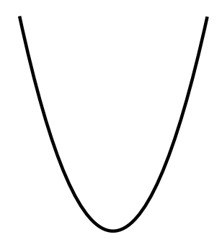


Optimization Problem
$$\min_{w}{f_{MSE}(y,\hat{y};w)}$$
Simple 1d Case – Convex Function
$$f_{MSE}$$
f
10
$$w$$

Slide 7
Convexity
Informally: bowl-shaped
f
10
Notes:
Inverse is concave

Slide 8
Convexity
Informally: bowl-shaped
f
What property ensures the existence of only one local minimum?
10

Slide 9
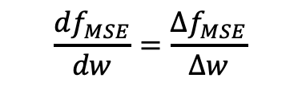
Convexity
Informally: bowl-shaped
f
$$\frac{df_{MSE}}{dw}=\frac{∆f_{MSE}}{∆w}$$
What property ensures the existence of only one local minimum?
From left to right, the slope of function never decreases
Derivative of the slope is always non-negative
10

Slide 10
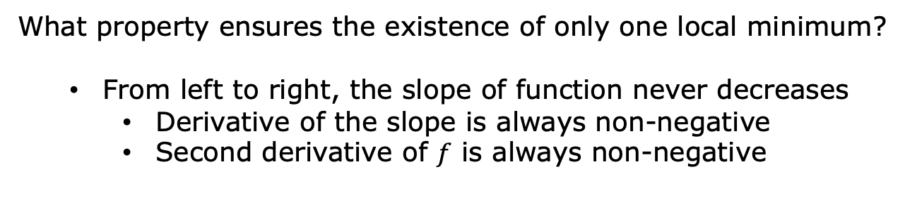
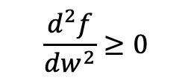

Convexity
Informally: bowl-shaped
f
$$\frac{df}{dw}=\frac{∆f}{∆w}$$
$$\frac{d^{2}f}{dw^{2}}≥0$$
What property ensures the existence of only one local minimum?
From left to right, the slope of function never decreases
Derivative of the slope is always non-negative
Second derivative of $f$ is always non-negative
10

Slide 11
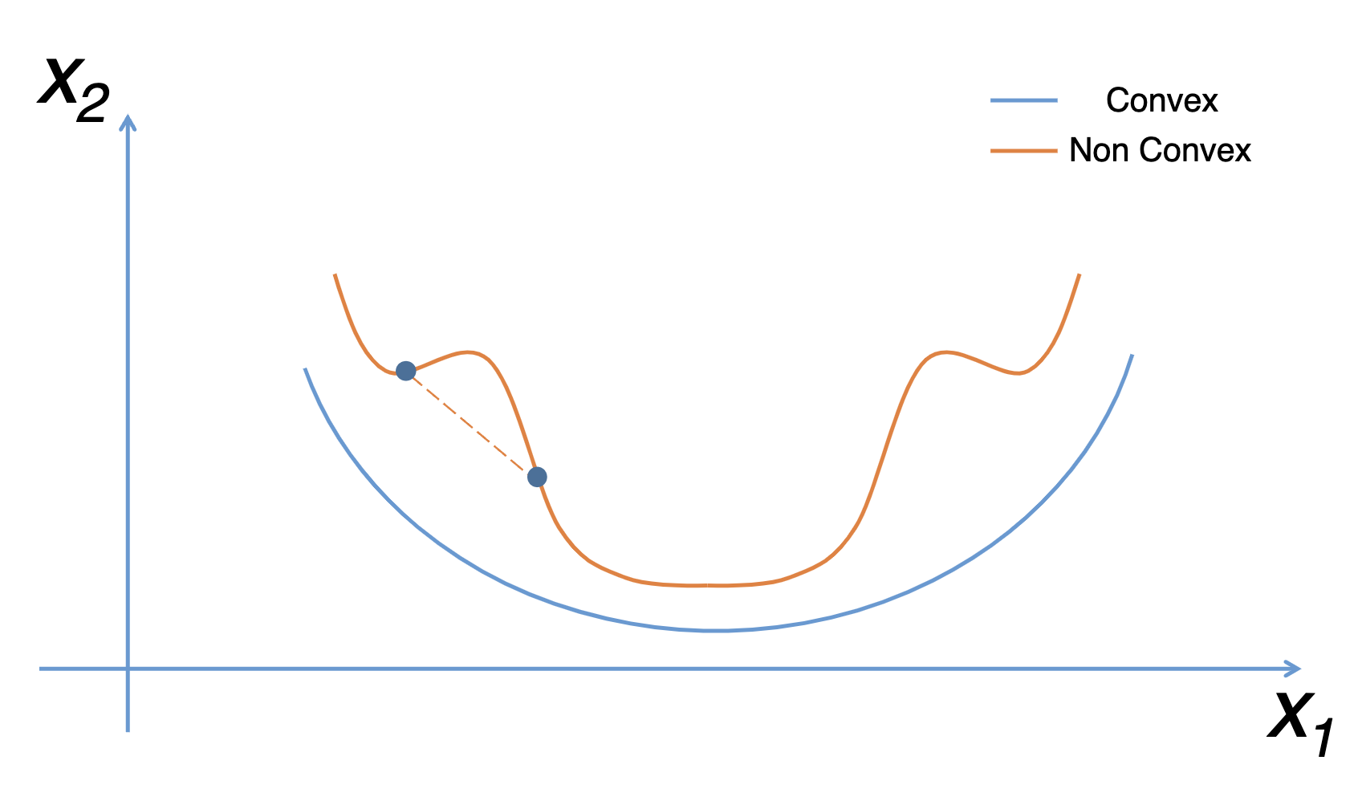
Convexity
https://fmin.xyz/docs/theory/Convex_function/
What property ensures the existence of only one local minimum?
From left to right, the slope of function never decreases
Derivative of the slope is always non-negative
Second derivative of $f$ is always non-negative
10

Slide 12
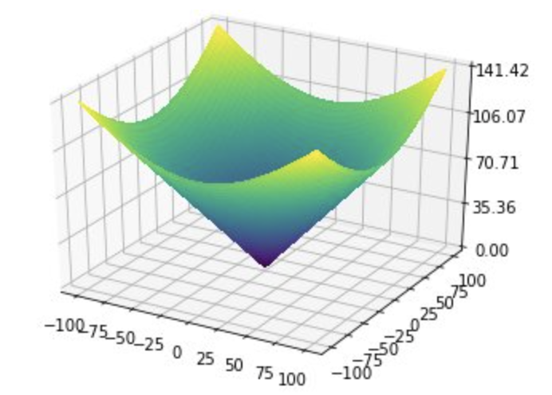
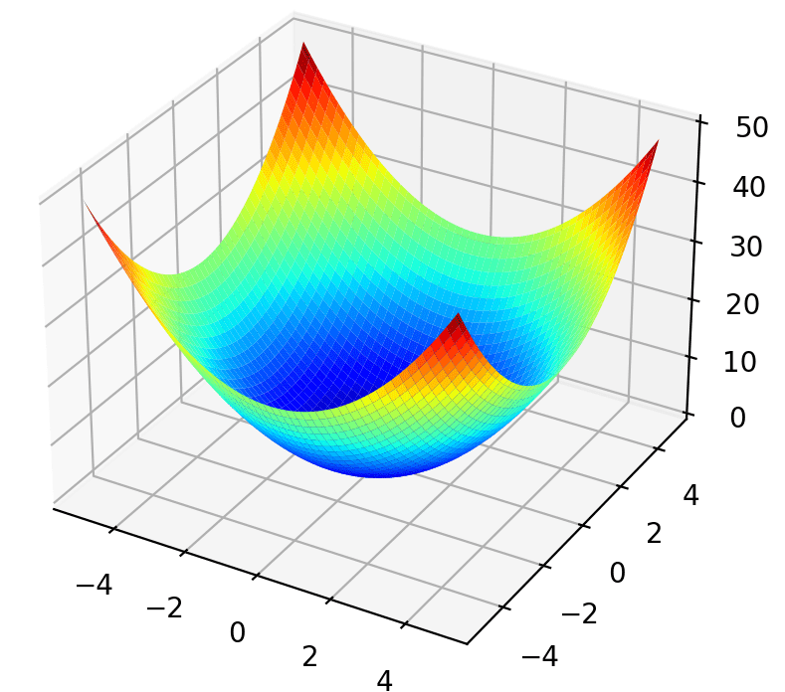
Convexity in Higher Dimensions
Informally: bowl-shaped
Benhamou, Eric, et al. "BCMA-ES: A Bayesian approach to CMA-ES." arXiv preprint arXiv:1904.01401 (2019).
https://machinelearningmastery.com/wp-content/uploads/2020/09/Surface-Plot-of-Unimodal-Optimization-Function-1.png
10

Slide 13
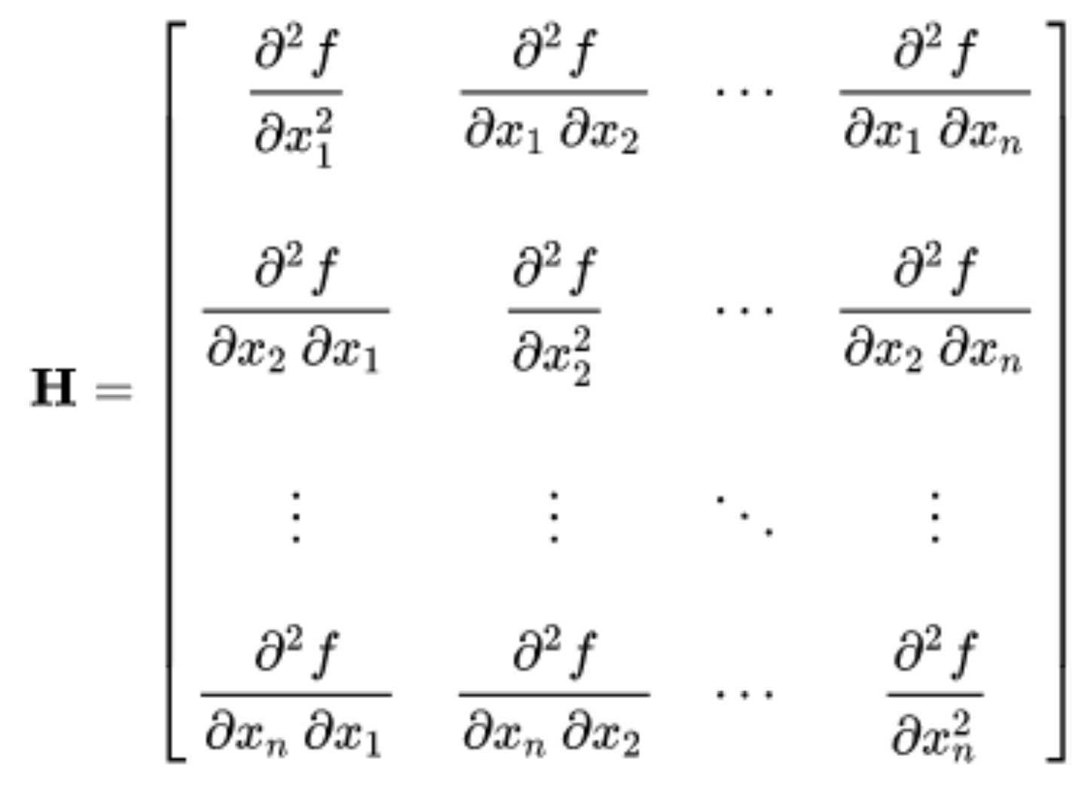
Convexity in Higher Dimensions
Informally: bowl-shaped
Formally: determined by the second-derivative matrix, Hessian
10

Slide 14
Convexity in Higher Dimensions
Informally: bowl-shaped
Formally: determined by the second-derivative matrix, Hessian
For function to be convex, Hessian matrix H should be positive
semi-definite (PSD) for every input x
10

Slide 15
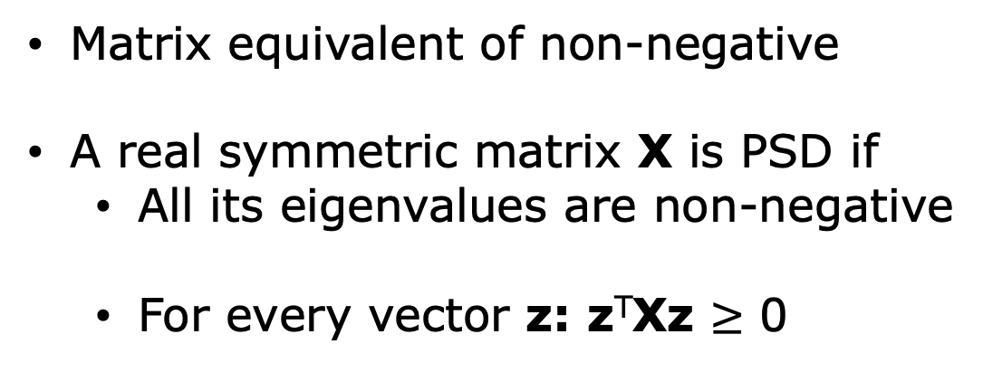
Positive Semi-Definite
Matrix equivalent of non-negative
A real symmetric matrix X is PSD if
All its eigenvalues are non-negative
For every vector z: z^{T}Xz $≥$ 0
10

Slide 16
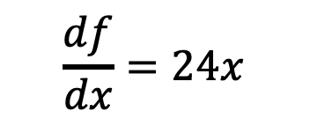
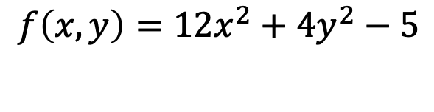
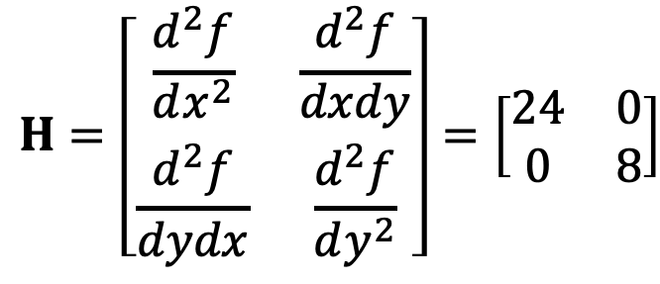
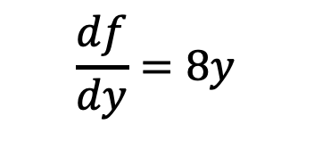
Hessian Example
$$f\left(x,y\right)=12x^{2}+4y^{2}−5$$
First derivatives:
$$\frac{df}{dx}=24x$$
$$\frac{df}{dy}=8y$$
$$H=\left[\begin{matrix}\frac{d^{2}f}{dx^{2}} & \frac{d^{2}f}{dxdy} \\ \frac{d^{2}f}{dydx} & \frac{d^{2}f}{dy^{2}}\end{matrix}\right]=\left[\begin{matrix}24 & 0 \\ 0 & 8\end{matrix}\right]$$
10

Slide 17
Hessian Example
$$f\left(x,y\right)=12x^{2}+4y^{2}−5$$
First derivatives:
$$\frac{df}{dx}=24x$$
$$\frac{df}{dy}=8y$$
$$H=\left[\begin{matrix}\frac{d^{2}f}{dx^{2}} & \frac{d^{2}f}{dxdy} \\ \frac{d^{2}f}{dydx} & \frac{d^{2}f}{dy^{2}}\end{matrix}\right]=\left[\begin{matrix}24 & 0 \\ 0 & 8\end{matrix}\right]$$
10

Slide 18
Gradient Descent

Slide 19
Optimization Problem
$$\min_{w}{f_{MSE}(y,\hat{y};w)}$$
Simple 1d Case – Convex Function
$$f_{MSE}$$
f
10
$$w$$

Slide 20
Gradient Descent
Gradient descent is a hill-climbing algorithm that
makes incremental changes to weight vector w
depending on the value of slope (i.e., gradient)
10

Slide 21
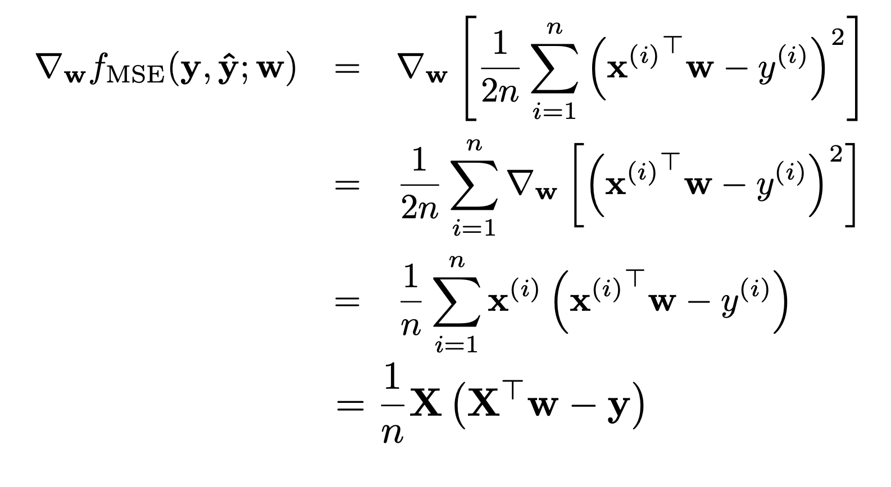
Gradient Descent
MSE case
10

Slide 22


Gradient Descent
Gradient descent is a hill-climbing algorithm that
makes incremental changes to weight vector w
depending on the value of slope (i.e., gradient)
$$f_{MSE}$$
f
$$w$$
10

Slide 23
Gradient Descent
Gradient descent is a hill-climbing algorithm that
makes incremental changes to weight vector w
depending on the value of slope (i.e., gradient)
$$f_{MSE}$$
f
$$w$$
10

Slide 24
Gradient Descent
Gradient descent is a hill-climbing algorithm that
makes incremental changes to weight vector w
depending on the value of slope (i.e., gradient)
$$f_{MSE}$$
f
$$w$$
10

Slide 25
Gradient Descent. Algorithm
Randomly initialize weights w. This is our initial
weight vector w⁽⁰⁾
10

Slide 26

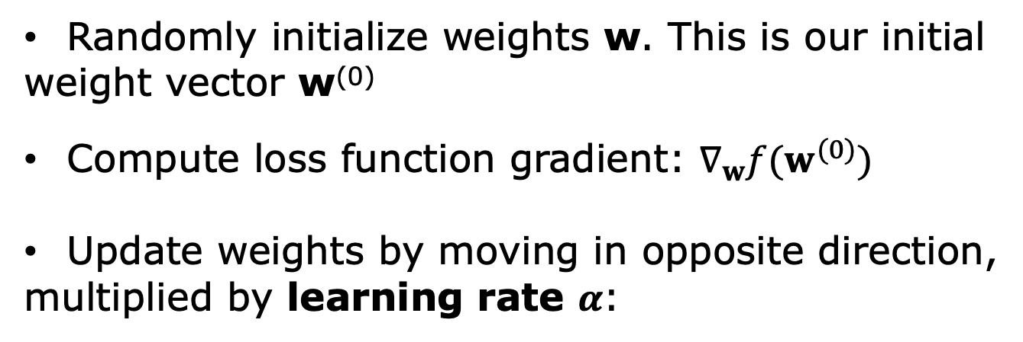
Gradient Descent. Algorithm
Randomly initialize weights w. This is our initial
weight vector w⁽⁰⁾
Compute loss function gradient: $∇_{w}f(w^{(0)})$
Update weights by moving in opposite direction,
multiplied by learning rate $α$:
$$w^{(1)}←w^{(0)}−α∇_{w}f(w^{(0)})$$
10

Slide 27
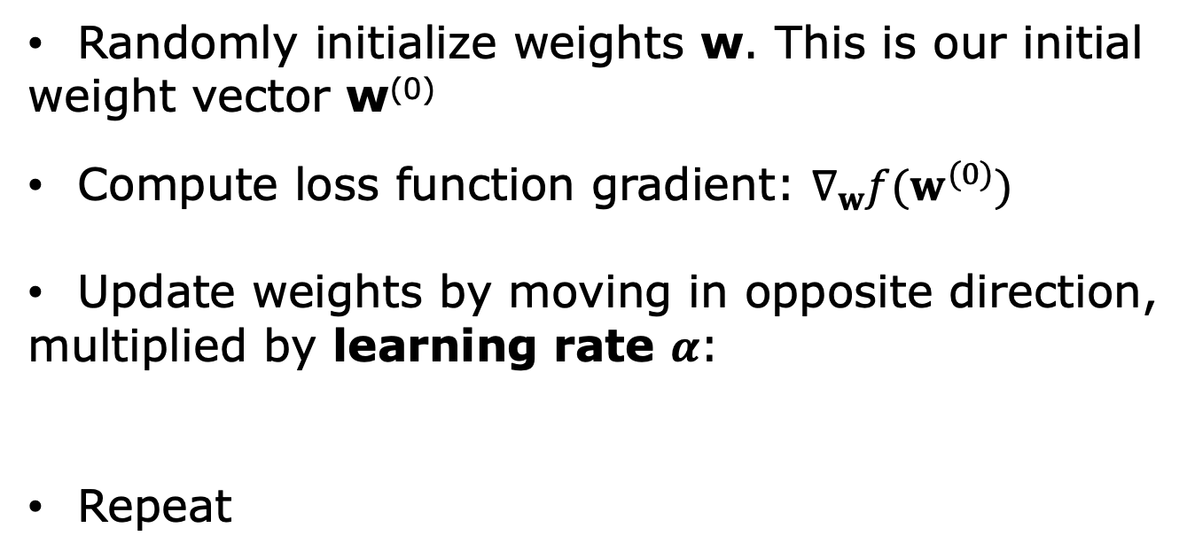

Gradient Descent. Algorithm
Randomly initialize weights w. This is our initial
weight vector w⁽⁰⁾
Compute loss function gradient: $∇_{w}f(w^{(0)})$
Update weights by moving in opposite direction,
multiplied by learning rate $α$:
Repeat
$$w^{(1)}←w^{(0)}−α∇_{w}f(w^{(0)})$$
$$w^{(i)}←w^{(i−1)}−α∇_{w}f(w^{(i−1)})$$
10

Slide 28
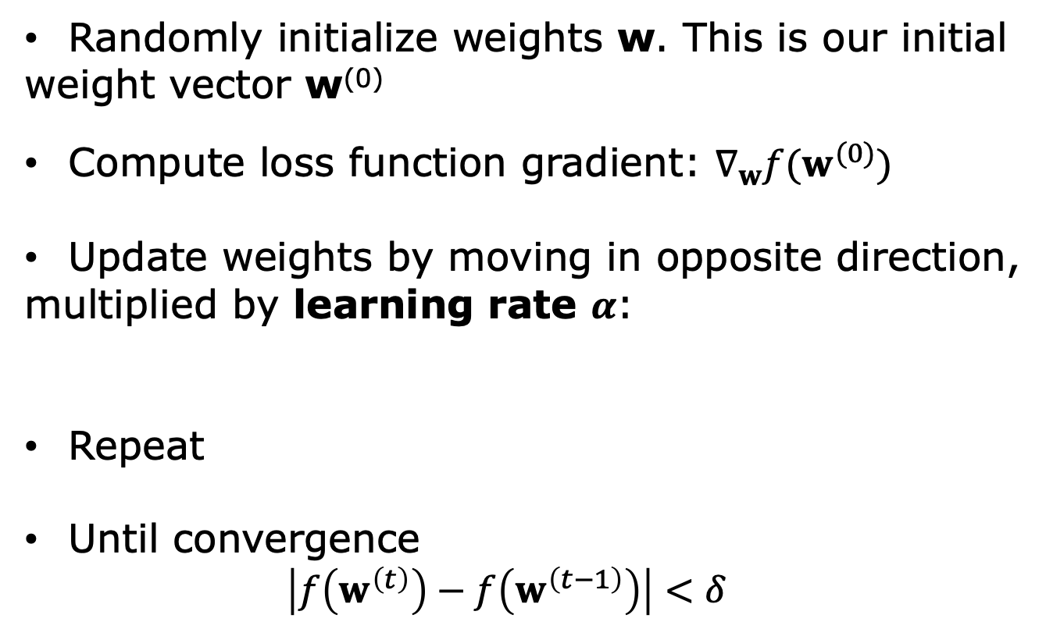

Gradient Descent. Algorithm
Randomly initialize weights w. This is our initial
weight vector w⁽⁰⁾
Compute loss function gradient: $∇_{w}f(w^{(0)})$
Update weights by moving in opposite direction,
multiplied by learning rate $α$:
Repeat
Until convergence
$$\left|f\left(w^{\left(t\right)}\right)−f\left(w^{\left(t−1\right)}\right)\right|<δ$$
$$w^{(1)}←w^{(0)}−α∇_{w}f(w^{(0)})$$
$$w^{(i)}←w^{(i−1)}−α∇_{w}f(w^{(i−1)})$$
10

