Slide 1
CS584 Machine Learning
Lecture 11. Decision Trees. Ensemble Methods
Oleksandr Narykov
onarykov@iit.edu

Slide 2
Midterm
Date – October 17
Fully online, because we have multiple sections
No derivations and no programming, but questions requiring calculations are included (e.g., fit a linear regression model to the dataset)
Conceptual questions, multiple choice
What to review
Assignment 1
Probability basics
Assignment 2 (will be released tomorrow, due date Oct 5)
Lecture slides, visualizations
Notes:
Without assumptions you cannot make predictions
Declarative representations are different from the purely data-driven machine learning algorithms
They allow us to incorporate prior domain knowledge into generative model and separate it from

Slide 3
Decision Trees

Slide 4
Data2
X₁ | X₂ | X₃ | Y
T | T | T | A
T | T | F | B
T | F | T | A
F | T | T | A
F | T | F | B

Slide 5
DATA2 – TREE2
X₁
T
F
X₂
X₃
T
F
T
F
X₃
A
A
B
T F
A
B
13

Slide 6
What kind of tree are we even looking for?
14

Slide 7
The Best Possible Tree on Validation Set?
An approach: consider all trees that are consistent with the training data and choose the one that has the best performance on the validation set
What’s wrong with this approach?
15

Slide 8
An Inductive Bias
Given two trees that are consistent with the training
data, prefer the “smaller” one
Why?
The simplicity principle; simpler solutions that work
are preferred over the more complex ones
Occam’s razor; law of parsimony; “Entities should not be multiplied beyond necessity”
"We are to admit no more causes of natural things than such as are both true and sufficient to explain their appearances. Therefore, to the same natural effects we must, so far as possible, assign the same causes.“
Isaac Newton
This does not mean simplicity is a rule; it’s rather a
preference; an inductive bias in this case
16

Slide 9
Bad News
Finding the smallest tree that is consistent with the training data is NP-complete
What do we do?
Be greedy!
Start with the “best” feature at the top and then the
next “best” and then the next “best”
Is this guaranteed to be optimal?
Of course not, but it’s faster than exponential ☺
Then, how do we measure how “good” a given
feature is?
17

Slide 10
Purity
Feature 𝑋_{𝑖} is “better” than feature 𝑋_{𝑗} if splitting the data using 𝑋_{𝑖} leads to a “purer” split
For example, given a dataset with 5 Yes and 5 No
cases
𝑋₁ splits the data into <2Y, 3N> and <3Y, 2N>
𝑋₂ splits the data into <1Y, 4N> and <4Y, 1N>
𝑋₃ splits the data into <0Y, 5N> and <5Y, 0N>
Then, 𝑋₃ ≻ X₂ ≻ X₁
We understand this visually; how do we formulize it?
18

Slide 11
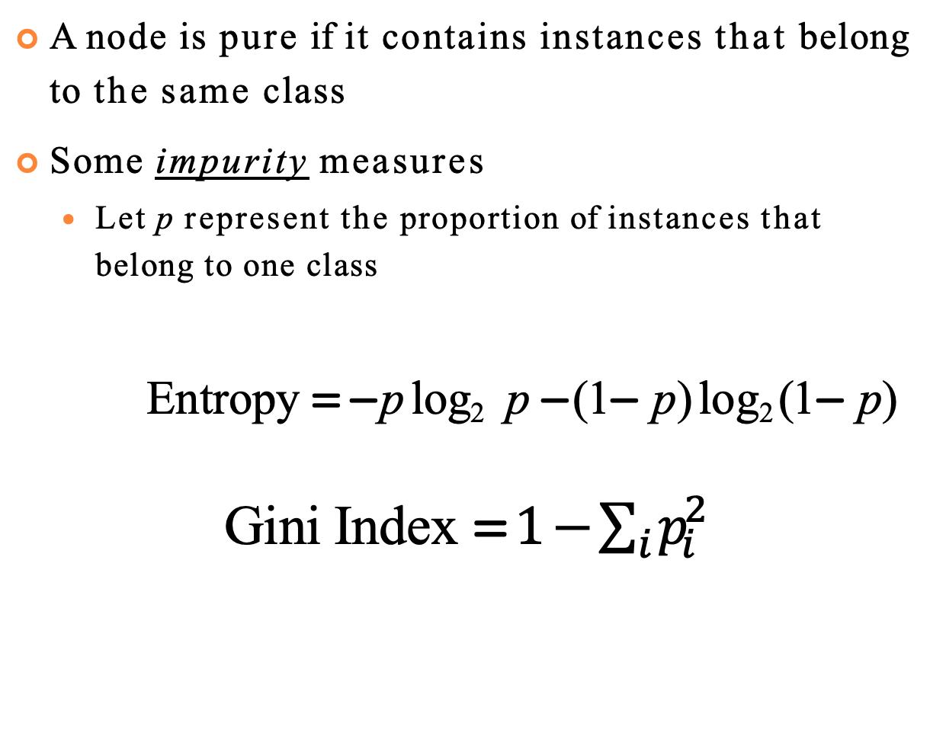
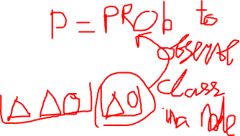
Purity
A node is pure if it contains instances that belong to the same class
Some impurity measures
Let p represent the proportion of instances that belong to one class
Entropy = − p log₂ p − (1− p) log₂ (1− p)
Gini Index =$1−\sum_{i}{p_{i}^{2}}$
18

Slide 12
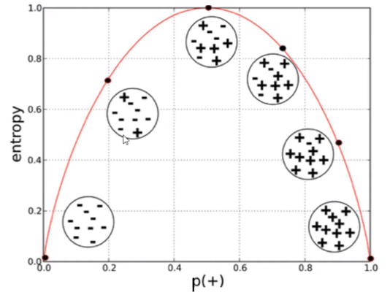
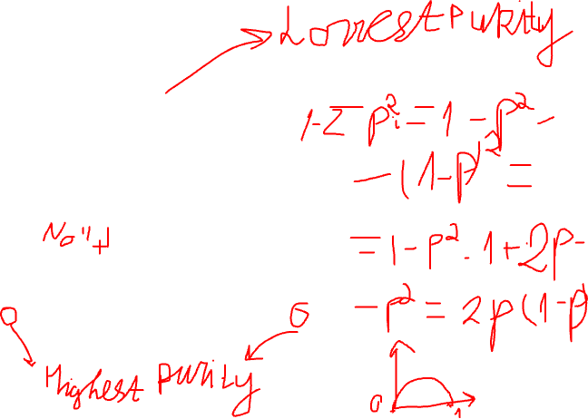
Visualization
Entropy
https://miro.medium.com/v2/resize:fit:1068/format:webp/1*vbbZdjEhxylwLj-z-qcL7w.png
18

Slide 13
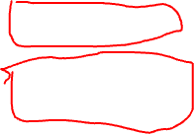
Data2
X₁ | X₂ | X₃ | Y
T | T | T | A
T | T | F | B
T | F | T | A
F | T | T | A
F | T | F | B

Slide 14
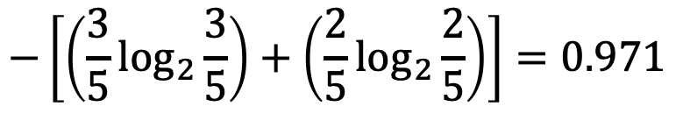
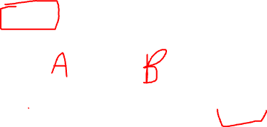
Locally Optimal Feature
A feature, X_{i}, is locally optimal if the impurity is
smallest after we split using X_{i}
Example from Data2
Before split: 3A, 2B
Entropy =
$$−\left[\left(\frac{3}{5}\log_{2}{\frac{3}{5}}\right)+\left(\frac{2}{5}\log_{2}{\frac{2}{5}}\right)\right]=0.971$$
20

Slide 15
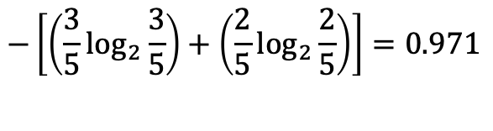

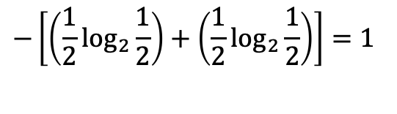
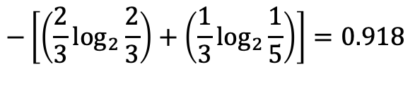
SPLIT ON X₁
Before
3A, 2B
$$−\left[\left(\frac{3}{5}\log_{2}{\frac{3}{5}}\right)+\left(\frac{2}{5}\log_{2}{\frac{2}{5}}\right)\right]=0.971$$
Q1: How do we combine
the two “after” measures?
TT
X₁
X₁
FF
Q2: How do compare
“before” and “after”?
2A, 1B
1A, 1B
2A, 1B
1A, 1B
$$−\left[\left(\frac{2}{3}\log_{2}{\frac{2}{3}}\right)+\left(\frac{1}{3}\log_{2}{\frac{1}{5}}\right)\right]=0.918$$
$$−\left[\left(\frac{1}{2}\log_{2}{\frac{1}{2}}\right)+\left(\frac{1}{2}\log_{2}{\frac{1}{2}}\right)\right]=1$$
After
21

Slide 16
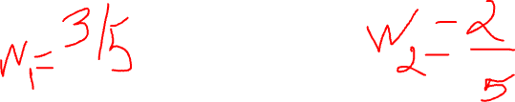
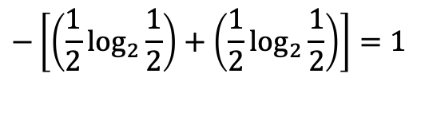
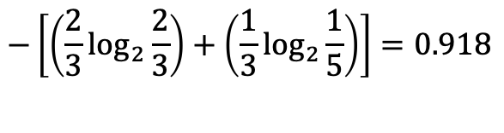
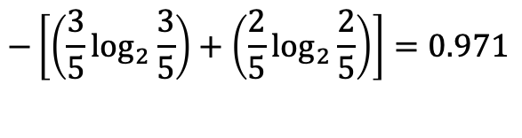
SPLIT ON X₁
Before
3A, 2B
$$−\left[\left(\frac{3}{5}\log_{2}{\frac{3}{5}}\right)+\left(\frac{2}{5}\log_{2}{\frac{2}{5}}\right)\right]=0.971$$
X₁
X₁
FF
2A, 1B
1A, 1B
2A, 1B
1A, 1B
$$−\left[\left(\frac{2}{3}\log_{2}{\frac{2}{3}}\right)+\left(\frac{1}{3}\log_{2}{\frac{1}{5}}\right)\right]=0.918$$
$$−\left[\left(\frac{1}{2}\log_{2}{\frac{1}{2}}\right)+\left(\frac{1}{2}\log_{2}{\frac{1}{2}}\right)\right]=1$$
After = weighted average
=
=
=
After
21
prob( X₁ = T ) × Entropy(LeftTree) + prob( X₁ = F ) × Entropy(RightTree)
³ × 0.918 + ² ×1
5 5
0.951
Notes:
Expected entropy

Slide 17
Information Gain
InformationGain( X_{i} ) = Entropy before - Expected entropy after
- Also works as a feature importance
23

Slide 18
SPLIT ON X₁
Before
3A, 2B
$$−\left[\left(\frac{3}{5}\log_{2}{\frac{3}{5}}\right)+\left(\frac{2}{5}\log_{2}{\frac{2}{5}}\right)\right]=0.971$$
X₁
X₁
FF
IG( X₁ ) = 0.971− 0.951 = 0.02
2A, 1B
1A, 1B
2A, 1B
1A, 1B
$$−\left[\left(\frac{2}{3}\log_{2}{\frac{2}{3}}\right)+\left(\frac{1}{3}\log_{2}{\frac{1}{5}}\right)\right]=0.918$$
$$−\left[\left(\frac{1}{2}\log_{2}{\frac{1}{2}}\right)+\left(\frac{1}{2}\log_{2}{\frac{1}{2}}\right)\right]=1$$
After = weighted average
=
=
=
After
21
prob( X₁ = T ) × Entropy(LeftTree) + prob( X₁ = F ) × Entropy(RightTree)
³ × 0.918 + ² ×1
5 5
0.951
Notes:
Expected entropy

Slide 19
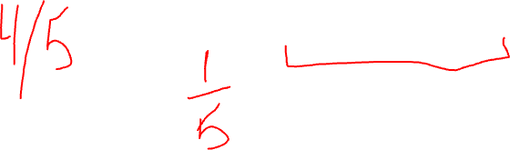
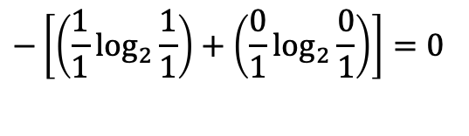
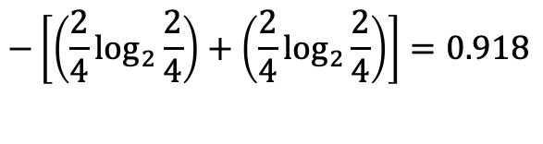
SPLIT ON X₂
Before
3A, 2B
$$−\left[\left(\frac{3}{5}\log_{2}{\frac{3}{5}}\right)+\left(\frac{2}{5}\log_{2}{\frac{2}{5}}\right)\right]=0.971$$
X₂
X₁
T
FF
IG( X₂ ) = 0.971− 0.8 = 0.171
2A, 2B
1A
2A, 1B
1A, 1B
$$−\left[\left(\frac{2}{4}\log_{2}{\frac{2}{4}}\right)+\left(\frac{2}{4}\log_{2}{\frac{2}{4}}\right)\right]=0.918$$
$$−\left[\left(\frac{1}{1}\log_{2}{\frac{1}{1}}\right)+\left(\frac{0}{1}\log_{2}{\frac{0}{1}}\right)\right]=0$$
After = weighted average
=
=
=
After
21
prob( X₁ = T ) × Entropy(LeftTree) + prob( X₁ = F ) × Entropy(RightTree)
⁴ × 0.918 + ¹ ×1
5 5
0.8
Notes:
Expected entropy

Slide 20

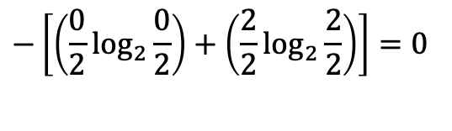
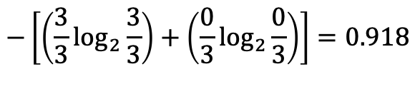
SPLIT ON X₃
Before
3A, 2B
$$−\left[\left(\frac{3}{5}\log_{2}{\frac{3}{5}}\right)+\left(\frac{2}{5}\log_{2}{\frac{2}{5}}\right)\right]=0.971$$
X₃
X₁
T
FF
IG( X₃ ) = 0.971− 0 = 0.971
3A
2B
2A, 1B
1A, 1B
$$−\left[\left(\frac{3}{3}\log_{2}{\frac{3}{3}}\right)+\left(\frac{0}{3}\log_{2}{\frac{0}{3}}\right)\right]=0.918$$
$$−\left[\left(\frac{0}{2}\log_{2}{\frac{0}{2}}\right)+\left(\frac{2}{2}\log_{2}{\frac{2}{2}}\right)\right]=0$$
After = weighted average
=
=
=
After
21
prob( X₁ = T ) × Entropy(LeftTree) + prob( X₁ = F ) × Entropy(RightTree)
³ × 0.0 + ² ×0
5 5
0
Notes:
Expected entropy

Slide 21
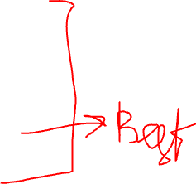
Information Gain on Data2
IG( X₁ ) = 0.971− 0.951 = 0.02
IG( X ₂ ) = 0.971− 0.8 = 0.171
IG( X₃ ) = 0.971− 0 = 0.971
27

Slide 22
A DT ALGORITHM (ID3)
Start with the empty tree
At each iteration
Pick the locally optimal feature and split on it
Stop when all leaves are pure (or no more features are left to split)
28

Slide 23
Let’s Apply it: Data2-Tree3
X₃
T
F
Empirical error?
Prediction power?
Size?
A
B
29

Slide 24

Play Tennis Example
Day | Outlook | Temperature | Humidity | Wind | PlayTennis
D1 | Sunny | Hot | High | Weak | No
D2 | Sunny | Hot | High | Strong | No
D3 | Overcast | Hot | High | Weak | Yes
D4 | Rain | Mild | High | Weak | Yes
D5 | Rain | Cool | Normal | Weak | Yes
D6 | Rain | Cool | Normal | Strong | No
D7 | Overcast | Cool | Normal | Strong | Yes
D8 | Sunny | Mild | High | Weak | No
D9 | Sunny | Cool | Normal | Weak | Yes
D10 | Rain | Mild | Normal | Weak | Yes
D11 | Sunny | Mild | Normal | Strong | Yes
D12 | Overcast | Mild | High | Strong | Yes
D13 | Overcast | Hot | Normal | Weak | Yes
D14 | Rain | Mild | High | Strong | No
30

Slide 25
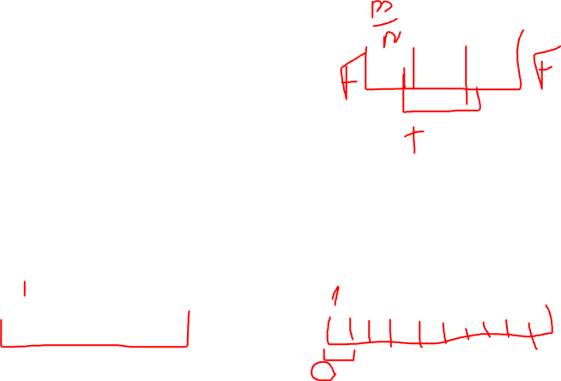
Features With Many Categorical Values
Let
A node has 𝑚 data points
Feature 𝐹_{𝑖} has 𝑛 possible values
On average, each split by each value of 𝐹_{𝑖} will have
m/n data points
When 𝑛 is large, m/n data points are expected to be more likely to be pure
For example, take the extreme case where 𝑚 ≤ 𝑛
Hence, having a large 𝑛 by itself is an advantage
31

Slide 26
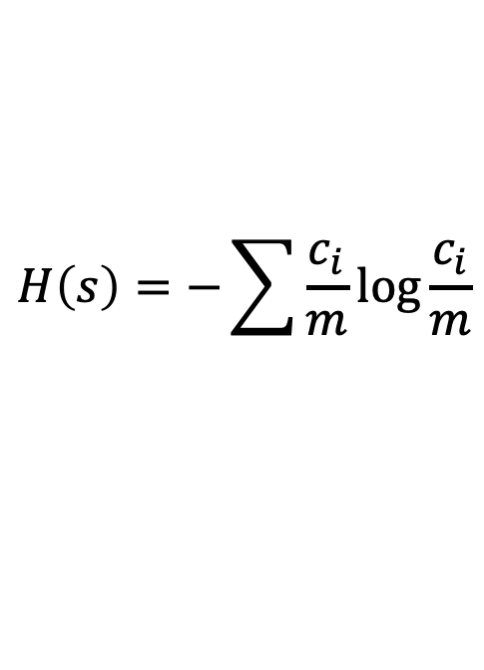
Gain Ratio
Solution: instead of Information Gain, use Gain Ratio
Gain Ratio = IG / (Entropy of the Split Proportions)
$$H\left(s\right)=−\sum{\frac{c_{i}}{m}\log{\frac{c_{i}}{m}}}$$
31

Slide 27
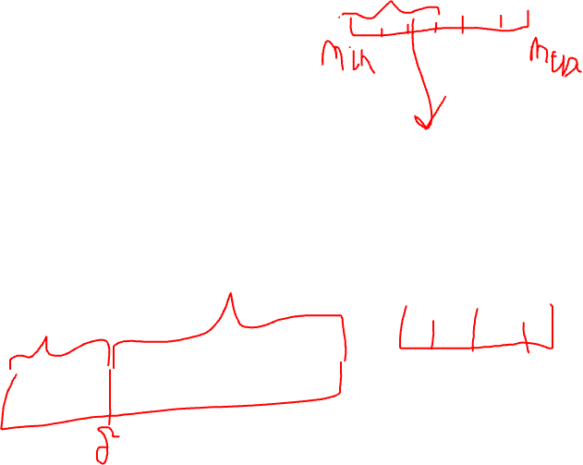
Continuous Features
Let 𝐹_{𝑖} be a continuous feature, such as temperature, age, etc.
Assume that you would like to create a binary
split, asking 𝐹_{𝑖} >? 𝛿
How many possible 𝛿 values do you need to consider?
32

Slide 28

Overfitting
Given a hypothesis h
error_{train}(h): Error of h on the train set
error_{distribution}(h): Error of h on the entire distribution
of the data
h∈H overfits the train set if there is an h’∈H
such that:
error_{train}( h ) < error_{train}( h’ ) and
^{error}distribution^{( h ) > error}distribution^{( h’ )}
34

Slide 29
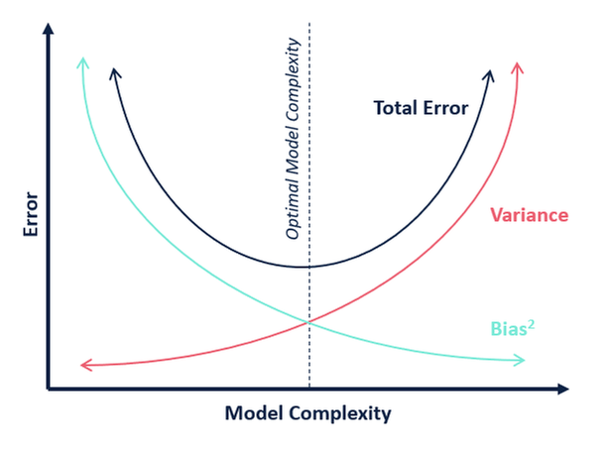
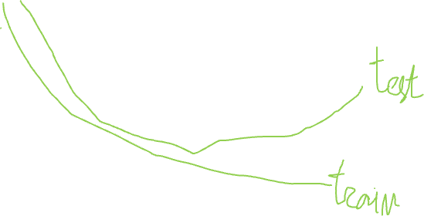
Overfitting
34

Slide 30
When to stop growing the tree?
Technically
Stop when the leaf is pure
Otherwise, stop when no more attributes are left to test
If there are errors in the training data
The tree can end up being larger than it needs to be
Remember that we want a small tree; larger trees tend to overfit the training data
Two solutions:
Stop early based on a criteria
Post-prune the tree
36

Slide 31

Early Stopping (pre-Pruning)
Stop growing a branch based on some fixed criteria
Example criteria:
Stop when the number of instances in a leaf gets below a threshold
Stop when the information gain of the remaining
attributes gets below a threshold
Stop when the entropy at a leaf is below a threshold
Stop when the depth of the tree reaches a threshold
(and so on)
37

Slide 32
Post-Pruning using validation data
Keep a separate data for validation
First, grow the full tree using the training data
Then, prune a node (and those below it) as long as pruning improves performance on the validation data
38

Slide 33
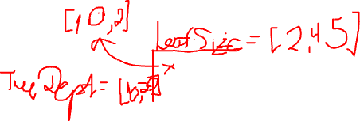
Grid Search
Typical strategy when given a validation set
Decide on a set of parameters for early stopping criteria
Train a classifier for all possible combinations of te parameters (grid search)
Choose the best model based on validation performance
39

Slide 34
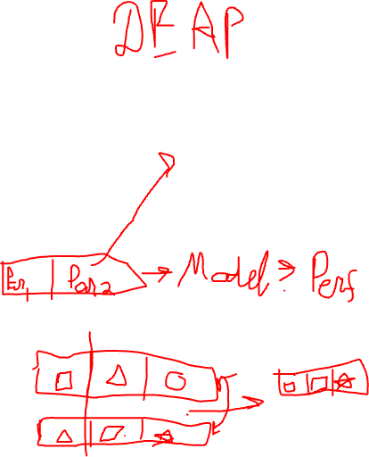
Genetic Algorithm
Also performed on a validation set
Define a list of parameters and their acceptable range
Define fitness function
Randomly populate a pool of ‘individuals’ of size N
Perform a set of ‘genetic’ operations over them:
- Mutation
- Crossover
Choose m best ‘individuals’, produce (N-m) random ones
Repeat
39

Slide 35
Ensemble Learning

Slide 36
Can Multiple Learners Help?
Which part of the total error we should aim for?
39

Slide 37
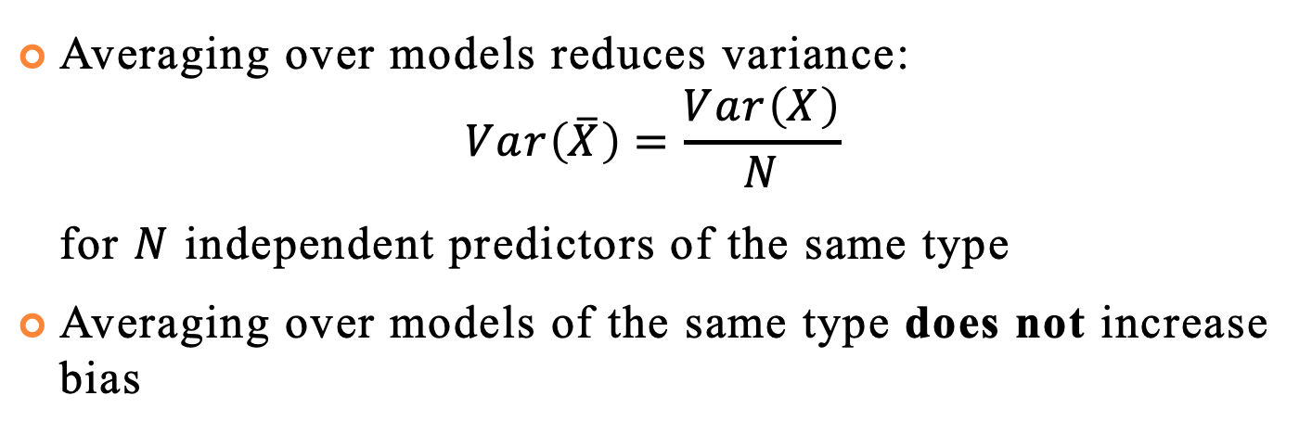
Variance Reduction
Averaging over models reduces variance:
$$Var\left(\overline{X}\right)=\frac{Var\left(X\right)}{N}$$
for $N$ independent predictors of the same type
Averaging over models of the same type does not increase bias
39

Slide 38
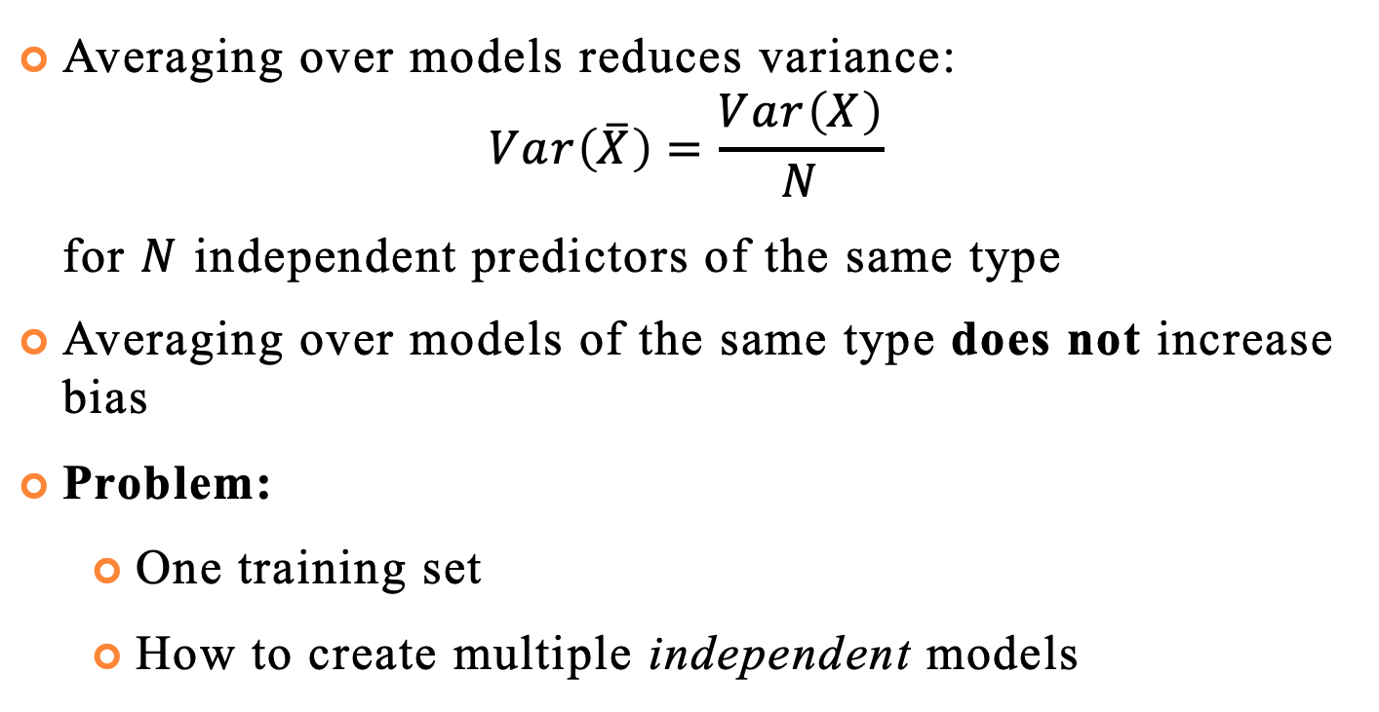
Variance Reduction
Averaging over models reduces variance:
$$Var\left(\overline{X}\right)=\frac{Var\left(X\right)}{N}$$
for $N$ independent predictors of the same type
Averaging over models of the same type does not increase bias
Problem:
One training set
How to create multiple independent models
39

Slide 39
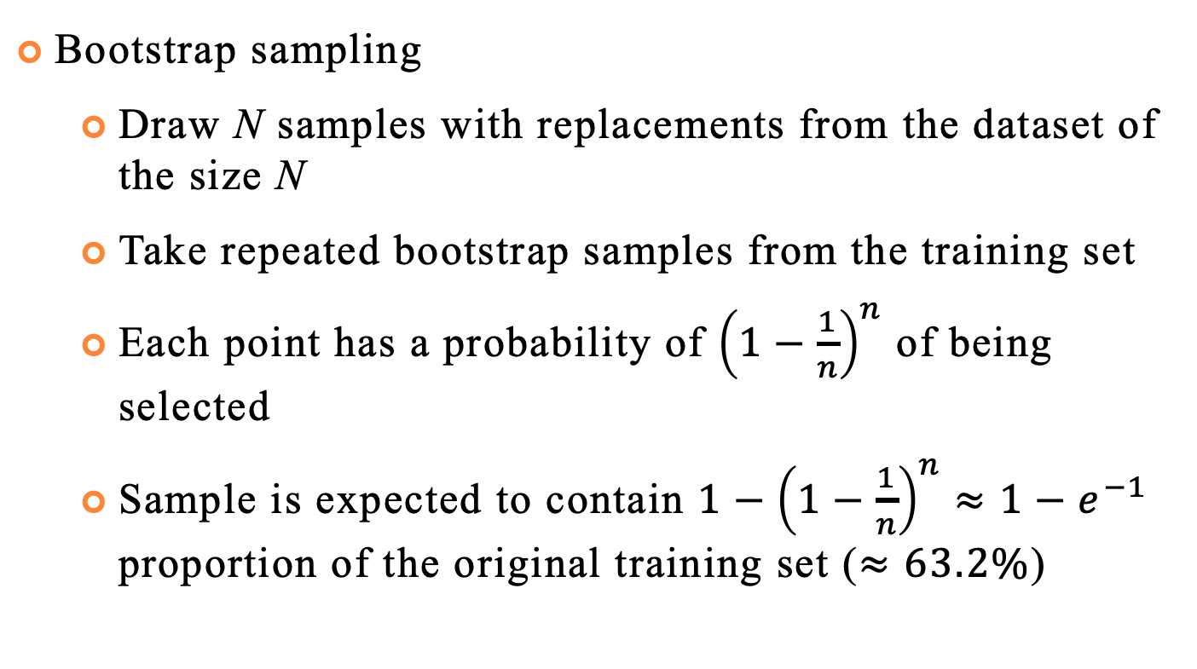

Bagging (Bootstrap Aggregation)
Bootstrap sampling
Draw N samples with replacements from the dataset of the size N
Take repeated bootstrap samples from the training set
Each point has a probability of ${\left(1−\frac{1}{n}\right)}^{n}$ of being selected
Sample is expected to contain $1−{\left(1−\frac{1}{n}\right)}^{n}≈1−e^{−1}$ proportion of the original training set ($≈63.2\%$)
39

Slide 40
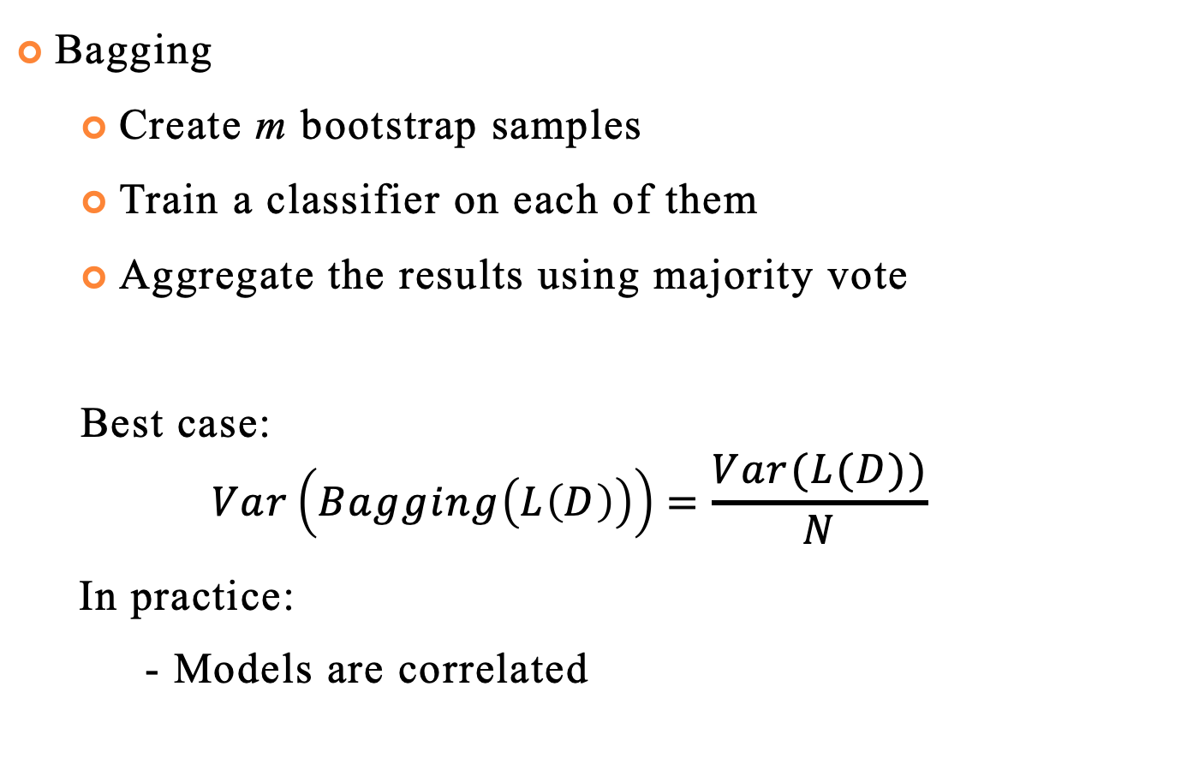
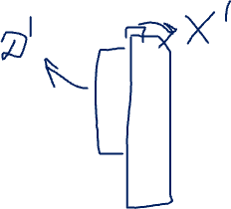
Bagging (Bootstrap Aggregation)
Bagging
Create m bootstrap samples
Train a classifier on each of them
Aggregate the results using majority vote
Best case:
$$Var\left(Bagging\left(L\left(D\right)\right)\right)=\frac{Var(L(D))}{N}$$
In practice:
- Models are correlated
39

Slide 41
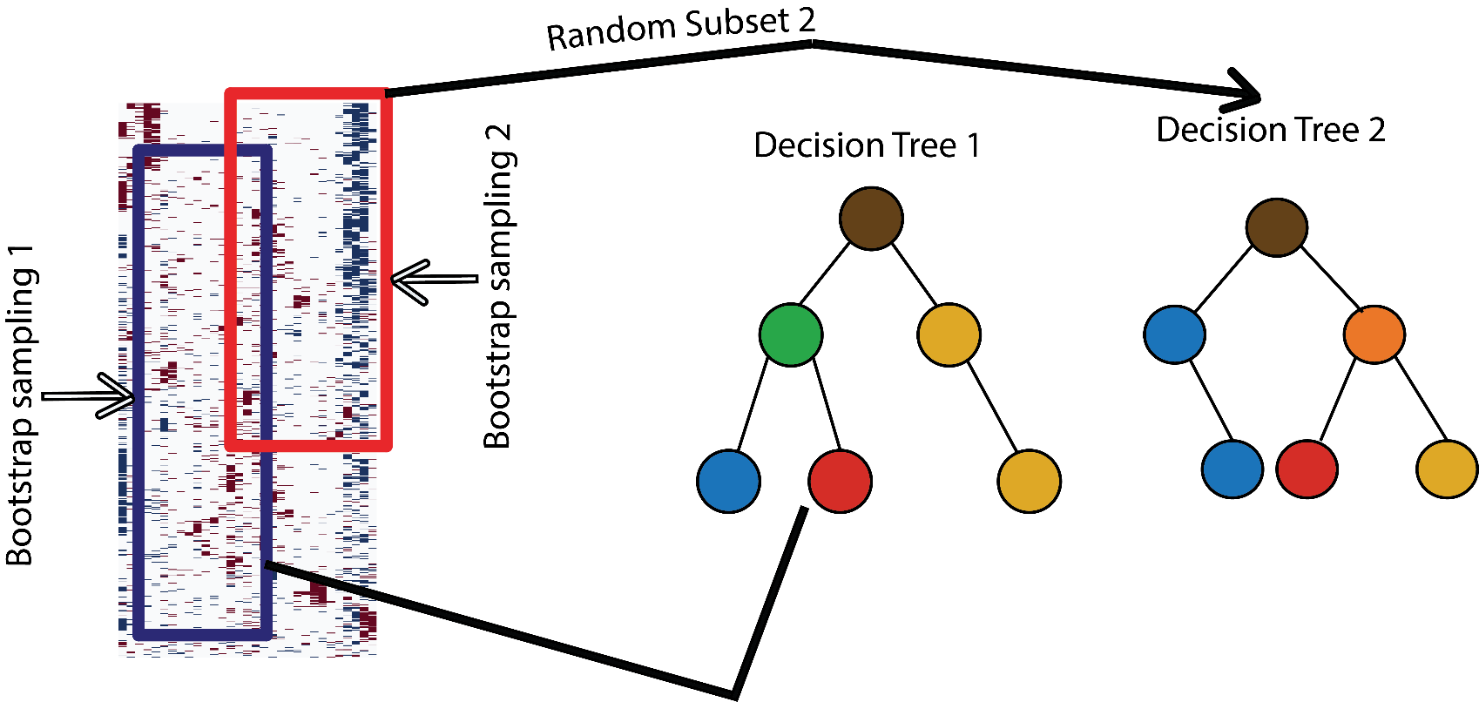
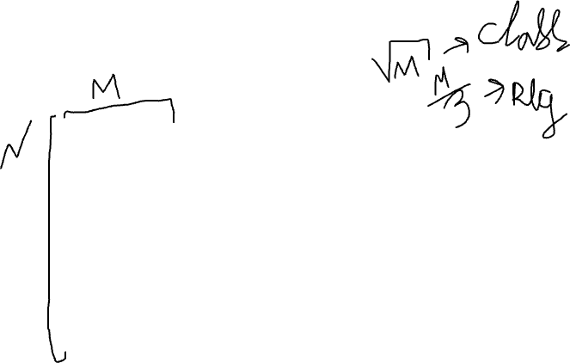
Random Forest
Introduce another source of randomness - random projections
39

Slide 42
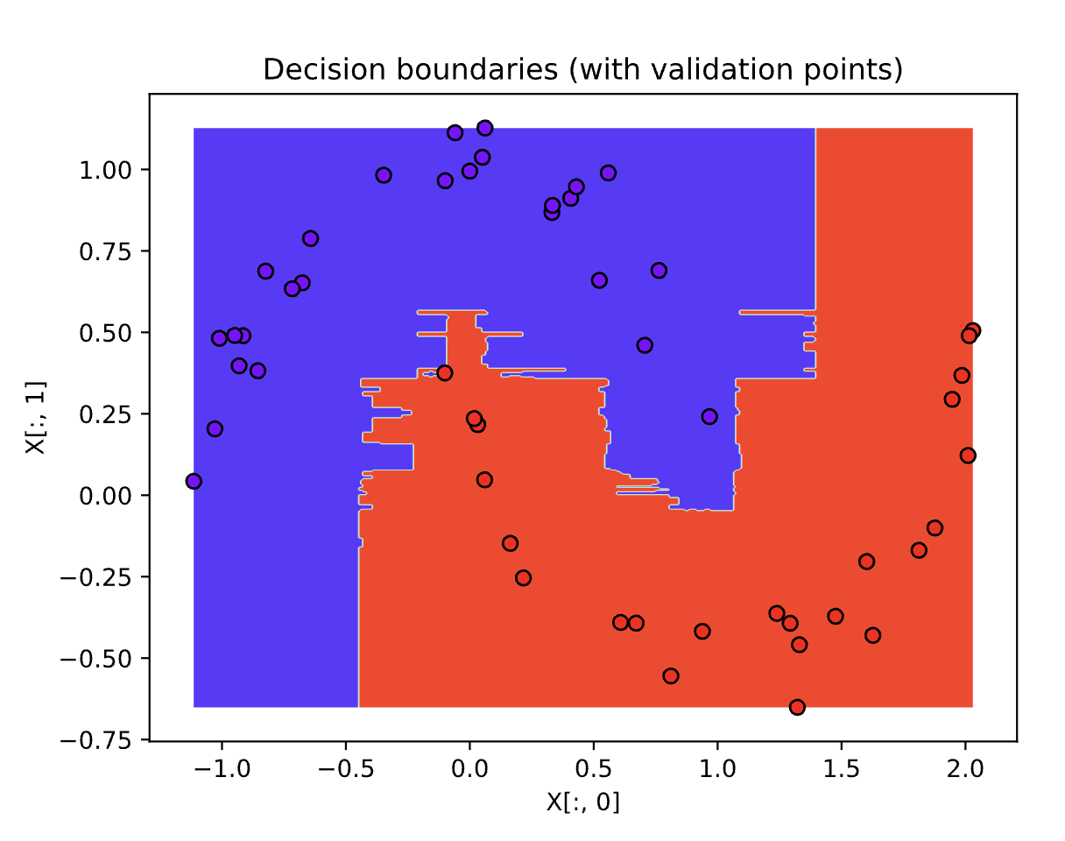
Random Forest
Complex decision boundaries
Feature importance – average over decision trees
39

Slide 43
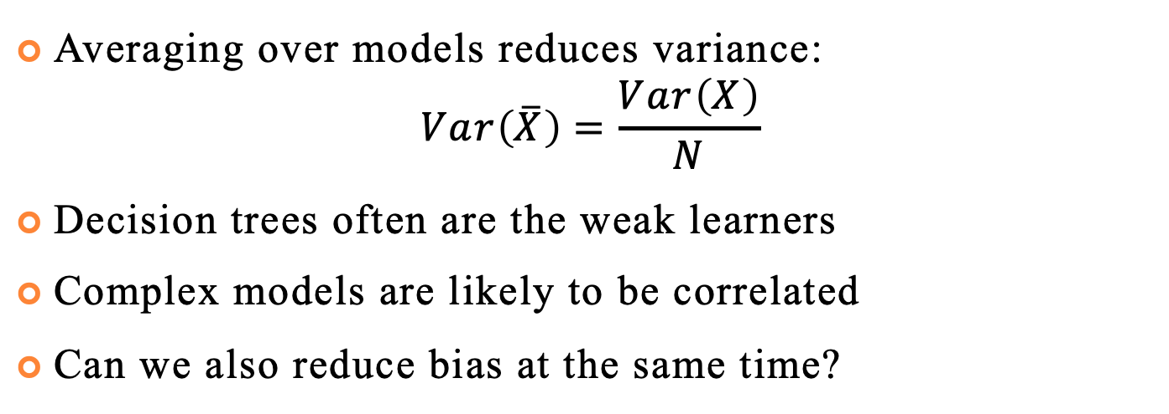
Further Improvements
Averaging over models reduces variance:
$$Var\left(\overline{X}\right)=\frac{Var\left(X\right)}{N}$$
Decision trees often are the weak learners
Complex models are likely to be correlated
Can we also reduce bias at the same time?
39

Slide 44
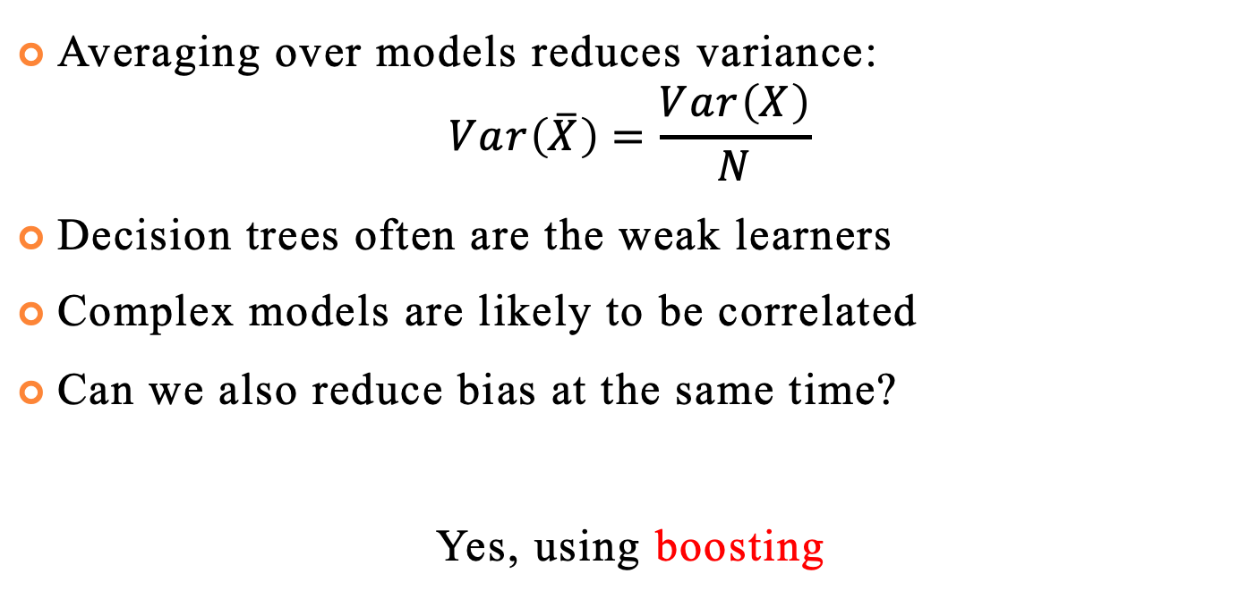
Further Improvements
Averaging over models reduces variance:
$$Var\left(\overline{X}\right)=\frac{Var\left(X\right)}{N}$$
Decision trees often are the weak learners
Complex models are likely to be correlated
Can we also reduce bias at the same time?
Yes, using boosting
39

Slide 45
Main Idea
Instead of increasing model complexity, make weak learners more relevant
Consider independent models as an expert
Each individual can have high bias, but the team of experts can be objective
Identify domain expertise you are lacking
Hire the one that addresses the issue
39

Slide 46
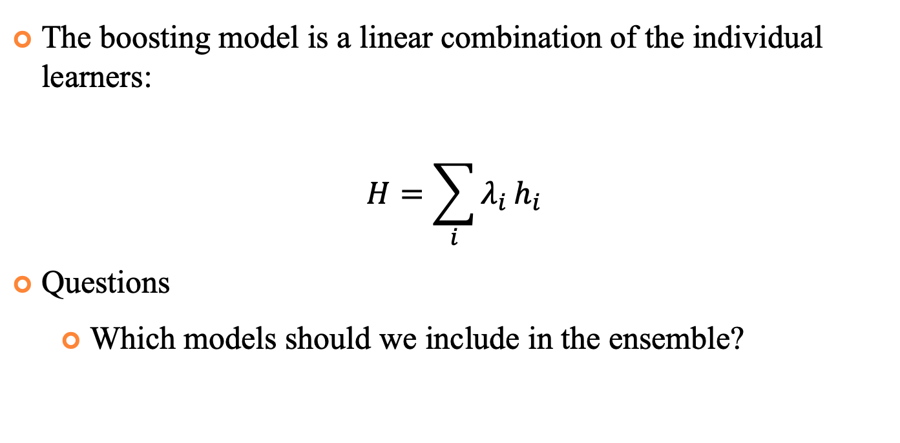
Main Idea
The boosting model is a linear combination of the individual learners:
$$H=\sum_{i}{λ_{i}}h_{i}$$
Questions
Which models should we include in the ensemble?
39

Slide 47
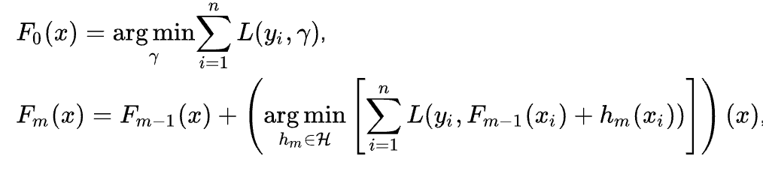
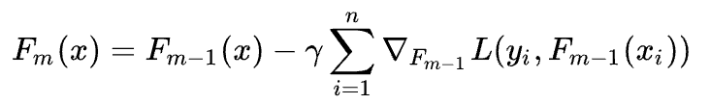
Gradient Boosting
Selecting the best model seems optimal
But in practice, it is not feasible, so we settle for the simplified version – making the best use of what we have
39

Slide 48
Useful Links
Decision Trees
https://scikit-learn.org/stable/modules/tree.html
https://scikit-learn.org/stable/modules/ensemble.html
Genetic Algorithm Framework
https://deap.readthedocs.io/en/master/
40

