Slide 1
CS584 Machine Learning
Lecture 10. Classification. Decision Trees
Oleksandr Narykov
onarykov@iit.edu

Slide 2
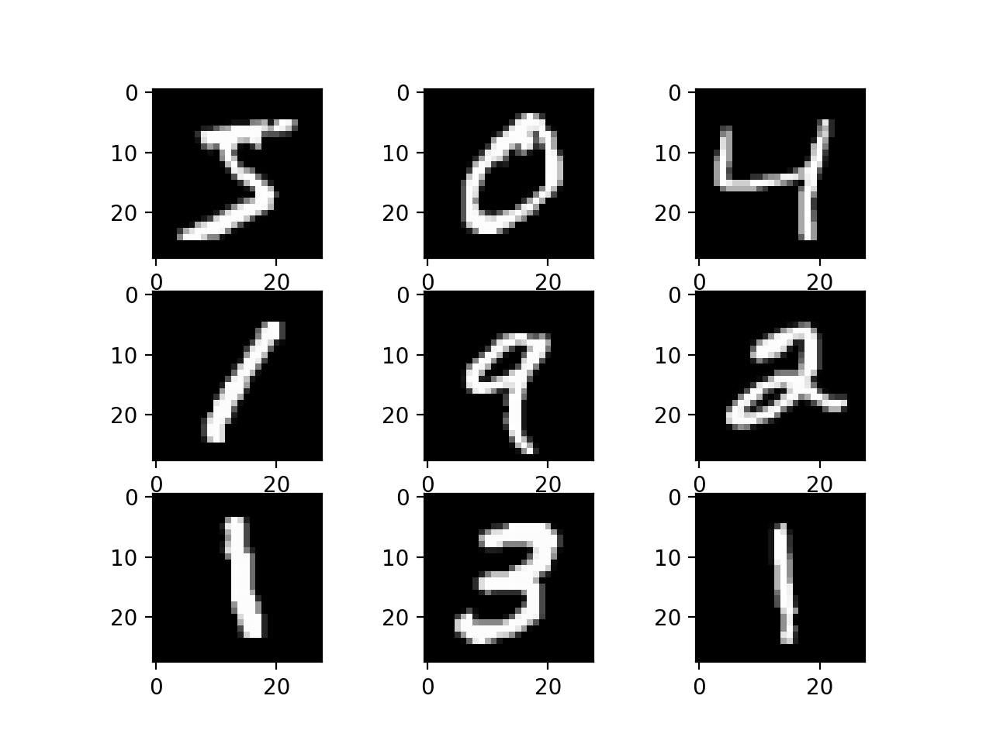
MNIST
15

Slide 3

Multi-Class Classification
Let’s consider predictions for each class as
probabilities:
$$\hat{y}=\left[\begin{matrix}0.13 \\ 0.2 \\ \begin{matrix}0.5 \\ 0.07 \\ 0.1\end{matrix}\end{matrix}\right]$$
15

Slide 4
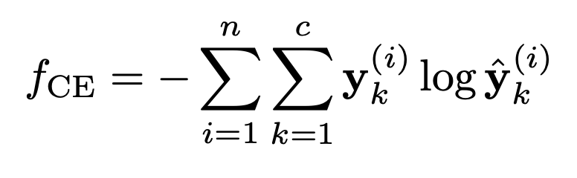
Multi-Class Classification
Let’s consider predictions for each class as
probabilities:
Cross-entropy:
$$\hat{y}=\left[\begin{matrix}0.13 \\ 0.2 \\ \begin{matrix}0.5 \\ 0.07 \\ 0.1\end{matrix}\end{matrix}\right]$$
15

Slide 5
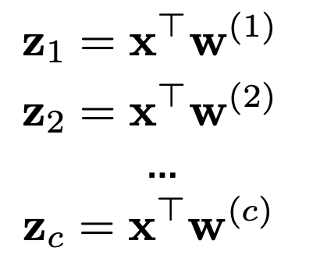
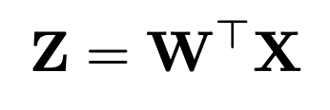
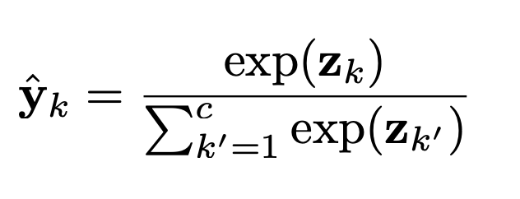

Soft-Max Regression Vectorization
Learn c logistic regressions simultaneously:
$$↔$$
Normalize across all classes
Use softmax function
15

Slide 6
Soft-Max Regression
Learn c logistic regressions simultaneously:
15

Slide 7
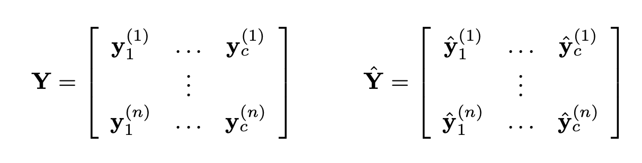
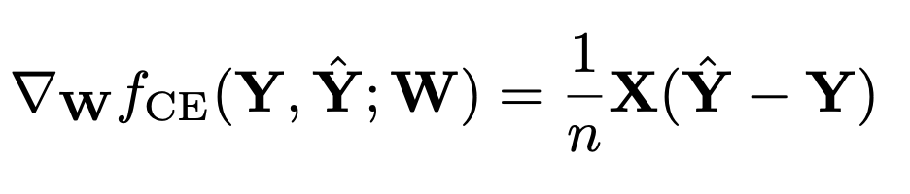
Gradient Descent
We know gradients for each vector w_{i}.
15

Slide 8
Decision Trees

Slide 9
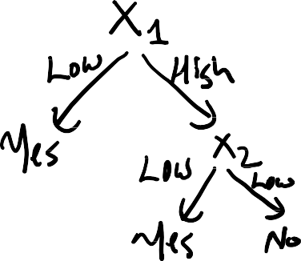

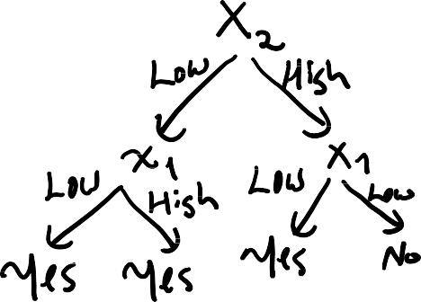
Example
𝑋₁ | 𝑋₂ | 𝑌
Low | Low | Yes
Low | High | Yes
High | Low | Yes
High | High | No
2

Slide 10

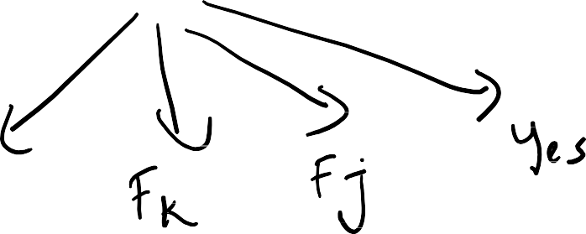

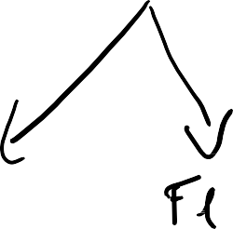











Non-Binary Decision Tree
3

Slide 11




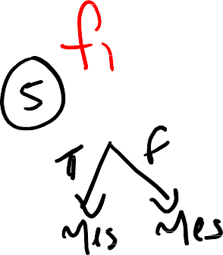
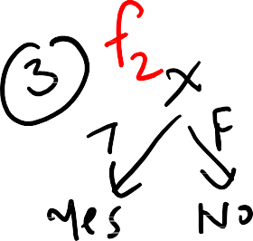
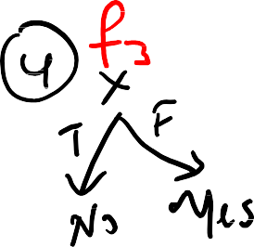










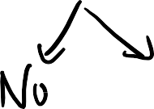


# Of Possible Decision Trees
Given one binary feature X (True/False) and a binary class Y (Yes/No), what is the
Size of the instance space
Size of the function space
Number of syntactically different decision trees?
X | f1 | f2 | f3 | f4
T | Yes | Yes | No | No
F | Yes | No | Yes | No
4

Slide 12













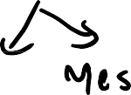

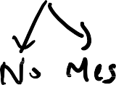





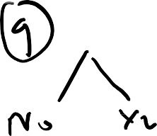

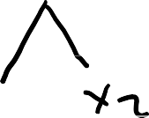
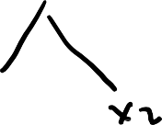


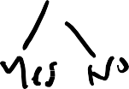
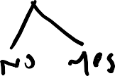
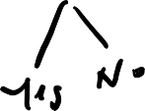





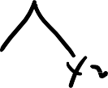
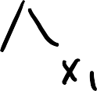





# Of Possible Decision Trees
Given two binary features 𝑋₁ and 𝑋₂ and a binary class 𝑌, the
Size of the instance space
2𝑥2 = 4
Size of the function space
2⁴ = 16
Number of syntactically different decision trees?
5

Slide 13
How would you learn a DT?
That is, how would you choose the nodes and leaves?
Which node(s) would you split on?
When would you stop splitting?
Here is a naïve DT learning algorithm
The node at the i^{th} level is the i^{th} feature
The leaf is the last feature
Let’s call this algorithm NDT
Questions
What’s the empirical error (error on training data)?
Can you use it for prediction?
Is it interpretable?
Does this provide any compression?
Can you do any better?
6
Notes:
0
No
Yes and No
No

Slide 14
Let’s Apply NDT: Data1
X₁ | X₂ | X₃ | Y
T | T | T | A
T | T | F | B
T | F | T | A
F | T | T | A
F | T | F | B
F | F | T | B
7

Slide 15
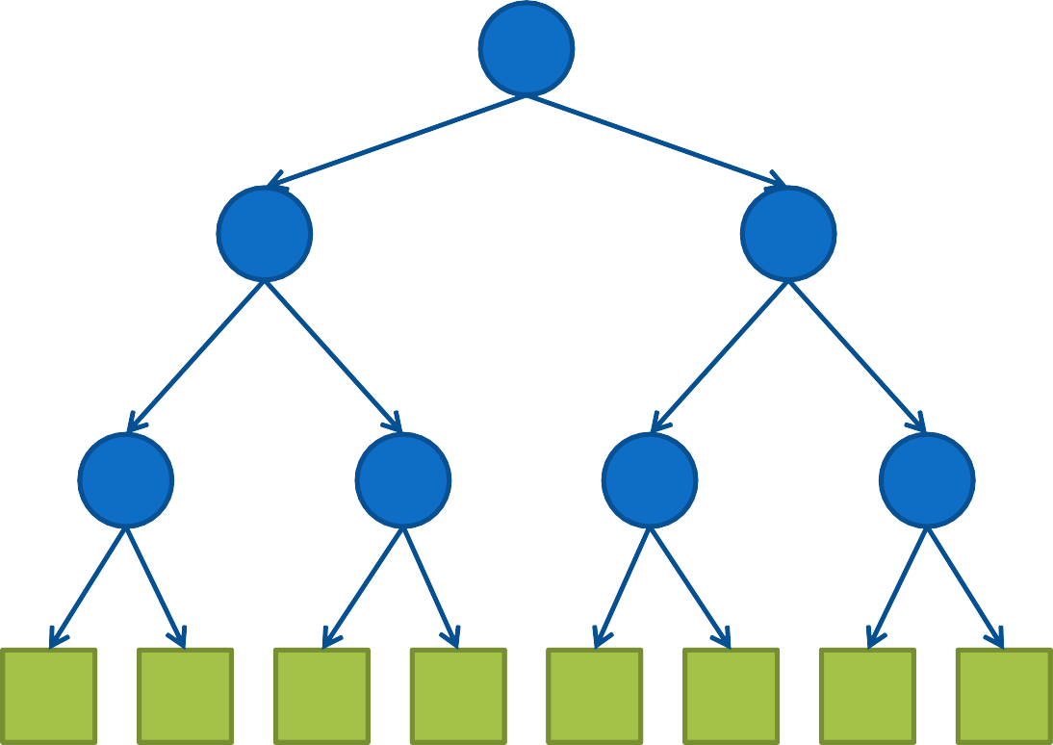
Let’s Apply NDT: Data1 – Tree1
X₁
Empirical error?
How do you predict F, F, F?
Introduce inductive bias. How?
T
F
X₂
X₂
T
F
T
F
X₃
X₃
X₃
X₃
T F T F T F T F
A B A ? A B B ?
8

Slide 16
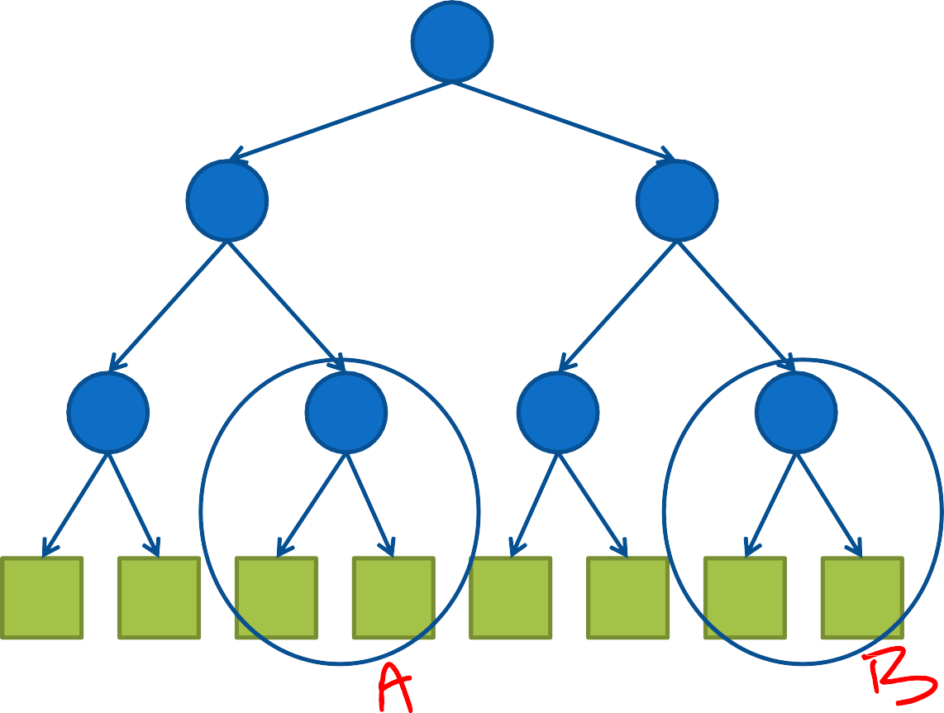
Data1– Tree1
X
No learning bias -> no prediction
T
1
F
Inductive bias = Similar instances -> similar
labels
X₂
X₂
T
F
T
F
X₃
X₃
X₃
X₃
T F T F T F T F
A B A ? A B B ?
9

Slide 17
Data1– Tree2
X
Can we use this for prediction?
Yes!
T
1
F
X
X
What if we had no case for X1=F, X2=F in the training data?
How would you classify those cases? A or B?
2
2
T
F
T
F
X₃
A
X₃
B
T F
T F
A
B
A
B
10

Slide 18
Let’s Apply it: Data2
X₁ | X₂ | X₃ | Y
T | T | T | A
T | T | F | B
T | F | T | A
F | T | T | A
F | T | F | B
Same as Data1, except the last row is removed.
11

Slide 19
DATA2 – TREE1
X₁
T
F
What if we reorder 𝑋 and 𝑋
2 3
for the 𝑋₁ = 𝐹 branch?
X₂
X₂
T
F
T
F
X₃
A
X₃
?
T F
T F
A
B
A
B
12

Slide 20
DATA2 – TREE2
X₁
T
F
X₂
X₃
T
F
T
F
X₃
A
A
B
T F
A
B
13

