Slide 1
CS584 Machine Learning
Lecture 10. Classification. Decision Trees
Oleksandr Narykov
onarykov@iit.edu

Slide 2
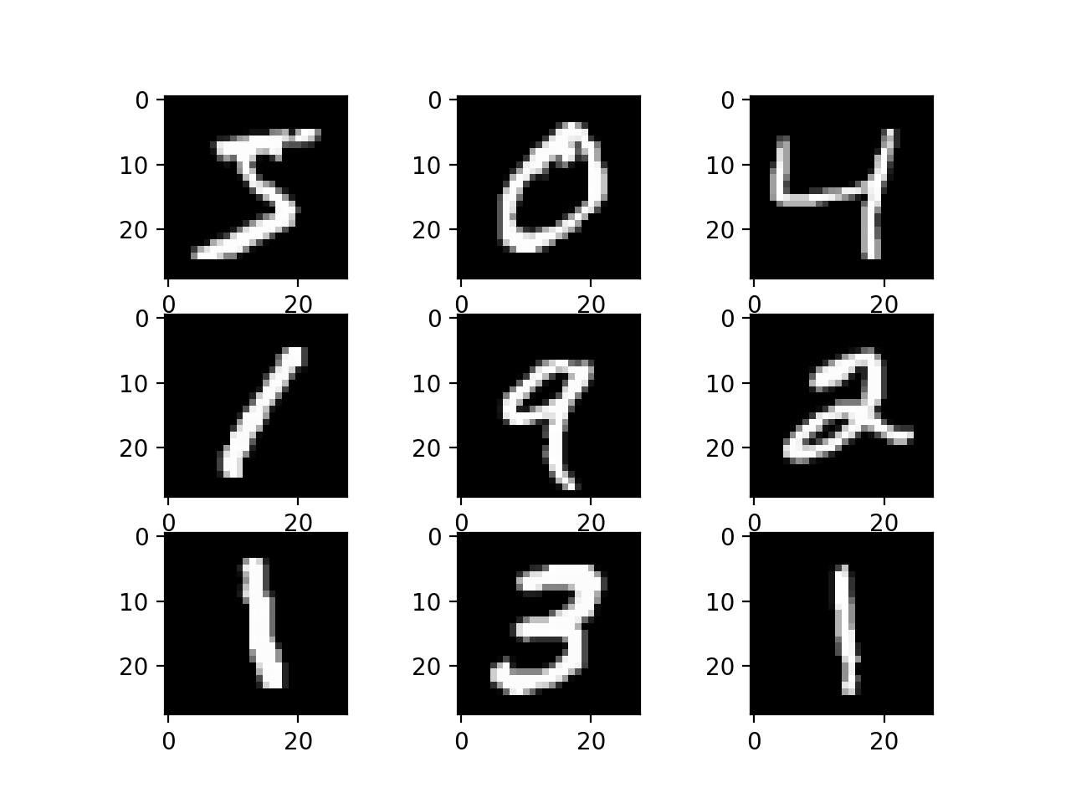
MNIST
15

Slide 3

Multi-Class Classification
Let’s consider predictions for each class as
probabilities:
$$\hat{y}=\left[\begin{matrix}0.13 \\ 0.2 \\ \begin{matrix}0.5 \\ 0.07 \\ 0.1\end{matrix}\end{matrix}\right]$$
15

Slide 4
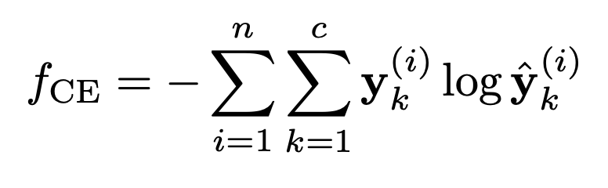
Multi-Class Classification
Let’s consider predictions for each class as
probabilities:
Cross-entropy:
$$\hat{y}=\left[\begin{matrix}0.13 \\ 0.2 \\ \begin{matrix}0.5 \\ 0.07 \\ 0.1\end{matrix}\end{matrix}\right]$$
15

Slide 5
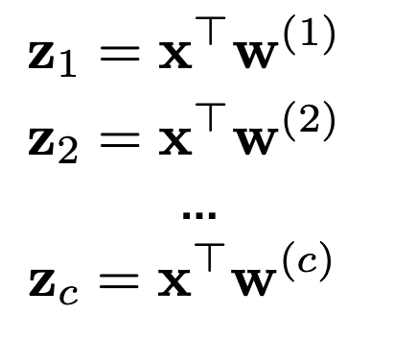
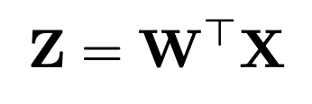
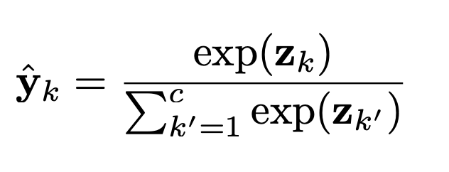

Soft-Max Regression Vectorization
Learn c logistic regressions simultaneously:
$$↔$$
Normalize across all classes
Use softmax function
15

Slide 6
Soft-Max Regression
Learn c logistic regressions simultaneously:
15

Slide 7
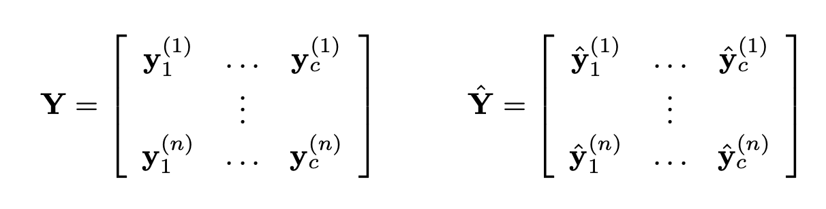
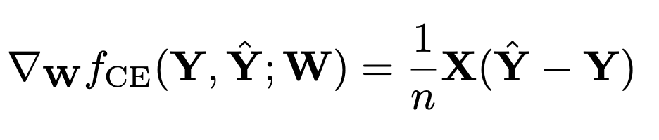
Gradient Descent
We know gradients for each vector w_{i}.
15

