Slide 1
CS584 Machine Learning
Lecture 3. Model Evaluation. Next steps
Oleksandr Narykov
onarykov@iit.edu

Slide 2
Review. Multiclass Confusion Matrix
 | C1 | C2 | C3 | C4 | C5
C1 | TN | TN | FP | TN | TN
C2 | TN | TN | FP | TN | TN
C3 | FN | FN | TP | FN | FN
C4 | TN | TN | FP | TN | TN
C5 | TN | TN | FP | TN | TN
12

Slide 3
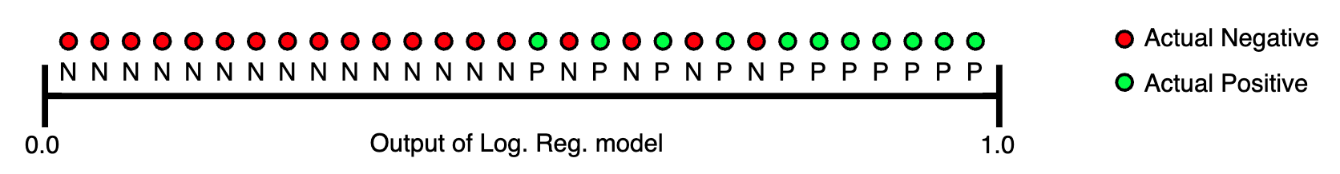
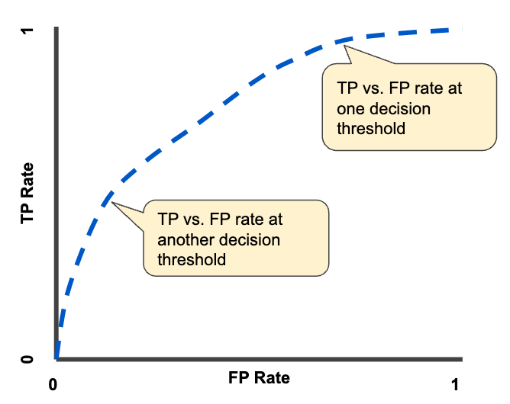
Review. AUC
16

Slide 4
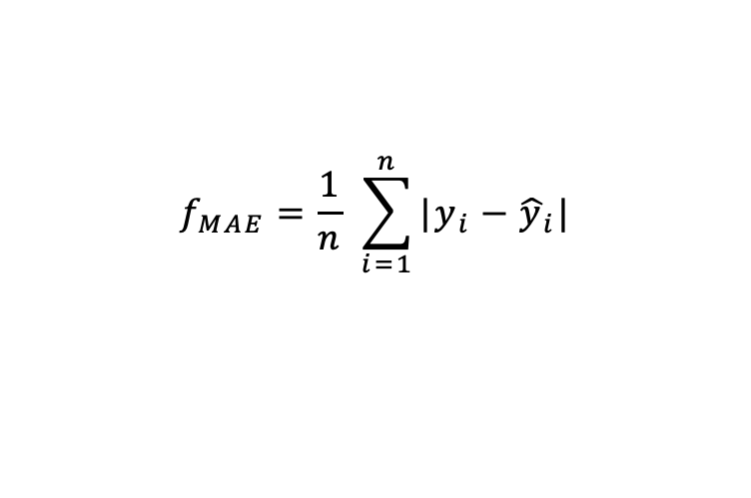
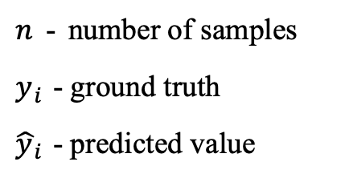
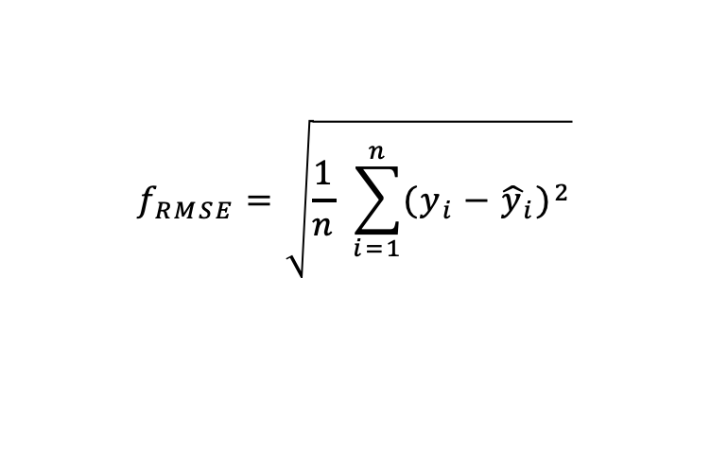
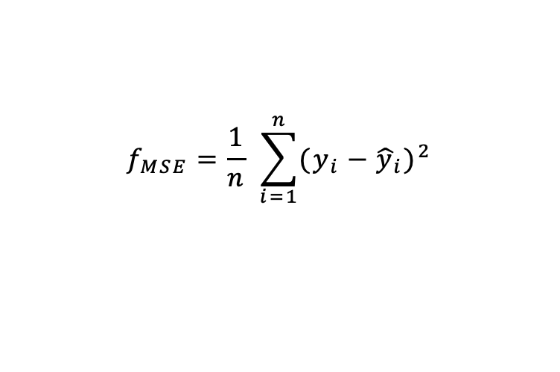
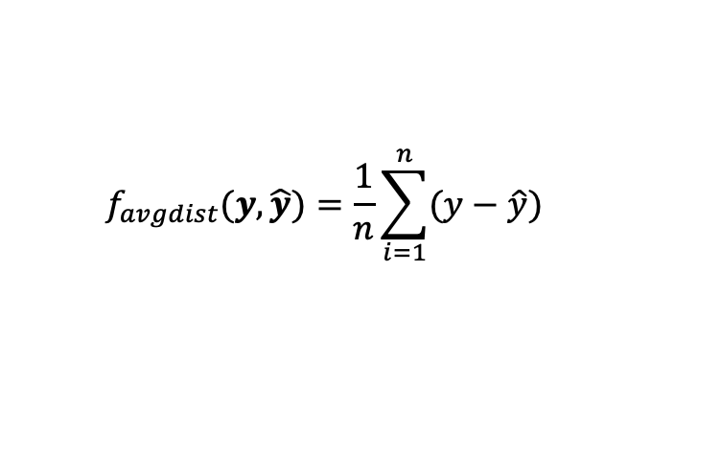
Review. Regression Error
Average Distance
Mean Absolute Error
Mean Squared Error
Root Mean Squared Error
$n$ - number of samples
$y_{i}$ - ground truth
${\hat{y}}_{i}$ - predicted value
$$f_{avgdist}(y,\hat{y})=\frac{1}{n}\sum_{i=1}^{n}{(y−\hat{y})}$$
$$f_{MAE}=\frac{1}{n} \sum_{i=1}^{n}{|y_{i}−{\hat{y}}_{i}|}$$
$$f_{MSE}=\frac{1}{n} \sum_{i=1}^{n}{{(y_{i}−{\hat{y}}_{i})}^{2}}$$
$$f_{RMSE}=\sqrt{\frac{1}{n} \sum_{i=1}^{n}{{(y_{i}−{\hat{y}}_{i})}^{2}}}$$
2

Slide 5
Error estimation. Practical considerations

Slide 6
Splitting the dataset
Train-test splits
Train-validation-test splits
Cross-validation
21

Slide 7
Train-Test Split
Randomly split the data into two disjoint sets
A typical approach: 2/3 for train and 1/3 for test
Train your model on training data and evaluate
it on the test data
Use your favorite performance metric
Report your performance as the expected performance on unseen data
Caveats:
You need a large dataset for this to work
You cannot tune your parameters on the test data
22

Slide 8
Train-Validation-Test Split
Split your data into three disjoint sets
Train, validation, test
Train your model(s) on the training data
Evaluate your model(s) on the validation data
Pick the model that performs best on the validation data
Test the model on the test data, and report its performance.
Typical split is 60% train, 20% validation, 20% test
Caveat:
You need a really big dataset for this to work
23

Slide 9
Cross-Validation
Split your data into k disjoint sets
Each time, one set is the test set and the rest is the training set
Training Set
Test Set

Slide 10
Cross-Validation
Split your data into k disjoint sets
Each time, one set is the test set and the rest is the training set
Training Set
Test Set
Validation Set

Slide 11
Imbalanced Dataset
Dataset
Stratified CV
Follows class distribution in the dataset
Weighted sampling
Increases importance of the drugs with smaller number of experiments
Stratified
Class 1
Class 2
Class 3
Weighted
Class 1
Class 2
Class 3

Slide 12
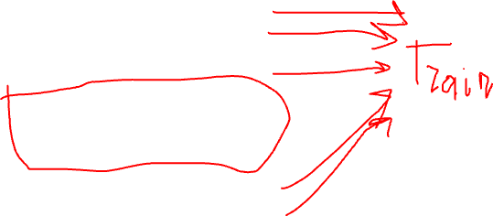
Grouped Cross-Validation
Split your data into k folds based on a group information
No samples from the same group is present both in test and train sets
Sample 1
Group 1
Sample 2
Sample 3
Sample 4
Group 2
Test Set
Sample 5
Group 3
Sample 6
Sample 7
Group 4
Sample 8

Slide 13
Error and Model Complexity

Slide 14
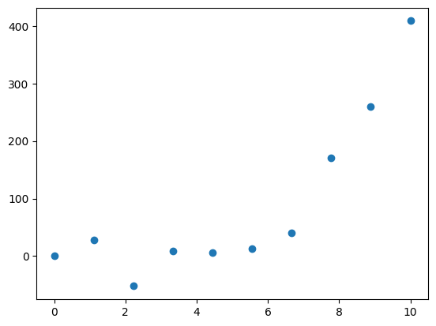
Bias / Variance Tradeoff
https://towardsdatascience.com/techniques-for-handling-underfitting-and-overfitting-in-machine-learning-348daa2380b9

Slide 15
Bias / Variance Tradeoff
Without assumptions you cannot make predictions
https://towardsdatascience.com/techniques-for-handling-underfitting-and-overfitting-in-machine-learning-348daa2380b9

Slide 16
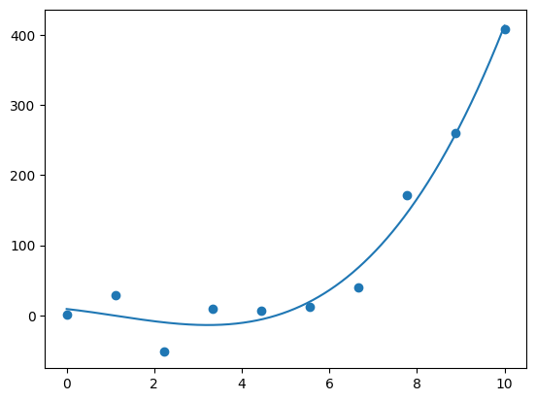
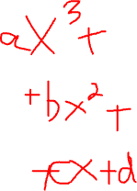
Bias / Variance Tradeoff
This model is just right

Slide 17
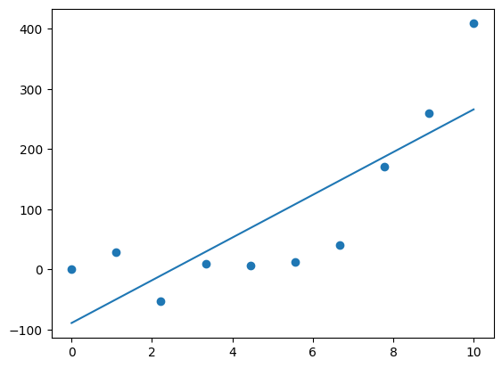
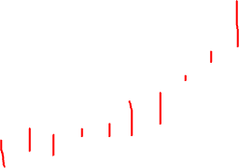
Bias / Variance Tradeoff
Making strong assumptions
Simple model
Underfitting
High Bias

Slide 18
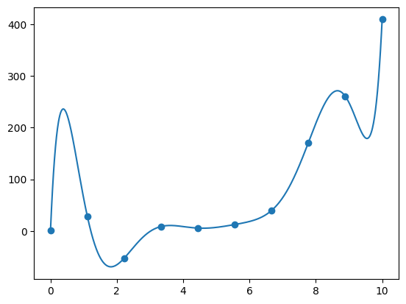
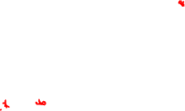
Bias / Variance Tradeoff
Making strong assumptions
Simple model
Underfitting
Allowing model to infer lots
of interdependencies in data
Very complex model
Overfitting
High Bias
High Variance

Slide 19
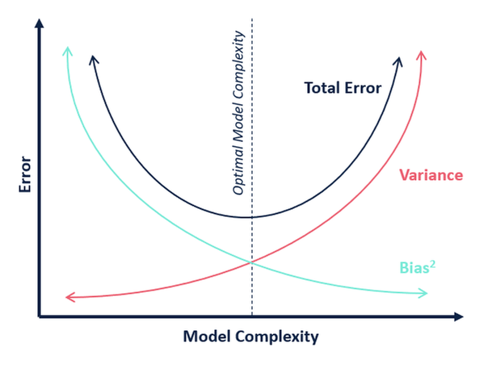
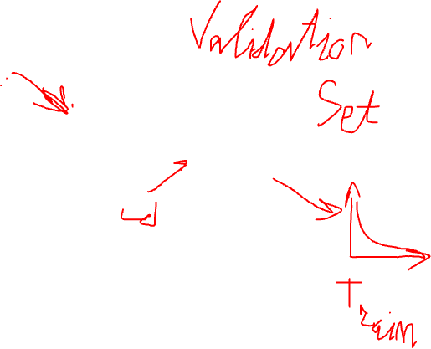
Bias / Variance Tradeoff

Slide 20
Revisiting Probability Theory

Slide 21
Motivation
Learning
Statistics, expectations, etc.
E.g., decision trees, naïve Bayes, logistic regression, …
Evaluation
Statistics, expectations, variance, etc.
E.g., expected error using a sample
2

Slide 22

Some Questions
Given a domain with n variables, 𝑋₁, 𝑋₂, … , 𝑋_{𝑛}, each of which has
𝑣₁, 𝑣₂, … , 𝑣_{𝑛} possible values, what is the size of the instance space?
Given a sample dataset and a hypothesis h, calculate the mean,
variance, and 95% confidence interval for the error rate of h
Type I error has cost 𝑐₁ and type II error has cost 𝑐₂. Correct decisions have no cost. The probability of the object belonging to Positive class is p. Should it be classified as Positive or Negative?
Given P(Symptoms|Diseases), P(Diseases) and P(Symptoms), calculate P(Diseases|Symptoms)
Given a probability distribution 𝑝₁, 𝑝₂, … , 𝑝_{𝑘}, calculate its entropy
3

Slide 23

Random Variables
Pick variables of interest
Medical diagnosis
Age, gender, weight, temperature, …
Loan application
Income, wealth, payment history, …
Every variable has a domain
Binary (True/False)
Categorical
Real-valued
Possible world
An assignment to all variables of interest
4

Slide 24

Probability Model
A probability model associates a numerical probability P(w) with each possible world w
P(w) sums to 1 over all possible worlds
An event is the set of possible worlds where a given predicate is true
Roll two dice
The possible worlds are (1,1), (1,2), …, (6,6); 36 possible worlds
Predicate = two dice sum to 10
Event = {(4,6), (5,5), (6,4)}
Toothache and cavity
Four possible worlds: (𝑡, 𝑐), (𝑡, ~𝑐), (~𝑡, 𝑐), (~𝑡, ~𝑐)
Some worlds are more likely than others
Predicate can be anything about these variables: 𝑡 ∧ 𝑐, 𝑡, 𝑡 ∨ ~𝑐,
5

Slide 25

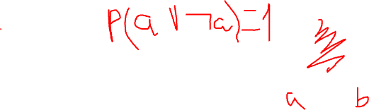
Axioms of Probability
The probability P(a) of a proposition a is a real number between 0 and 1
P(true) = 1, P(false) = 0
P(a ∨ b) = P(a) + P(b) – P(a ∧ b)
6

Slide 26









P(¬a)
P(a ∨ ¬a) = P(a) + P(¬a) – P (a ∧ ¬a)
P(true) = P(a) + P(¬a) – P(false)
1 = P(a) + P(¬a) – 0
P(¬a) = 1 – P(a)
Intuitive explanation:
The probability of all possible worlds is 1
Either a or ¬a holds in one world
The worlds that a holds and the worlds that ¬a holds
are mutually exclusive and exhaustive
7

Slide 27
Random Variables – Notation
Capital: X: variable
Lowercase: x: a particular value of X
Val(X): the set of values X can take
Bold Capital: X: a set of variables
Bold lowercase: x: an assignment to all variables in X
P(X=x) will be shortened as P(x)
P(X=x ∩ Y=y) will be shortened as P(x,y)
8

Slide 28
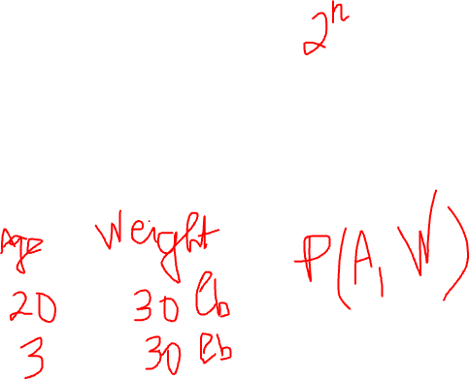
Joint Distribution
We have n random variables, X₁, X₂, …, X_{n}
We are interested in the probability of a possible world, where
X₁=low, X₂=red, …, X_{n}=circle
P(X₁, X₂, …, X_{n}) associates a probability for each possible world ≡
the joint distribution
How many entries are there, if we assume the variables are all
binary?
9
Notes:
2^n

Slide 29
Toothache example
Feeling | X-Ray | P(F,X)
toothache | cavity | 0.15
toothache | ¬cavity | 0.10
¬toothache | cavity | 0.05
¬toothache | ¬cavity | 0.70
10

Slide 30
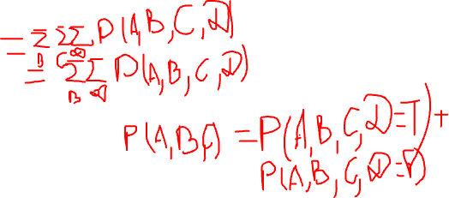
Marginalization
Given a distribution over n variables, you can calculate the distribution over any subset of the variables by summing out the irrelevant ones
For example
Given P(A, B, C, D)
Calculate
P(A)
P(A, C)
… (any subset)
11
Notes:
Sum by B,C,D
Sum by B,D

Slide 31
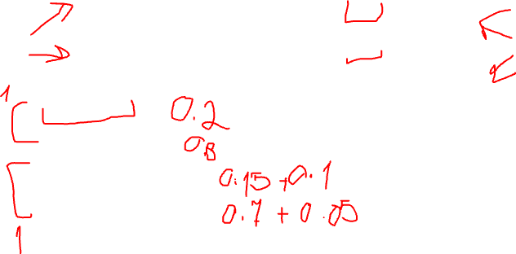
Let’s Answer a few queries
Feeling | X-Ray | P(F,X)
toothache | cavity | 0.15
toothache | ¬cavity | 0.10
¬toothache | cavity | 0.05
¬toothache | ¬cavity | 0.70
P(cavity) = ?
P(¬cavity) = ?
P(toothache) = ?
P(¬toothache) = ?
12
Notes:
0.15 + 0.05
0.70 + 0.10
0.15 + 0.10
0.70 + 0.05

