Slide 1
CS584 Machine Learning
Lecture 2. Model Evaluation
Oleksandr Narykov
onarykov@iit.edu

Slide 2
Classification Problem
Given a labeled dataset 𝒟 = {⟨𝑥_{𝑖}, 𝑦_{𝑖}⟩}, where 𝑥_{𝑖} is the input and 𝑦_{𝑖} is the discrete output
Train a classifier 𝑓: 𝒳 → 𝒴 using 𝒟
The purpose of 𝑓 is to perform “well” on unseen data
How do we define “well”?
2

Slide 3
Accuracy
The simplest measure is “is the prediction correct?”
Examples
Given an email, the model predicts it’s spam. Is it
correct?
Given a patient, the model predicts the patient is suffering from Heart disease. Is it correct?
Given a loan application, the model recommends reject. Is the recommendation correct?
Given a dataset, accuracy is the percentage of objects the
model’s predictions are correct
3

Slide 4
True Error
Given ℎ(𝑥), we are interested in
σ_{𝑥~𝓧} 𝑃 𝑥 I ℎ(𝑥) ≠ 𝑐(𝑥) , where
𝓧 is the space of all possible instances
𝑃 𝑥 is the probability of seeing instance 𝑥
I ℎ(𝑥) ≠ 𝑐(𝑥)
0 otherwise
Problems
is 1 if the prediction by h is incorrect;
𝓧 is super large; exponential in the size of the
domains of the variables
We do not know 𝑃 𝑥
17

Slide 5
Sampling
When space is large, sample from 𝑃 𝑥
When 𝑃 𝑥 is not known, or sampling from 𝑃 𝑥
is not possible, collect a “representative” sample
Let 𝒟~𝑃 𝑥 be a representative sample
For example, true mean versus sample mean
σ_{𝑥~𝓧} 𝑃 𝑥 𝑥
1
σ 𝑥

𝑥∈𝒟
|𝒟|
How do we know how close the true mean and the sample mean are?
19

Slide 6
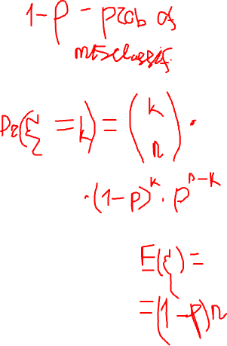
Sample Error
Let 𝒟~𝑃 𝑥 be a representative dataset
Sample error
1

|𝒟|
σ_{𝑥∈𝒟} I ℎ(𝑥) ≠ 𝑐(𝑥)
Remember the binomial distribution
n experiments, each with p success probability
n data points, each with p true error
Sample error is based on a binomial distribution where exactly
k objects are incorrectly labeled
What is the probability that k objects are incorrectly labeled? What is the expectation? What is the variance? What is the 95% confidence interval?
Important note: h and 𝒟 must be independent; h cannot depend on 𝒟
20

Slide 7
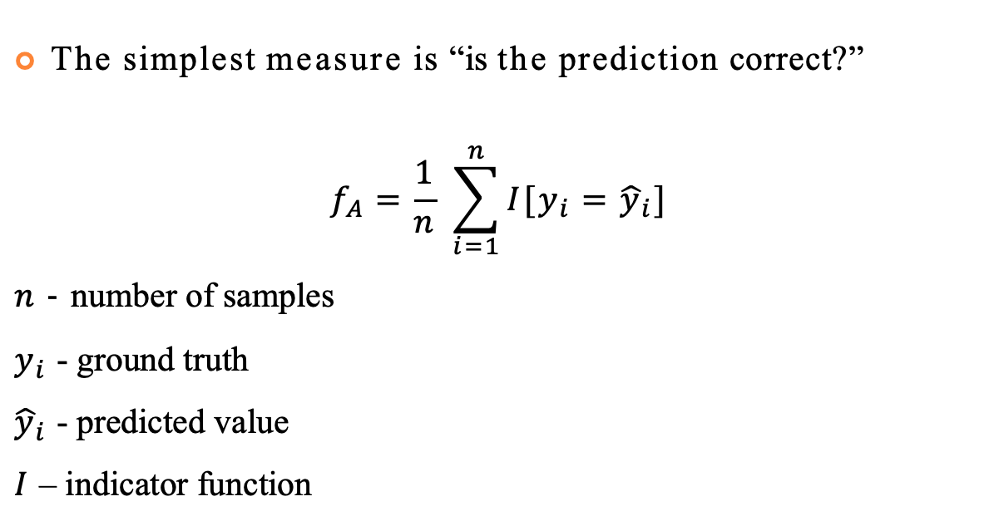
Accuracy
The simplest measure is “is the prediction correct?”
$$f_{A}=\frac{1}{n} \sum_{i=1}^{n}{I[y_{i}={\hat{y}}_{i}]}$$
$n$ - number of samples
$y_{i}$ - ground truth
${\hat{y}}_{i}$ - predicted value
$I$ – indicator function
3

Slide 8
Some Problems with Accuracy
All mistakes are considered equal; for example
Misclassifying a spam email as spam, and misclassifying an important email as spam are considered equally bad
Approving a loan application that should have been rejected, and rejecting a loan application that should have been approved are considered equally bad
95% of tested patient do not have cancer
If a class is dominant, it’s often easy to get high accuracy by simply predicting every object as the dominant class; for example
If 80% of the emails are good, a classifier that classifies every email as good will have 80% accuracy
All cases are considered equal; for example, email from your family, boss, bank, social media updates, … are all considered equally important, which might or might not be true
4

Slide 9
Types of Classification Errors
Assume a target/positive class
Spam, HasHeartDisease, Approve, etc.
This step is important; positive does not mean “good”; positive mean
the concept of interest and you decide which class is positive
For example, positive covid test does not mean “good” news
False positive
Falsely classifying an object as positive
E.g., classifying a ham email as spam, diagnosing a healthy patient as having heart disease, approving a loan that should have been rejected, and so on
Also called Type I error
False negative
Falsely classifying an object as negative
E.g., classifying a spam email as spam, claiming that a heart-disease patient
is healthy, rejecting a loan that should have been approved, and so on
Also called Type II error
5

Slide 10
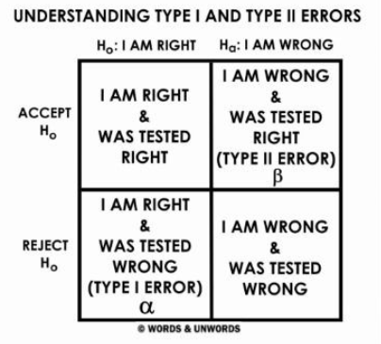
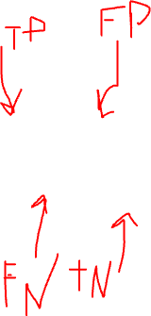
Types of Classification Errors
Assume a target/positive class
Spam, HasHeartDisease, Approve, etc.
This step is important; positive does not mean “good”; positive mean
the concept of interest and you decide which class is positive
For example, positive covid test does not mean “good” news
False positive
Falsely classifying an object as positive
E.g., classifying a ham email as spam, diagnosing a healthy patient as having heart disease, approving a loan that should have been rejected, and so on
Also called Type I error
False negative
Falsely classifying an object as negative
E.g., classifying a spam email as spam, claiming that a heart-disease patient
is healthy, rejecting a loan that should have been approved, and so on
Also called Type II error
5

Slide 11
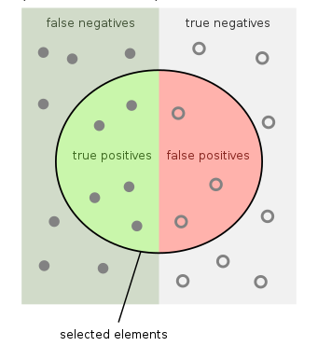
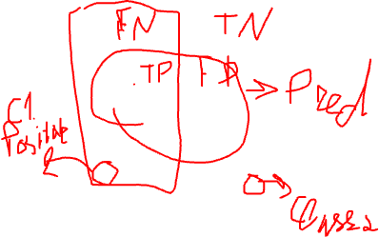
Confusion Matrix
 |  | Predicted Class
 |  | Positive | Negative
Actual Class | Positive | True Positive | False Negative
 | Negative | False Positive | True Negative
6

Slide 12
Accuracy
 |  | Predicted Class
 |  | Positive | Negative
Actual Class | Positive | True Positive | False Negative
 | Negative | False Positive | True Negative
𝑁𝑢𝑚 𝐶𝑜𝑟𝑟𝑒𝑐𝑡
𝑇𝑃 + 𝑇𝑁
𝐴𝑐𝑐𝑢𝑟𝑎𝑐𝑦 =
=
𝐷𝑎𝑡𝑎 𝑆𝑖𝑧𝑒
𝑇𝑃 + 𝑇𝑁 + 𝐹𝑃 + 𝐹𝑁
7

Slide 13

Precision
 |  | Predicted Class
 |  | Positive | Negative
Actual Class | Positive | True Positive | False Negative
 | Negative | False Positive | True Negative
𝑇𝑟𝑢𝑒 𝑃𝑜𝑠𝑖𝑡𝑖𝑣𝑒
𝑇𝑃
𝑃𝑟𝑒𝑐𝑖𝑠𝑖𝑜𝑛 =
=
𝑃𝑟𝑒𝑑𝑖𝑐𝑡𝑒𝑑 𝑃𝑜𝑠𝑖𝑡𝑖𝑣𝑒
𝑇𝑃 + 𝐹𝑃
8

Slide 14

Recall – True Positive Rate – Sensitivity
 |  | Predicted Class
 |  | Positive | Negative
Actual Class | Positive | True Positive | False Negative
 | Negative | False Positive | True Negative
𝑇𝑟𝑢𝑒 𝑃𝑜𝑠𝑖𝑡𝑖𝑣𝑒
𝑇𝑃
𝑇𝑃𝑅 = 𝑅𝑒𝑐𝑎𝑙𝑙 =
=
𝐴𝑐𝑡𝑢𝑎𝑙 𝑃𝑜𝑠𝑖𝑡𝑖𝑣𝑒
𝑇𝑃 + 𝐹𝑁
9

Slide 15

True Negative Rate – Specificity
 |  | Predicted Class
 |  | Positive | Negative
Actual Class | Positive | True Positive | False Negative
 | Negative | False Positive | True Negative
𝑇𝑟𝑢𝑒 𝑁𝑒𝑔𝑎𝑡𝑖𝑣𝑒
𝑇𝑁
𝑇𝑁𝑅 = 𝑆𝑝𝑒𝑐𝑖𝑓𝑖𝑐𝑖𝑡𝑦 =
=
𝐴𝑐𝑡𝑢𝑎𝑙 𝑁𝑒𝑔𝑎𝑡𝑖𝑣𝑒
𝑇𝑁 + 𝐹𝑃
10

Slide 16

False Positive Rate – Fall-out
 |  | Predicted Class
 |  | Positive | Negative
Actual Class | Positive | True Positive | False Negative
 | Negative | False Positive | True Negative
𝐹𝑎𝑙𝑠𝑒 𝑃𝑜𝑠𝑖𝑡𝑖𝑣𝑒
𝐹𝑃
𝐹𝑃𝑅 = 𝐹𝑎𝑙𝑙𝑂𝑢𝑡 =
=
𝐴𝑐𝑡𝑢𝑎𝑙 𝑁𝑒𝑔𝑎𝑡𝑖𝑣𝑒
𝑇𝑁 + 𝐹𝑃
11

Slide 17

False Negative Rate – Miss Rate
 |  | Predicted Class
 |  | Positive | Negative
Actual Class | Positive | True Positive | False Negative
 | Negative | False Positive | True Negative
𝐹𝑎𝑙𝑠𝑒 𝑁𝑒𝑔𝑎𝑡𝑖𝑣𝑒
𝐹𝑁
𝐹𝑁𝑅 = 𝑀𝑖𝑠𝑠 𝑅𝑎𝑡𝑒 =
=
𝐴𝑐𝑡𝑢𝑎𝑙 𝑃𝑜𝑠𝑖𝑡𝑖𝑣𝑒
𝑇𝑃 + 𝐹𝑁
12

Slide 18
F1
 |  | Predicted Class
 |  | Positive | Negative
Actual Class | Positive | True Positive | False Negative
 | Negative | False Positive | True Negative
2 ∗ 𝑃𝑟𝑒𝑐𝑖𝑠𝑖𝑜𝑛 ∗ 𝑅𝑒𝑐𝑎𝑙𝑙
𝐹1 =
𝑃𝑟𝑒𝑐𝑖𝑠𝑖𝑜𝑛 + 𝑅𝑒𝑐𝑎𝑙𝑙
12

Slide 19
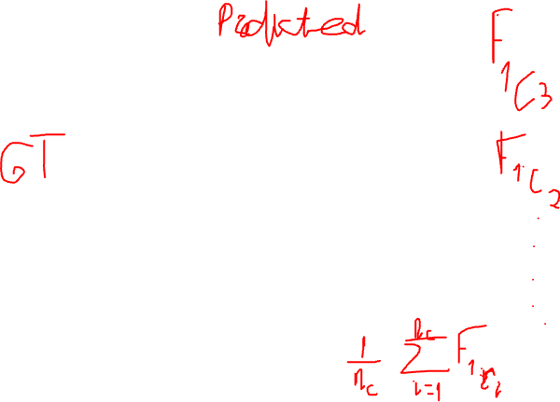
Multiclass Confusion Matrix
 | C1 | C2 | C3 | C4 | C5
C1 | TN | TN | FP | TN | TN
C2 | TN | TN | FP | TN | TN
C3 | FN | FN | TP | FN | FN
C4 | TN | TN | FP | TN | TN
C5 | TN | TN | FP | TN | TN
12

Slide 20
Other Measures based on Confusion Matrix
False discovery rate = FP/PP
False omission rate = FN/PN
Negative predictive value = TN/PN
Positive likelihood ratio = TPR/FPR
Negative likelihood ratio = FNR/TNR
Diagnostic odd ratio = PLR / NLR
…
14

Slide 21
Cost-Sensitive Classification
Given a probabilistic output for an object, say
𝑝, 1 − 𝑝 , how do we decide which class to assign to this object?
The simplest approach is check whether 𝑝 > 0.5
and make a decision accordingly
This assumes each mistakes (False Positives and False Negatives) are equally costly
25

Slide 22
Equal Misclassification Costs?
Which one is worse for you:
Delivering a spam email into your Inbox (False Negative), or
Delivering a legitimate email into your Spam folder (False Positive)?
If one is worse than the other, then, should we use 0.5 as the decision threshold or should we adjust it to your preference?
26

Slide 23
Cost Matrix
 |  | Predicted Class
 |  | Positive | Negative
Actual Class | Positive | 0 | a
 | Negative | b | 0
Given a probability distribution of 𝑝, 1 − 𝑝 for
𝑃𝑜𝑠𝑖𝑡𝑖𝑣𝑒, 𝑁𝑒𝑔𝑎𝑡𝑖𝑣𝑒 respectively, and given the above cost matrix, under what conditions (in terms of 𝑎, 𝑏, and 𝑝) would you classify an object as 𝑃𝑜𝑠𝑖𝑡𝑖𝑣𝑒?
27

Slide 24
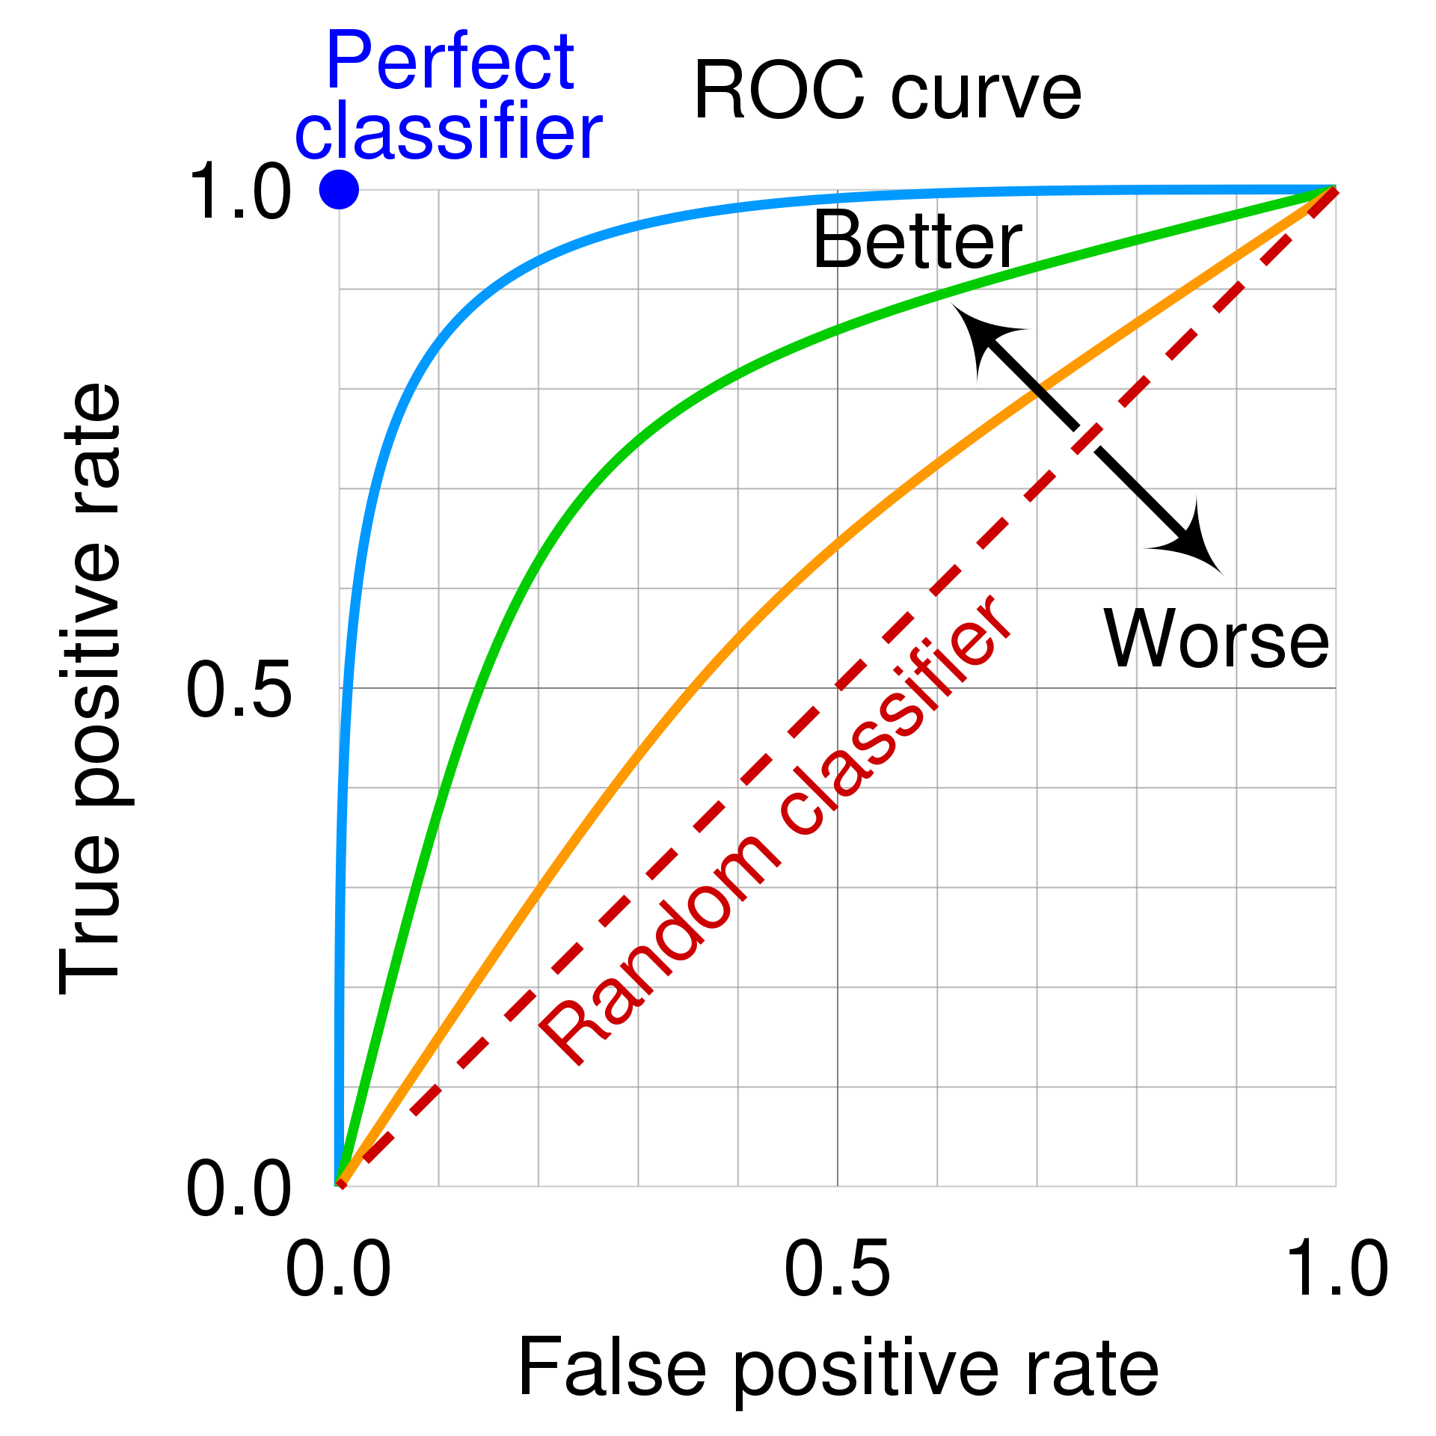
Area Under the Curve (AUC)
Area Under the Curve
What curve? ROC Curve
Receiving Operating Characteristic
The X axis is FPR
The Y axis is TPR
The curve is plotted by varying the “decision” threshold
15

Slide 25
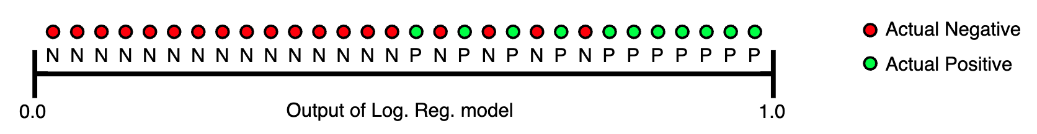
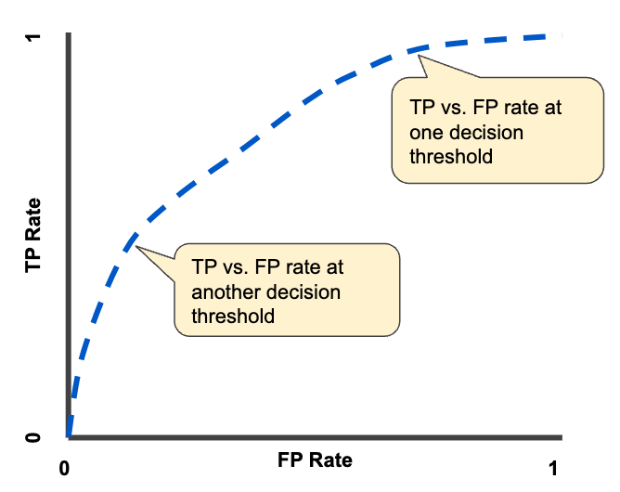
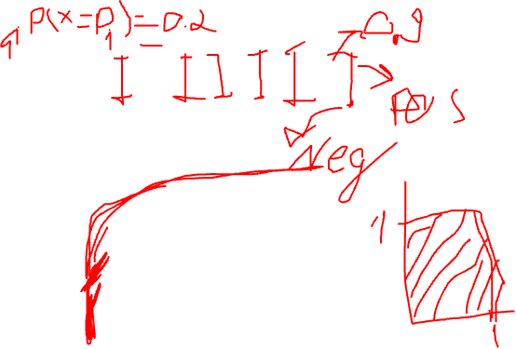
AUC Example
16

Slide 26
Classification. Other Considerations
47

Slide 27
Is the Coffee Good?
You grind and brew your own coffee at home
You can control grind size, the amount of coffee, the water temperature, brewing time, etc.
For simplicity, let’s look at only the coffee amount and
the water temperature
Too little or too much coffee is not good
Too cold or too hot water is not good
What’s best depends on the person
You experiment with different coffee amounts and water temperatures and record your experience as positive or negative
48

Slide 28
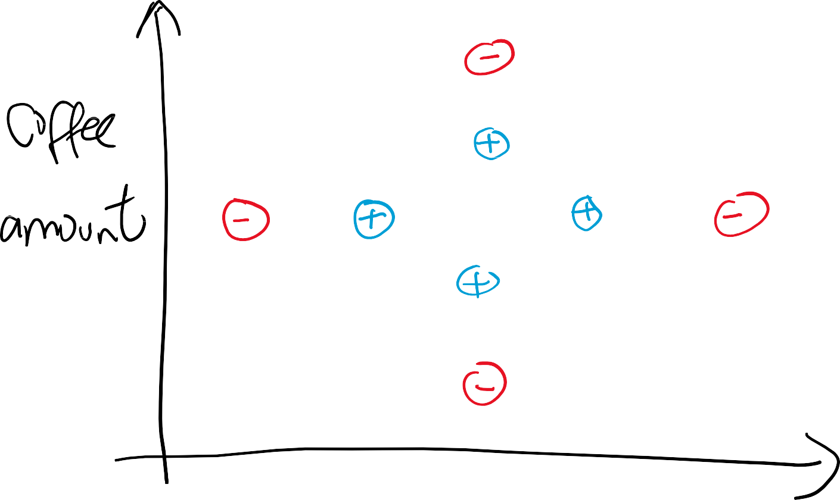






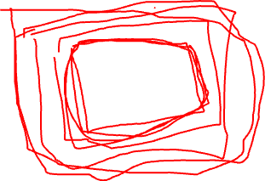
Experiment
49

Slide 29
Experiment
Assume the hypothesis space is the space of rectangles
That is,
ℎ 𝑎, 𝑡 = 𝑝𝑜𝑠𝑖𝑡𝑖𝑣𝑒 if 𝑎₁ ≤ 𝑎 ≤ 𝑎₂ and 𝑡₁ ≤ 𝑡 ≤ 𝑡₂
What are S, G, and version space based on the training data?
50

Slide 30
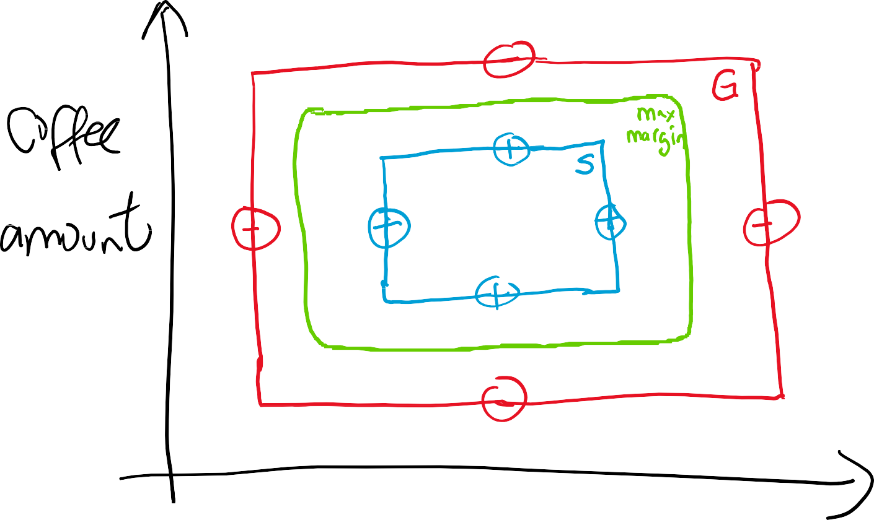
S, G, Version Space, Max Margin
51

Slide 31
Regression
So far, we talked about classification, where the target variable 𝑌 is discrete
Find-S, candidate elimination, decision trees, naïve Bayes,
logistic regression, neural networks
If the target variable 𝑌 is continuous, the task is called regression
Examples
Recommendations (ratings)
Economics and finance (credit score, house prices, stock prices, consumption, etc.)
Weather forecasting (temperature, humidity, wind speed,
etc.)
and more …
2

Slide 32
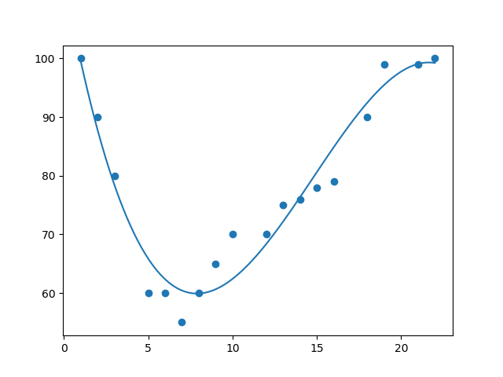
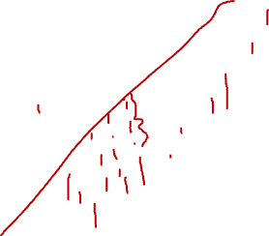
Regression Example
2

Slide 33
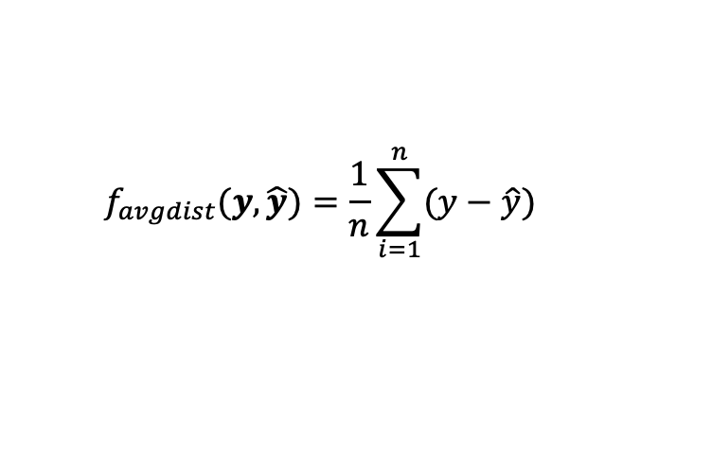
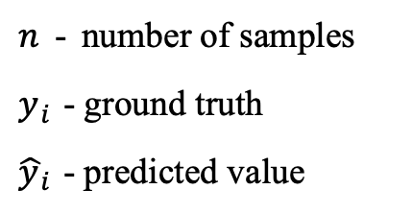
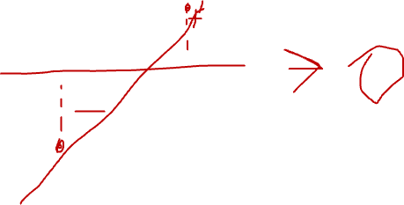
Regression Error
Average Distance
$n$ - number of samples
$y_{i}$ - ground truth
${\hat{y}}_{i}$ - predicted value
$$f_{avgdist}(y,\hat{y})=\frac{1}{n}\sum_{i=1}^{n}{(y−\hat{y})}$$
2

Slide 34
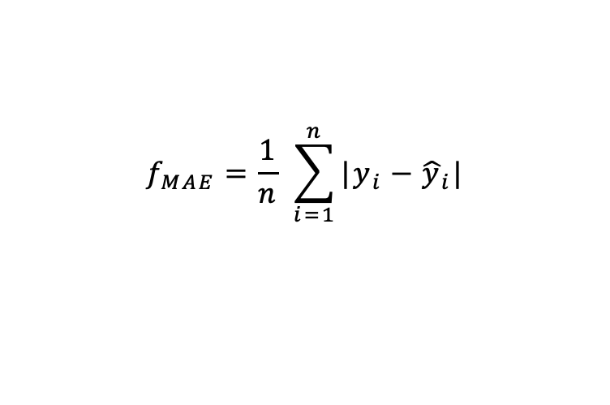
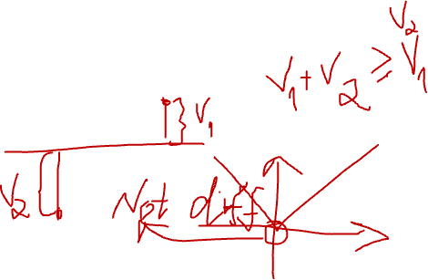
Regression Error
Average Distance
Mean Absolute Error
$n$ - number of samples
$y_{i}$ - ground truth
${\hat{y}}_{i}$ - predicted value
$$f_{avgdist}(y,\hat{y})=\frac{1}{n}\sum_{i=1}^{n}{(y−\hat{y})}$$
$$f_{MAE}=\frac{1}{n} \sum_{i=1}^{n}{|y_{i}−{\hat{y}}_{i}|}$$
2

Slide 35
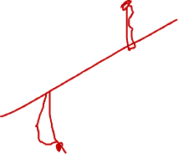
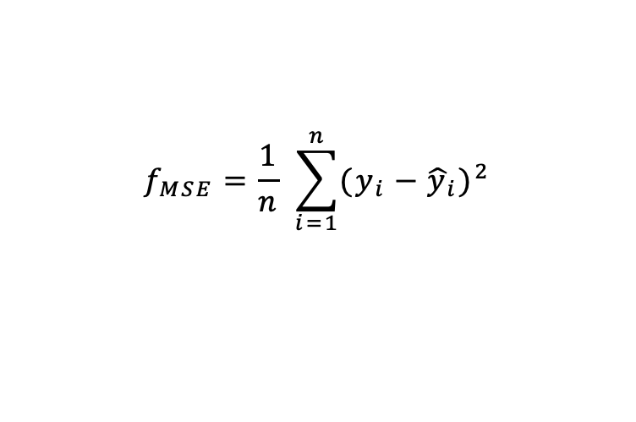
Regression Error
Average Distance
Mean Absolute Error
Mean Squared Error
$n$ - number of samples
$y_{i}$ - ground truth
${\hat{y}}_{i}$ - predicted value
$$f_{avgdist}(y,\hat{y})=\frac{1}{n}\sum_{i=1}^{n}{(y−\hat{y})}$$
$$f_{MAE}=\frac{1}{n} \sum_{i=1}^{n}{|y_{i}−{\hat{y}}_{i}|}$$
$$f_{MSE}=\frac{1}{n} \sum_{i=1}^{n}{{(y_{i}−{\hat{y}}_{i})}^{2}}$$
2

Slide 36

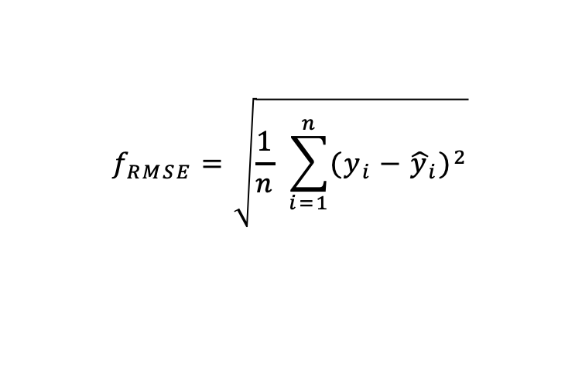
Regression Error
Average Distance
Mean Absolute Error
Mean Squared Error
Root Mean Squared Error
$n$ - number of samples
$y_{i}$ - ground truth
${\hat{y}}_{i}$ - predicted value
$$f_{avgdist}(y,\hat{y})=\frac{1}{n}\sum_{i=1}^{n}{(y−\hat{y})}$$
$$f_{MAE}=\frac{1}{n} \sum_{i=1}^{n}{|y_{i}−{\hat{y}}_{i}|}$$
$$f_{MSE}=\frac{1}{n} \sum_{i=1}^{n}{{(y_{i}−{\hat{y}}_{i})}^{2}}$$
$$f_{RMSE}=\sqrt{\frac{1}{n} \sum_{i=1}^{n}{{(y_{i}−{\hat{y}}_{i})}^{2}}}$$
2

