Slide 1
CS584 Machine Learning
Lecture 13. Probabilistic Graphical Models
Oleksandr Narykov
onarykov@iit.edu

Slide 2
Assignment 2
Released Oct 1
Due Oct 11, 11:59pm
Written part
Programming part and conceptual questions
Notes:
Without assumptions you cannot make predictions
Declarative representations are different from the purely data-driven machine learning algorithms
They allow us to incorporate prior domain knowledge into generative model and separate it from

Slide 3
Motivation
To extract information from the data, we would like to represent a joint distribution P over X = {X₁, X₂, …, X_{n}} task- conditional distribution P(X |Y).
The naïve representation is to specify a value for each possible combination. To make a tractable model, we need to introduce an inductive bias
Real-world data is structured, containing domain-specific dependencies
We would like to decompose P(X₁, X₂, …, X_{n}) into series of simpler distributions, e.g., P(X₁, X₂) and P(X₃, X₄ , X₅), that reflect our domain knowledge
Notes:
2^N
log(2) = 0.30103
Log(2^1000) = 301.03
2^1000 = 10^301.03
The number of atoms in the observable universe is estimated to be 10^80.
2^x = 10^80
x = 80/0.30103 = 265.75
Using all the atoms in the observable universe, we can represent a joint distribution of only 266 variables.

Slide 4
We would like to have a representation that is
Compact
Easy to store, manipulate, understand, and estimate
Intuitive
Easy to understand, verify, and construct
Modular
Easy to add and remove variables
Declarative
Separates representation and reasoning

Slide 5
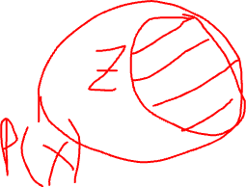
Mathematical Tools. Probability
Joint Distribution
P(X) = P(X₁, X₂, …, X_{n})
Specifies a probability value to all possible assignments
P(X₁, X₂, X₃, …, X_{k}) =
P(X₁) P(X₂|X₁) P(X₃|X₁,X₂)… P(X_{k} |X₁, X₂, X₃, …, X_{k-1})
Bayes Rule
P(X|Y) = P(Y|X)P(X) / P(Y)
Conditional Bayes Rule
P(X|Y, Z) = P(Y|X, Z)P(X|Z) / P(Y|Z)
Notes:
2^N
log(2) = 0.30103
Log(2^1000) = 301.03
2^1000 = 10^301.03
The number of atoms in the observable universe is estimated to be 10^80.
2^x = 10^80
x = 80/0.30103 = 265.75
Using all the atoms in the observable universe, we can represent a joint distribution of only 266 variables.

Slide 6
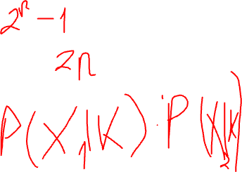
Mathematical Tools. Independence
Marginal Independence
Represent a joint distribution P over X = {X₁, X₂, …, X_{n}}, where all X_{i} are binary
How many independent parameters?
Assume for ∀i≠j, X_{i} ⊥ X_{j}
P(X) = P(X₁)P(X₂)…P(X_{n})
Now, how many independent parameters?
Conditional Independence
Compactness
Fewer parameters to specify
Intuition
Easier to specify
Modularity
Adding a new variable does not cause us to change all the entries in the joint table

Slide 7
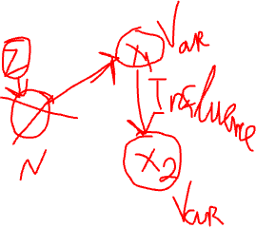
Mathematical Tools. Graphs
In Bayesian Networks, graph reflects explicit assumptions about dependencies between random variables (features)
A graph consists of nodes and edges
Nodes: X={X₁, X₂, …, X_{n}}
Undirected Edge: X_{i} – X_{j}
Directed Edge: X_{i} → X_{j}
Between a pair of nodes, at most one type of edge exists
We cannot have X_{i} → X_{j} and X_{j} → X_{i} at the same time, and
We cannot have X_{i} → X_{j} and X_{i} – X_{j} at the same time
Some edge: X_{i}  X_{j}

Slide 8
Directed and undirected
A graph is directed if its all edges are directed
A graph is undirected if its all edges are undirected

Slide 9
Relationships
X_{i} → X_{j}
X_{i} is the parent
X_{j} is the child
X_{i} – X_{j}
X_{i} and X_{j} are neighbors
X_{i}  X_{j}
X_{i} and X_{j} are adjacent
Degree of X_{i}: The number of edges X_{i} is part of
Indegree of X_{i}: The number of directed edges pointing to X_{i}
Degree of a graph: The maximal degree of a node in the graph

Slide 10
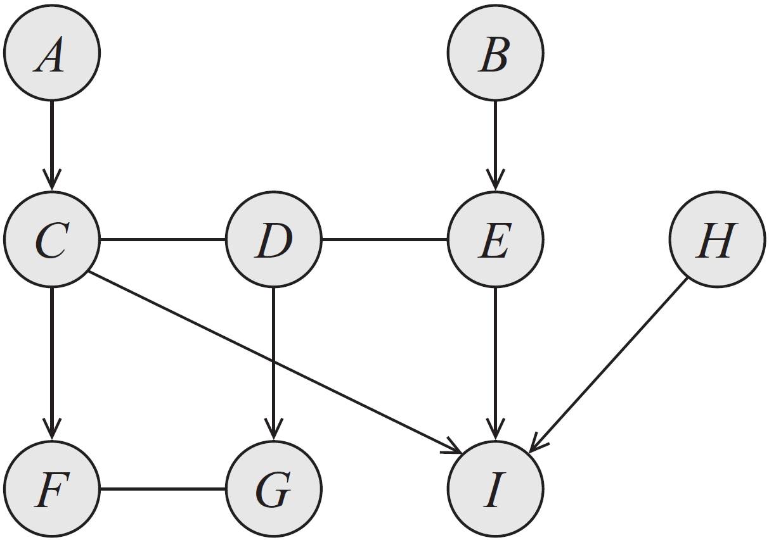
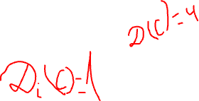
Example
Examples of:
Parents
Children
Neighbors
Adjacent nodes
Degree
Indegree
Notes:
Parents, children, neighbors, adjacent nodes, degree, indegree

Slide 11
Paths and Trails
X₁, X₂, …, X_{k} forms a path if, for every i =1, 2, …, k-1, we have that either X_{i} – X_{i+1} or X_{i} → X_{i+1}.
A path is directed if, for at least one i, X_{i} → X_{i+1}.
X₁, X₂, …, X_{k} forms a trail if, for every i =1, 2, …, k-1, we have X_{i}  X_{i+1}.
What is the difference between a path and a trail? Is every path also a trail? Is every trail also a path?

Slide 12

Ancestors and descendants
X_{i} is an ancestor of X_{j} if there is a directed path from X_{i} to X_{j}
X_{i} is a descendant of X_{j} if there is a directed path from X_{j} to X_{i}
Nondescendants(X_{i}) ≡ X \ Descendants(X_{i})

Slide 13
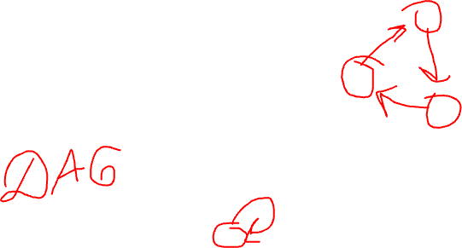
Cycles and Loops
A cycle is a directed path from a node to itself
A graph is acyclic if it contains no cycles
A directed acyclic graph is the one where all edges are directed and there are no cycles
A loop is a trail from a node to itself
A graph is singly-connected if it contains no loops

Slide 14
Bayesian Networks

Slide 15
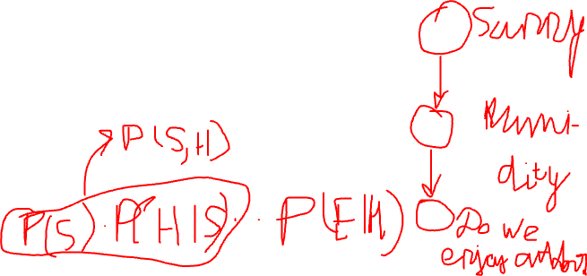
Bayesian Networks
A Bayesian Network is a directed acyclic graph whose nodes are random variables and edges represent, intuitively, the direct influence of one node on another
Naïve Bayes is a special Bayesian network
Bayesian networks is
A data structure that provides the skeleton for representing a joint distribution compactly in a factorized way
A compact representation for a set of conditional independence assumptions about a distribution

Slide 16
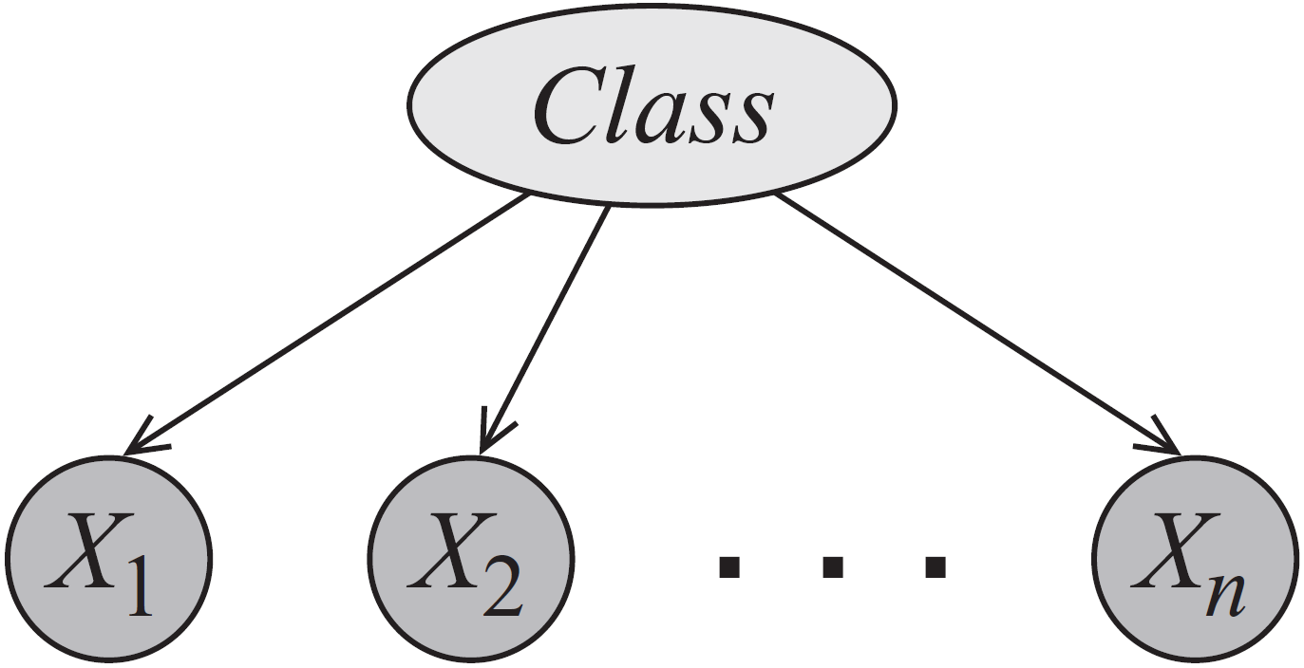
Naïve Bayes

Slide 17
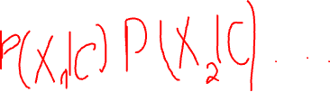
Naïve Bayes
How do we write the joint P(C, X₁, X₂, …, X_{n})?
How many independent parameters are needed if C and X_{i} are all binary?
Naïve Bayes is used for classification: given attributes of an object (X_{i}), classify it into one of pre-given categories (C) (i.e., P(C|X₁, …, X_{n}).

Slide 18
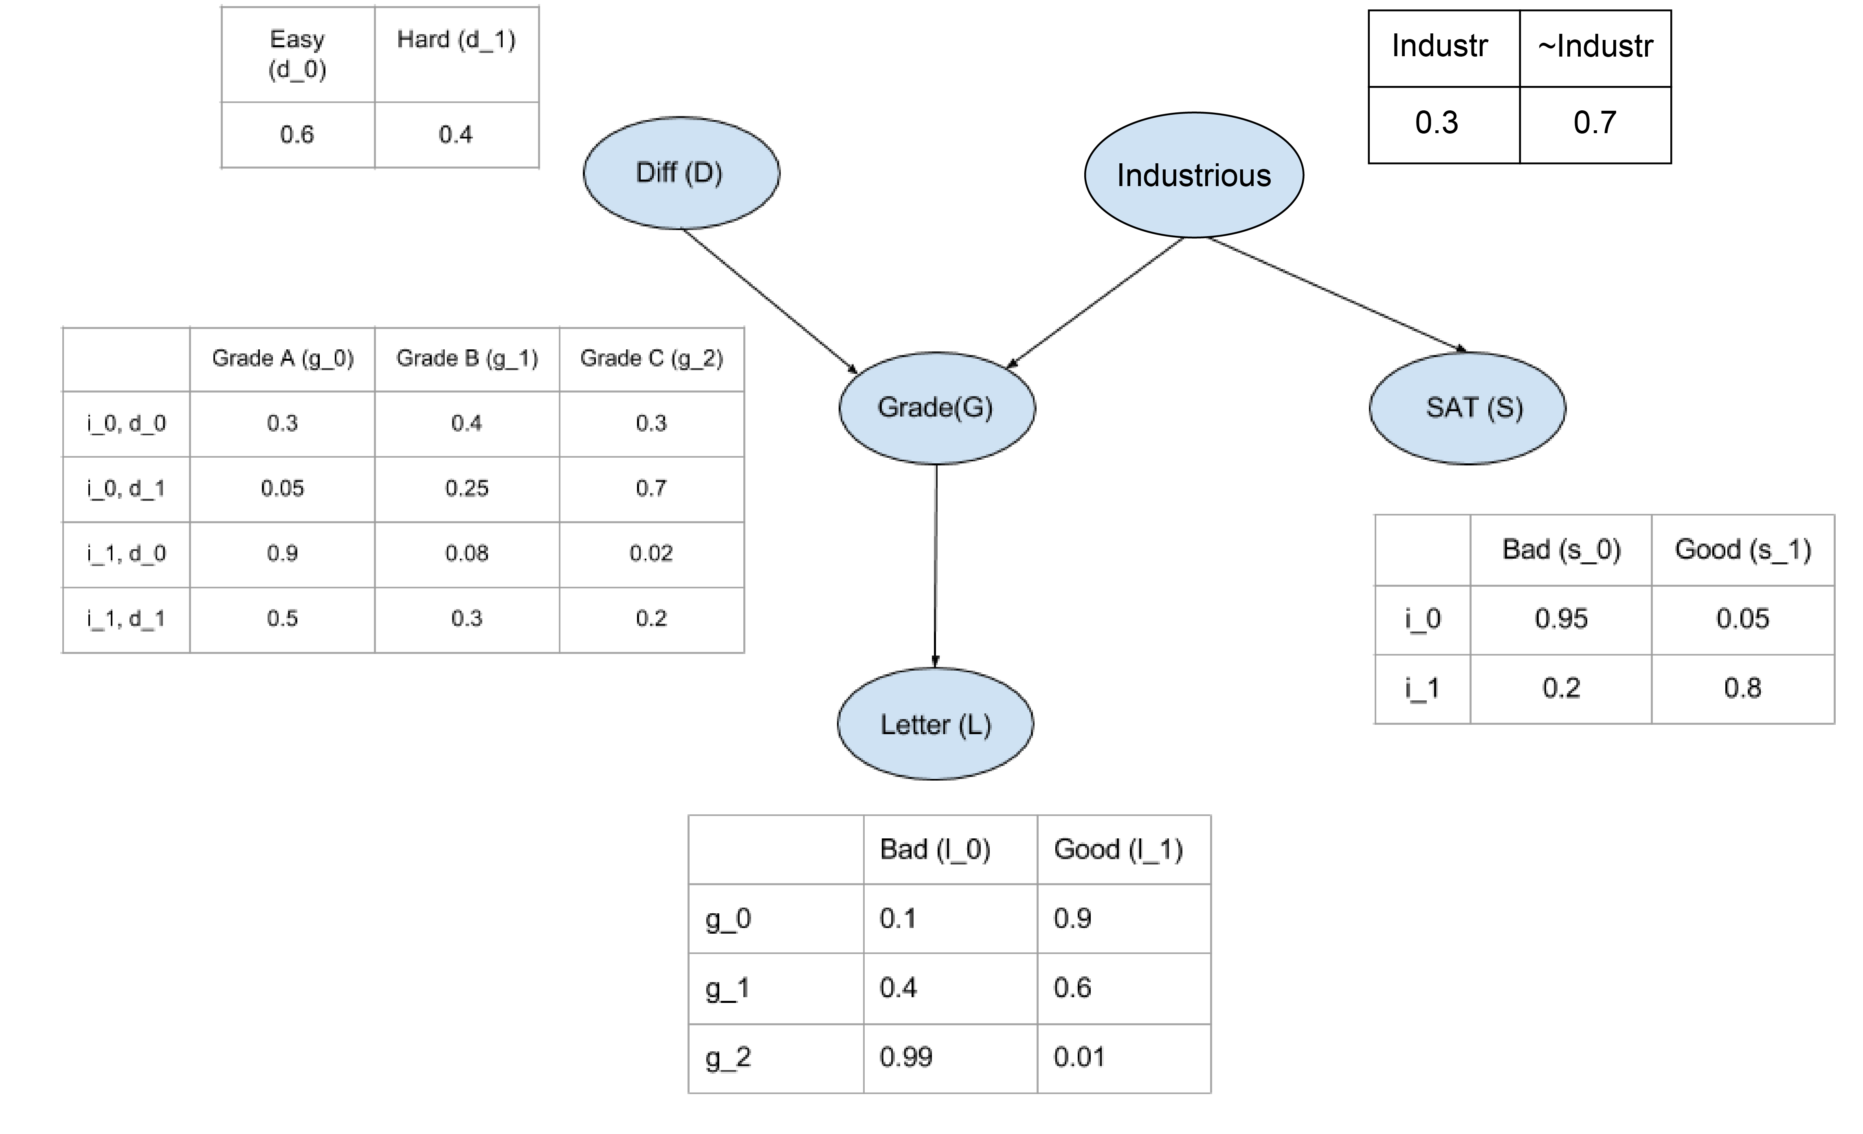
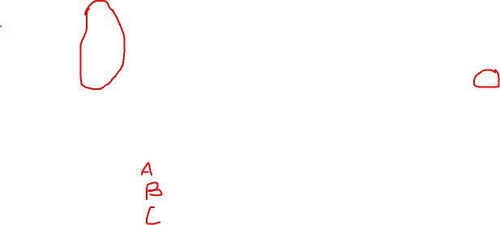
Bayesian Network Representation
1. The structure
i¹, d⁰
i¹, d¹
2. Parameters:
Local probability model
Conditional probability distribution
g³
How many parameters?

Slide 19
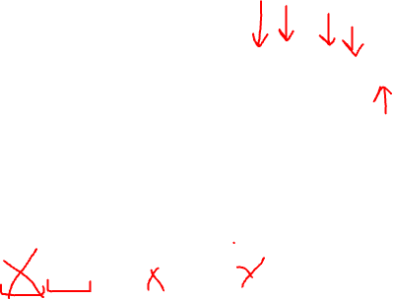
The joint?
What is the meaning of P(i¹, d⁰, g², s¹, l⁰)?
Probability that
The student is industrious
The class is easy
The industrious student gets a B in an easy class
The industrious student gets a high score in SAT
The student who got a B in the class gets a weak letter
= P(i¹) P(d⁰) P(g²|i¹, d⁰) P(s¹|i¹)P(l⁰|g²)

Slide 20
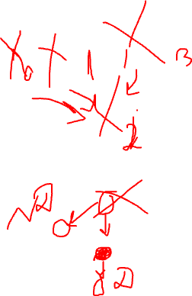
Bayesian Network Structure
A Bayesian network structure G is a directed acyclic graph whose nodes represent random variables X₁, …, X_{n}. Let Pa(X_{i}) denote the parents of X_{i}, and ND(X_{i}) denote the variables that are not descendants of X_{i}. Then G encodes the following set of conditional independence assumptions:
X_{i} ⊥ ND(X_{i}) | Pa(X_{i})
These independencies are called the local independencies
Clarification. A node itself and its parents are part of non-descendants according to the definition of ND. A clearer statement would be, in my opinion:
X_{i} ⊥ ND(X_{i}) \ {X_{i} ∪ Pa(X_{i})} | Pa(X_{i})

Slide 21
Bayesian Network Factorization
Why is this factorization useful?
How can you prove this factorization holds?

Slide 22
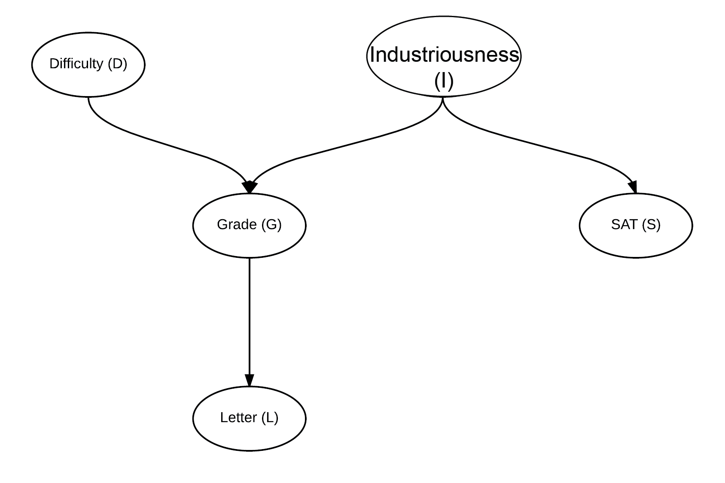
Factorization example
P(I, D, S, G, L) =
P(I)*
P(D)*
P(S | I)*
P(G | I, D)*
P(L | G)

Slide 23
Local independencies example
D ⊥ I, S
I ⊥ D
S ⊥ D, G, L | I
G ⊥ S | D, I
L ⊥ D, I, S | G

Slide 24
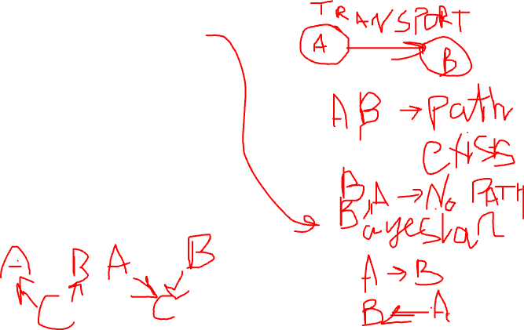

Reasoning Patterns
Causal reasoning
Causes to effects
A → B → C
Evidential reasoning
Effects to causes
A ← B ← C
Intercausal reasoning
A → B ← C
Explaining away

Slide 25
Causal Reasoning
Causes to effects
Don’t know anything. Probability of a strong letter
P(l¹) = 0.502
Learn that the student is not industrious
P(l¹|i⁰) = 0.389
Additionally, learn the class is easy
P(l¹|i⁰, d⁰) = 0.513

Slide 26
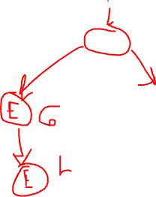
Evidential Reasoning
Effects to causes
Don’t know anything. Probability of a student being industrious
P(i¹) = 0.3
Learn that the student got a C in a class
P(i¹|g³) = 0.079
Or, learn that the student received a weak letter
P(i¹|l⁰) = 0.14
Learn both
P(i¹|g³, l⁰) = 0.079

Slide 27
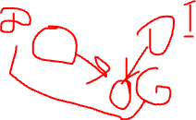
Intercausal reasoning
Different causes of the same effect interact
Don’t know anything. Probability of a student being industrious
P(i¹) = 0.3
Learn that the student got a B in a class
P(i¹|g²) = 0.175
Learn that the class was difficult
P(i¹|g², d¹) = 0.34
Student’s B is explained away with the other cause

Slide 28
Independencies in graphs
We have already seen the local independence assertions
Are there additional independence statements we can make simply based on the graph structure?
Yes.
Will these additional independencies help us reduce the number parameters further?
No.
Why are they useful then?

Slide 29
Dependence ≡ Information flow
X and Y are independent if the information cannot flow from one to the other
No trail between X and Y
Information cannot flow; X and Y are independent
X and Y are connected by an edge
Information can flow; X and Y are not independent
X and Y are not connected by an edge, but there is a trail between them
Depends…

Slide 30

Trails
Causal trail
X → Z → Y
Information can flow between X and Y if Z is not observed; if Z is observed, it blocks the information flow. X ⊥ Y | Z
E.g, I → G → L
If we don’t know the student’s grade, then knowing her intelligence tells us something about the strength of the letter. But, once we know her grade, I and L are independent
Evidential trail
X ← Z ← Y
Information can flow between X and Y if Z is not observed; if Z is observed, it blocks the information flow. X ⊥ Y | Z
Notes:
Note: Make these variables italic

Slide 31
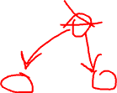
Trails
Common cause
X ← Z → Y
Information can flow between X and Y if Z is not observed; if Z is observed, it blocks the information flow. X ⊥ Y | Z
E.g, G ← I → S
If we don’t know the student’s intelligence, then knowing his SAT score tells us something about his grade. If we know his intelligence, then his grade and SAT score are independent

Slide 32
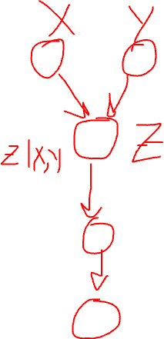
Trails
Common effect
X → Z ← Y (v-structure)
Information can flow between X and Y only if Z or at least one of Z’s descendants is observed
E.g. D → G ← I
If we do not know the grade or the letter quality, then D and I are independent. If we know, however, the grade or the letter quality, then D and I interact

Slide 33
D-Separation
To answer whether X_{i} and X_{j} are independent given E
Find all trails between X_{i} and X_{j}
If information can flow through at least one trail, then X_{i} and X_{j} are dependent given E; otherwise they are independent given E

Slide 34
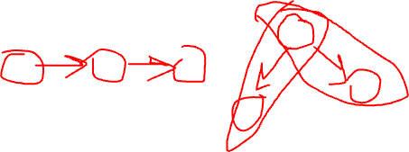
Constructing Bayesian Networks
Given a distribution P over X, how can we find a structure G that is a graph with the least amount of edges for P?
The procedure is the following:
Pick an ordering of the variables, X₁, X₂, …, X_{n}
For each X_{i}, find minimal subset U of {X₁, X₂, …, X_{i-1}} such that X_{i} ⊥ {X₁, X₂, …, X_{i-1}} \ U | U
Set U to be the parents of X_{i}

Slide 35
Plate Notation
A
A¹
A²
A^{n}
.
.
.
B
B¹
B²
B^{n}
The marginal P(A) and the conditional P(B|A) are copied for each replica.

Slide 36
Plate Notation
A
A
B
B¹
B²
…
B^{n}
The conditional P(B|A) is copied for each replica.

Slide 37
Plate Notation
A
A
B
B¹
B²
…
B^{n}
C
C¹¹
…
C^{1m}
C²¹
…
C^{2m}
C^{n1}
…
C^{nm}

Slide 38
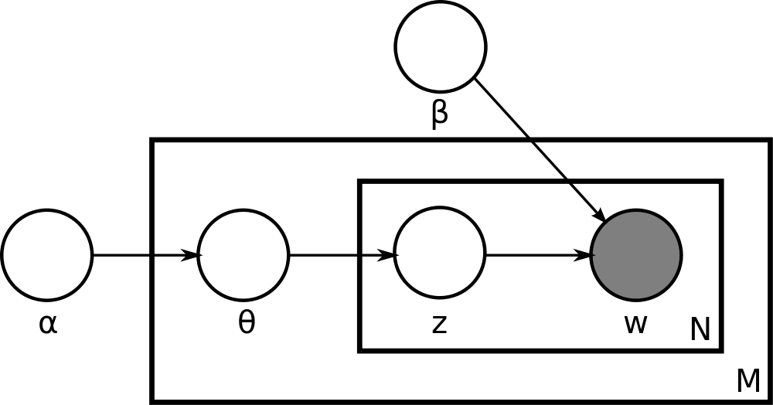
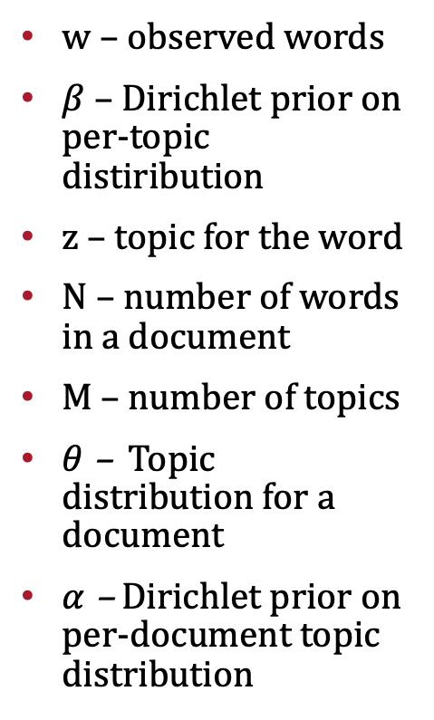
Latent Dirichlet Allocation
w – observed words
$β$ – Dirichlet prior on per-topic distiribution
z – topic for the word
N – number of words in a document
M – number of topics
$θ$ – Topic distribution for a document
$α$ – Dirichlet prior on per-document topic distribution
https://www.jmlr.org/papers/volume3/blei03a/blei03a.pdf
https://scikit-learn.org/stable/modules/generated/sklearn.decomposition.LatentDirichletAllocation.html
Notes:
α is the parameter of the Dirichlet prior on the per-document topic distributions, β is the parameter of the Dirichlet prior on the per-topic word distribution, theta_i is the topic distribution for document i,, z_ij is the topic for the jth word in document i, w_ij and is the specific word.

Slide 39
Markov Networks

Slide 40
Motivation for Markov Networks
There are distributions that cannot be represented Bayesian networks (and vice versa)
Guaranteeing acyclicity can be hard

Slide 41
An example
We’d like a graph where
A ⊥ C | B, D
B ⊥ D | A, C
(A, B), (B, C), (C, D), and (D, A) are correlated but no causal direction exists
Alice and Charles pair and Bob and Debbie pair do not talk to each other directly
Alice and Bob, Bob and Charles, and Alice and Debbie pairs agree most of the time, and Charles and Debbie pair disagrees most of the time

Slide 42
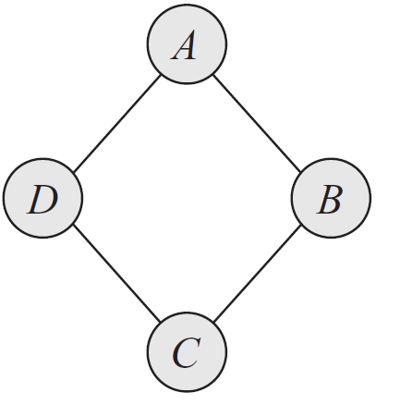
Example

Slide 43
Graphs
Structure
Parameters
The joint distribution
Independencies

Slide 44
Bayesian Networks
Structure
Directed acyclic graph
Parameters
Conditional probability distributions
The joint distribution
P(X) = ΠP(X_{i} | Pa(X_{i}))
Independencies
X_{i} ⊥ ND(X_{i}) | Pa(X_{i})
D-separation

Slide 45
Markov Networks
Structure
?
Parameters
?
The joint distribution
?
Independencies
?

Slide 46
Markov Networks
Structure
Undirected graphs
Parameters
?
The joint distribution
?
Independencies
?

Slide 47
Independencies in Markov networks
Separation
X ⊥ Y | Z if X and Y are separated in H given Z
Pairwise independencies
X ⊥ Y | X \ {X, Y}
Local independencies
X ⊥ X \ MB(X) | MB(X), where MB stands for Markov Blanket. Markov Blanket of a variable X in a Markov network H is its neighbors.

Slide 48
Markov Networks
Structure
Undirected graphs
Parameters
?
The joint distribution
?
Independencies
Separation
Pairwise independencies
Local independencies

Slide 49
Markov Networks
Structure
Undirected graphs
Parameters
Conditional Probability Distributions?
The joint distribution
?
Independencies
Separation
Pairwise independencies
Local independencies

Slide 50
Conditioned on the neighbors?
Consider the simple graph of A – B
Can we say
P(A, B) = P(A | B)P(B | A)?

Slide 51
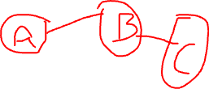
Marginals on the (maximal) cliques?
Consider the simple graph of A – B
Can we say
P(A, B) = P(A, B)?
Now consider A – B – C
Can we say
P(A, B, C) = P(A, B) P(B, C)?
How would you parameterize Markov Networks?
Notes:
Solution – Split the edges!

Slide 52
Parameterization
Parameterization is perhaps the least intuitive concept about MNs
Bayesian networks
P(X_{i} | Pa(X_{i}))
Markov networks
Cannot use probability distributions directly, but
MNs provide more flexibility in the parameterization

Slide 53
Factors
Let D be a set of random variables
Definition: A factor φ is a function from Val(D) to R.
A factor is nonnegative if all entries are nonnegative
The scope of factor, denoted as, Scope[φ], is the set of variables D it is associated with

Slide 54
An example
Structure: A – B – C
Factors: φ(A, B) and φ(B, C)
Remember the factors are functions from D to R.
How can we represent the joint P(A, B, C) using factors?

Slide 55
Gibbs Distribution
Definition: A distribution P is a Gibbs distribution parameterized by a set of factors Φ = {φ(D₁), …, φ(D_{k})} if it is defined as follows:
X₁, …, X_{n}
What is Z?
φ(D_{i}) are factors, but what are D_{i}?
Can you relate this to Bayesian Network parameterization?

Slide 56
Log-Linear models
ɛ(D) = -ln(φ(D)) is often called the energy function.
In statistical physics, the probability of a physical state depends inversely on its energy.
Log-linear models guarantee that the factors are positive, in turn guaranteeing that the probability is positive.

Slide 57
Log-linear models
X₁, …, X_{n}

Slide 58
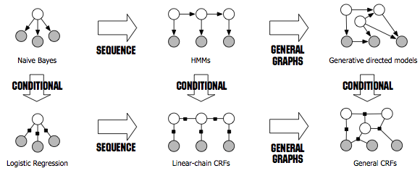
Relationships
Sutton, Charles, and Andrew McCallum. ”An introduction to conditional random ﬁelds.” Foundations and Trends in Machine Learning 4.4 (2012): 267–373
Notes:
A clique with n variables: 2^n parameters.
Pairwise: n(n-1) edges: 4n(n-1) params. n nodes: 2n params. Total: 4n^2-2n params.

Slide 59
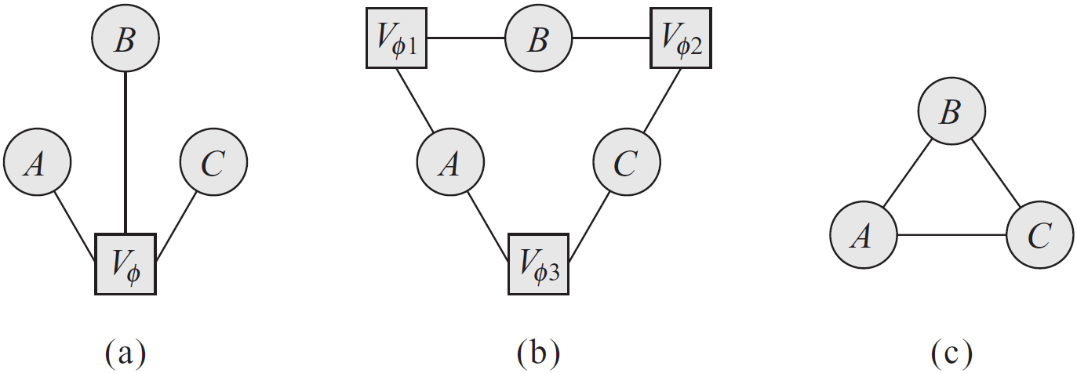
Factor graph example
Markov network as a clique over three variables, A, B, C
How would you represent a pairwise MRF with factors over the nodes and edges?

Slide 60
Markov network factorization
We say that a distribution P with Φ = {φ(D₁), …, φ(D_{k})} factorizes over a Markov network H if each D_{i} (i=1, …, k) is a complete subgraph of H
The factors φ(D_{i}) are called the clique potentials
D_{i} can be maximal cliques but they do not have to be

Slide 61
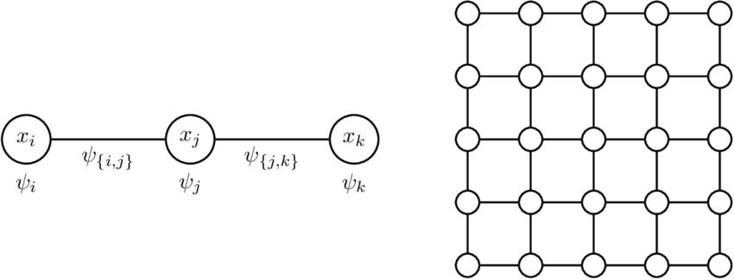
Pairwise Markov Random Fields

Slide 62
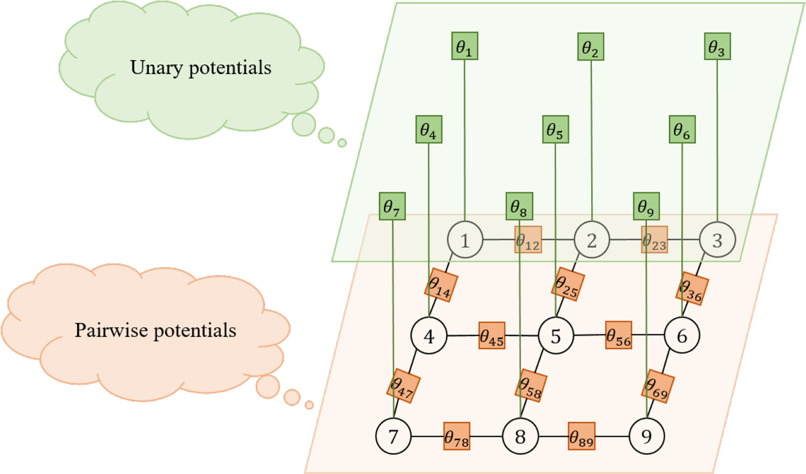
Pairwise Markov Random Fields
https://www.sciencedirect.com/science/article/pii/S0925231220306524

Slide 63
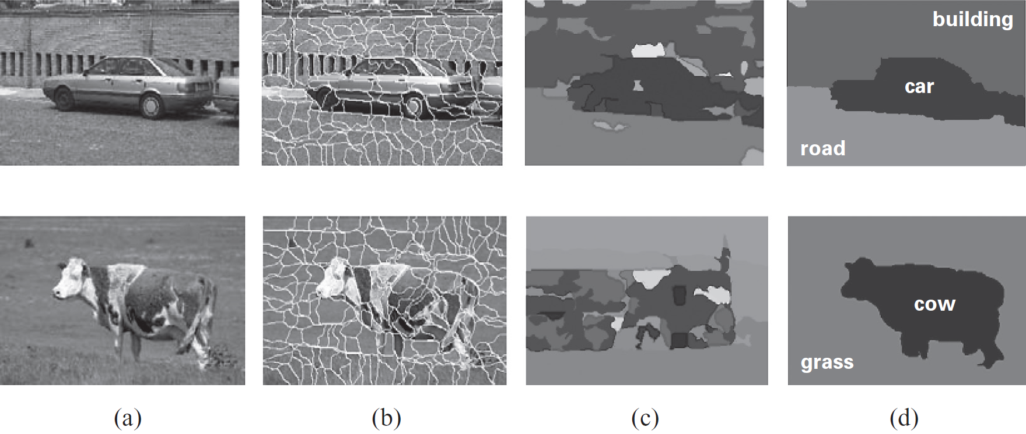
Image Segmentation Example

Slide 64
Markov Networks
Structure
Undirected graphs
Parameters
Factors
The joint distribution
P(X) = 1/Z Πφ(D_{i})
Independencies
Separation
Pairwise independencies
Local independencies

Slide 65
Parameterization
Factors over maximal cliques
Pairwise Markov random fields
Factors over nodes, and
Factors over connected pairs (i.e., edges)
Pairwise Markov random fields do not introduce additional independencies, however,
The number of parameters is quadratic instead of exponential, but, of course,
The sets of distributions that can be represented over maximal cliques and pairwise interactions are not the same
Notes:
A clique with n variables: 2^n parameters.
Pairwise: n(n-1) edges: 4n(n-1) params. n nodes: 2n params. Total: 4n^2-2n params.

