Slide 1
CS584 Machine Learning
Lecture 14. Markov Networks
Oleksandr Narykov
onarykov@iit.edu

Slide 2
Bayesian Networks
A Bayesian Network is a directed acyclic graph whose nodes are random variables and edges represent, intuitively, the direct influence of one node on another
Naïve Bayes is a special Bayesian network
Bayesian networks is
A data structure that provides the skeleton for representing a joint distribution compactly in a factorized way
A compact representation for a set of conditional independence assumptions about a distribution

Slide 3
Querying a distribution
All variables: X, evidence variables: E
Probability query
P(Y|e)
MAP query
W = X \ E (i.e., all the non-evidence variables)
MAP|e = argmax_{w}P(w,e)
Marginal MAP query
MAP(Y|e) = argmax_{y}P(y|e)
Let Z = X \ E∪Y
MAP(Y|e) = argmax_{y} ∑_{z}P(z, y|e)

Slide 4
Forward sampling
Use for Bayesian networks and marginal probabilities
For each variable V_{i} that is ready
Sample a value v_{i} for V_{i} using P(V_{i} | Pa(V_{i}))
Repeat this process M times to generate M instances
A variable is ready if
It has no parents, or
You have sampled its all parents
To compute marginal
Use maximum likelihood estimate
Count and normalize

Slide 5
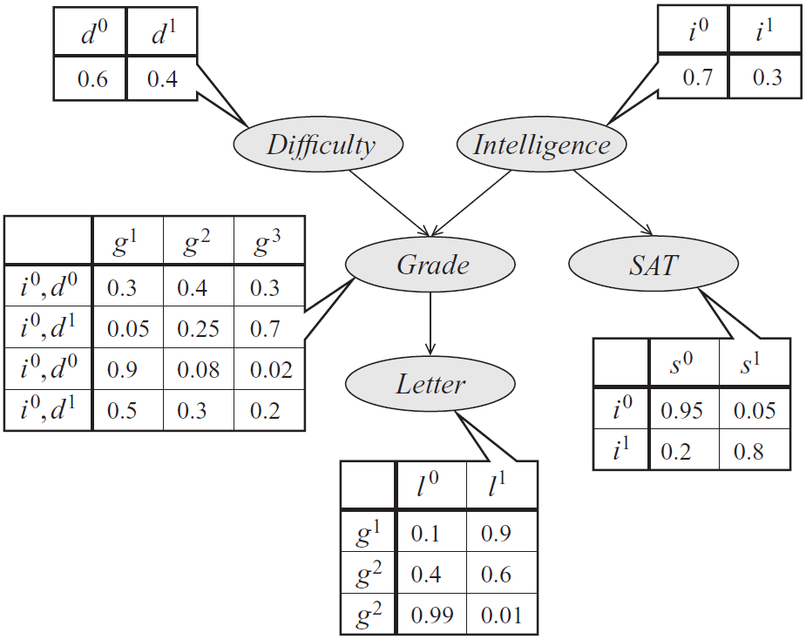
Forward sampling on the student network
D and I are ready.
Sample D from P(D): d⁰.
Only I is ready.
Sample I from P(I): i¹.
G and S are now ready.
Sample G from P(G|i¹,d⁰): g¹.
S and L are ready.
Sample S from P(S|i¹): s⁰.
L is ready.
Sample L from P(L|g¹): l⁰
The instance is <d⁰,i¹,s⁰,g¹,l⁰>
Repeat the process from step 1 M times.
Industrious
i⁰, d⁰
i⁰, d¹
i¹, d⁰
i¹, d¹
g¹
g²
g³

Slide 6
Plate Notation
A
A¹
A²
A^{n}
.
.
.
B
B¹
B²
B^{n}
The marginal P(A) and the conditional P(B|A) are copied for each replica.

Slide 7
Plate Notation
A
A
B
B¹
B²
…
B^{n}
The conditional P(B|A) is copied for each replica.

Slide 8
Plate Notation
A
A
B
B¹
B²
…
B^{n}
C
C¹¹
…
C^{1m}
C²¹
…
C^{2m}
C^{n1}
…
C^{nm}

Slide 9
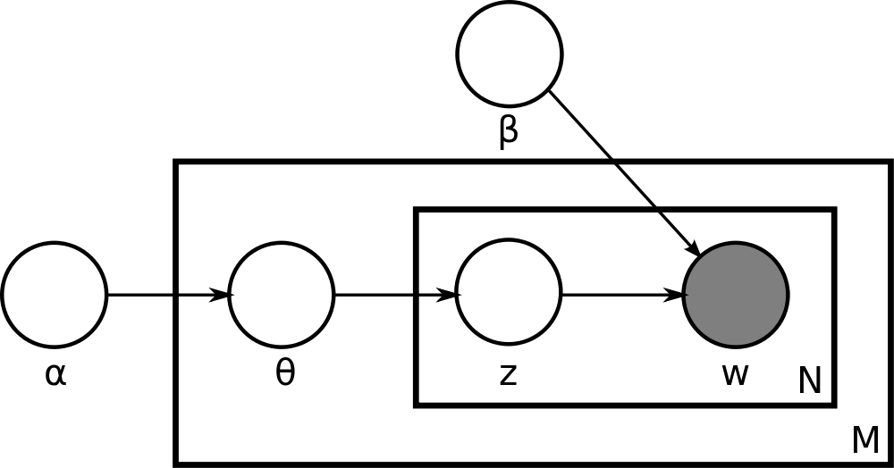
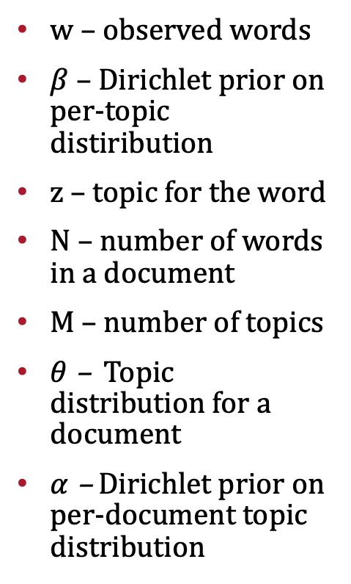
Latent Dirichlet Allocation
w – observed words
$β$ – Dirichlet prior on per-topic distiribution
z – topic for the word
N – number of words in a document
M – number of topics
$θ$ – Topic distribution for a document
$α$ – Dirichlet prior on per-document topic distribution
https://www.jmlr.org/papers/volume3/blei03a/blei03a.pdf
https://scikit-learn.org/stable/modules/generated/sklearn.decomposition.LatentDirichletAllocation.html
Notes:
α is the parameter of the Dirichlet prior on the per-document topic distributions, β is the parameter of the Dirichlet prior on the per-topic word distribution, theta_i is the topic distribution for document i,, z_ij is the topic for the jth word in document i, w_ij and is the specific word.

Slide 10
Markov Networks

Slide 11
Motivation for Markov Networks
There are distributions that cannot be represented Bayesian networks (and vice versa)
Guaranteeing acyclicity can be hard

Slide 12
An example
We’d like a graph where
A ⊥ C | B, D
B ⊥ D | A, C
(A, B), (B, C), (C, D), and (D, A) are correlated but no causal direction exists
Alice and Charles pair and Bob and Debbie pair do not talk to each other directly
Alice and Bob, Bob and Charles, and Alice and Debbie pairs agree most of the time, and Charles and Debbie pair disagrees most of the time

Slide 13
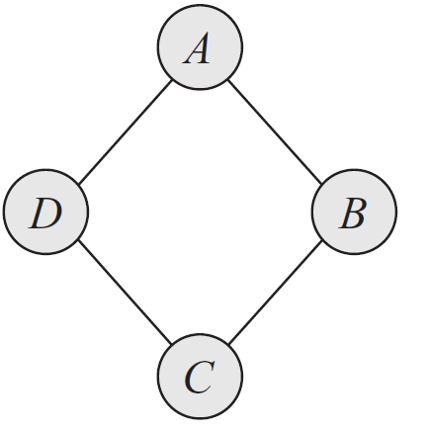
Example

Slide 14
Graphs
Structure
Parameters
The joint distribution
Independencies

Slide 15
Bayesian Networks
Structure
Directed acyclic graph
Parameters
Conditional probability distributions
The joint distribution
P(X) = ΠP(X_{i} | Pa(X_{i}))
Independencies
X_{i} ⊥ ND(X_{i}) | Pa(X_{i})
D-separation

Slide 16
Markov Networks
Structure
?
Parameters
?
The joint distribution
?
Independencies
?

Slide 17
Markov Networks
Structure
Undirected graphs
Parameters
?
The joint distribution
?
Independencies
?

Slide 18
Independencies in Markov networks
Separation
X ⊥ Y | Z if X and Y are separated in H given Z
Pairwise independencies
X ⊥ Y | X \ {X, Y}
Local independencies
X ⊥ X \ MB(X) | MB(X), where MB stands for Markov Blanket. Markov Blanket of a variable X in a Markov network H is its neighbors.

Slide 19
Markov Networks
Structure
Undirected graphs
Parameters
?
The joint distribution
?
Independencies
Separation
Pairwise independencies
Local independencies

Slide 20
Markov Networks
Structure
Undirected graphs
Parameters
Conditional Probability Distributions?
The joint distribution
?
Independencies
Separation
Pairwise independencies
Local independencies

Slide 21
Conditioned on the neighbors?
Consider the simple graph of A – B
Can we say
P(A, B) = P(A | B)P(B | A)?

Slide 22
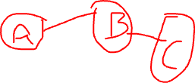
Marginals on the (maximal) cliques?
Consider the simple graph of A – B
Can we say
P(A, B) = P(A, B)?
Now consider A – B – C
Can we say
P(A, B, C) = P(A, B) P(B, C)?
How would you parameterize Markov Networks?
Notes:
Solution – Split the edges!

Slide 23
Parameterization
Parameterization is perhaps the least intuitive concept about MNs
Bayesian networks
P(X_{i} | Pa(X_{i}))
Markov networks
Cannot use probability distributions directly, but
MNs provide more flexibility in the parameterization

Slide 24
Factors
Let D be a set of random variables
Definition: A factor φ is a function from Val(D) to R.
A factor is nonnegative if all entries are nonnegative
The scope of factor, denoted as, Scope[φ], is the set of variables D it is associated with

Slide 25
An example
Structure: A – B – C
Factors: φ(A, B) and φ(B, C)
Remember the factors are functions from D to R.
How can we represent the joint P(A, B, C) using factors?

Slide 26
Gibbs Distribution
Definition: A distribution P is a Gibbs distribution parameterized by a set of factors Φ = {φ(D₁), …, φ(D_{k})} if it is defined as follows:
X₁, …, X_{n}
What is Z?
φ(D_{i}) are factors, but what are D_{i}?
Can you relate this to Bayesian Network parameterization?

Slide 27
Log-Linear models
ɛ(D) = -ln(φ(D)) is often called the energy function.
In statistical physics, the probability of a physical state depends inversely on its energy.
Log-linear models guarantee that the factors are positive, in turn guaranteeing that the probability is positive.

Slide 28
Log-linear models
X₁, …, X_{n}

Slide 29
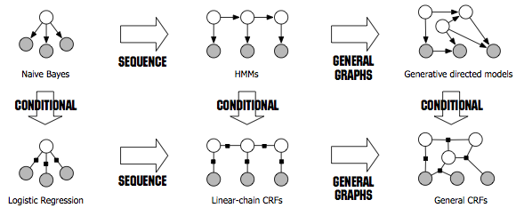
Relationships
Sutton, Charles, and Andrew McCallum. ”An introduction to conditional random ﬁelds.” Foundations and Trends in Machine Learning 4.4 (2012): 267–373
Notes:
A clique with n variables: 2^n parameters.
Pairwise: n(n-1) edges: 4n(n-1) params. n nodes: 2n params. Total: 4n^2-2n params.

Slide 30
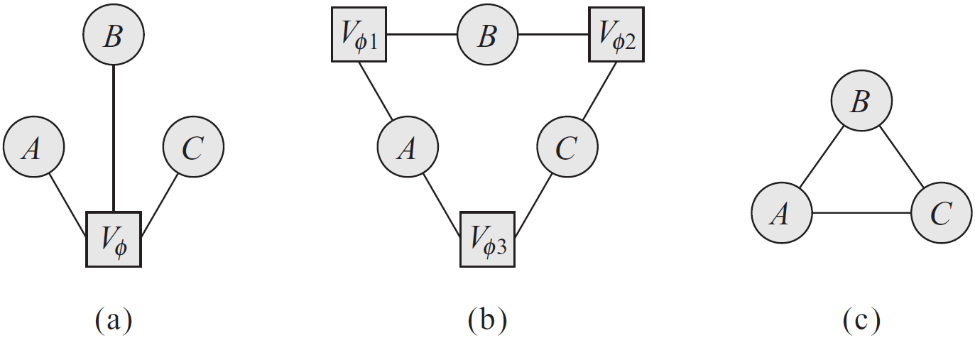
Factor graph example
Markov network as a clique over three variables, A, B, C
How would you represent a pairwise MRF with factors over the nodes and edges?

Slide 31
Markov network factorization
We say that a distribution P with Φ = {φ(D₁), …, φ(D_{k})} factorizes over a Markov network H if each D_{i} (i=1, …, k) is a complete subgraph of H
The factors φ(D_{i}) are called the clique potentials
D_{i} can be maximal cliques but they do not have to be

Slide 32
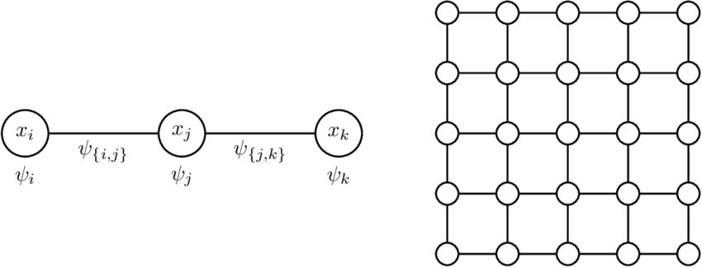
Pairwise Markov Random Fields

Slide 33
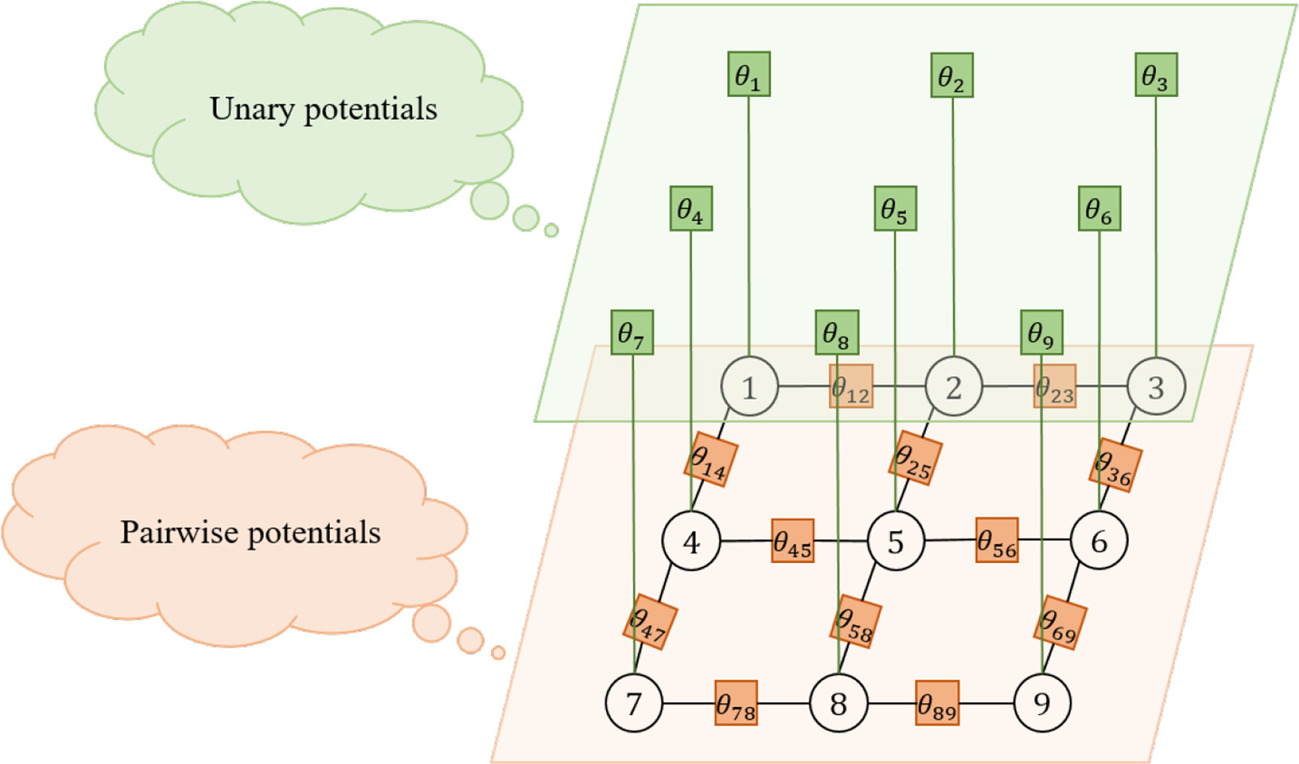
Pairwise Markov Random Fields
https://www.sciencedirect.com/science/article/pii/S0925231220306524

Slide 34
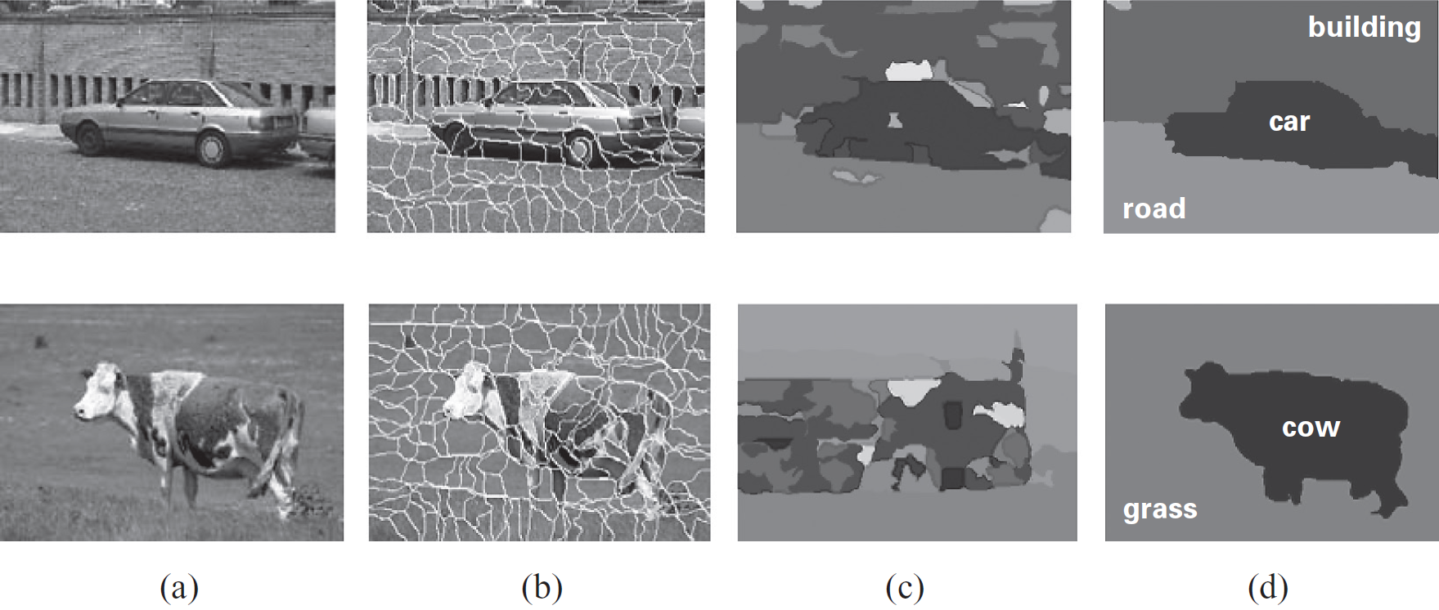
Image Segmentation Example

Slide 35
Markov Networks
Structure
Undirected graphs
Parameters
Factors
The joint distribution
P(X) = 1/Z Πφ(D_{i})
Independencies
Separation
Pairwise independencies
Local independencies

Slide 36
Parameterization
Factors over maximal cliques
Pairwise Markov random fields
Factors over nodes, and
Factors over connected pairs (i.e., edges)
Pairwise Markov random fields do not introduce additional independencies, however,
The number of parameters is quadratic instead of exponential, but, of course,
The sets of distributions that can be represented over maximal cliques and pairwise interactions are not the same
Notes:
A clique with n variables: 2^n parameters.
Pairwise: n(n-1) edges: 4n(n-1) params. n nodes: 2n params. Total: 4n^2-2n params.

