Slide 1
CS584 Machine Learning
Lecture 4. Probability
Oleksandr Narykov
onarykov@iit.edu

Slide 2
Office Hours
Office hours
Oleksandr Narykov – Thu, 11:30am-12:30pm, 105B Stuart,
Zoom: https://iit-edu.zoom.us/j/5326229313
Ruo Yang – Wed, TBD
Zoom: TBD
Bandhavi Parvathaneni – Tue, 1:30pm-2:30pm
Zoom: TBD
Reza Shahbazi – Mon, 2-3pm
Zoom: TBD
Notes:
Without assumptions you cannot make predictions
Declarative representations are different from the purely data-driven machine learning algorithms
They allow us to incorporate prior domain knowledge into generative model and separate it from

Slide 3
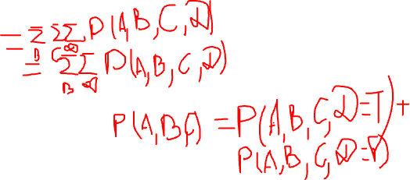
Marginalization
Given a distribution over n variables, you can calculate the distribution over any subset of the variables by summing out the irrelevant ones
For example
Given P(A, B, C, D)
Calculate
P(A)
P(A, C)
… (any subset)
11
Notes:
Sum by B,C,D
Sum by B,D

Slide 4
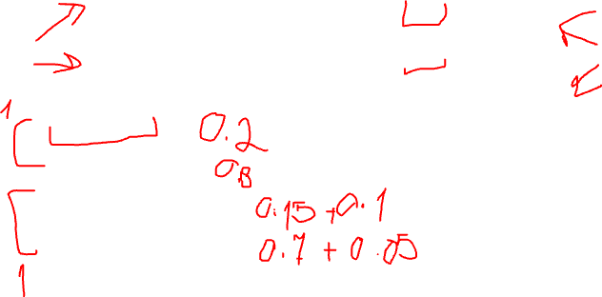
Let’s Answer a few queries
Feeling | X-Ray | P(F,X)
toothache | cavity | 0.15
toothache | ¬cavity | 0.10
¬toothache | cavity | 0.05
¬toothache | ¬cavity | 0.70
P(cavity) = ?
P(¬cavity) = ?
P(toothache) = ?
P(¬toothache) = ?
12
Notes:
0.15 + 0.05
0.70 + 0.10
0.15 + 0.10
0.70 + 0.05

Slide 5
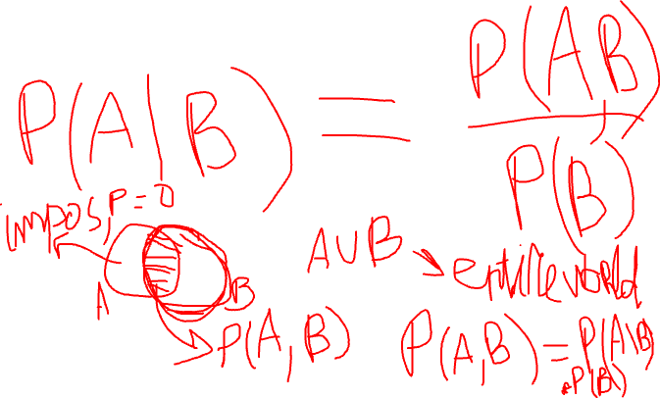
Conditional Distribution
𝑃 𝐴, 𝐵, 𝐶 𝐷, 𝐸, 𝐹, 𝐺 =
𝑃(𝐴,𝐵,𝐶,𝐷,𝐸,𝐹,𝐺)
𝑃(𝐷,𝐸,𝐹,𝐺)
13

Slide 6
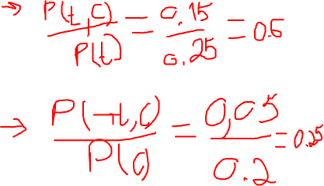
Let’s Answer a few queries
Feeling | X-Ray | P(F,X)
toothache | cavity | 0.15
toothache | ¬cavity | 0.10
¬toothache | cavity | 0.05
¬toothache | ¬cavity | 0.70
P(cavity | toothache) = ?
P(cavity | ¬toothache) = ?
P(¬cavity | toothache) = ?
P(¬cavity | ¬toothache) = ?
P(toothache | cavity) = ?
P(¬toothache | cavity) = ?
P(toothache | ¬cavity) = ?
P(¬toothache | ¬cavity) = ?
14
Notes:
P(-t|c)=P(-t,c)/P(c)

Slide 7
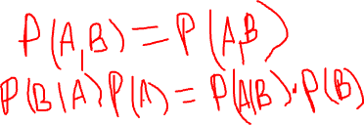
Bayes’ Rule
𝑃(𝐵|𝐴) =
𝑃(𝐴|𝐵)∗𝑃(𝐵)
𝑃(𝐴)
Example use
P(cause|effect) = P(effect|cause)*P(cause) / P(effect)
Why is this useful?
Because in practice it is easier to get probabilities for P(effect|cause) and P(cause) than for P(cause|effect)
E.g., P(disease|symptoms) =
P(symptoms|disease)*P(disease) / P(symptoms)
It is easier to know what symptoms diseases cause. It is harder to diagnose a disease given symptoms
15

Slide 8
Bayes Rule
Can we compute P(α|β) from P(β|α)?
16

Slide 9
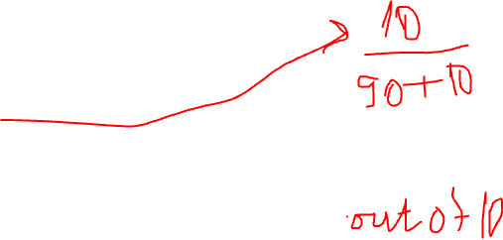
Class Example
Let’s say there are 100 students in the class
Let’s say 10 of them work hard (h), 90 do not (~h)
Probability of a randomly picked student being hardworking
P(h) = 0.1
We are told that 70% of the hardworking students got an A.
P(a|h) = 0.7
7 hardworking students got an A; 3 did not get an A.
What is P(h|a) = ?
Notes:
P(h|a) = P(a|h)P(h)/P(a)

Slide 10
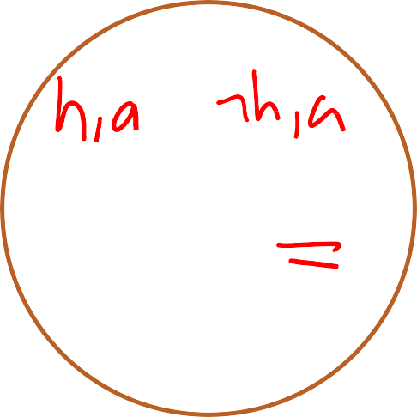




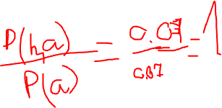
Very Hard Class
hardworking
~hardworking
A
3
7
0
90
P(h|a) = ?
18
Notes:
P(h) = 0.1
P(h|a) = P(h,a )/ P(a)

Slide 11
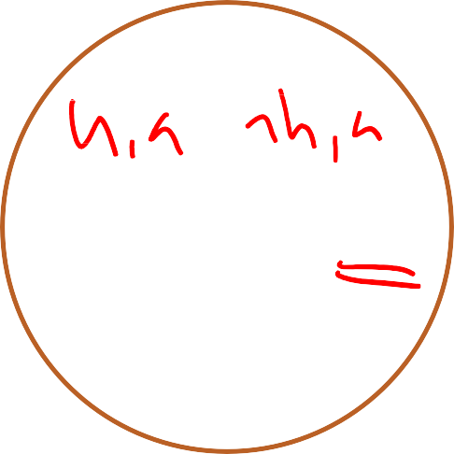
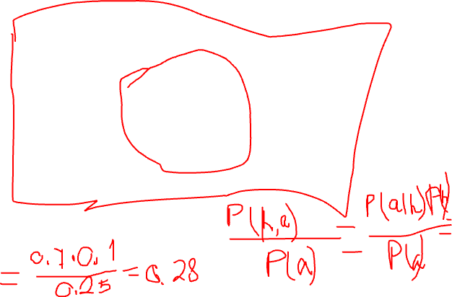
Medium Hard Class
hardworking
~hardworking
A
3
7
18
72
P(h|a) = ?
Notes:
P(h|a) = P(h,a )/ P(a)

Slide 12
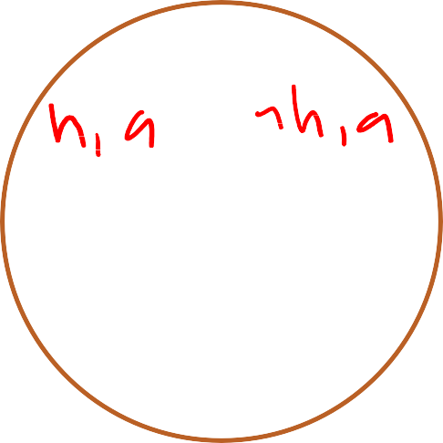
Weird Class
hardworking
~hardworking
A
3
7
90
0
P(h|a) = ?
Notes:
P(h|a) = P(h,a )/ P(a)

Slide 13
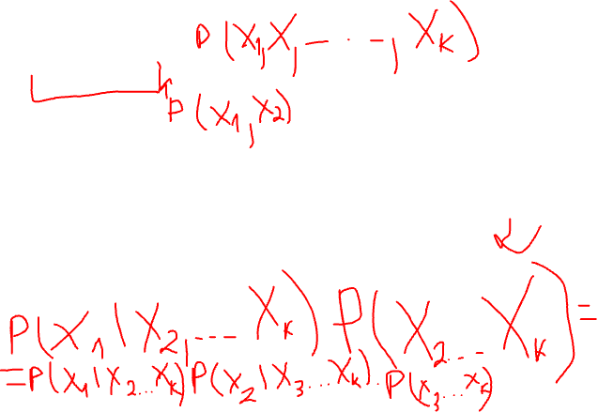
Chain Rule
P(X₁, X₂, X₃, …, X_{k}) =
P(X₁) P(X₂|X₁) P(X₃|X₁,X₂)… P(X_{k} |X₁, X₂, X₃, …, X_{k-1})
or
P(X₂) P(X₁|X₂) P(X₃|X₁,X₂)… P(X_{k} |X₁, X₂, X₃, …, X_{k-1})
or
P(X₂) P(X₃|X₂) P(X₁|X₃,X₂)… P(X_{k} |X₁, X₂, X₃, …, X_{k-1})
or
Pick an order, then
P(first)P(second|first)P(third|first,second)…P(last|all_previous)
21
Notes:
P(A,B,C,D) = P(B,C,D)*P(A|B,C,D)

Slide 14
Marginal Independence
An event α is independent of event β in P, denoted as P╞
α ⊥ β, if
P(α|β) = P(α), or
P(β) = 0
Proposition: A distribution P satisfies α ⊥ β if and only if
P(α, β) = P(α) P(β)
Can you prove it?
Corollary: α ⊥ β implies β ⊥ α
23

Slide 15
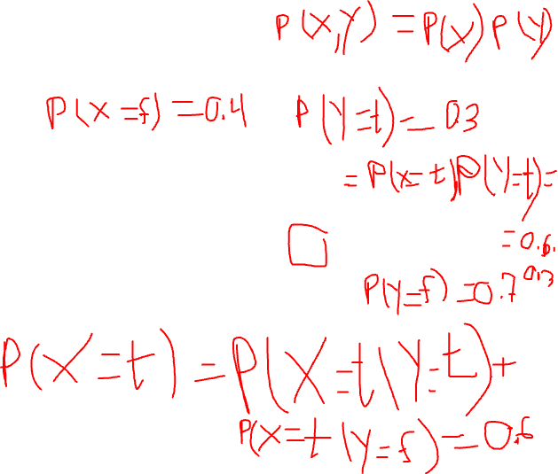
Marginal Independence
X | Y | P(X, Y)
t | t | 0.18
t | f | 0.42
f | t | 0.12
f | f | 0.28
Is X ⊥ Y?
24
Notes:
P(X=t) = P(X=t|Y=t) + P(X=t|Y=f)
…
Yes

Slide 16
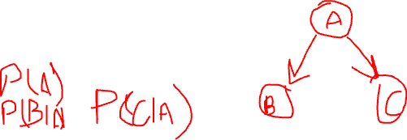
Conditional Independence
Two events are independent given another event
An event α is independent of event β given event γ in P, denoted as P╞ (α ⊥ β | γ), if
P(α|β, γ) = P(α| γ), or
P(β, γ) = 0
Proposition: A distribution P satisfies α ⊥ β | γ if and only if
P(α, β | γ) = P(α| γ) P(β| γ)

Slide 17
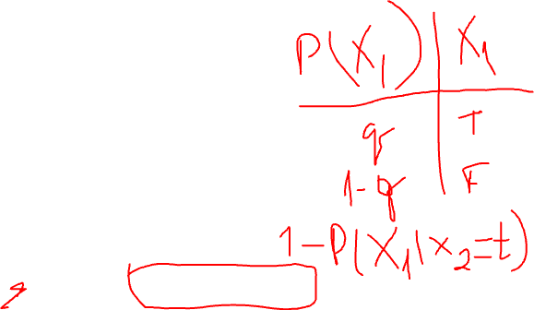
Number of Parameters
Assuming everything is binary
P(X₁) requires
1 independent parameter
P(X₁, X₂, …, X_{n}) requires
2^{n}-1 independent parameters
P(X₁|X₂) requires
2 independent parameters
P(X₁,X₂, …, X_{n} | X_{n+1}, X_{n+2}, …, X_{n+m}) requires
2^{m} × (2^{n}-1) independent parameters
26

Slide 18
Number of Parameters
Assuming everything is binary
P(X₁) requires
1 independent parameter
P(X₁, X₂, …, X_{n}) requires
2^{n}-1 independent parameters
P(X₁|X₂) requires
2 independent parameters
P(X₁,X₂, …, X_{n} | X_{n+1}, X_{n+2}, …, X_{n+m}) requires
2^{m} × (2^{n}-1) independent parameters
27
Notes:
(2^n-1)*2^m

Slide 19
Continuous Spaces
Assume X is continuous and Val(X) = [0,1]
If you would like to assign the same probability to all real numbers in [0, 1], what is, for e.g., P(X=0.5) = ?
Answer: P(X=0.5) = 0.
29

Slide 20
Probability Density Function
We define probability density function, p(x), a
non-negative integrable function, such that ∫
Val ( X )
p(x)dx = 1
a
P( X ≤ a) = ∫ p(x)dx
-00
b
P(a ≤ X ≤ b) = ∫ p(x)dx
a
30

Slide 21

Conditional Probability
We want P(Y|X=x) where X is continuous, Y is discrete
P(Y|X=x) = P(Y,X=x) / P(X=x)
What’s wrong with this expression?
Instead, we use the following expression
P(Y | X = x) = lim P(Y | x - ε ≤ X ≤ x + ε )
ε →0
31

Slide 22
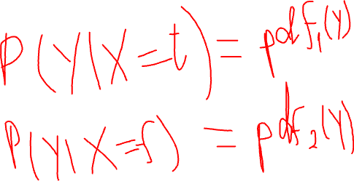
Conditional Probability
We want p(Y|X) where X is discrete, Y is continuous
How would you represent it?
32
Notes:
P(Y|X=t) = pdf

Slide 23
Expectation
E_{P} [ X ] = ∑ xP(x)
x
E_{P} [ X ] = ∫ xp(x)dx
E_{P} [aX + b] = aE_{P} [ X ] + b
E_{P} [ X + Y ] = E_{P} [ X ] + E_{P} [Y ]
E_{P} [ X | y] = ∑ xP(x | y)
x
x
What about E[X*Y]?
33

Slide 24
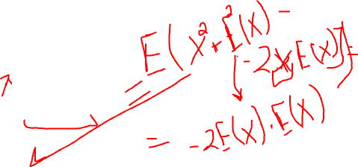
Variance
[ ]
⎡
( )
⎤
Var
X = E
X - E
[ ]
2
P ⎢⎣
X
P
P
⎥⎦
[ ]
( )
Var
X = E
⎡
2
⎤
[ ]
2
X - E
X
P
P
⎣ ⎦
P
Can you derive the second expression using the first expression?
Var
[ ]
2
[ ]
aX + b =
a Var
X
P
P
What is Var[X+Y]?
34

Slide 25
Some Distributions
35

Slide 26
Binomial Distribution
Two parameters
n – number of independent experiments each measuring a binary outcome (e.g., Yes/No, Heads/Tails, Positive/Negative,
…)
p – “success” probability for each individual experiment (e.g., Yes, Heads, Positive, …)
Probability of exactly k successes
𝑛
𝑘
_{𝑝}𝑘
𝑛
𝑘
𝑛!
𝑃 𝑘; 𝑛, 𝑝 =
1 − 𝑝 ^{𝑛−𝑘}, where
=
𝑘! 𝑛−𝑘 !
Expected value: 𝑛𝑝
Variance: 𝑛𝑝(1 − 𝑝)
An important use for binomial distribution: estimate a
binary measure using a sample
Given k success in n experiments, estimate p and a confidence interval for p
36

Slide 27
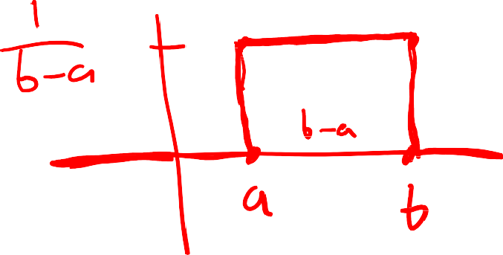
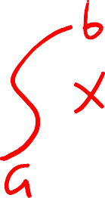
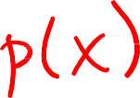


Uniform Distribution
A variable X has a uniform distribution over [a,b] if it has the PDF
⎧
1
a ≤ x ≤ b
0 otherwise
p(x) = ⎪b - a
⎨
⎪⎩
Check and make sure that p(x) integrates to 1.
What are the mean and variances of this distribution?
37

Slide 28
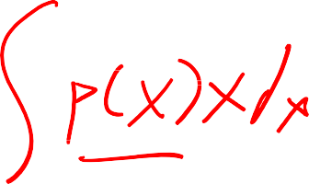
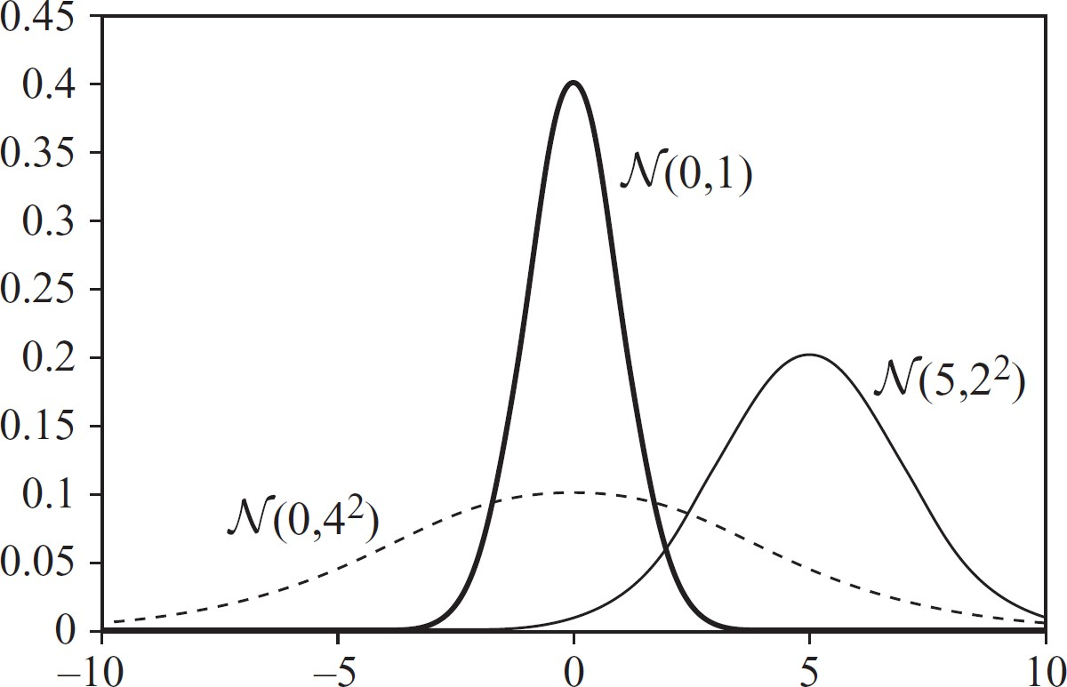
Gaussian Distribution
A variable X has a Gaussian distribution with mean μ and variance σ², if it has the PDF
1
( x-μ )²
-
p(x) =
e
2σ ²
2πσ
Can p(x) be ever greater than 1?
38

Slide 29
Other Topics
Information theory
Parameter estimation
Decision-making under uncertainty
39

Slide 30
Bias / Variance Tradeoff Analytical Approach

Slide 31
Learning
True target
True distribution 𝑃
True function 𝑐
Given a dataset 𝐷₁
Assume 𝐷₁~𝑃 is a representative sample
We learn a model ℎ₁ from 𝐷₁
Error
What is the expected error of ℎ₁ with respect to 𝑐?
Previous lecture (3-classifier-evaluation.pdf)
True error/sample error
Accuracy, precision, recall, F1, AUC, …
Train/test split, train-val-test split, cross validation
Another important question
How different would ℎ be if I got a different dataset? For example, given 𝐷₂ and what would be the error of ℎ₂ with respect to 𝑐?
2

Slide 32
A Different Sample 𝐷’?
𝐷₁~𝑃 is a finite sample
What would happen if we got a different sample D₂~𝑃?
For e.g., assume you need to estimate 𝑃 𝐻𝑒𝑎𝑑𝑠 = 𝜃 and
you collect a sample of 50 data points
Your 𝐷 could be: 𝐷₁ = {23𝐻, 27𝑇}, 𝐷₂ = {22𝐻, 28𝑇}, 𝐷₃ =
{27𝐻, 23𝑇}, etc.
You estimate 𝜃_{𝑖} from 𝐷_{𝑖} using your favorite method (e.g.,
MLE, Bayesian with different priors)
Assume the true (unknown) parameter is 𝜃∗
What is the expected error of your estimates compared to the true 𝜃∗
2
𝐸_{𝐷} 𝜃_{𝑖} − 𝜃∗ =?
3

Slide 33
Bias-Variance Trade-off
Given the set 𝐷 of datasets 𝐷_{𝑖}, models ℎ_{𝑖}, and true function 𝑐
Compute the expected error
𝐸_{𝐷} ℎ − 𝑐
2
In English: what is the expected error of the models ℎ_{𝑖} with respect to 𝑐, where the expectation is taken over possible samples (datasets)
Why expectation over datasets?
I got one particular dataset, which is a sample of the true
distribution, but I could’ve gotten another dataset, which is
also a sample of the true distribution
4

Slide 34
Bias-Variance Trade-off Derivation
5

Slide 35
Bias-Variance Trade-off Derivation
5

Slide 36

Bias-Variance Trade-off Derivation
5

Slide 37
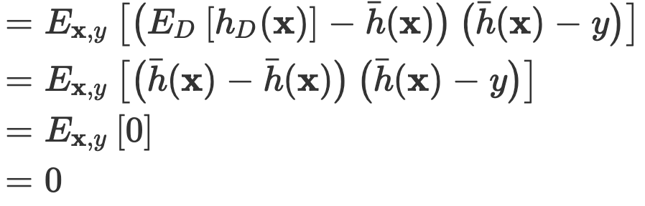

Bias-Variance Trade-off Derivation
5

Slide 38
Bias vs Variance
High bias
More assumptions
E.g., naïve Bayes, linear regression, large priors
Simpler models
E.g., linear models, small decision trees, small neural
networks, high regularization, …
High variance
Fewer assumptions
E.g., logistic regression versus naïve Bayes, MLE vs Bayesian, small priors
More complex models
E.g., polynomial regression versus linear regression, bigger
neural nets versus smaller ones, less regularization
Small data
7

Slide 39
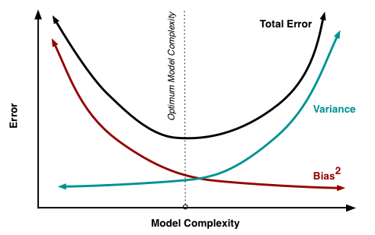
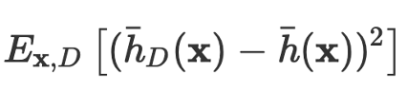
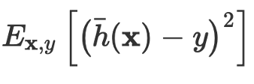
Bias vs Variance
7
http://scott.fortmann-roe.com/docs/BiasVariance.html

Slide 40
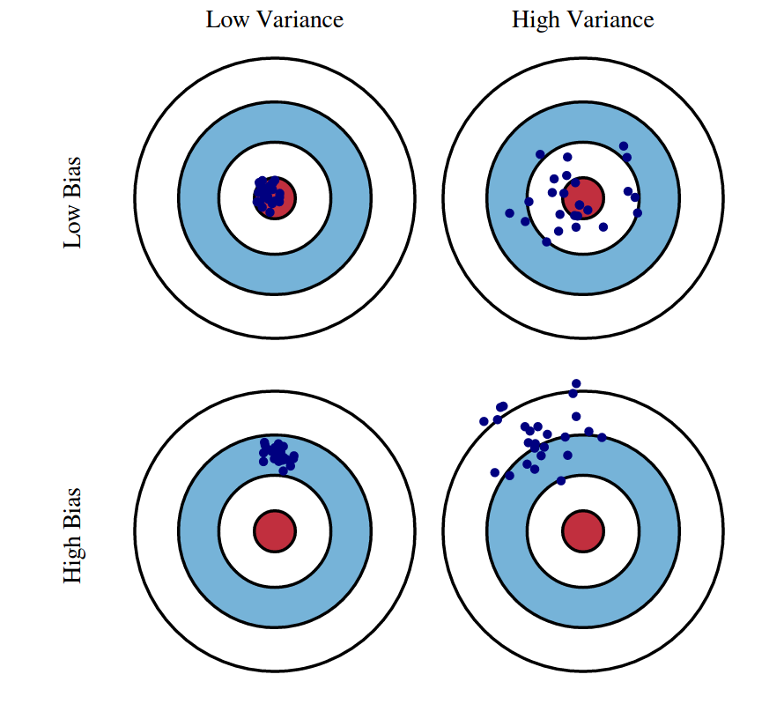
Bias vs Variance
7
http://scott.fortmann-roe.com/docs/BiasVariance.html

