Slide 1
CS584 Machine Learning
Lecture 5. Linear Regression
Oleksandr Narykov
onarykov@iit.edu

Slide 2
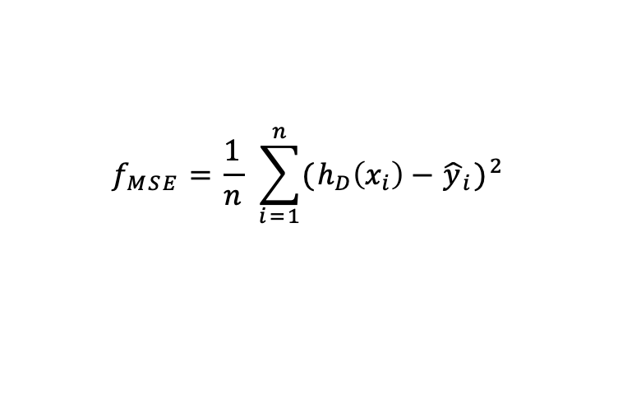
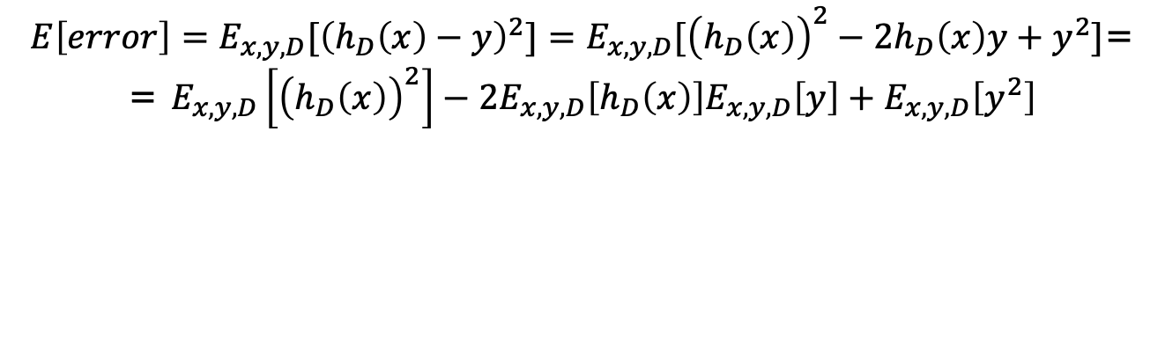
Bias-Variance Trade-off Derivation
$$f_{MSE}=\frac{1}{n} \sum_{i=1}^{n}{{(h_{D}\left(x_{i}\right)−{\hat{y}}_{i})}^{2}}$$
$E\left[error\right]=E_{x,y,D}[{\left(h_{D}\left(x\right)−y\right)}^{2}]=E_{x,y,D}[{\left(h_{D}\left(x\right)\right)}^{2}−2h_{D}\left(x\right)y+y^{2}]$=
= $E_{x,y,D}\left[{\left(h_{D}\left(x\right)\right)}^{2}\right]−2E_{x,y,D}\left[h_{D}\left(x\right)\right]E_{x,y,D}\left[y\right]+E_{x,y,D}\left[y^{2}\right]$
5

Slide 3
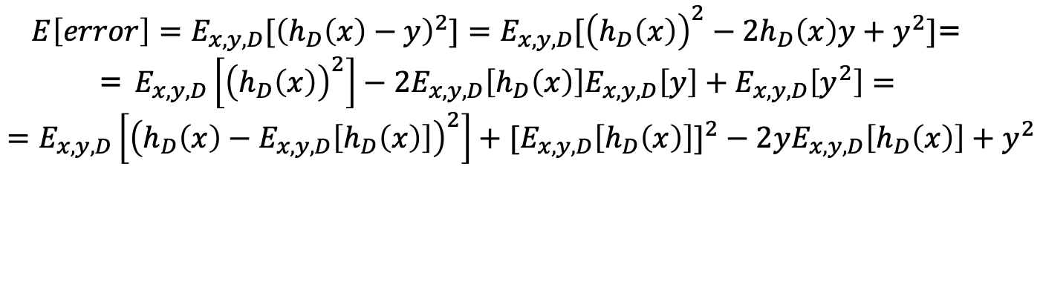
Bias-Variance Trade-off Derivation
$$f_{MSE}=\frac{1}{n} \sum_{i=1}^{n}{{(h_{D}\left(x_{i}\right)−{\hat{y}}_{i})}^{2}}$$
$E\left[error\right]=E_{x,y,D}[{\left(h_{D}\left(x\right)−y\right)}^{2}]=E_{x,y,D}[{\left(h_{D}\left(x\right)\right)}^{2}−2h_{D}\left(x\right)y+y^{2}]$=
= $E_{x,y,D}\left[{\left(h_{D}\left(x\right)\right)}^{2}\right]−2E_{x,y,D}\left[h_{D}\left(x\right)\right]E_{x,y,D}\left[y\right]+E_{x,y,D}\left[y^{2}\right]=$
$$=E_{x,y,D}\left[{\left(h_{D}\left(x\right)−E_{x,y,D}\left[h_{D}\left(x\right)\right]\right)}^{2}\right]+{{[E}_{x,y,D}\left[h_{D}\left(x\right)\right]]}^{2}−2yE_{x,y,D}\left[h_{D}\left(x\right)\right]+y^{2}$$
5

Slide 4
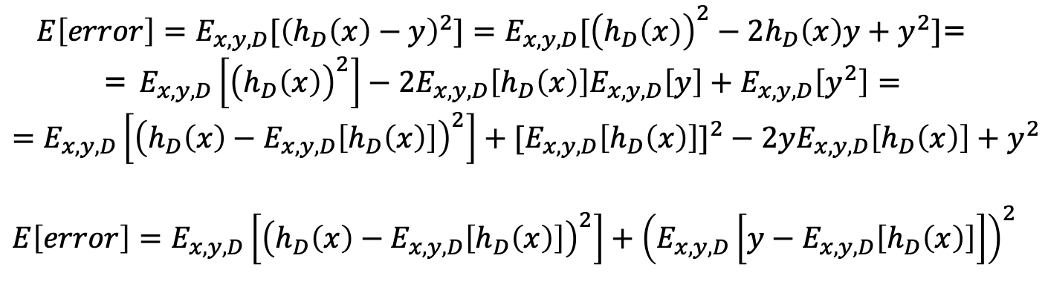
Bias-Variance Trade-off Derivation
$$f_{MSE}=\frac{1}{n} \sum_{i=1}^{n}{{(h_{D}\left(x_{i}\right)−{\hat{y}}_{i})}^{2}}$$
$E\left[error\right]=E_{x,y,D}[{\left(h_{D}\left(x\right)−y\right)}^{2}]=E_{x,y,D}[{\left(h_{D}\left(x\right)\right)}^{2}−2h_{D}\left(x\right)y+y^{2}]$=
= $E_{x,y,D}\left[{\left(h_{D}\left(x\right)\right)}^{2}\right]−2E_{x,y,D}\left[h_{D}\left(x\right)\right]E_{x,y,D}\left[y\right]+E_{x,y,D}\left[y^{2}\right]=$
$$=E_{x,y,D}\left[{\left(h_{D}\left(x\right)−E_{x,y,D}\left[h_{D}\left(x\right)\right]\right)}^{2}\right]+{{[E}_{x,y,D}\left[h_{D}\left(x\right)\right]]}^{2}−2yE_{x,y,D}\left[h_{D}\left(x\right)\right]+y^{2}$$
$$E\left[error\right]=E_{x,y,D}\left[{\left(h_{D}\left(x\right)−E_{x,y,D}\left[h_{D}\left(x\right)\right]\right)}^{2}\right]+{\left(E_{x,y,D}\left[y−E_{x,y,D}\left[h_{D}\left(x\right)\right]\right]\right)}^{2}$$
5

Slide 5
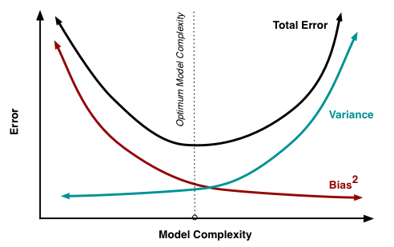


Bias vs Variance
$$E_{x,y,D}\left[{\left(h_{D}\left(x\right)−E_{x,y,D}\left[h_{D}\left(x\right)\right]\right)}^{2}\right]$$
$${\left(E_{x,y,D}\left[y−E_{x,y,D}\left[h_{D}\left(x\right)\right]\right]\right)}^{2}$$
7
http://scott.fortmann-roe.com/docs/BiasVariance.html

Slide 6
Linear Regression

Slide 7
Representation
𝑥: the input vector, the object
𝑟: the true value of the regression
𝑓(𝑥): the true underlying function
𝑔(𝑥): the estimated underlying function
𝜖: the noise
𝑝(𝑟|𝑥): the conditional distribution of 𝑟 and 𝑥
𝐷: the dataset that consists of 𝑥, 𝑟 pairs
3

Slide 8
Regression Function
𝑟 = 𝑓(𝑥) + 𝜖
𝜖 is the noise (i.e., what the model cannot capture)
Noise can exist due to several reasons
The input variables are insufficient to capture everything there is to capture
Noisy sensors
𝜖 is typically assumed to be a zero mean Gaussian with constant variance 𝜎²
𝜖~𝒩(0, 𝜎²)
4

Slide 9
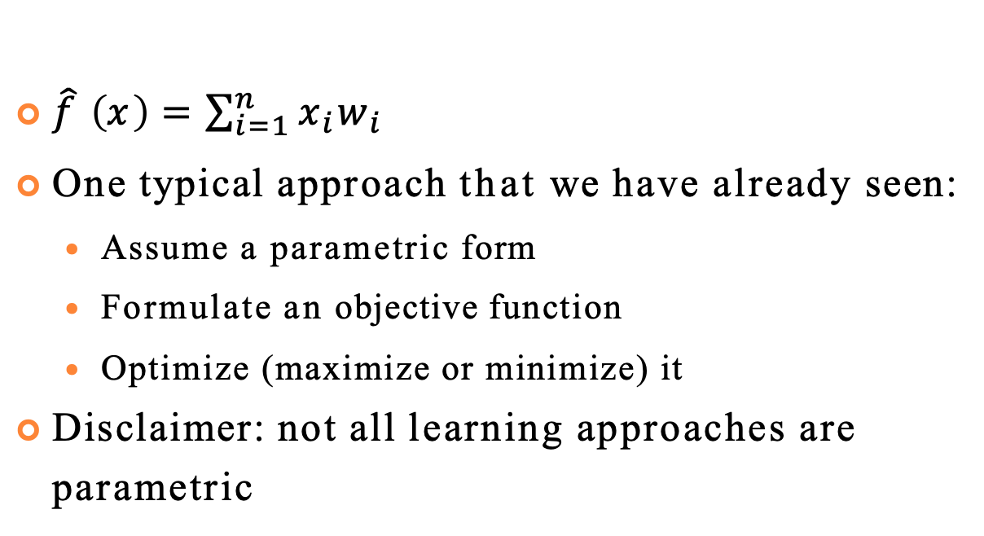
How To Learn 𝑓(𝑥)
$\hat{f} \left(x\right)=\sum_{i=1}^{n}{x_{i}w_{i}}$
One typical approach that we have already seen:
Assume a parametric form
Formulate an objective function
Optimize (maximize or minimize) it
Disclaimer: not all learning approaches are parametric
5

Slide 10
Maximize Conditional Log Likelihood
Assuming 𝜖~𝒩(0, 𝜎²), then
𝑝(𝑟 ∣ 𝑥) ~𝒩(𝑔(𝑥 ∣ 𝑤), 𝜎²)
Given the dataset 𝐷 that has 𝑁 instances and the
parameter vector 𝑤, the conditional log-likelihood
CLL = ∑ln 𝑝 𝑟 𝑑 ∣ 𝑥[𝑑]
1
₋ 𝑟[𝑑]−𝑔(𝑥 𝑑 ∣𝑤) ²
CLL = ∑ ln
𝑒
2𝜎²
2𝜋𝜎
CLL = −𝑁 ln
2𝜋𝜎 −
1
𝑥
𝑑
∣ 𝑤)
2
∑ 𝑟[𝑑] − 𝑔(
2𝜎²
6

Slide 11
Maximize CLL = Minimize Squared Loss
argmax 𝐶𝐿𝐿 =
𝑤
argmax −𝑁 ln 2𝜋𝜎 −
𝑤
argmin σ 𝑟[𝑑] − 𝑔(𝑥 𝑑
𝑤
1
σ 𝑟[𝑑] − 𝑔(𝑥 𝑑
∣ 𝑤) ²
2𝜎²
∣ 𝑤) ²
7

Slide 12
𝑔(𝑥|𝑤)
So far, we did not specify what 𝑔(𝑥|𝑤) is
One popular approach is to assume a linear function
Assume in each instance 𝑥 has 𝑘 features
𝑥 = 𝑥₁, 𝑥₂, ⋯ , 𝑥_{𝑘}
Then, a polynomial of degree one linear regression is
𝑔 𝑥 𝑤 = 𝑤₀ + σ^{𝑘} 𝑤_{𝑖}𝑥_{𝑖}
𝑖=1
8

Slide 13
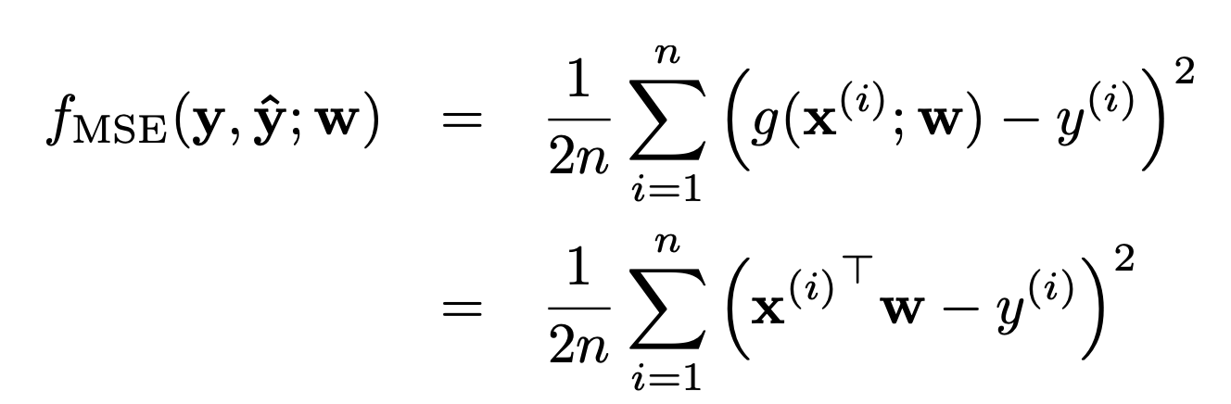
Regression Loss
10

Slide 14
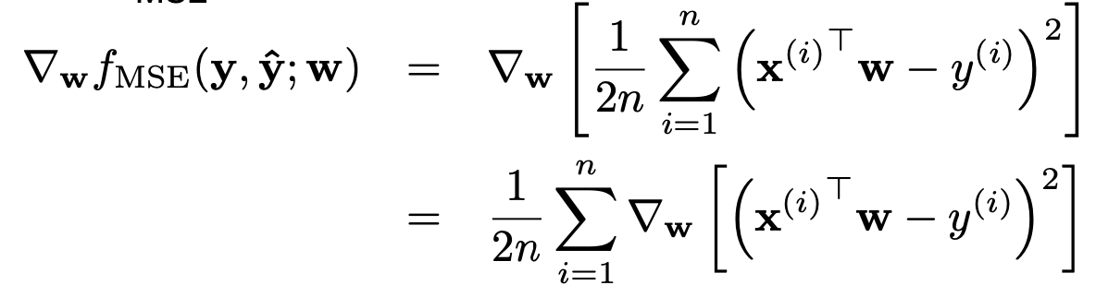
Regression Gradient
10

Slide 15
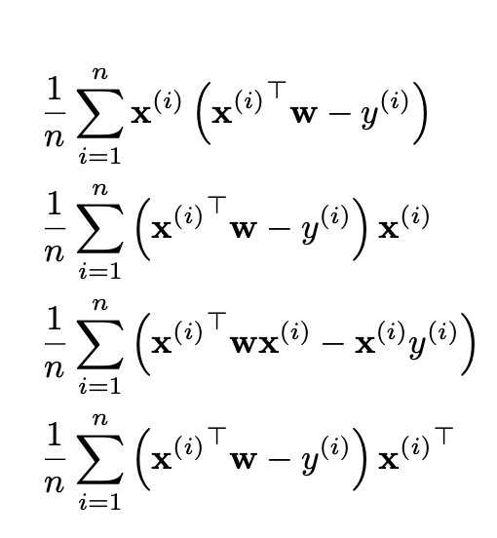
Regression Gradient
=
=
=
10

Slide 16
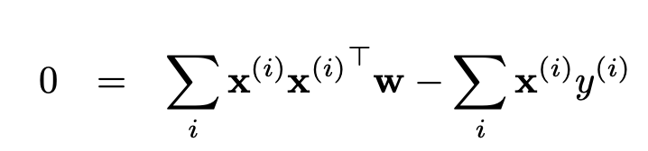
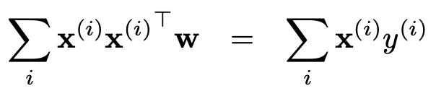
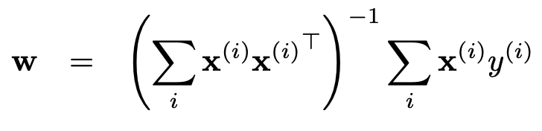
Regression Gradient
10

Slide 17
Regularization
L₂ regularization
Minimize squared-loss + L₂ penalty
Also called Ridge regression
L₁ regularization
Minimize squared-loss + L₁ penalty
Also called Lasso regression
See OneNote for derivation
11

Slide 18
Polynomial Regression – Arbitrary Degree
Simply change the input representation by adding new features that correspond to powers and products
See https://scikit- learn.org/stable/modules/preprocessing.html#poly nomial-features
12

Slide 19
Other Regression Approaches
There are other approaches besides linear regression, such as
Decision tree regression
Support vector regression
Neural networks
…
14

Slide 20
Python

Slide 21
Python
Created in 1991
Named for Monty Python
Interpreted scripting language
Interpreted: not compiled before execution
Scripting: Targeted for small program meant for one-time use
Transformed into fully-operational object-oriented programming (OOP) language
Widely used by:
Deep Learning and AI communities
Linux distributions
Games and apps

Slide 22
numpy
Numerical Python
Fundamental package for HPC, data analysis, and ML applications
NumPy can efficiently handle large arrays of data
Features:
ndarray type for arrays with an arbitrary number of dimensions
Uses much less memory than standard Python objects
Standard math functions
ndarrays are important for vectorization – ability to perform element-wise operations on arrays without for loops

Slide 23

pandas
Data manipulation library
Starting point for many ML applications
Main entities:
Series
1D labeled homogeneous array, size-immutable
DataFrames
2D size-mutable tabular structure with possibly heterogeneous columns
Labeled axes
Panels
3D arrays

Slide 24
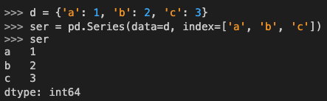
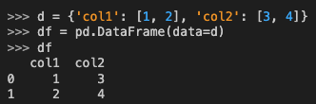

pandas. Examples
Series
DataFrame

Slide 25
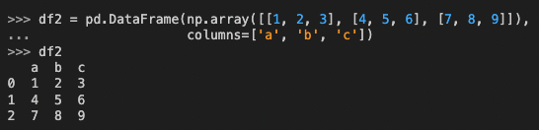
pandas. Examples
DataFrame can be constructed from multiple input types:
List
dict
Series
Numpy ndarrays
Another DataFrame

Slide 26

Scikit-Learn
General-purpose Machine Learning library
Implements a number of widely used algorithms:
Classification
SVM
Random Forest
Naïve Bayes
AdaBoost
Regression
Linear regression
Kernel ridge regression
Lasso
Elastic-Net
Regression Trees/Forest

Slide 27
Regression in Scikit-Learn
Least squares
http://scikit-learn.org/stable/modules/linear_model.html#ordinary- least-squares
https://scikit- learn.org/stable/modules/generated/sklearn.linear_model.LinearRegre ssion.html
Ridge
http://scikit-learn.org/stable/modules/linear_model.html#ridge- regression
https://scikit- learn.org/stable/modules/generated/sklearn.linear_model.Ridge.html
Lasso
http://scikit-learn.org/stable/modules/linear_model.html#lasso
https://scikit- learn.org/stable/modules/generated/sklearn.linear_model.Lasso.html
15

