Slide 1
CS584 Machine Learning
Lecture 5. Linear Regression. Practice
Oleksandr Narykov
onarykov@iit.edu

Slide 2
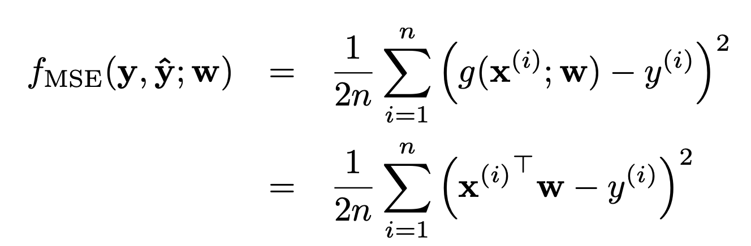
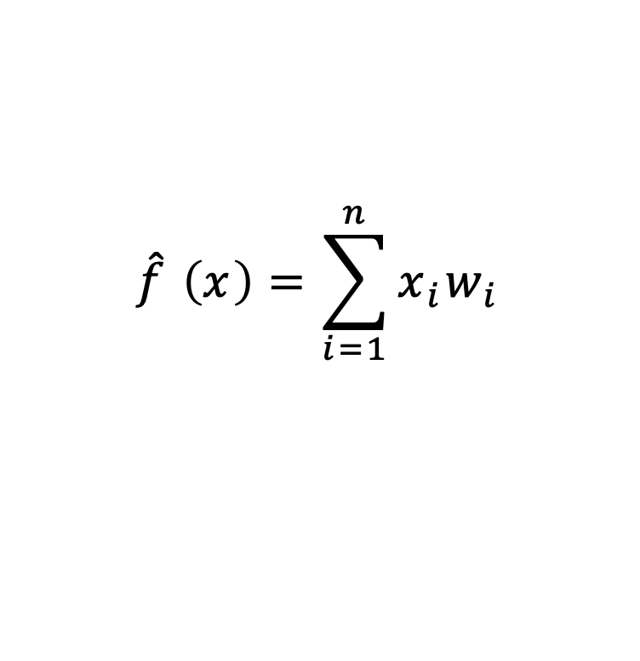
Linear Regression
$$\hat{f} \left(x\right)=\sum_{i=1}^{n}{x_{i}w_{i}}$$
10

Slide 3
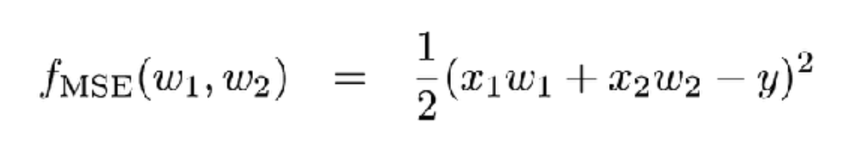
Linear Regression. 2D case
10

Slide 4
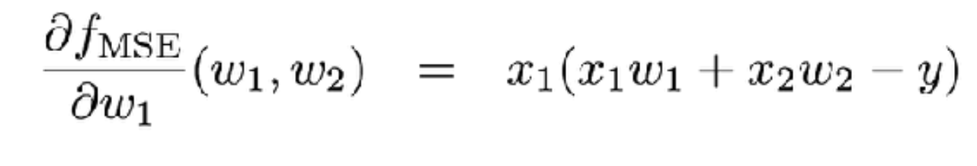
Linear Regression. 2D case
10

Slide 5
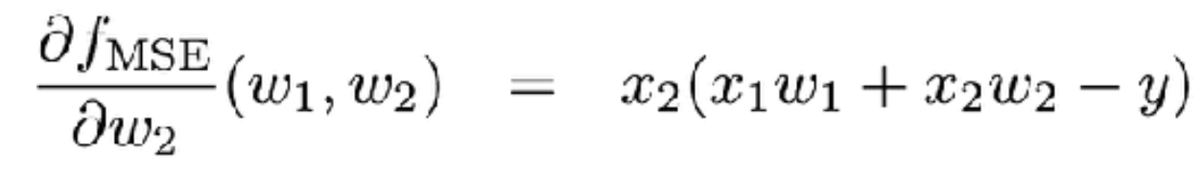
Linear Regression. 2D case
10

Slide 6
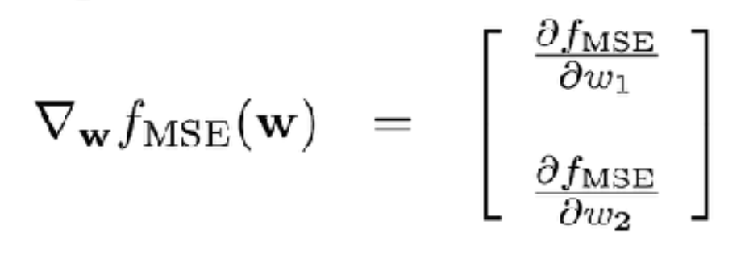
Linear Regression. 2D case
10

Slide 7
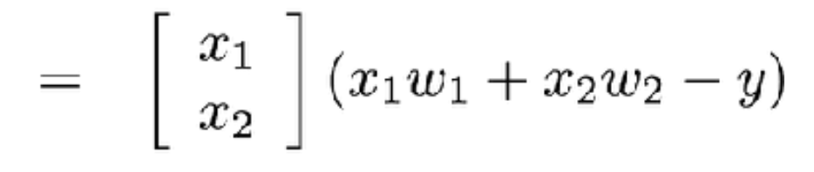
Linear Regression. 2D case
10

Slide 8
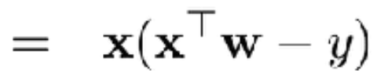
Linear Regression. 2D case
10

Slide 9
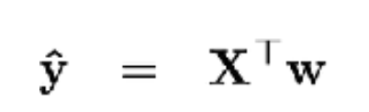
Linear Regression. 2D case
10

Slide 10
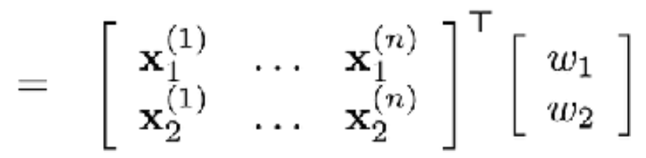
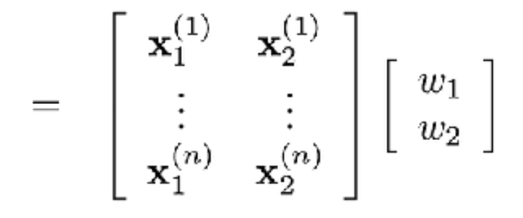
Linear Regression. 2D case
10

Slide 11
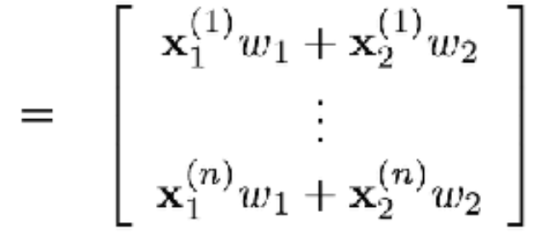
Linear Regression. 2D case
10

Slide 12
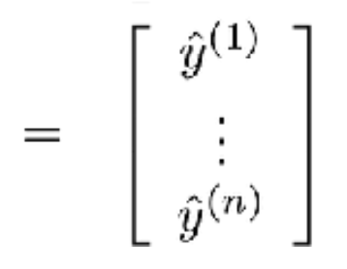
Linear Regression. 2D case
10

Slide 13
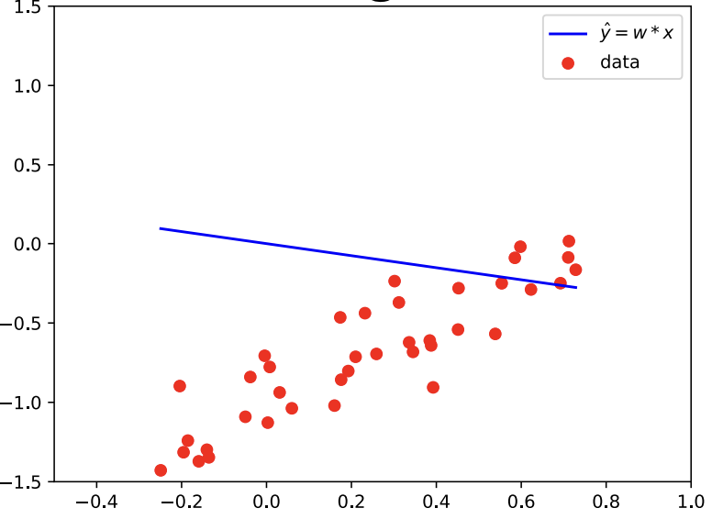
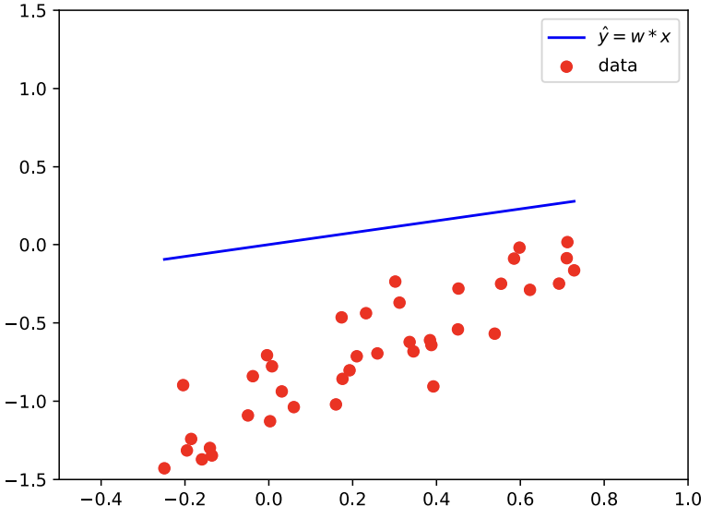
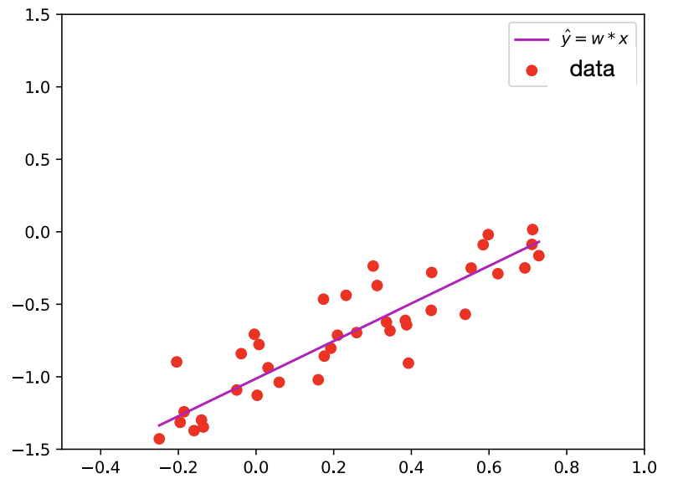
Linear Regression. Learning a Model

Slide 14
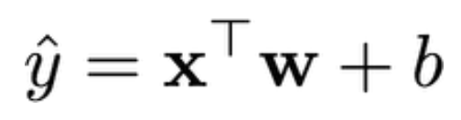
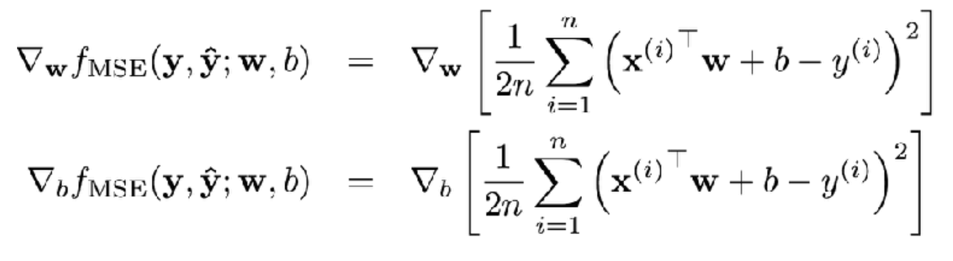
Linear Regression. Bias
10

Slide 15
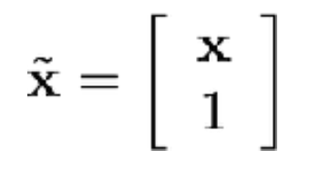
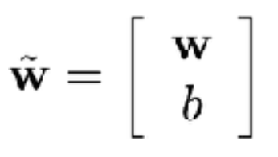
Linear Regression. Bias. Matrix Notation
10

Slide 16
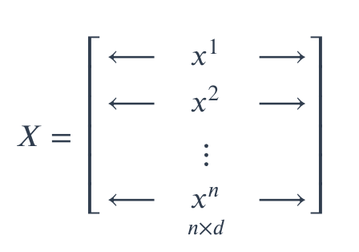

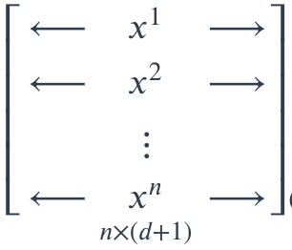


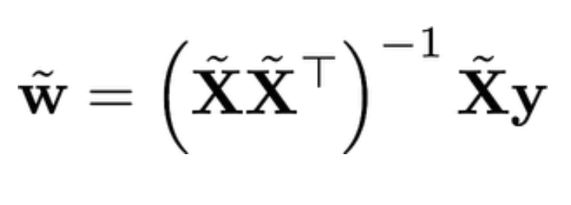

Linear Regression. Bias. Matrix Notation
$$\begin{matrix}\begin{matrix}\begin{aligned} \\ 1\end{aligned} \\ 1\end{matrix} \\ \begin{matrix}\begin{aligned}. \\ . \\ .\end{aligned} \\ \begin{aligned}1 \\ \end{aligned}\end{matrix}\end{matrix}$$
10

Slide 17
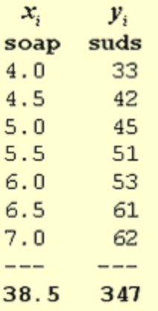
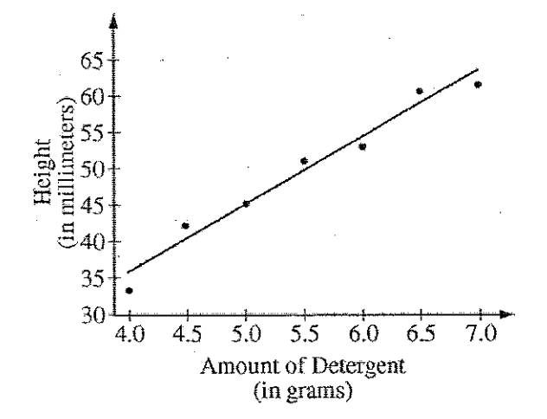
Linear Regression. Soap
10

Slide 18
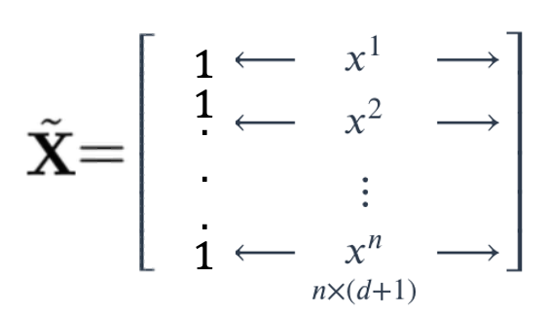
Linear Regression. Soap
10

Slide 19
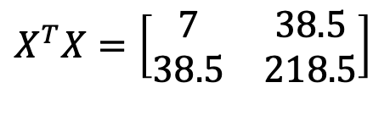
Linear Regression. Soap
$$X^{T}X=\left[\begin{matrix}7 & 38.5 \\ 38.5 & 218.5\end{matrix}\right]$$
10

Slide 20
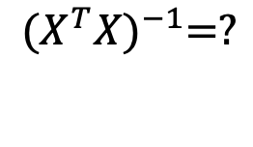
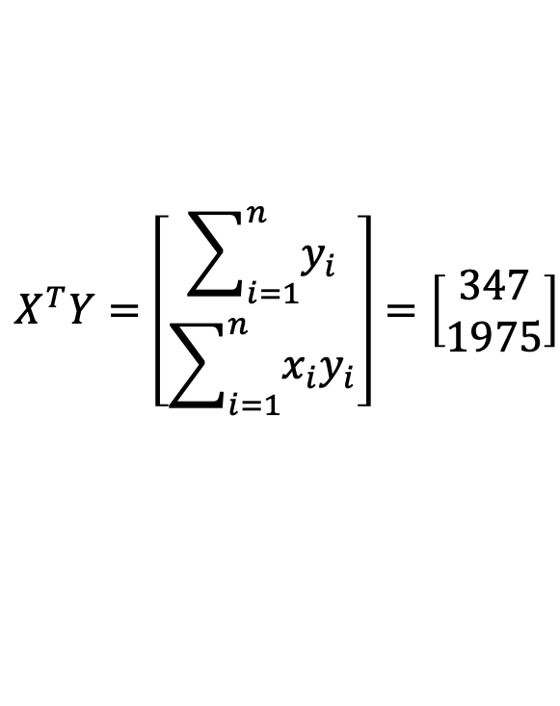
Linear Regression. Soap
$$X^{T}X=\left[\begin{matrix}7 & 38.5 \\ 38.5 & 218.5\end{matrix}\right]$$
$$X^{T}Y=\left[\begin{matrix}\sum_{i=1}^{n}{y_{i}} \\ \sum_{i=1}^{n}{{x_{i}y}_{i}}\end{matrix}\right]=\left[\begin{matrix}347 \\ 1975\end{matrix}\right]$$
$${(X^{T}X)}^{−1}=?$$
10

Slide 21
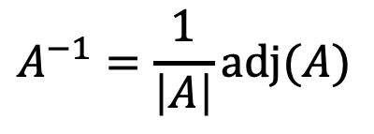

Linear Algebra Recap
$$AA^{−1}=I$$
$$A^{−1}=\frac{1}{\left|A\right|}adj(A)$$
10

Slide 22
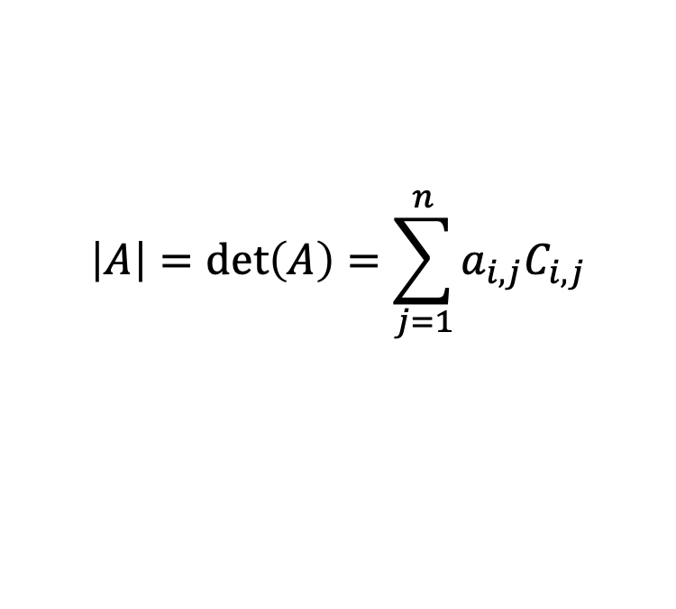
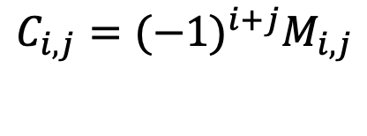

Linear Algebra Recap
$$AA^{−1}=I$$
$$A^{−1}=\frac{1}{\left|A\right|}adj(A)$$
$$adj\left(A\right)=C^{T}$$
$$C_{i,j}={(−1)}^{i+j}M_{i,j}$$
$$\left|A\right|=\det\left(A\right)=\sum_{j=1}^{n}{a_{i,j}C_{i,j}}$$
10

Slide 23
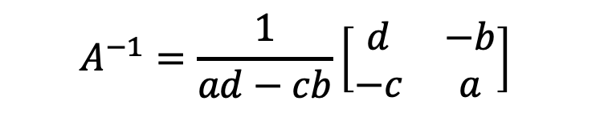

Linear Algebra Recap
$$AA^{−1}=I$$
$$A^{−1}=\frac{1}{\left|A\right|}adj(A)$$
$$adj\left(A\right)=C^{T}$$
$$C_{i,j}={(−1)}^{i+j}M_{i,j}$$
$$\left|A\right|=\det\left(A\right)=\sum_{j=1}^{n}{a_{i,j}C_{i,j}}$$
$$A=\left[\begin{matrix}a & b \\ c & d\end{matrix}\right]$$
$$A^{−1}=\frac{1}{ad−cb}\left[\begin{matrix}d & −b \\ −c & a\end{matrix}\right]$$
10

Slide 24
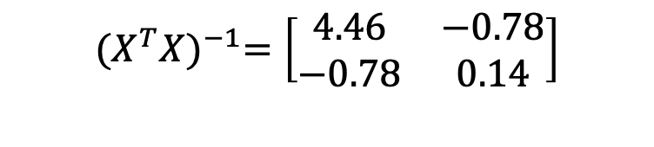
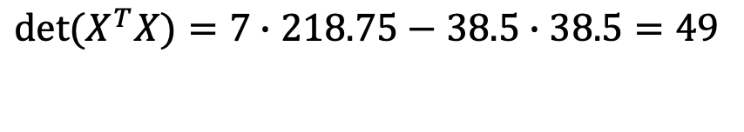
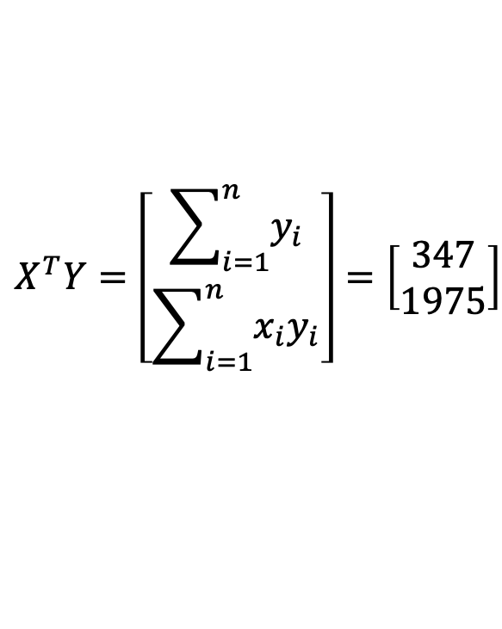
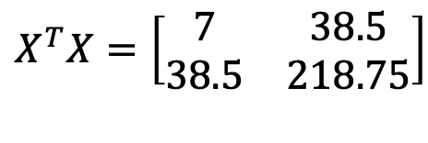
Linear Regression. Soap
$$X^{T}X=\left[\begin{matrix}7 & 38.5 \\ 38.5 & 218.75\end{matrix}\right]$$
$$\det{(X^{T}X)}=7∙218.75−38.5∙38.5=49$$
$$X^{T}Y=\left[\begin{matrix}\sum_{i=1}^{n}{y_{i}} \\ \sum_{i=1}^{n}{{x_{i}y}_{i}}\end{matrix}\right]=\left[\begin{matrix}347 \\ 1975\end{matrix}\right]$$
$${(X^{T}X)}^{−1}=\left[\begin{matrix}4.46 & −0.78 \\ −0.78 & 0.14\end{matrix}\right]$$
10
Notes:
3

Slide 25
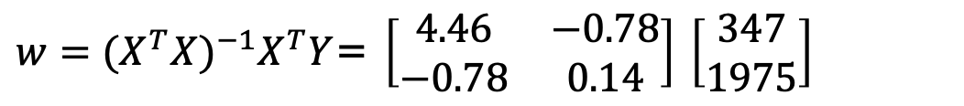
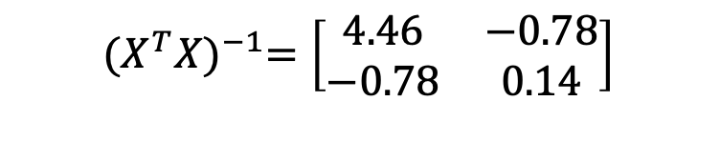
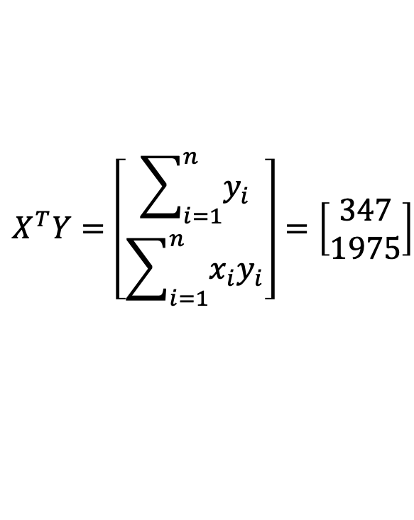
Linear Regression. Soap
$$X^{T}Y=\left[\begin{matrix}\sum_{i=1}^{n}{y_{i}} \\ \sum_{i=1}^{n}{{x_{i}y}_{i}}\end{matrix}\right]=\left[\begin{matrix}347 \\ 1975\end{matrix}\right]$$
$${(X^{T}X)}^{−1}=\left[\begin{matrix}4.46 & −0.78 \\ −0.78 & 0.14\end{matrix}\right]$$
${w=(X^{T}X)}^{−1}X^{T}Y$= $\left[\begin{matrix}4.46 & −0.78 \\ −0.78 & 0.14\end{matrix}\right]$ $\left[\begin{matrix}347 \\ 1975\end{matrix}\right]$
10
Notes:
3

Slide 26
Linear Regression. Soap
$$X^{T}Y=\left[\begin{matrix}\sum_{i=1}^{n}{y_{i}} \\ \sum_{i=1}^{n}{{x_{i}y}_{i}}\end{matrix}\right]=\left[\begin{matrix}347 \\ 1975\end{matrix}\right]$$
$${(X^{T}X)}^{−1}=\left[\begin{matrix}4.46 & −0.78 \\ −0.78 & 0.14\end{matrix}\right]$$
${w=(X^{T}X)}^{−1}X^{T}Y$= $\left[\begin{matrix}4.46 & −0.78 \\ −0.78 & 0.14\end{matrix}\right]$ $\left[\begin{matrix}347 \\ 1975\end{matrix}\right]=\left[\begin{matrix}−2.67 \\ 9.51\end{matrix}\right]$
10
Notes:
3

Slide 27
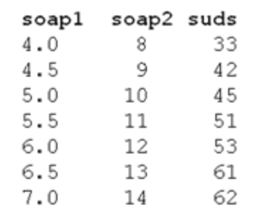

Linear Regression. Numerical Stability
$$X^{T}Y=\left[\begin{matrix}\sum_{i=1}^{n}{y_{i}} \\ \sum_{i=1}^{n}{{x_{i}y}_{i}}\end{matrix}\right]=\left[\begin{matrix}347 \\ 1975\end{matrix}\right]$$
$${(X^{T}X)}^{−1}=\left[\begin{matrix}4.46 & −0.78 \\ −0.78 & 0.14\end{matrix}\right]$$
$${(X^{T}X)}^{−1}=?$$
10
Notes:
3

Slide 28
Linear Regression. Numerical Stability
$$X^{T}Y=\left[\begin{matrix}\sum_{i=1}^{n}{y_{i}} \\ \sum_{i=1}^{n}{{x_{i}y}_{i}}\end{matrix}\right]=\left[\begin{matrix}347 \\ 1975\end{matrix}\right]$$
$${(X^{T}X)}^{−1}=\left[\begin{matrix}4.46 & −0.78 \\ −0.78 & 0.14\end{matrix}\right]$$
$${(X^{T}X)}^{−1}=?$$
In practice, pseudoinverse is used
10
Notes:
3

Slide 29
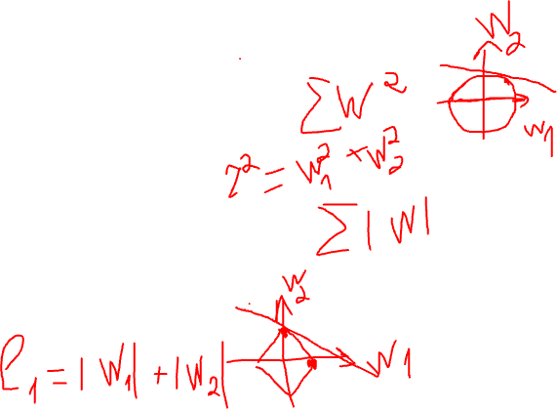
Regularization
L₂ regularization
Minimize squared-loss + L₂ penalty
Also called Ridge regression
L₁ regularization
Minimize squared-loss + L₁ penalty
Also called Lasso regression
11

Slide 30
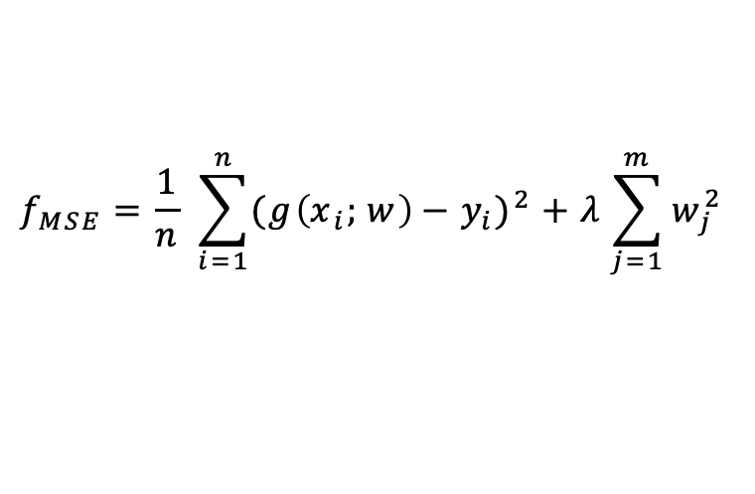
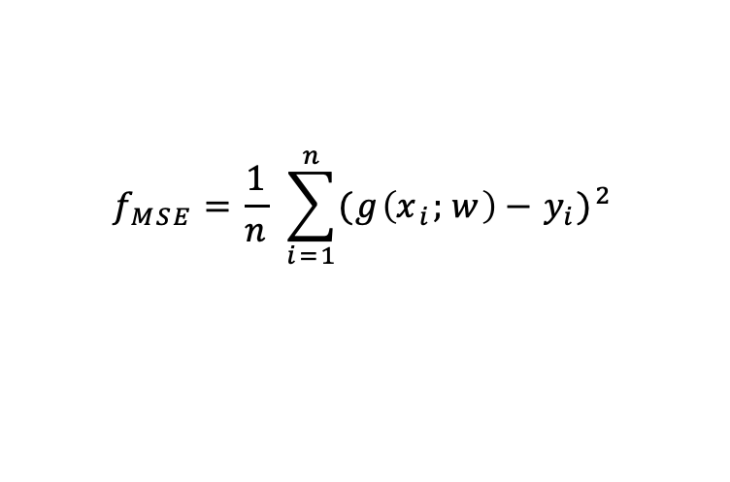
Regularization
$$f_{MSE}=\frac{1}{n} \sum_{i=1}^{n}{{({g\left(x_{i};w\right)−y}_{i})}^{2}}$$
L₂ regularization
$$f_{MSE}=\frac{1}{n} \sum_{i=1}^{n}{{({g\left(x_{i};w\right)−y}_{i})}^{2}}+λ\sum_{j=1}^{m}{w_{j}^{2}}$$
11

Slide 31
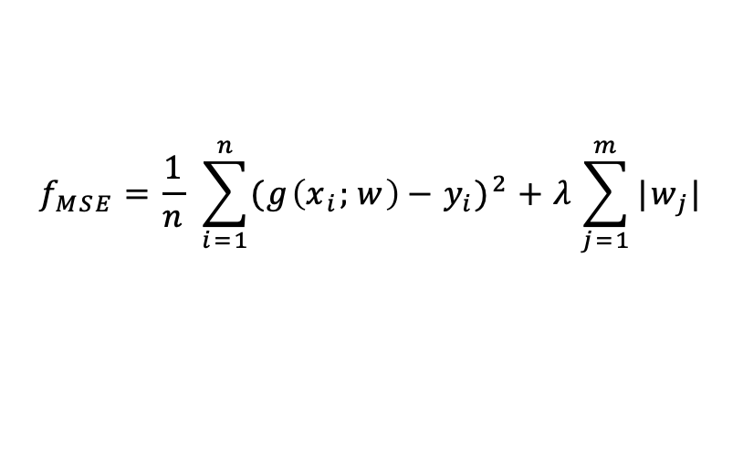
Regularization
$$f_{MSE}=\frac{1}{n} \sum_{i=1}^{n}{{({g\left(x_{i};w\right)−y}_{i})}^{2}}$$
L₂ regularization
$$f_{MSE}=\frac{1}{n} \sum_{i=1}^{n}{{({g\left(x_{i};w\right)−y}_{i})}^{2}}+λ\sum_{j=1}^{m}{w_{j}^{2}}$$
L₁ regularization
$$f_{MSE}=\frac{1}{n} \sum_{i=1}^{n}{{({g\left(x_{i};w\right)−y}_{i})}^{2}}+λ\sum_{j=1}^{m}{|w_{j}|}$$
11

Slide 32
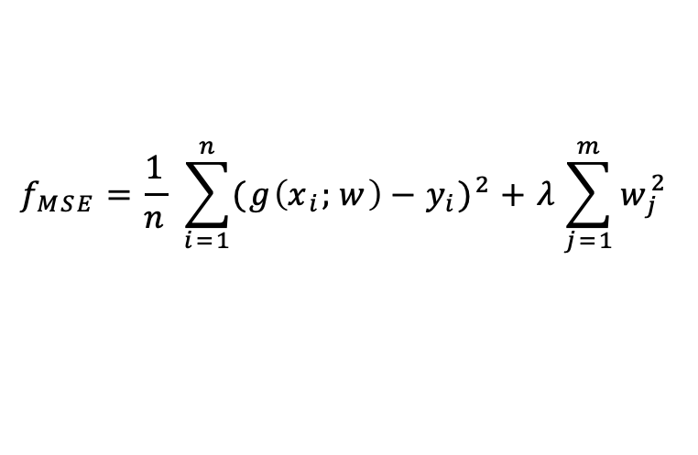
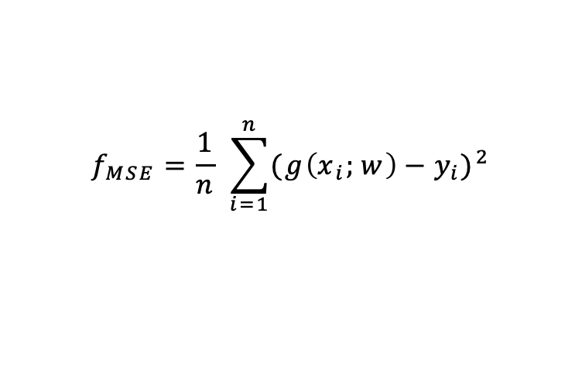
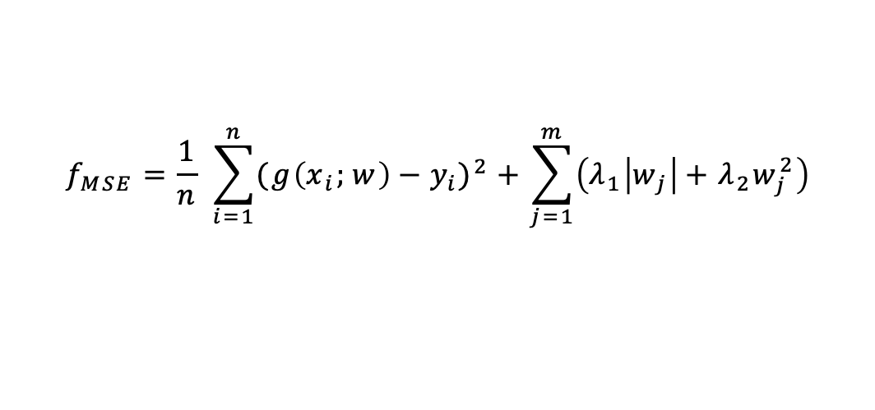
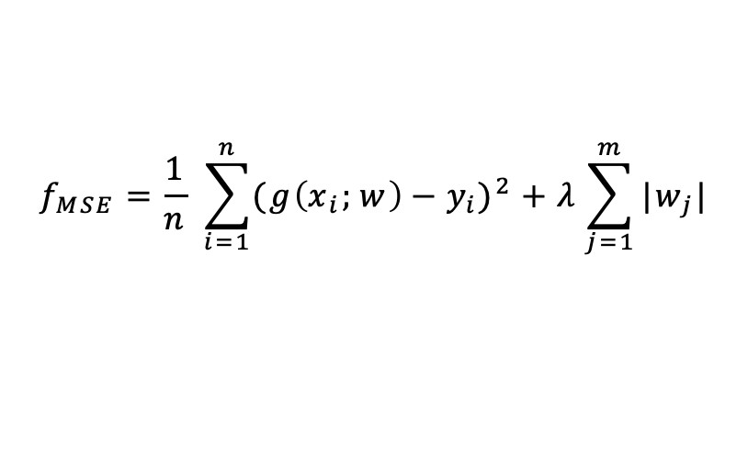
Regularization
$$f_{MSE}=\frac{1}{n} \sum_{i=1}^{n}{{({g\left(x_{i};w\right)−y}_{i})}^{2}}$$
L₂ regularization
$$f_{MSE}=\frac{1}{n} \sum_{i=1}^{n}{{({g\left(x_{i};w\right)−y}_{i})}^{2}}+λ\sum_{j=1}^{m}{w_{j}^{2}}$$
L₁ regularization
$$f_{MSE}=\frac{1}{n} \sum_{i=1}^{n}{{({g\left(x_{i};w\right)−y}_{i})}^{2}}+λ\sum_{j=1}^{m}{|w_{j}|}$$
ElasticNet
$$f_{MSE}=\frac{1}{n} \sum_{i=1}^{n}{{({g\left(x_{i};w\right)−y}_{i})}^{2}}+\sum_{j=1}^{m}{\left(λ_{1}\left|w_{j}\right|+λ_{2}w_{j}^{2}\right)}$$
11

Slide 33
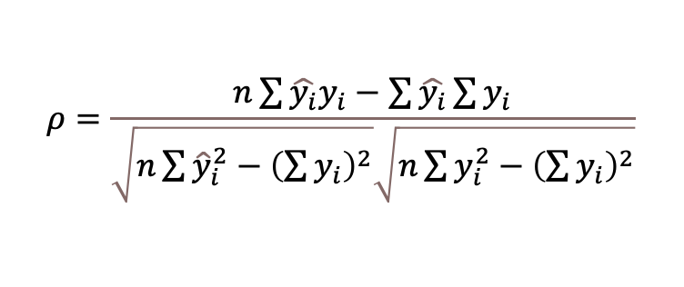
More Regression Metrics
Pearson Correlation Coefficient
$$ρ=\frac{n\sum{\hat{y_{i}}y_{i}}−\sum{\hat{y_{i}}}\sum{y_{i}}}{\sqrt{n\sum{{\hat{y}}_{i}^{2}}−{\left(\sum{y_{i}}\right)}^{2}}\sqrt{n\sum{y_{i}^{2}}−{\left(\sum{y_{i}}\right)}^{2}}}$$
11
Notes:
PCC describes linear correlation between two sets of points. It is computed by dividing covariance between two sets of points over the product of standard deviation for each of the individual sets. For the case of 1-D points it can be computed using the following equation:

Slide 34

More Regression Metrics
Pearson Correlation Coefficient
$$ρ=\frac{n\sum{\hat{y_{i}}y_{i}}−\sum{\hat{y_{i}}}\sum{y_{i}}}{\sqrt{n\sum{{\hat{y}}_{i}^{2}}−{\left(\sum{y_{i}}\right)}^{2}}\sqrt{n\sum{y_{i}^{2}}−{\left(\sum{y_{i}}\right)}^{2}}}$$
Spearman Correlation Coefficient
$$r_{s}=\frac{cov\left(R , \left(\hat{Y}\right), R\left(Y\right)\right)}{σ\left(R\left(\hat{Y}\right)\right)σ\left(R\left(Y\right)\right)},$$
11
Notes:
PCC describes linear correlation between two sets of points. It is computed by dividing covariance between two sets of points over the product of standard deviation for each of the individual sets. For the case of 1-D points it can be computed using the following equation:
SCC describes alignment of the rankings among two sets of points. It allows this score to capture non-linear components of the alignment. Correlation is defined in a similar fashion to PCC, with the only exception of using rankings of the points instead of their values:
where $cov(X,Y)$ is a covariance between $X$ and $Y$, $R(X)$ is a ranking of the set $X$, $σ(X)$ is the standard deviation of $X$, $Y$ is the set of the ground truth values, and $\hat{Y}$ is the set of the predicted values.

Slide 35

More Regression Metrics
Coefficient of Determination (R²)
$$R^{2}=1−\frac{{SS}_{res}}{{SS}_{tot}},$$
$${SS}_{res}=\sum_{i=1}^{n}{{\left(y_{i}−f_{i}\right)}^{2}},$$
$${SS}_{tot}=\sum_{i=1}^{n}{{\left(y_{i}−\overline{y}\right)}^{2}},$$
11
Notes:
Coefficient of determination indicates variance proportion of the variable of interest that is explained by a given regression model.
where ${SS}_{res}$ is a residual variance from the regression model, ${SS}_{tot}$ is a total variance, $n$ is a total number of points in evaluation set, $y_{i}$ is the true value of the $i$-th point, $f_{i}$ is the predicted value of the $i$-th point, $\overline{y}$ is the mean of the true values in evaluation set. $R^{2}$ is a common metric used for evaluating regression models in general and is frequently used to assess quality of drug response prediction models.

Slide 36
Python

Slide 37

Metrics
https://scikit-learn.org/stable/modules/model_evaluation.html
11

Slide 38


Metrics
https://docs.scipy.org/doc/scipy/reference/generated/scipy.stats.pearsonr.html
11

