Slide 1
CS584 Machine Learning
Lecture 8. Stochastic Gradient Descent. Classification
Oleksandr Narykov
onarykov@iit.edu

Slide 2
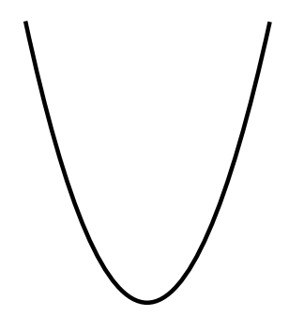


Gradient Descent
Gradient descent is a hill-climbing algorithm that
makes incremental changes to weight vector w
depending on the value of slope (i.e., gradient)
$$f_{MSE}$$
f
$$w$$
10

Slide 3
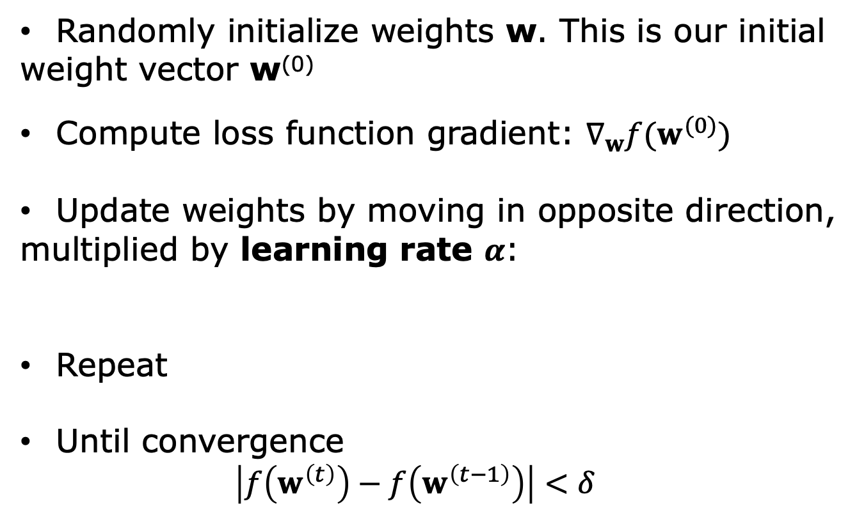


Gradient Descent. Algorithm
Randomly initialize weights w. This is our initial
weight vector w⁽⁰⁾
Compute loss function gradient: $∇_{w}f(w^{(0)})$
Update weights by moving in opposite direction,
multiplied by learning rate $α$:
Repeat
Until convergence
$$\left|f\left(w^{\left(t\right)}\right)−f\left(w^{\left(t−1\right)}\right)\right|<δ$$
$$w^{(1)}←w^{(0)}−α∇_{w}f(w^{(0)})$$
$$w^{(i)}←w^{(i−1)}−α∇_{w}f(w^{(i−1)})$$
10

Slide 4
Gradient Descent. Algorithm
Drawbacks:
Requires to go over every point of dataset.
Ineffective for big data problems
Selecting learning rate is non-trivial
Notes:
Convergence to global minimum is guaranteed only
for convex functions!
10

Slide 5
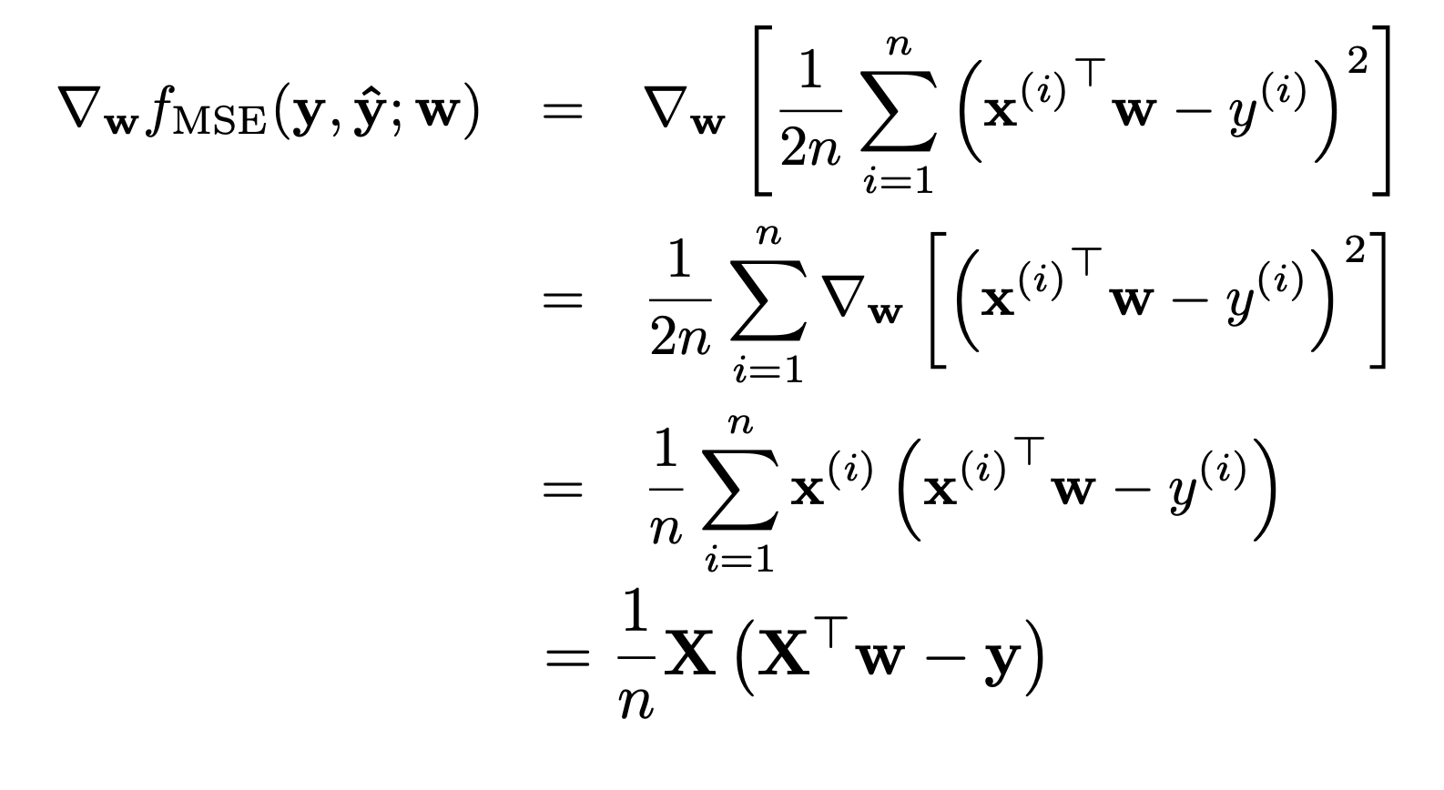
Stochastic Gradient Descent
10

Slide 6
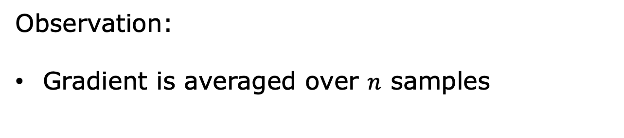
Stochastic Gradient Descent
Observation:
Gradient is averaged over $n$ samples
10

Slide 7
Stochastic Gradient Descent
Observation:
Gradient is averaged over $n$ samples
Question:
Can we approximate it?
10

Slide 8
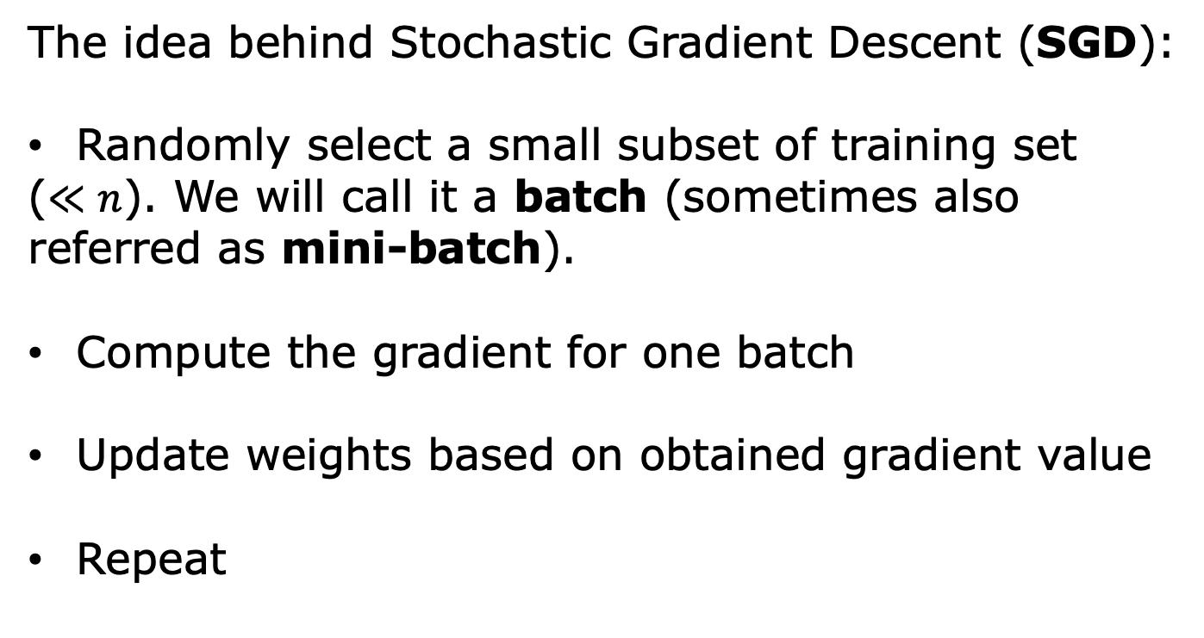
Stochastic Gradient Descent
The idea behind Stochastic Gradient Descent (SGD):
Randomly select a small subset of training set
($≪n$). We will call it a batch (sometimes also
referred as mini-batch).
Compute the gradient for one batch
Update weights based on obtained gradient value
Repeat
10

Slide 9
Stochastic Gradient Descent
A single pass over training set is called epoch
In practice, SGD is conducted over multiple epochs
Covergence with randomized sampling over
different epochs is either faster or have the same
speed as convergence with non-randomized
sampling
Koloskova, Anastasia, et al. "Shuffle SGD is Always Better than SGD: Improved Analysis of SGD with Arbitrary Data Orders." arXiv preprint arXiv:2305.19259 (2023).
10

Slide 10
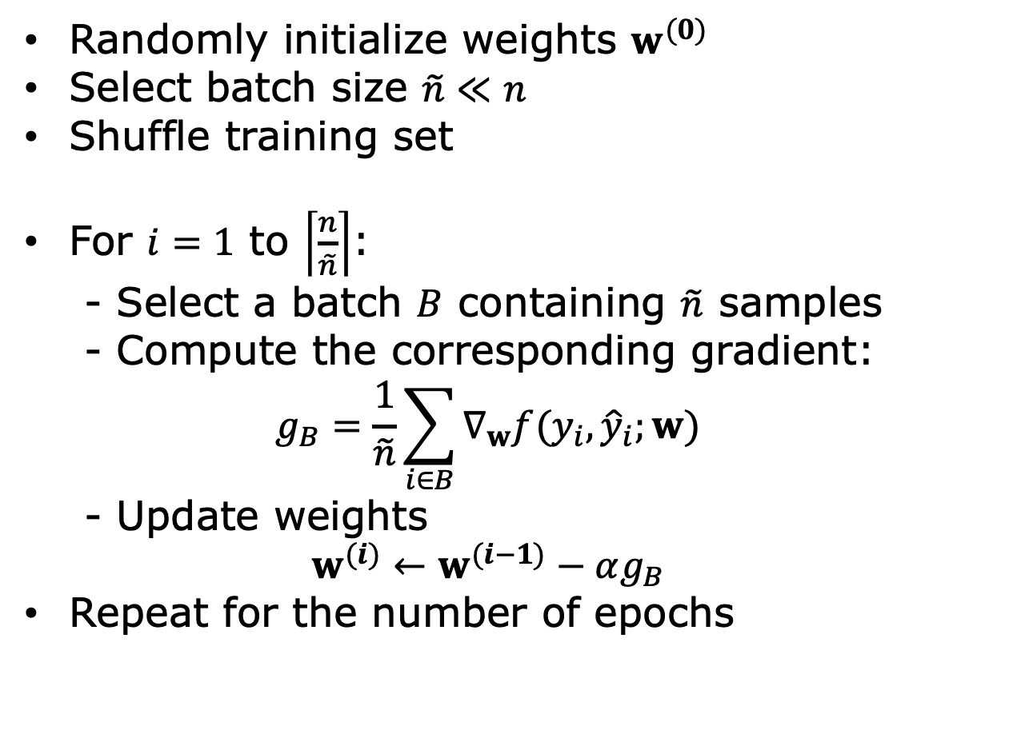
SGD. Algorithm
Randomly initialize weights $w^{(0)}$
Select batch size $\tilde{n}≪n$
Shuffle training set
For $i=1$ to $\left\lceil \frac{n}{\tilde{n}}\right\rceil$:
- Select a batch $B$ containing $\tilde{n}$ samples
- Compute the corresponding gradient:
$$g_{B}=\frac{1}{\tilde{n}}\sum_{i∈B}{∇_{w}f(y_{i},{\hat{y}}_{i};w)}$$
- Update weights
$$w^{(i)}←w^{(i−1)}−αg_{B}$$
Repeat for the number of epochs
10

Slide 11
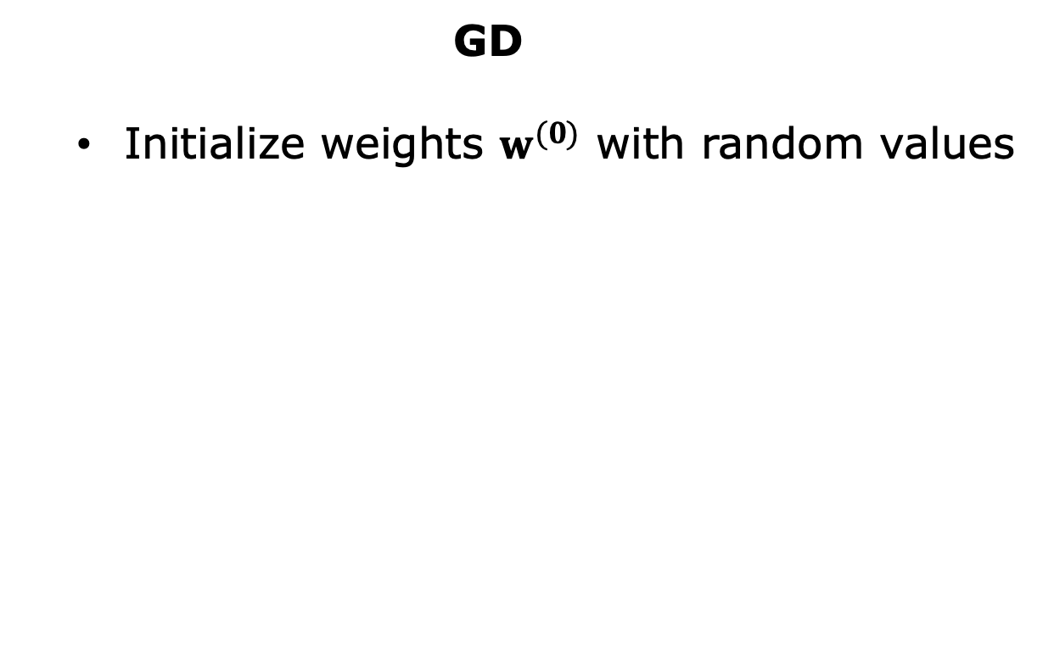
SGD vs. GD Example
GD
Initialize weights $w^{(0)}$ with random values
Training Set
1
2
3
4
5
6
7
8
10

Slide 12
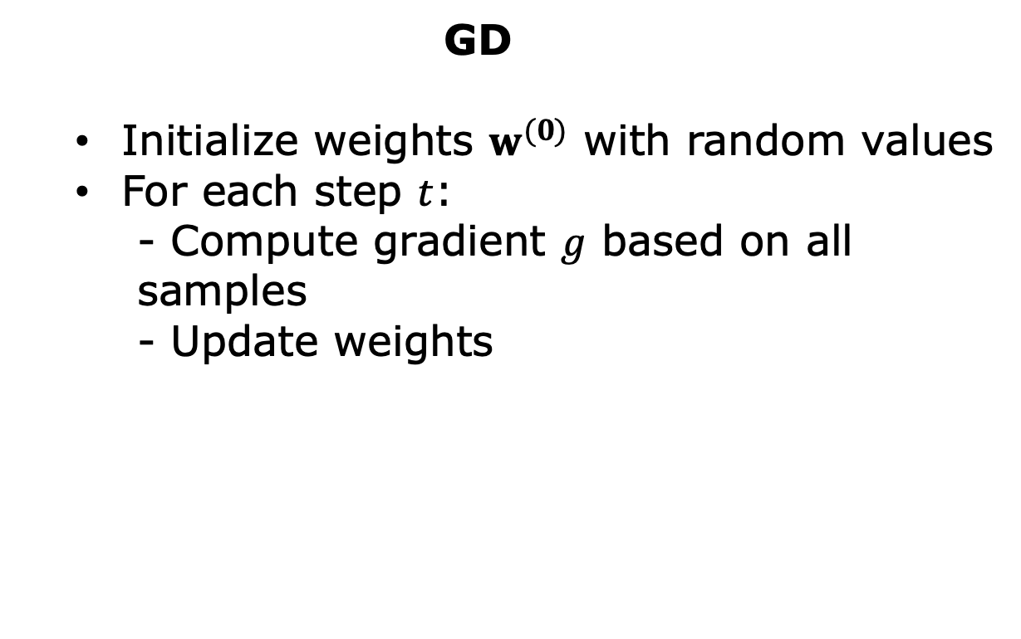

SGD vs. GD Example
GD
Initialize weights $w^{(0)}$ with random values
For each step $t$:
- Compute gradient $g$ based on all
samples
- Update weights
Training Set
1
2
3
4
5
6
7
8
$$w^{(t)}←w^{(t−1)}−α∇_{w}f(w^{(t−1)})$$
10

Slide 13
SGD vs. GD Example
GD
Initialize weights $w^{(0)}$ with random values
Training Set
1
2
3
4
5
6
7
8
10

Slide 14
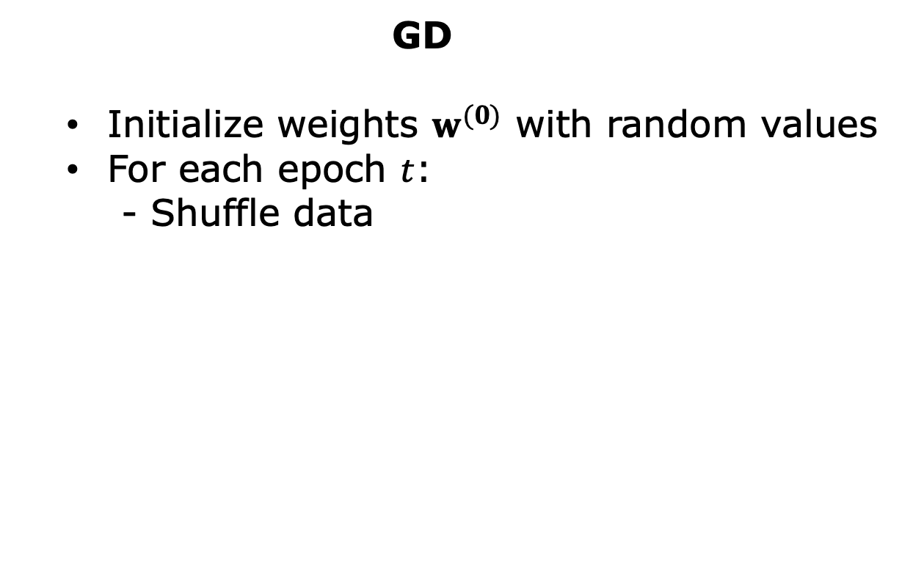
SGD vs. GD Example
GD
Initialize weights $w^{(0)}$ with random values
For each epoch $t$:
- Shuffle data
Training Set
7
5
3
2
6
8
4
1
10

Slide 15
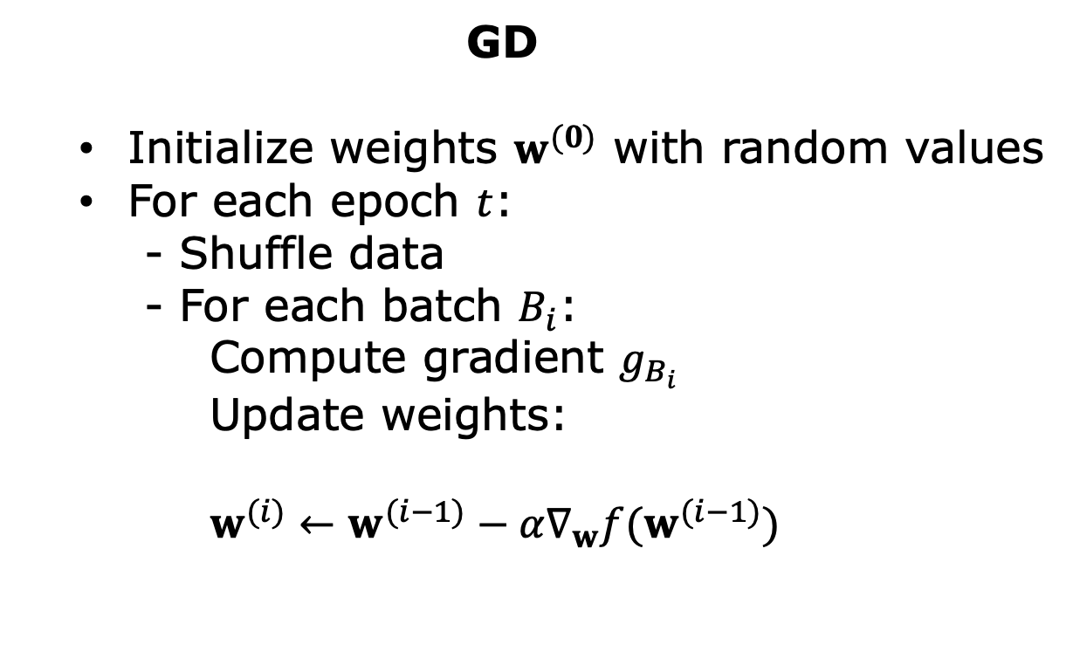
SGD vs. GD Example
GD
Initialize weights $w^{(0)}$ with random values
For each epoch $t$:
- Shuffle data
- For each batch $B_{i}$:
Compute gradient $g_{B_{i}}$
Update weights:
$w^{(i)}←w^{(i−1)}−α∇_{w}f(w^{(i−1)})$
Training Set
7
5
3
2
6
8
4
1
10

Slide 16
SGD vs. GD Example
GD
Initialize weights $w^{(0)}$ with random values
For each epoch $t$:
- Shuffle data
- For each batch $B_{i}$:
Compute gradient $g_{B_{i}}$
Update weights:
$w^{(i)}←w^{(i−1)}−α∇_{w}f(w^{(i−1)})$
Training Set
7
5
3
2
6
8
4
1
10

Slide 17
SGD vs. GD Example
GD
Initialize weights $w^{(0)}$ with random values
For each epoch $t$:
- Shuffle data
- For each batch $B_{i}$:
Compute gradient $g_{B_{i}}$
Update weights:
$w^{(i)}←w^{(i−1)}−α∇_{w}f(w^{(i−1)})$
Training Set
7
5
3
2
6
8
4
1
10

Slide 18
SGD vs. GD Example
GD
Initialize weights $w^{(0)}$ with random values
For each epoch $t$:
- Shuffle data
- For each batch $B_{i}$:
Compute gradient $g_{B_{i}}$
Update weights:
$w^{(i)}←w^{(i−1)}−α∇_{w}f(w^{(i−1)})$
Training Set
7
5
3
2
6
8
4
1
10

Slide 19
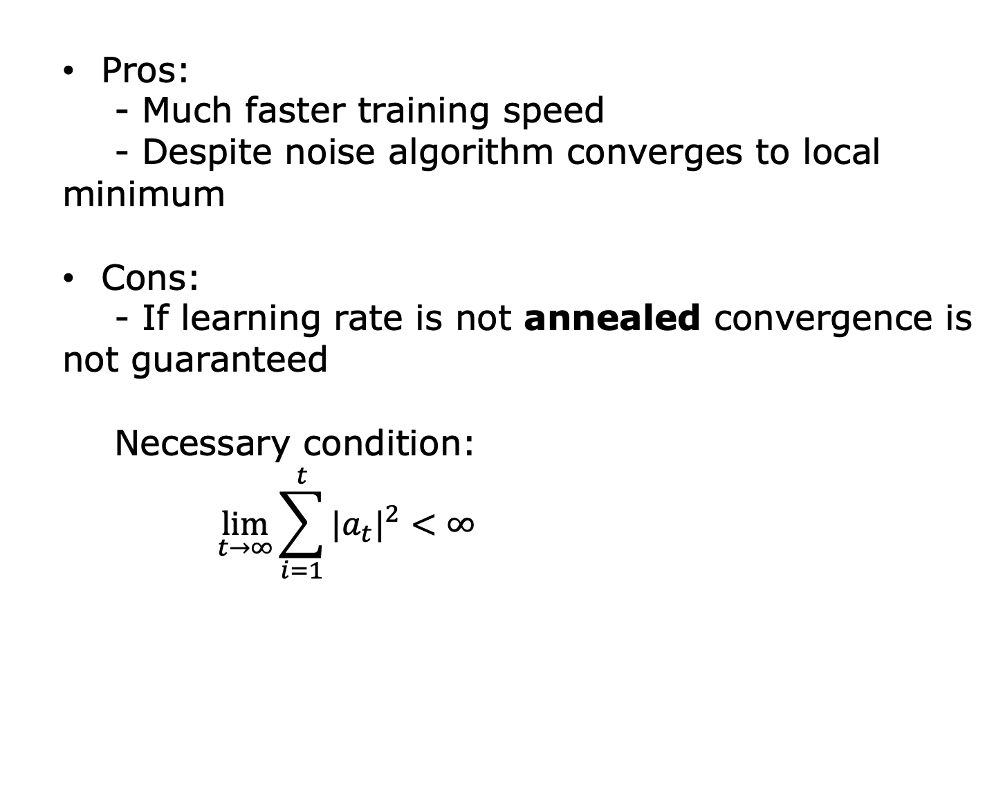
SGD Summary
Pros:
- Much faster training speed
- Despite noise algorithm converges to local
minimum
Cons:
- If learning rate is not annealed convergence is
not guaranteed
Necessary condition:
$$\lim_{t→∞}{\sum_{i=1}^{t}{{|a_{t}|}^{2}<∞}}$$
10

Slide 20

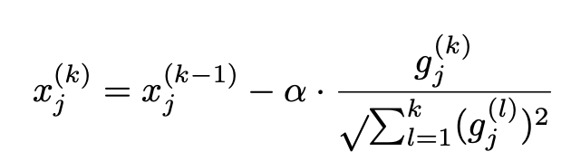
SGD Extensions. AdaGrad
Let
For each step:
Pros:
- Adaptive step size
10

Slide 21
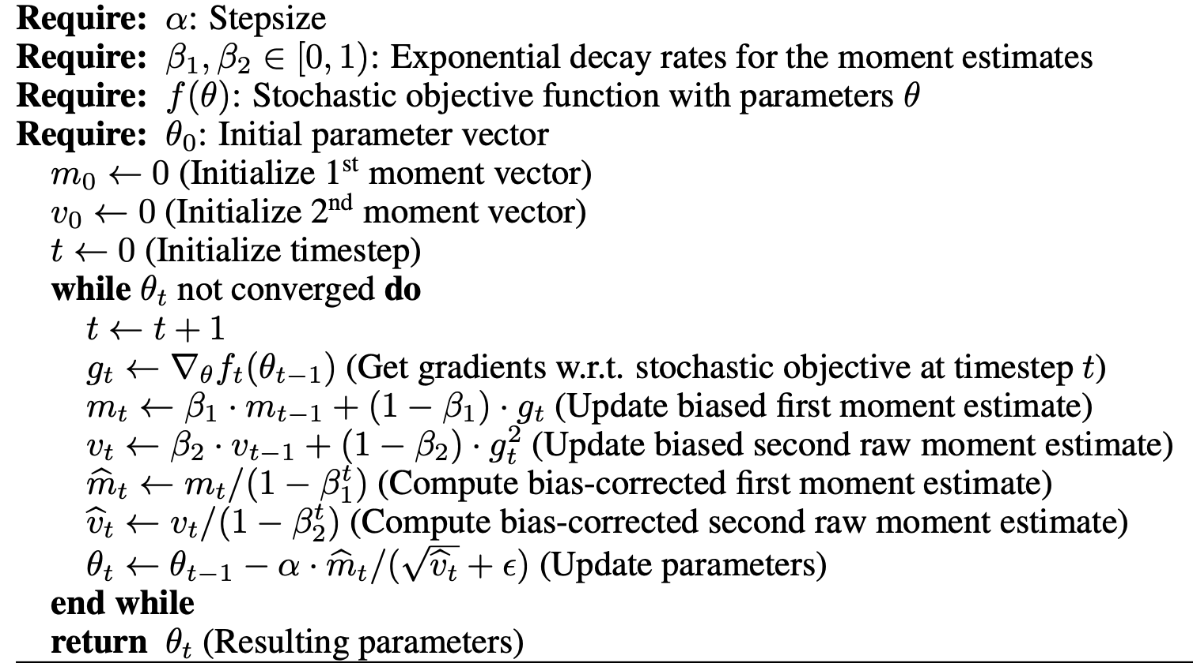
SGD Extensions. ADAM
10

Slide 22
Logistic Regression

Slide 23
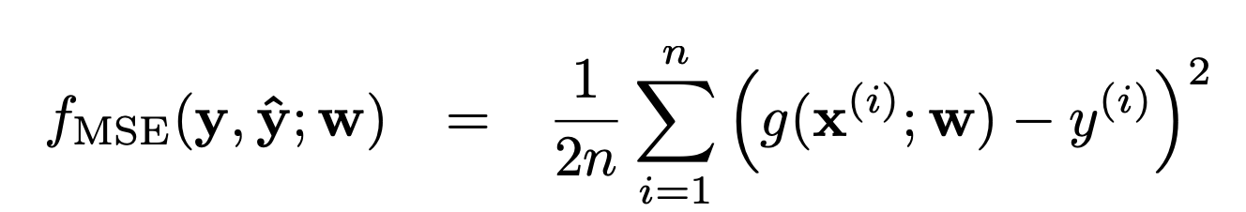

Regression Problem
$y∈\{0,1\}$
10

Slide 24
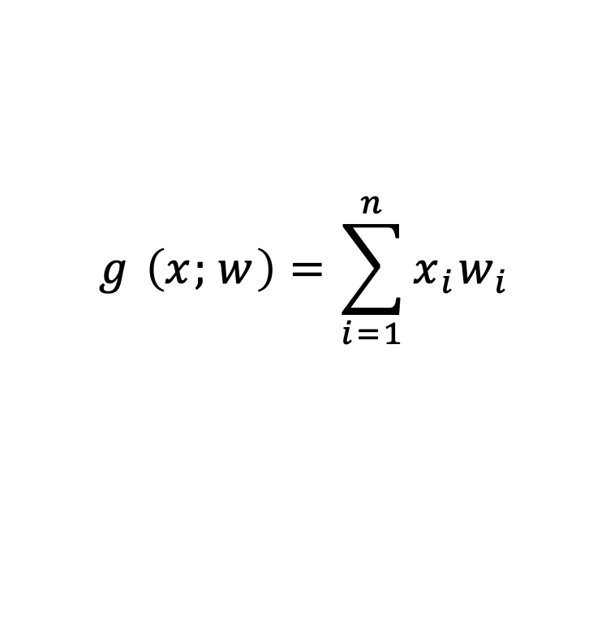
Regression Problem
$y∈\{0,1\}$
$$g \left(x;w\right)=\sum_{i=1}^{n}{x_{i}w_{i}}$$
10

Slide 25
Regression Example
10

Slide 26
Regression Example
10

Slide 27
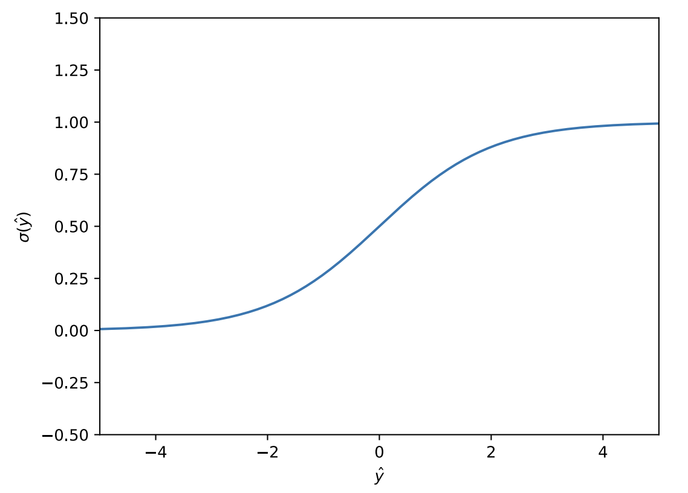
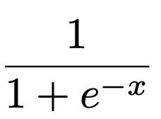
Sigmoid Function
10

Slide 28
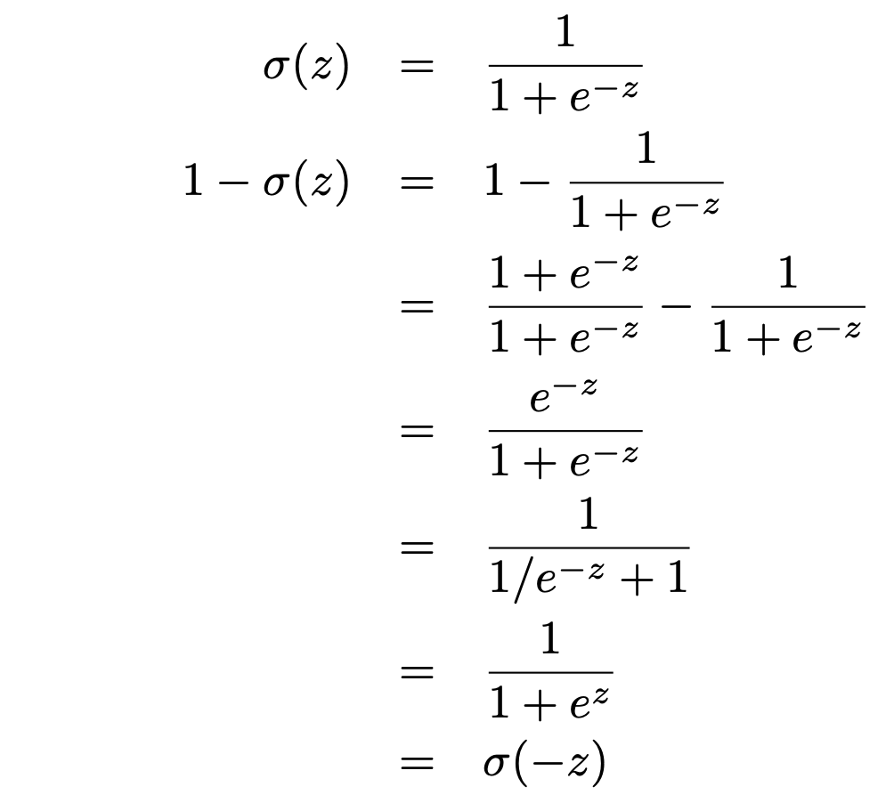
Sigmoid Function Properties
10

Slide 29
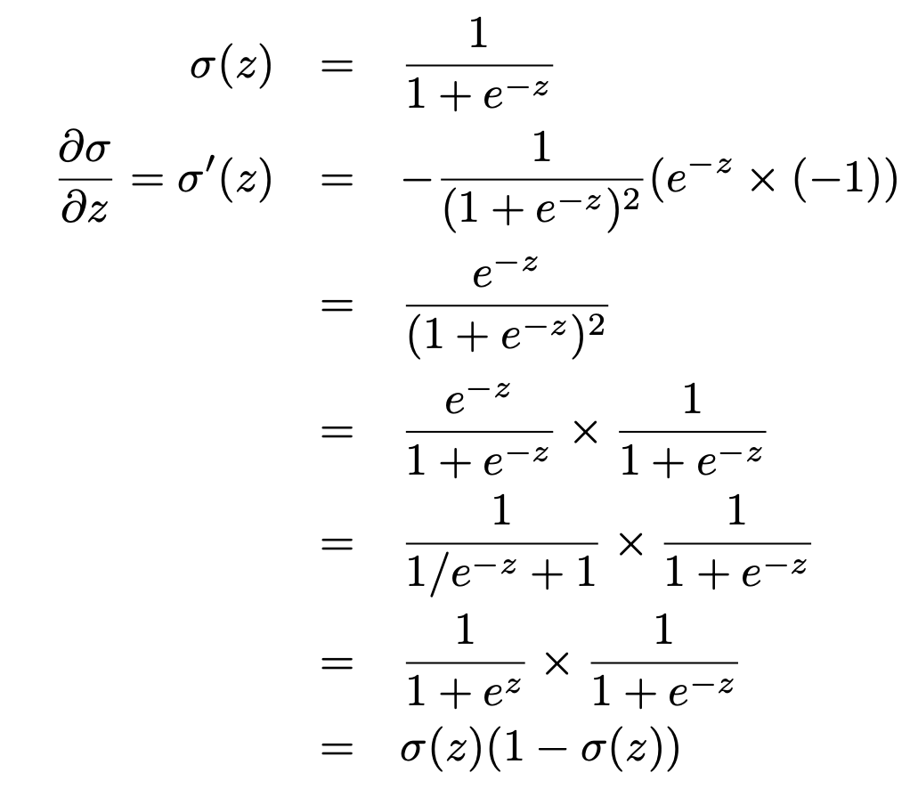
Sigmoid Function Properties
10

Slide 30
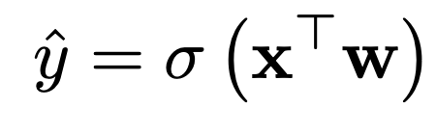
Logistic Regression
No analytical solution
Interpretation:
- Score corresponds to the prediction confidence,
Or probability of sample to belong to certain class
10

Slide 31
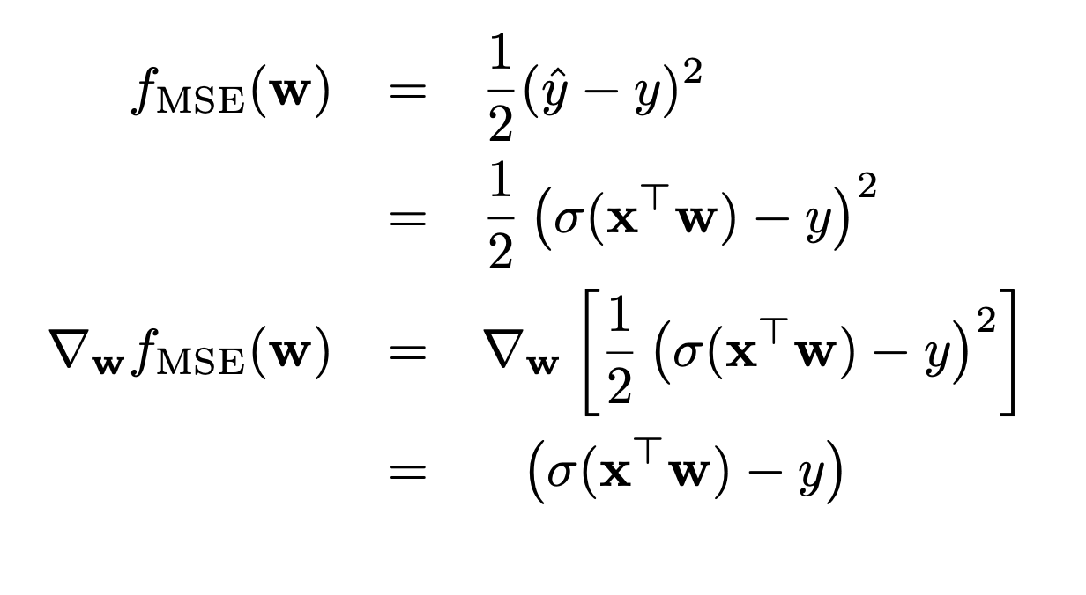
Gradient Descent
10

Slide 32
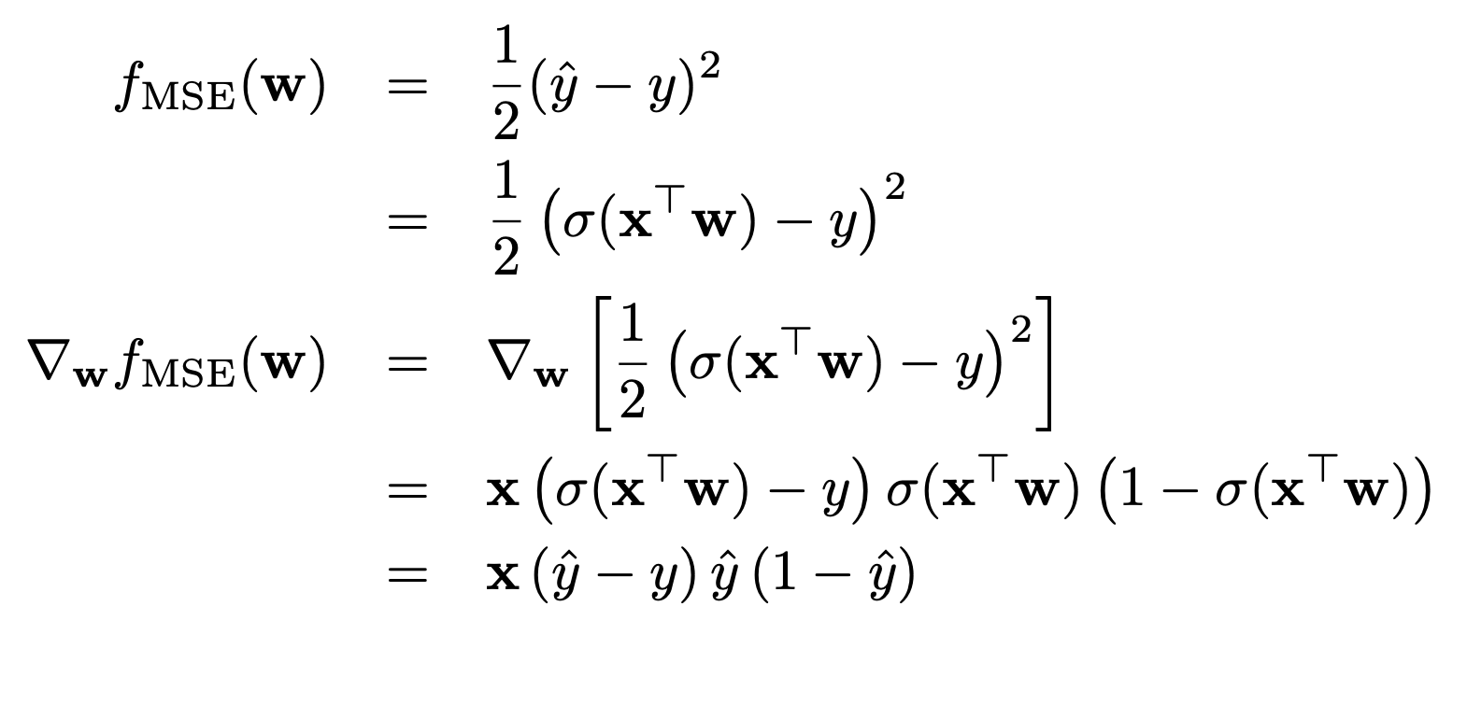
Gradient Descent
Problem:
Gradient is very close to zero
10

Slide 33
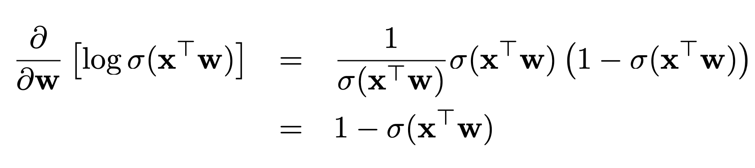
Gradient Descent
Alternative solution:
10

Slide 34


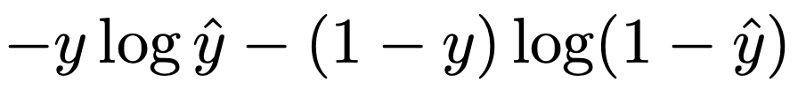
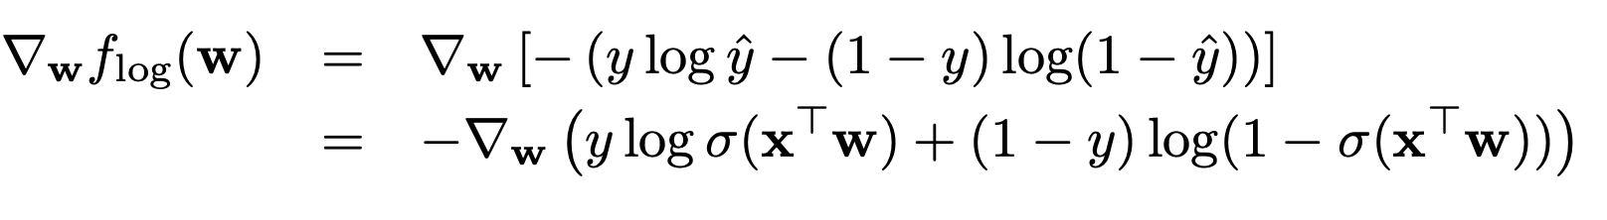
Log-Loss
10

Slide 35
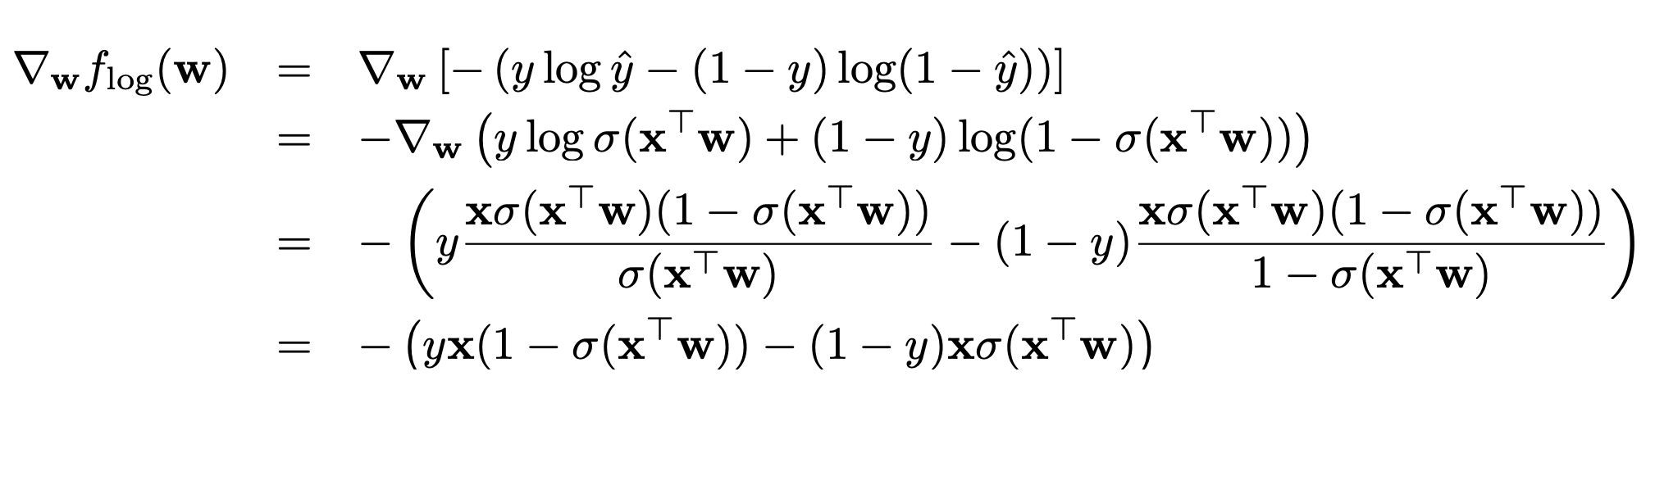
Gradient Descent
10

Slide 36
Gradient Descent
10

Slide 37
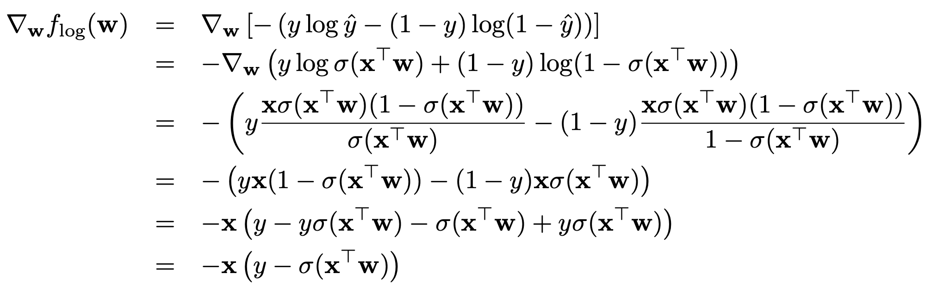
Gradient Descent
10

