Slide 1
CS584 Machine Learning
Lecture 17. Midterm and Assignments Overview
Oleksandr Narykov
onarykov@iit.edu

Slide 2
Assignment 2 Clarification
Q1. You roll two dice. What is the probability of rolling a number greater than eight if you know the following:
b) Dice 2 displays the number 5
Outcomes where the sum of the dice is larger than eight and one dice is 5:
(4,5)
(5,5)
(6,5)
23

Slide 3
Assignment 2 Clarification
Q1. You roll two dice. What is the probability of rolling a number greater than eight if you know the following:
b) Dice 2 displays the number 5
Outcomes where the sum of the dice is larger than eight and one dice is 5:
(4,5)
(5,5)
(6,5)
23

Slide 4
Midterm
Q1. You have the following dataset:
X | Y
2 | 1
3 | 4
5 | 7
Use closed-form matrix equation to compute linear regression coefficients.
23

Slide 5


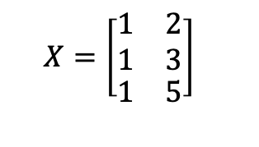

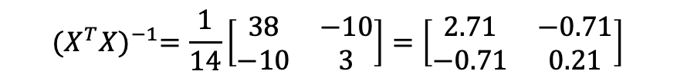

Midterm
Q1. You have the following dataset:
$$X=\left[\begin{matrix}\begin{matrix}1 \\ 1\end{matrix} & \begin{matrix}2 \\ 3\end{matrix} \\ 1 & 5\end{matrix}\right]$$
$$X^{T}X=\left[\begin{matrix}3 & 10 \\ 10 & 38\end{matrix}\right]$$
$${det⁡(X}^{T}X)=3∙38−10∙10=14$$
$${(X^{T}X)}^{−1}=\frac{1}{14}\left[\begin{matrix}38 & −10 \\ −10 & 3\end{matrix}\right]=\left[\begin{matrix}2.71 & −0.71 \\ −0.71 & 0.21\end{matrix}\right]$$
$$X^{T}Y=\left[\begin{matrix}12 \\ 49\end{matrix}\right]$$
$$w={(X^{T}X)}^{−1}X^{T}Y=\left[\begin{matrix}−2.27 \\ 1.77\end{matrix}\right]$$
23

Slide 6

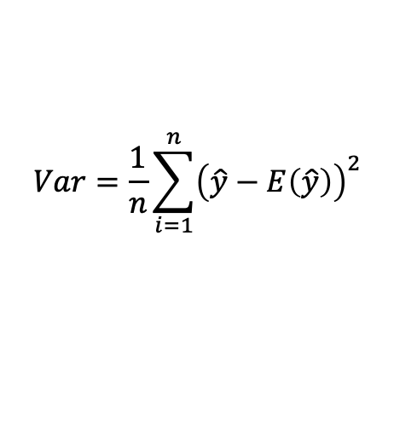
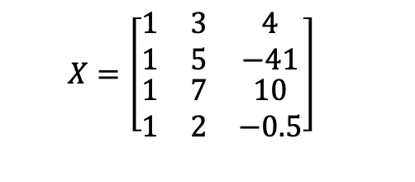

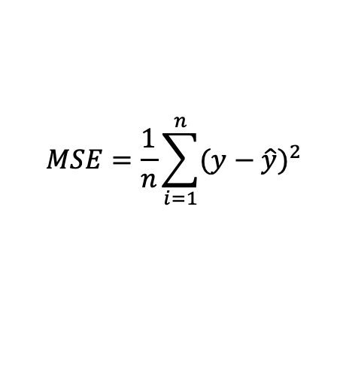

Midterm
Q2. For a model with a given weights estimate bias, variance, and MSE on a following dataset :
$$Bias=\frac{1}{n}\sum_{i=1}^{n}{\left(y−E\left(\hat{y}\right)\right)=0}$$
$$X=\left[\begin{matrix}1 & 3 & 4 \\ 1 & 5 & −41 \\ \begin{matrix}1 \\ 1\end{matrix} & \begin{matrix}7 \\ 2\end{matrix} & \begin{matrix}10 \\ −0.5\end{matrix}\end{matrix}\right]$$
$$Y=\left[\begin{matrix}4 \\ 40 \\ \begin{matrix}7 \\ 8\end{matrix}\end{matrix}\right]$$
$$w=\left[\begin{matrix}1.5 \\ \begin{matrix}2.5 \\ −1\end{matrix}\end{matrix}\right]$$
$$Var=\frac{1}{n}\sum_{i=1}^{n}{{\left(\hat{y}−E\left(\hat{y}\right)\right)}^{2}}$$
$$MSE=\frac{1}{n}\sum_{i=1}^{n}{{(y−\hat{y})}^{2}}$$
23

Slide 7
Midterm
Q2. For a model with a given weights estimate bias, variance, and MSE on a following dataset :
$$Bias=\frac{1}{n}\sum_{i=1}^{n}{\left(y−E\left(\hat{y}\right)\right)=0}$$
$$X=\left[\begin{matrix}1 & 3 & 4 \\ 1 & 5 & −41 \\ \begin{matrix}1 \\ 1\end{matrix} & \begin{matrix}7 \\ 2\end{matrix} & \begin{matrix}10 \\ −0.5\end{matrix}\end{matrix}\right]$$
$$Y=\left[\begin{matrix}4 \\ 40 \\ \begin{matrix}7 \\ 8\end{matrix}\end{matrix}\right]$$
$$w=\left[\begin{matrix}1.5 \\ \begin{matrix}2.5 \\ −1\end{matrix}\end{matrix}\right]$$
$$Var=\frac{1}{n}\sum_{i=1}^{n}{{\left(\hat{y}−E\left(\hat{y}\right)\right)}^{2}}$$
$$MSE=\frac{1}{n}\sum_{i=1}^{n}{{(y−\hat{y})}^{2}}$$
23

Slide 8
Midterm
Q3. Physicians were asked what the odds of breast cancer would be for a woman with initial assumption to have a 1% risk of cancer but who ended up with a positive mammogram result. This test accurately classifies 80% of cancerous tumors and 90% of benign tumors. 95 out of a hundred medical professionals estimated the probability of cancer to be about 75%. Do you agree? Show step-by-step solution.
23

Slide 9
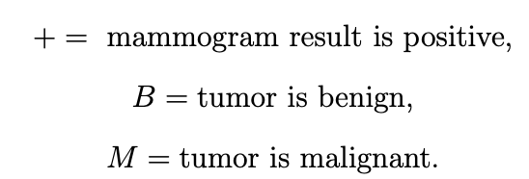





Midterm
Q3.
23

Slide 10
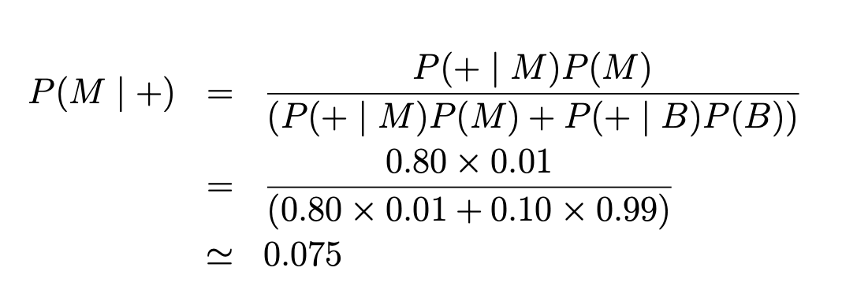
Midterm
Q3.
23

Slide 11
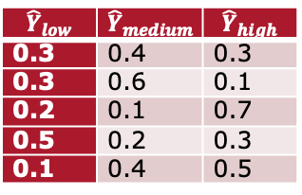
Midterm
Q4. Some model estimate pitch of the sound currently playing from persons’ facial expression.
It categorizes pitch into classes low, medium, and high. You are presented with the following logit matrix with the model’s predictions and corresponding ground truth values.
Construct confusion matrix for these results. Calculate Accuracy and Precision for each class.
$${\hat{Y}}_{low}$$ | $${\hat{Y}}_{medium}$$ | $${\hat{Y}}_{high}$$
0.3 | 0.4 | 0.3
0.3 | 0.6 | 0.1
0.2 | 0.1 | 0.7
0.5 | 0.2 | 0.3
0.1 | 0.4 | 0.5
Y
Medium
High
High
Low
Medium
23

Slide 12

Midterm
Q4. Some model estimate pitch of the sound currently playing from persons’ facial expression.
It categorizes pitch into classes low, medium, and high. You are presented with the following logit matrix with the model’s predictions and corresponding ground truth values.
Construct confusion matrix for these results. Calculate Accuracy and Precision for each class.
$${\hat{Y}}_{low}$$ | $${\hat{Y}}_{medium}$$ | $${\hat{Y}}_{high}$$
0.3 | 0.4 | 0.3
0.3 | 0.6 | 0.1
0.2 | 0.1 | 0.7
0.5 | 0.2 | 0.3
0.1 | 0.4 | 0.5
Y
Medium
High
High
Low
Medium
1 | 0 | 0
0 | 1 | 1
0 | 1 | 1
23

Slide 13
Precision
 |  | Predicted Class
 |  | Positive | Negative
Actual Class | Positive | True Positive | False Negative
 | Negative | False Positive | True Negative
𝑇𝑟𝑢𝑒 𝑃𝑜𝑠𝑖𝑡𝑖𝑣𝑒
𝑇𝑃
𝑃𝑟𝑒𝑐𝑖𝑠𝑖𝑜𝑛 =
=
𝑃𝑟𝑒𝑑𝑖𝑐𝑡𝑒𝑑 𝑃𝑜𝑠𝑖𝑡𝑖𝑣𝑒
𝑇𝑃 + 𝐹𝑃
8

Slide 14
Multiclass Confusion Matrix
 | C1 | C2 | C3 | C4 | C5
C1 | TN | TN | FP | TN | TN
C2 | TN | TN | FP | TN | TN
C3 | FN | FN | TP | FN | FN
C4 | TN | TN | FP | TN | TN
C5 | TN | TN | FP | TN | TN
12

Slide 15
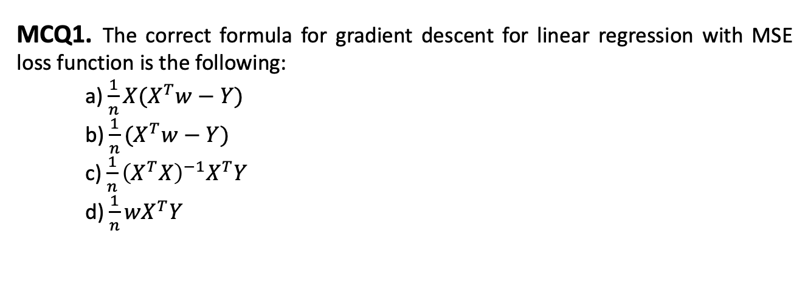
Midterm
MCQ1. The correct formula for gradient descent for linear regression with MSE loss function is the following:
a) $\frac{1}{n}X(X^{T}w−Y)$
b) $\frac{1}{n}(X^{T}w−Y)$
c) $\frac{1}{n}{\left(X^{T}X\right)}^{−1}X^{T}Y$
d) $\frac{1}{n}wX^{T}Y$
23

Slide 16
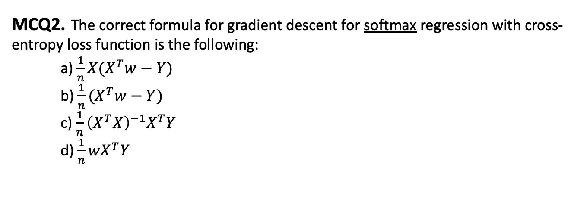
Midterm
MCQ2. The correct formula for gradient descent for softmax regression with cross-entropy loss function is the following:
a) $\frac{1}{n}X(X^{T}w−Y)$
b) $\frac{1}{n}(X^{T}w−Y)$
c) $\frac{1}{n}{\left(X^{T}X\right)}^{−1}X^{T}Y$
d) $\frac{1}{n}wX^{T}Y$
23

Slide 17
Midterm
MCQ3. Which statements are true about bagging?
a) In bagging, we choose random subsamples of the input points with replacement
b) Bagging is ineffective with linear regression because both methods are linear
c) Bagging decreases bias of the model
d) Bagging decreases variance of the model
23

Slide 18
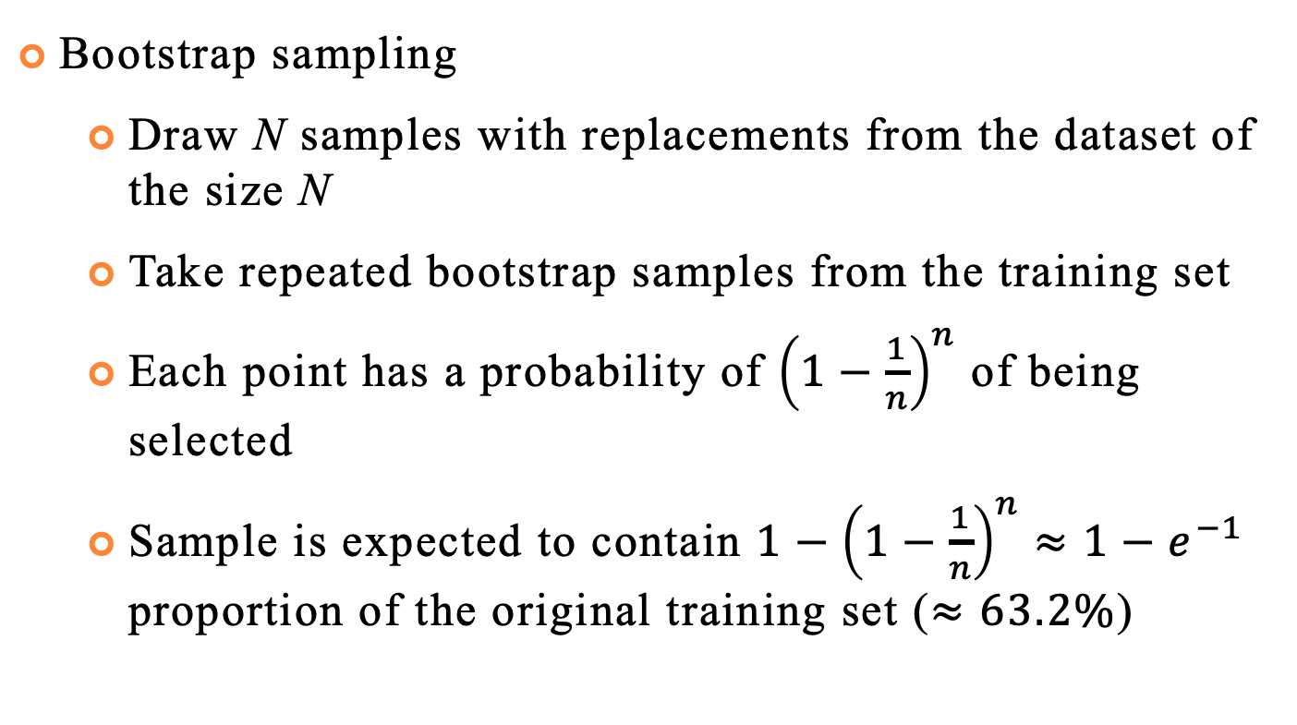
Bagging (Bootstrap Aggregation)
Bootstrap sampling
Draw N samples with replacements from the dataset of the size N
Take repeated bootstrap samples from the training set
Each point has a probability of ${\left(1−\frac{1}{n}\right)}^{n}$ of being selected
Sample is expected to contain $1−{\left(1−\frac{1}{n}\right)}^{n}≈1−e^{−1}$ proportion of the original training set ($≈63.2\%$)
39

Slide 19
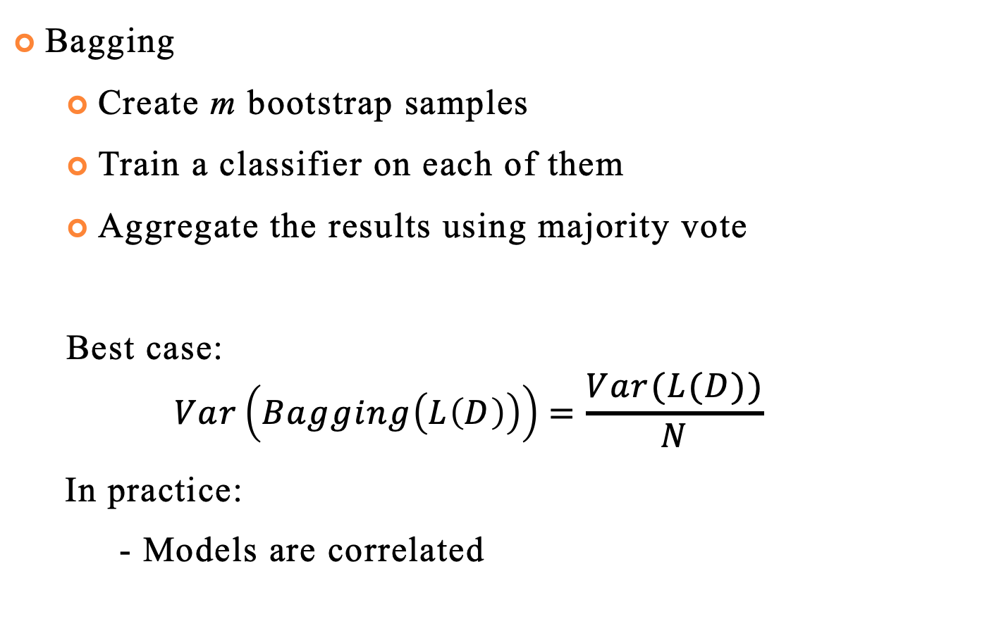
Bagging (Bootstrap Aggregation)
Bagging
Create m bootstrap samples
Train a classifier on each of them
Aggregate the results using majority vote
Best case:
$$Var\left(Bagging\left(L\left(D\right)\right)\right)=\frac{Var(L(D))}{N}$$
In practice:
- Models are correlated
39

Slide 20
Midterm
MCQ3. Which statements are true about bagging?
a) In bagging, we choose random subsamples of the input points with replacement
b) Bagging is ineffective with linear regression because both methods are linear
c) Bagging decreases bias of the model
d) Bagging decreases variance of the model
23

Slide 21
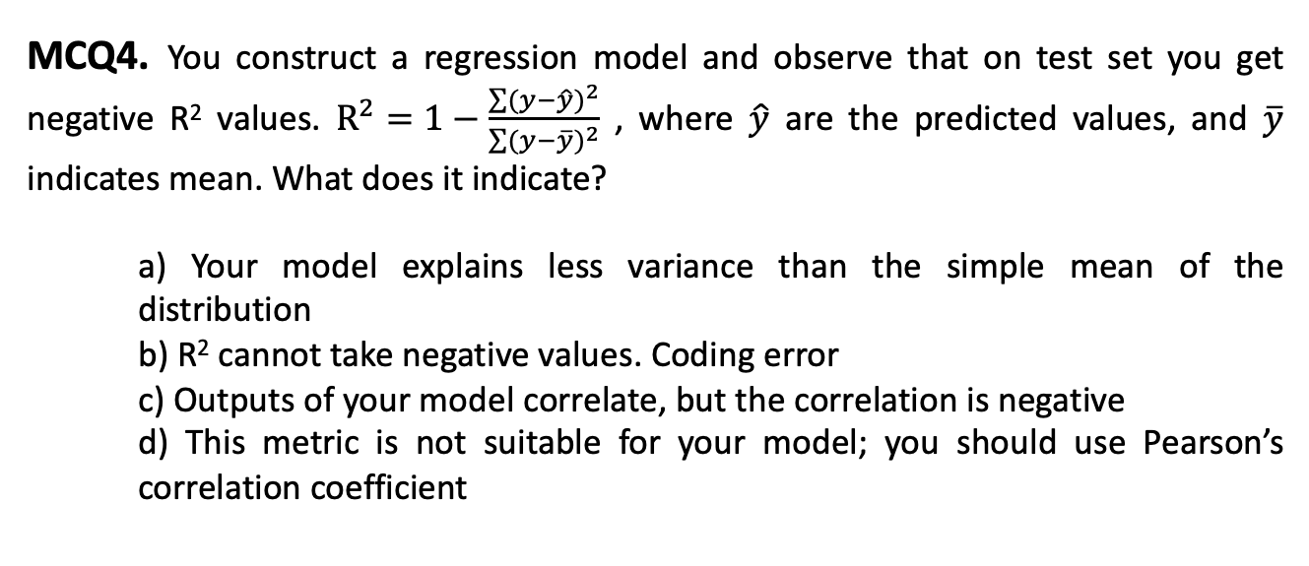
Midterm
MCQ4. You construct a regression model and observe that on test set you get negative R² values. $R^{2}=1−\frac{\sum{{(y−\hat{y})}^{2}}}{\sum{{(y−\overline{y})}^{2}}}$ , where $\hat{y}$ are the predicted values, and $\overline{y}$ indicates mean. What does it indicate?
a) Your model explains less variance than the simple mean of the distribution
b) R² cannot take negative values. Coding error
c) Outputs of your model correlate, but the correlation is negative
d) This metric is not suitable for your model; you should use Pearson’s correlation coefficient
23

Slide 22
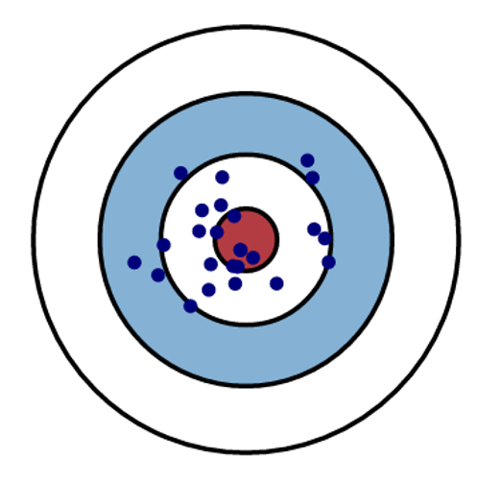
Midterm
MCQ5. Let’s consider model performance analogous to shooting practice, with bullseye being correct prediction and everything else being deviation. In terms of bias and variance, what are the characteristics of this model?
a) High bias, high variance
b) Low bias, low variance
c) Low bias, high variance
d) High bias, low variance
23

Slide 23
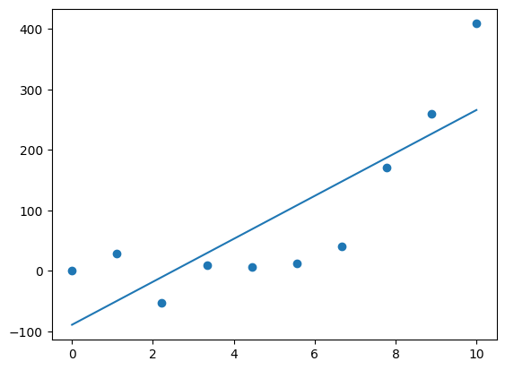
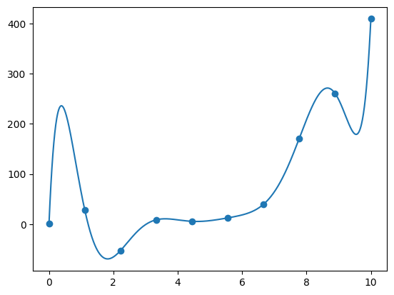
Bias / Variance Tradeoff
Making strong assumptions
Simple model
Underfitting
Allowing model to infer lots
of interdependencies in data
Very complex model
Overfitting
High Bias
High Variance

Slide 24
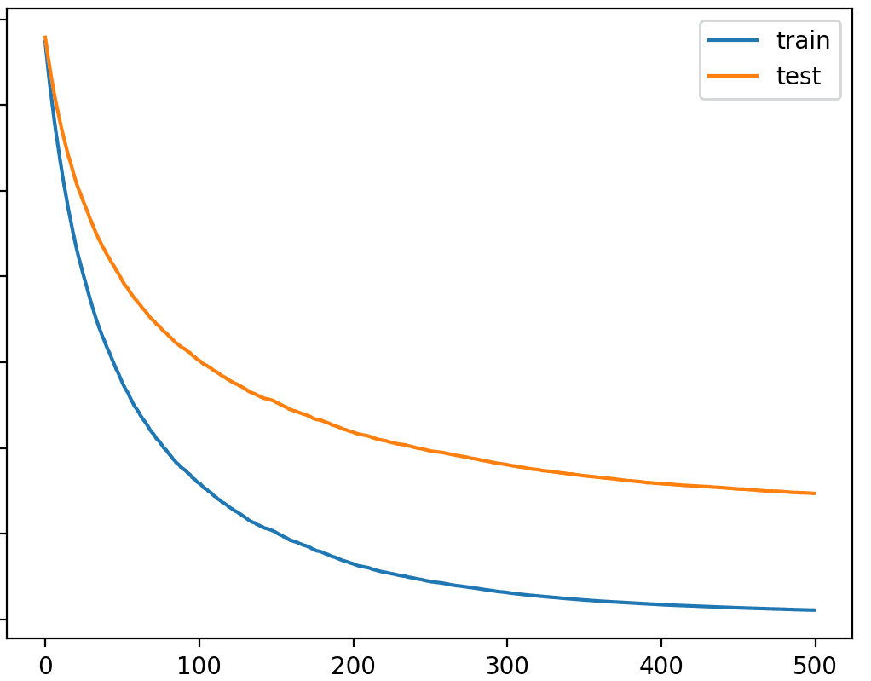
Midterm
MCQ6. You are presented with the following learning curve that indicates loss function. Remember bias / variance tradeoff charts. Y depicts loss, and X indicates model’s complexity. Which characteristics can you attribute to the model in figure at the complexity level 500?
a) Overfitting
b) Underfitting
c) Optimal value
d) Variance
23

Slide 25
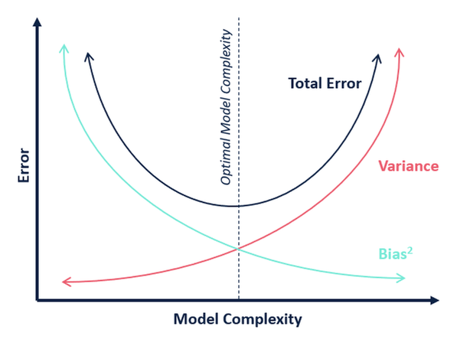
Bias / Variance Tradeoff

Slide 26
Midterm
MCQ7. Which of the following can help to avoid overfitting when training decision tree?
a) Setting a minimum number of samples in leaf nodes
b) Limiting the maximum depth of the tree
c) Reusing features over which there was a split at a higher level of the decision tree
d) Making each leaf node achieve maximum purity
23

Slide 27
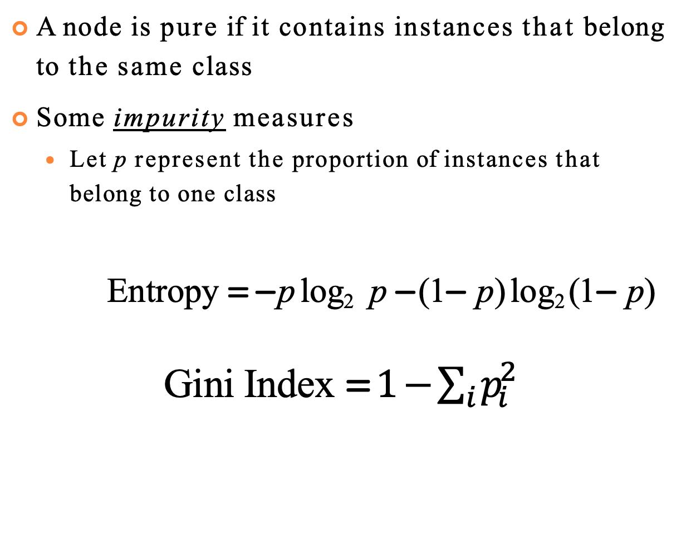
Purity
A node is pure if it contains instances that belong to the same class
Some impurity measures
Let p represent the proportion of instances that belong to one class
Entropy = − p log₂ p − (1− p) log₂ (1− p)
Gini Index =$1−\sum_{i}{p_{i}^{2}}$
18

Slide 28
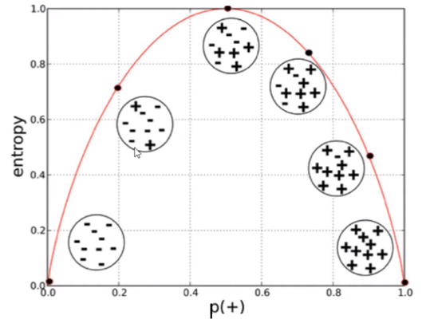
Visualization
Entropy
https://miro.medium.com/v2/resize:fit:1068/format:webp/1*vbbZdjEhxylwLj-z-qcL7w.png
18

Slide 29
Midterm
MCQ8. Which statements are true about logistic regression and softmax regression?
a) Logistic regression’s solutions are equivalent to the ones from softmax regression
b) Logistic regression’s loss function is a binary cross-entropy
c) Softmax regression trains multiple linear models simultaneously
d) Softmax regression adopts one-versus-all strategy when dealing with multiple classes
23

Slide 30
Midterm
MCQ9. Your dataset contains multiple classes and is highly imbalanced, but you want to achieve reasonably high performance on all classes. Which strategy would be the most appropriate option for cross-validation?
a) Random split
b) Grouped cross-validation
c) Stratified cross-validation
d) 60/20/20 split
23

Slide 31
Cross-Validation
Split your data into k disjoint sets
Each time, one set is the test set and the rest is the training set
Training Set
Test Set
Validation Set

Slide 32
Grouped Cross-Validation
Split your data into k folds based on a group information
No samples from the same group is present both in test and train sets
Sample 1
Group 1
Sample 2
Sample 3
Sample 4
Group 2
Test Set
Sample 5
Group 3
Sample 6
Sample 7
Group 4
Sample 8

Slide 33
Imbalanced Dataset
Dataset
Stratified CV
Follows class distribution in the dataset
Weighted sampling
Increases importance of the drugs with smaller number of experiments
Stratified
Class 1
Class 2
Class 3
Weighted
Class 1
Class 2
Class 3

Slide 34
Midterm
MCQ10. Which functions are usually used to estimate the purity of the nodes in the decision trees?
a) MSE
b) Entropy
c) Gini Index
d) Sigmoid
23

Slide 35

Class Project
Team effort, 2-3 people. Teams of one are possible, but prior discussion is needed
Recommended data source – Kaggle
Consider necessary compute time!
Timeline:
Oct 26 – teams are formed, dataset selected and registration spreadsheet filled
https://docs.google.com/spreadsheets/d/10MJH1GuE4USLNtRfGlrkqTPTciY0JMwpNkR-6XhP0p8/edit?usp=sharing
Nov 14,16 – Interim project review. Short 3-min presentation about your progress
Nov 30 – Final report is due. Approximately 5 pages + code in a publicly accessible git repository. Link should be included in the report document
39

Slide 36
Class Project Requirements
Explore dataset – correlation between features, their impact on target, independence assumptions
Try multiple visualization strategies: correlation plots, dimensionality reduction approaches – PCA, UMAP, t-SNE
Identify appropriate cross-validation strategy
Train a simple model first. Use validation set for hyperparameter tuning and/or early stopping. Analyze its performance using cross-validation. Identify potential pitfalls.
Propose ways to improve performance – e.g., feature selection, regularization, increasing model complexity. Conduct at least 2 more experiments
39

