Slide 1
CS584 Machine Learning
Lecture 20. Neural Networks. Backpropagation
Oleksandr Narykov
onarykov@iit.edu

Slide 2
Learning the Weights
Define an error (loss) function
Take its derivative with respect to the weights
Perform gradient descent
25

Slide 3
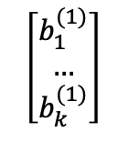
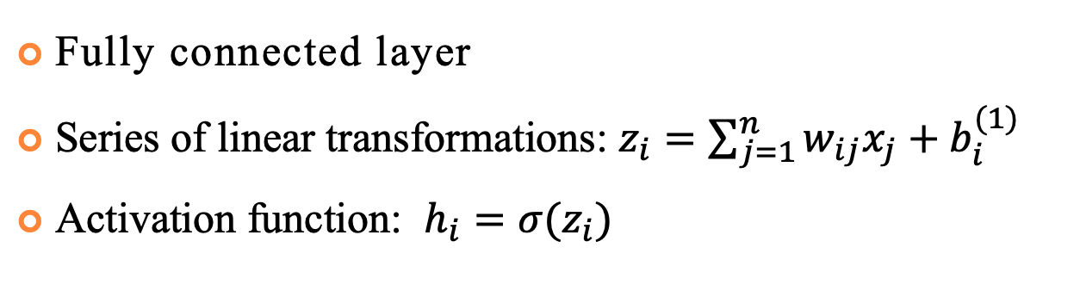
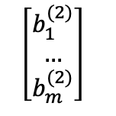
Fully Connected Neural Network
Fully connected layer
Series of linear transformations: $z_{i}=\sum_{j=1}^{n}{w_{ij}x_{j}}+b_{i}^{(1)}$
Activation function: $h_{i}=σ(z_{i})$
x₁
W⁽¹⁾
W⁽²⁾
z₁
h₁
y₁
x₂
…
…
…
y_{m}
…
z_{k}
h_{k}
$$\left[\begin{matrix}b_{1}^{(2)} \\ … \\ b_{m}^{(2)}\end{matrix}\right]$$
x_{n}
$$\left[\begin{matrix}b_{1}^{(1)} \\ … \\ b_{k}^{(1)}\end{matrix}\right]$$
25

Slide 4
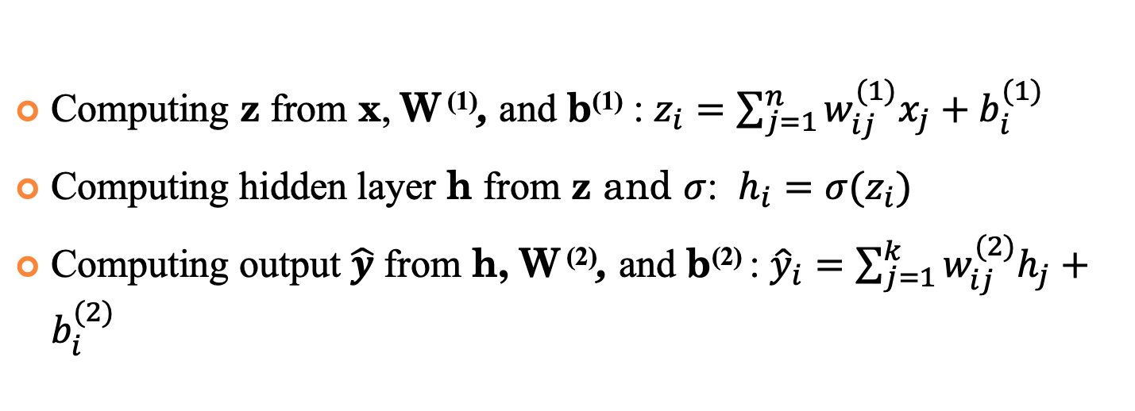
Forward Pass
Computing z from x, W ⁽¹⁾, and b⁽¹⁾ : $z_{i}=\sum_{j=1}^{n}{w_{ij}^{(1)}x_{j}}+b_{i}^{(1)}$
Computing hidden layer h from z and $σ$: $h_{i}=σ(z_{i})$
Computing output $\hat{y}$ from h, W ⁽²⁾, and b⁽²⁾ : ${\hat{y}}_{i}=\sum_{j=1}^{k}{w_{ij}^{(2)}h_{j}}+b_{i}^{(2)}$
x₁
W⁽¹⁾
W⁽²⁾
z₁
h₁
y₁
x₂
…
…
…
y_{m}
…
z_{k}
h_{k}
$$\left[\begin{matrix}b_{1}^{(2)} \\ … \\ b_{m}^{(2)}\end{matrix}\right]$$
x_{n}
$$\left[\begin{matrix}b_{1}^{(1)} \\ … \\ b_{k}^{(1)}\end{matrix}\right]$$
25

Slide 5
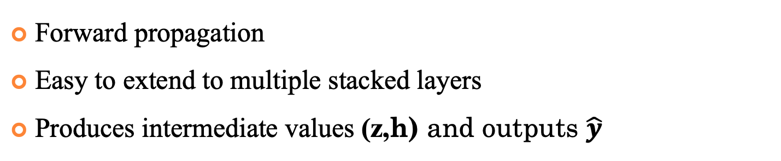
Forward Pass
Forward propagation
Easy to extend to multiple stacked layers
Produces intermediate values (z,h) and outputs $\hat{y}$
x₁
W⁽¹⁾
W⁽²⁾
z₁
h₁
y₁
x₂
…
…
…
y_{m}
…
z_{k}
h_{k}
$$\left[\begin{matrix}b_{1}^{(2)} \\ … \\ b_{m}^{(2)}\end{matrix}\right]$$
x_{n}
$$\left[\begin{matrix}b_{1}^{(1)} \\ … \\ b_{k}^{(1)}\end{matrix}\right]$$
25

Slide 6

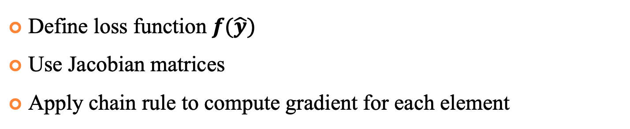
Backpropagation
Define loss function $f(\hat{y})$
Use Jacobian matrices
Apply chain rule to compute gradient for each element
x₁
W⁽¹⁾
W⁽²⁾
z₁
h₁
y₁
x₂
…
…
$$f$$
…
y_{m}
…
z_{k}
h_{k}
$$\left[\begin{matrix}b_{1}^{(2)} \\ … \\ b_{m}^{(2)}\end{matrix}\right]$$
x_{n}
$$\left[\begin{matrix}b_{1}^{(1)} \\ … \\ b_{k}^{(1)}\end{matrix}\right]$$
25

Slide 7
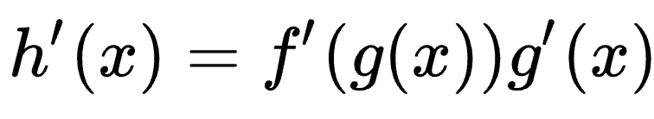
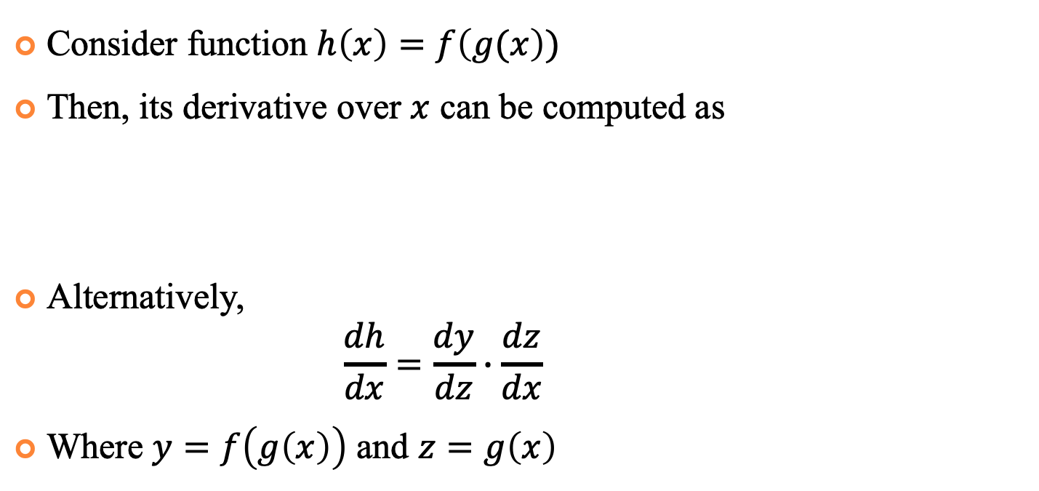
Chain Rule
Consider function $h\left(x\right)=f\left(g(x\right))$
Then, its derivative over $x$ can be computed as
Alternatively,
$$\frac{dh}{dx}=\frac{dy}{dz}∙\frac{dz}{dx}$$
Where $y=f\left(g\left(x\right)\right)$ and $z=g\left(x\right)$

Slide 8
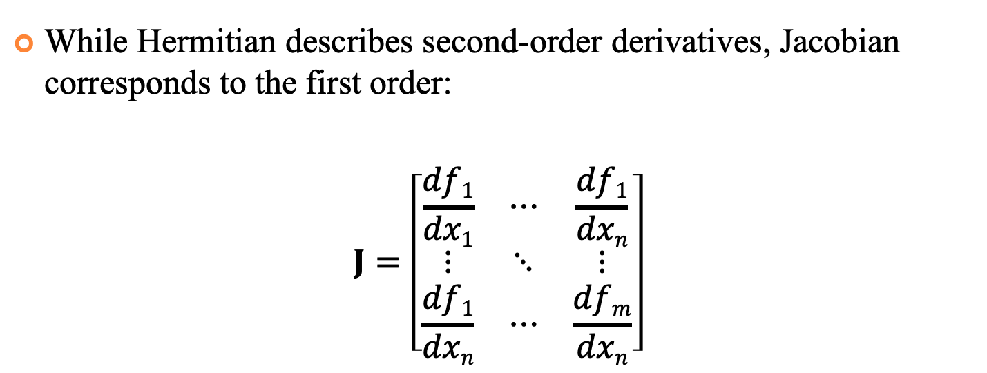
Jacobian Matrix
While Hermitian describes second-order derivatives, Jacobian corresponds to the first order:
$$J=\left[\begin{matrix}\frac{df1}{dx1} & ⋯ & \frac{df1}{dxn} \\ ⋮ & ⋱ & ⋮ \\ \frac{df1}{dxn} & ⋯ & \frac{dfm}{dxn}\end{matrix}\right]$$

Slide 9


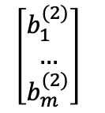
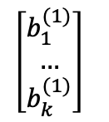
Backpropagation
Apply chain rule to the Neural Network:
$$\frac{df}{dW^{(2)}}=\frac{df}{d\hat{y}}∙\frac{d\hat{y}}{dW^{\left(2\right)}}$$
$$\frac{df}{db^{(2)}}=\frac{df}{d\hat{y}}∙\frac{d\hat{y}}{db^{(2)}}$$
x₁
W⁽¹⁾
W⁽²⁾
z₁
h₁
y₁
x₂
…
…
…
$$f$$
y_{m}
…
z_{k}
h_{k}
x_{n}
$$\left[\begin{matrix}b_{1}^{(2)} \\ … \\ b_{m}^{(2)}\end{matrix}\right]$$
$$\left[\begin{matrix}b_{1}^{(1)} \\ … \\ b_{k}^{(1)}\end{matrix}\right]$$
25

Slide 10

Backpropagation
$$\frac{df}{dW^{(2)}}=\frac{df}{d\hat{y}}∙\frac{d\hat{y}}{dW^{\left(2\right)}}$$
$$\frac{df}{db^{(2)}}=\frac{df}{d\hat{y}}∙\frac{d\hat{y}}{db^{(2)}}$$
$$\frac{df}{dW^{(1)}}=\frac{df}{d\hat{y}}∙\frac{d\hat{y}}{dh}∙\frac{dh}{dz}∙\frac{dz}{dW^{\left(1\right)}}$$
$$\frac{df}{db^{(1)}}=\frac{df}{d\hat{y}}∙\frac{d\hat{y}}{dh}∙\frac{dh}{dz}∙\frac{d\hat{y}}{db^{(1)}}$$
x₁
W⁽¹⁾
W⁽²⁾
z₁
h₁
y₁
x₂
…
…
…
$$f$$
y_{m}
…
z_{k}
h_{k}
x_{n}
$$\left[\begin{matrix}b_{1}^{(2)} \\ … \\ b_{m}^{(2)}\end{matrix}\right]$$
$$\left[\begin{matrix}b_{1}^{(1)} \\ … \\ b_{k}^{(1)}\end{matrix}\right]$$
25

Slide 11

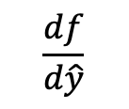

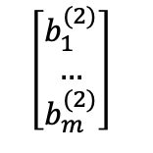
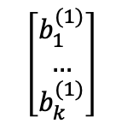
Backpropagation
$$\frac{df}{dW^{(2)}}=\frac{df}{d\hat{y}}$$
x₁
W⁽¹⁾
W⁽²⁾
$$\frac{df}{d\hat{y}}$$
z₁
h₁
y₁
x₂
…
$$f$$
…
…
y_{m}
…
z_{k}
h_{k}
$$\left[\begin{matrix}b_{1}^{(2)} \\ … \\ b_{m}^{(2)}\end{matrix}\right]$$
x_{n}
$$\left[\begin{matrix}b_{1}^{(1)} \\ … \\ b_{k}^{(1)}\end{matrix}\right]$$
25

Slide 12

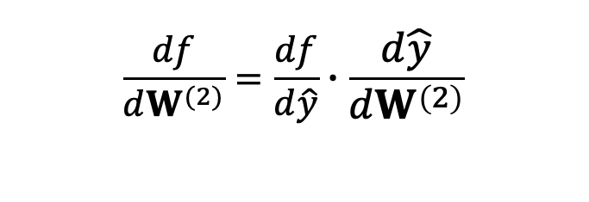
Backpropagation
$$\frac{df}{dW^{(2)}}=\frac{df}{d\hat{y}}∙\frac{d\hat{y}}{dW^{\left(2\right)}}$$
x₁
W⁽¹⁾
W⁽²⁾
$$\frac{df}{d\hat{y}}$$
z₁
h₁
y₁
x₂
$$\frac{d\hat{y}}{dW^{\left(2\right)}}$$
$$f$$
…
…
…
y_{m}
…
z_{k}
h_{k}
$$\left[\begin{matrix}b_{1}^{(2)} \\ … \\ b_{m}^{(2)}\end{matrix}\right]$$
x_{n}
$$\left[\begin{matrix}b_{1}^{(1)} \\ … \\ b_{k}^{(1)}\end{matrix}\right]$$
25

Slide 13
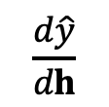
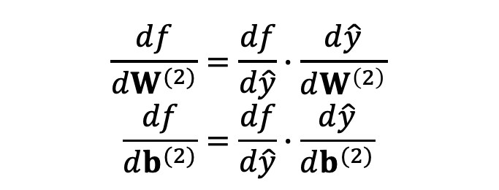
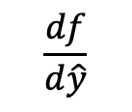
Backpropagation
$$\frac{df}{dW^{(2)}}=\frac{df}{d\hat{y}}∙\frac{d\hat{y}}{dW^{\left(2\right)}}$$
$$\frac{df}{db^{(2)}}=\frac{df}{d\hat{y}}∙\frac{d\hat{y}}{db^{(2)}}$$
x₁
W⁽¹⁾
W⁽²⁾
z₁
h₁
y₁
x₂
$$\frac{d\hat{y}}{dh}$$
$$f$$
…
…
…
$$\frac{df}{d\hat{y}}$$
y_{m}
…
z_{k}
h_{k}
$$\left[\begin{matrix}b_{1}^{(2)} \\ … \\ b_{m}^{(2)}\end{matrix}\right]$$
x_{n}
$$\left[\begin{matrix}b_{1}^{(1)} \\ … \\ b_{k}^{(1)}\end{matrix}\right]$$
25

Slide 14
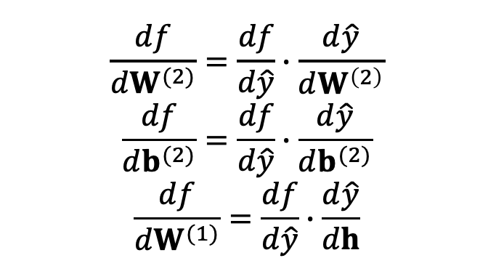
Backpropagation
$$\frac{df}{dW^{(2)}}=\frac{df}{d\hat{y}}∙\frac{d\hat{y}}{dW^{\left(2\right)}}$$
$$\frac{df}{db^{(2)}}=\frac{df}{d\hat{y}}∙\frac{d\hat{y}}{db^{(2)}}$$
$$\frac{df}{dW^{(1)}}=\frac{df}{d\hat{y}}∙\frac{d\hat{y}}{dh}$$
x₁
W⁽¹⁾
W⁽²⁾
z₁
h₁
y₁
x₂
$$\frac{d\hat{y}}{dh}$$
$$f$$
…
…
…
$$\frac{df}{d\hat{y}}$$
y_{m}
…
z_{k}
h_{k}
$$\left[\begin{matrix}b_{1}^{(2)} \\ … \\ b_{m}^{(2)}\end{matrix}\right]$$
x_{n}
$$\left[\begin{matrix}b_{1}^{(1)} \\ … \\ b_{k}^{(1)}\end{matrix}\right]$$
25

Slide 15
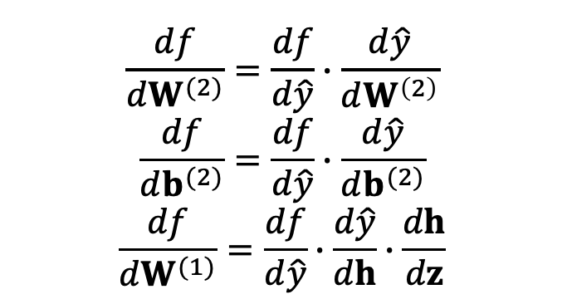
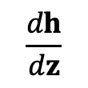
Backpropagation
$$\frac{df}{dW^{(2)}}=\frac{df}{d\hat{y}}∙\frac{d\hat{y}}{dW^{\left(2\right)}}$$
$$\frac{df}{db^{(2)}}=\frac{df}{d\hat{y}}∙\frac{d\hat{y}}{db^{(2)}}$$
$$\frac{df}{dW^{(1)}}=\frac{df}{d\hat{y}}∙\frac{d\hat{y}}{dh}∙\frac{dh}{dz}$$
x₁
W⁽¹⁾
W⁽²⁾
z₁
h₁
y₁
x₂
$$\frac{dh}{dz}$$
$$\frac{d\hat{y}}{dh}$$
$$f$$
…
…
…
$$\frac{df}{d\hat{y}}$$
y_{m}
…
z_{k}
h_{k}
$$\left[\begin{matrix}b_{1}^{(2)} \\ … \\ b_{m}^{(2)}\end{matrix}\right]$$
x_{n}
$$\left[\begin{matrix}b_{1}^{(1)} \\ … \\ b_{k}^{(1)}\end{matrix}\right]$$
25

Slide 16
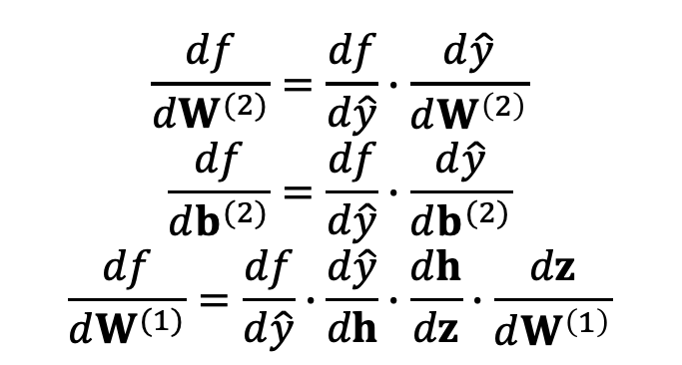
Backpropagation
$$\frac{df}{dW^{(2)}}=\frac{df}{d\hat{y}}∙\frac{d\hat{y}}{dW^{\left(2\right)}}$$
$$\frac{df}{db^{(2)}}=\frac{df}{d\hat{y}}∙\frac{d\hat{y}}{db^{(2)}}$$
$$\frac{df}{dW^{(1)}}=\frac{df}{d\hat{y}}∙\frac{d\hat{y}}{dh}∙\frac{dh}{dz}∙\frac{dz}{dW^{\left(1\right)}}$$
x₁
W⁽¹⁾
W⁽²⁾
z₁
h₁
y₁
x₂
$$\frac{dh}{dz}$$
$$\frac{d\hat{y}}{dh}$$
$$f$$
…
…
…
$$\frac{df}{d\hat{y}}$$
y_{m}
…
z_{k}
h_{k}
$$\left[\begin{matrix}b_{1}^{(2)} \\ … \\ b_{m}^{(2)}\end{matrix}\right]$$
x_{n}
$$\left[\begin{matrix}b_{1}^{(1)} \\ … \\ b_{k}^{(1)}\end{matrix}\right]$$
25

Slide 17
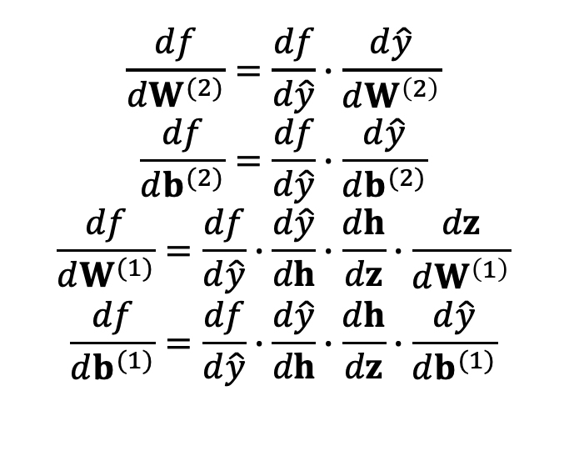
Backpropagation
$$\frac{df}{dW^{(2)}}=\frac{df}{d\hat{y}}∙\frac{d\hat{y}}{dW^{\left(2\right)}}$$
$$\frac{df}{db^{(2)}}=\frac{df}{d\hat{y}}∙\frac{d\hat{y}}{db^{(2)}}$$
$$\frac{df}{dW^{(1)}}=\frac{df}{d\hat{y}}∙\frac{d\hat{y}}{dh}∙\frac{dh}{dz}∙\frac{dz}{dW^{\left(1\right)}}$$
$$\frac{df}{db^{(1)}}=\frac{df}{d\hat{y}}∙\frac{d\hat{y}}{dh}∙\frac{dh}{dz}∙\frac{d\hat{y}}{db^{(1)}}$$
x₁
W⁽¹⁾
W⁽²⁾
z₁
h₁
y₁
x₂
$$\frac{dh}{dz}$$
$$\frac{d\hat{y}}{dh}$$
$$f$$
…
…
…
$$\frac{df}{d\hat{y}}$$
y_{m}
…
z_{k}
h_{k}
$$\left[\begin{matrix}b_{1}^{(2)} \\ … \\ b_{m}^{(2)}\end{matrix}\right]$$
x_{n}
$$\left[\begin{matrix}b_{1}^{(1)} \\ … \\ b_{k}^{(1)}\end{matrix}\right]$$
25

Slide 18
Some Error/Loss Functions
Classification: log-loss, cross entropy, negative CLL
− 1 − 𝑡 × 𝑙𝑛 1 − 𝑦 − 𝑡 × 𝑙𝑛 𝑦
t: the true target value (0/1)
y: probability of class 1
Regression: squared error
1
𝑡 − 𝑦
2
2
t: the true target value
y: the predicted value
26

Slide 19
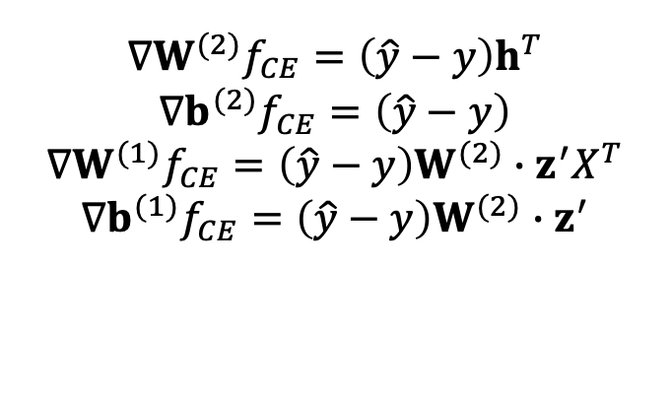
Cross-Entropy Gradients
$$∇W^{(2)}f_{CE}=\left(\hat{y}−y\right)h^{T}$$
$$∇b^{(2)}f_{CE}=\left(\hat{y}−y\right)$$
$$∇W^{(1)}f_{CE}=\left(\hat{y}−y\right)W^{(2)}∙z^{′}X^{T}$$
$$∇b^{(1)}f_{CE}=\left(\hat{y}−y\right)W^{(2)}∙z^{′}$$
x₁
W⁽¹⁾
W⁽²⁾
z₁
h₁
y₁
x₂
$$\frac{dh}{dz}$$
$$\frac{d\hat{y}}{dh}$$
$$f$$
…
…
…
$$\frac{df}{d\hat{y}}$$
y_{m}
…
z_{k}
h_{k}
$$\left[\begin{matrix}b_{1}^{(2)} \\ … \\ b_{m}^{(2)}\end{matrix}\right]$$
x_{n}
$$\left[\begin{matrix}b_{1}^{(1)} \\ … \\ b_{k}^{(1)}\end{matrix}\right]$$
25

Slide 20
Derivatives of the Activation Functions
f is the activation function, h is the weighted sum of the incoming signals
f(z(x)) ≡ binary sigmoid
𝜕𝑓 z(𝑥) 𝜕z(𝑥)

= 𝑓 z(𝑥) × 1 − 𝑓 z(𝑥) ×
𝜕𝑥 𝜕𝑥
f(z(x)) ≡ tanh
𝜕𝑓 z(𝑥)
= 1 + 𝑓 z(𝑥) × 1 − 𝑓 z(𝑥) ×
𝜕z(𝑥)

𝜕𝑥
𝜕𝑥
28

Slide 21
Autograd
The architecture of the Neural Networks changes quite frequently
Optimization steps can be this flexible!
Gradients can be computed automatically
Autograd is a PyTorch module responsible for computational steps and computing derivatives
Simplified version for getting familiar with the concept: https://github.com/karpathy/micrograd
28

Slide 22
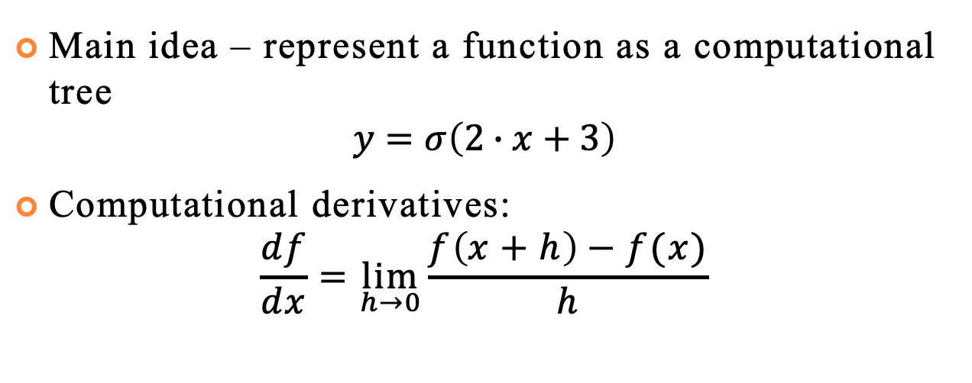
Autograd
Main idea – represent a function as a computational tree
$$y=σ\left(2∙x+3\right)$$
Computational derivatives:
$$\frac{df}{dx}=\lim_{h→0}{\frac{f\left(x+h\right)−f(x)}{h}}$$
28

Slide 23
Autograd
Main idea – represent a function as a computational tree
$$y=σ\left(2∙x+3\right)$$
Computational derivatives:
$$\frac{df}{dx}=\lim_{h→0}{\frac{f\left(x+h\right)−f(x)}{h}}$$
2
x
3
*
+
𝜎
28
y

Slide 24
Overfitting
Neural networks are powerful tools
Even with a single hidden layer, they are “universal approximators”, i.e., they can approximate arbitrary functions arbitrarily close
Therefore, it is very easy to overfit them
To prevent overfitting, utilize
Domain knowledge
Shared parameters
Validation data
Regularization
Dropout
29

Slide 25
Weight Initialization
Neural networks are non-convex ML model
Because of this, initial values of the weights and biases play a significant role
Model may get stuck in the local minimum
29

Slide 26
Weight Initialization
Neural networks are non-convex ML model
Because of this, initial values of the weights and biases play a significant role
Model may get stuck in the local minimum
29

Slide 27
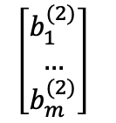
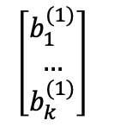

Weight Initialization
Consider fully-connected neural network initialized with zero weights and biases
What happens when we apply gradient descent? Let’s consider ReLU activation function
x₁
W⁽¹⁾
W⁽²⁾
z₁
h₁
y₁
x₂
…
…
…
$$f$$
y_{m}
…
z_{k}
h_{k}
x_{n}
$$\left[\begin{matrix}b_{1}^{(2)} \\ … \\ b_{m}^{(2)}\end{matrix}\right]$$
$$\left[\begin{matrix}b_{1}^{(1)} \\ … \\ b_{k}^{(1)}\end{matrix}\right]$$
29

Slide 28
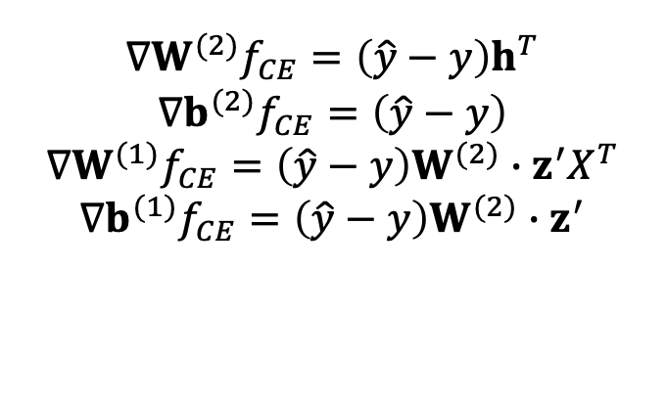
Weight Initialization
$$∇W^{(2)}f_{CE}=\left(\hat{y}−y\right)h^{T}$$
$$∇b^{(2)}f_{CE}=\left(\hat{y}−y\right)$$
$$∇W^{(1)}f_{CE}=\left(\hat{y}−y\right)W^{(2)}∙z^{′}X^{T}$$
$$∇b^{(1)}f_{CE}=\left(\hat{y}−y\right)W^{(2)}∙z^{′}$$
x₁
W⁽¹⁾
W⁽²⁾
z₁
h₁
y₁
x₂
…
…
…
$$f$$
y_{m}
…
z_{k}
h_{k}
x_{n}
$$\left[\begin{matrix}b_{1}^{(2)} \\ … \\ b_{m}^{(2)}\end{matrix}\right]$$
$$\left[\begin{matrix}b_{1}^{(1)} \\ … \\ b_{k}^{(1)}\end{matrix}\right]$$
29

Slide 29
Weight Initialization
Zero weight initialization will make algorithm stuck in local minimum, never changing its value
x₁
W⁽¹⁾
W⁽²⁾
z₁
h₁
y₁
x₂
…
…
…
$$f$$
y_{m}
…
z_{k}
h_{k}
x_{n}
$$\left[\begin{matrix}b_{1}^{(2)} \\ … \\ b_{m}^{(2)}\end{matrix}\right]$$
$$\left[\begin{matrix}b_{1}^{(1)} \\ … \\ b_{k}^{(1)}\end{matrix}\right]$$
29

Slide 30
Weight Initialization
Consider W⁽¹⁾ is 0, b⁽¹⁾ is 0
W⁽²⁾, b⁽²⁾ are non-zero
x₁
W⁽¹⁾
W⁽²⁾
z₁
h₁
y₁
x₂
…
…
…
$$f$$
y_{m}
…
z_{k}
h_{k}
x_{n}
$$\left[\begin{matrix}b_{1}^{(2)} \\ … \\ b_{m}^{(2)}\end{matrix}\right]$$
$$\left[\begin{matrix}b_{1}^{(1)} \\ … \\ b_{k}^{(1)}\end{matrix}\right]$$
29

Slide 31
Weight Initialization
Consider W⁽²⁾ is 0, b⁽²⁾ is 0
W⁽¹⁾, b⁽¹⁾ are non-zero
x₁
W⁽¹⁾
W⁽²⁾
z₁
h₁
y₁
x₂
…
…
…
$$f$$
y_{m}
…
z_{k}
h_{k}
x_{n}
$$\left[\begin{matrix}b_{1}^{(2)} \\ … \\ b_{m}^{(2)}\end{matrix}\right]$$
$$\left[\begin{matrix}b_{1}^{(1)} \\ … \\ b_{k}^{(1)}\end{matrix}\right]$$
29
Notes:
Since W(2)=0, then g=0. Hence, = 0. •
However, h is non-zero. Hence, is nonzero => will change. •
During the next gradient update, g is non-zero => W(1), b(1) will change. •
In summary: this initialization does not severely inhibit the network’s performance (though initializing W(2), b(2) to 0 is still not recommended)

Slide 32
Weight Initialization
Consider weights and bias matrices are composed of the repeated row
x₁
W⁽¹⁾
W⁽²⁾
z₁
h₁
y₁
x₂
…
…
…
$$f$$
y_{m}
…
z_{k}
h_{k}
x_{n}
$$\left[\begin{matrix}b_{1}^{(2)} \\ … \\ b_{m}^{(2)}\end{matrix}\right]$$
$$\left[\begin{matrix}b_{1}^{(1)} \\ … \\ b_{k}^{(1)}\end{matrix}\right]$$
29
Notes:
Since W(2)=0, then g=0. Hence, = 0. •
However, h is non-zero. Hence, is nonzero => will change. •
During the next gradient update, g is non-zero => W(1), b(1) will change. •
In summary: this initialization does not severely inhibit the network’s performance (though initializing W(2), b(2) to 0 is still not recommended)

Slide 33
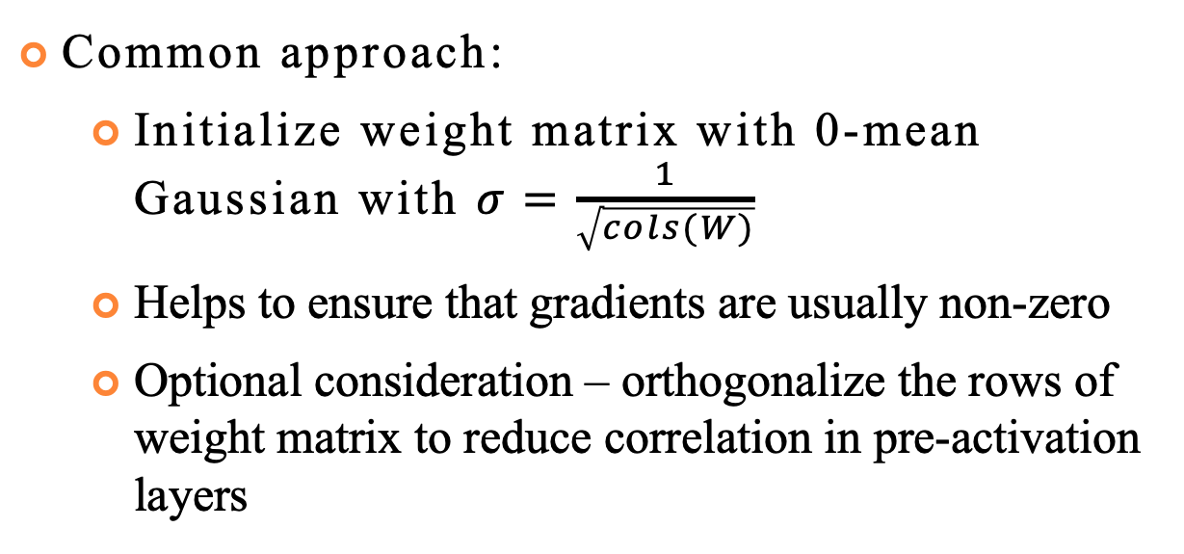
Weight Initialization
Common approach:
Initialize weight matrix with 0-mean Gaussian with $σ=\frac{1}{\sqrt{cols(W)}}$
Helps to ensure that gradients are usually non-zero
Optional consideration – orthogonalize the rows of weight matrix to reduce correlation in pre-activation layers
29
Notes:
Since W(2)=0, then g=0. Hence, = 0. •
However, h is non-zero. Hence, is nonzero => will change. •
During the next gradient update, g is non-zero => W(1), b(1) will change. •
In summary: this initialization does not severely inhibit the network’s performance (though initializing W(2), b(2) to 0 is still not recommended)

Slide 34
Some Libraries
Scikit-learn
https://scikit- learn.org/stable/modules/neural_networks_supervised.h tml
Only MLP; no GPU support
Keras
https://keras.io/
Tensorflow
https://www.tensorflow.org/
PyTorch
https://pytorch.org/
30

