Slide 1
CS584 Machine Learning
Lecture 22. Support Vector Machines. Practical Considerations in ML
Oleksandr Narykov
onarykov@iit.edu

Slide 2
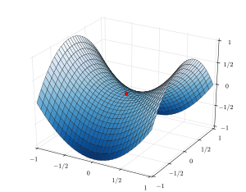
Background – Constrained optimization
Find θ
maximizing f (θ) subject to
c₁ (θ) = 0
...
c_{m} (θ) = 0
Form the Lagrangian:
F (θ, λ) = f (θ) − ∑λ_{j}c_{j} (θ)
j =1
m
9

Slide 3
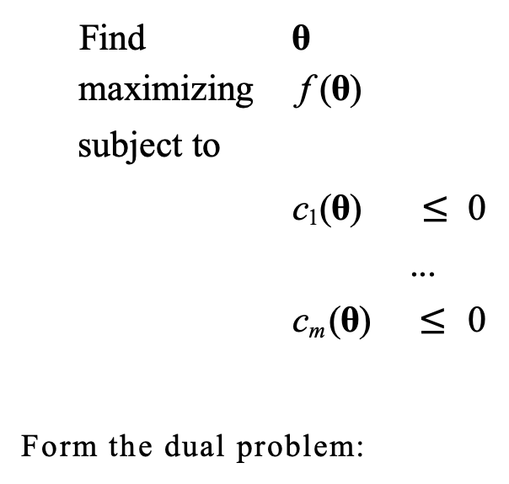
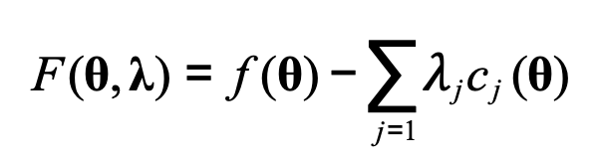
Karush-Kuhn-Tucker (KKT) Conditions
Generalization of the Lagrange Multipliers for inequality setting
Find θ
maximizing f (θ) subject to
c₁ (θ) $≤$ 0
...
c_{m} (θ) $≤$ 0
Form the dual problem:
F (θ, λ) = f (θ) − ∑$λ$_{j}c_{j} (θ)
j =1
9
m

Slide 4
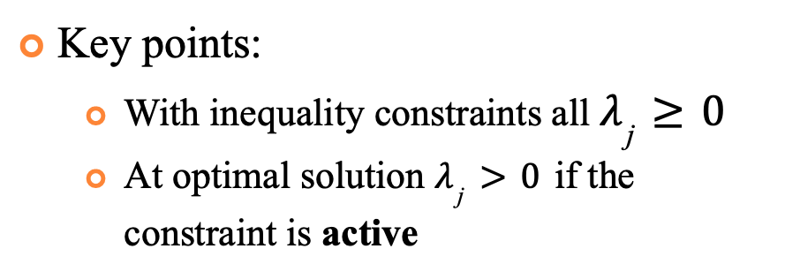
Karush-Kuhn-Tucker (KKT) Conditions
Generalization of the Lagrange Multipliers for inequality setting
Key points:
With inequality constraints all $λ_{\text{j}}≥0$
At optimal solution $λ_{\text{j}}>0$ if the constraint is active
Find θ
maximizing f (θ) subject to
c₁ (θ) $≤$ 0
...
c_{m} (θ) $≤$ 0
Form the dual problem:
F (θ, λ) = f (θ) − ∑$λ$_{j}c_{j} (θ)
j =1
9
m

Slide 5


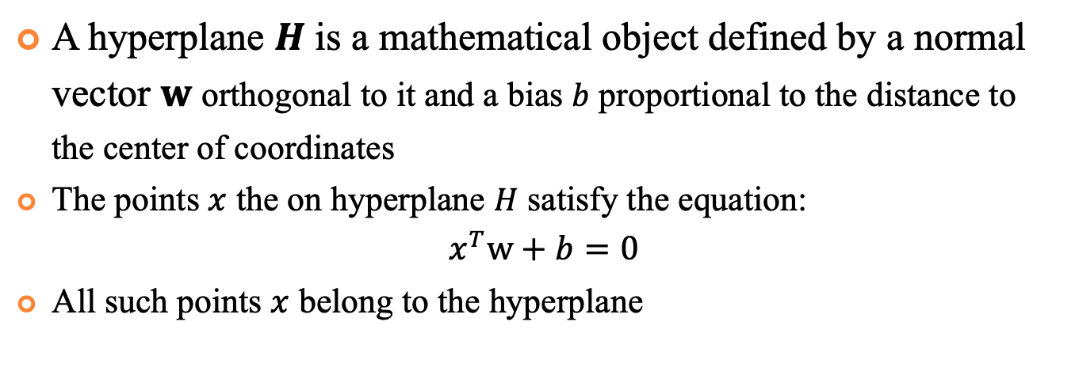
Hyperplanes
A hyperplane $H$ is a mathematical object defined by a normal vector $w$ orthogonal to it and a bias $b$ proportional to the distance to the center of coordinates
The points $x$ the on hyperplane $H$ satisfy the equation:
$$x^{T}w+b=0$$
All such points $x$ belong to the hyperplane
$$b$$
$$w$$
O
$$H$$
9

Slide 6
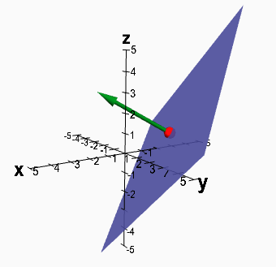

Hyperplanes
Less formally, a hyperplane is a subspace with one less dimensions than an ambient space
For 3D space hyperplane is a regular plane (2D)
For 2D space hyperplane is a line
2D space, 1D hyperplane
3D space, 2D hyperplane
$$w$$
$$b$$
O
$$H$$
9

Slide 7
Hyperplanes
Less formally, a hyperplane is a subspace with one less dimensions than an ambient space
For 3D space hyperplane is a regular plane (2D)
For 2D space hyperplane is a line
2D space, 1D hyperplane
3D space, 2D hyperplane
$$w$$
$$b$$
O
$$H$$
9

Slide 8
Hyperplanes
Less formally, a hyperplane is a subspace with one less dimensions than an ambient space
For 3D space hyperplane is a regular plane (2D)
For 2D space hyperplane is a line
2D space, 1D hyperplane
3D space, 2D hyperplane
$$w$$
$$b$$
O
$$H$$
9

Slide 9
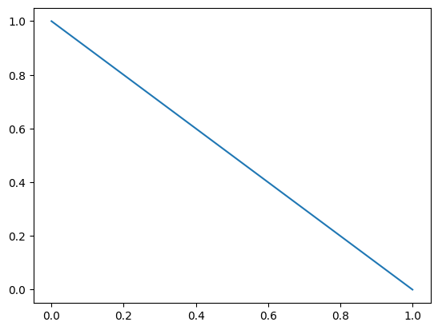
Example
Hyperplane in 2D space with $w$=[1,1] and b=-1

Slide 10
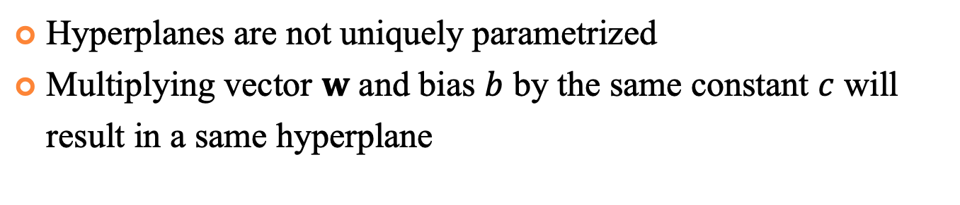


Hyperplanes
Hyperplanes are not uniquely parametrized
Multiplying vector $w$ and bias $b$ by the same constant $c$ will result in a same hyperplane
$$x^{T}w+b=0$$
$w$=[1,1], b=-1
$w$=[5,5], b=-5

Slide 11
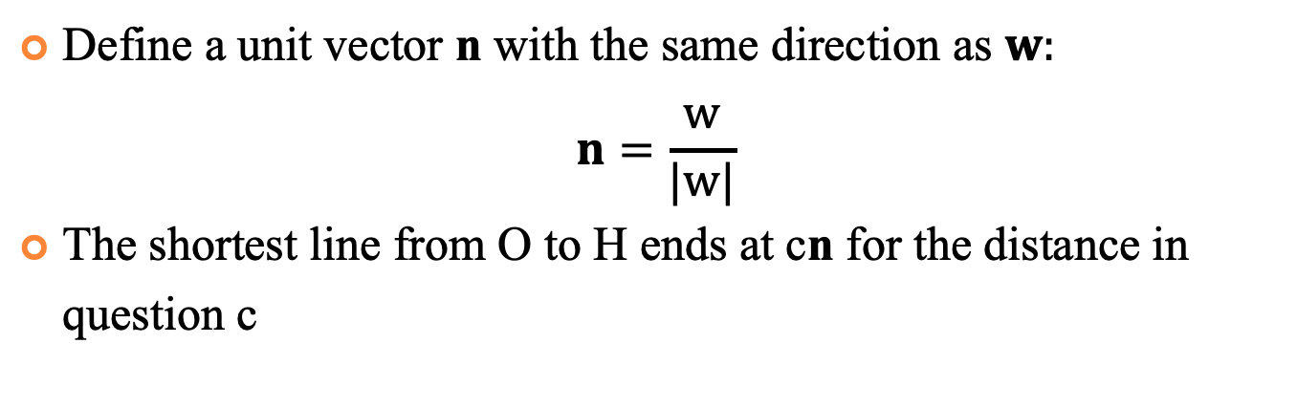

Distance from the Center of Coordinates
Define a unit vector n with the same direction as $w:$
$$n=\frac{w}{|w|}$$
The shortest line from O to H ends at cn for the distance in question c
$$w$$
$$b$$
$$cn$$
O
$$H$$

Slide 12
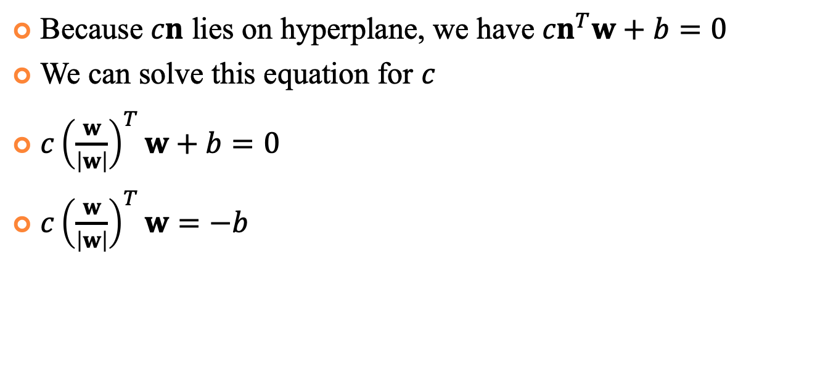
Distance from the Center of Coordinates
Because $cn$ lies on hyperplane, we have ${cn}^{T}w+b=0$
We can solve this equation for $c$
${c\left(\frac{w}{\left|w\right|}\right)}^{T}w+b=0$
${c\left(\frac{w}{\left|w\right|}\right)}^{T}w=−b$
$$H=\{{x ∈R^{m}: x}^{T}w+b=0\}$$
$$w$$
$$b$$
$$cn$$
O
$$H$$

Slide 13
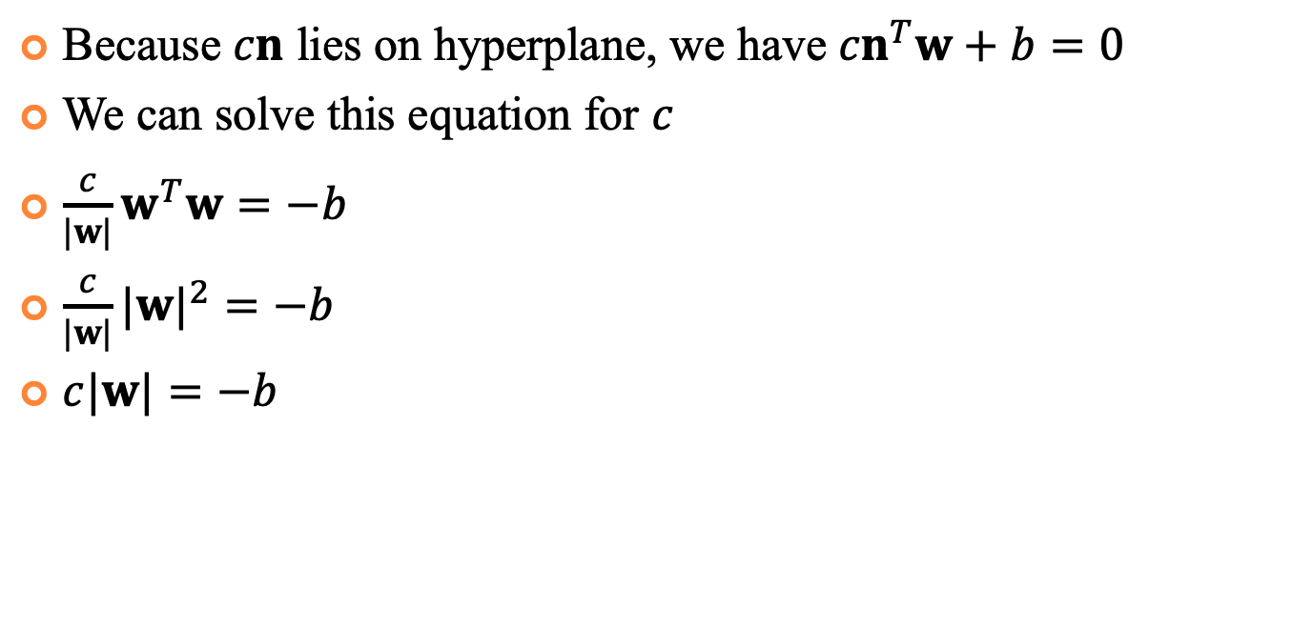
Distance from the Center of Coordinates
Because $cn$ lies on hyperplane, we have ${cn}^{T}w+b=0$
We can solve this equation for $c$
$\frac{c}{|w|}w^{T}w=−b$
$\frac{c}{|w|}{|w|}^{2}=−b$
$c|w|=−b$
$$H=\{{x ∈R^{m}: x}^{T}w+b=0\}$$
$$w$$
$$b$$
$$cn$$
O
$$H$$

Slide 14
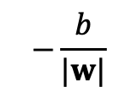
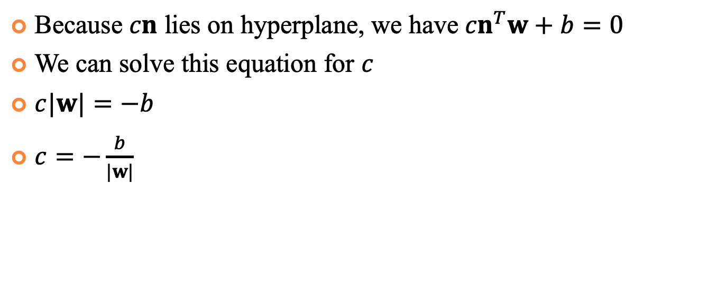
Distance from the Center of Coordinates
Because $cn$ lies on hyperplane, we have ${cn}^{T}w+b=0$
We can solve this equation for $c$
$c|w|=−b$
$c=−\frac{b}{|w|}$
$$H=\{{x ∈R^{m}: x}^{T}w+b=0\}$$
$$w$$
$$b$$
$$−\frac{b}{|w|}$$
O
$$H$$

Slide 15
Support Vector Machine
Support vector machine is a binary classification ML model
SVMs utilize constrained optimization instead of unconstrained one (e.g., softmax regression)

Slide 16
Support Vector Machine
Let’s denote blue samples as negative, red as positive
Examples below the line will be classified as negative above the line – as positive
B
A

Slide 17
Support Vector Machine
Which decision boundary is likely to perform better on testing data? Why?
B
A

Slide 18
Support Vector Machine
The goal of SVM is to find a hyperplane with maximum margin between the data points
To do this, first find the subset S⁻ of the – examples that lie closest to separating hyperplane H
S⁻
d⁻
H
H⁻

Slide 19
Support Vector Machine
Those points lie on the hyperplane H⁻ parallel to H
The shortest distance between H⁻ and H is d⁻
S⁻
d⁻
H
H⁻

Slide 20
Support Vector Machine
Do the same for + data
The sum of d⁻ and d⁺ is a margin d
The optimization objective is to find H that maximizes d
S⁺
S⁻
d
H⁺
d⁺
d⁻
H
H⁻

Slide 21



Support Vector Machine
As H⁻ || H || H⁺ we can scale w and b such that
H⁻ : $x^{T}w+b=−1$
H : $x^{T}w+b=0$
H⁺ : $x^{T}w+b=1$
$$x^{T}w+b=1$$
$$x^{T}w+b=−1$$
w
H⁺
H
H⁻

Slide 22

Support Vector Machine
We classify points as
$$x^{T}w+b ≥1 → y^{(i)}=+1$$
$$x^{T}w+b ≤−1 → y^{\left(i\right)}=−1$$
$$x^{T}w+b=1$$
$$x^{T}w+b=−1$$
w
H⁺
H
H⁻

Slide 23

Support Vector Machine
We can unify previous equations in a set of constraints:
$$y^{\left(i\right)}(x^{T}w+b) ≥1$$
$$x^{T}w+b=1$$
$$x^{T}w+b=−1$$
w
H⁺
H
H⁻

Slide 24

Support Vector Machine
Let’s consider H that is equidistant from H⁺ and H⁻
H⁻ is (-1-b)/|w| from the origin and H⁺ is (1-b)/|w| from the origin. Then the margin is
$d=\frac{1−b}{|w|}−\frac{−1−b}{\left|w\right|}=\frac{2}{|w|}$
$$x^{T}w+b=1$$
$$x^{T}w+b=−1$$
w
H⁺
H
H⁻

Slide 25
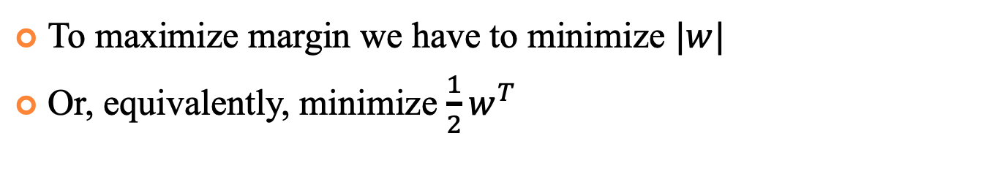
Support Vector Machine
To maximize margin we have to minimize $|w|$
Or, equivalently, minimize $\frac{1}{2}w^{T}$
$$x^{T}w+b=1$$
$$x^{T}w+b=−1$$
w
H⁺
H
H⁻

Slide 26
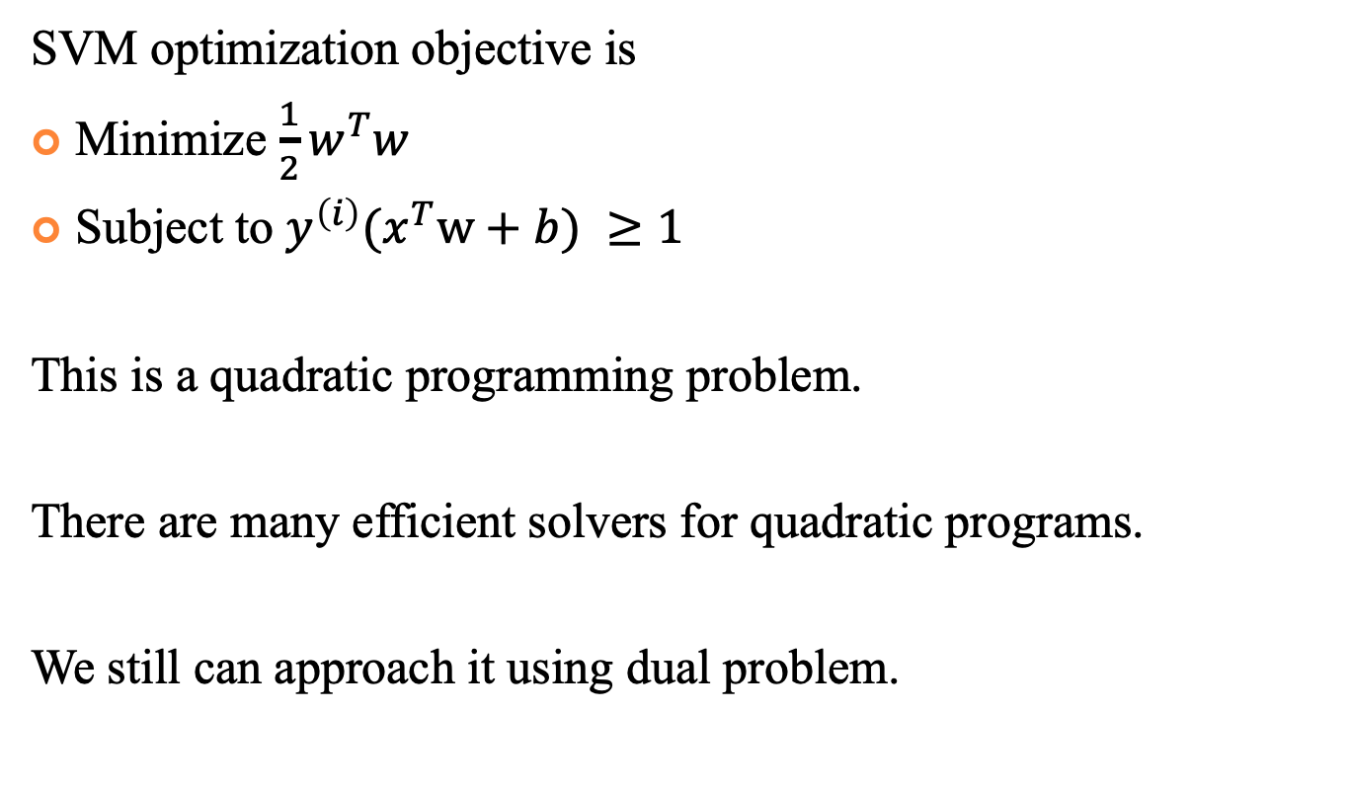
Optimization Problem
SVM optimization objective is
Minimize $\frac{1}{2}w^{T}w$
Subject to $y^{\left(i\right)}(x^{T}w+b) ≥1$
This is a quadratic programming problem.
There are many efficient solvers for quadratic programs.
We still can approach it using dual problem.

Slide 27
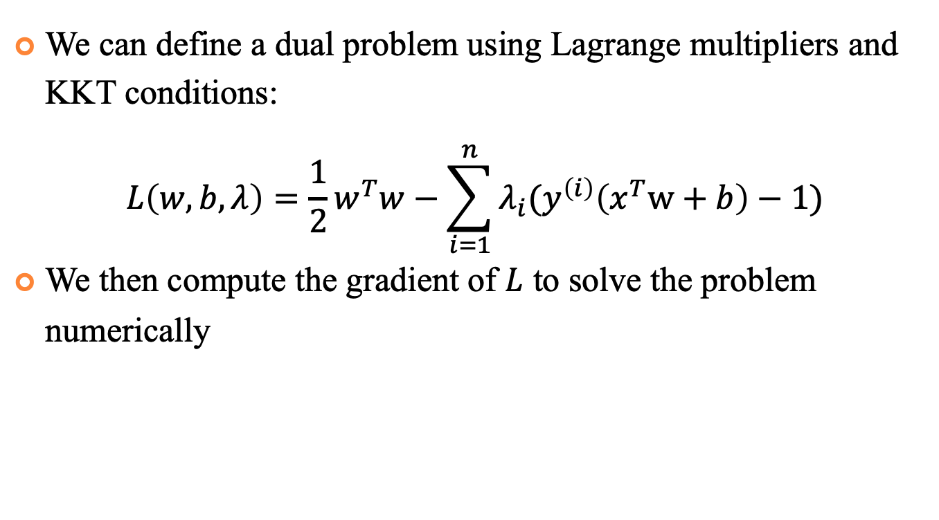
Optimization Problem
We can define a dual problem using Lagrange multipliers and KKT conditions:
$$L\left(w,b,λ\right)=\frac{1}{2}w^{T}w−\sum_{i=1}^{n}{λ_{i}(y^{\left(i\right)}\left(x^{T}w+b\right)−1)}$$
We then compute the gradient of $L$ to solve the problem numerically

Slide 28
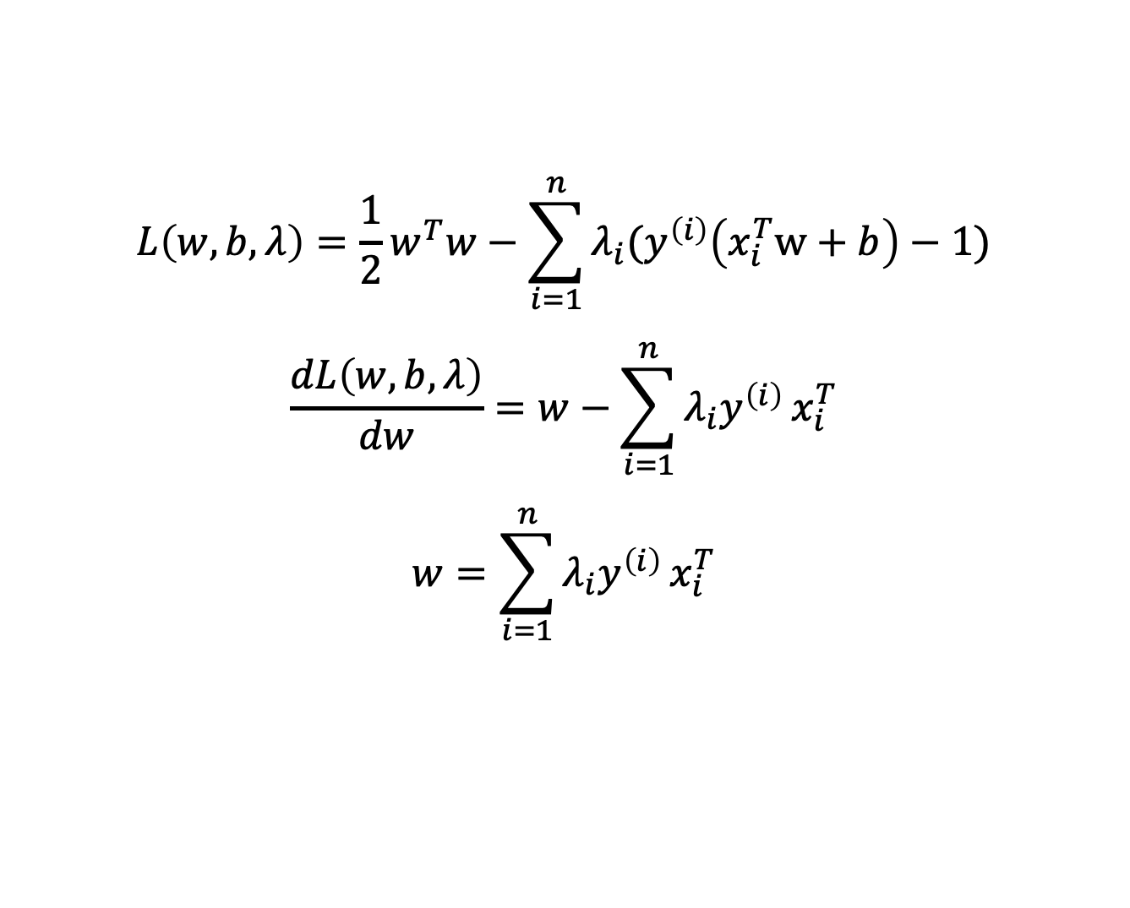
Optimization Problem
$$L\left(w,b,λ\right)=\frac{1}{2}w^{T}w−\sum_{i=1}^{n}{λ_{i}(y^{\left(i\right)}\left(x_{i}^{T}w+b\right)−1)}$$
$$\frac{dL\left(w,b,λ\right)}{dw}=w−\sum_{i=1}^{n}{λ_{i}y^{\left(i\right)}}x_{i}^{T}$$
$$w=\sum_{i=1}^{n}{λ_{i}y^{\left(i\right)}}x_{i}^{T}$$

Slide 29
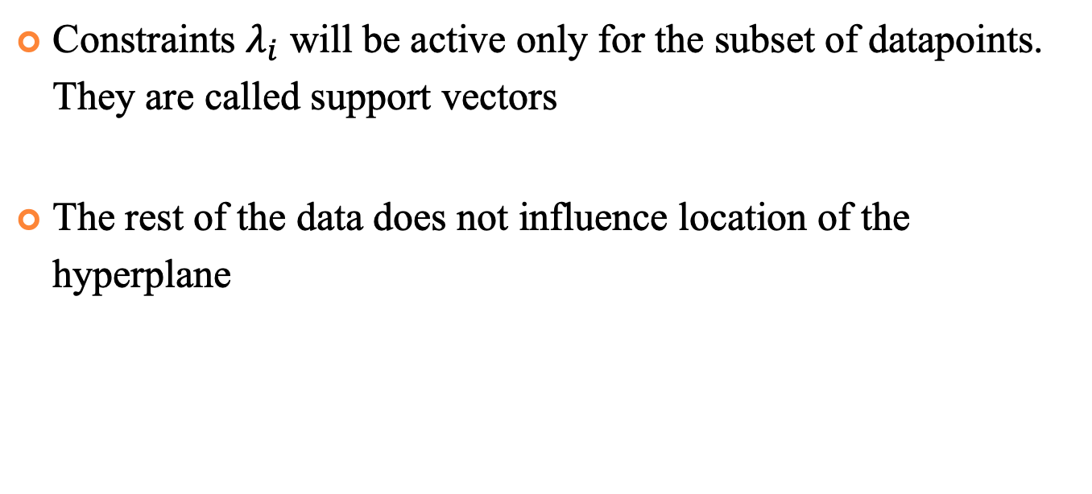
Support Vectors
Constraints $λ_{i}$ will be active only for the subset of datapoints. They are called support vectors
The rest of the data does not influence location of the hyperplane
S⁺
S⁻
d
H⁺
d⁺
d⁻
H⁻

Slide 30
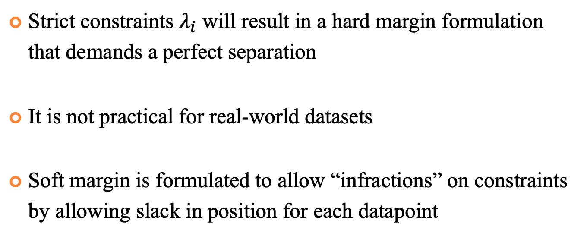
Soft vs Hard Margin
Strict constraints $λ_{i}$ will result in a hard margin formulation that demands a perfect separation
It is not practical for real-world datasets
Soft margin is formulated to allow “infractions” on constraints by allowing slack in position for each datapoint

Slide 31
Soft vs Hard Margin
Strict constraints $λ_{i}$ will result in a hard margin formulation that demands a perfect separation
It is not practical for real-world datasets
Soft margin is formulated to allow “infractions” on constraints by allowing slack in position for each datapoint

Slide 32


Soft vs Hard Margin
$$x^{T}w+b=1$$
w
$$ξ_{i}$$
H⁺
H

Slide 33
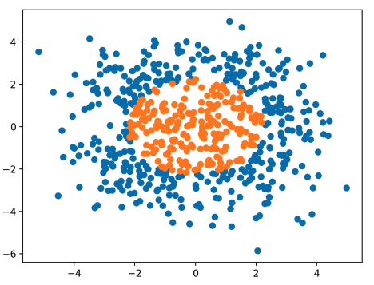

Kernel Trick
We represent our data as a similarity matrix
A function that takes vectors in the original space and return the dot product of the vectors in the feature space is called a kernel function:

