Slide 1
CSP571 Data Preparation and Analysis
Lecture 2. Linear Regression
Oleksandr Narykov
onarykov@iit.edu

Slide 2
Regression
If the target variable 𝑌 is continuous, the task is called regression
Examples
Recommendations (ratings)
Economics and finance (credit score, house prices, stock prices, consumption, etc.)
Weather forecasting (temperature, humidity, wind speed,
etc.)
and more …
2
Slide deck is partially based on Michael Sinocruz work

Slide 3
Real-World Problems
Energy Demand
How much will be the energy demand in 20xx or outlook period?
Which is the most energy consuming sector?
How much oil, or gas or coal will be needed to supply the energy requirements in 20xx outlook period?
How much will be the electricity demand for the next number of years?
Power generation
How many new power plants are needed or what type of power plant will be needed to meet the electricity demand?
Is the indigenous supply enough or how much will be imported?
2

Slide 4
Real-World Problems
Predicting the price of a house given house features
Estimating the sales based on input parameters
Forecasting weather and climate change
Predicting patient response to treatment
2

Slide 5
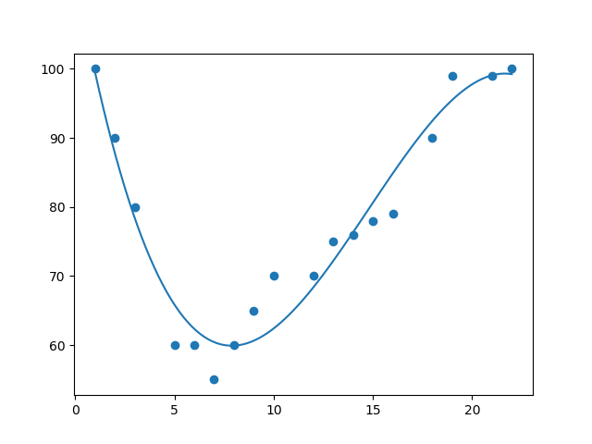

Regression Example
2

Slide 6
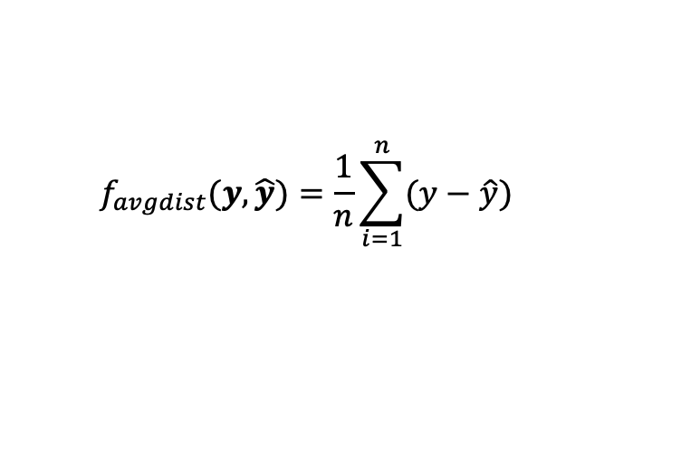
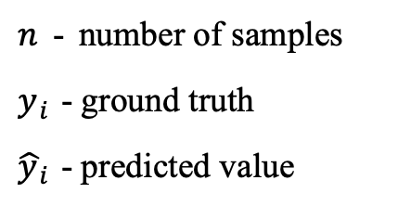
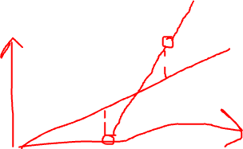
Regression Error
Average Distance
$n$ - number of samples
$y_{i}$ - ground truth
${\hat{y}}_{i}$ - predicted value
$$f_{avgdist}(y,\hat{y})=\frac{1}{n}\sum_{i=1}^{n}{(y−\hat{y})}$$
2

Slide 7
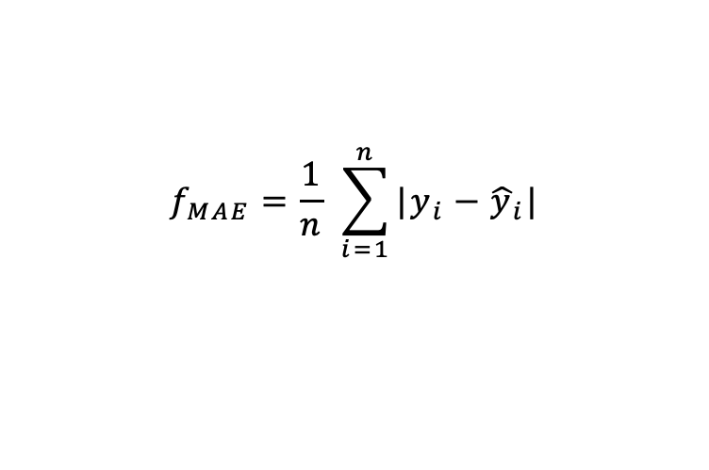
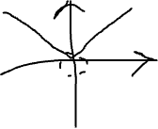
Regression Error
Average Distance
Mean Absolute Error
$n$ - number of samples
$y_{i}$ - ground truth
${\hat{y}}_{i}$ - predicted value
$$f_{avgdist}(y,\hat{y})=\frac{1}{n}\sum_{i=1}^{n}{(y−\hat{y})}$$
$$f_{MAE}=\frac{1}{n} \sum_{i=1}^{n}{|y_{i}−{\hat{y}}_{i}|}$$
2

Slide 8
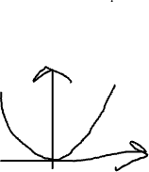
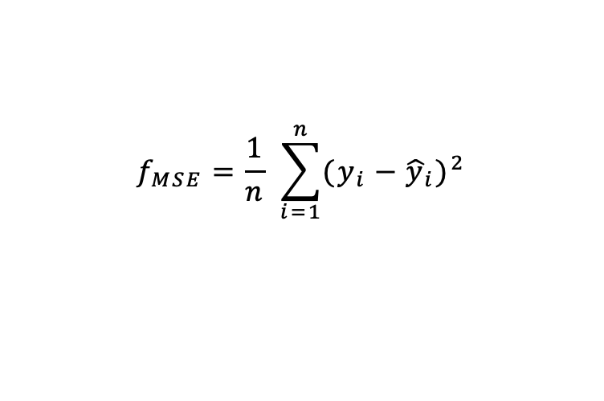
Regression Error
Average Distance
Mean Absolute Error
Mean Squared Error
$n$ - number of samples
$y_{i}$ - ground truth
${\hat{y}}_{i}$ - predicted value
$$f_{avgdist}(y,\hat{y})=\frac{1}{n}\sum_{i=1}^{n}{(y−\hat{y})}$$
$$f_{MAE}=\frac{1}{n} \sum_{i=1}^{n}{|y_{i}−{\hat{y}}_{i}|}$$
$$f_{MSE}=\frac{1}{n} \sum_{i=1}^{n}{{(y_{i}−{\hat{y}}_{i})}^{2}}$$
2

Slide 9

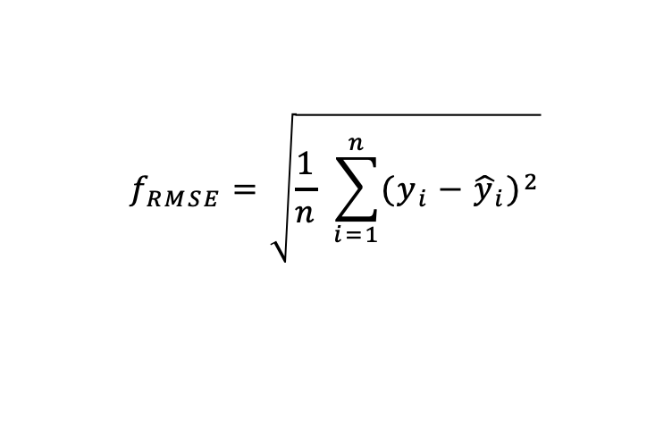
Regression Error
Average Distance
Mean Absolute Error
Mean Squared Error
Root Mean Squared Error
$n$ - number of samples
$y_{i}$ - ground truth
${\hat{y}}_{i}$ - predicted value
$$f_{avgdist}(y,\hat{y})=\frac{1}{n}\sum_{i=1}^{n}{(y−\hat{y})}$$
$$f_{MAE}=\frac{1}{n} \sum_{i=1}^{n}{|y_{i}−{\hat{y}}_{i}|}$$
$$f_{MSE}=\frac{1}{n} \sum_{i=1}^{n}{{(y_{i}−{\hat{y}}_{i})}^{2}}$$
$$f_{RMSE}=\sqrt{\frac{1}{n} \sum_{i=1}^{n}{{(y_{i}−{\hat{y}}_{i})}^{2}}}$$
2

Slide 10
Linear Regression

Slide 11
Representation
𝑥: the input vector, the object
𝑟: the true value of the regression
𝑓(𝑥): the true underlying function
𝑔(𝑥): the estimated underlying function
𝜖: the noise
𝑝(𝑟|𝑥): the conditional distribution of 𝑟 and 𝑥
𝐷: the dataset that consists of 𝑥, 𝑟 pairs
3

Slide 12
Regression Function
𝑟 = 𝑓(𝑥) + 𝜖
𝜖 is the noise (i.e., what the model cannot capture)
Noise can exist due to several reasons
The input variables are insufficient to capture everything there is to capture
Noisy sensors
𝜖 is typically assumed to be a zero mean Gaussian with constant variance 𝜎²
𝜖~𝒩(0, 𝜎²)
4

Slide 13
Linear Regression
Regression Line or the Least Square Regression Line
mathematical procedure to identify the linear equation that best fits a set of ordered pairs by finding the values of w, the y-intercept and b, the slope.
The goal of the least square method is to minimize the total squared error between the values of y (actual value) and r (response value).
w or the or the slope of the straight line is the ratio of the rise of the line over the run of the line
b, or w₀, y-intercept is the point where the line crosses the y-axis
If b = 0, it means there is no relationship between the independent and dependent variables
3

Slide 14
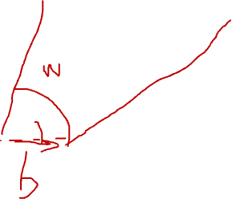
Linear Regression
Y
Y=wX+b
X
3

Slide 15
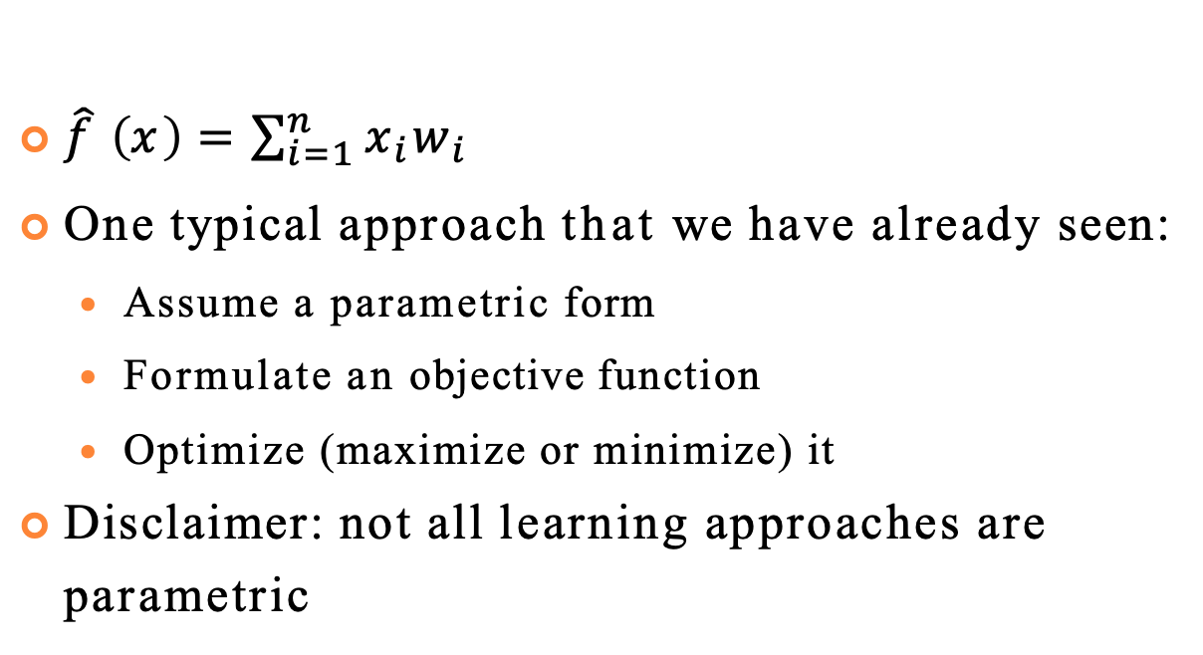
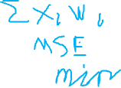
How To Estimate 𝑓(𝑥)
$\hat{f} \left(x\right)=\sum_{i=1}^{n}{x_{i}w_{i}}$
One typical approach that we have already seen:
Assume a parametric form
Formulate an objective function
Optimize (maximize or minimize) it
Disclaimer: not all learning approaches are parametric
5

Slide 16
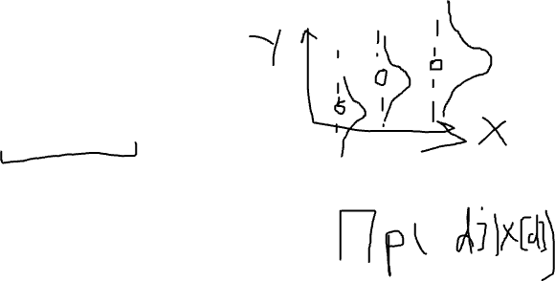
Maximize Conditional Log Likelihood
Assuming 𝜖~𝒩(0, 𝜎²), then
𝑝(𝑟 ∣ 𝑥) ~𝒩(𝑔(𝑥 ∣ 𝑤), 𝜎²)
Given the dataset 𝐷 that has 𝑁 instances and the
parameter vector 𝑤, the conditional log-likelihood
CLL = ∑ln 𝑝 𝑟 𝑑 ∣ 𝑥[𝑑]
1
₋ 𝑟[𝑑]−𝑔(𝑥 𝑑 ∣𝑤) ²
CLL = ∑ ln
𝑒
2𝜎²
2𝜋𝜎
CLL = −𝑁 ln
2𝜋𝜎 −
1
𝑥
𝑑
∣ 𝑤)
2
∑ 𝑟[𝑑] − 𝑔(
2𝜎²
6

Slide 17
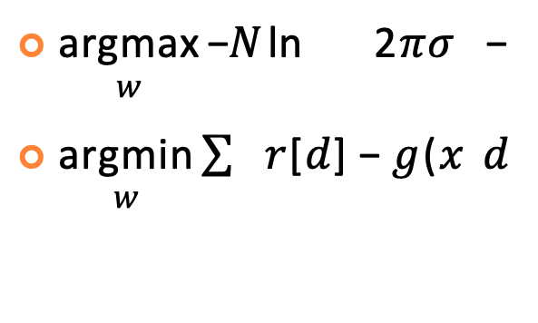
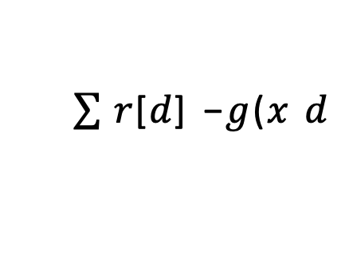
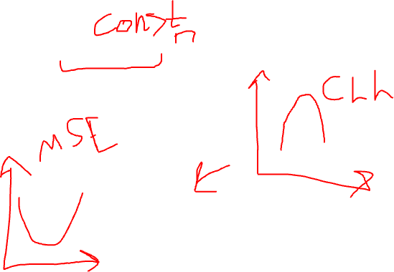
Maximize CLL = Minimize Squared Loss
argmax 𝐶𝐿𝐿
𝑤
argmax −𝑁 ln 2𝜋𝜎 −
𝑤
argmin 𝑟[𝑑] − 𝑔(𝑥 𝑑
𝑤
1
𝑟[𝑑] − 𝑔(𝑥 𝑑
∣ 𝑤) ²
2𝜎²
∣ 𝑤) ²
7

Slide 18
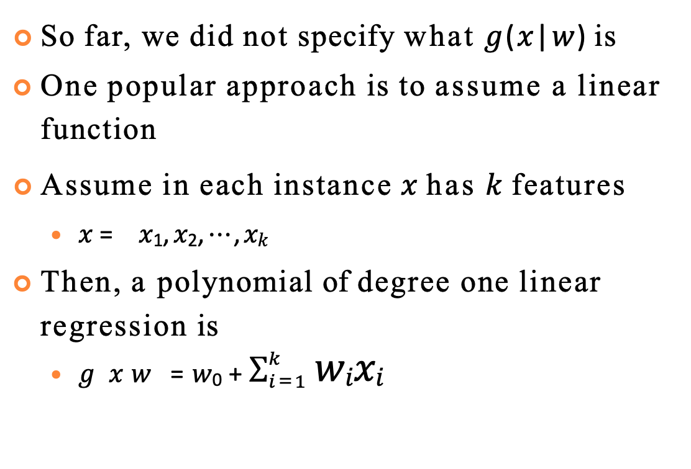
𝑔(𝑥|𝑤)
So far, we did not specify what 𝑔(𝑥|𝑤) is
One popular approach is to assume a linear function
Assume in each instance 𝑥 has 𝑘 features
𝑥 = 𝑥₁, 𝑥₂, ⋯ , 𝑥_{𝑘}
Then, a polynomial of degree one linear regression is
𝑔 𝑥 𝑤 = 𝑤₀ + $\sum_{i=1}^{k}{\text{w}\text{i}\text{x}\text{i}}$
8

Slide 19
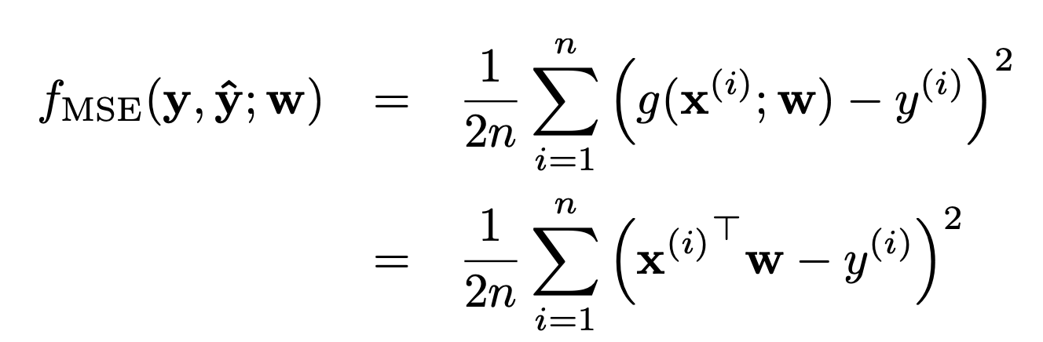
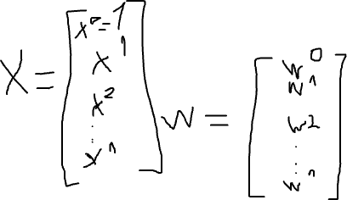
Regression Loss
10

Slide 20
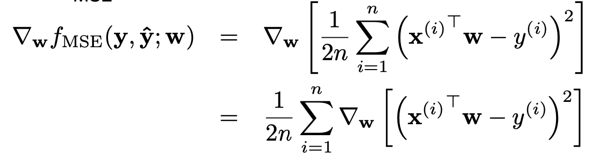
Regression Gradient
10

Slide 21
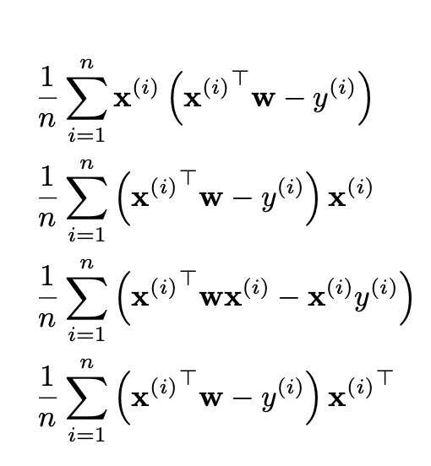
Regression Gradient
=
=
=
10

Slide 22
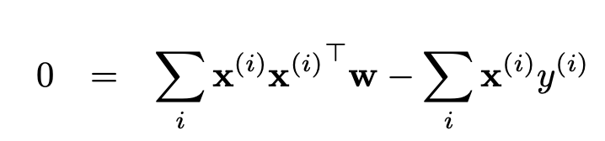
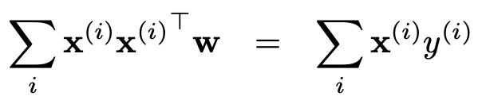
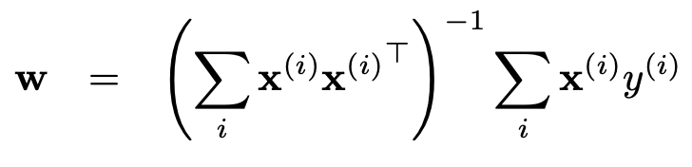
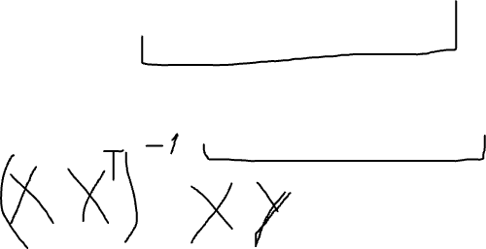
Regression Gradient
10

Slide 23
Polynomial Regression – Arbitrary Degree
Simply change the input representation by adding new features that correspond to powers and products
See https://scikit- learn.org/stable/modules/preprocessing.html#poly nomial-features
12

Slide 24
Other Regression Approaches
There are other approaches besides linear regression, such as
Decision tree regression
Support vector regression
Neural networks
…
14

Slide 25
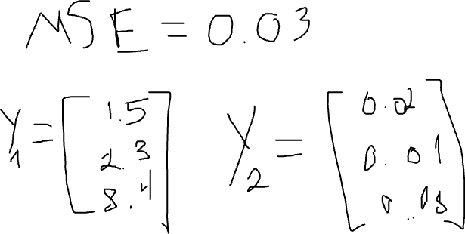
Performance Metrics
Is MSE a good performance estimate?

Slide 26
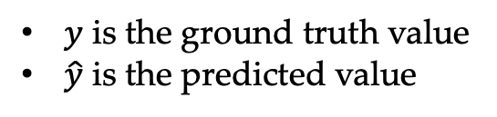
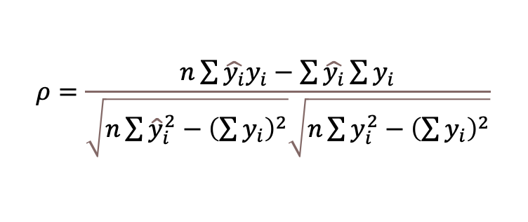
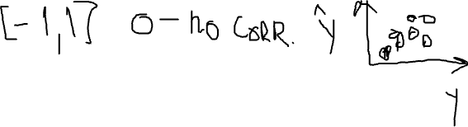
Performance Metrics
Pearson correlation coefficient (PCC)
PCC describes linear correlation between two sets of points.
Computed by dividing covariance between two sets of points over the product of standard deviation for each of the individual sets.
For the case of 1-D points it can be computed using the following equation
$$ρ=\frac{n\sum{\hat{y_{i}}y_{i}}−\sum{\hat{y_{i}}}\sum{y_{i}}}{\sqrt{n\sum{{\hat{y}}_{i}^{2}}−{\left(\sum{y_{i}}\right)}^{2}}\sqrt{n\sum{y_{i}^{2}}−{\left(\sum{y_{i}}\right)}^{2}}}$$
$y$ is the ground truth value
$\hat{y}$ is the predicted value
2

Slide 27
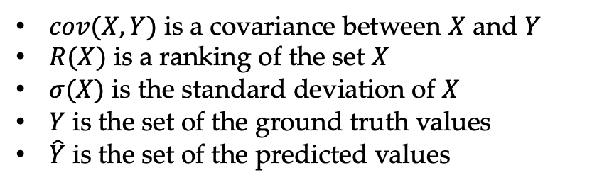

Performance Metrics
Spearman correlation coefficient (SCC)
SCC describes alignment of the rankings among two sets of points
It allows this score to capture non-linear components of the alignment
Correlation is defined in a similar fashion to PCC, with the only exception of using rankings of the points instead of their values
$cov(X,Y)$ is a covariance between $X$ and $Y$
$R(X)$ is a ranking of the set $X$
$σ(X)$ is the standard deviation of $X$
$Y$ is the set of the ground truth values
$\hat{Y}$ is the set of the predicted values
$$r_{s}=\frac{cov\left(R , \left(\hat{Y}\right) R\left(Y\right)\right)}{σ\left(R\left(\hat{Y}\right)\right)σ\left(R\left(Y\right)\right)}$$
2

Slide 28
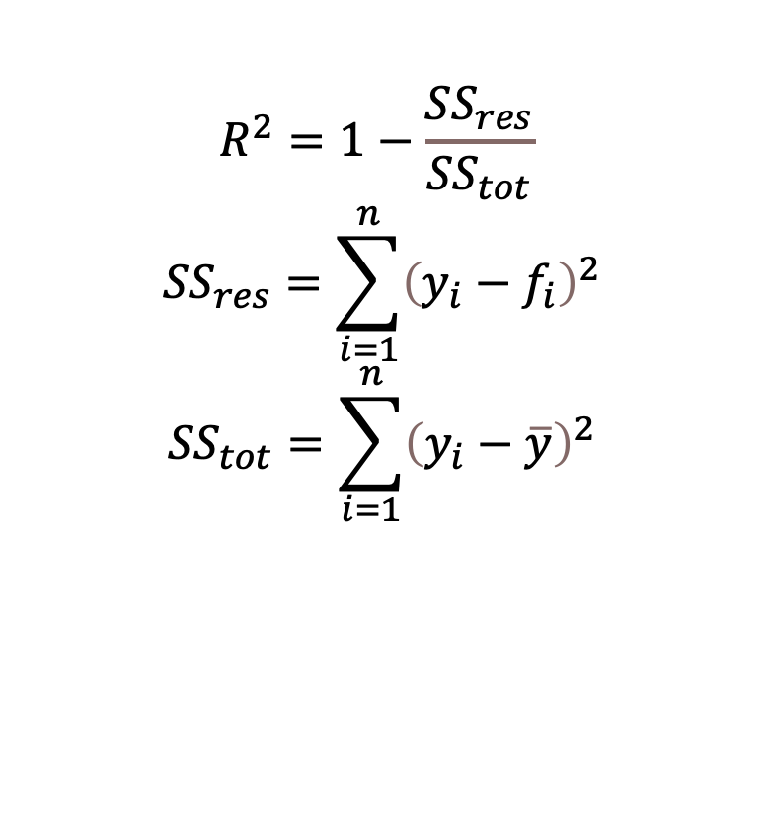
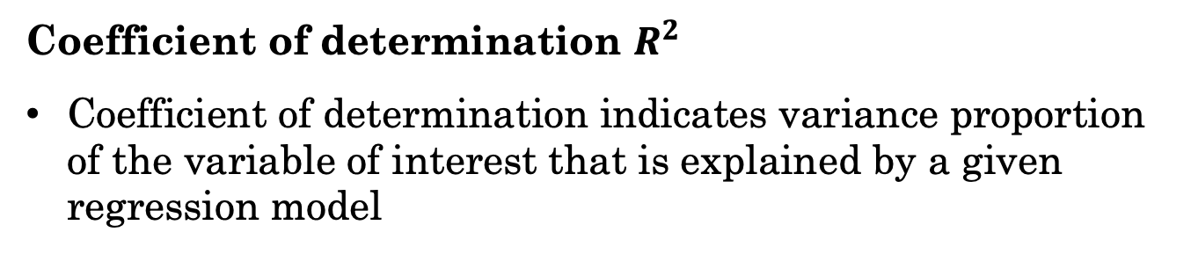
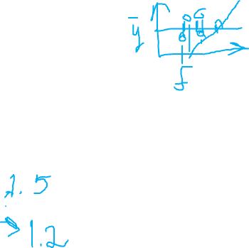
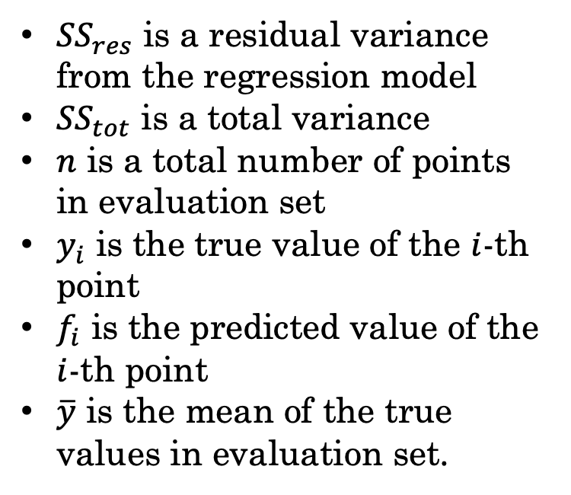
Performance Metrics
Coefficient of determination $R^{2}$
Coefficient of determination indicates variance proportion of the variable of interest that is explained by a given regression model
${SS}_{res}$ is a residual variance from the regression model
${SS}_{tot}$ is a total variance
$n$ is a total number of points in evaluation set
$y_{i}$ is the true value of the $i$-th point
$f_{i}$ is the predicted value of the $i$-th point
$\overline{y}$ is the mean of the true values in evaluation set.
$$R^{2}=1−\frac{{SS}_{res}}{{SS}_{tot}}$$
$${SS}_{res}=\sum_{i=1}^{n}{{\left(y_{i}−f_{i}\right)}^{2}}$$
$${SS}_{tot}=\sum_{i=1}^{n}{{\left(y_{i}−\overline{y}\right)}^{2}}$$
2

Slide 29
Python

Slide 30
Python
Created in 1991
Named for Monty Python
Interpreted scripting language
Interpreted: not compiled before execution
Scripting: Targeted for small program meant for one-time use
Transformed into fully-operational object-oriented programming (OOP) language
Widely used by:
Deep Learning and AI communities
Linux distributions
Games and apps

Slide 31
numpy
Numerical Python
Fundamental package for HPC, data analysis, and ML applications
NumPy can efficiently handle large arrays of data
Features:
ndarray type for arrays with an arbitrary number of dimensions
Uses much less memory than standard Python objects
Standard math functions
ndarrays are important for vectorization – ability to perform element-wise operations on arrays without for loops

Slide 32

pandas
Data manipulation library
Starting point for many ML applications
Main entities:
Series
1D labeled homogeneous array, size-immutable
DataFrames
2D size-mutable tabular structure with possibly heterogeneous columns
Labeled axes
Panels
3D arrays

Slide 33
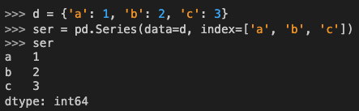
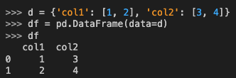


pandas. Examples
Series
DataFrame

Slide 34
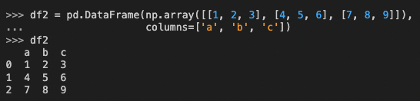
pandas. Examples
DataFrame can be constructed from multiple input types:
List
dict
Series
Numpy ndarrays
Another DataFrame

Slide 35

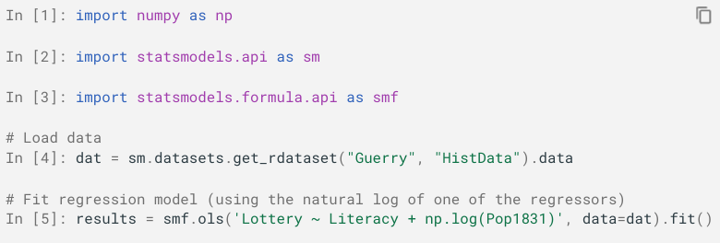
StatsModels
Statistical models estimation
Detailed information on model properties

Slide 36
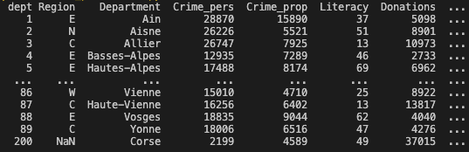
StatsModels

Slide 37
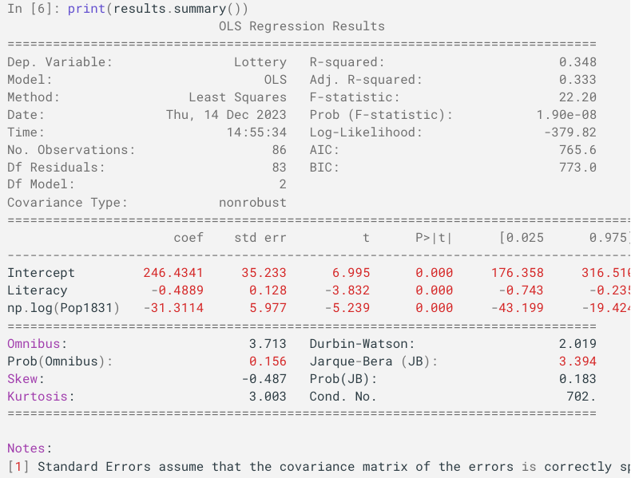
StatsModels
Notes:
Kurtosis is a descriptive statistic used to help measure how data disperse between a distribution's center and tails, with larger values indicating a data distribution may have “heavy” tails that are thickly concentrated with observations or that are long with extreme observations
The Durbin Watson (DW) statistic is a test for autocorrelation in the residuals from a statistical model or regression analysis. The Durbin-Watson statistic will always have a value ranging between 0 and 4. A value of 2.0 indicates there is no autocorrelation detected in the sample
arque–Bera test is a goodness-of-fit test of whether sample data have the skewness and kurtosis matching a normal distribution

Slide 38

Scikit-Learn
General-purpose Machine Learning library
Implements a number of widely used algorithms:
Classification
SVM
Random Forest
Naïve Bayes
AdaBoost
Regression
Linear regression
Kernel ridge regression
Lasso
Elastic-Net
Regression Trees/Forest

Slide 39
Regression in Scikit-Learn
Least squares
http://scikit-learn.org/stable/modules/linear_model.html#ordinary- least-squares
https://scikit- learn.org/stable/modules/generated/sklearn.linear_model.LinearRegre ssion.html
Ridge
http://scikit-learn.org/stable/modules/linear_model.html#ridge- regression
https://scikit- learn.org/stable/modules/generated/sklearn.linear_model.Ridge.html
Lasso
http://scikit-learn.org/stable/modules/linear_model.html#lasso
https://scikit- learn.org/stable/modules/generated/sklearn.linear_model.Lasso.html
15

