Slide 1
CS584 Machine Learning
Lecture 12. Boosting. Support Vector Machines
Oleksandr Narykov
onarykov@iit.edu

Slide 2
Midterm Exam
Date: Oct 8th, Tuesday
Format: In-person or Virtual.
The virtual option requires connecting to Zoom with the camera on!
2 parts: written part (e.g., assignment 1 problems), followed by MCQs
Last lecture covered: up to Sep 31st

Slide 3
Boosting

Slide 4
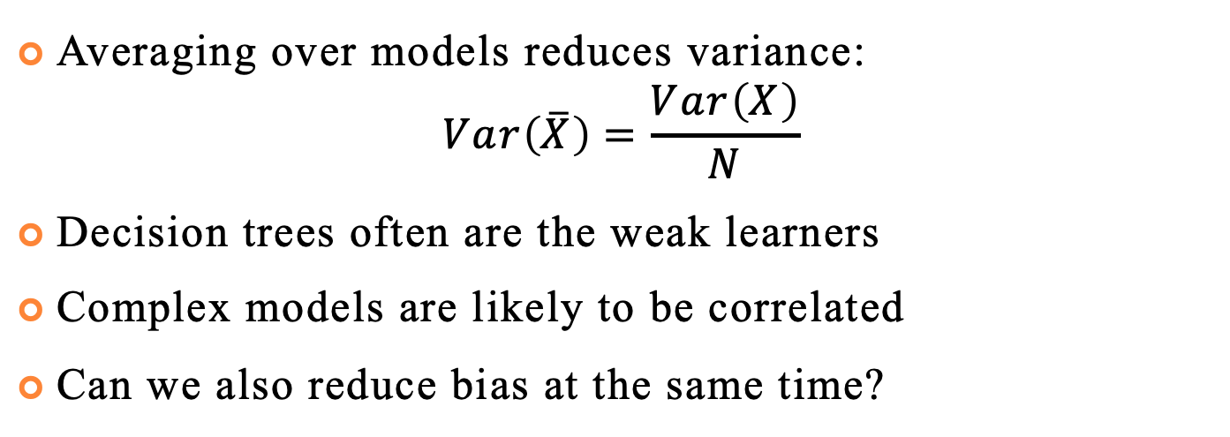
Further Improvements
Averaging over models reduces variance:
$$Var\left(\overline{X}\right)=\frac{Var\left(X\right)}{N}$$
Decision trees often are the weak learners
Complex models are likely to be correlated
Can we also reduce bias at the same time?
39

Slide 5
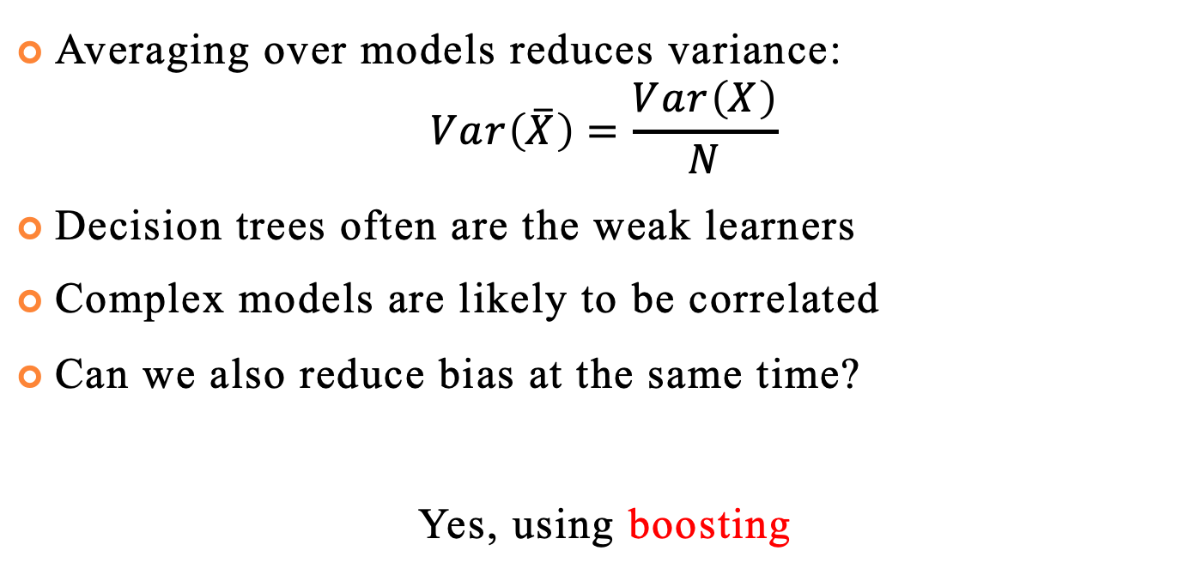
Further Improvements
Averaging over models reduces variance:
$$Var\left(\overline{X}\right)=\frac{Var\left(X\right)}{N}$$
Decision trees often are the weak learners
Complex models are likely to be correlated
Can we also reduce bias at the same time?
Yes, using boosting
39

Slide 6
Main Idea
Instead of increasing model complexity, make weak learners more relevant
Consider independent models as an expert
Each individual can have high bias, but the team of experts can be objective
Identify domain expertise you are lacking
Hire the one that addresses the issue
39

Slide 7
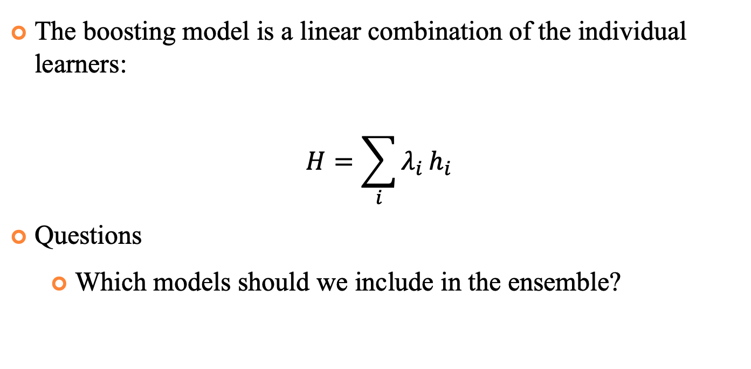
Main Idea
The boosting model is a linear combination of the individual learners:
$$H=\sum_{i}{λ_{i}}h_{i}$$
Questions
Which models should we include in the ensemble?
39

Slide 8
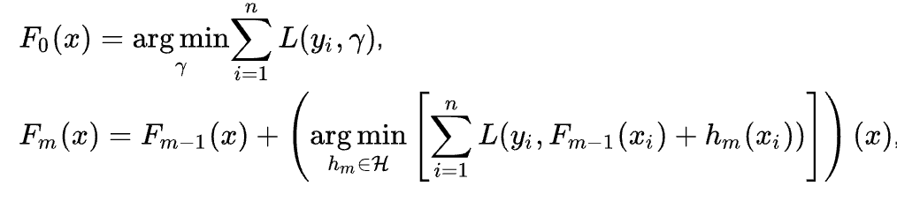
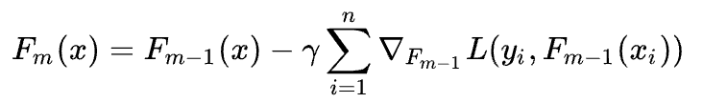
Gradient Boosting
Selecting the best model seems optimal
But in practice, it is not feasible, so we settle for the simplified version – making the best use of what we have
39

Slide 9
Useful Links
Decision Trees
https://scikit-learn.org/stable/modules/tree.html
https://scikit-learn.org/stable/modules/ensemble.html
Genetic Algorithm Framework
https://deap.readthedocs.io/en/master/
40

Slide 10
Support Vector Machine

Slide 11
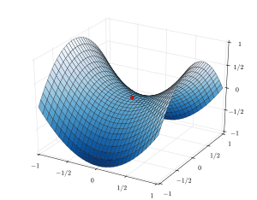
Background – Constrained optimization
Find θ
maximizing f (θ) subject to
c₁ (θ) = 0
...
c_{m} (θ) = 0
Form the Lagrangian:
F (θ, λ) = f (θ) − ∑λ_{j}c_{j} (θ)
j =1
m
9

Slide 12
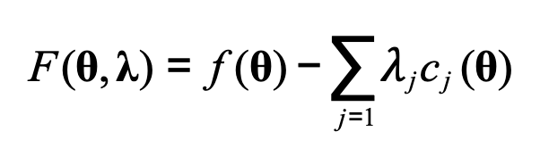
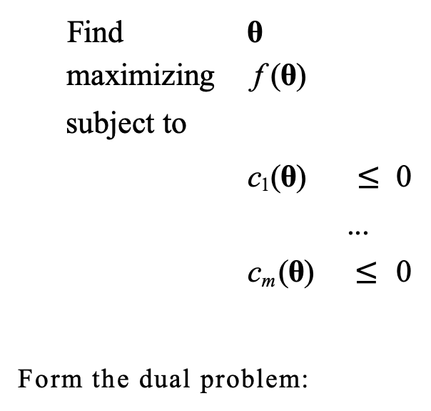
Karush-Kuhn-Tucker (KKT) Conditions
Generalization of the Lagrange Multipliers for inequality setting
Find θ
maximizing f (θ) subject to
c₁ (θ) $≤$ 0
...
c_{m} (θ) $≤$ 0
Form the dual problem:
F (θ, λ) = f (θ) − ∑$λ$_{j}c_{j} (θ)
j =1
9
m

Slide 13
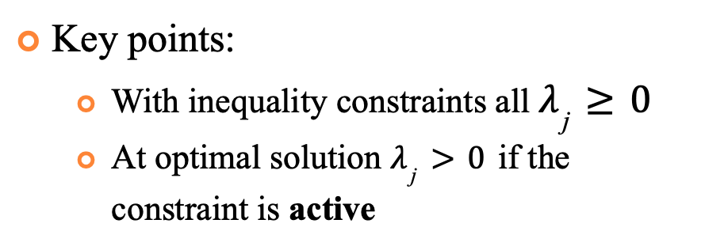
Karush-Kuhn-Tucker (KKT) Conditions
Generalization of the Lagrange Multipliers for inequality setting
Key points:
With inequality constraints all $λ_{\text{j}}≥0$
At optimal solution $λ_{\text{j}}>0$ if the constraint is active
Find θ
maximizing f (θ) subject to
c₁ (θ) $≤$ 0
...
c_{m} (θ) $≤$ 0
Form the dual problem:
F (θ, λ) = f (θ) − ∑$λ$_{j}c_{j} (θ)
j =1
9
m

Slide 14


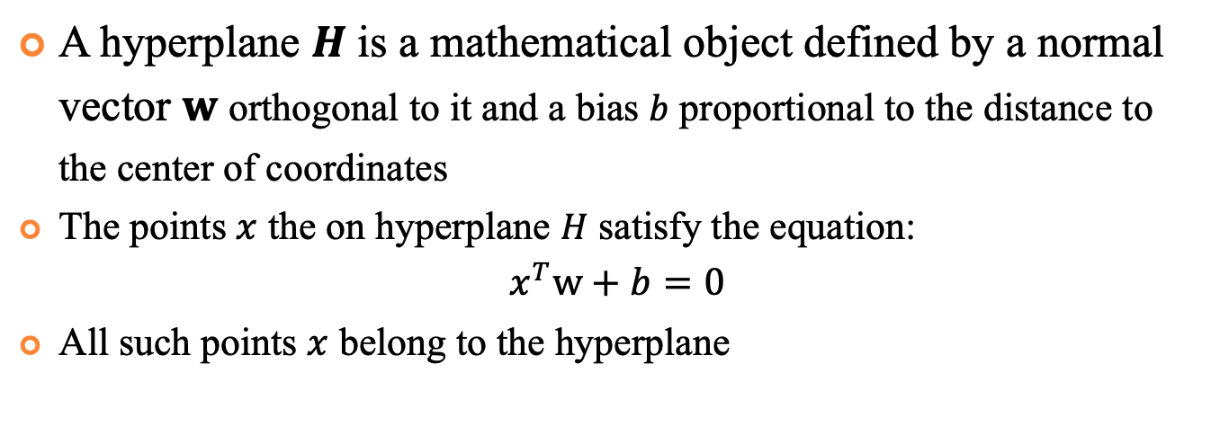
Hyperplanes
A hyperplane $H$ is a mathematical object defined by a normal vector $w$ orthogonal to it and a bias $b$ proportional to the distance to the center of coordinates
The points $x$ the on hyperplane $H$ satisfy the equation:
$$x^{T}w+b=0$$
All such points $x$ belong to the hyperplane
$$b$$
$$w$$
O
$$H$$
9

Slide 15
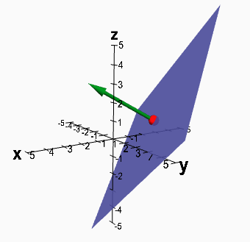

Hyperplanes
Less formally, a hyperplane is a subspace with one less dimensions than an ambient space
For 3D space hyperplane is a regular plane (2D)
For 2D space hyperplane is a line
2D space, 1D hyperplane
3D space, 2D hyperplane
$$w$$
$$b$$
O
$$H$$
9

Slide 16
Hyperplanes
Less formally, a hyperplane is a subspace with one less dimensions than an ambient space
For 3D space hyperplane is a regular plane (2D)
For 2D space hyperplane is a line
2D space, 1D hyperplane
3D space, 2D hyperplane
$$w$$
$$b$$
O
$$H$$
9

Slide 17
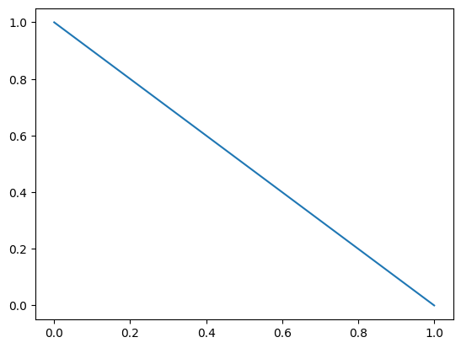
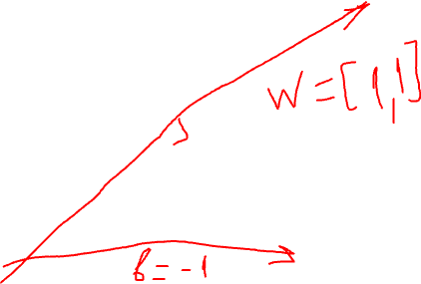
Example
Hyperplane in 2D space with $w$=[1,1] and b=-1

Slide 18
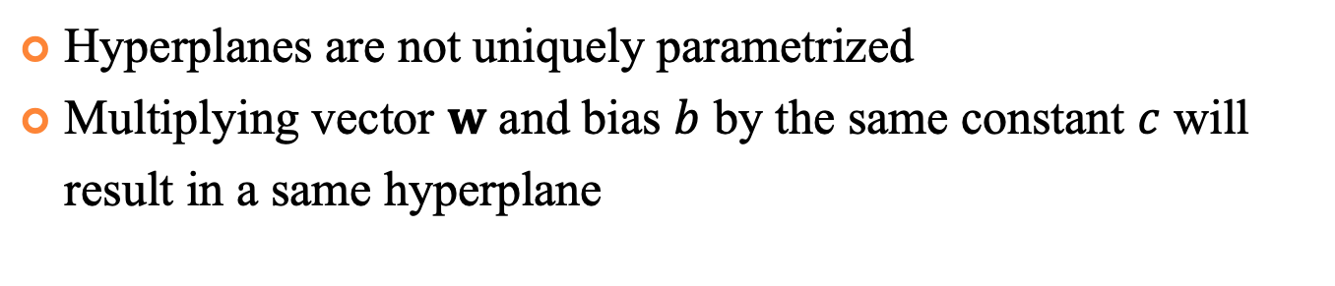


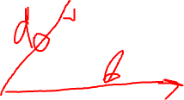
Hyperplanes
Hyperplanes are not uniquely parametrized
Multiplying vector $w$ and bias $b$ by the same constant $c$ will result in a same hyperplane
$$x^{T}w+b=0$$
$w$=[1,1], b=-1
$w$=[5,5], b=-5

Slide 19
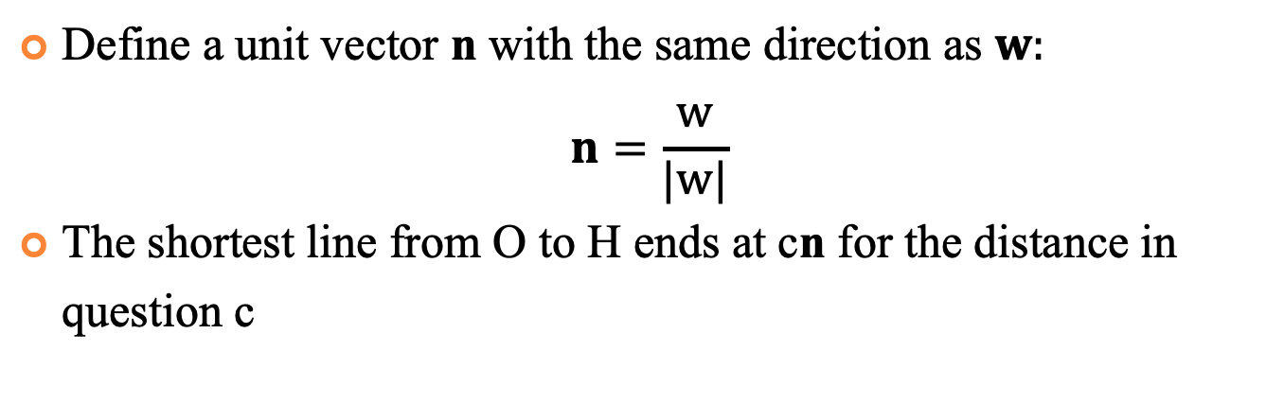

Distance from the Center of Coordinates
Define a unit vector n with the same direction as $w:$
$$n=\frac{w}{|w|}$$
The shortest line from O to H ends at cn for the distance in question c
$$w$$
$$b$$
$$cn$$
O
$$H$$

Slide 20
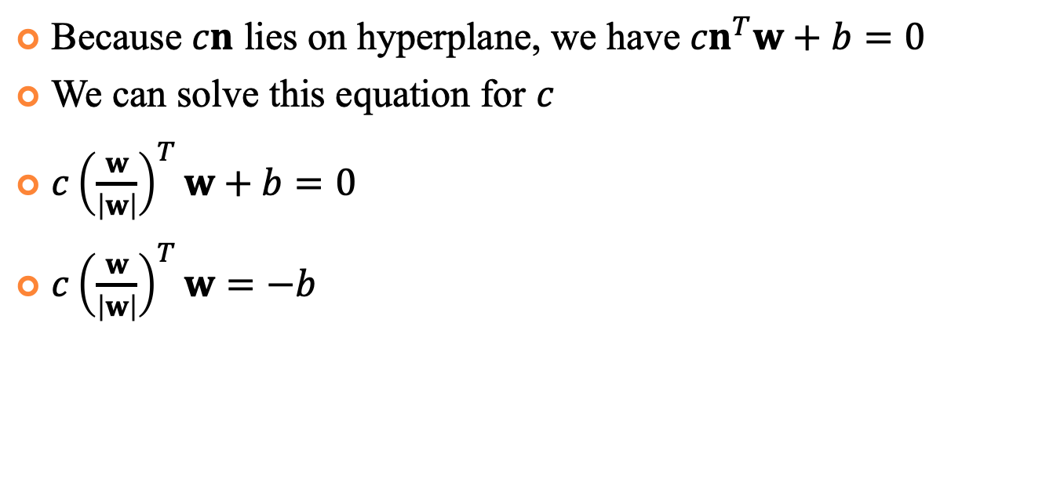

Distance from the Center of Coordinates
Because $cn$ lies on hyperplane, we have ${cn}^{T}w+b=0$
We can solve this equation for $c$
${c\left(\frac{w}{\left|w\right|}\right)}^{T}w+b=0$
${c\left(\frac{w}{\left|w\right|}\right)}^{T}w=−b$
$$H=\{{x ∈R^{m}: x}^{T}w+b=0\}$$
$$w$$
$$b$$
$$cn$$
O
$$H$$

Slide 21
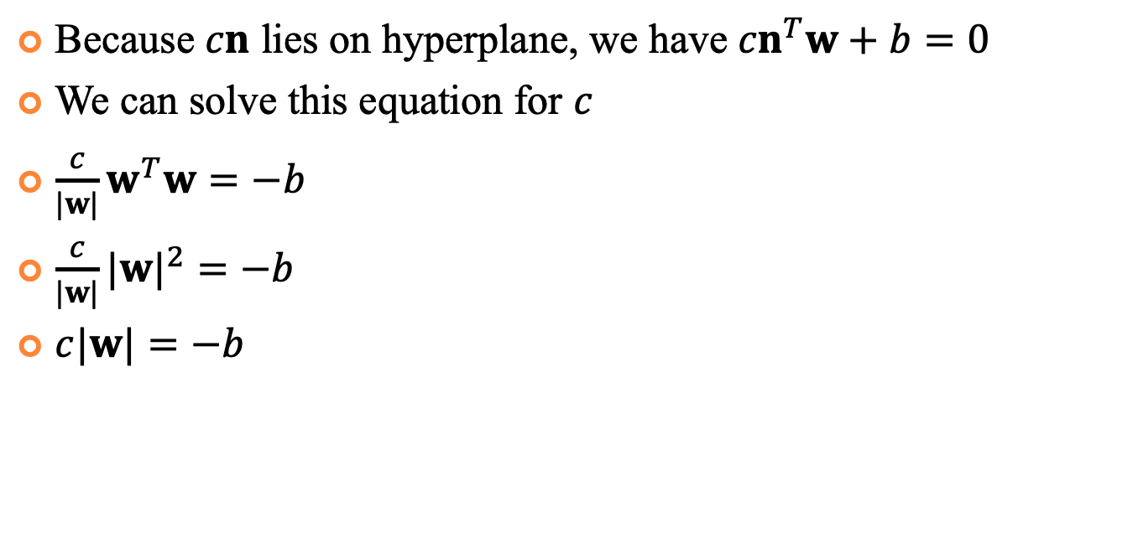
Distance from the Center of Coordinates
Because $cn$ lies on hyperplane, we have ${cn}^{T}w+b=0$
We can solve this equation for $c$
$\frac{c}{|w|}w^{T}w=−b$
$\frac{c}{|w|}{|w|}^{2}=−b$
$c|w|=−b$
$$H=\{{x ∈R^{m}: x}^{T}w+b=0\}$$
$$w$$
$$b$$
$$cn$$
O
$$H$$

Slide 22
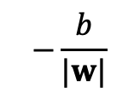
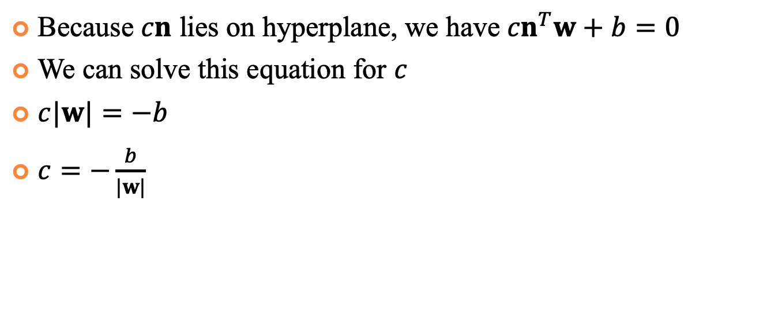
Distance from the Center of Coordinates
Because $cn$ lies on hyperplane, we have ${cn}^{T}w+b=0$
We can solve this equation for $c$
$c|w|=−b$
$c=−\frac{b}{|w|}$
$$H=\{{x ∈R^{m}: x}^{T}w+b=0\}$$
$$w$$
$$b$$
$$−\frac{b}{|w|}$$
O
$$H$$

Slide 23
Support Vector Machine
Support vector machine is a binary classification ML model
SVMs utilize constrained optimization instead of unconstrained one (e.g., softmax regression)

Slide 24
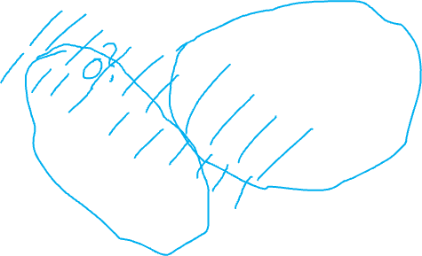
Support Vector Machine
Let’s denote blue samples as negative, red as positive
Examples below the line will be classified as negative above the line – as positive
B
A

Slide 25
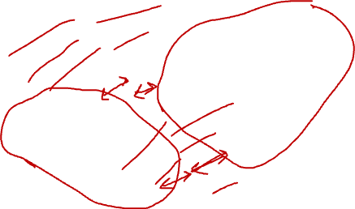
Support Vector Machine
Which decision boundary is likely to perform better on testing data? Why?
B
A

Slide 26
Support Vector Machine
The goal of SVM is to find a hyperplane with maximum margin between the data points
To do this, first find the subset S⁻ of the – examples that lie closest to separating hyperplane H
S⁻
d⁻
H
H⁻

Slide 27
Support Vector Machine
Those points lie on the hyperplane H⁻ parallel to H
The shortest distance between H⁻ and H is d⁻
S⁻
d⁻
H
H⁻

Slide 28
Support Vector Machine
Do the same for + data
The sum of d⁻ and d⁺ is a margin d
The optimization objective is to find H that maximizes d
S⁺
S⁻
d
H⁺
d⁺
d⁻
H
H⁻

Slide 29




Support Vector Machine
As H⁻ || H || H⁺ we can scale w and b such that
H⁻ : $x^{T}w+b=−1$
H : $x^{T}w+b=0$
H⁺ : $x^{T}w+b=1$
$$x^{T}w+b=1$$
$$x^{T}w+b=−1$$
w
H⁺
H
H⁻

Slide 30

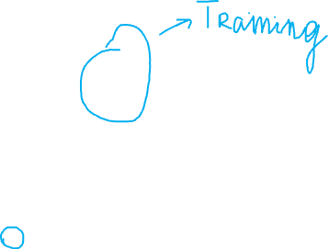
Support Vector Machine
We classify points as
$$x^{T}w+b ≥1 → y^{(i)}=+1$$
$$x^{T}w+b ≤−1 → y^{\left(i\right)}=−1$$
$$x^{T}w+b=1$$
$$x^{T}w+b=−1$$
w
H⁺
H
H⁻

Slide 31

Support Vector Machine
We can unify previous equations in a set of constraints:
$$y^{\left(i\right)}(x^{T}w+b) ≥1$$
$$x^{T}w+b=1$$
$$x^{T}w+b=−1$$
w
H⁺
H
H⁻

Slide 32

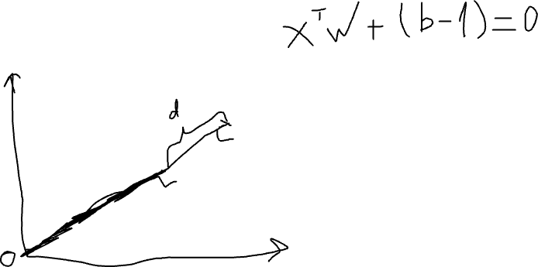
Support Vector Machine
Let’s consider H that is equidistant from H⁺ and H⁻
H⁻ is (-1-b)/|w| from the origin and H⁺ is (1-b)/|w| from the origin. Then the margin is
$d=\frac{1−b}{|w|}−\frac{−1−b}{\left|w\right|}=\frac{2}{|w|}$
$$x^{T}w+b=1$$
$$x^{T}w+b=−1$$
w
H⁺
H
H⁻

Slide 33
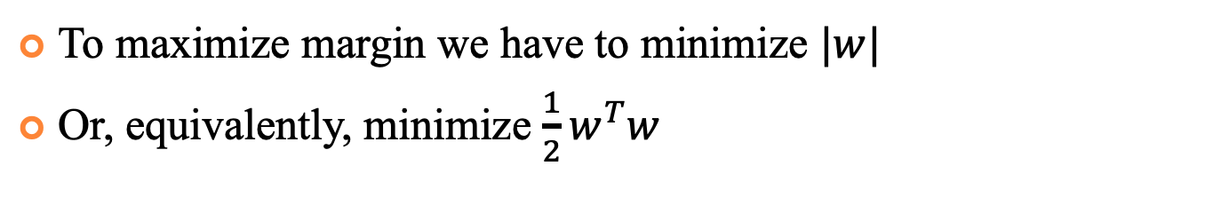
Support Vector Machine
To maximize margin we have to minimize $|w|$
Or, equivalently, minimize $\frac{1}{2}w^{T}w$
$$x^{T}w+b=1$$
$$x^{T}w+b=−1$$
w
H⁺
H
H⁻

Slide 34
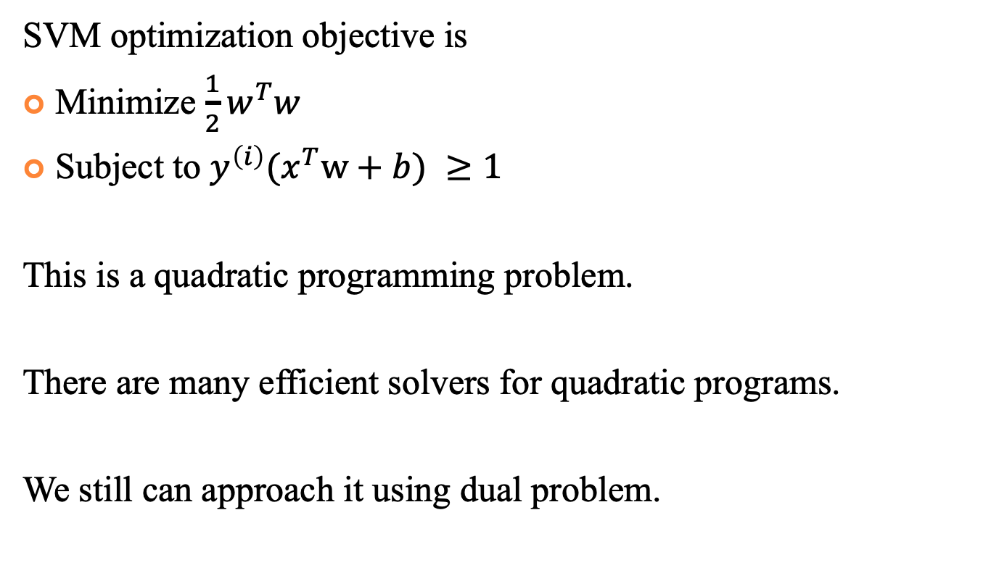

Optimization Problem
SVM optimization objective is
Minimize $\frac{1}{2}w^{T}w$
Subject to $y^{\left(i\right)}(x^{T}w+b) ≥1$
This is a quadratic programming problem.
There are many efficient solvers for quadratic programs.
We still can approach it using dual problem.

Slide 35
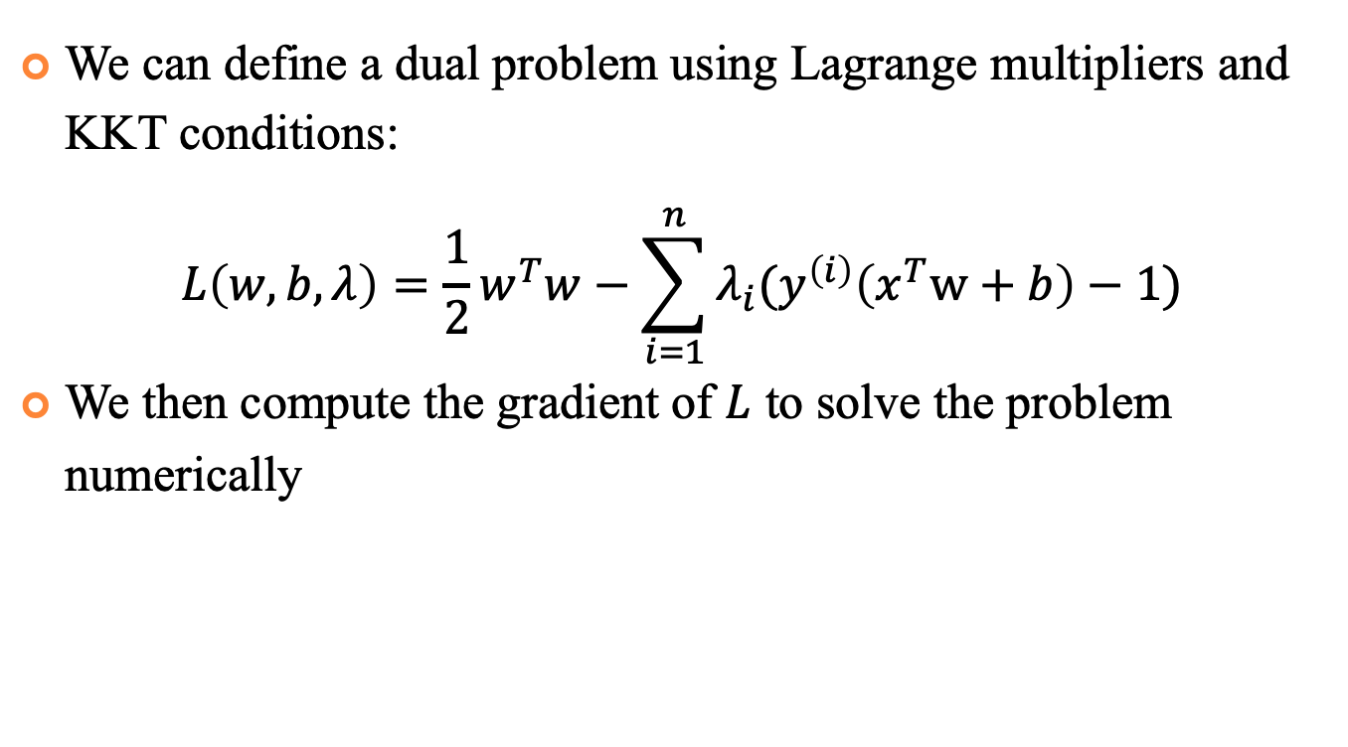

Optimization Problem
We can define a dual problem using Lagrange multipliers and KKT conditions:
$$L\left(w,b,λ\right)=\frac{1}{2}w^{T}w−\sum_{i=1}^{n}{λ_{i}(y^{\left(i\right)}\left(x^{T}w+b\right)−1)}$$
We then compute the gradient of $L$ to solve the problem numerically

Slide 36
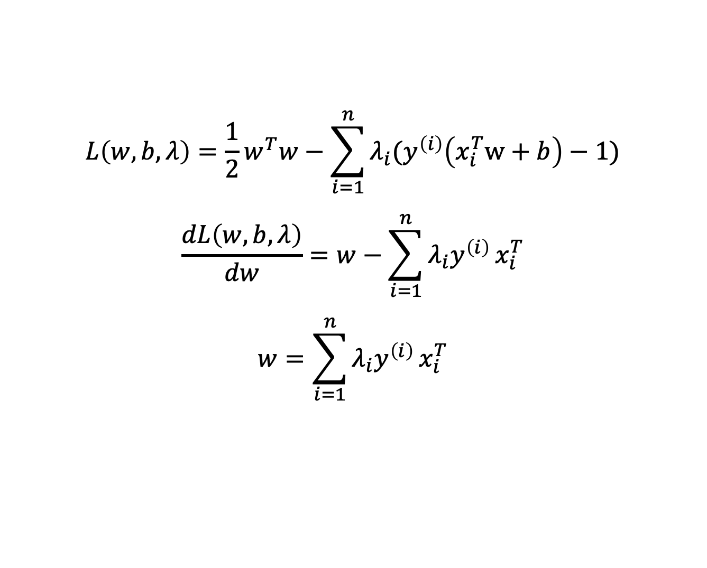

Optimization Problem
$$L\left(w,b,λ\right)=\frac{1}{2}w^{T}w−\sum_{i=1}^{n}{λ_{i}(y^{\left(i\right)}\left(x_{i}^{T}w+b\right)−1)}$$
$$\frac{dL\left(w,b,λ\right)}{dw}=w−\sum_{i=1}^{n}{λ_{i}y^{\left(i\right)}}x_{i}^{T}$$
$$w=\sum_{i=1}^{n}{λ_{i}y^{\left(i\right)}}x_{i}^{T}$$

Slide 37
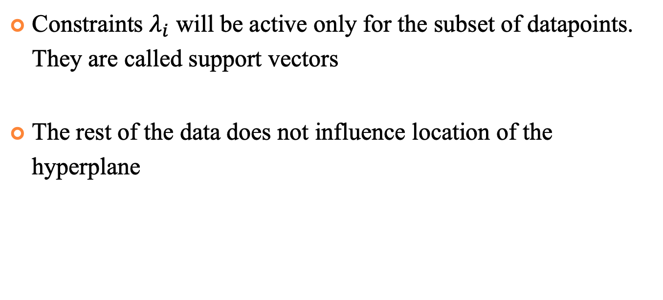
Support Vectors
Constraints $λ_{i}$ will be active only for the subset of datapoints. They are called support vectors
The rest of the data does not influence location of the hyperplane
S⁺
S⁻
d
H⁺
d⁺
d⁻
H⁻

Slide 38
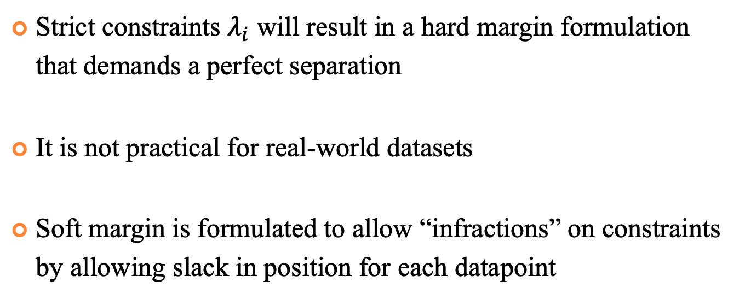
Soft vs Hard Margin
Strict constraints $λ_{i}$ will result in a hard margin formulation that demands a perfect separation
It is not practical for real-world datasets
Soft margin is formulated to allow “infractions” on constraints by allowing slack in position for each datapoint

Slide 39
Soft vs Hard Margin
Strict constraints $λ_{i}$ will result in a hard margin formulation that demands a perfect separation
It is not practical for real-world datasets
Soft margin is formulated to allow “infractions” on constraints by allowing slack in position for each datapoint

Slide 40

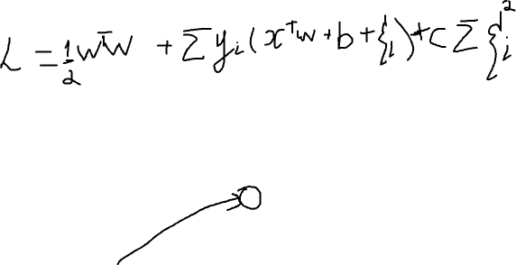

Soft vs Hard Margin
$$x^{T}w+b=1$$
w
$$ξ_{i}$$
H⁺
H

Slide 41
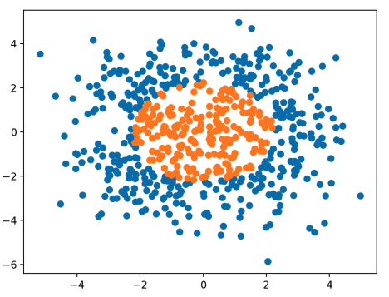

Kernel Trick
We represent our data as a similarity matrix
A function that takes vectors in the original space and return the dot product of the vectors in the feature space is called a kernel function:

Slide 42
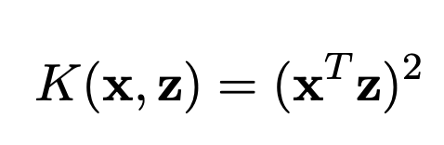
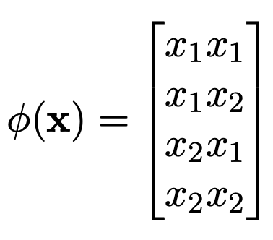
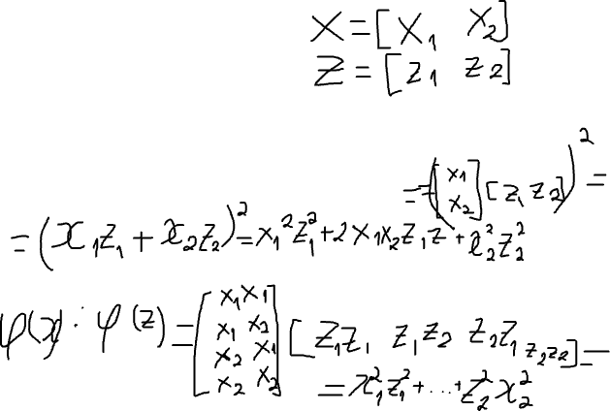
Kernel Trick. Examples
Polynomial Kernel
Important trick: we can often compute kernel without actually doing the expansion
the kernel corresponding to φ(x) is

Slide 43
Kernel Trick. Examples
Polynomial Kernel

Slide 44
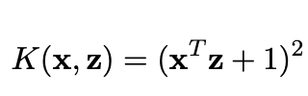
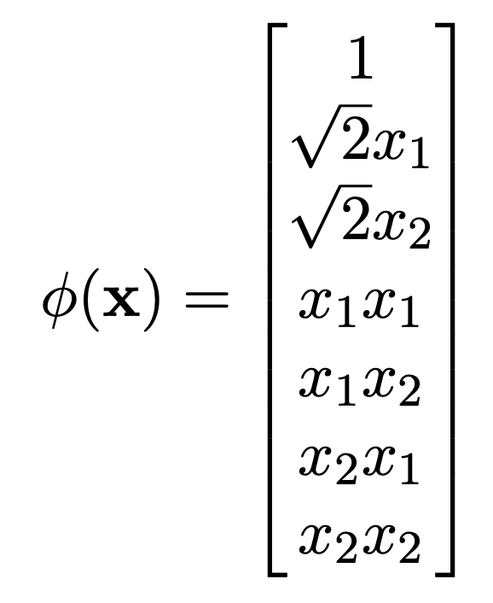
Kernel Trick. Examples
Another polynomial Kernel
the kernel corresponding to φ(x) is

Slide 45
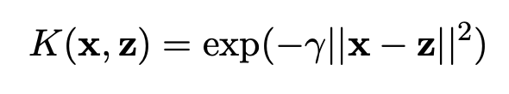
Kernel Trick. Examples
Gaussian Kernel
Highly flexible, non-linear kernel
Corresponds to infinite dimensional φ (cannot implement feature mapping, but can still use kernel)

