Slide 1
CS584 Machine Learning
Lecture 13. Neural Networks
Oleksandr Narykov
onarykov@iit.edu

Slide 2
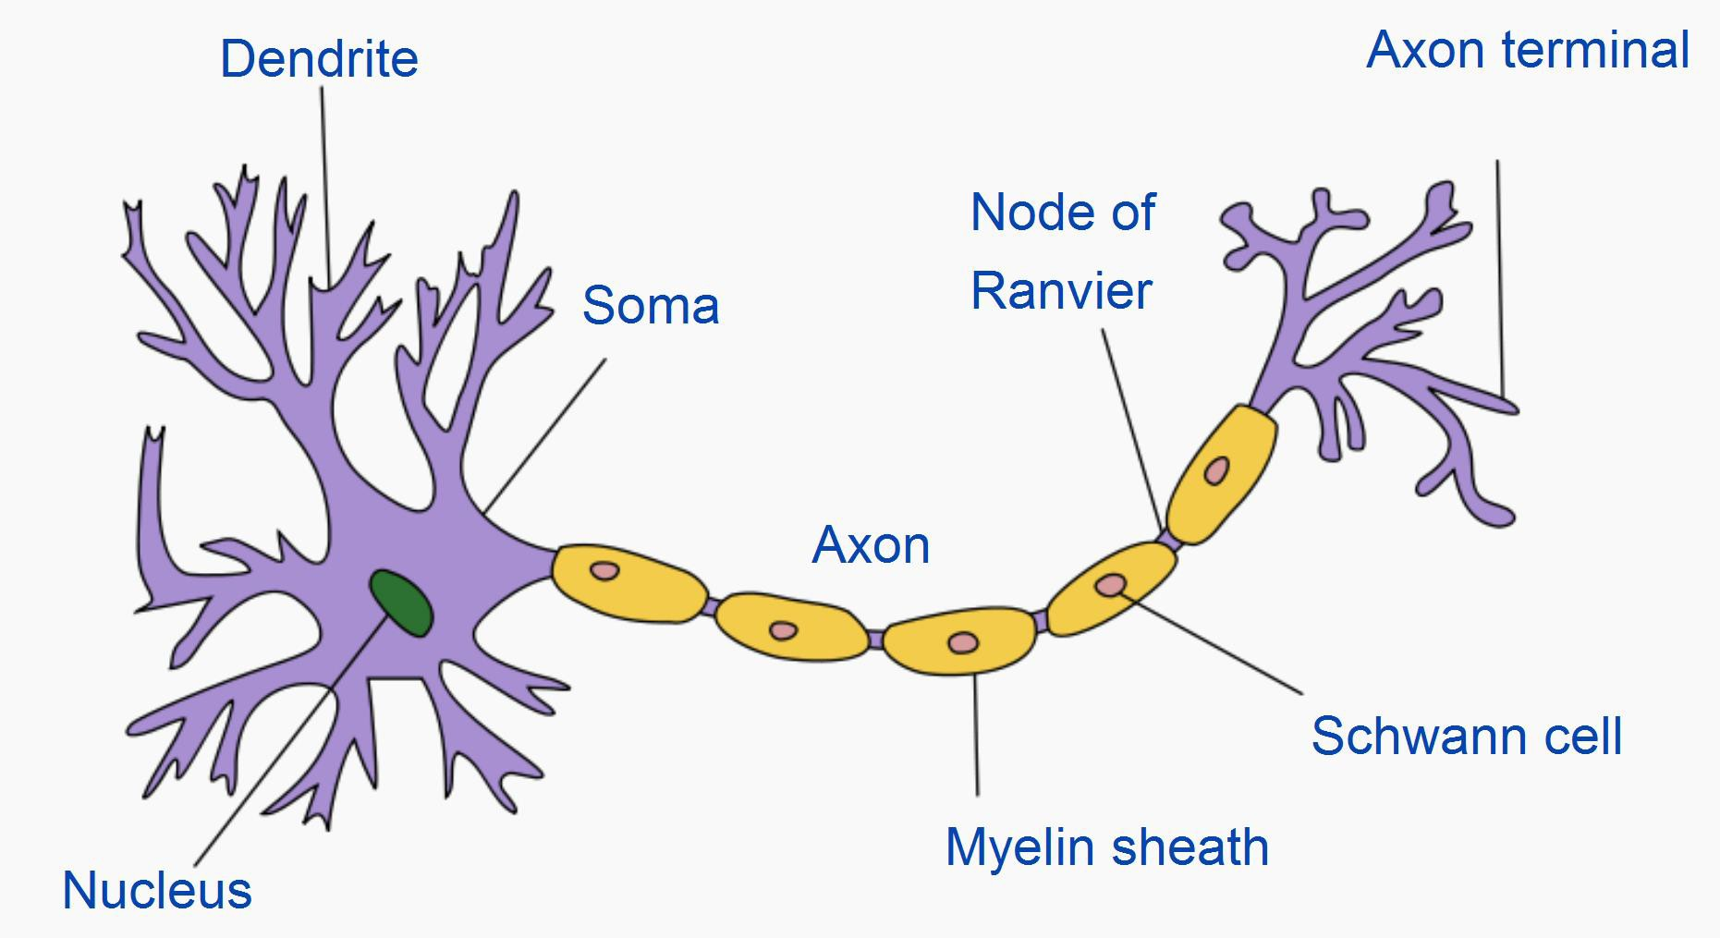
Neuron
By Quasar Jarosz at English Wikipedia, CC BY-SA 3.0, https://commons.wikimedia.org/w/index.php?curid=7616130
2

Slide 3
Neuron
Neurons can have multiple dendrites and at most one axon
Typical connections are from an axon of a neuron to dendrites of other neurons
Synaptic signals are received through dendrites and somas; signals are transmitted through axons
Signals can excite or inhibit the receiving neuron
A neuron fires when the excitement is above a threshold
Note: these are general statements and simplifications, and there are many exceptions!
3

Slide 4
Artificial Neural Networks
Artificial neural networks are inspired by real neurons
1943 – One of the first neural computational models was proposed by McCulloch and Pitts
1958 – Rosenblatt proposed perceptron
1969 – A paper by Minsky and Papert almost killed the entire field
Perceptrons are incapable of representing XOR
Computational resources are too great
1975 – Backpropagation algorithm renewed interest in neural
networks
1980s – parallel architectures were popular
Late 1990s and 2000s – other methods, such as support vector machines, became more popular
2010s – neural networks of several hidden layers are back with the
new name “deep learning”
4

Slide 5
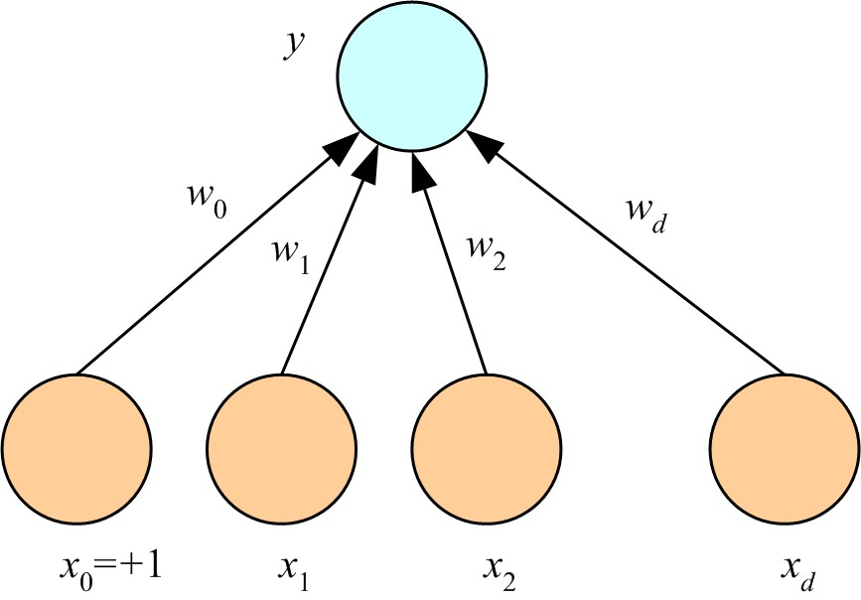
Perceptron
𝑦 = 𝑠𝑖𝑔𝑛 𝑤₀ + σ 𝑤_{𝑖}𝑥_{𝑖}
5

Slide 6
What AN Artificial Neuron Does
Takes a weighted sum of its inputs
𝑤₀ + ∑^{𝑘} 𝑤_{𝑖}𝑥_{𝑖}
𝑖=1
Assume that there is always a constant input 1, that
is, 𝑥₀ = 1. Then,

∑𝑘
𝑤_{𝑖}𝑥_{𝑖}
𝑖=0
Passes this sum through its activation function
𝑓 ∑^{𝑘} 𝑤_{𝑖}𝑥_{𝑖}
𝑖=0
6

Slide 7
Examples
Logical NOT
Logical AND
Logical OR
Logical XOR
7

Slide 8

Examples
Logical NOT
7
https://miro.medium.com/v2/resize:fit:184/format:webp/1*2YxHEu05jeYvxxd9Rsf_7A.png

Slide 9
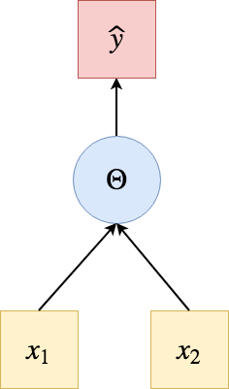
Examples
Logical AND, Logical OR
7
https://miro.medium.com/v2/resize:fit:472/format:webp/1*zNs6iNlZIs7-XhNmPHlB9Q.png

Slide 10
Simple Multilayer Network for XOR
𝑋𝑂𝑅 𝐴, 𝐵 = 𝐴 ∧ ¬𝐵 ∨ ¬𝐴 ∧ 𝐵
One perceptron for
One perceptron for
𝐴 ∧ ¬𝐵
¬𝐴 ∧ 𝐵
One perceptron for combining the outputs, through OR, of the two previous perceptrons
8

Slide 11
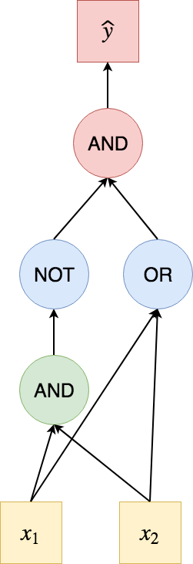
Simple Multilayer Network for XOR
𝑋𝑂𝑅 𝐴, 𝐵 = 𝐴 ∧ ¬𝐵 ∨ ¬𝐴 ∧ 𝐵
One perceptron for
One perceptron for
𝐴 ∧ ¬𝐵
¬𝐴 ∧ 𝐵
One perceptron for combining the outputs, through OR, of the two previous perceptrons
8
https://miro.medium.com/v2/resize:fit:502/format:webp/1*Rm1Cd2KDoi1ACE-5KFP_Iw.png

Slide 12
Various Activation Functions
Identity function
Bipolar step function
Binary sigmoid
Bipolar sigmoid
Hyperbolic tangent
9

Slide 13
Bipolar Step Function
𝑓 ∑^{𝑘} 𝑤_{𝑖}𝑥_{𝑖} = 𝑠𝑖𝑔𝑛 ∑^{𝑘} 𝑤 𝑥
𝑖=0 𝑖=0 𝑖 𝑖
Returns either +1 or -1 (except right on the decision boundary)
Useful for both hidden layers and output layer
However, its discontinuous and it is problematic for learning algorithms that require taking its derivative
10

Slide 14
Bipolar Sigmoid
𝑓 σ^{𝑘} 𝑤 𝑥 =
2
− 1
𝑖=0
𝑖 𝑖
− ∑^{𝑘} 𝑤_{𝑖}𝑥_{𝑖}
1+𝑒
𝑖=0
This is a rescaled version of the binary sigmoid
The output of the bipolar sigmoid is between -1 and +1
Useful for output layer when the task is classification
Useful for both hidden and output layers
15

Slide 15
Identity Function
𝑓 ∑^{𝑘} 𝑤_{𝑖}𝑥_{𝑖} = ∑^{𝑘} 𝑤 𝑥
𝑖=0 𝑖=0 𝑖 𝑖
Typically used for the output neurons when the task is regression
The identity function should not be used in the hidden layers
Linear combination of linear functions is another linear function, and hence, using the identity function in the hidden layers does not increase the representative power of the neural network
11

Slide 16
Binary Sigmoid
𝑓 ∑^{𝑘} 𝑤 𝑥 =
1
𝑖=0
𝑖 𝑖
−∑^{𝑘} 𝑤_{𝑖}𝑥_{𝑖}
1+𝑒
𝑖=0
This is the logistic function that we used
Except, notice the minus sign in front of the sum
This is only a convention and does not change much
The output of the binary sigmoid is between 0
and 1
Useful for output layer when the task is classification
The output can be interpreted as a probability
12

Slide 17
Hyperbolic Tangent
₌ 𝑒
∑𝑘
𝑤_{𝑖}𝑥_{𝑖} − ∑^{𝑘} 𝑤_{𝑖}𝑥_{𝑖}
𝑓. ∑^{𝑘}
𝑤 𝑥
𝑖=0
−𝑒
𝑖=0
𝑖=0
𝑖 𝑖
∑𝑘
𝑤_{𝑖}𝑥_{𝑖} − ∑^{𝑘} 𝑤_{𝑖}𝑥_{𝑖}
𝑒 +𝑒
𝑖=0 𝑖=0
The output of tanh is between -1 and +1
Useful for output layer when the task is classification
Useful for both hidden and output layers
13

Slide 18
Relu
𝑓 ∑^{𝑘} 𝑤_{𝑖}𝑥_{𝑖} = ∑^{𝑘} 𝑤_{𝑖}𝑥_{𝑖} if ∑^{𝑘} 𝑤_{𝑖}𝑥_{𝑖} > 0;
𝑖=0 𝑖=0 𝑖=0
0 otherwise
Typically used for hidden layers, especially for
computer vision tasks
14

Slide 19
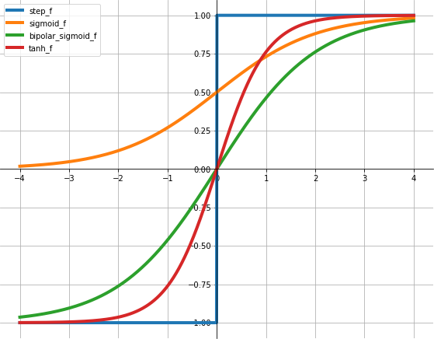
Activation Function Plots
16

Slide 20
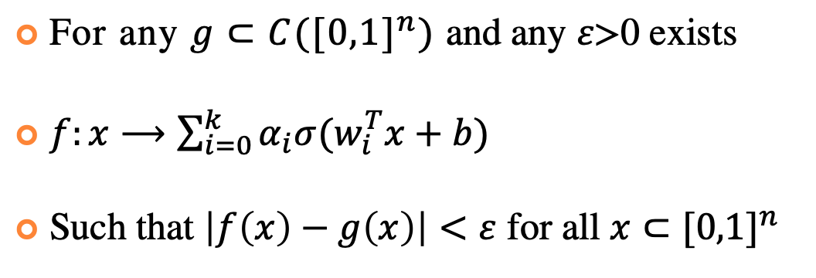
Universal Approximation
For any $g⊂C({[0,1]}^{n})$ and any $ε\text{>0}$ exists
$f:x⟶\sum_{i=0}^{k}{α_{i}σ(w_{i}^{T}x+b)}$
Such that $\left|f\left(x\right)−g\left(x\right)\right|<ε$ for all $x⊂{[0,1]}^{n}$
8

Slide 21
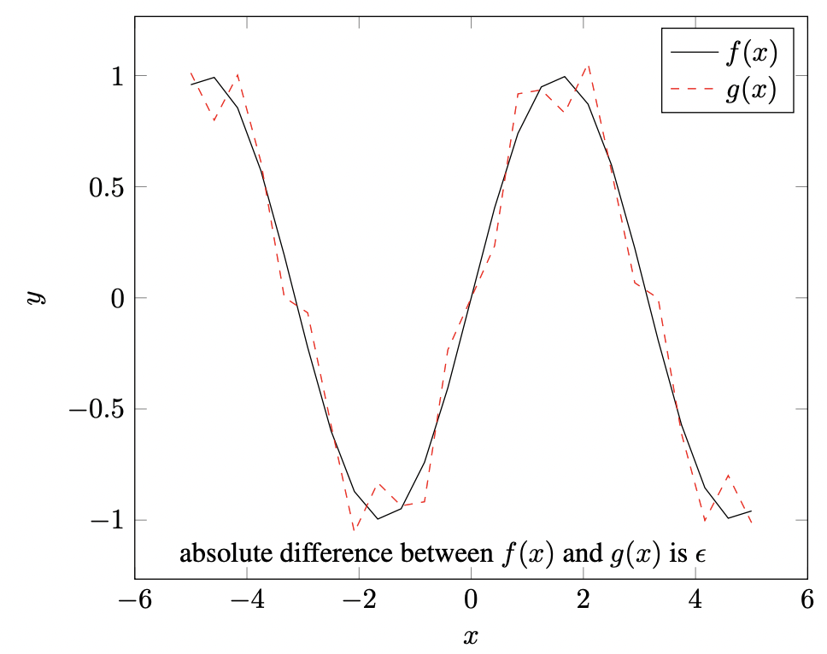
Universal Approximation
For any $g⊂C({[0,1]}^{n})$ and any $ε\text{>0}$ exists
$f:x⟶\sum_{i=0}^{k}{α_{i}σ(w_{i}^{T}x+b)}$
Such that $\left|f\left(x\right)−g\left(x\right)\right|<ε$ for all $x⊂{[0,1]}^{n}$
8

Slide 22
Deep Learning
Several hidden layers
Millions of parameters
Big data, big computation
If a neural network with a single hidden layer is a universal approximator, why go deep?
“Why and When Can Deep -- but Not Shallow -- Networks Avoid the Curse of Dimensionality: a Review” https://arxiv.org/abs/1611.00740
17

Slide 23
Example DL Network Architectures
Convolutional neural networks (CNN)
Recurrent neural networks (RNN)
Long Short-Term Memory networks (LSTM)
18

Slide 24
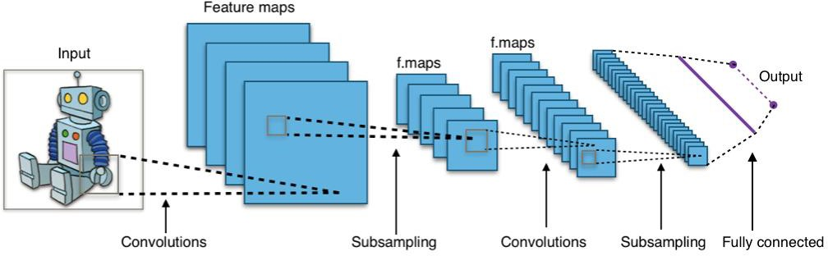
Convolutional Neural Networks
https://commons.wikimedia.org/wiki/File:Typical_cnn.png
19

Slide 25
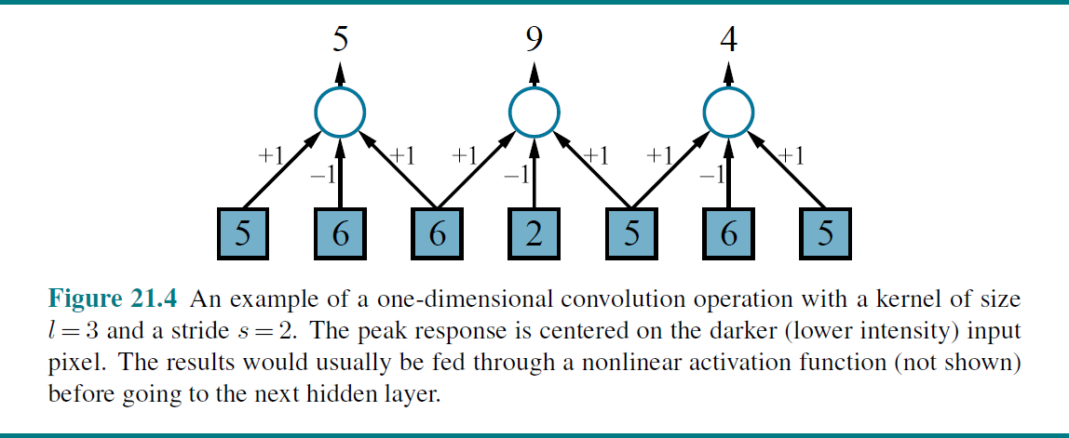
Convolution
Figure from http://aima.cs.berkeley.edu/figures.pdf
20

Slide 26
Pooling
Aggregates a set of adjacent units
Like convolution, has a kernel size and a stride size
Unlike convolution, weights are fixed (not learned)
Examples
Average pooling
Max pooling
21

Slide 27
Learning the Weights
Define an error (loss) function
Take its derivative with respect to the weights
Perform gradient descent
25

Slide 28
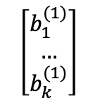
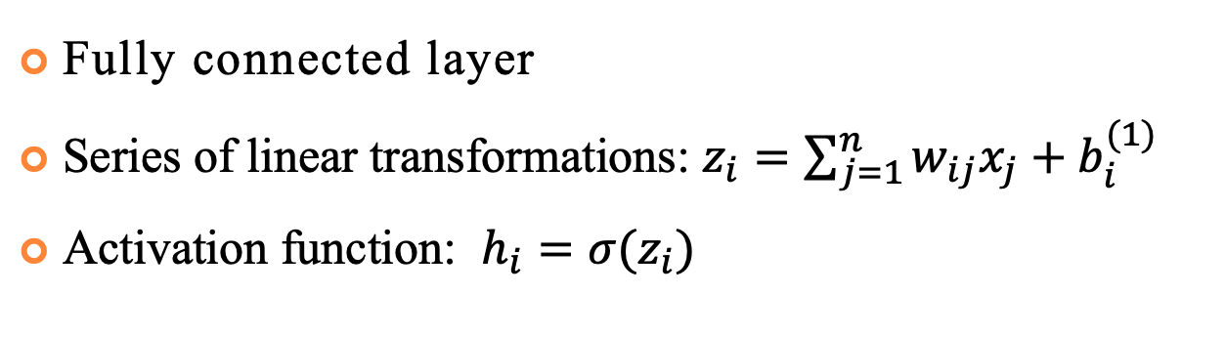
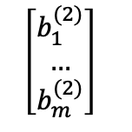
Fully Connected Neural Network
Fully connected layer
Series of linear transformations: $z_{i}=\sum_{j=1}^{n}{w_{ij}x_{j}}+b_{i}^{(1)}$
Activation function: $h_{i}=σ(z_{i})$
x₁
W⁽¹⁾
W⁽²⁾
z₁
h₁
y₁
x₂
…
…
…
y_{m}
…
z_{k}
h_{k}
$$\left[\begin{matrix}b_{1}^{(2)} \\ … \\ b_{m}^{(2)}\end{matrix}\right]$$
x_{n}
$$\left[\begin{matrix}b_{1}^{(1)} \\ … \\ b_{k}^{(1)}\end{matrix}\right]$$
25

Slide 29
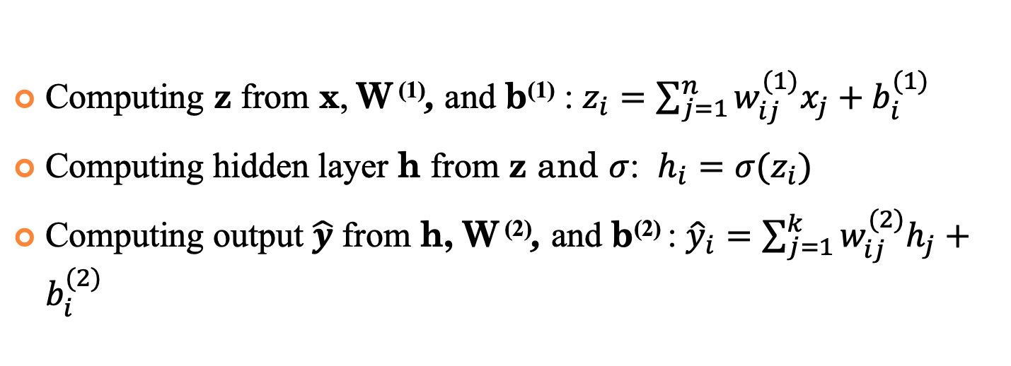
Forward Pass
Computing z from x, W ⁽¹⁾, and b⁽¹⁾ : $z_{i}=\sum_{j=1}^{n}{w_{ij}^{(1)}x_{j}}+b_{i}^{(1)}$
Computing hidden layer h from z and $σ$: $h_{i}=σ(z_{i})$
Computing output $\hat{y}$ from h, W ⁽²⁾, and b⁽²⁾ : ${\hat{y}}_{i}=\sum_{j=1}^{k}{w_{ij}^{(2)}h_{j}}+b_{i}^{(2)}$
x₁
W⁽¹⁾
W⁽²⁾
z₁
h₁
y₁
x₂
…
…
…
y_{m}
…
z_{k}
h_{k}
$$\left[\begin{matrix}b_{1}^{(2)} \\ … \\ b_{m}^{(2)}\end{matrix}\right]$$
x_{n}
$$\left[\begin{matrix}b_{1}^{(1)} \\ … \\ b_{k}^{(1)}\end{matrix}\right]$$
25

Slide 30
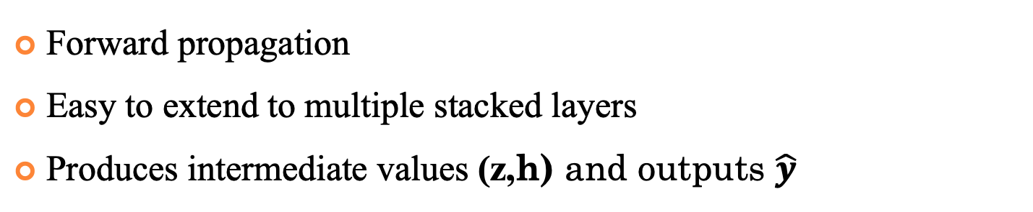
Forward Pass
Forward propagation
Easy to extend to multiple stacked layers
Produces intermediate values (z,h) and outputs $\hat{y}$
x₁
W⁽¹⁾
W⁽²⁾
z₁
h₁
y₁
x₂
…
…
…
y_{m}
…
z_{k}
h_{k}
$$\left[\begin{matrix}b_{1}^{(2)} \\ … \\ b_{m}^{(2)}\end{matrix}\right]$$
x_{n}
$$\left[\begin{matrix}b_{1}^{(1)} \\ … \\ b_{k}^{(1)}\end{matrix}\right]$$
25

Slide 31

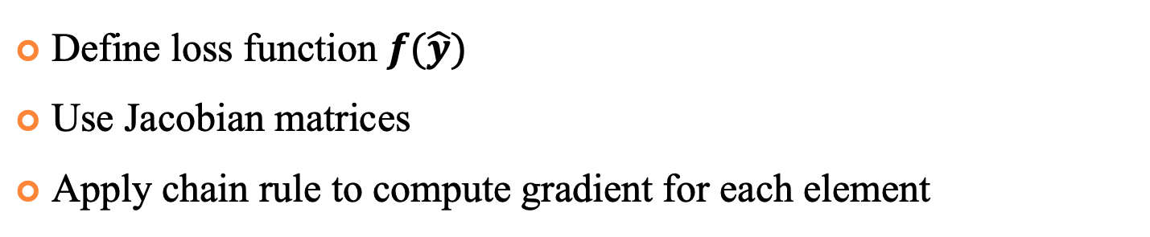
Backpropagation
Define loss function $f(\hat{y})$
Use Jacobian matrices
Apply chain rule to compute gradient for each element
x₁
W⁽¹⁾
W⁽²⁾
z₁
h₁
y₁
x₂
…
…
$$f$$
…
y_{m}
…
z_{k}
h_{k}
$$\left[\begin{matrix}b_{1}^{(2)} \\ … \\ b_{m}^{(2)}\end{matrix}\right]$$
x_{n}
$$\left[\begin{matrix}b_{1}^{(1)} \\ … \\ b_{k}^{(1)}\end{matrix}\right]$$
25

Slide 32
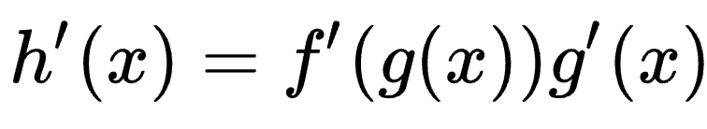
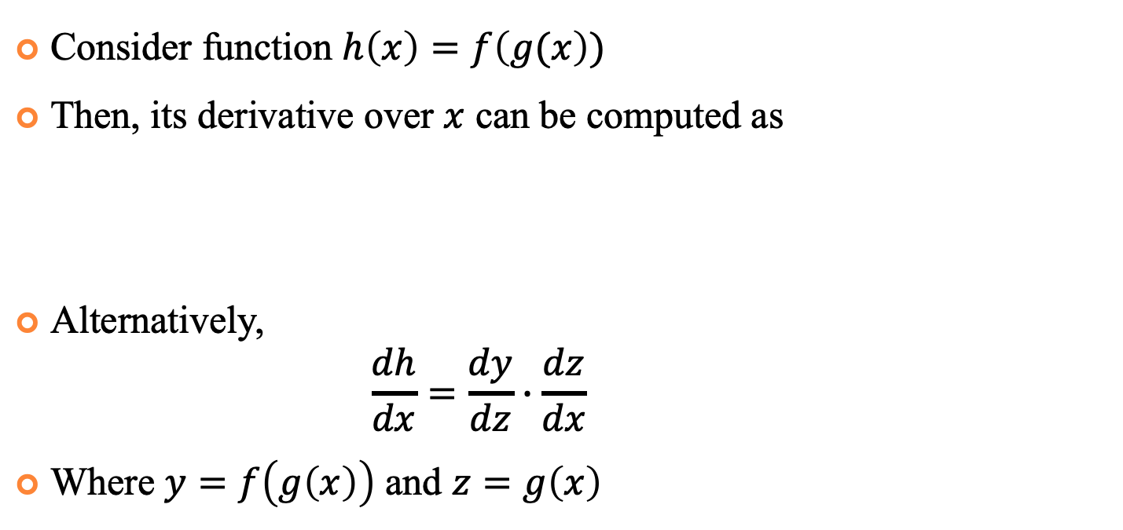
Chain Rule
Consider function $h\left(x\right)=f\left(g(x\right))$
Then, its derivative over $x$ can be computed as
Alternatively,
$$\frac{dh}{dx}=\frac{dy}{dz}∙\frac{dz}{dx}$$
Where $y=f\left(g\left(x\right)\right)$ and $z=g\left(x\right)$

Slide 33
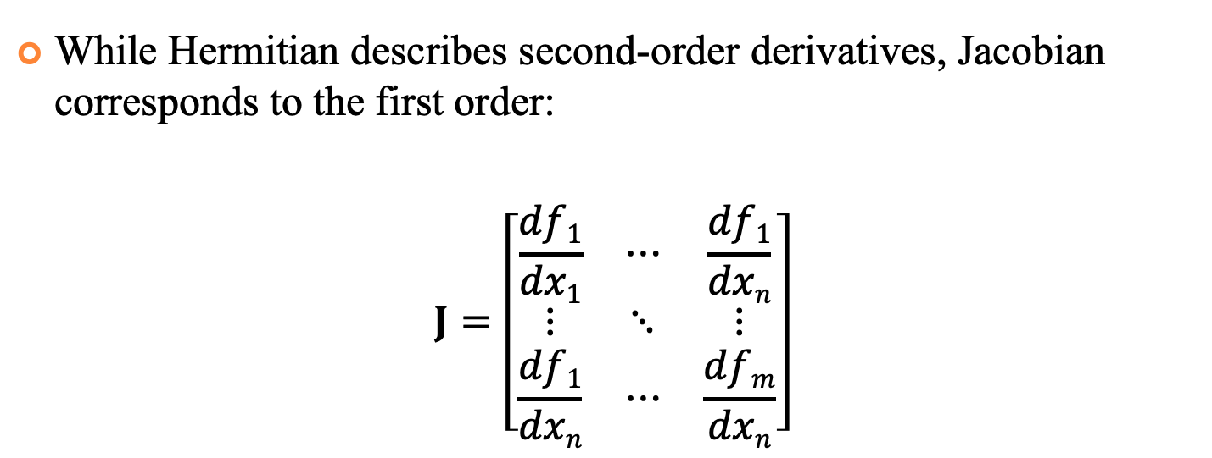
Jacobian Matrix
While Hermitian describes second-order derivatives, Jacobian corresponds to the first order:
$$J=\left[\begin{matrix}\frac{df1}{dx1} & ⋯ & \frac{df1}{dxn} \\ ⋮ & ⋱ & ⋮ \\ \frac{df1}{dxn} & ⋯ & \frac{dfm}{dxn}\end{matrix}\right]$$

Slide 34


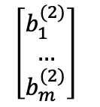
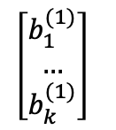
Backpropagation
Apply chain rule to the Neural Network:
$$\frac{df}{dW^{(2)}}=\frac{df}{d\hat{y}}∙\frac{d\hat{y}}{dW^{\left(2\right)}}$$
$$\frac{df}{db^{(2)}}=\frac{df}{d\hat{y}}∙\frac{d\hat{y}}{db^{(2)}}$$
x₁
W⁽¹⁾
W⁽²⁾
z₁
h₁
y₁
x₂
…
…
…
$$f$$
y_{m}
…
z_{k}
h_{k}
x_{n}
$$\left[\begin{matrix}b_{1}^{(2)} \\ … \\ b_{m}^{(2)}\end{matrix}\right]$$
$$\left[\begin{matrix}b_{1}^{(1)} \\ … \\ b_{k}^{(1)}\end{matrix}\right]$$
25

Slide 35

Backpropagation
$$\frac{df}{dW^{(2)}}=\frac{df}{d\hat{y}}∙\frac{d\hat{y}}{dW^{\left(2\right)}}$$
$$\frac{df}{db^{(2)}}=\frac{df}{d\hat{y}}∙\frac{d\hat{y}}{db^{(2)}}$$
$$\frac{df}{dW^{(1)}}=\frac{df}{d\hat{y}}∙\frac{d\hat{y}}{dh}∙\frac{dh}{dz}∙\frac{dz}{dW^{\left(1\right)}}$$
$$\frac{df}{db^{(1)}}=\frac{df}{d\hat{y}}∙\frac{d\hat{y}}{dh}∙\frac{dh}{dz}∙\frac{d\hat{y}}{db^{(1)}}$$
x₁
W⁽¹⁾
W⁽²⁾
z₁
h₁
y₁
x₂
…
…
…
$$f$$
y_{m}
…
z_{k}
h_{k}
x_{n}
$$\left[\begin{matrix}b_{1}^{(2)} \\ … \\ b_{m}^{(2)}\end{matrix}\right]$$
$$\left[\begin{matrix}b_{1}^{(1)} \\ … \\ b_{k}^{(1)}\end{matrix}\right]$$
25

Slide 36

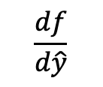

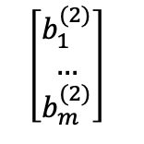
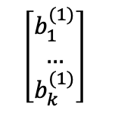
Backpropagation
$$\frac{df}{dW^{(2)}}=\frac{df}{d\hat{y}}$$
x₁
W⁽¹⁾
W⁽²⁾
$$\frac{df}{d\hat{y}}$$
z₁
h₁
y₁
x₂
…
$$f$$
…
…
y_{m}
…
z_{k}
h_{k}
$$\left[\begin{matrix}b_{1}^{(2)} \\ … \\ b_{m}^{(2)}\end{matrix}\right]$$
x_{n}
$$\left[\begin{matrix}b_{1}^{(1)} \\ … \\ b_{k}^{(1)}\end{matrix}\right]$$
25

Slide 37

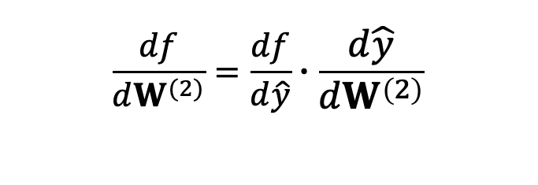
Backpropagation
$$\frac{df}{dW^{(2)}}=\frac{df}{d\hat{y}}∙\frac{d\hat{y}}{dW^{\left(2\right)}}$$
x₁
W⁽¹⁾
W⁽²⁾
$$\frac{df}{d\hat{y}}$$
z₁
h₁
y₁
x₂
$$\frac{d\hat{y}}{dW^{\left(2\right)}}$$
$$f$$
…
…
…
y_{m}
…
z_{k}
h_{k}
$$\left[\begin{matrix}b_{1}^{(2)} \\ … \\ b_{m}^{(2)}\end{matrix}\right]$$
x_{n}
$$\left[\begin{matrix}b_{1}^{(1)} \\ … \\ b_{k}^{(1)}\end{matrix}\right]$$
25

Slide 38
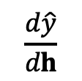
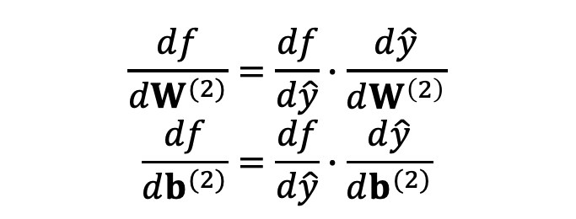
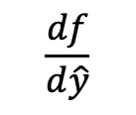
Backpropagation
$$\frac{df}{dW^{(2)}}=\frac{df}{d\hat{y}}∙\frac{d\hat{y}}{dW^{\left(2\right)}}$$
$$\frac{df}{db^{(2)}}=\frac{df}{d\hat{y}}∙\frac{d\hat{y}}{db^{(2)}}$$
x₁
W⁽¹⁾
W⁽²⁾
z₁
h₁
y₁
x₂
$$\frac{d\hat{y}}{dh}$$
$$f$$
…
…
…
$$\frac{df}{d\hat{y}}$$
y_{m}
…
z_{k}
h_{k}
$$\left[\begin{matrix}b_{1}^{(2)} \\ … \\ b_{m}^{(2)}\end{matrix}\right]$$
x_{n}
$$\left[\begin{matrix}b_{1}^{(1)} \\ … \\ b_{k}^{(1)}\end{matrix}\right]$$
25

Slide 39
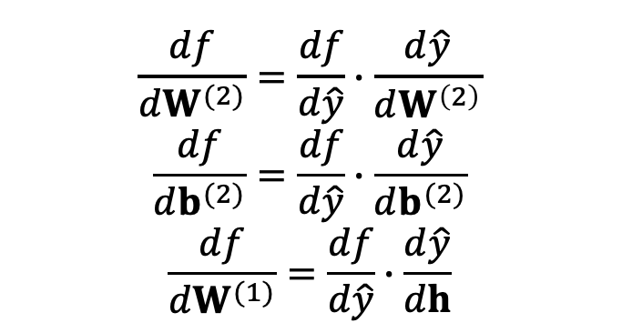
Backpropagation
$$\frac{df}{dW^{(2)}}=\frac{df}{d\hat{y}}∙\frac{d\hat{y}}{dW^{\left(2\right)}}$$
$$\frac{df}{db^{(2)}}=\frac{df}{d\hat{y}}∙\frac{d\hat{y}}{db^{(2)}}$$
$$\frac{df}{dW^{(1)}}=\frac{df}{d\hat{y}}∙\frac{d\hat{y}}{dh}$$
x₁
W⁽¹⁾
W⁽²⁾
z₁
h₁
y₁
x₂
$$\frac{d\hat{y}}{dh}$$
$$f$$
…
…
…
$$\frac{df}{d\hat{y}}$$
y_{m}
…
z_{k}
h_{k}
$$\left[\begin{matrix}b_{1}^{(2)} \\ … \\ b_{m}^{(2)}\end{matrix}\right]$$
x_{n}
$$\left[\begin{matrix}b_{1}^{(1)} \\ … \\ b_{k}^{(1)}\end{matrix}\right]$$
25

Slide 40
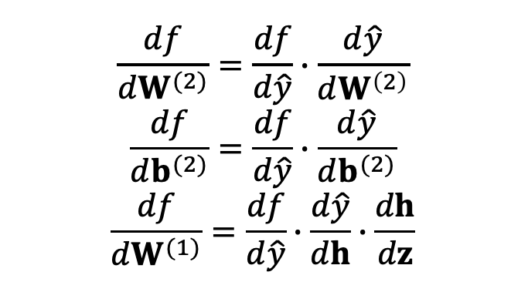
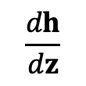
Backpropagation
$$\frac{df}{dW^{(2)}}=\frac{df}{d\hat{y}}∙\frac{d\hat{y}}{dW^{\left(2\right)}}$$
$$\frac{df}{db^{(2)}}=\frac{df}{d\hat{y}}∙\frac{d\hat{y}}{db^{(2)}}$$
$$\frac{df}{dW^{(1)}}=\frac{df}{d\hat{y}}∙\frac{d\hat{y}}{dh}∙\frac{dh}{dz}$$
x₁
W⁽¹⁾
W⁽²⁾
z₁
h₁
y₁
x₂
$$\frac{dh}{dz}$$
$$\frac{d\hat{y}}{dh}$$
$$f$$
…
…
…
$$\frac{df}{d\hat{y}}$$
y_{m}
…
z_{k}
h_{k}
$$\left[\begin{matrix}b_{1}^{(2)} \\ … \\ b_{m}^{(2)}\end{matrix}\right]$$
x_{n}
$$\left[\begin{matrix}b_{1}^{(1)} \\ … \\ b_{k}^{(1)}\end{matrix}\right]$$
25

Slide 41
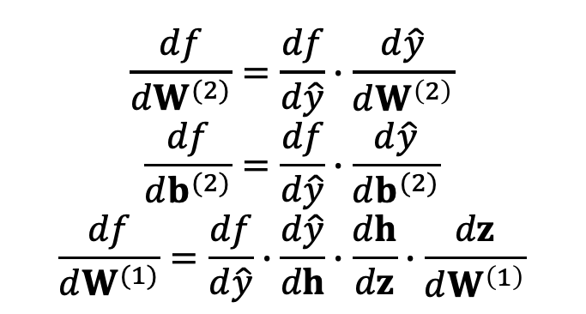
Backpropagation
$$\frac{df}{dW^{(2)}}=\frac{df}{d\hat{y}}∙\frac{d\hat{y}}{dW^{\left(2\right)}}$$
$$\frac{df}{db^{(2)}}=\frac{df}{d\hat{y}}∙\frac{d\hat{y}}{db^{(2)}}$$
$$\frac{df}{dW^{(1)}}=\frac{df}{d\hat{y}}∙\frac{d\hat{y}}{dh}∙\frac{dh}{dz}∙\frac{dz}{dW^{\left(1\right)}}$$
x₁
W⁽¹⁾
W⁽²⁾
z₁
h₁
y₁
x₂
$$\frac{dh}{dz}$$
$$\frac{d\hat{y}}{dh}$$
$$f$$
…
…
…
$$\frac{df}{d\hat{y}}$$
y_{m}
…
z_{k}
h_{k}
$$\left[\begin{matrix}b_{1}^{(2)} \\ … \\ b_{m}^{(2)}\end{matrix}\right]$$
x_{n}
$$\left[\begin{matrix}b_{1}^{(1)} \\ … \\ b_{k}^{(1)}\end{matrix}\right]$$
25

Slide 42
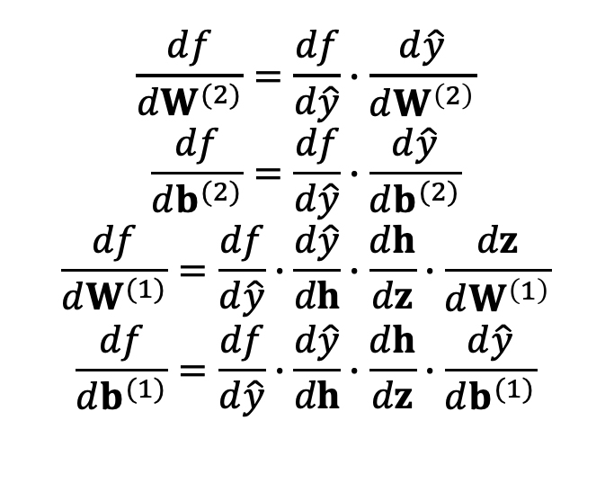
Backpropagation
$$\frac{df}{dW^{(2)}}=\frac{df}{d\hat{y}}∙\frac{d\hat{y}}{dW^{\left(2\right)}}$$
$$\frac{df}{db^{(2)}}=\frac{df}{d\hat{y}}∙\frac{d\hat{y}}{db^{(2)}}$$
$$\frac{df}{dW^{(1)}}=\frac{df}{d\hat{y}}∙\frac{d\hat{y}}{dh}∙\frac{dh}{dz}∙\frac{dz}{dW^{\left(1\right)}}$$
$$\frac{df}{db^{(1)}}=\frac{df}{d\hat{y}}∙\frac{d\hat{y}}{dh}∙\frac{dh}{dz}∙\frac{d\hat{y}}{db^{(1)}}$$
x₁
W⁽¹⁾
W⁽²⁾
z₁
h₁
y₁
x₂
$$\frac{dh}{dz}$$
$$\frac{d\hat{y}}{dh}$$
$$f$$
…
…
…
$$\frac{df}{d\hat{y}}$$
y_{m}
…
z_{k}
h_{k}
$$\left[\begin{matrix}b_{1}^{(2)} \\ … \\ b_{m}^{(2)}\end{matrix}\right]$$
x_{n}
$$\left[\begin{matrix}b_{1}^{(1)} \\ … \\ b_{k}^{(1)}\end{matrix}\right]$$
25

Slide 43
Some Error/Loss Functions
Classification: log-loss, cross entropy, negative CLL
− 1 − 𝑡 × 𝑙𝑛 1 − 𝑦 − 𝑡 × 𝑙𝑛 𝑦
t: the true target value (0/1)
y: probability of class 1
Regression: squared error
1
𝑡 − 𝑦
2
2
t: the true target value
y: the predicted value
26

Slide 44
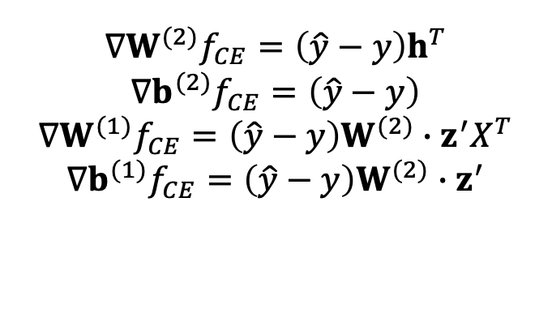
Cross-Entropy Gradients
$$∇W^{(2)}f_{CE}=\left(\hat{y}−y\right)h^{T}$$
$$∇b^{(2)}f_{CE}=\left(\hat{y}−y\right)$$
$$∇W^{(1)}f_{CE}=\left(\hat{y}−y\right)W^{(2)}∙z^{′}X^{T}$$
$$∇b^{(1)}f_{CE}=\left(\hat{y}−y\right)W^{(2)}∙z^{′}$$
x₁
W⁽¹⁾
W⁽²⁾
z₁
h₁
y₁
x₂
$$\frac{dh}{dz}$$
$$\frac{d\hat{y}}{dh}$$
$$f$$
…
…
…
$$\frac{df}{d\hat{y}}$$
y_{m}
…
z_{k}
h_{k}
$$\left[\begin{matrix}b_{1}^{(2)} \\ … \\ b_{m}^{(2)}\end{matrix}\right]$$
x_{n}
$$\left[\begin{matrix}b_{1}^{(1)} \\ … \\ b_{k}^{(1)}\end{matrix}\right]$$
25

Slide 45
Derivatives of the Activation Functions
f is the activation function, h is the weighted sum of the incoming signals
f(z(x)) ≡ binary sigmoid
𝜕𝑓 z(𝑥) 𝜕z(𝑥)

= 𝑓 z(𝑥) × 1 − 𝑓 z(𝑥) ×
𝜕𝑥 𝜕𝑥
f(z(x)) ≡ tanh
𝜕𝑓 z(𝑥)
= 1 + 𝑓 z(𝑥) × 1 − 𝑓 z(𝑥) ×
𝜕z(𝑥)

𝜕𝑥
𝜕𝑥
28

Slide 46
Autograd
The architecture of the Neural Networks changes quite frequently
Optimization steps can be this flexible!
Gradients can be computed automatically
Autograd is a PyTorch module responsible for computational steps and computing derivatives
Simplified version for getting familiar with the concept: https://github.com/karpathy/micrograd
28

Slide 47
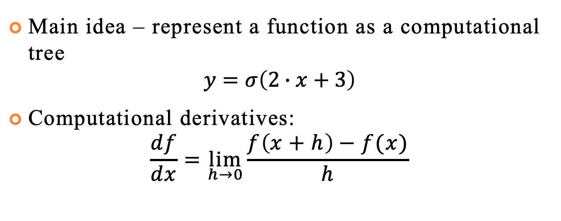
Autograd
Main idea – represent a function as a computational tree
$$y=σ\left(2∙x+3\right)$$
Computational derivatives:
$$\frac{df}{dx}=\lim_{h→0}{\frac{f\left(x+h\right)−f(x)}{h}}$$
28

Slide 48
Autograd
Main idea – represent a function as a computational tree
$$y=σ\left(2∙x+3\right)$$
Computational derivatives:
$$\frac{df}{dx}=\lim_{h→0}{\frac{f\left(x+h\right)−f(x)}{h}}$$
2
x
3
*
+
𝜎
28
y

Slide 49
Overfitting
Neural networks are powerful tools
Even with a single hidden layer, they are “universal approximators”, i.e., they can approximate arbitrary functions arbitrarily close
Therefore, it is very easy to overfit them
To prevent overfitting, utilize
Domain knowledge
Shared parameters
Validation data
Regularization
Dropout
29

Slide 50
Weight Initialization
Neural networks are non-convex ML model
Because of this, initial values of the weights and biases play a significant role
Model may get stuck in the local minimum
29

Slide 51
Weight Initialization
Neural networks are non-convex ML model
Because of this, initial values of the weights and biases play a significant role
Model may get stuck in the local minimum
29

Slide 52
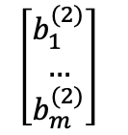
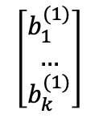

Weight Initialization
Consider fully-connected neural network initialized with zero weights and biases
What happens when we apply gradient descent? Let’s consider ReLU activation function
x₁
W⁽¹⁾
W⁽²⁾
z₁
h₁
y₁
x₂
…
…
…
$$f$$
y_{m}
…
z_{k}
h_{k}
x_{n}
$$\left[\begin{matrix}b_{1}^{(2)} \\ … \\ b_{m}^{(2)}\end{matrix}\right]$$
$$\left[\begin{matrix}b_{1}^{(1)} \\ … \\ b_{k}^{(1)}\end{matrix}\right]$$
29

Slide 53
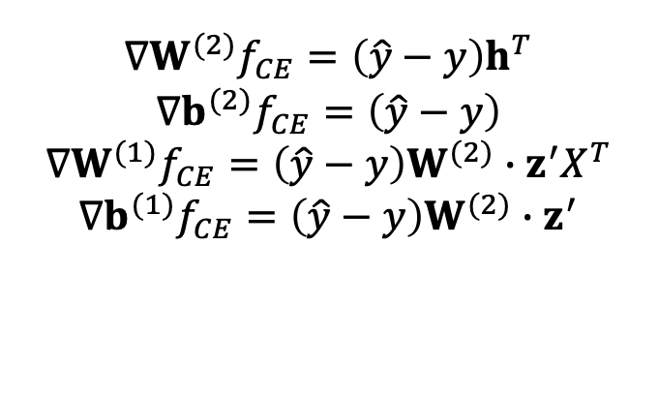
Weight Initialization
$$∇W^{(2)}f_{CE}=\left(\hat{y}−y\right)h^{T}$$
$$∇b^{(2)}f_{CE}=\left(\hat{y}−y\right)$$
$$∇W^{(1)}f_{CE}=\left(\hat{y}−y\right)W^{(2)}∙z^{′}X^{T}$$
$$∇b^{(1)}f_{CE}=\left(\hat{y}−y\right)W^{(2)}∙z^{′}$$
x₁
W⁽¹⁾
W⁽²⁾
z₁
h₁
y₁
x₂
…
…
…
$$f$$
y_{m}
…
z_{k}
h_{k}
x_{n}
$$\left[\begin{matrix}b_{1}^{(2)} \\ … \\ b_{m}^{(2)}\end{matrix}\right]$$
$$\left[\begin{matrix}b_{1}^{(1)} \\ … \\ b_{k}^{(1)}\end{matrix}\right]$$
29

Slide 54
Weight Initialization
Zero weight initialization will make algorithm stuck in local minimum, never changing its value
x₁
W⁽¹⁾
W⁽²⁾
z₁
h₁
y₁
x₂
…
…
…
$$f$$
y_{m}
…
z_{k}
h_{k}
x_{n}
$$\left[\begin{matrix}b_{1}^{(2)} \\ … \\ b_{m}^{(2)}\end{matrix}\right]$$
$$\left[\begin{matrix}b_{1}^{(1)} \\ … \\ b_{k}^{(1)}\end{matrix}\right]$$
29

Slide 55
Weight Initialization
Consider W⁽¹⁾ is 0, b⁽¹⁾ is 0
W⁽²⁾, b⁽²⁾ are non-zero
x₁
W⁽¹⁾
W⁽²⁾
z₁
h₁
y₁
x₂
…
…
…
$$f$$
y_{m}
…
z_{k}
h_{k}
x_{n}
$$\left[\begin{matrix}b_{1}^{(2)} \\ … \\ b_{m}^{(2)}\end{matrix}\right]$$
$$\left[\begin{matrix}b_{1}^{(1)} \\ … \\ b_{k}^{(1)}\end{matrix}\right]$$
29

Slide 56
Weight Initialization
Consider W⁽²⁾ is 0, b⁽²⁾ is 0
W⁽¹⁾, b⁽¹⁾ are non-zero
x₁
W⁽¹⁾
W⁽²⁾
z₁
h₁
y₁
x₂
…
…
…
$$f$$
y_{m}
…
z_{k}
h_{k}
x_{n}
$$\left[\begin{matrix}b_{1}^{(2)} \\ … \\ b_{m}^{(2)}\end{matrix}\right]$$
$$\left[\begin{matrix}b_{1}^{(1)} \\ … \\ b_{k}^{(1)}\end{matrix}\right]$$
29
Notes:
Since W(2)=0, then g=0. Hence, = 0. •
However, h is non-zero. Hence, is nonzero => will change. •
During the next gradient update, g is non-zero => W(1), b(1) will change. •
In summary: this initialization does not severely inhibit the network’s performance (though initializing W(2), b(2) to 0 is still not recommended)

Slide 57
Weight Initialization
Consider weights and bias matrices are composed of the repeated row
x₁
W⁽¹⁾
W⁽²⁾
z₁
h₁
y₁
x₂
…
…
…
$$f$$
y_{m}
…
z_{k}
h_{k}
x_{n}
$$\left[\begin{matrix}b_{1}^{(2)} \\ … \\ b_{m}^{(2)}\end{matrix}\right]$$
$$\left[\begin{matrix}b_{1}^{(1)} \\ … \\ b_{k}^{(1)}\end{matrix}\right]$$
29
Notes:
Since W(2)=0, then g=0. Hence, = 0. •
However, h is non-zero. Hence, is nonzero => will change. •
During the next gradient update, g is non-zero => W(1), b(1) will change. •
In summary: this initialization does not severely inhibit the network’s performance (though initializing W(2), b(2) to 0 is still not recommended)

Slide 58
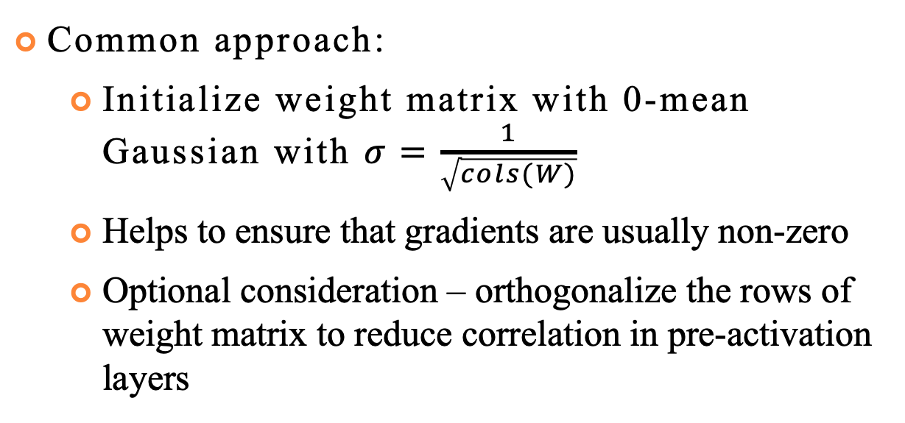
Weight Initialization
Common approach:
Initialize weight matrix with 0-mean Gaussian with $σ=\frac{1}{\sqrt{cols(W)}}$
Helps to ensure that gradients are usually non-zero
Optional consideration – orthogonalize the rows of weight matrix to reduce correlation in pre-activation layers
29
Notes:
Since W(2)=0, then g=0. Hence, = 0. •
However, h is non-zero. Hence, is nonzero => will change. •
During the next gradient update, g is non-zero => W(1), b(1) will change. •
In summary: this initialization does not severely inhibit the network’s performance (though initializing W(2), b(2) to 0 is still not recommended)

Slide 59
Some Libraries
Scikit-learn
https://scikit- learn.org/stable/modules/neural_networks_supervised.h tml
Only MLP; no GPU support
Keras
https://keras.io/
Tensorflow
https://www.tensorflow.org/
PyTorch
https://pytorch.org/
30

