Slide 1
CSP571 Data Preparation and Analysis
Lecture 17. Statistical Methods for Data Analysis
Oleksandr Narykov
onarykov@iit.edu

Slide 2
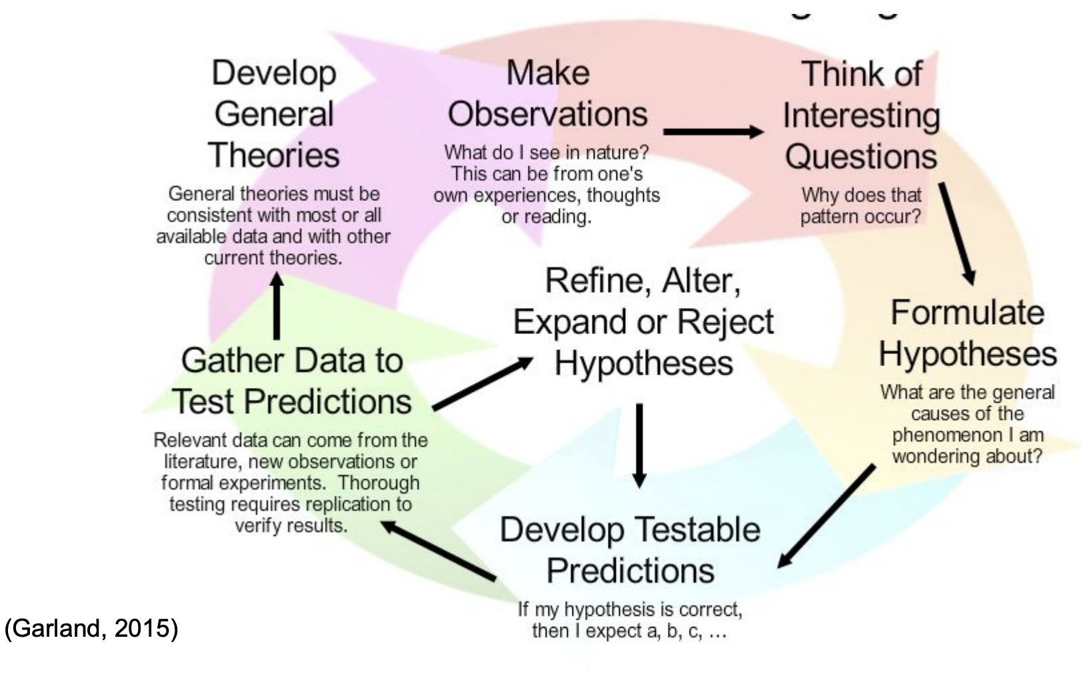
Scientific Method

Slide 3
Statistical Analysis
Statistical analysis is the organization and analysis of quantitative or qualitative data using statistical procedures, including both descriptive and inferential statistics.
It’s the science of collecting, exploring and presenting large amounts of data to discover underlying patterns and trends.

Slide 4
Statistical Analysis
Statistics is a branch of science that deals with the collection, organisation, analysis of data and drawing of inferences from the samples to the whole population.
Sample is a small portion of population which truly represents the population with respect to the study characteristic of the population.

Slide 5
Tasks
Summarize
Explore the meaning of deviations in data
Compare or contrast descriptively
Test the proposed relationships in a theoretical model
Infer that the findings from sample are indicative
Examine causality.
Predict or infer from the sample to a theoretical model.

Slide 6
Assumptions
The assumption of normality which specifies that the means of the sample group are normally distributed
The assumption of equal variance which specifies that the variances of the samples and of their corresponding population are equal.
The data can be treated as random samples

Slide 7
Statistical Analysis Types
By purpose:
Exploratory data analysis
Confirmatory data analysis
By methods:
Parametric analysis
Non-parametric analysis

Slide 8
Statistical Analysis Purposes
Exploratory data analysis to obtain a preliminary indication of the nature of the data and to search data for hidden structure or models.
Confirmatory data analysis involves traditional inferential statistics , which you can use to make an inference about a population or a process based on evidence from the study sample.

Slide 9
Parametric Analysis
Most commonly used type of statistical analysis.
This analysis is referred to as parametric statistical analysis because the findings are inferred to the parameters of a normally distributed populations.
Numerical data (quantitative variables) that are normally distributed are analysed with parametric tests.

Slide 10
Hypothesis Testing
Hypothesis - something one asserts to be true.
When attempting to determine if an outcome is related to a cause, it is necessary to know if the outcomes or results could have occurred by chance alone.
This cannot be done with certainty, but researchers can determine the probability that the hypothesis is true.

Slide 11
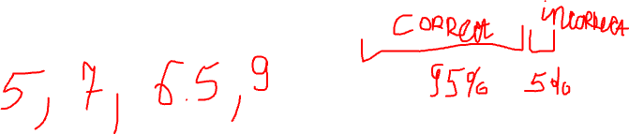
Hypothesis Testing
Hypothesis - something one asserts to be true.
Accepting a null hypothesis is a statement that there are no differences in the outcomes based on the intervention or observation(that is, there is no cause-and-effect relationship).
Using a null hypothesis enables the researcher to quantify and report the probability that the outcome was due to random error.

Slide 12
Hypothesis Testing
Hypothesis - something one asserts to be true.
Classical Approach:
H0 : null hypothesis -- some “default” value (usually that one’s hypothesis is false)
H1 : the alternative -- usually that one’s “hypothesis” is true

Slide 13

Hypothesis Testing
Hypothesis - something one asserts to be true.
Classical Approach:
H0 : null hypothesis -- some “default” value (usually that one’s hypothesis is false)
H1 : the alternative -- usually that one’s “hypothesis” is true
Goal:
: Use probability to determine if we can “reject the null”(H0 ) in favor of H1 . “There is less than a 5% chance the null is true” (i.e. 95% alternative is true).

Slide 14
Hypothesis Testing
Hypothesis - something one asserts to be true.
Classical Approach:
H0 : null hypothesis -- some “default” value (usually that one’s hypothesis is false)
H1 : the alternative -- usually that one’s “hypothesis” is true
Goal:
: Use probability to determine if we can “reject the null”(H0 ) in favor of H1 . “There is less than a 5% chance the null is true” (i.e. 95% alternative is true).

Slide 15
Student’s t-test
Student's t-test is used to test the null hypothesis that there is no difference between the means of the two groups
One-sample t-test
Independent Two Sample T Test (the unpaired t-test)
The paired t-test

Slide 16
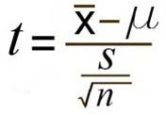

One-sample t-test
Testing if a sample mean (as an estimate of a population mean) differs significantly from a given population mean.
The mean of one sample is compared with population mean
where $\overline{x}$= sample mean, μ = population mean and S = standard deviation, n = sample size

Slide 17
One-sample t-test
First, find the t-value for which you want the right-tail probability (call it t), and find the sample size (for example, n).
Next, find the row corresponding to the degrees of freedom (df) for your problem (for example, n – 1). Go across that row to find the two t-values between which your t falls.
Then, go to the top of the columns containing the two t-values from Step 2. The right-tail (greater-than) probability for your t-value is somewhere between the two values at the top of these columns.
Notes:
mean = 40 , $μ=44$, n = 20 and S = 6

Slide 18
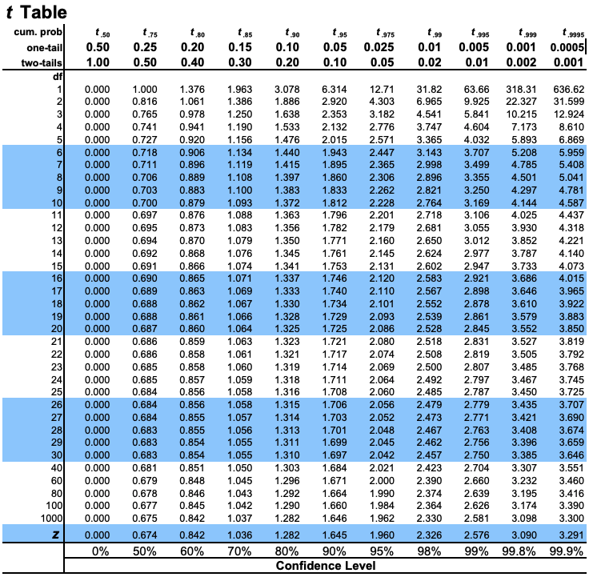

One-sample t-test
Notes:
mean = 40 , $μ=44$, n = 20 and S = 6

Slide 19
One-sample t-test example
A random sample of size 20 from a normal population gives a sample mean of 40, standard deviation of 6. Test the hypothesis is population mean is 44. Check whether there is any difference between mean.
H₀: There is no significant difference between sample mean and population mean
H₁: There is no significant difference between sample mean and population mean
Notes:
mean = 40 , $μ=44$, n = 20 and S = 6

Slide 20
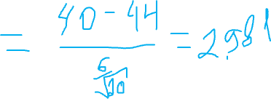
One-sample t-test example
t_{calculated} = 2.981
t_{table value} = 2.093
t_{calculated} > t _{table value}
Notes:
mean = 40 , $μ=44$, n = 20 and S = 6
Reject H0
t_{calculated} = 2.981

Slide 21
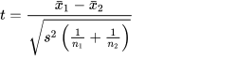
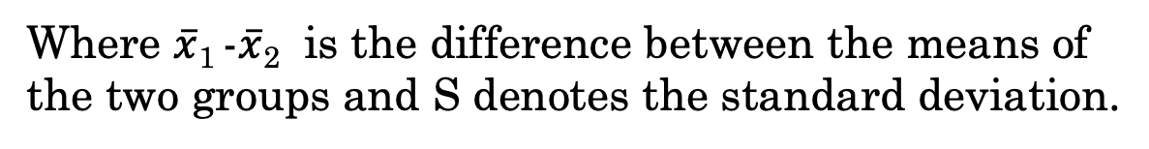
Independent Two Sample t-test
Testing if the population means estimated by two independent samples differ significantly.
Two different samples with the same mean at the initial point and compared mean at the end
1. Assume equal variance
Where $\overline{x}$₁ -$\overline{x}$₂ is the difference between the means of the two groups and S denotes the standard deviation.
Notes:
mean = 40 , $μ=44$, n = 20 and S = 6
Reject H0
t_{calculated} = 2.981

Slide 22
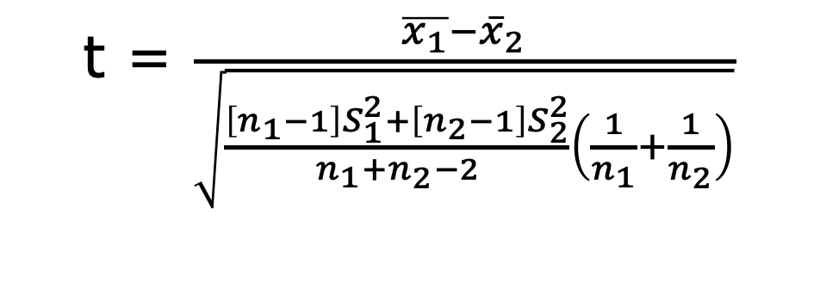
Independent Two Sample t-test
Testing if the population means estimated by two independent samples differ significantly.
Two different samples with the same mean at the initial point and compared mean at the end
2. Assume non-equal variance
t = $\frac{\overline{x_{1}}−{\overline{x}}_{2}}{\sqrt{\frac{\left[n_{1}−1\right]S_{1}^{2}+\left[n_{2}−1\right]S_{2}^{2}}{n_{1}+n_{2}−2}\left(\frac{1}{n_{1}}+\frac{1}{n_{2}}\right)}}$
Notes:
mean = 40 , $μ=44$, n = 20 and S = 6
Reject H0
t_{calculated} = 2.981

Slide 23
Independent Two Sample t-test example
Mean Hb level of 5 male are 10, 11, 12.5, 10.5, 12 and 5 female are 10, 17.5, 14.2,15 and 14.1 . Test whether there is any significant difference between Hb values.
H0: There is no significant difference between Hb Level
H1: There is no significant difference between Hb level.
t = $\frac{\overline{x_{1}}−{\overline{x}}_{2}}{\sqrt{\frac{\left[n_{1}−1\right]S_{1}^{2}+\left[n_{2}−1\right]S_{2}^{2}}{n_{1}+n_{2}−2}\left(\frac{1}{n_{1}}+\frac{1}{n_{2}}\right)}}$
Notes:
mean = 40 , $μ=44$, n = 20 and S = 6
Reject H0
t_{calculated} = 2.981

Slide 24
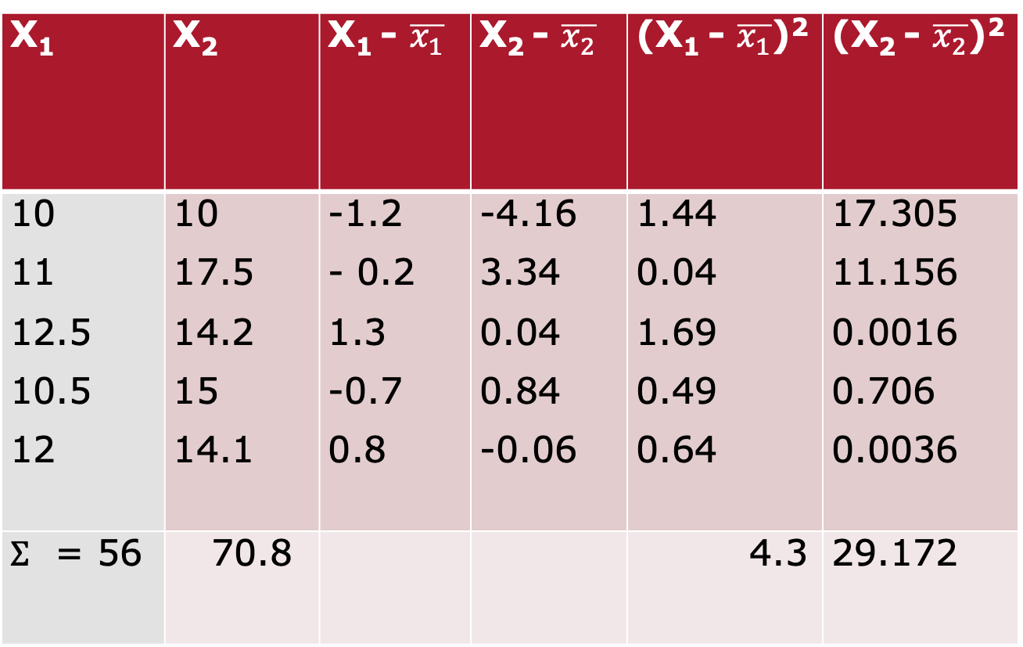
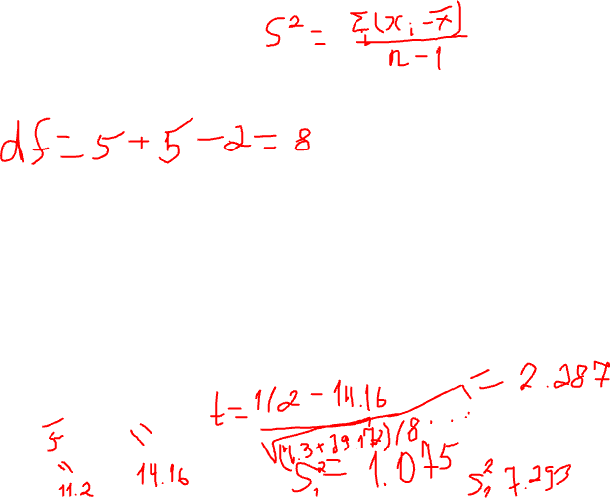
Independent Two Sample t-test example
X₁ | X₂ | X₁ - $\overline{x_{1}}$ | X₂ - $\overline{x_{2}}$ | (X₁ - $\overline{x_{1}}$)² | (X₂ - $\overline{x_{2}}$)²
10 11 12.5 10.5 12 | 10 17.5 14.2 15 14.1 | -1.2 - 0.2 1.3 -0.7 0.8 | -4.16 3.34 0.04 0.84 -0.06 | 1.44 0.04 1.69 0.49 0.64 | 17.305 11.156 0.0016 0.706 0.0036
$Σ$ = 56 | 70.8 |  |  | 4.3 | 29.172
Notes:
The degrees of freedom are calculated as the sum of the sample sizes minus 2 or (n1 + n2 - 2) when the variances of two populations are assumed to be the same
$\overline{x_{1}}$ = 11.2 , $\overline{x_{2}} =$14.16 , $S_{1}^{2}$ = 1.075, $S_{2}^{2}$ = 7.293
t_{calculated} = 2.287, t _{table} = 2.306, t_{calculated} > t _{table value} ; reject H_{0.}
Reject H0

Slide 25
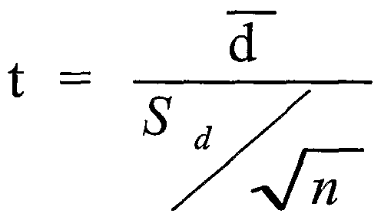
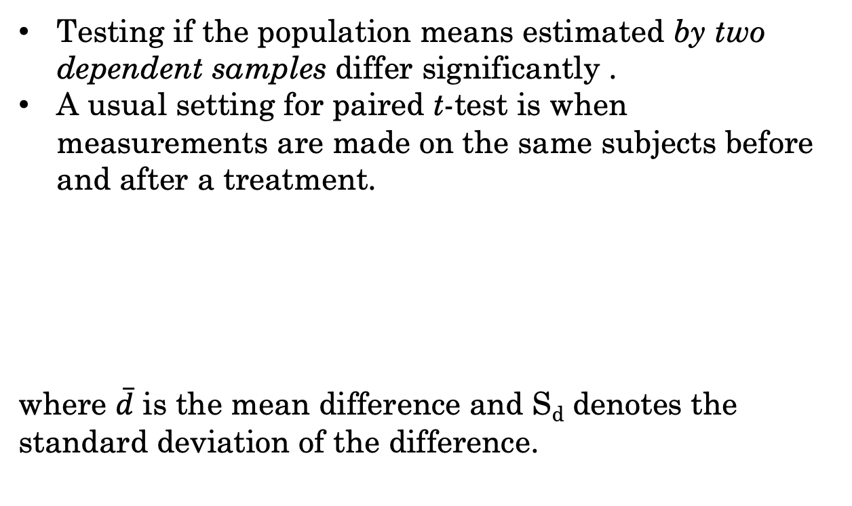
Paired t-test
Testing if the population means estimated by two dependent samples differ significantly .
A usual setting for paired t-test is when measurements are made on the same subjects before and after a treatment.
where $\overline{d}$ is the mean difference and S_{d} denotes the standard deviation of the difference.
Notes:
mean = 40 , $μ=44$, n = 20 and S = 6
Reject H0
t_{calculated} = 2.981

Slide 26
Paired t-test example
Systolic BP of 5 patients before and after a drug therapy is
Before: 160, 150, 170, 130, 140
After: 140, 110, 120, 140, 130
Test whether there is any significant difference between BP levels.
H0: There is no significant difference between BP levels before and after the drug
H1: There is a significant difference between BP levels before and after the drug
Notes:
mean = 40 , $μ=44$, n = 20 and S = 6
Reject H0
t_{calculated} = 2.981

Slide 27
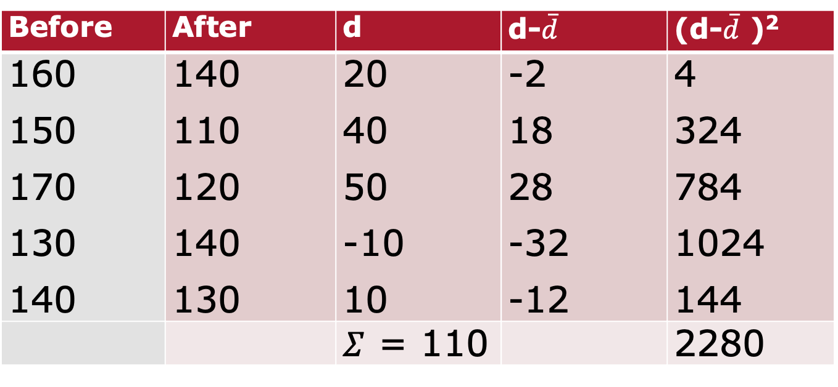
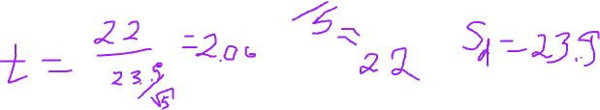
Paired t-test example
Before | After | d | d-$\overline{d}$ | (d-$\overline{d}$ )²
160 150 170 130 140 | 140 110 120 140 130 | 20 40 50 -10 10 | -2 18 28 -32 -12 | 4 324 784 1024 144
 |  | $Σ$ = 110 |  | 2280
Notes:
$\overline{d}$ = 22, S_{d} = 23.875
t_{calculated} = 2.060, t _{table} = 2.567, t_{calculated} < t _{table value} ; Accept H_{0.}

Slide 28
ANOVA
ANOVA tests the following hypotheses:
• H₀ (null hypothesis): The means of all the groups are equal.
• H₁ : Not all the means are equal
• doesn’t say how or which ones differ.
• can follow up with “multiple comparisons”
Notes:
mean = 40 , $μ=44$, n = 20 and S = 6
Reject H0
t_{calculated} = 2.981

Slide 29
ANOVA assumptions
The distribution of data in each group is approximately normal
• check this by looking at histograms and/or normal quantile plots
• can handle some non-normality, but not severe outliers
Standard deviations of each group are approximately equal
• rule of thumb: ratio of largest to smallest sample st. dev. must be less than 2:1
Notes:
mean = 40 , $μ=44$, n = 20 and S = 6
Reject H0
t_{calculated} = 2.981

Slide 30
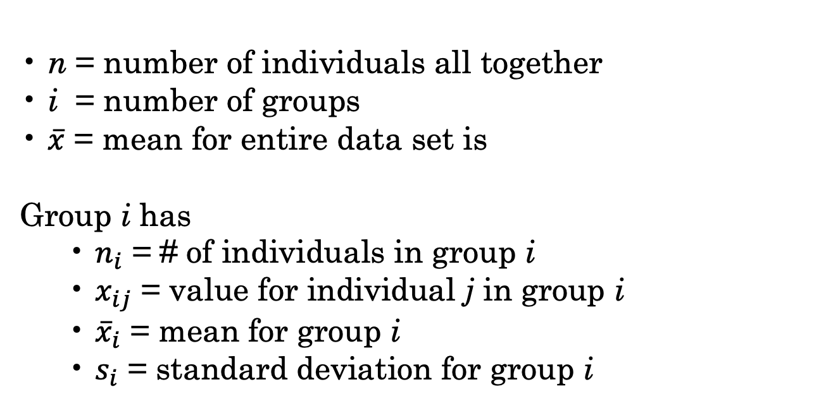
ANOVA Notations
• n = number of individuals all together
• i = number of groups
• $\overline{x}$ = mean for entire data set is
Group i has
• $n_{i}$ = # of individuals in group i
• $x_{ij}$ = value for individual j in group i
• ${\overline{x}}_{i}$ = mean for group i
• $s_{i}$ = standard deviation for group i
Notes:
mean = 40 , $μ=44$, n = 20 and S = 6
Reject H0
t_{calculated} = 2.981

Slide 31


ANOVA
ANOVA measures two sources of variation in the data and compares their relative sizes
• variation BETWEEN groups
• for each data value look at the difference between its group mean and the overall mean
• variation WITHIN groups
• for each data value we look at the difference between that value and the mean of its group
Notes:
mean = 40 , $μ=44$, n = 20 and S = 6
Reject H0
t_{calculated} = 2.981

Slide 32

F-score
The ANOVA F-statistic is a ratio of the Between Group Variaton divided by the Within Group Variation:
A large F is evidence against H0, since it indicates that there is more difference between groups than within groups.
Notes:
mean = 40 , $μ=44$, n = 20 and S = 6
Reject H0
t_{calculated} = 2.981

Slide 33
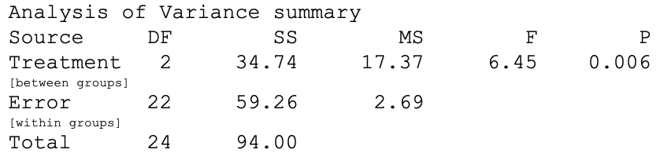

ANOVA Example Output

Slide 34
ANOVA Example Output

Slide 35
Post-hoc analysis
ANOVA indicates that the groups do not all appear to have the same means… what next? How do we know what the differences really are?
• If we only had two groups, then we’re done, we know the difference between them is significant.
• If we have three or more groups, then a post hoc test is needed to determine which groups are significantly different from each other
Tukey test is commonly used for post-hoc analysis

Slide 36

Statistical Analysis Pitfalls
Statistics can be used, intentionally or unintentionally, to reach faulty conclusions.
Data dredging
Survey questions
It is, therefore, important to understand not just the numbers but the meaning behind the numbers. Statistics is a tool, not a substitute for in-depth reasoning and analysis

Slide 37
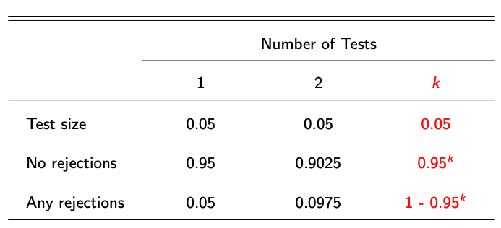

Multiple Hypothesis Testing
Consider testing 100 true null hypotheses — how many will be rejected?

Slide 38
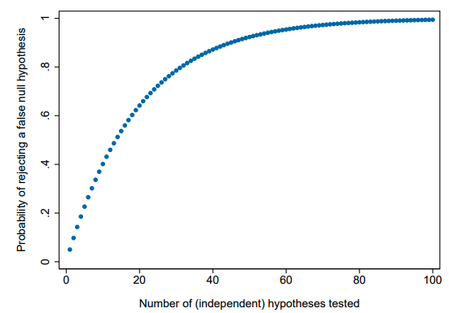
Multiple Hypothesis Testing

Slide 39
Multiple Hypothesis Testing
How can we (credibly) test multiple hypotheses?
Valid reasons for testing many hypotheses:
Studies often have 2 or 3 treatment arms (and rightly so!)
Difficult to predict which outcomes will be affected
Particularly true for secondary hypotheses/treatment effects
Different measures of the same outcome often available
Heterogeneity in treatment effects (across sub-samples)

Slide 40
Bonferroni Correction
Most conservative approach is the Bonferroni method
Problem: you wish to test hypotheses H₁,...,H_{k} using a test size of α
Solution (of sorts): use a test size of α/k instead
Family-wise error rate (FWER): the probability of rejecting a true null
Bonferroni correction holds FWER below α
Bonferroni corrections are too conservative:
FWER ≈ 0.04877 when number of independent tests is large
Bonferroni corrections can be extremely conservative when tests are not independent (consider example of perfectly correlated tests)

Slide 41
Controlling False Discovery Rate
Anderson (JASA, 2008): “[Family-wise error rate] adjustments become increasingly severe as the number of tests grows — it is inherent in controlling the probability of making a single false rejection.”
• Alternative is to tolerate some small number of false positives

Slide 42
Controlling False Discovery Rate
The false discovery rate: expected proportion of rejections that are Type I errors (i.e. where null was true and should not have been rejected)
• FWER and FDR are identical under the null (all rejections are errors)
• When some null hypotheses are false, FDR adjustments can be less stringent than FWER adjustments (because FDR < FWER)

Slide 43
Controlling False Discovery Rate
Thought experiment: Let k = 100. The first 20 hypotheses are false, and clearly rejected using any approach. What expected number of false rejections you are willing to accept in the remaining set of 80 hypotheses?

Slide 44
Benjamini and Hochberg FDR
1. Order k p-values from smallest to largest, p₁, p₂, ..., p_{j} , ..., p_{k}, where j indicates the rank of the p-value for a specific hypothesis
2. Rejecting all p-values with p_{j} < q_{j}/k yields an expected FDR no higher than q when p-values are independent or positively correlated

Slide 45
Benjamini and Hochberg FDR
All of the procedures discussed so far modify test sizes (“accept”/reject)
• We often want an adjusted p-value, not a yes/no decision
Anderson (2008) proposed intuitive approach to calculating BH q-values:
• Rescale p-values by number of hypotheses / p-value rank
• Adjust for non-monotonicity

Slide 46
Summary
Try to avoid testing a large number of hypotheses
• Aggregate your main outcomes into indices (when appropriate)
• Consider pre-specifying “surprising” relationships
Acceptable adjustments differ in complexity, control/power tradeoffs
• Use simple approaches (Bonferroni, Holm) when they work
• Choose more control vs. more power when appropriate
Be suspicious of (your own and others’) p-values near significance cutoffs

