Slide 1
CSP571 Data Preparation and Analysis
Lecture 18. Statistical Methods for Data Analysis
Oleksandr Narykov
onarykov@iit.edu
Based on lectures of Shippenburg University,
Yibi Huang, Dr. S.A.Rizwan

Slide 2
Multiple Hypothesis Testing

Slide 3
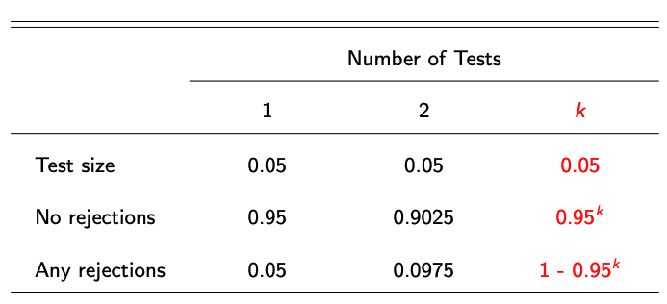

Multiple Hypothesis Testing
Consider testing 100 true null hypotheses — how many will be rejected?

Slide 4
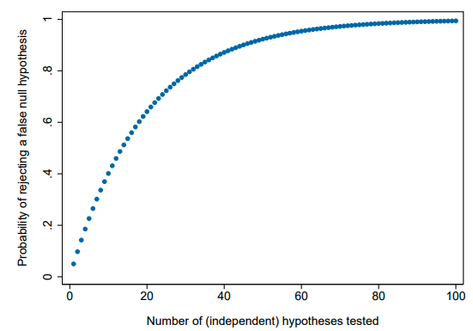
Multiple Hypothesis Testing

Slide 5
Multiple Hypothesis Testing
How can we (credibly) test multiple hypotheses?
Valid reasons for testing many hypotheses:
Studies often have 2 or 3 treatment arms (and rightly so!)
Difficult to predict which outcomes will be affected
Particularly true for secondary hypotheses/treatment effects
Different measures of the same outcome often available
Heterogeneity in treatment effects (across sub-samples)

Slide 6
Bonferroni Correction
Most conservative approach is the Bonferroni method
Problem: you wish to test hypotheses H₁,...,H_{k} using a test size of α
Solution (of sorts): use a test size of α/k instead
Family-wise error rate (FWER): the probability of rejecting a true null
Bonferroni correction holds FWER below α
Bonferroni corrections are too conservative:
FWER ≈ 0.04877 when number of independent tests is large
Bonferroni corrections can be extremely conservative when tests are not independent (consider example of perfectly correlated tests)

Slide 7
Controlling False Discovery Rate
Anderson (JASA, 2008): “[Family-wise error rate] adjustments become increasingly severe as the number of tests grows — it is inherent in controlling the probability of making a single false rejection.”
• Alternative is to tolerate some small number of false positives

Slide 8
Controlling False Discovery Rate
The false discovery rate: expected proportion of rejections that are Type I errors (i.e. where null was true and should not have been rejected)
• FWER and FDR are identical under the null (all rejections are errors)
• When some null hypotheses are false, FDR adjustments can be less stringent than FWER adjustments (because FDR < FWER)

Slide 9
Controlling False Discovery Rate
Thought experiment: Let k = 100. The first 20 hypotheses are false, and clearly rejected using any approach. What expected number of false rejections you are willing to accept in the remaining set of 80 hypotheses?

Slide 10
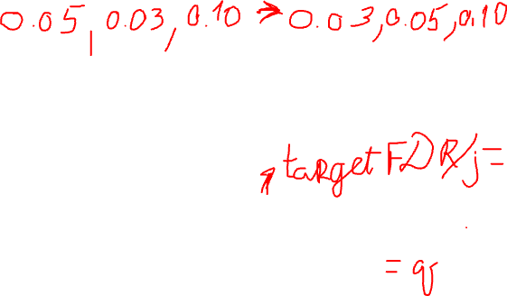
Benjamini and Hochberg FDR
1. Order k p-values from smallest to largest, p₁, p₂, ..., p_{j} , ..., p_{k}, where j indicates the rank of the p-value for a specific hypothesis
2. Rejecting all p-values with p_{j} < q_{j}/k yields an expected FDR no higher than q when p-values are independent or positively correlated

Slide 11
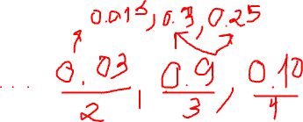
Benjamini and Hochberg FDR
All of the procedures discussed so far modify test sizes (“accept”/reject)
• We often want an adjusted p-value, not a yes/no decision
Anderson (2008) proposed intuitive approach to calculating BH q-values:
• Rescale p-values by number of hypotheses / p-value rank
• Adjust for non-monotonicity

Slide 12
Summary
Try to avoid testing a large number of hypotheses
• Aggregate your main outcomes into indices (when appropriate)
• Consider pre-specifying “surprising” relationships
Acceptable adjustments differ in complexity, control/power tradeoffs
• Use simple approaches (Bonferroni, Holm) when they work
• Choose more control vs. more power when appropriate
Be suspicious of (your own and others’) p-values near significance cutoffs

Slide 13
Notes on Hypothesis Testing

Slide 14
Hypothesis Testing
Rejecting H0 doesn’t mean we are 100% that H0 is false. We might make Type 1 errors. Setting a significance level just guarantees we won’t make Type 1 errors too often
The P-value is not P(H0 is true | data), but it is P(data | H0 is true).significance cutoffs

Slide 15
Don’t Take the 0.05 Significance Level Too Seriously
A p-value of 0.049 and a p-value of 0.051 give nearly the same strength of evidence against H0
For example, in the highly publicized 2009 study involving a vaccine that may protect against HIV infection, the two-sided p-value is 0.08, and the one-sided p-value of is 0.04
Much debate and controversy ensued, partially because the two ways of analyzing the data produce p-values on either side of 0.05

Slide 16
Hypothesis Testing Cannot Tell Us…
Hypothesis testing cannot tell us
whether the design of a study is flawed
whether the data is appropriately collected
So we cannot conclude from a small P-value about whether one variable has a causal effect on another variable or whether the conclusion can be generalized to a bigger population.

Slide 17
Statistical Significance Does Not Mean Practical Importance
Another mistake is reading too much into the term “statistically significant”
Saying that results are statistically significant informs the reader that the findings are unlikely to be due to chance alone
However, it says nothing about the practical importance of the finding.
E.g., rejecting the H0: µ1 = µ2 just tells us µ1 , µ2, but not how big and how important µ1 − µ2 is. It is possible that the difference is too small

Slide 18
Summary
Rejecting H0 doesn’t mean we are 100% sure that H0 is false. We might make Type 1 errors
P-value is not the probability that the H0 is true
Failing to reject H0 does not prove H0 to be true
Don’t take the 0.05 significance level too seriously
Hypothesis testing cannot tell us if data were collected properly or if the design of a study was flawed
Statistical significance does not mean practical importance

Slide 19
Testing for Normality

Slide 20
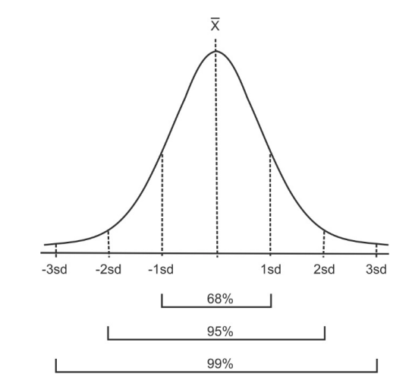
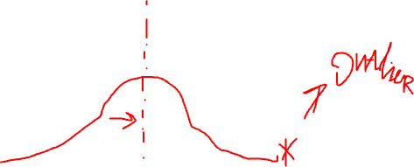
Normal Distribution
For each mean and standard deviation combination a theoretical normal distribution can be determined. This distribution is based on the proportions shown below.

Slide 21
When is non-normality a problem?
Non-normality can be a problem when the sample size is small.
Highly skewed data create problems.
Normality becomes a serious concern when there is “activity” in the tails of the data set.
Outliers are a problem.
“Clumps” of data in the tails are worse

Slide 22
Thumb Rules
Mean & Range & SD
Skewness and kurtosis
Compare mean, median and mode
Trimmed mean
Outliers

Slide 23
Thumb Rules
SD less than half of mean -> may be normally distributed
Calculate the observed mean minus the lowest possible value (or the highest possible value minus the observed mean), and divide this by the standard deviation.
A ratio less than 2 suggests skew (Altman 1996). If the ratio is less than 1 there is strong evidence of a skewed distribution.

Slide 24
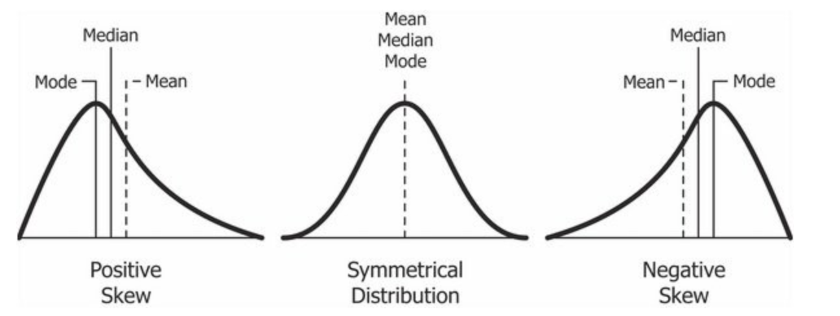
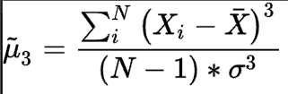
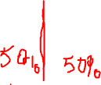
Skewness

Slide 25
Thumb Rules
Skewness
<-1 or >1, highly skewed
-1 to -0.5 or 0.5 to 1, moderately skewed.
-0.5 to 0.5, approximately symmetric
Kurtosis
For normally distributed data, the value is 3 if computed theoretically
Statistical packages adjust this to zero –
Extremely non-normal distributions may have high positive or negative kurtosis values, while nearly normal distributions close to 0

Slide 26

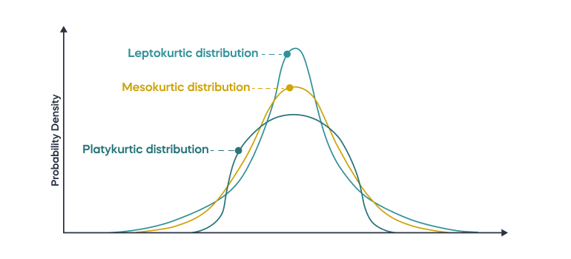
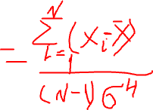
Kurtosis
Describes prevalence of data in tails

Slide 27
Thumb Rules
Skewness
<-1 or >1, highly skewed
-1 to -0.5 or 0.5 to 1, moderately skewed.
-0.5 to 0.5, approximately symmetric
Kurtosis
For normally distributed data the value is 3, theoretically
Statistical packages adjust this to zero –
Extremely non-normal distributions may have high positive or negative kurtosis values, while nearly normal distributions close to 0

Slide 28
Thumb Rules
In a normal distribution, mean=median=mode
5% Trimmed Mean
lower and upper 5% of values deleted
If the value of the 5% trimmed mean is very different from the mean, this indicates outliers
Examine the lowest and highest 5 extreme values to look for outliers

Slide 29
Plots
Histogram with theoretical normal curve
QQ plot
Box plot and outlier detection
Stem and leaf plot

Slide 30
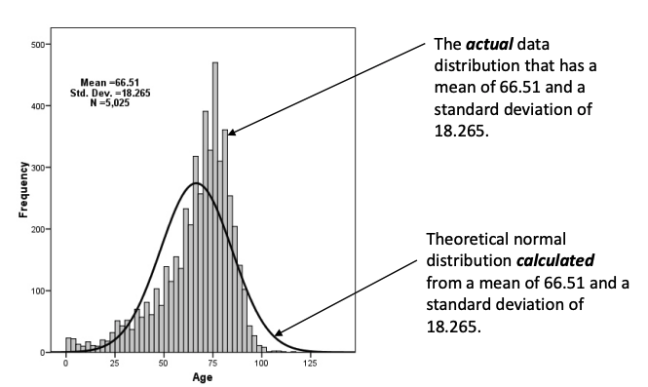
Histograms with Theoretical Normal Distribution Plots

Slide 31
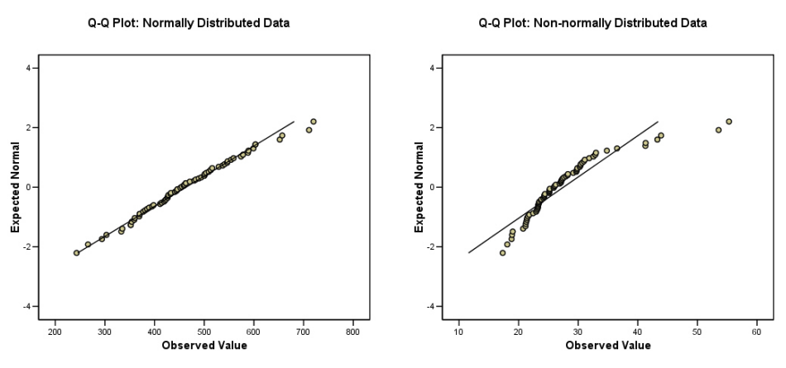
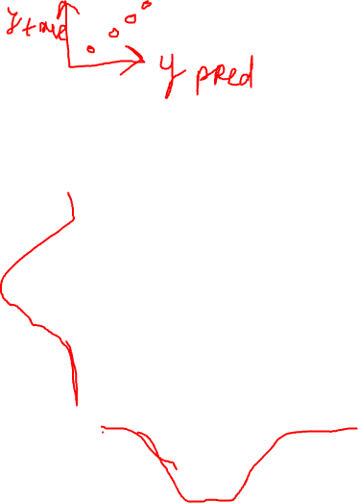
Q-Q Plots

Slide 32
Q-Q Plots

Slide 33
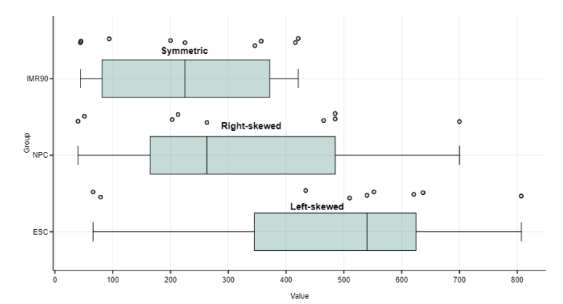

Box Plots

Slide 34
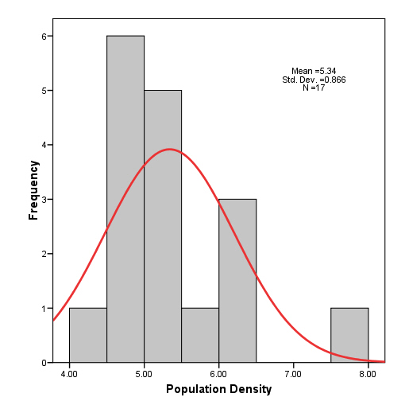
Note on Checking Normality with Plots
Graphical methods are typically not very useful when the sample size is small. This is a histogram of the last example. These data do not ‘look’ normal, but they are not statistically different than normal.

Slide 35
Statistical Tests
W/S test
D’Agostino test
Jarque-Bera test
Shapiro-Wilks test
Kolmogorov-Smirnov test
Grubbs and Dixon test (for outliers)

Slide 36
Statistical Tests
Statistical tests for normality are more precise since actual probabilities are calculated.
Tests for normality calculate the probability that the sample was drawn from a normal population.
The hypotheses used are:
H0: The sample data are not significantly different than a normal population.
H1: The sample data are significantly different than a normal population.

Slide 37
Statistical Tests
Typically, we are interested in finding a difference between groups. When we are, we ‘look’ for small probabilities.
If the probability of finding an event is rare (less than 5%) and we actually find it, that is of interest.
When testing normality, we are not ‘looking’ for a difference.
We want to accept the null hypothesis.
So when testing for normality:
Probabilities > 0.05 mean the data are normal.
Probabilities < 0.05 mean the data are NOT normal.

Slide 38
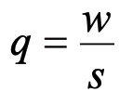
W/S test
A simple test that requires only the sample standard deviation and the data range.
Should not be confused with the Shapiro-Wilk test.
Based on the q statistic, which is the ‘studentized’ (meaning t distribution) range, or the range expressed in standard deviation units. Tests kurtosis.
where q is the test statistic, w is the range of the data and s is the standard deviation.
The test statistic q (Kanji 1994, table 14) is often reported as u in the literature.

Slide 39
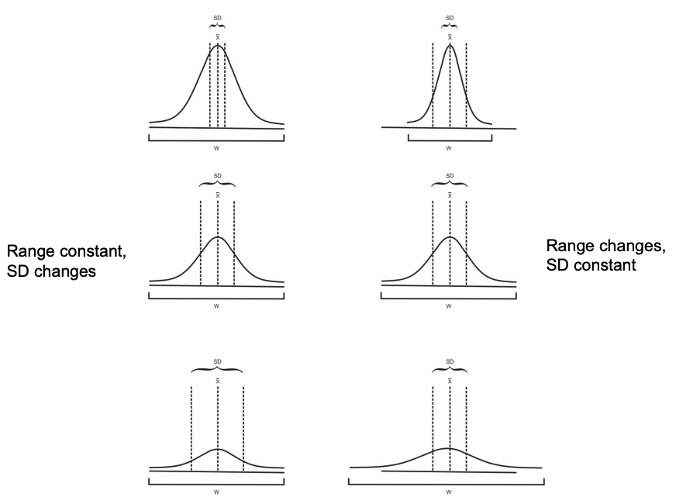
W/S test

Slide 40
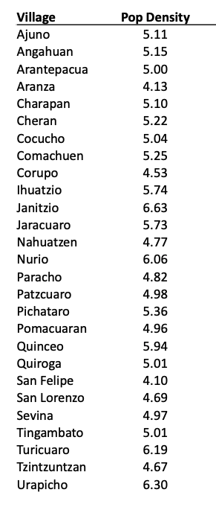
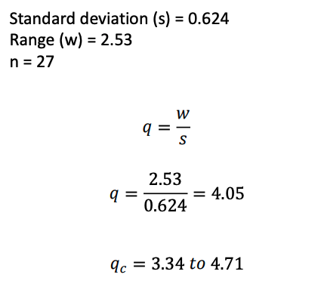
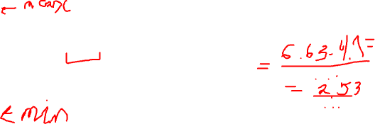
W/S test
The W/S test uses a critical range. If the calculated value falls within the range, then accept H0. If the calculated value falls outside the range then reject H0.

Slide 41
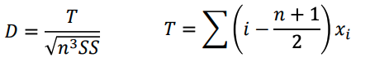
D’Agostino Test
A very powerful test for departures from normality.
First, the data are ordered from smallest to largest or largest to smallest
Based on the D statistic, which gives an upper and lower critical value
where D is the test statistic, SS is the sum of squares of the data and n is the sample size, and i is the order or rank of observation x. The df for this test is n (sample size).

Slide 42
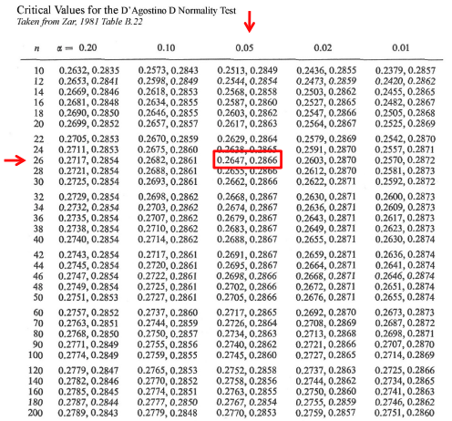
D’Agostino Test
Use the next lower n on the table if the sample size is not listed

Slide 43
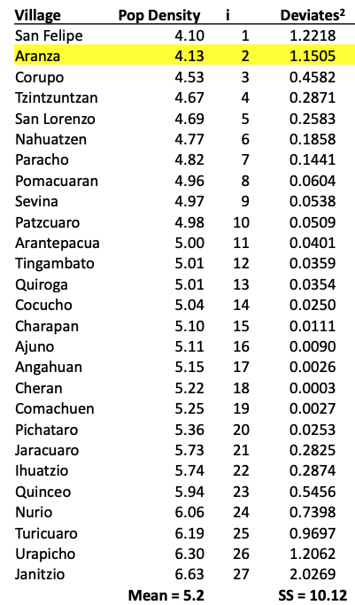
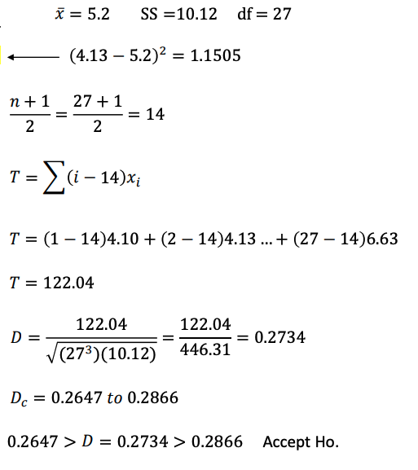
D’Agostino Test

Slide 44
Nonparametric Tests

Slide 45
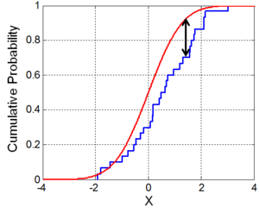
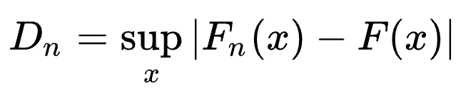


Kolmogorov-Smirnov Test
Nonparametric of the equality of continuous (or discontinuous), one-dimensional probability distributions that can be used to test whether a sample came from a given reference probability distribution (one-sample K–S test), or to test whether two samples came from the same distribution (two-sample K–S test)

